Slide 1
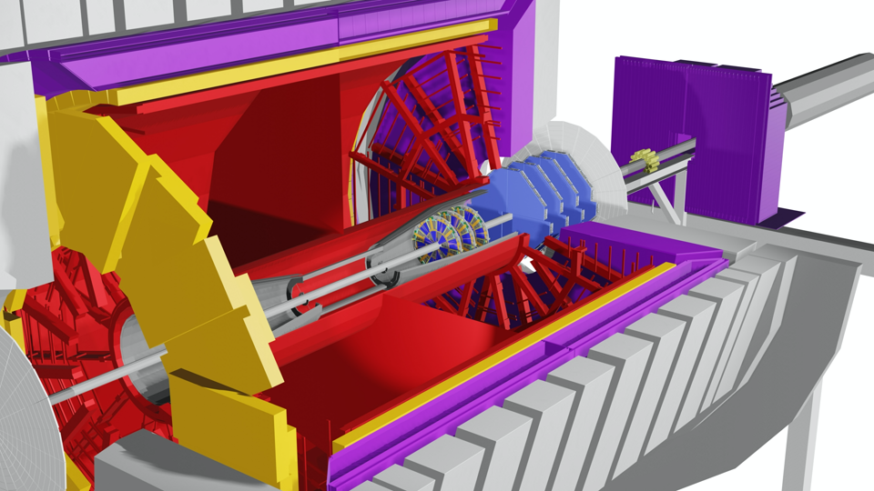


STAR Forward sTGC Tracker
Integration
Rahul Sharma
April 27, 2020

Slide 2
Outline
Integration Scope
Integration Interfaces
Design
  Single Pentagon
  Single Plane
  Multiplane Assembly
  Cooling Manifold Design
  Cart Design for Transportation
  Final Installation
Schedule and Milestones
Safety
Conclusion

Slide 3
Integration Scope
Integration group is responsible for designing, analyzing, testing and building:
The support structure of individual detector modules (Also referred as Pentagons) into a plane
Assembly 4 detector plane assemblies to form complete detector assembly
Cooling Manifolds and ducting for FEB boards
Cable paths and cable supports (cable trays, clips etc.) to route the cables to the desired locations. Also, identifying right cable lengths for the detectors.

Slide 4
Workforce
STSG Group:
Rahul Sharma – Chief Mechanical Engineer
Mechanical Designers – Felix Archampong
Mechanical Technicians – Robert Soja, William Struble
Other Resources:
CAD Technicians (Will be used for help during installation activities)
CAD ESRC : For reviewing and approvals related to Engineered Lift

Slide 5
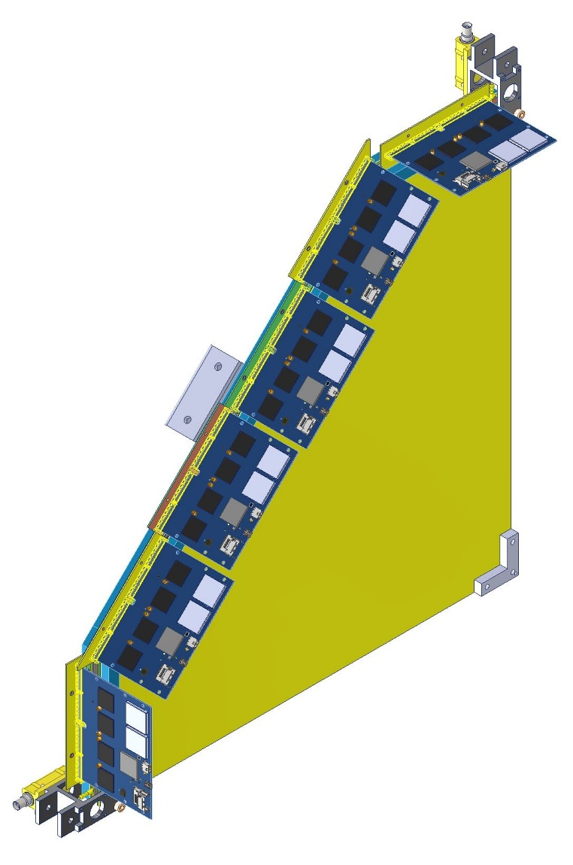
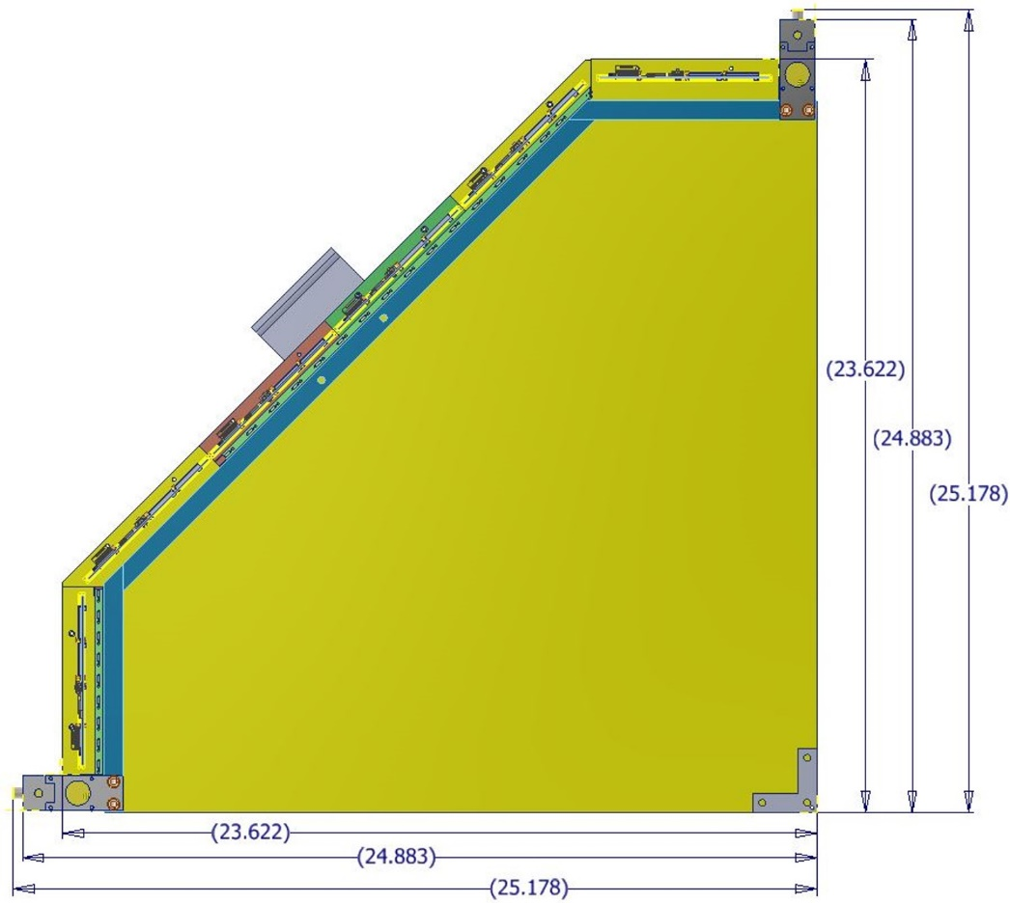
Design (Single Pentagon)
sTGC detector modules (that are shaped like irregular pentagons) also referred to as Pentagons will be delivered to BNL from SDU, China

Slide 6
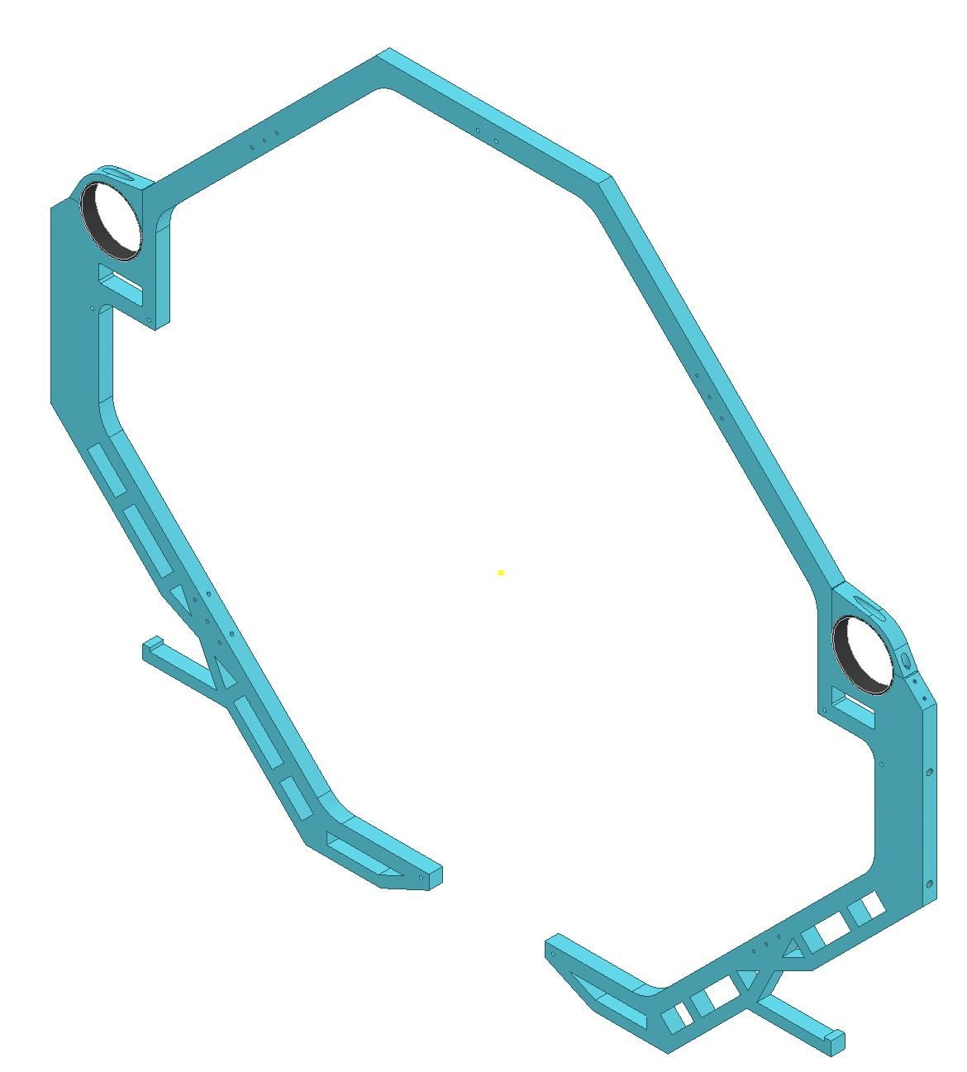
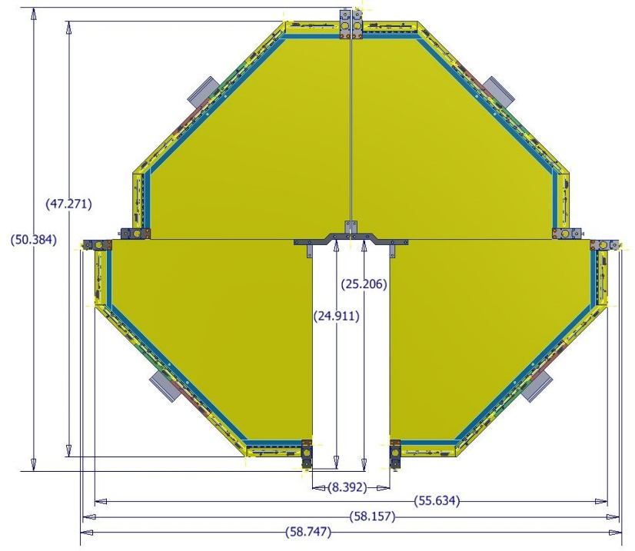
Plane Frame and Single Plane Assembly

Slide 7
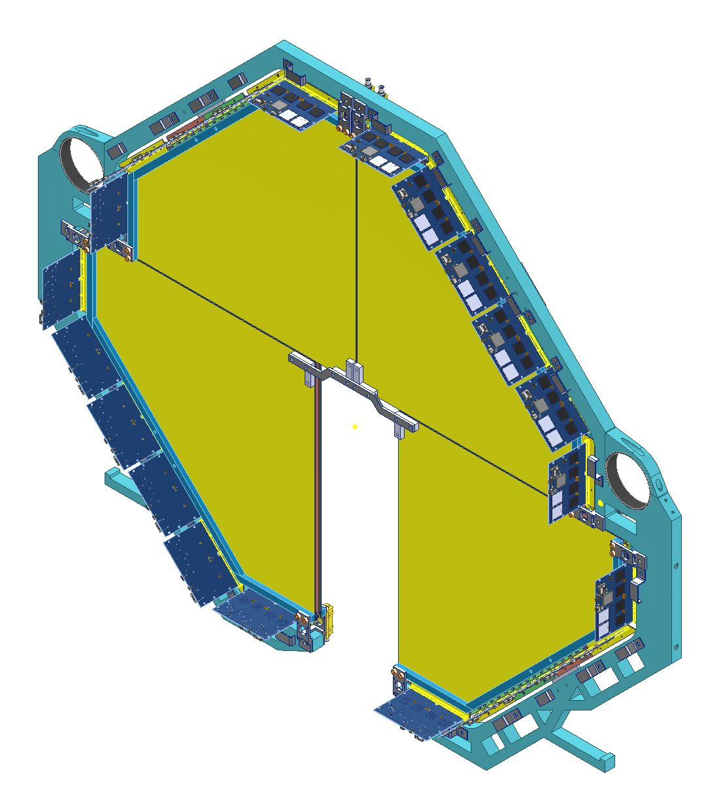
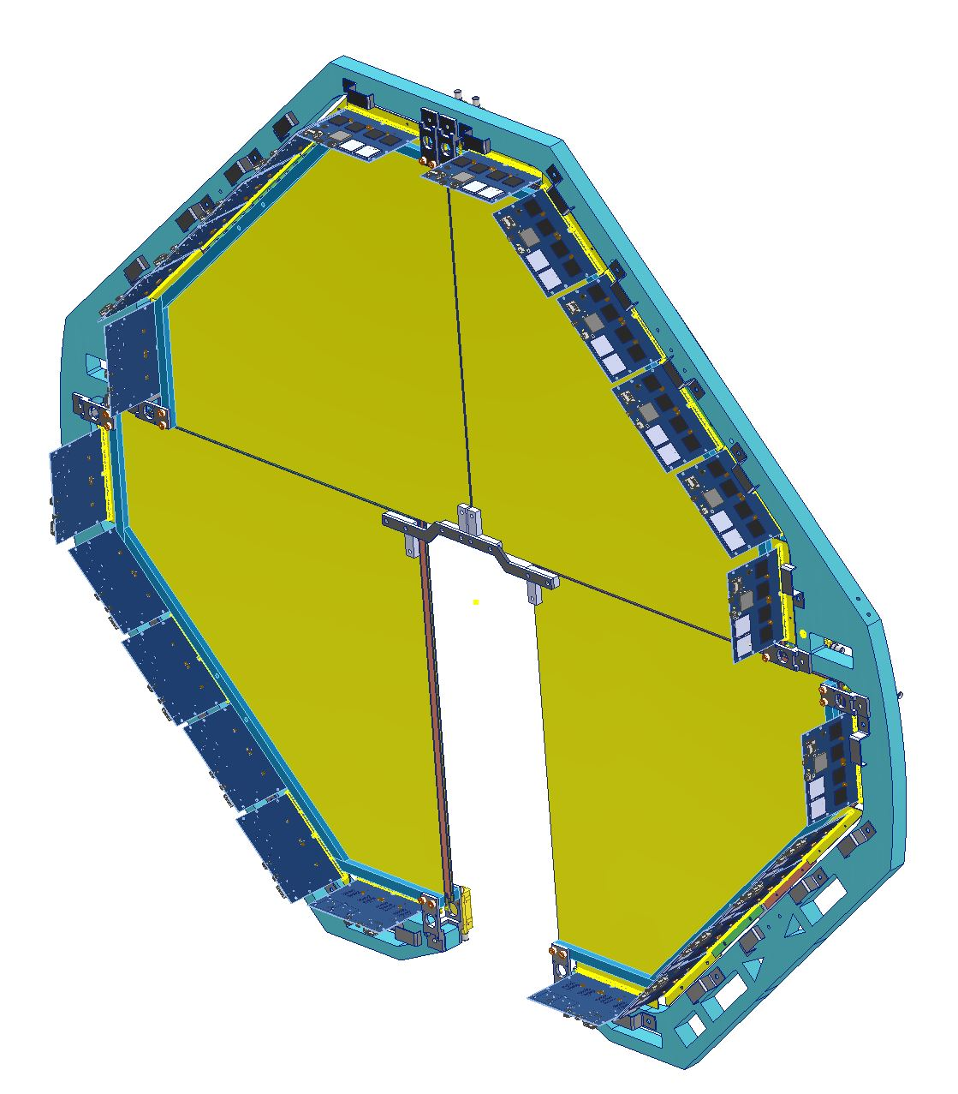
Plane Frame and Single Plane Assembly

Slide 8
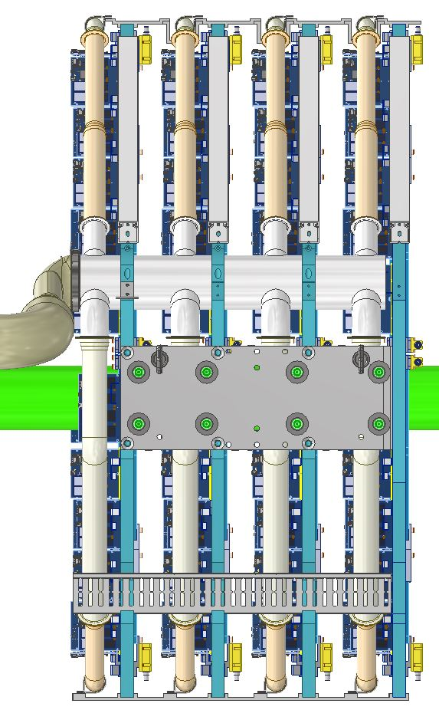
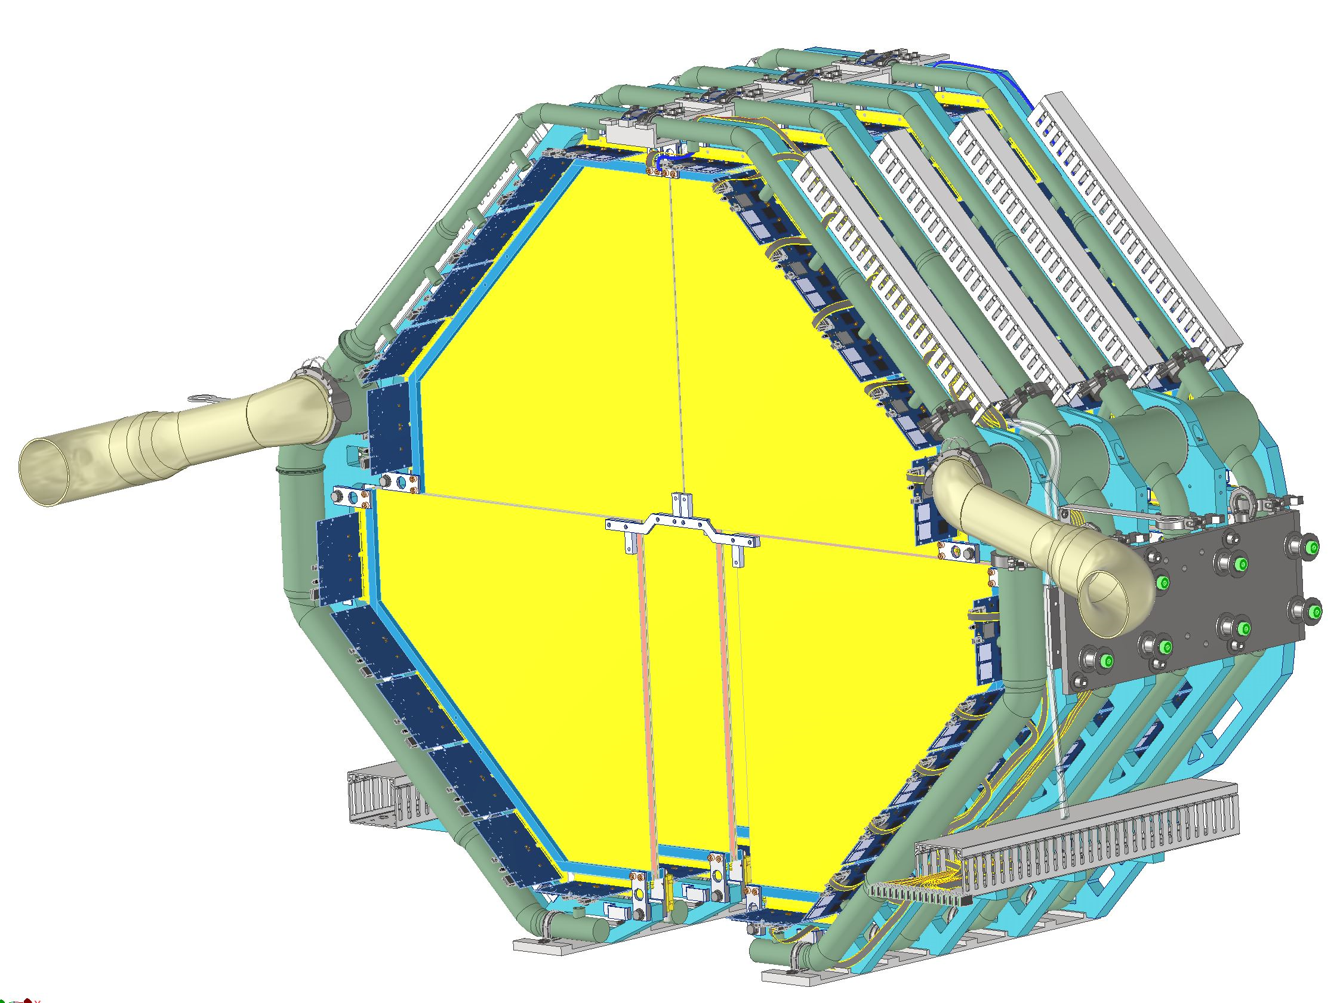
Multiplane Assembly (Cooling Manifolds, Ducting and Cable Trays)

Slide 9
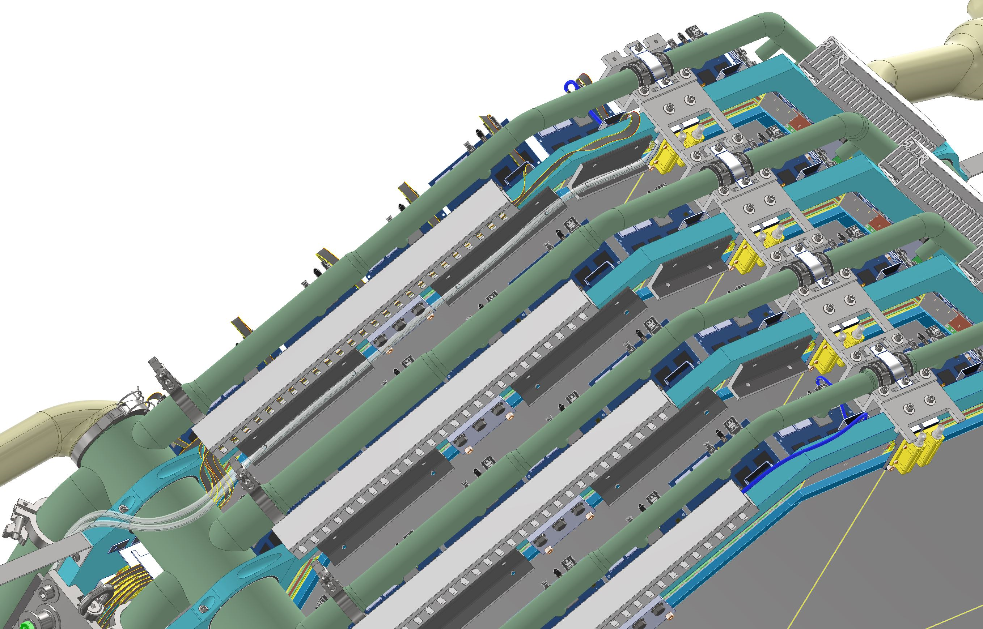
Multiplane Assembly (With Cooling Manifolds and Ducting)

Slide 10
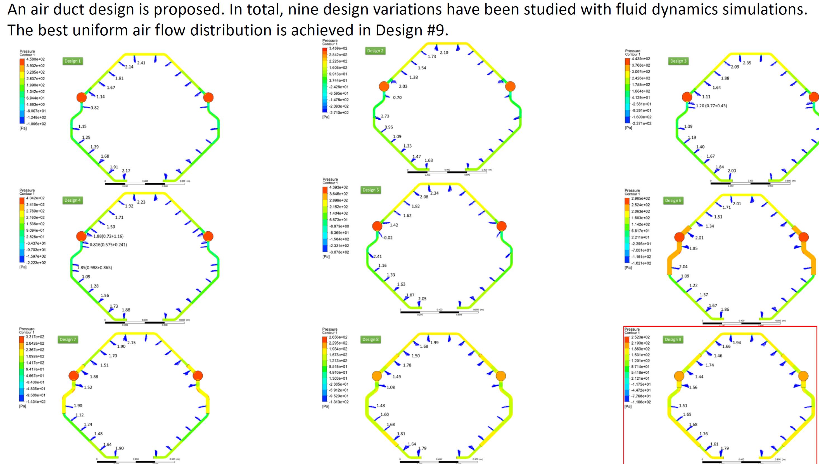
Cooling Manifold and Ducting Design
Objective: Design and optimize air ducts to deliver air flow to all PCBs in STAR-sTGC individually and as evenly as possible.
Existing moving cool unit will be used to cool the detector electronics (FEB Boards). The flow rate delivered to the detector will be 300CFM.

Slide 11
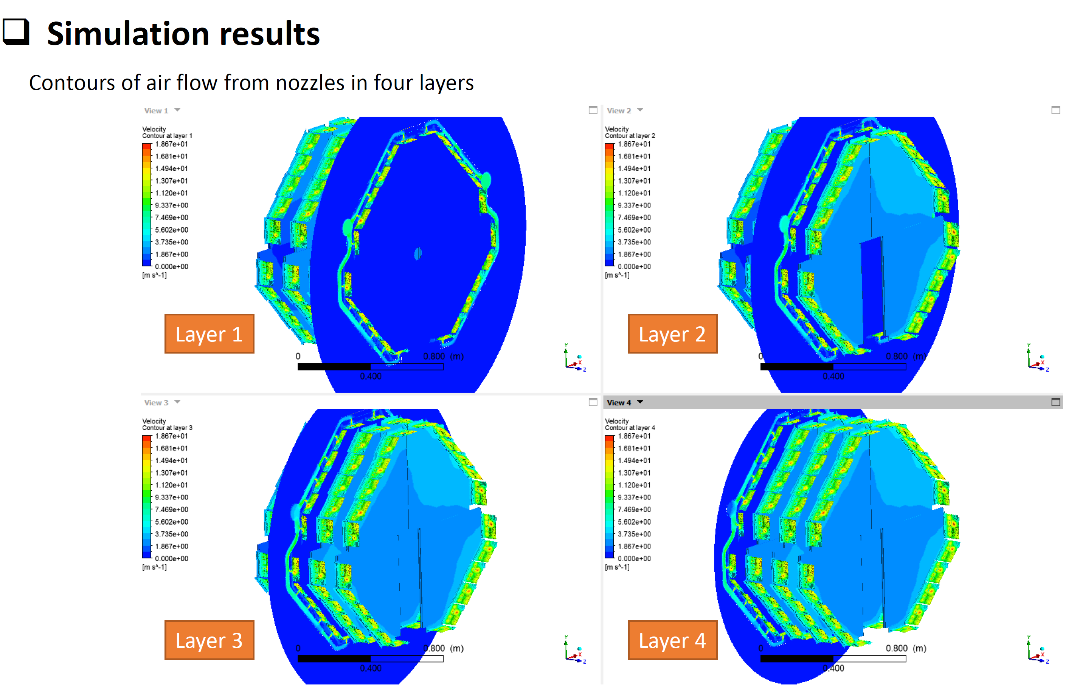
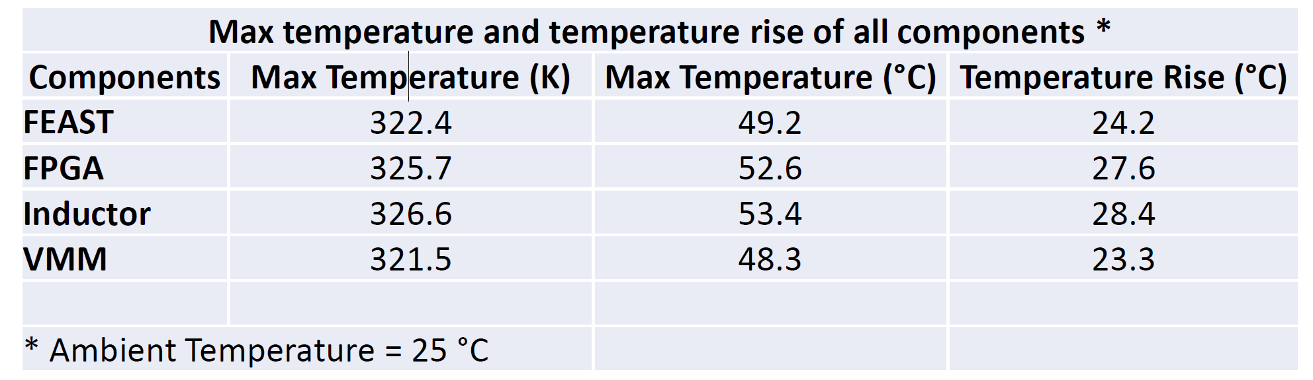
Cooling Manifold and Ducting Design

Slide 12
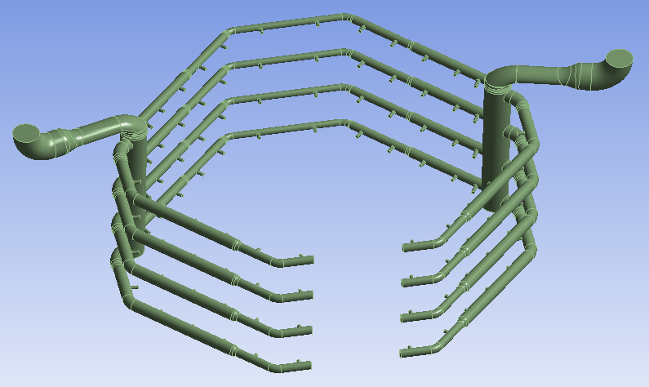
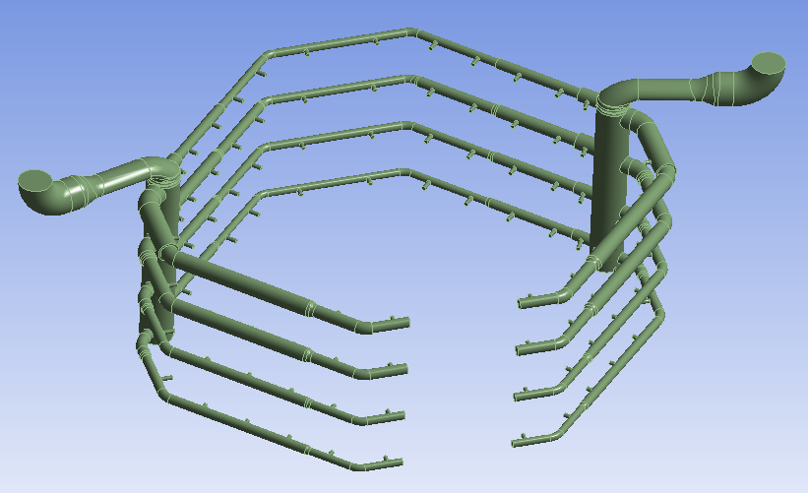
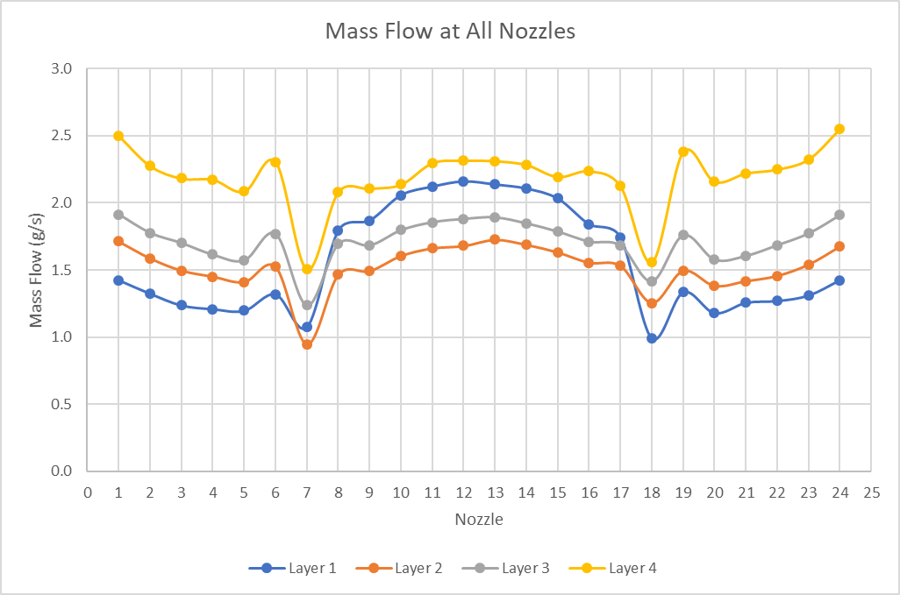
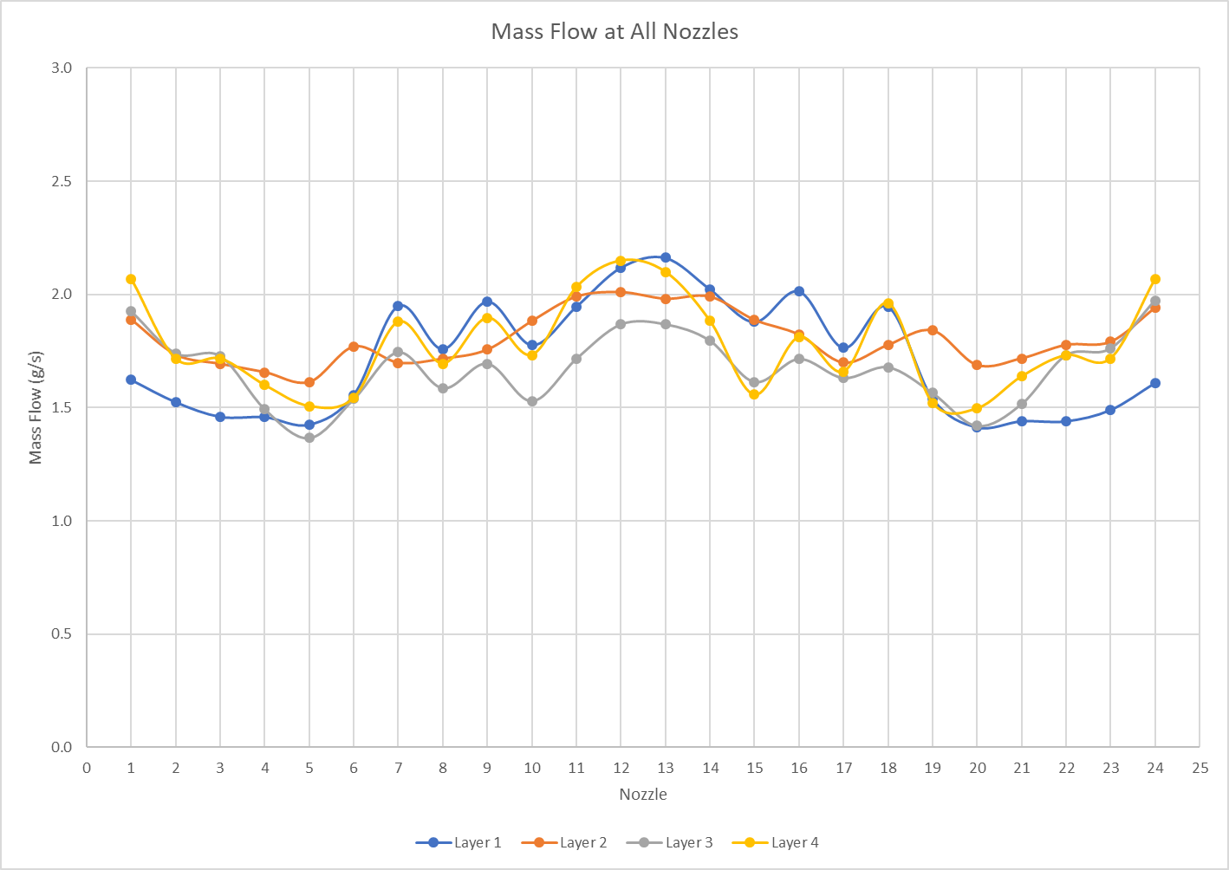
Original 4in air duct
Optimized 4in air duct

Slide 13
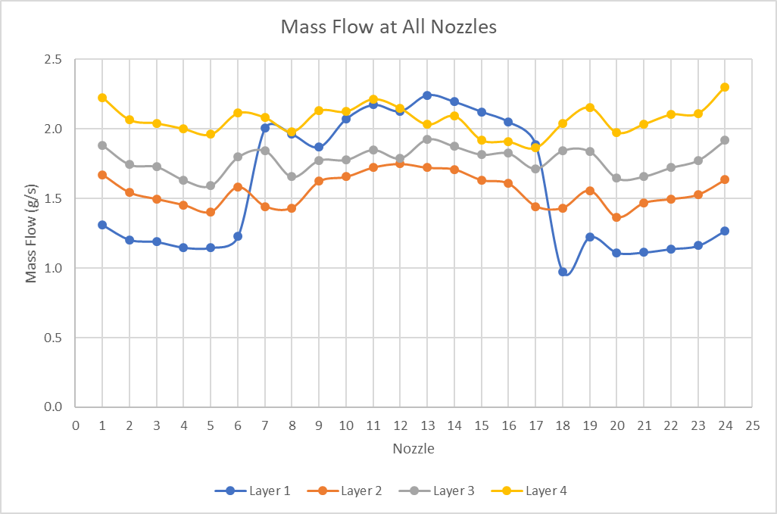
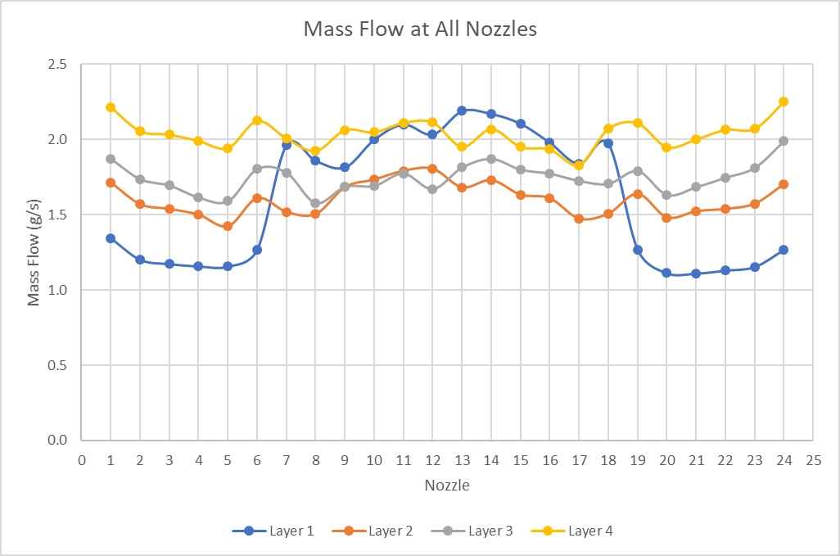
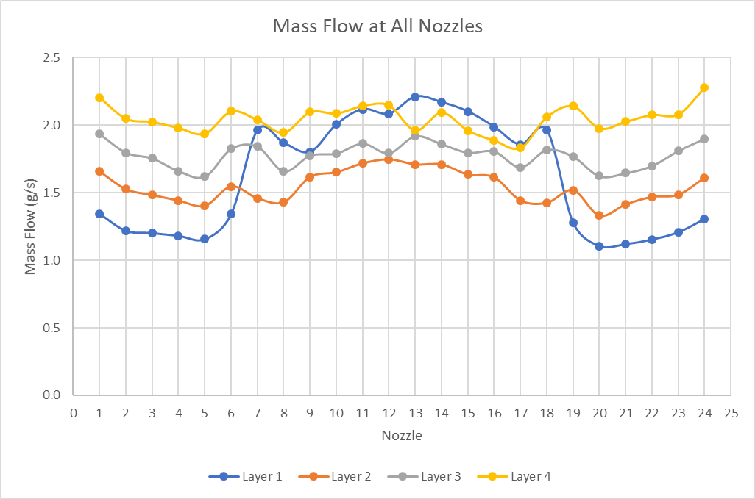
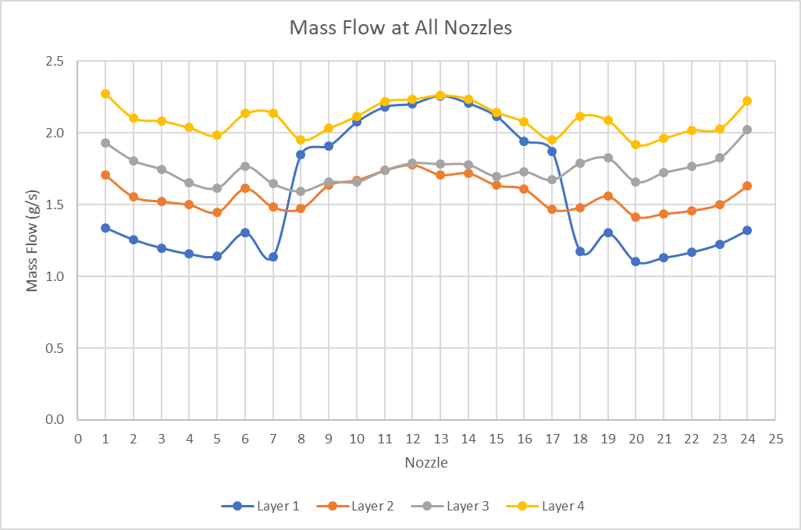
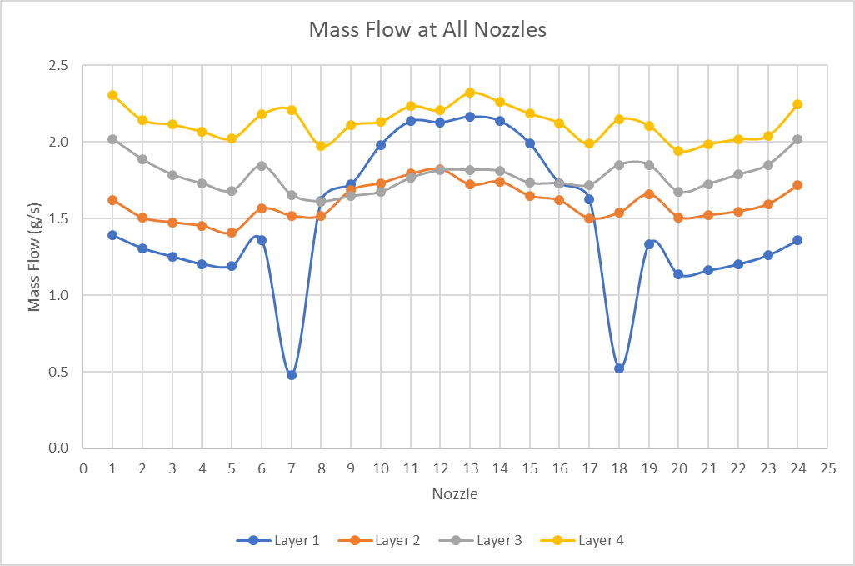
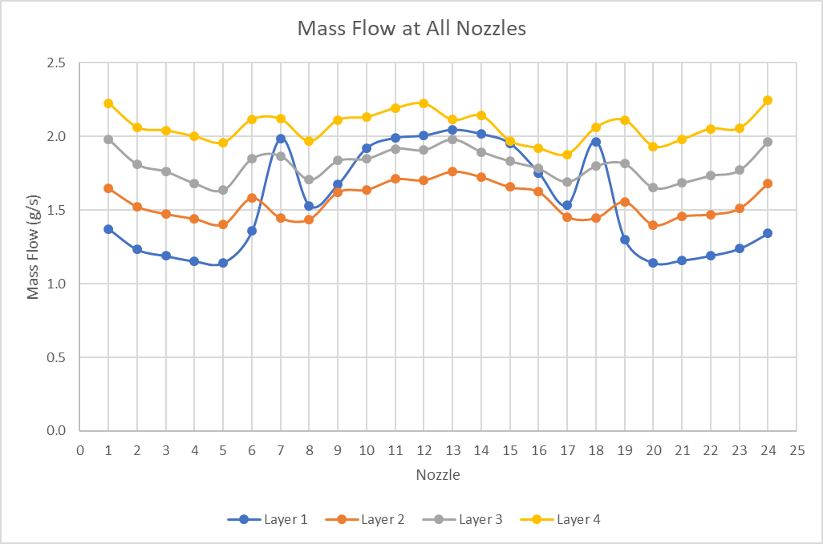
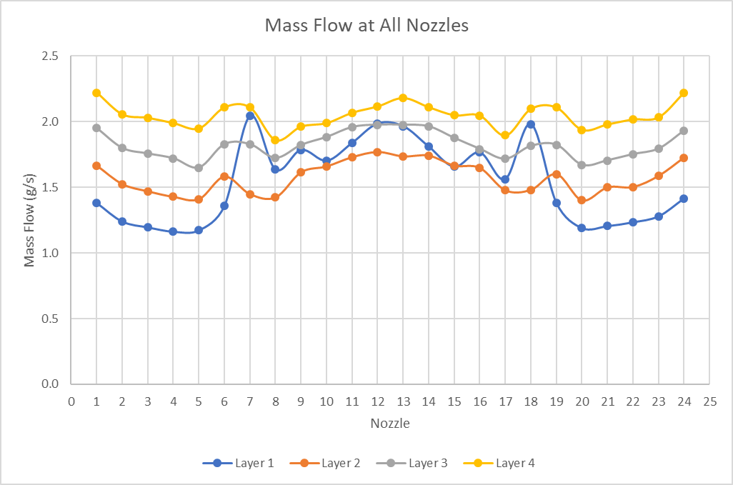
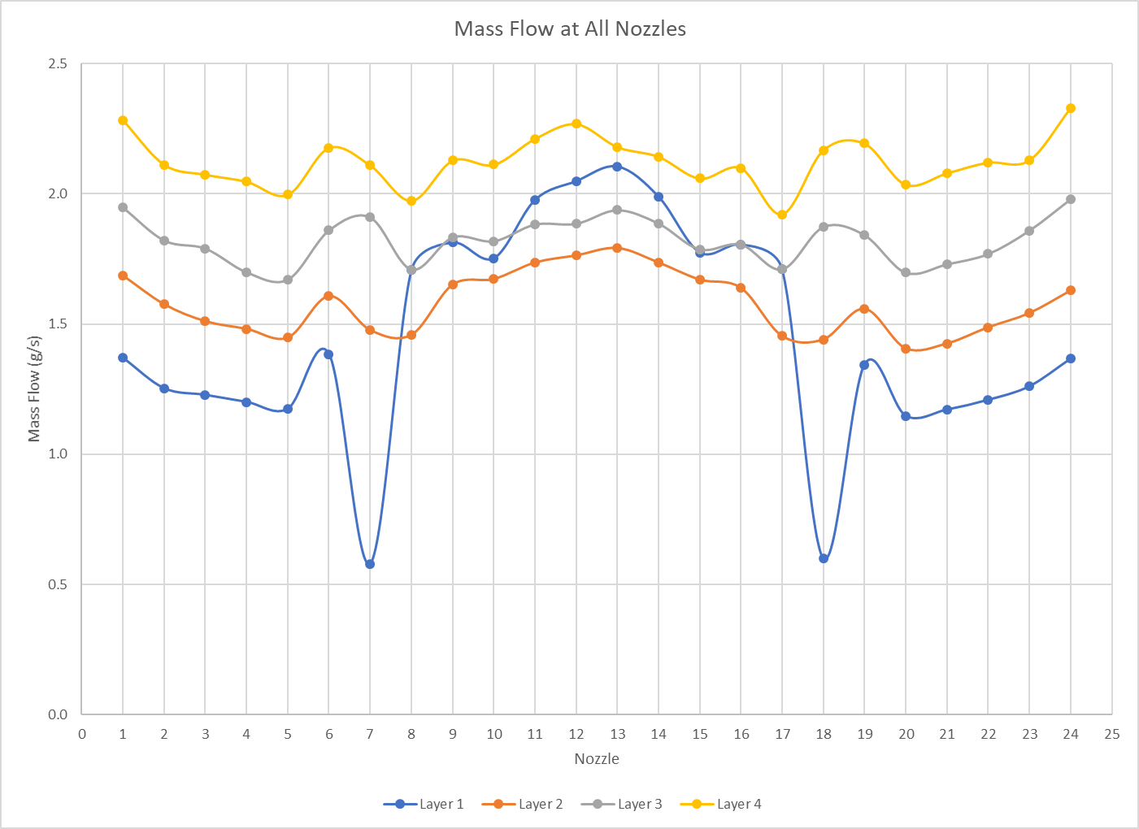
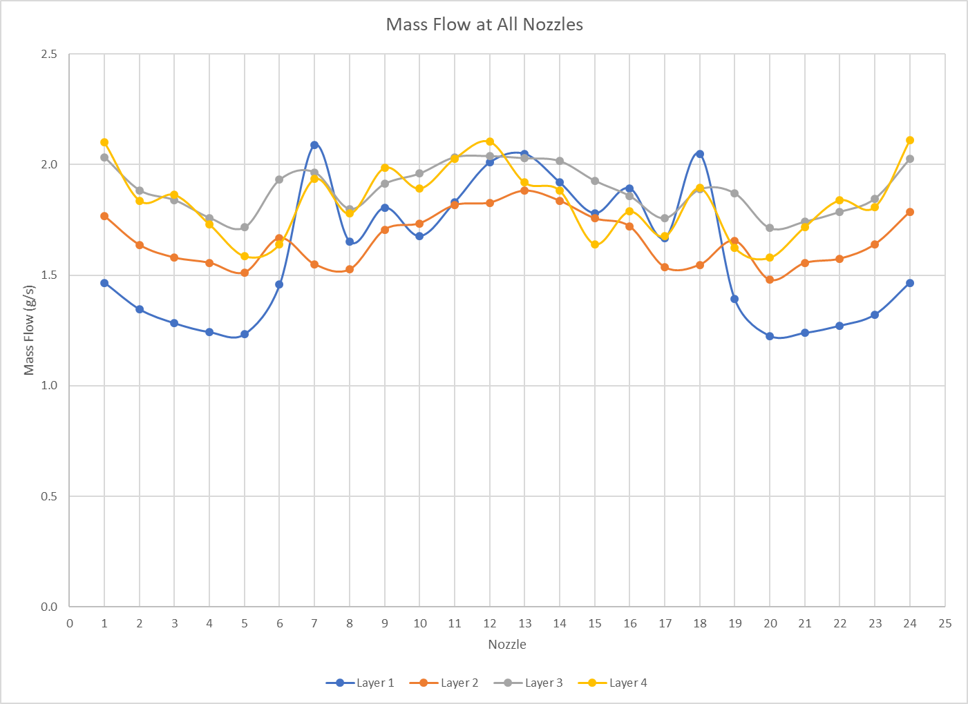
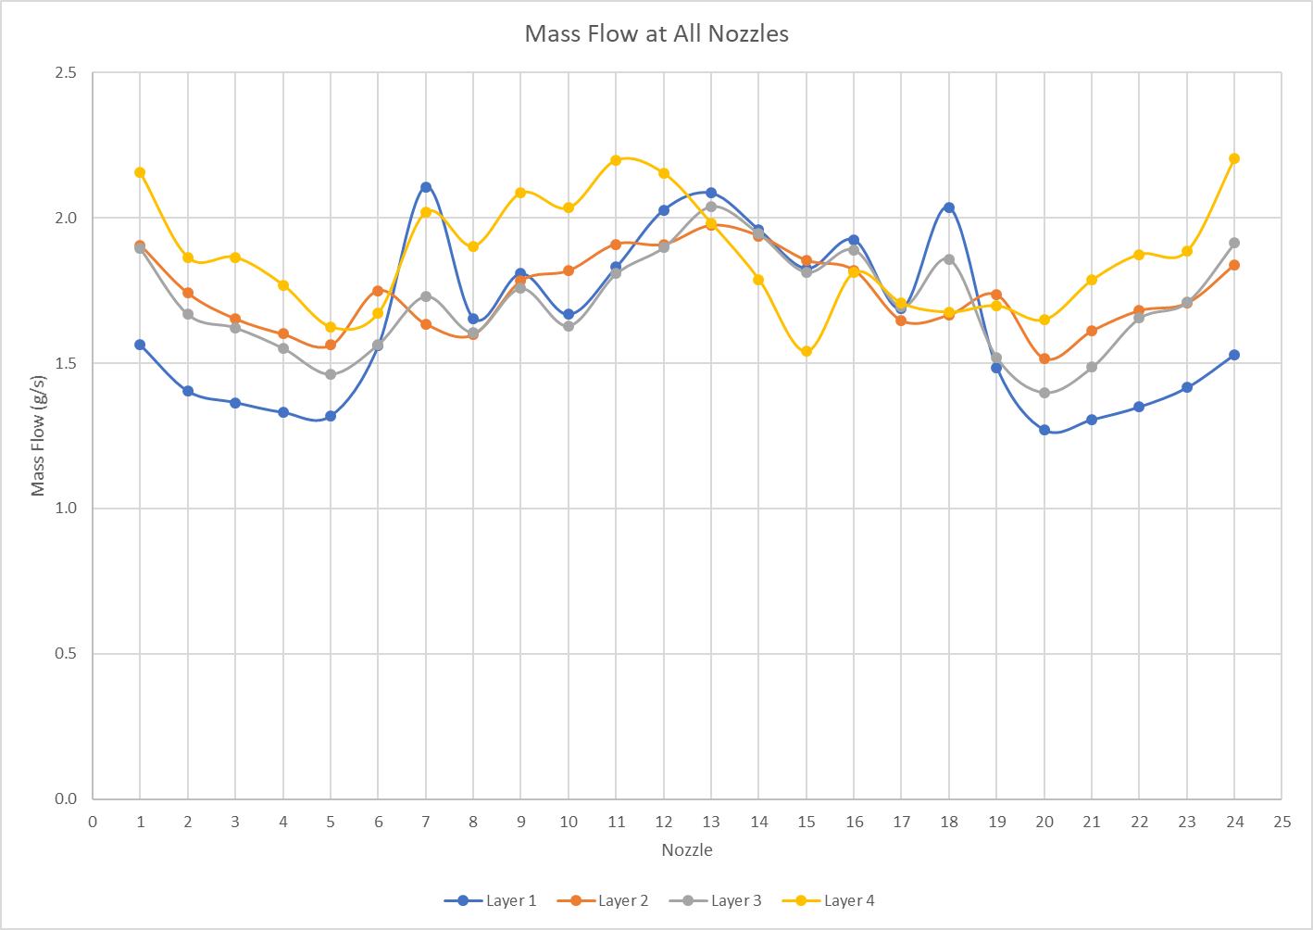
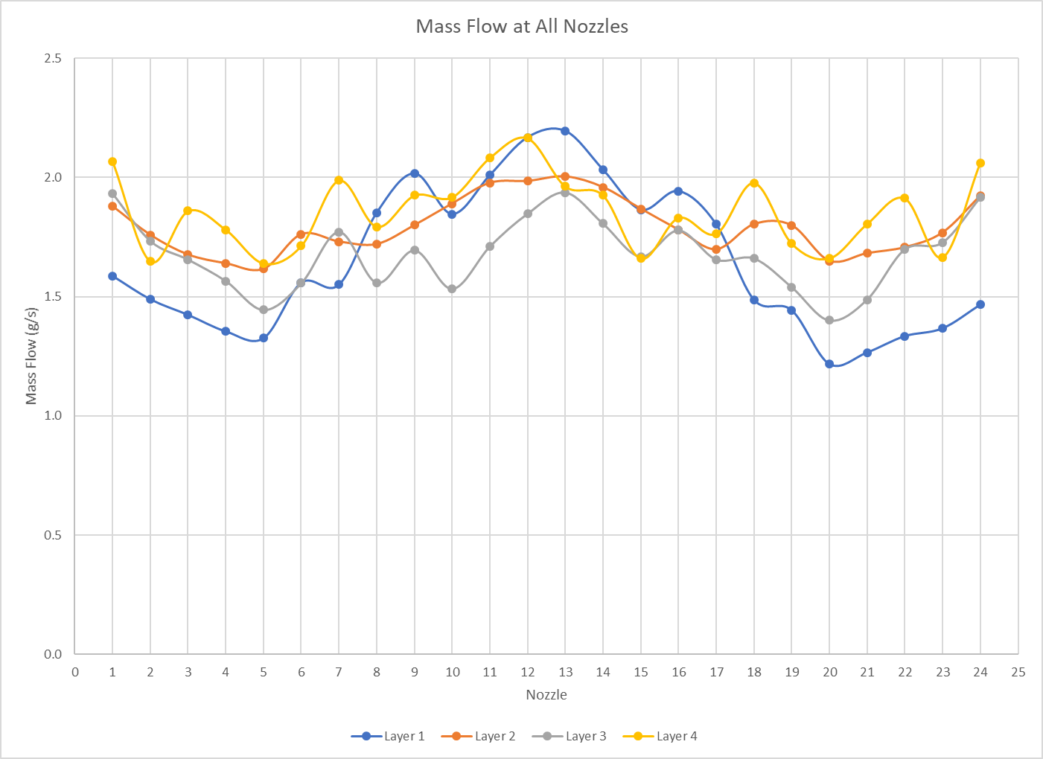
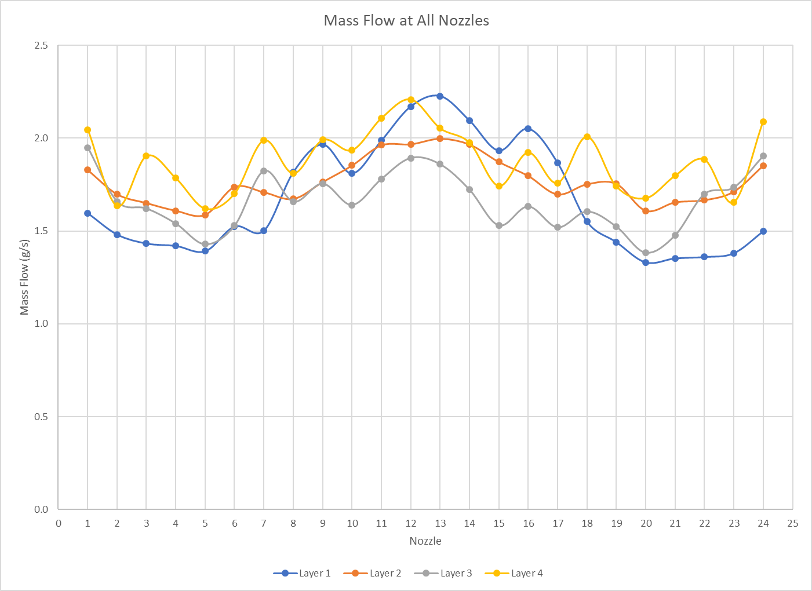
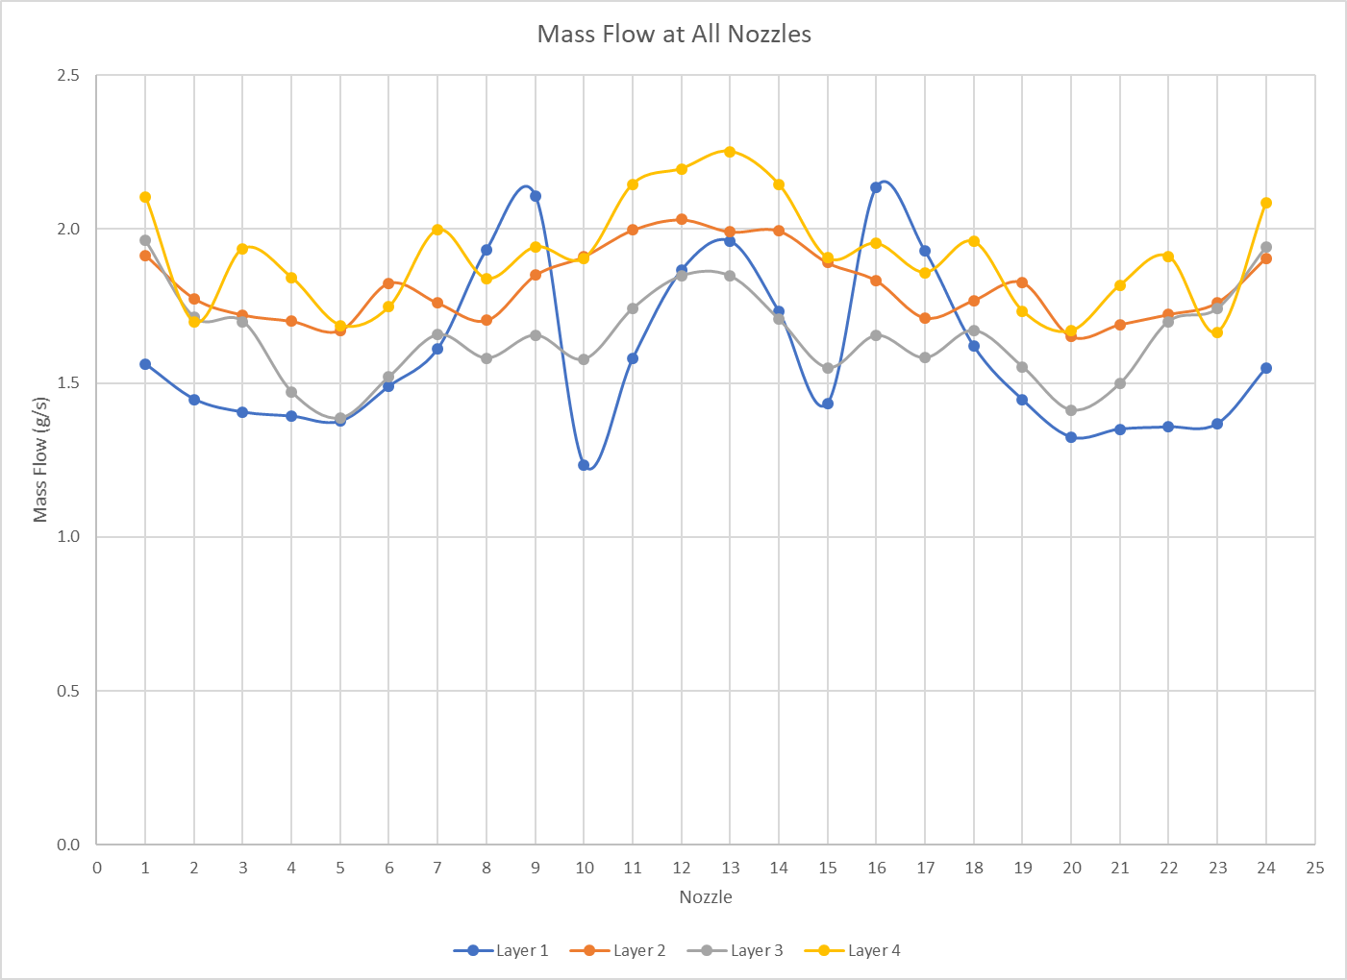
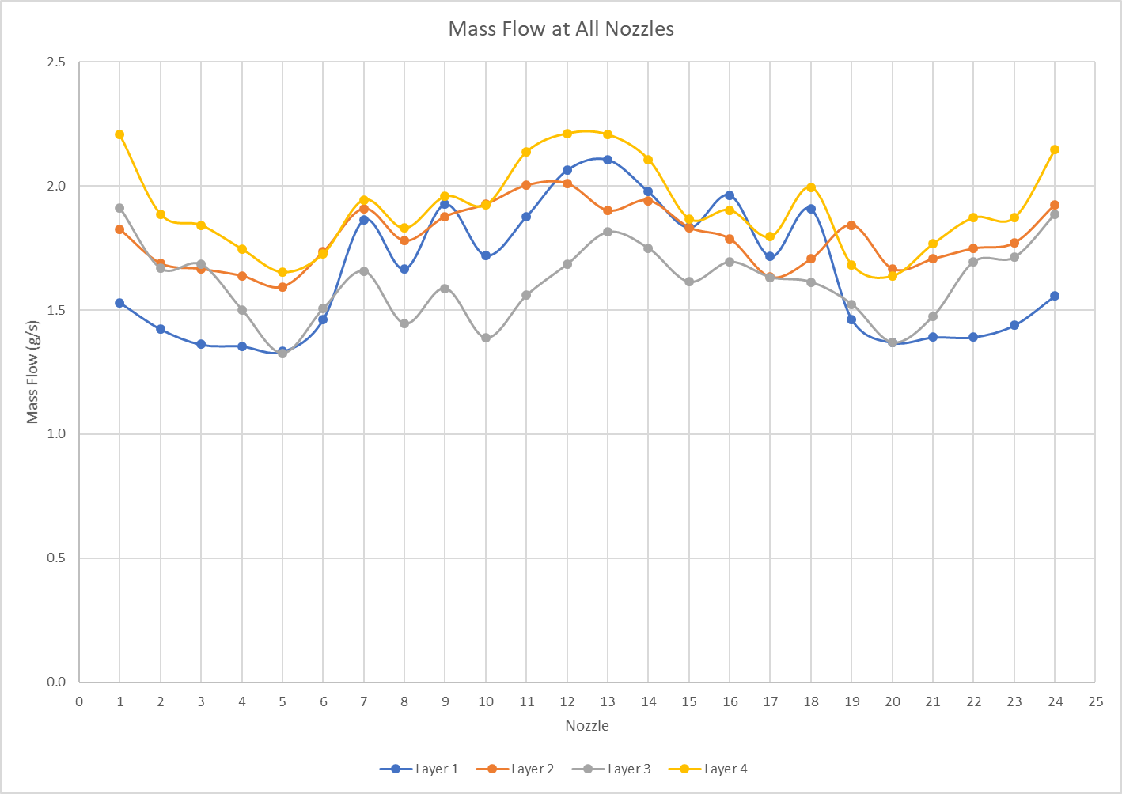
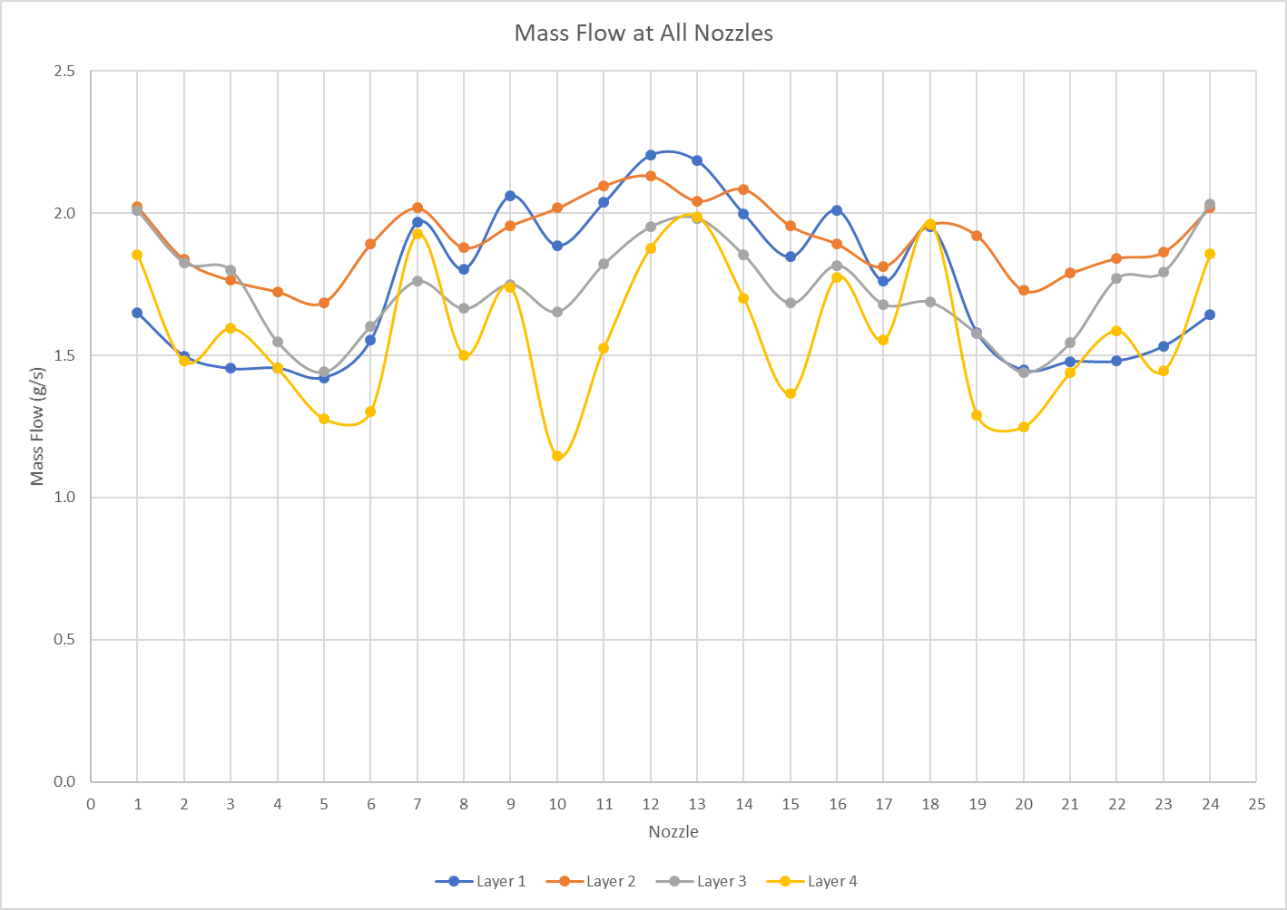
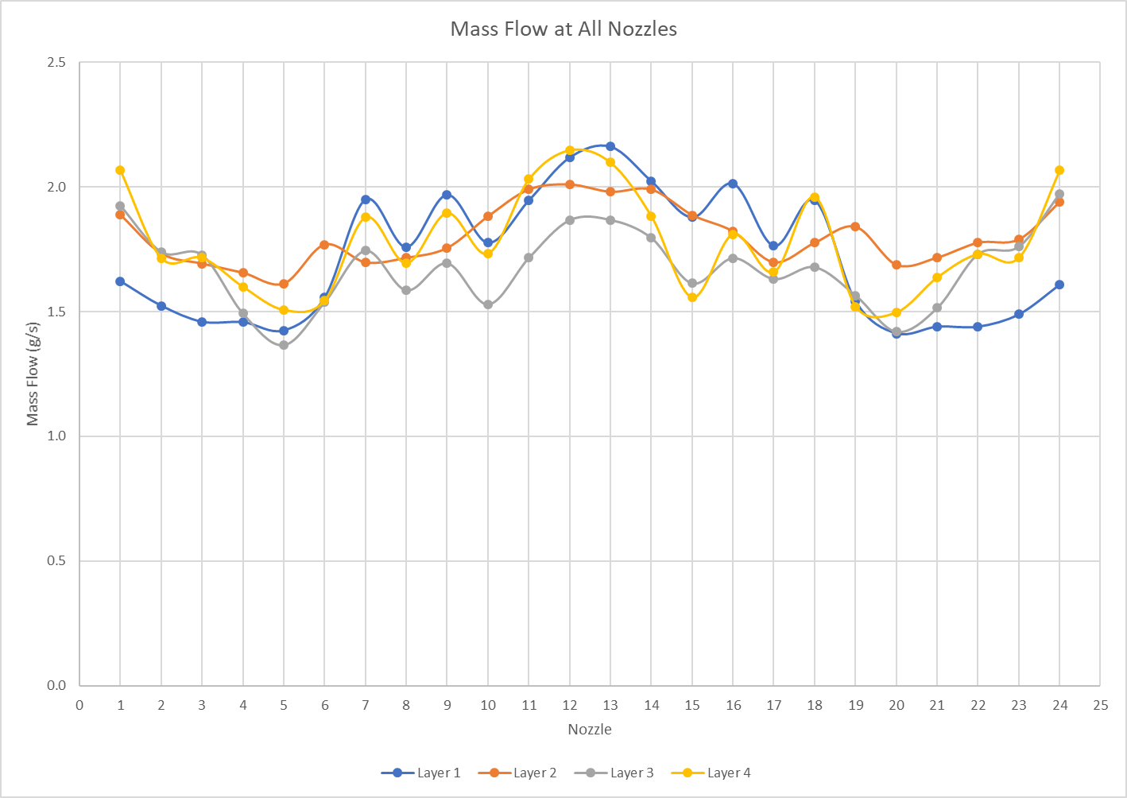
More than 25 modified designs are simulated for optimization.

Slide 14
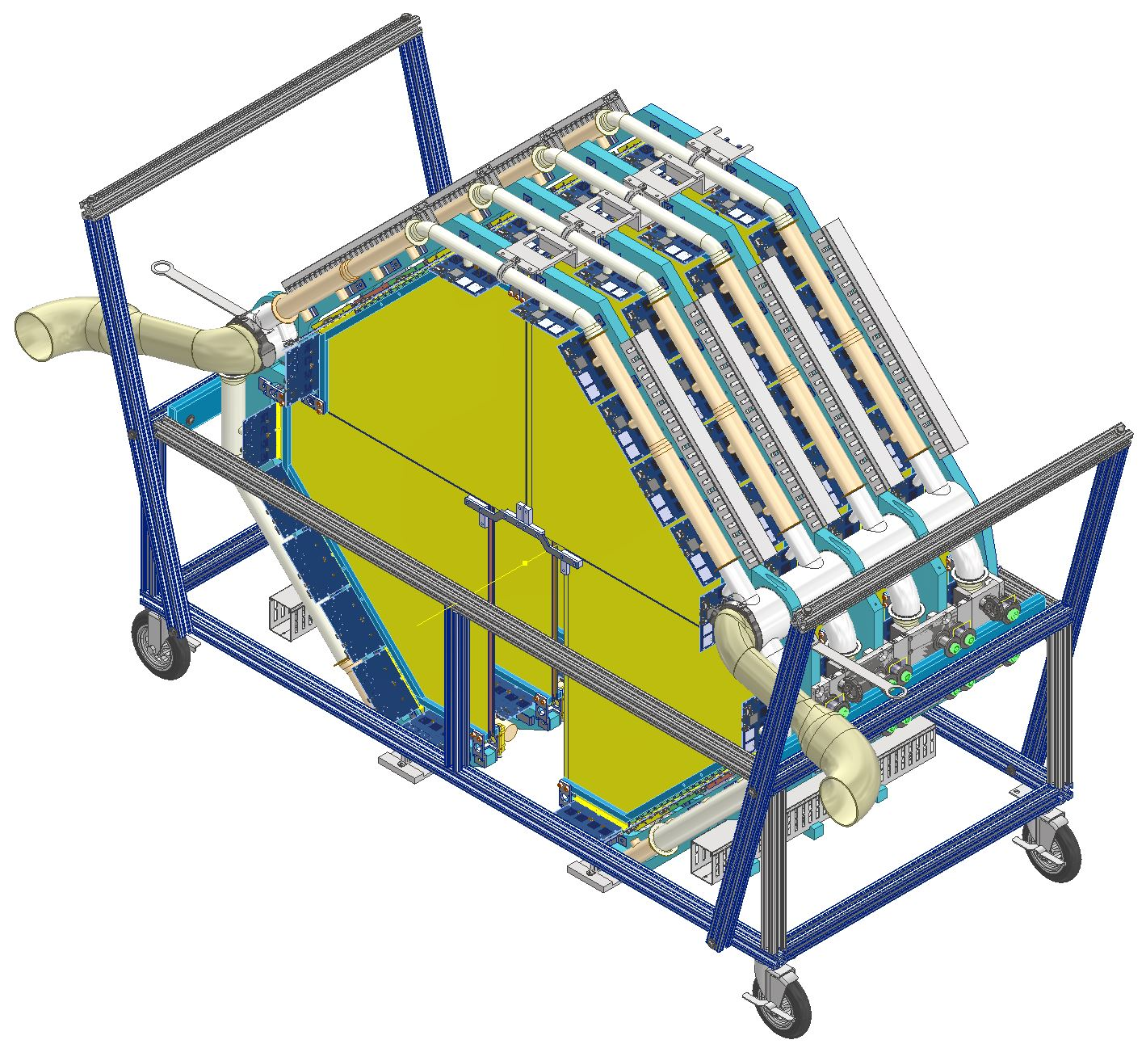
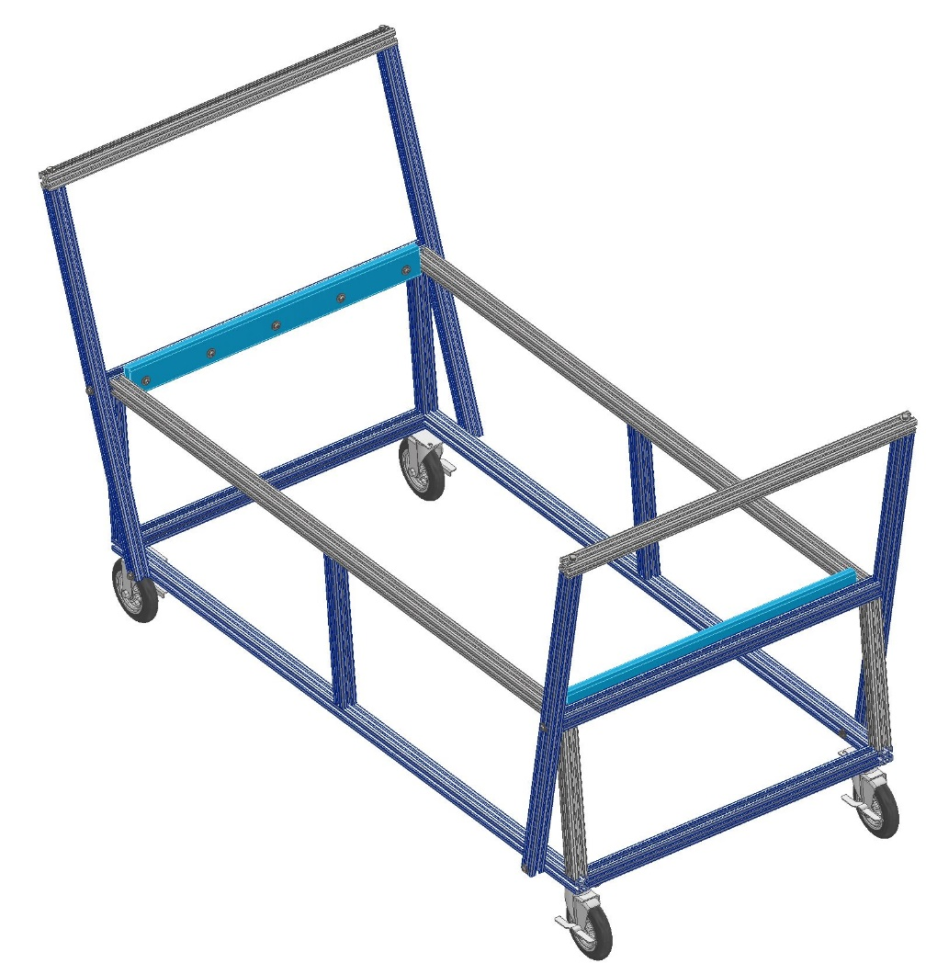
Transportation Cart

Slide 15
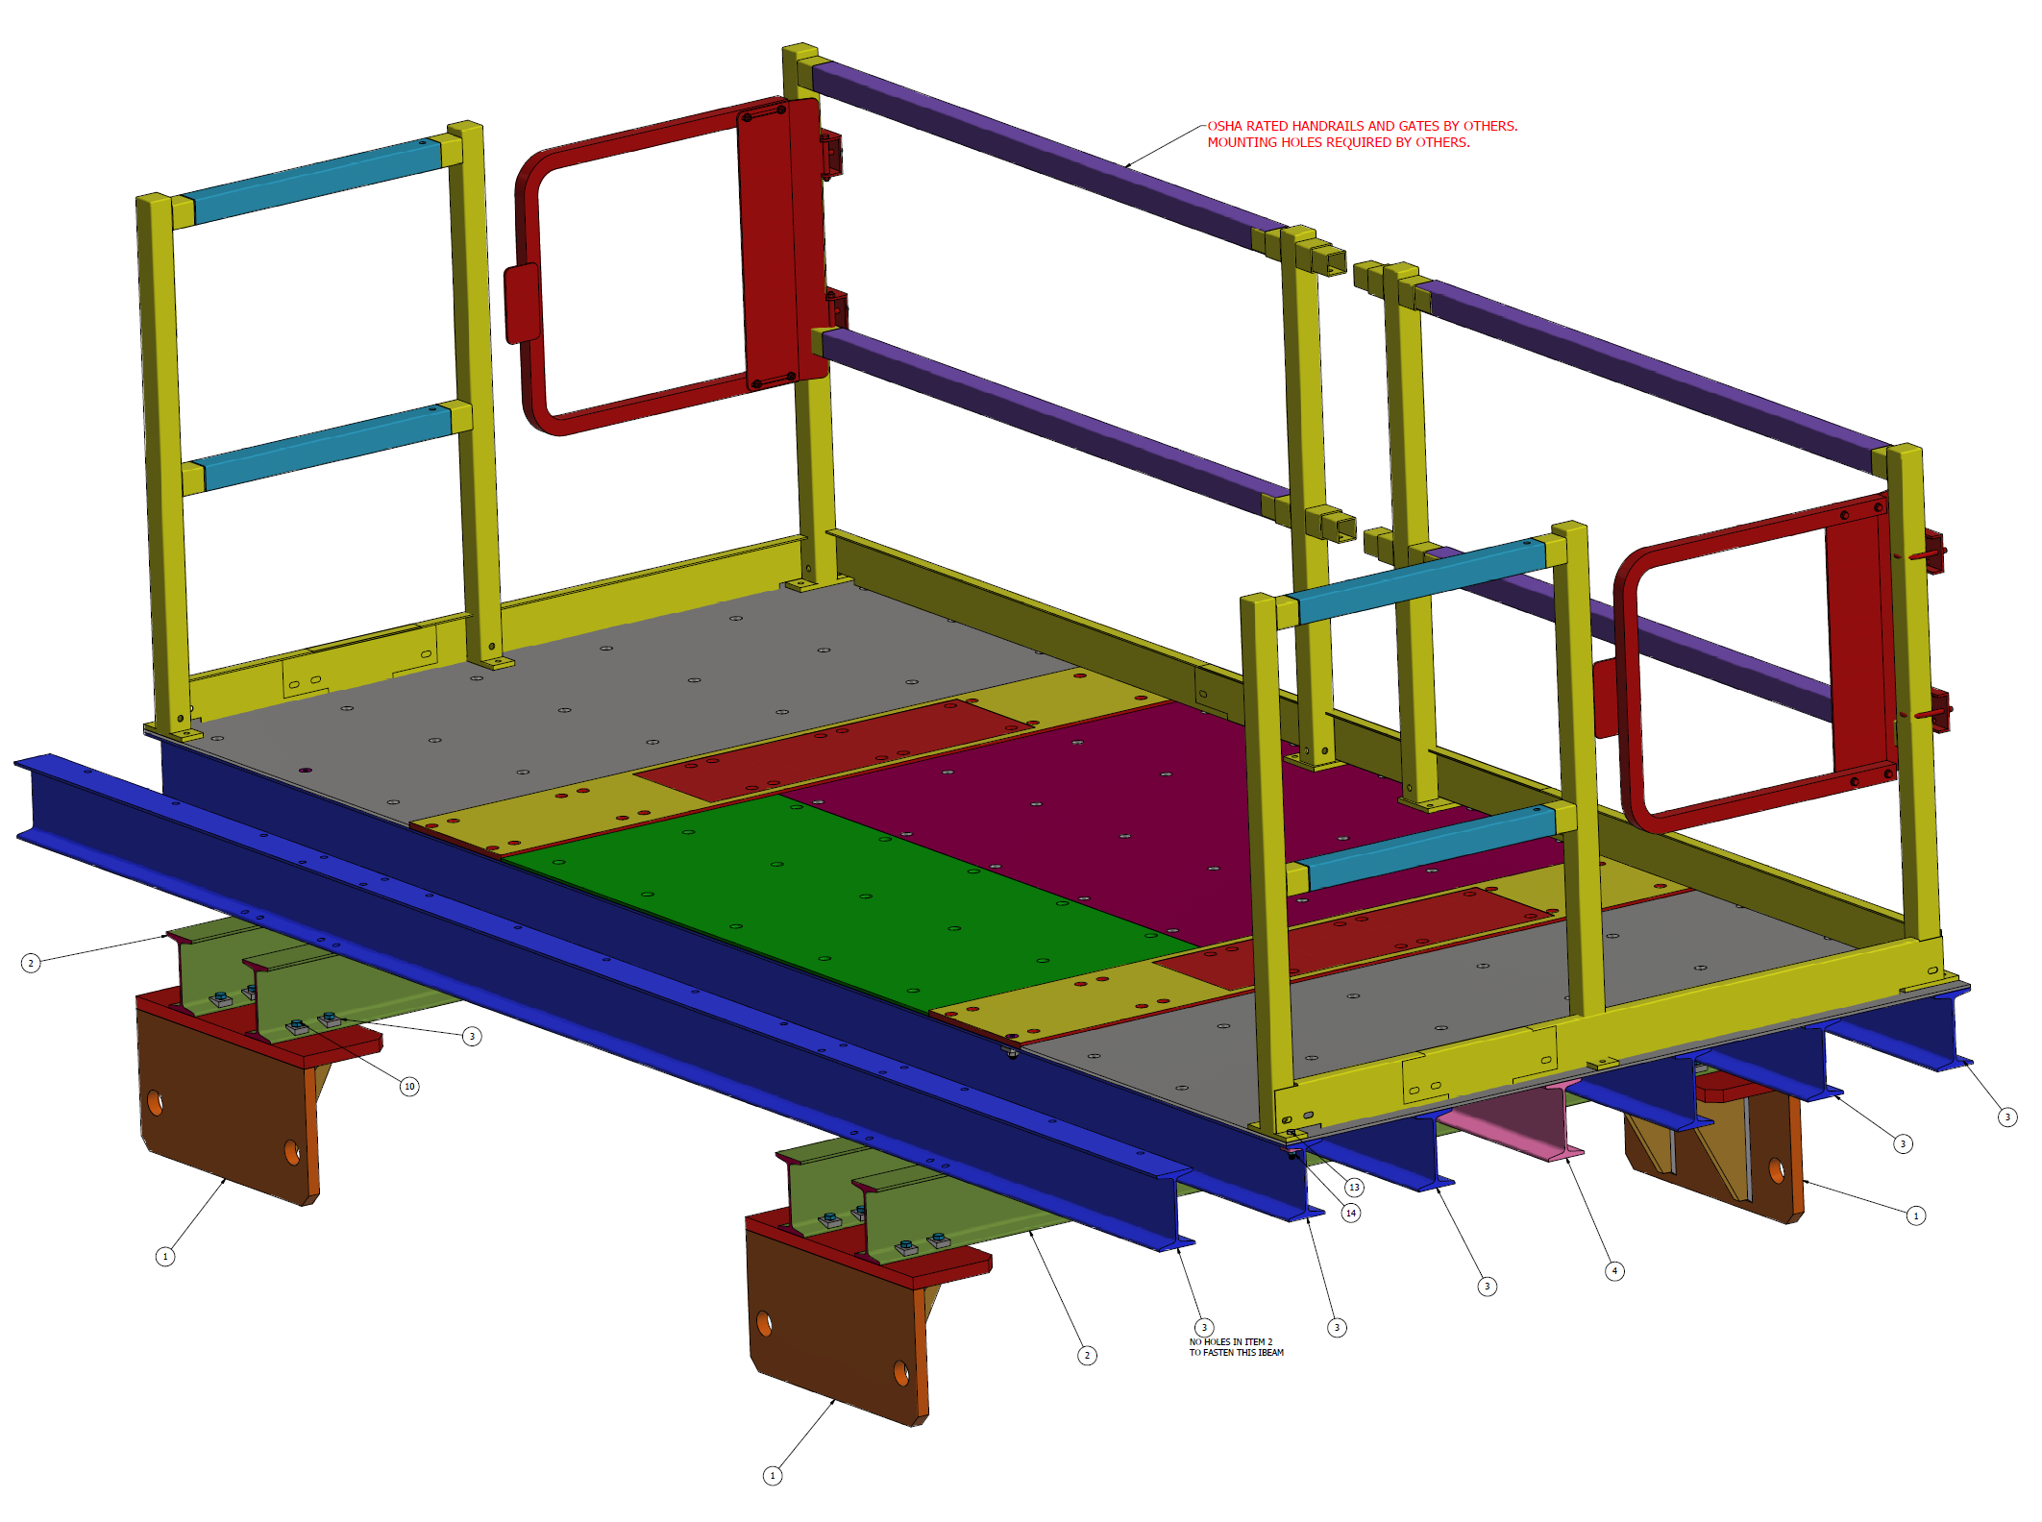
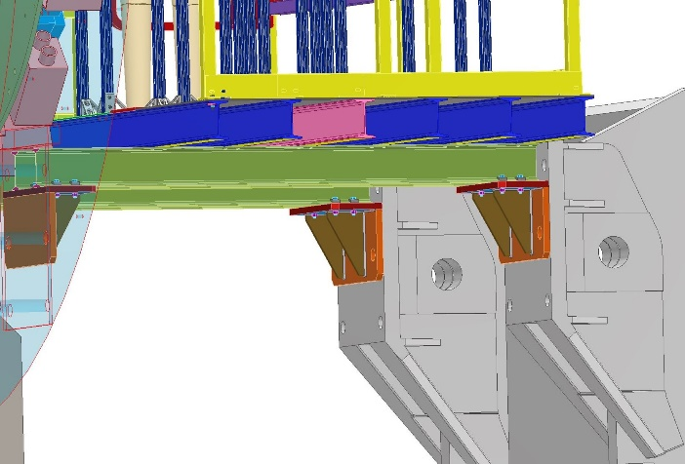
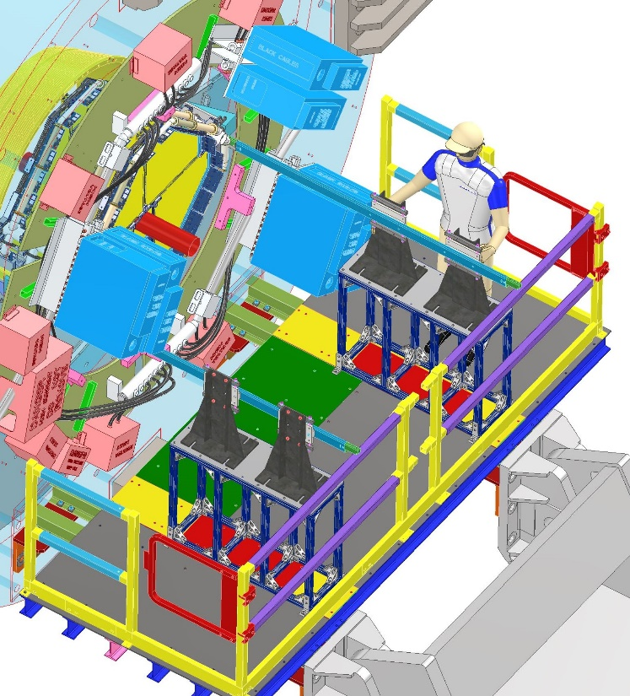
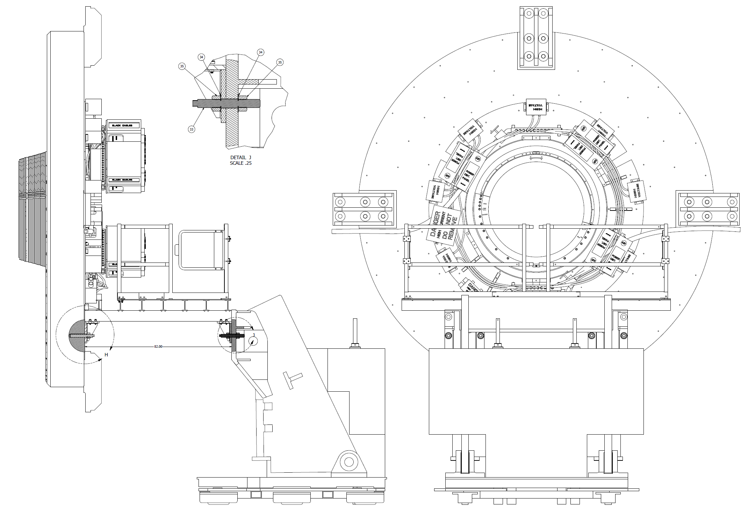
Platform Design

Slide 16
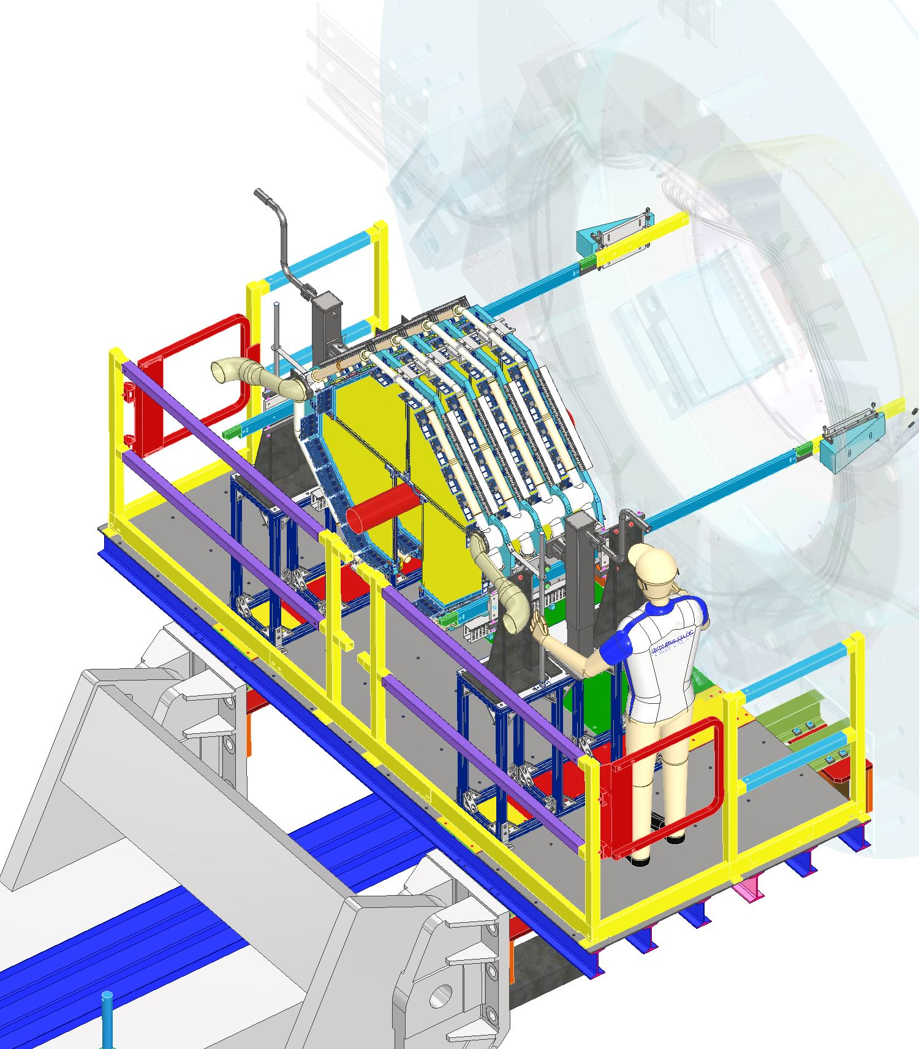
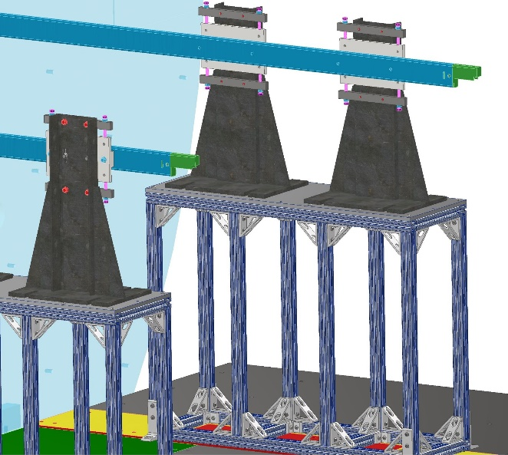
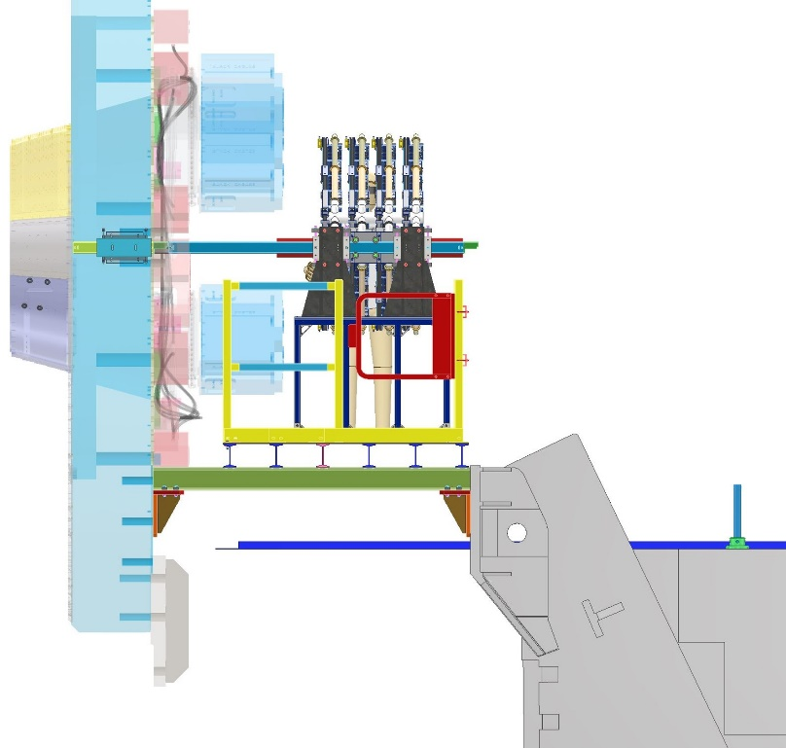
Installation of STGC in STAR
Stanchions, Stands and Rails

Slide 17
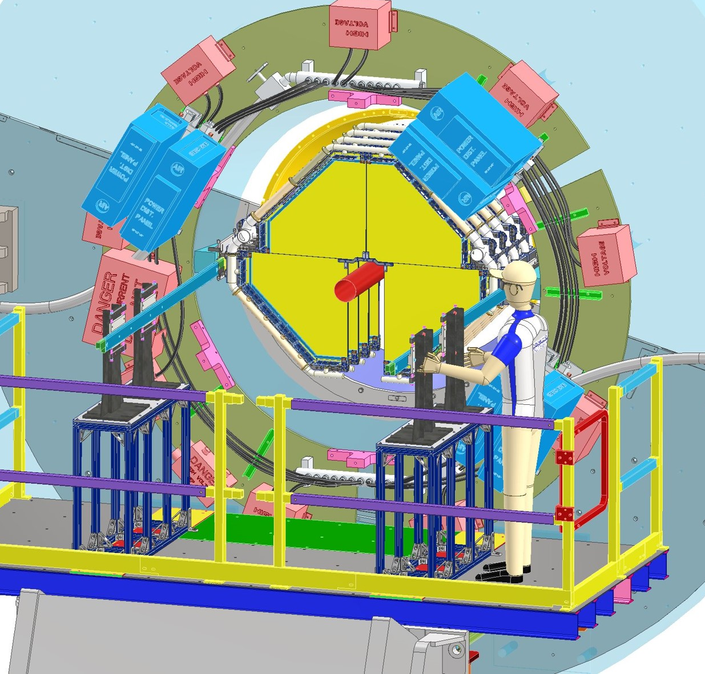
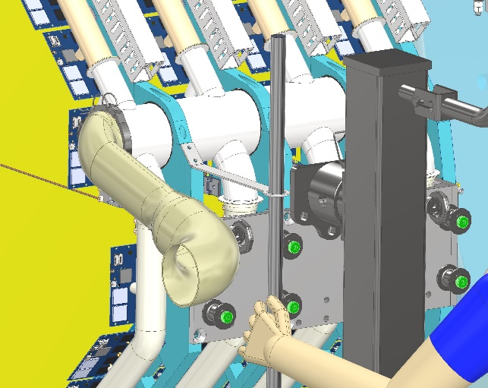
Installation of STGC in STAR

Slide 18
ES&H
sTGC Detector:
  sTGC Detector has to be lowered around the beam pipe with 1” clearance all around. Any potential failure in lifting fixtures or the frame will damage the beampipe. This makes the lift operation an Engineered lift. Elaborate analysis and calculations are being done to satisfy the requirements of such a lift. Additional testing will also be done as required by BNL safety.

Slide 19
sTGC Schedule
sTGC Support Structure and Installation Design Status:
CFD Simulations - Done
3D Design – Done
Initial Meeting with Mike Gaffney for ESRC approvals was conducted in December.
Detail Drawings:
  Frames and Side Plates package out for manufacturing
  Cart and pedestal package out for manufacturing
  Platform package just completed is being reviewed before sending out to the shops
  Cooling ducting and manifolds package sent out for quotation.
Drawings/Design tasks remaining:
  Design of the poletip bracket and stoppers.
  Design of assembly tooling for the 4 plane assembly.
Structural Analysis:
Detailed hand calculation and analysis done for assuring safety of the components. First pass of analysis introduced some changes in the design. It was incorporated before sending out the drawings. See the spreadsheet.
Schedule:
4 plane Assembly in assembly hall: Jun- August 2021
Installation in STAR: Sept 2021

Slide 20
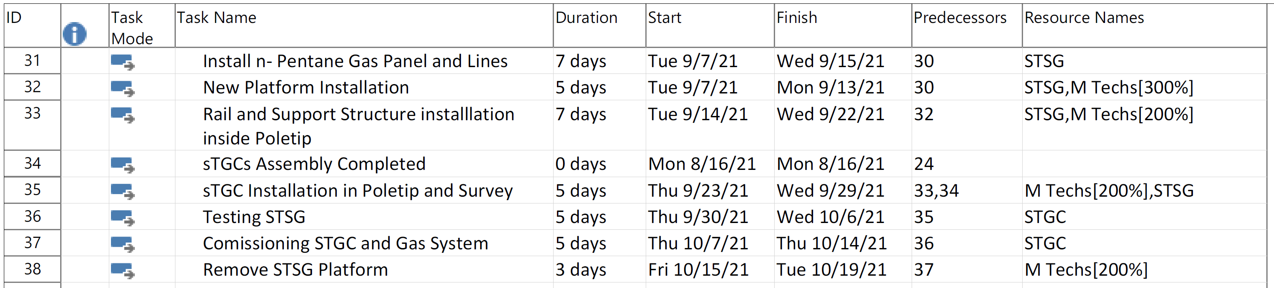
Conclusion
STGC
  Detailed design complete. Most of the Parts out for manufacturing. For others detailed drawings are being created.
  All approvals including Engineering Lift Approvals : June - August 2021
  All parts in hand: End of June
  4 plane Assembly in assembly hall: Jun- August 2021
  Installation in STAR: Sept 2021

