Slide 1
Spin Asymmetry Measurements at EIC
Arun Tadepalli – Jefferson Lab
In collaboration with I. Ivica, J. R. Pybus, A. Jentsch, E. P. Segarra, M. D. Baker, O. Hen, D. Higinbotham, R. Milner, D. Nguyen*, Z. Tu, J. Rittenhouse West
* = special thanks!

Slide 2
Contents
Introduction
A1n in the high-x region
Most recent A1n measurement in Hall C at Jefferson Lab
Double spectator tagging method at the EIC
Summary

Slide 3
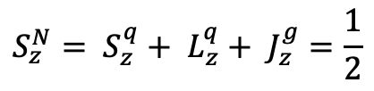
Introduction
Understanding the spin structure in the valence region is a central goal
  Free from sea effects
  Valence region defines the global properties of the nucleon
Pinning down the spin and OAM contribution of various constituents is the current “spin puzzle”
Virtual photon asymmetries A1n at high-x give an insight into the role of orbital angular momentum of the valence quarks
$$S_{z}^{N}= S_{z}^{q}+ L_{z}^{q}+ J_{z}^{g}=\frac{1}{2}$$

Slide 4
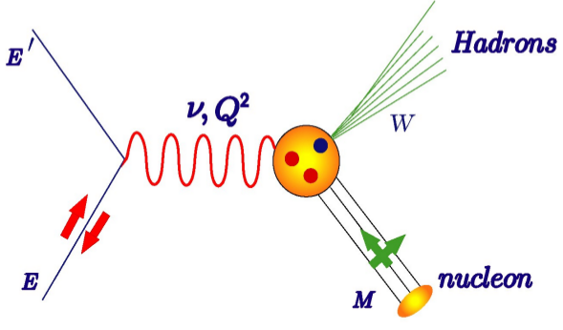
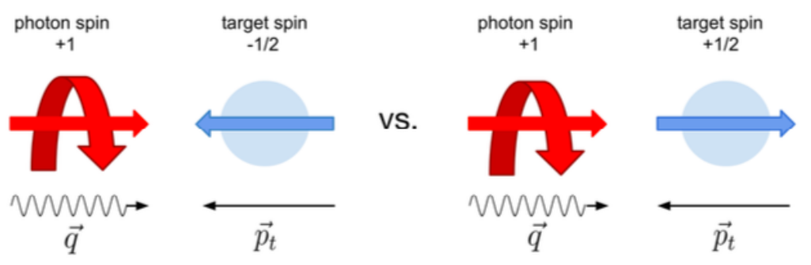
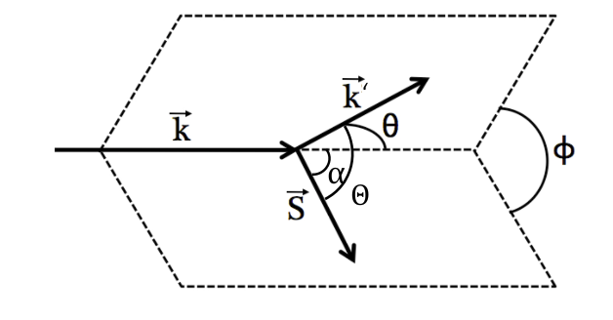
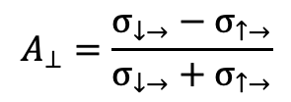
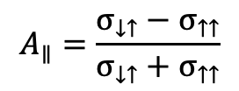
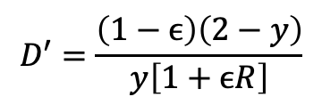

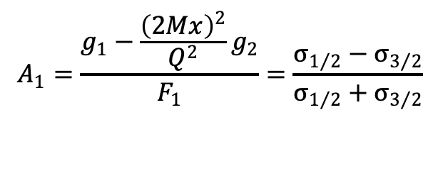
Longitudinal Virtual Photon Asymmetry A₁^{n}
$$A_{1}=\frac{g_{1}−\frac{{\left(2Mx\right)}^{2}}{Q^{2}}g_{2}}{F_{1}}=\frac{σ_{1/2}−σ_{3/2}}{σ_{1/2}+σ_{3/2}}$$
Anti-parallel spins
Parallel spins
$$A_{1}=\frac{1}{\left(E+E′\right)D′}\left[\left(E−E′cosθ\right)A_{∥}−\frac{E′sinθ}{cosϕ}A_{⊥}\right]$$
$$A_{∥}=\frac{σ_{↓↑}−σ_{↑↑}}{σ_{↓↑}+σ_{↑↑}}$$
$$D′=\frac{\left(1−ϵ\right)\left(2−y\right)}{y\left[1+ϵR\right]}$$
$$A_{⊥}=\frac{σ_{↓→}−σ_{↑→}}{σ_{↓→}+σ_{↑→}}$$
Angular kinematics for polarized electron scattering

Slide 5
Why A₁^{n} in high-x region?
Virtual photon asymmetry A1 give insight into role of OAM of valence quarks in the high-x region
Also, Q² dependence needs to be mapped out for a wide range of values
Parno et al., Phy Let B DOI: 10.1016/j.physletb.2015.03.067
X. Zheng et al., PRL 92, 012004 (2004); PRC 70, 065207 (2004)

Slide 6
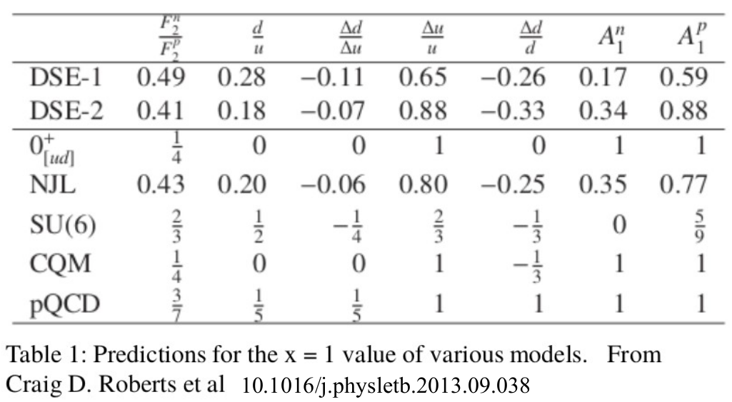
Flavor Spin Decomposition of Nucleon Structure
A1n taken together with A1p could give flavor separated spin distributions in the valence region

Slide 7
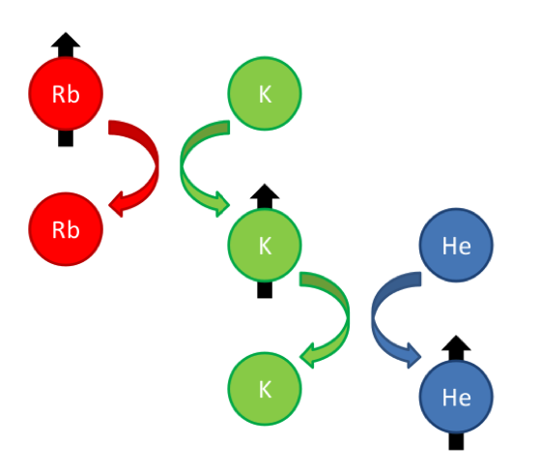
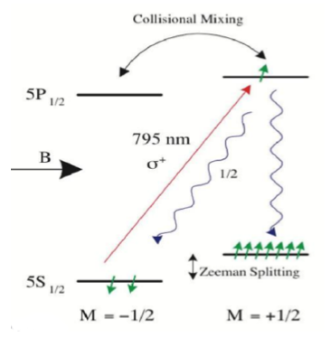
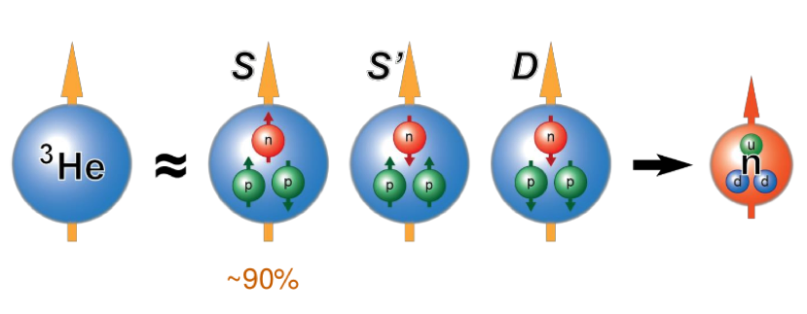
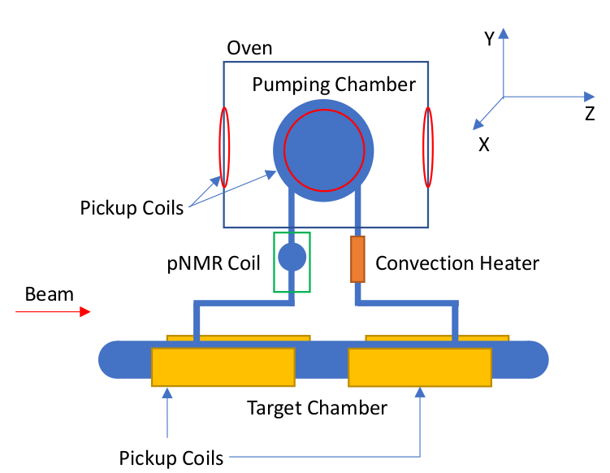
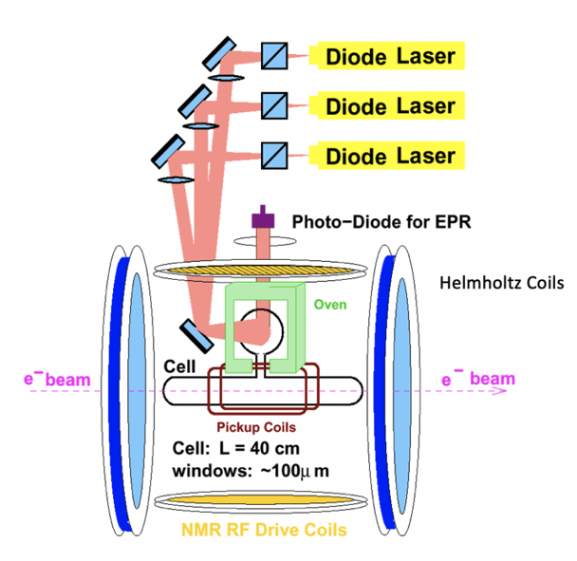
Polarized ³He target in Hall C
Collisional mixing
Spin exchange optical pumping
Effective neutron target

Slide 8
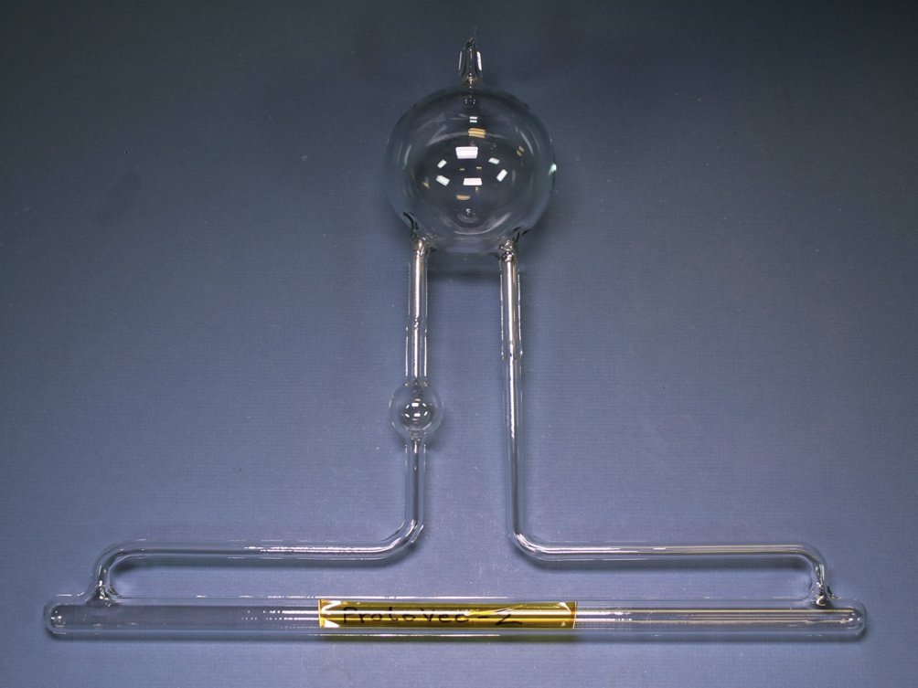
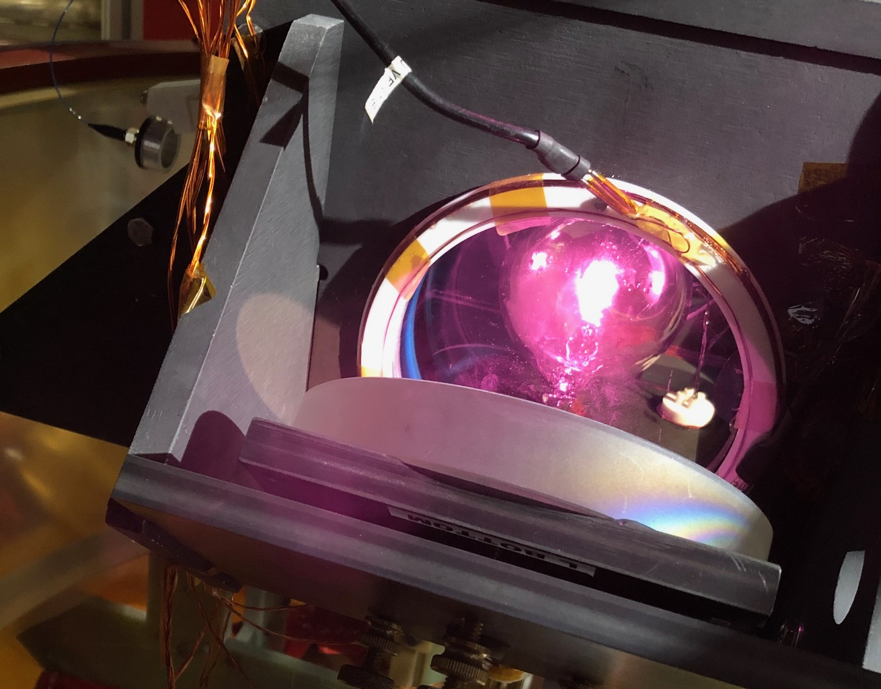
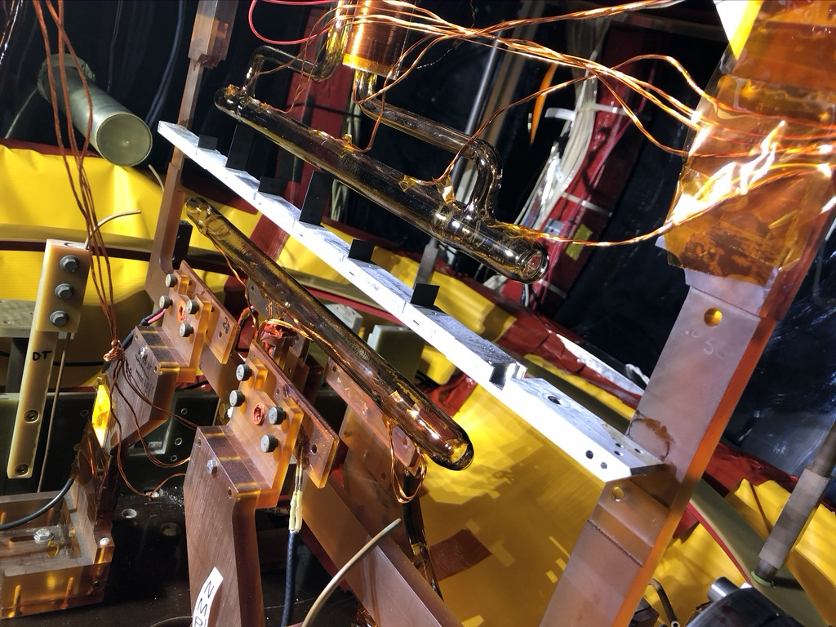
Polarized Target in Hall C
Polarized He3 cell
Target ladder
Infrared hue captured by iPhone
Cell installation in Hall C

Slide 9
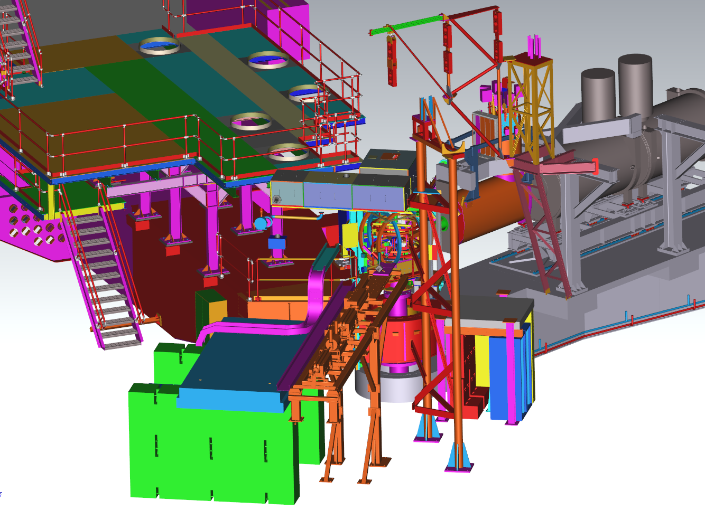
Polarized 3He Run Group in Hall C
SHMS
HMS
Pol ³He Target
e- beam
Hall C

Slide 10
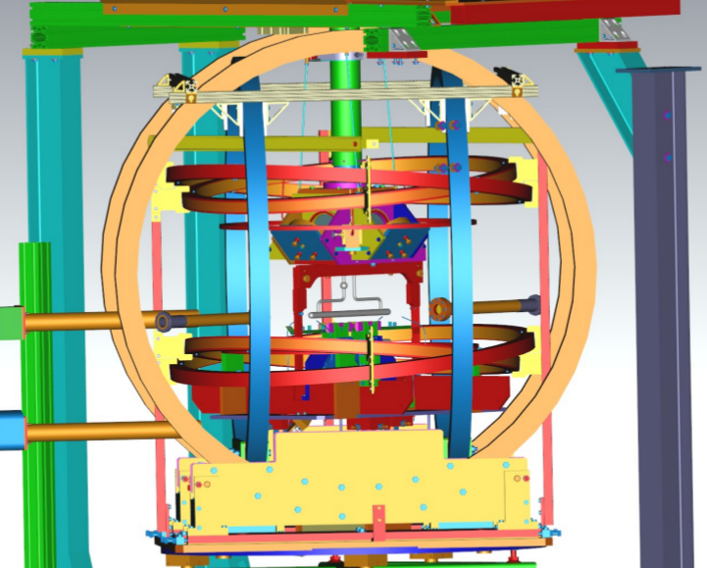
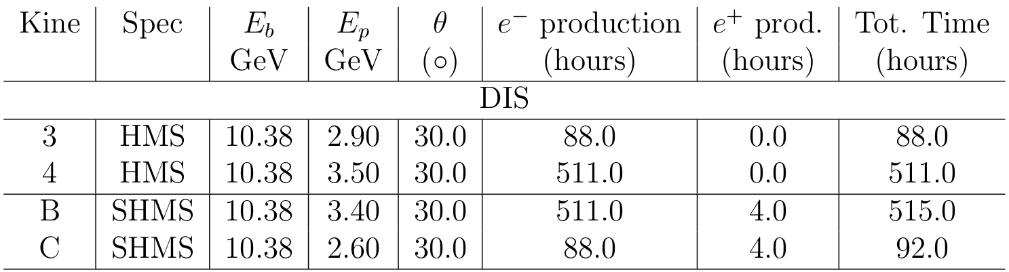
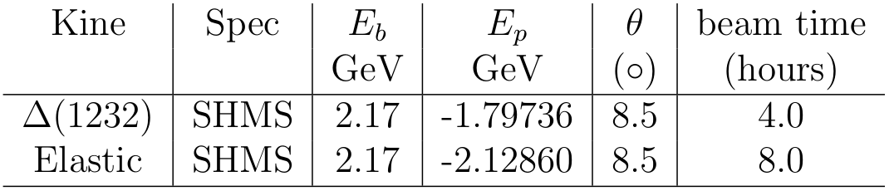
A1n experiment in Hall C at Jefferson Lab
Electron Beam:
E_{beam}=2.17 GeV (1-pass commission)
E_{beam}=10.38 GeV (5-pass DIS production)
Beam polarization: 85%
  <3% uncertainty by Moller Polarimeter
Circular beam raster with 2.0 - 2.5mm radius
< 50 ppm charge asymmetry
Polarized ³He target:
³He production cell (40cm)
55–60% polarization without beam
Reached over 50% polarization with 30 uA beam current
About 3% uncertainty for polarimetry
Offline analysis in progress

Slide 11
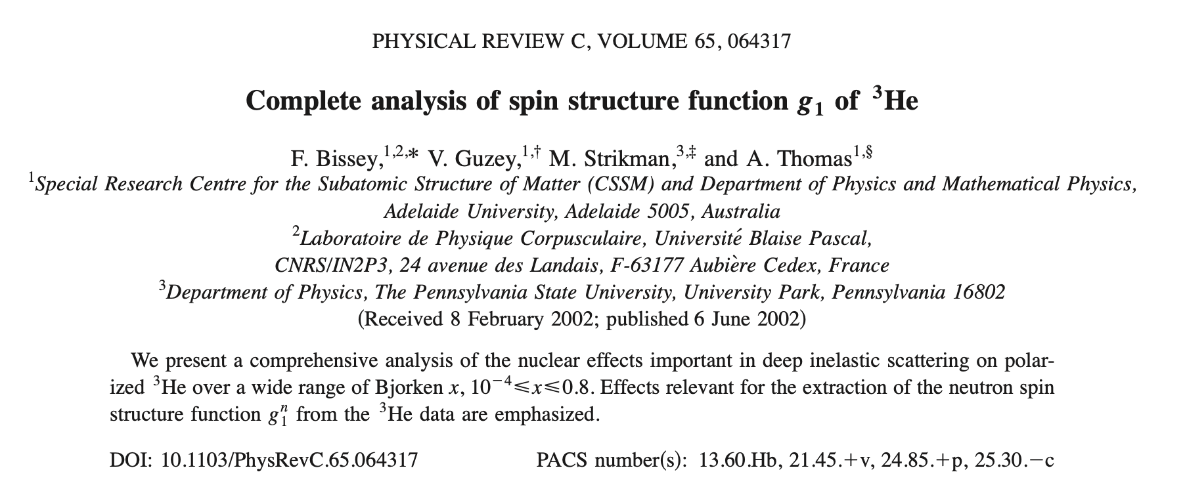
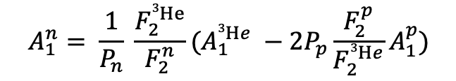
Limitations of a Fixed Target
Measured is ^{He3}A₁ from which A₁^{n} is extracted
Systematic errors separated into different components
Although F₂, A₁^{p}, P_{p} and P_{n} contribute, the model dependent proton polarization P_{p} dominates the systematic uncertainty
$$A_{1}^{n}= \frac{1}{P_{n}} \frac{F_{2}^{3He}}{F_{2}^{n}}(A_{1}^{3He} −2P_{p}\frac{F_{2}^{p}}{F_{2}^{3He}}A_{1}^{p})$$

Slide 12
Pol He3 ion beam at a collider
Pol He3 fixed target
Accessing the same neutron… right?

Slide 13
What happens to the spin structure of the neutron at high-x?
Are all the corrections we apply for a fixed target case accurate?
How to transform from an “effective neutron” to a “free neutron” target?
OAM for valence quarks?
Polarized 3He beam allows us to ask interesting physics questions!

Slide 14



EIC (Electron Ion Collider)
EIC x:Q2 coverage
Unique opportunity for tagging measurements
Large coverage in x and Q2 (which is what we need for A1n)
EIC Yellow report
Arxiv: 2103.05419v2
Notes:
An other issue: A1 is ratio of g1F1 was assume to be Q2-independent.
But this assumption was never been tested due to the limited Q2 data.
Now at EIC: the collider experiment which give us much larger Q2-x coverage
-> It will be great place to study this Q2- dependence

Slide 15
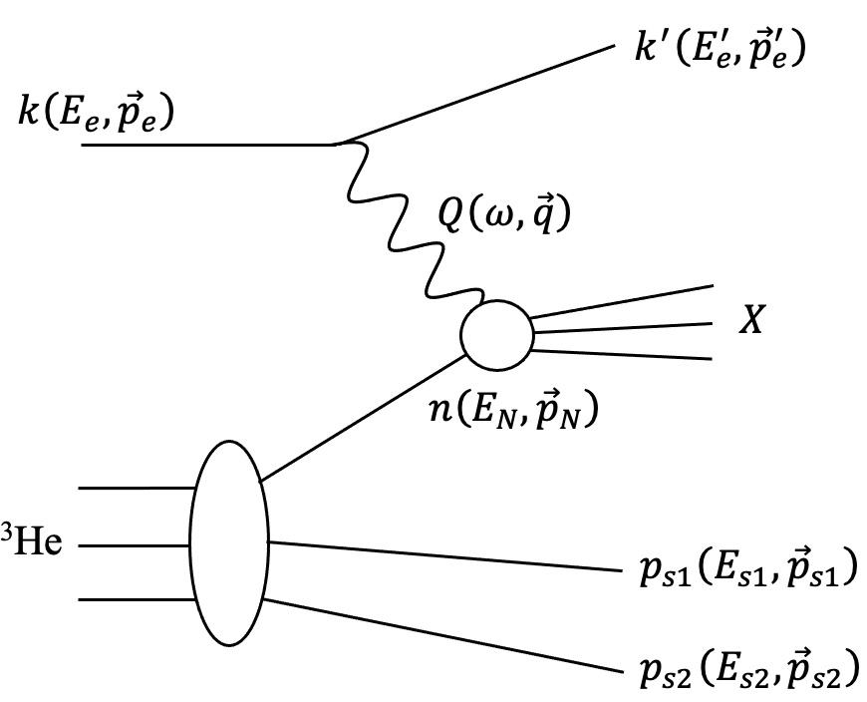
Double spectators tagging from ³He at EIC
Tags
Select the active nucleon in the reaction and break up channel by spectator tagging
Suppress the contribution of non-nucleonic degree of freedom
Access to an “effective” free neutron target
Notes:
Now we come to the double measurement from He3.
Electron interact with the struck nucleon, there are two spectator nucleon. We will detect both of them.
-BY doing this double tagging we can: provide the “effective” free neutron target

Slide 16
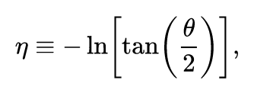
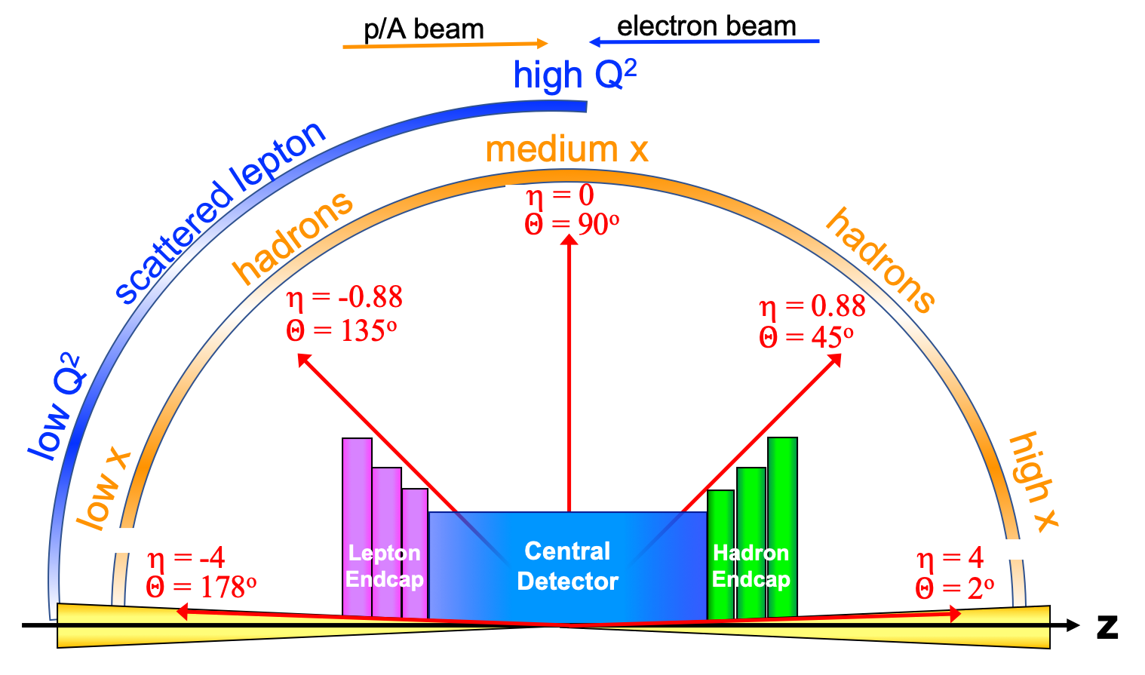
Double spectators tagging from ³He at EIC
Particles outside the main detector: 𝜃 < 35 mrad
Protons and light nuclei: B0 tracker, Off-momentum detectors and Roman Pots
Neutrons: Zero-Degree-Calorimeter (ZDC)
Notes:
Now we come to the double measurement from He3.
Electron interact with the struck nucleon, there are two spectator nucleon. We will detect both of them.
-BY doing this double tagging we can: provide the “effective” free neutron target

Slide 17
DIS ³He(e, e’pp)X: Electron kinematics
3BBU SRC
110x18 41x5

Slide 18
DIS ³He(e, e’pp)X: Spectator protons
eN: 5 x 41
3BBU

Slide 19
Effective “Free Neutron” target
IRF eN: 5x41
IRF eN:18x110
Advantage of the double tagging measurements:
In Ion Rest Frame (IRF): Constraint the total momentum of two spectator nucleons to low momentum provides almost “Free neutron” target.
Minimize the nuclear correction model effects.

Slide 20
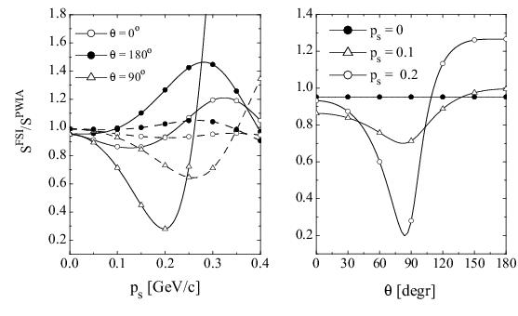

Angle distribution: $θ_{rq}$: FSI
eN: 5x41
Ciofi degli Atti and Kopeliovich, Eur. Phys. J. A17(2003)133
Minimal FSI for low spectator momenta and large θ (blue bands)
eN: 18x110

Slide 21
A1n projections
Comparison of tagged (black) and inclusive (blue) measurement A1n extractions
Plot credit: Dien Nguyen

Slide 22
Summary
A1n provides an excellent probe of the nucleon structure in the valence region elucidating on the role of valence quark OAM
Recent measurements of A1n successfully completed in Hall C of Jefferson lab and offline analysis in progress.
With the advent of EIC, A1n can be investigated by taking advantage of the far-forward detection capabilities
Double spectator tagging method greatly reduces the systematic uncertainties by allowing us to select electron scattering DIS events on “free” neutron targets thereby reducing model dependence
In collaboration with I. Ivica, J. R. Pybus, A. Jentsch, E. P. Segarra, M. D. Baker, O. Hen, D. Higinbotham, R. Milner, D. Nguyen*, Z. Tu, J. Rittenhouse West

Slide 23
BACK UP

Slide 24

Event generator and processing
Generator:
Section: 7.3.8
CLASDIS for inclusive and SIDIS based on PEPSI
Unpolarized and polarized PDFs
Generate event at fixed target frame
No nuclear effect
Boosted to collide frame
Fermi-correction:
Using the light-cone spectral function
Adding the motion of active nucleon
Determine kinematic of spectators
2BBU, 3BBU, SRCs
EIC simulation: EIC smear and EIC root
Acceptance and resolution
Many Many thanks to: A. Harut, I. Ivica, J. R. Pybus, E. P. Segarra, A. Jentsch, M. Baker, Or Hen, D. Higinbotham, Zhoudunming Tu, A.S. Tadepalli.

