Slide 1

The ECCE Experiment
John Lajoie
Iowa State University
for the ECCE Consortium

Slide 2
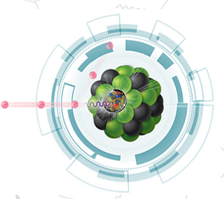

ECCE 101
ECCE is 77 institutions (& counting) collaborating to design an EIC detector offering full kinematic coverage and an optimized far forward detector system
ECCE is investigating a design which incorporates the existing 1.5T BaBar magnet, which will help reduce cost and risk, to allow it to be ready for first EIC detector operations (CD4a)
ECCE is also investigating the costs and benefits associated with using either IP6 with 25 mrad crossing angle, or IP8 with 35 mrad
ECCE is planning to submit a proposal to be the EIC project detector (“Detector 1”), which will address the complete science program outlined in the NAS report and Yellow Report
ECCE is fully supportive of two detectors at the EIC, in both IR8 and IR6, to maximize the scientific output of the EIC
ECCE is open to everyone in the community to participate, even if they wish to contribute to other proposals.
EIC Comprehensive Chromodynamics Experiment

Slide 3
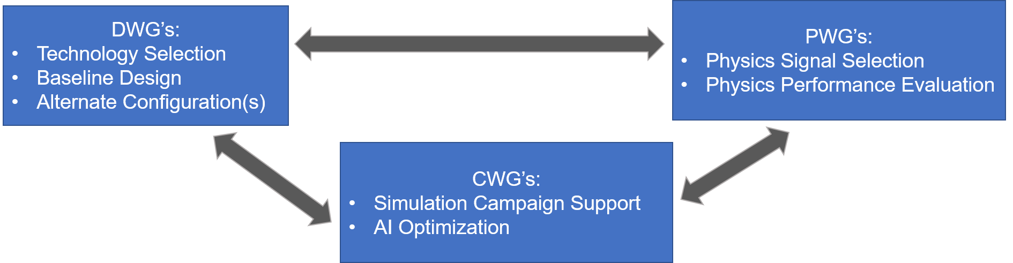
ECCE Consortium Structure
Website:
https://www.ecce-eic.org/
Mailing Lists:
https://lists.bnl.gov
ecce-eic-public-l
ecce-eic-ib-l
ecce-eic-comp-l
ecce-eic-dei-l
ecce-eic-det-l
ecce-eic-phys-l
ecce-eic-prop-l
Indico:
https://indico.bnl.gov/category/339/

Slide 4
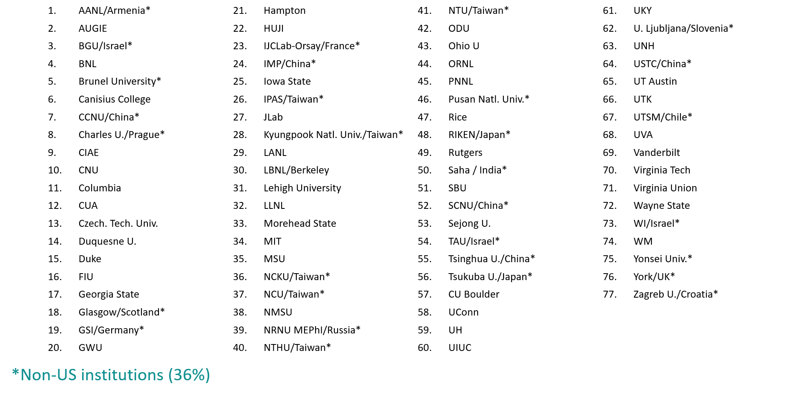
ECCE is Growing…

Slide 5
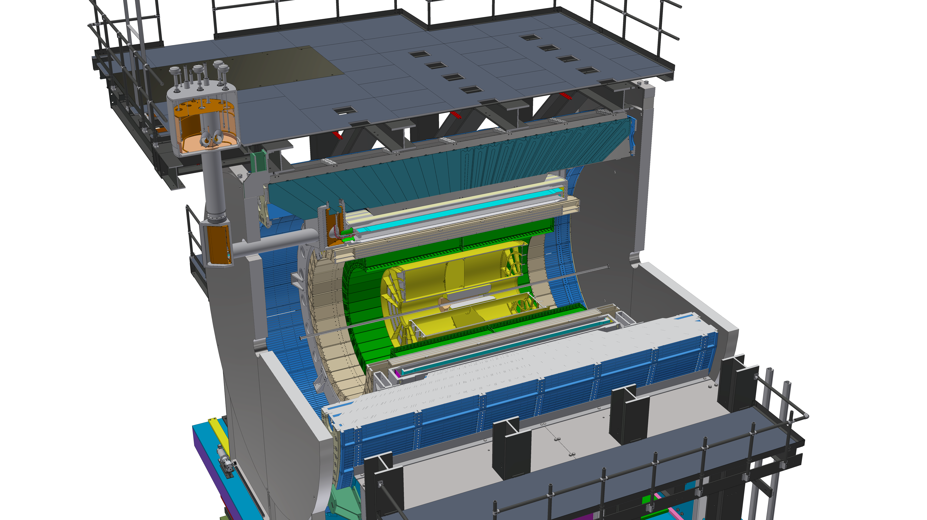
Existing Infrastructure
Existing BaBar solenoid (1.5T), flux return and cradle
  Substantial investment/risk reduction
IP8 infrastructure
  Cryogenic connection to RHIC
  Racks, mechanical, safety, electrical, etc.
Potential re-use/refurbish existing
sPHENIX detectors as appropriate
ECCE consortium has considerable
recent DOE project experience
Currently under construction, sPHENIX represents a $27M investment by DOE (MIE)

Slide 6
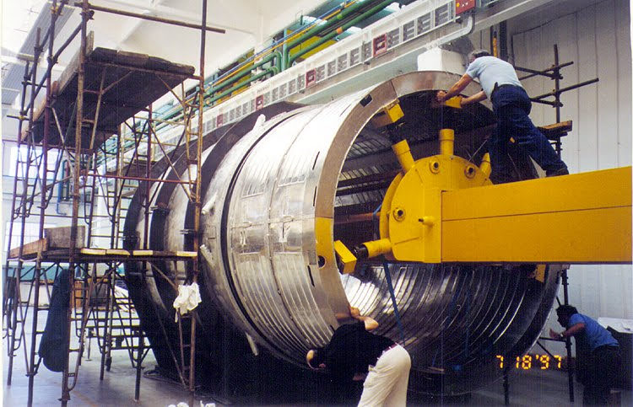
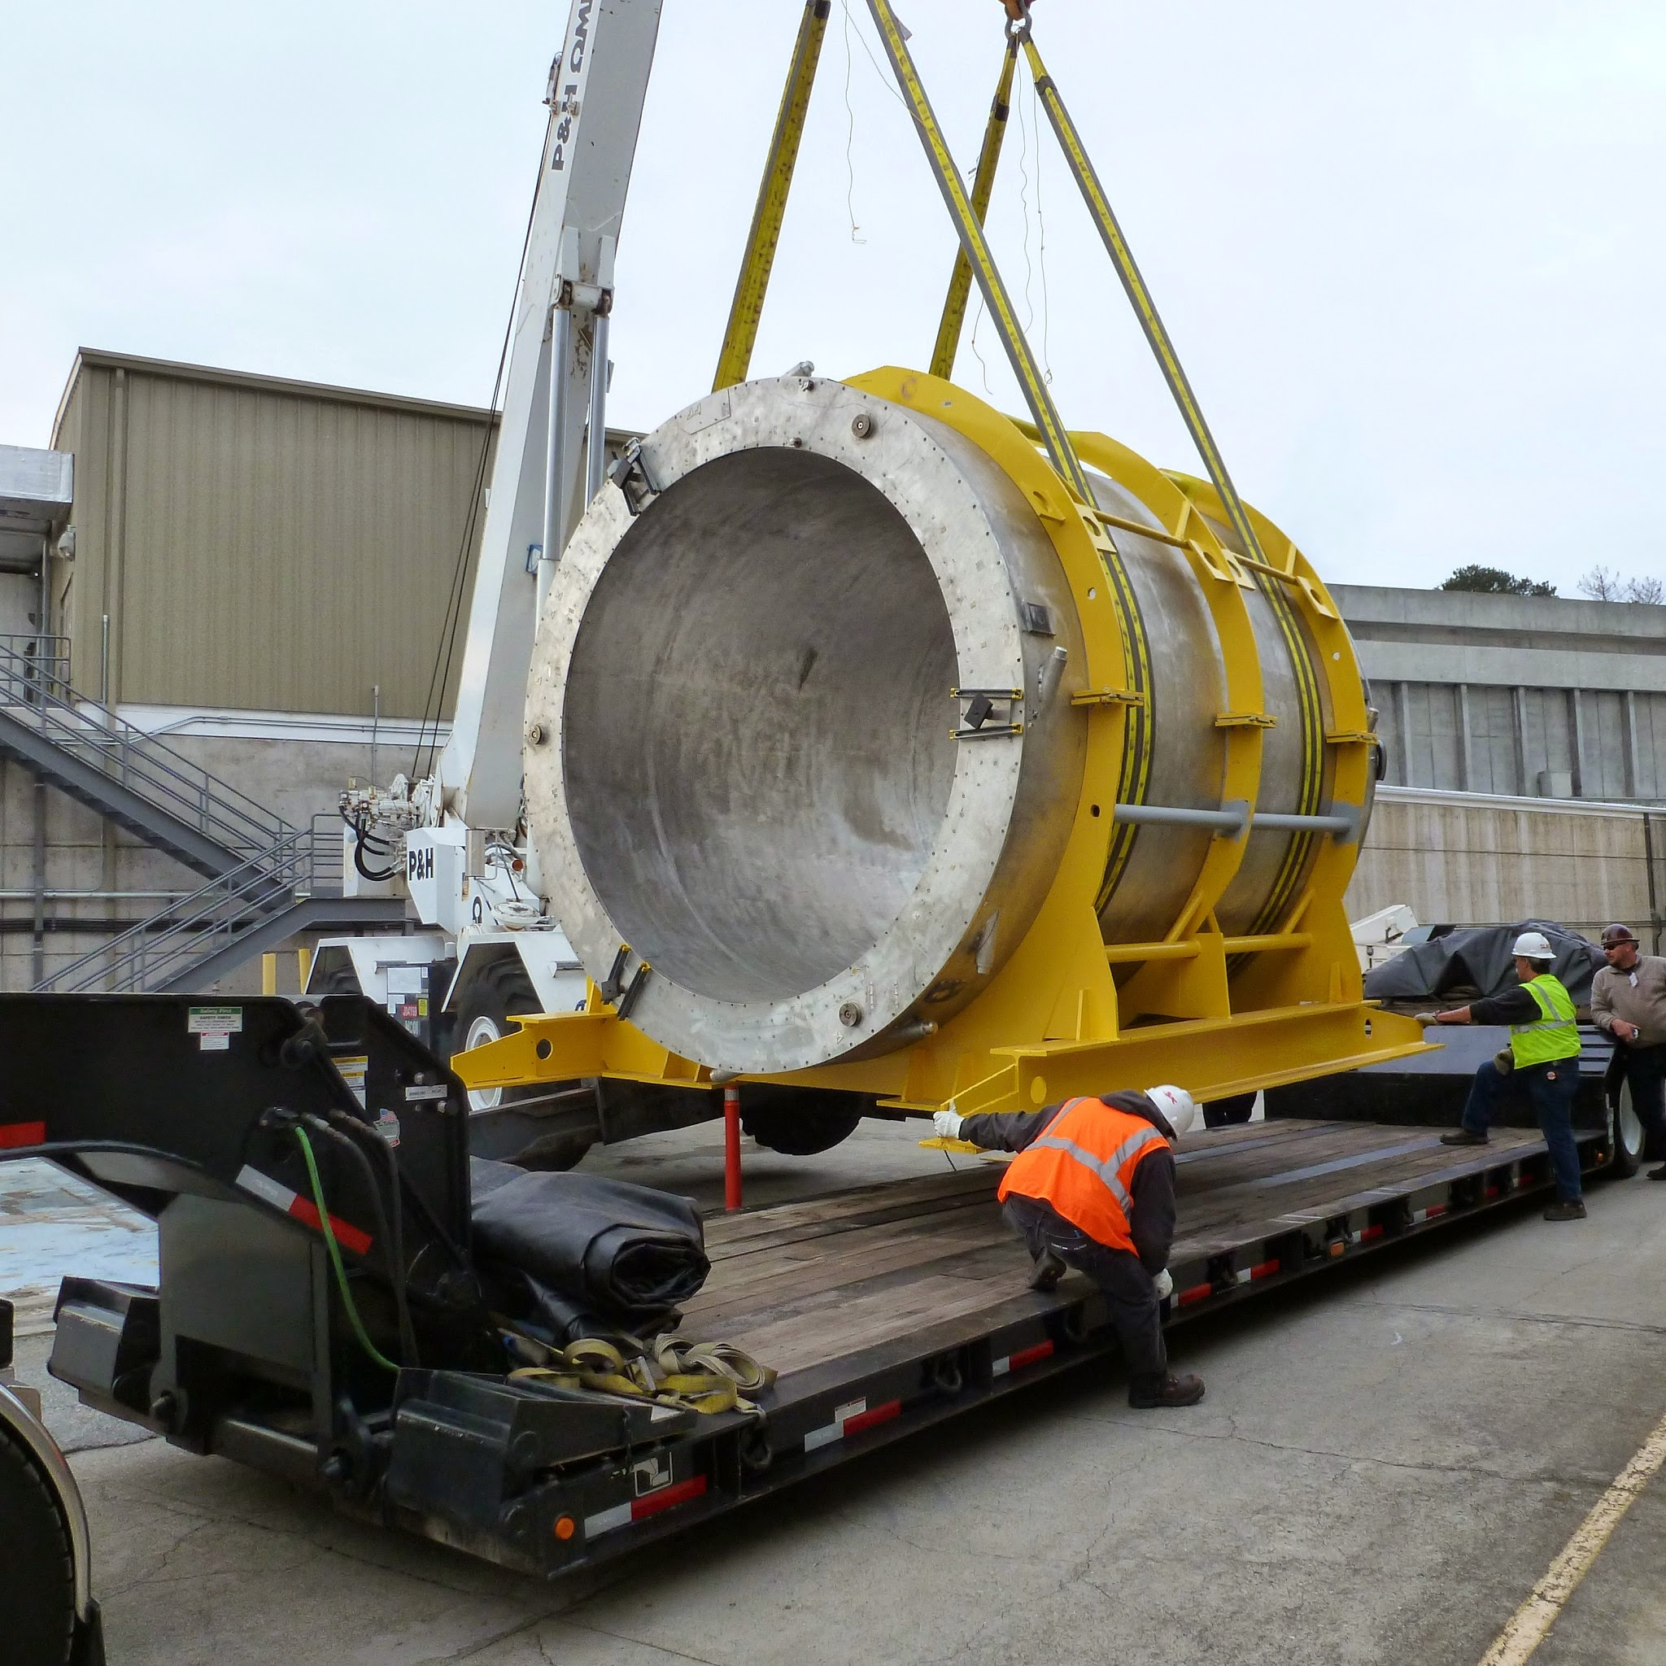
1.5T BaBar Solenoid
under construction
Built in 1997 (Ansaldo)
Very conservative design
3.7m long,
1.4m bore radius
Designed for 1.5T @ 5kA
  20MJ stored energy
Transported to BNL 2015
  Successful low and
  high field tests
Extensive risk analysis shows that the magnet is in excellent shape
  Some refurbishment required
shipping to BNL
Pasquale Fabbricatore
Designed BaBar and CMS 4T superconducting magnets
Recipient of IEEE Award for Continuing and Significant Contributions in the Field of Applied Superconductivity (2020)
Notes:
GlueX solenoid nee' LASS at SLAC 1972 – from Glenn (https://arxiv.org/pdf/2005.14272.pdf). Note also that this magnetic was refurbished, also involving opening the cryostats. Note also this is higher stored energy (24.1MJ) at full field. Ansaldo also made LHC dipoles and the CMS solenoid

Slide 7
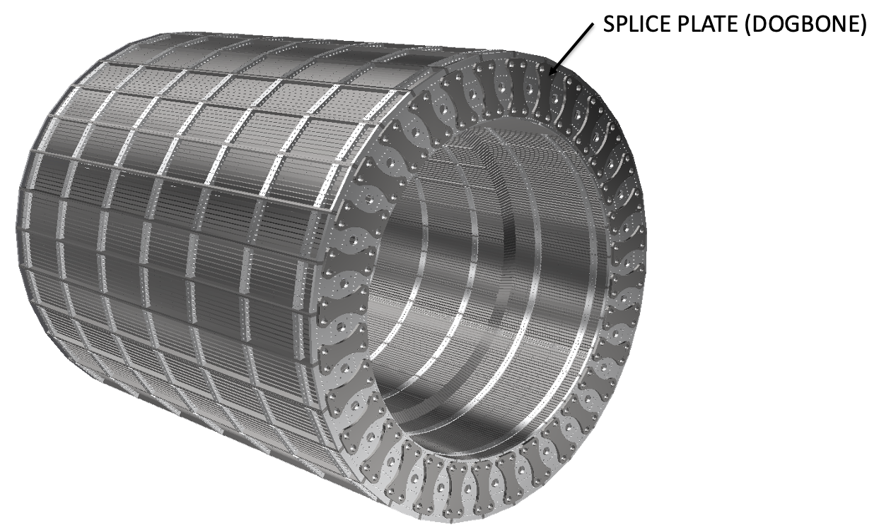
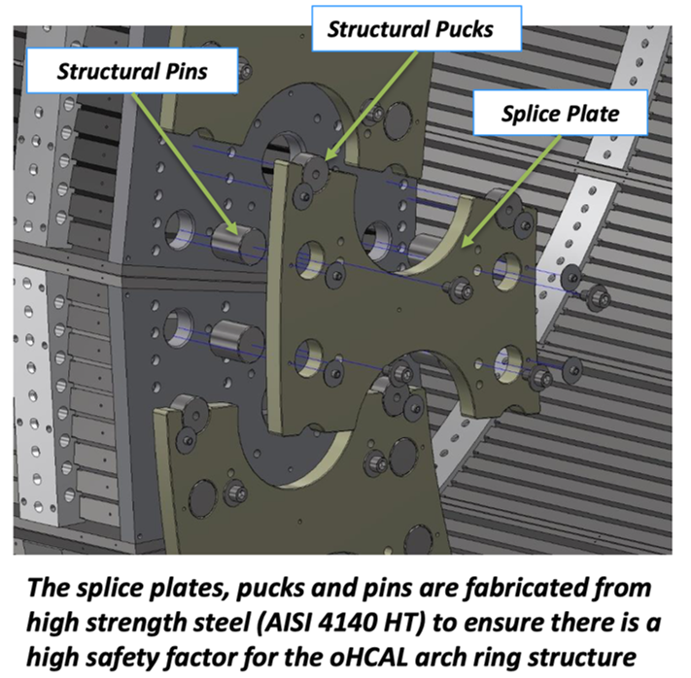
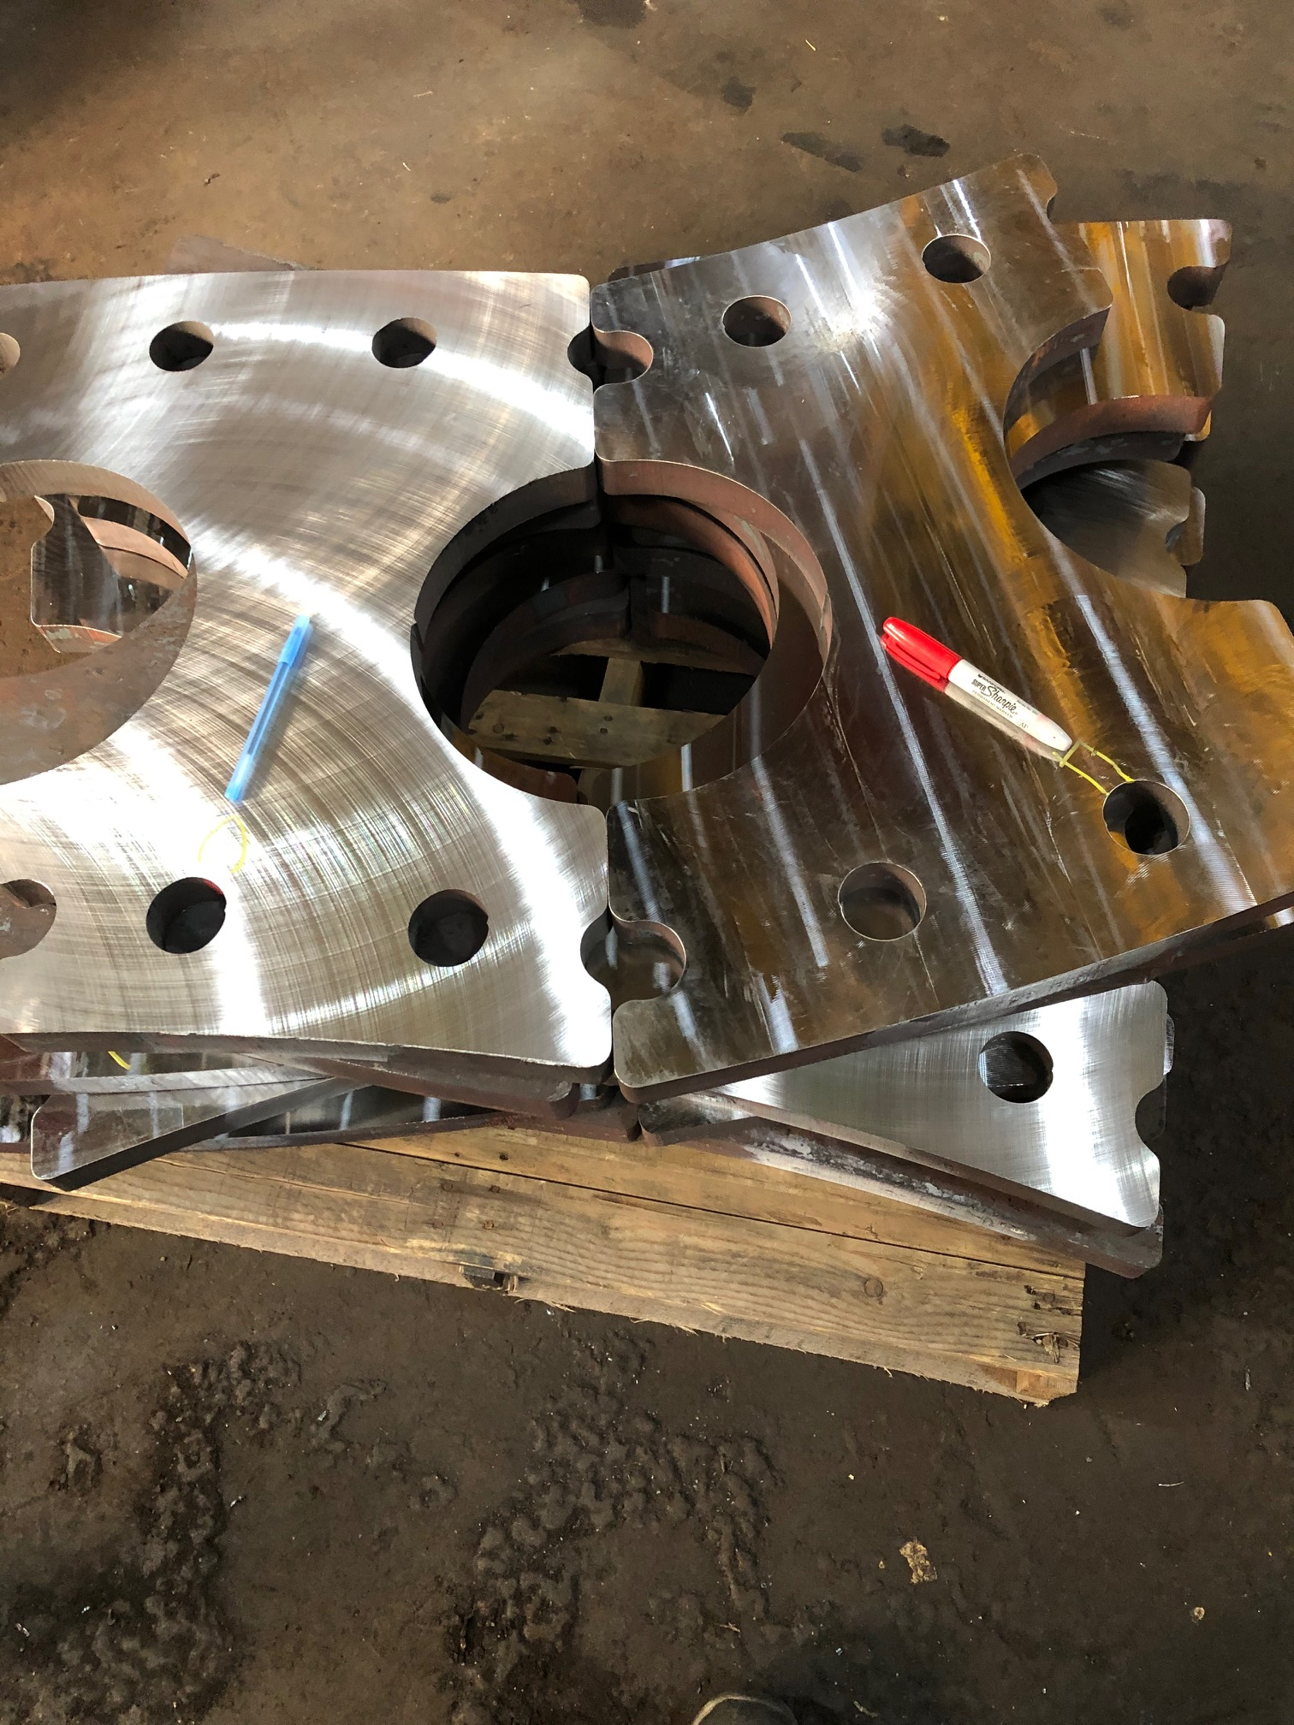
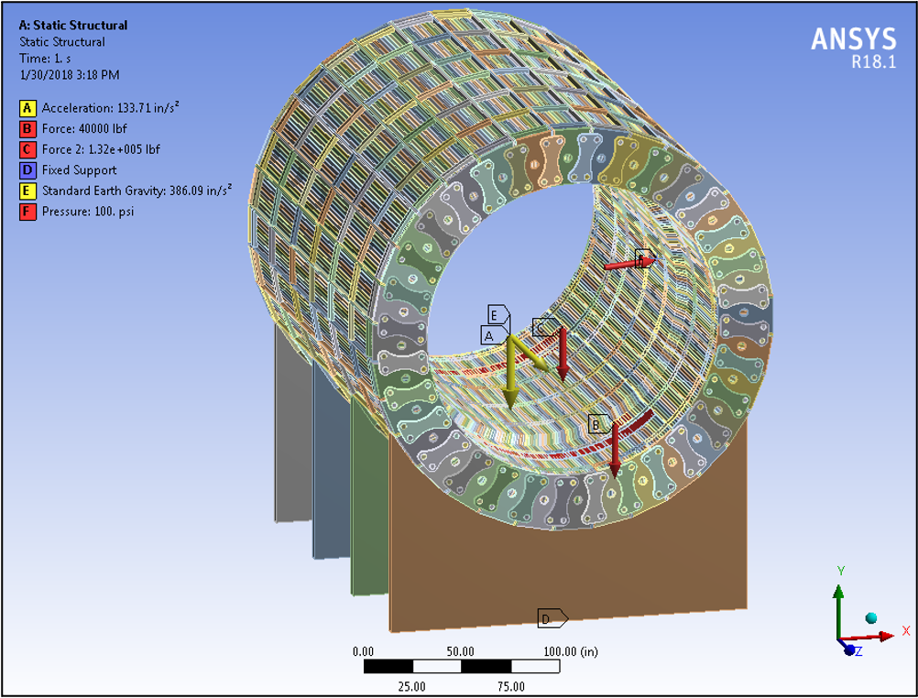
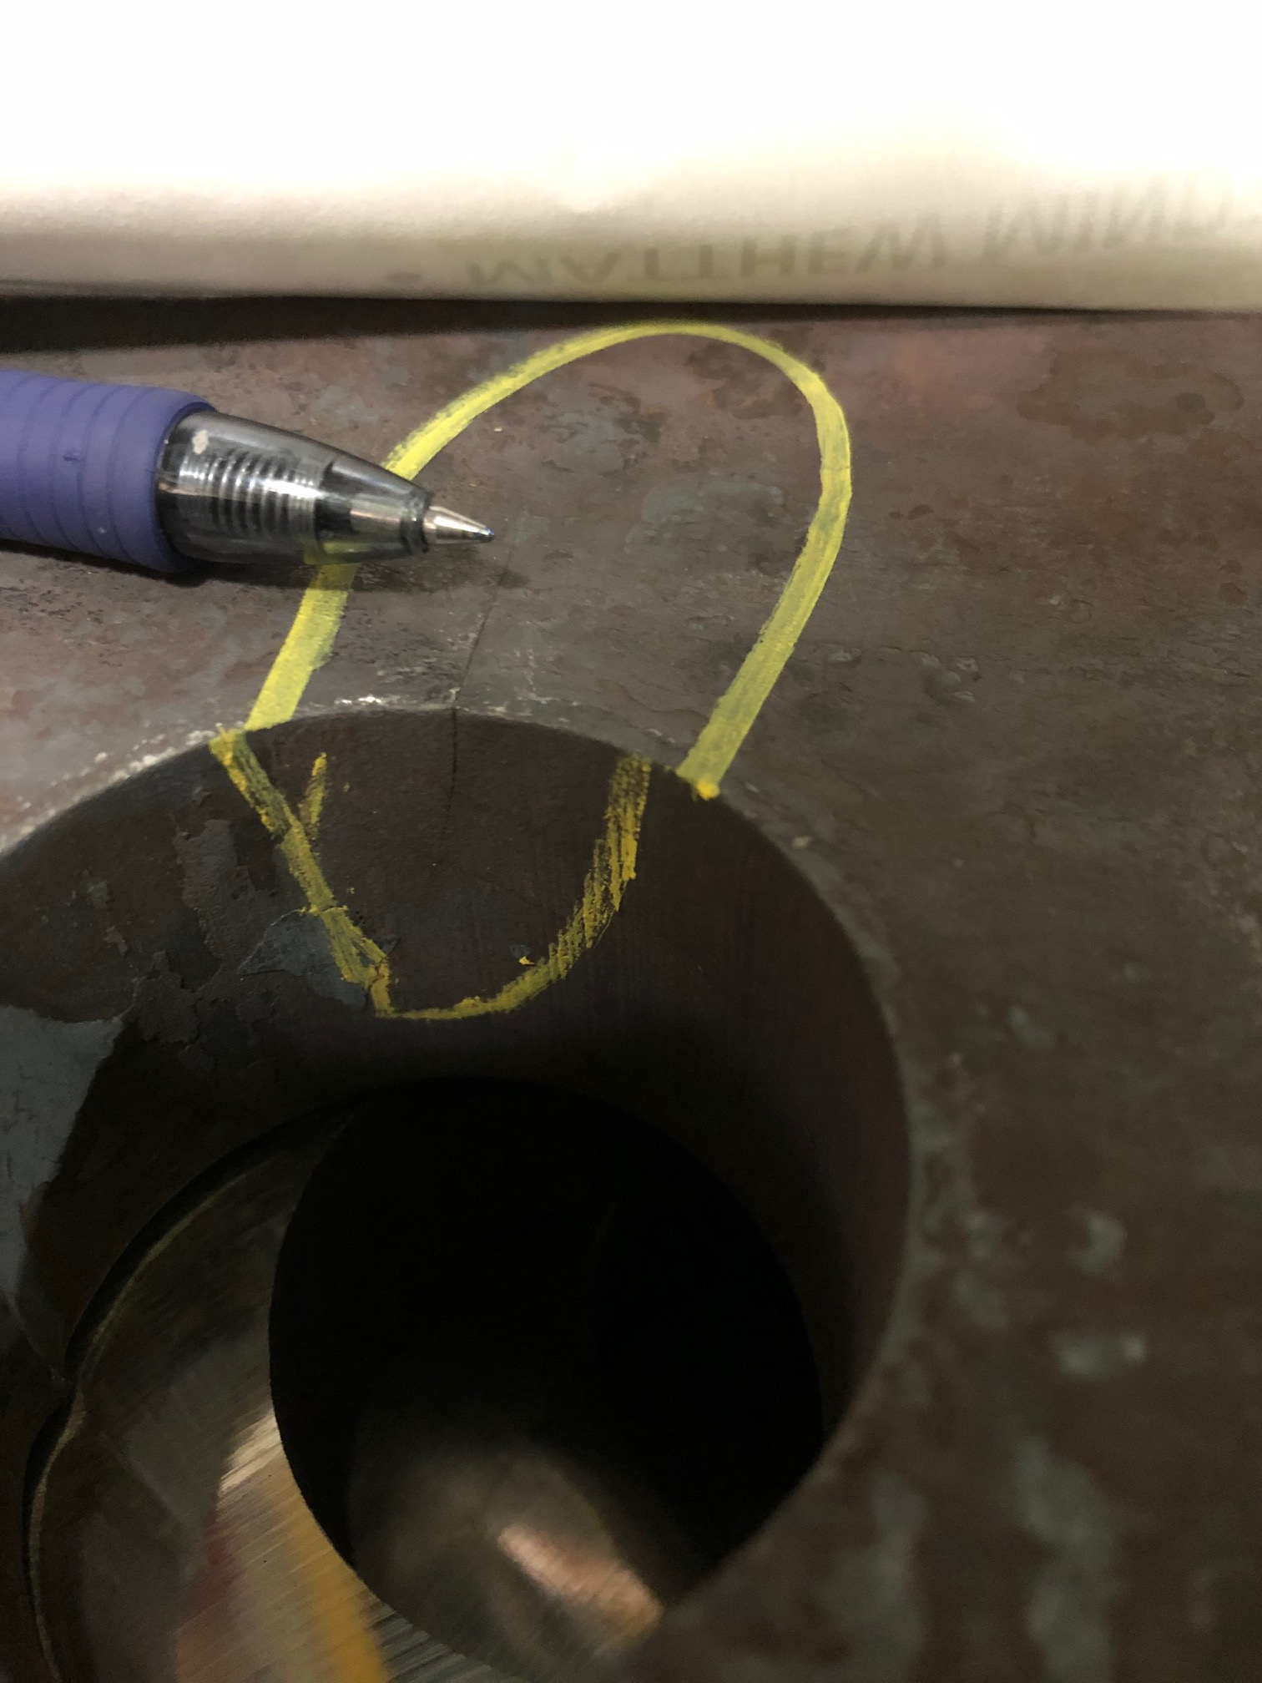
Other Infrastructure…
Multiple rounds of prototyping to adapt 4140 HT process to thick material:
Initial attempt cracked when machined, required modified treatment and machining
engineering, FEA, reviews, prototyping, material choice, vendor selection, test fitting, and so on
8+ months to engineer and certify “dogbone” plates: reuse brings time and cost savings

Slide 8

ECCE Highlights from Past Few Months
Much activity – moving at a rapid pace to meet the global timeline
26 February: first IB meeting
5 March: IB approves the Consortium Structure
March 2021
  Team Conveners were selected
  Additional institutions joined the effort
  Team Conveners added WG co-conveners
  Mailing lists were set up
  Indico pages were set up
2 April: 1st Simulations Workshop was held
9 April: Start of PWG/DWG meetings
April 1st - ~June 7th: Start up activities
  Finish implementing initial ECCE setup in Fun4All.
  Identify technology alternatives to study with Fun4All.
  Identify key physics processes to address physics of NAS/YR
  Collected required event generators
  Wiki was setup to collect information
  21 May: 2nd Simulation Workshop
  Demonstration of pipeline for AI detector optimization
Mid-June: ECCE Baseline
  Finish implementing initial ECCE baseline setup in Fun4All.
  First simulation campaign

Slide 9
ECCE Timeline
Today, 9 June 2021

Slide 10
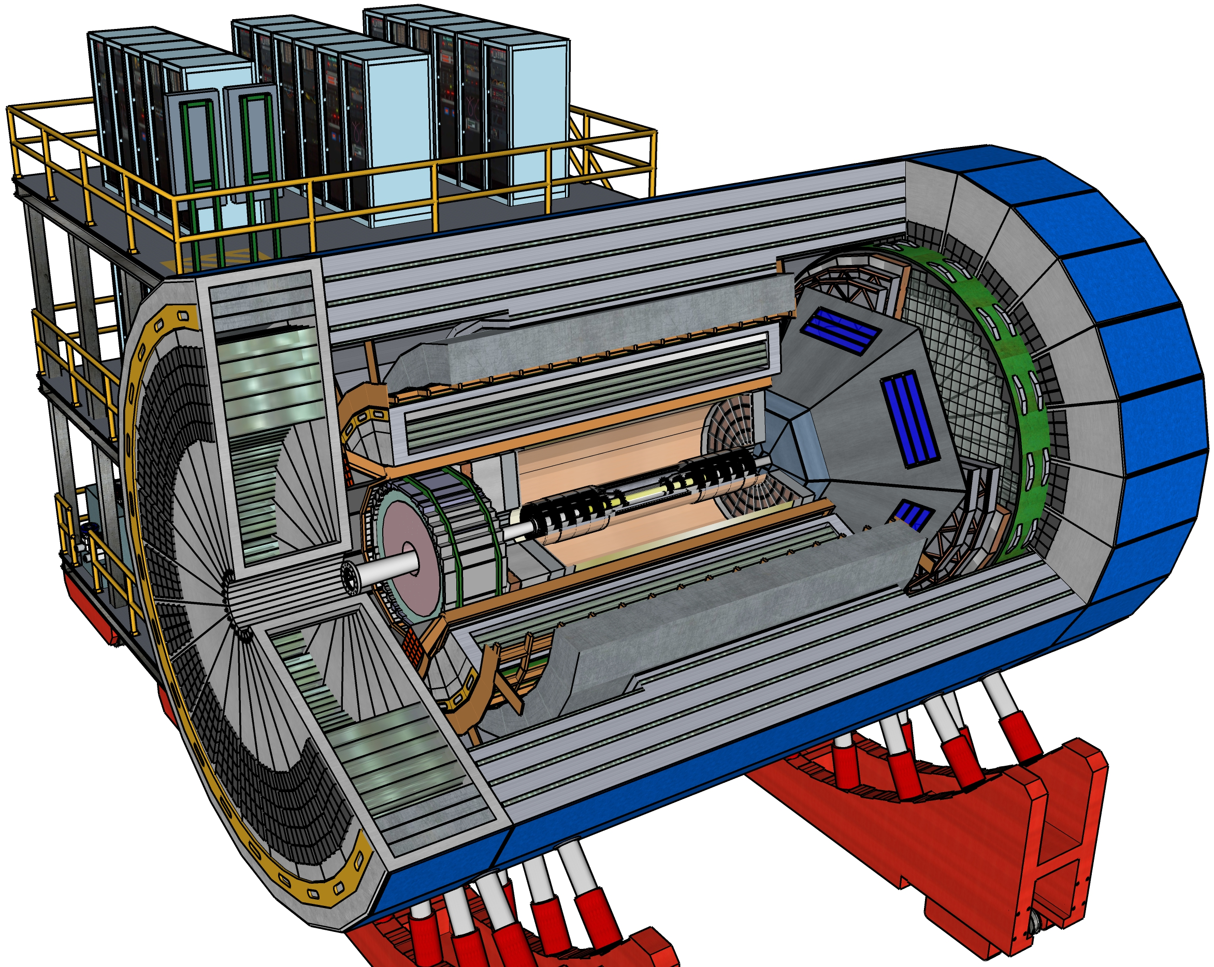
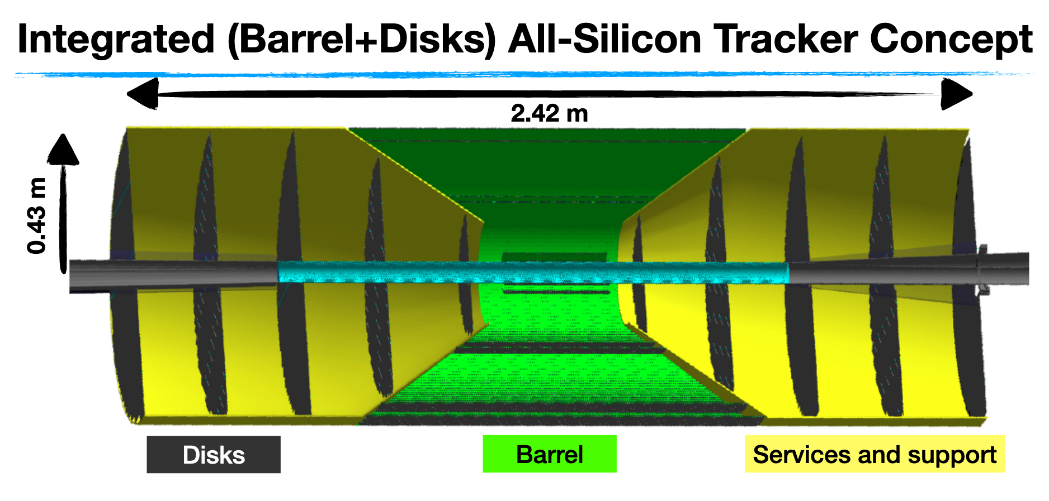
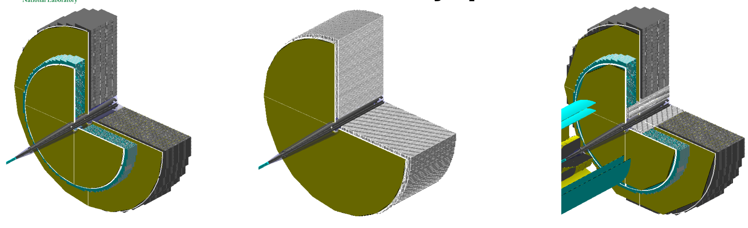
ECCE Detector Team – Detailed Studies Ongoing
Team Leaders: Ken Read (ORNL) and Doug Higinbotham (JLab)
Topic and Conveners
Magnetic Field: Paul Brindza (JLab) & Renuka Rajput-Ghoshal (JLab)
Tracking: Xuan Li (LANL) & Nilanga Liyanage (UVA)
Particle ID: Greg Kalicy (CUA) & Xiaochun He (GSU)
Calorimetry: Friederike Bock (ORNL) & Yongsun Kim (Sejong U.)
DAQ/Electronics/Readout: Chris Cuevas (JLab) & Martin Purschke (BNL)
Far Forward/Far Backward: Michael Murray (KU)
IP8/Equipment Re-use: John Haggerty (BNL)
Calendar of meetings can be found at: https://indico.bnl.gov/category/345/
Sketchup of ECCE
Detailed review of Calorimetry options (far forward shown)
Presented at May 11th ECCE Tracking Meeting
Presented at May 4th Calorimetry meeting

Slide 11
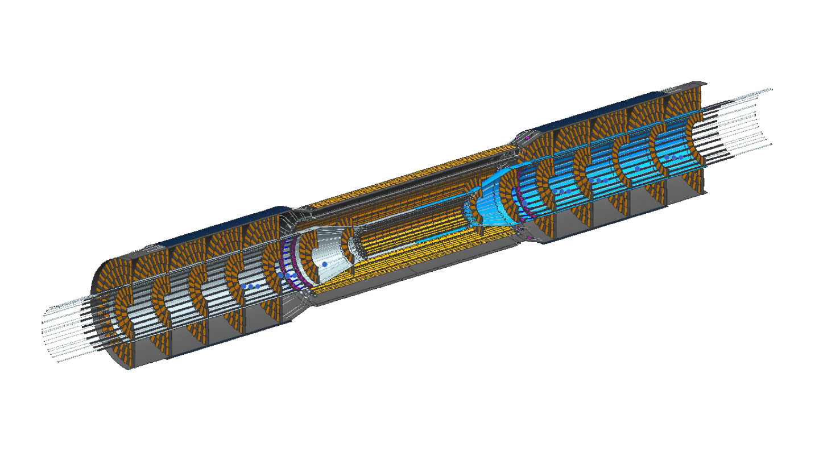
Tracking DWG Progress
Tracking DWG has recently presented updates on studies of:
  MAPS Silicon tracker barrel performance
  Forward silicon tracker performance
  μRWell (MPGD) end-cap tracking
  Further recent details here:
    https://indico.bnl.gov/event/11654/
    https://indico.bnl.gov/event/11659/
Details of how the central tracker can be built (drawing in Siemens NX)
  Will need to clam shell around the beamline
  Details like the cooling lines and cables shown & add to the material budget.
Development of AI pipeline for optimizing tracker design:
  https://indico.bnl.gov/event/12052/

Slide 12
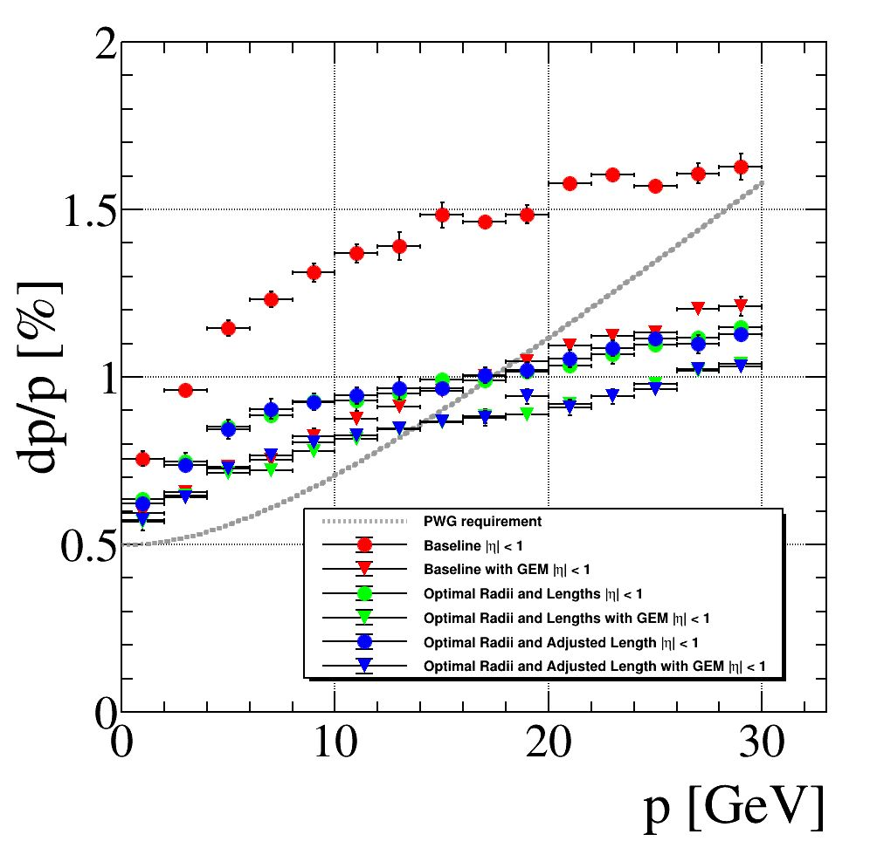
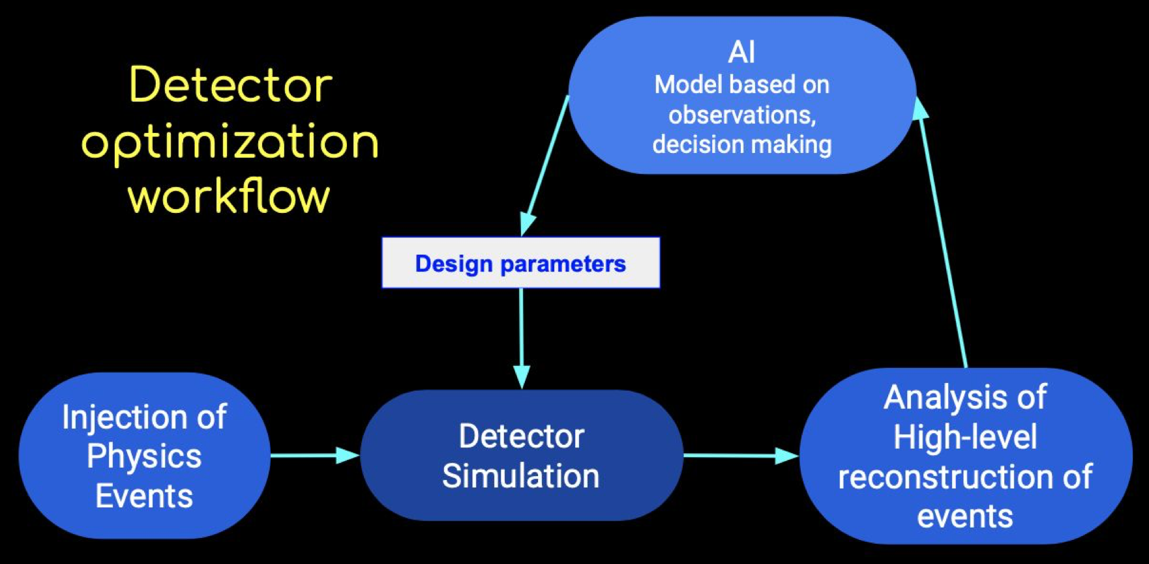
AI Detector Optimization
AI WG is starting to optimize ECCE
Building on existing experience (e.g. dRICH)
Working from the inside out
First ECCE-specific example: Tracker layer radii
Pushing to optimize for PHYSICS as opposed to single detector element performance
EXCELLENT Opportunities:
  For collaborators to contribute and gain experience in AI
  For ECCE to integrate AI starting from its
  early design stage
Cristiano Fanelli (MIT), William Phelps (CNU/Jlab)
https://indico.bnl.gov/event/11517/

Slide 13
PID DWG Progress

Slide 14
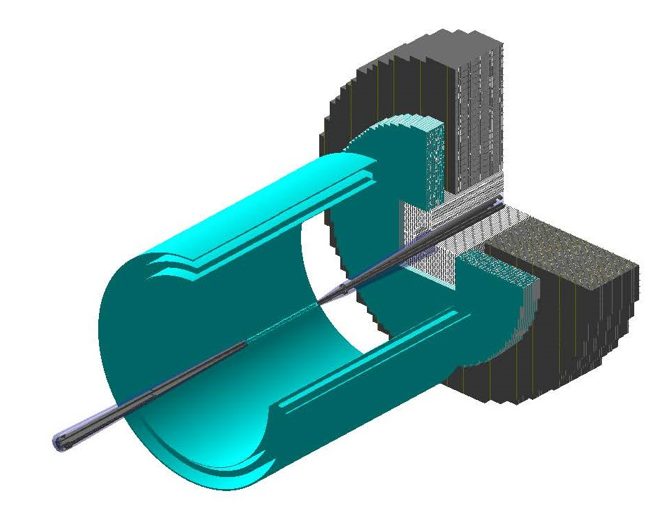
Calorimetry DWG Progress
G4 Implementation of Dual Readout
Option with Dual Readout Insert
FHCAL
DRCALO inset

Slide 15
ECCE Design Status
DWGs proceeding with evaluation of leading technology alternatives.
Converging on initial setup for first IP6 simulations campaign starting next week!
Detector Team Group Meeting June 10th 11am to 2pm:
  co-conveners will present latest evaluated technology options,
  Focus on detectors choices to move forward with DAQ and determining optimal re-use,
  https://indico.bnl.gov/event/12079/
Still need to optimize performance / cost / risk with inputs from simulations.

Slide 16
ECCE Detector (W.I.P.)
Red = preferred technology
Blue = preferred technology
with some open questions
Black = still being discussed
ELECTRON ENDCAP
Tracking: GEM / MPGD
Electron Detection:
  Inner part: PWO crystals (reuse some)
  Outer part: SciGlass (backup PbGl)
h-PID: mRICH & AC-LGAD
HCAL: Steel from magnet or Fe/Sc
  Not instrumented and only serve as flux return?
  Instrumented \w reduced thickness (lower energies)
CENTRAL BARREL
Tracking: Silicon barrel + forward tracker (optional Si/GEM hybrid)
Electron PID: SciGlass (backup: PbGl or W(Pb)/Sc shashlik)
h-PID: hpDIRC & AC-LGAD/LYSO [progress: DIRC orientation]
HCAL: magnet steel (reuse) - Fe/Sc
HADRON ENDCAP
Tracking: GEM / MPGD
PID: dual-RICH & AC-LGAD
Calorimetry: standard W/ScFi + Fe/Sc
Upgrade: Dual Readout EM+Had Cal?
Example discussions:
Backup for AC-LGAD in barrel
SciGlass ongoing R&D timeline
Hadron Endcap calorimetry

Slide 17
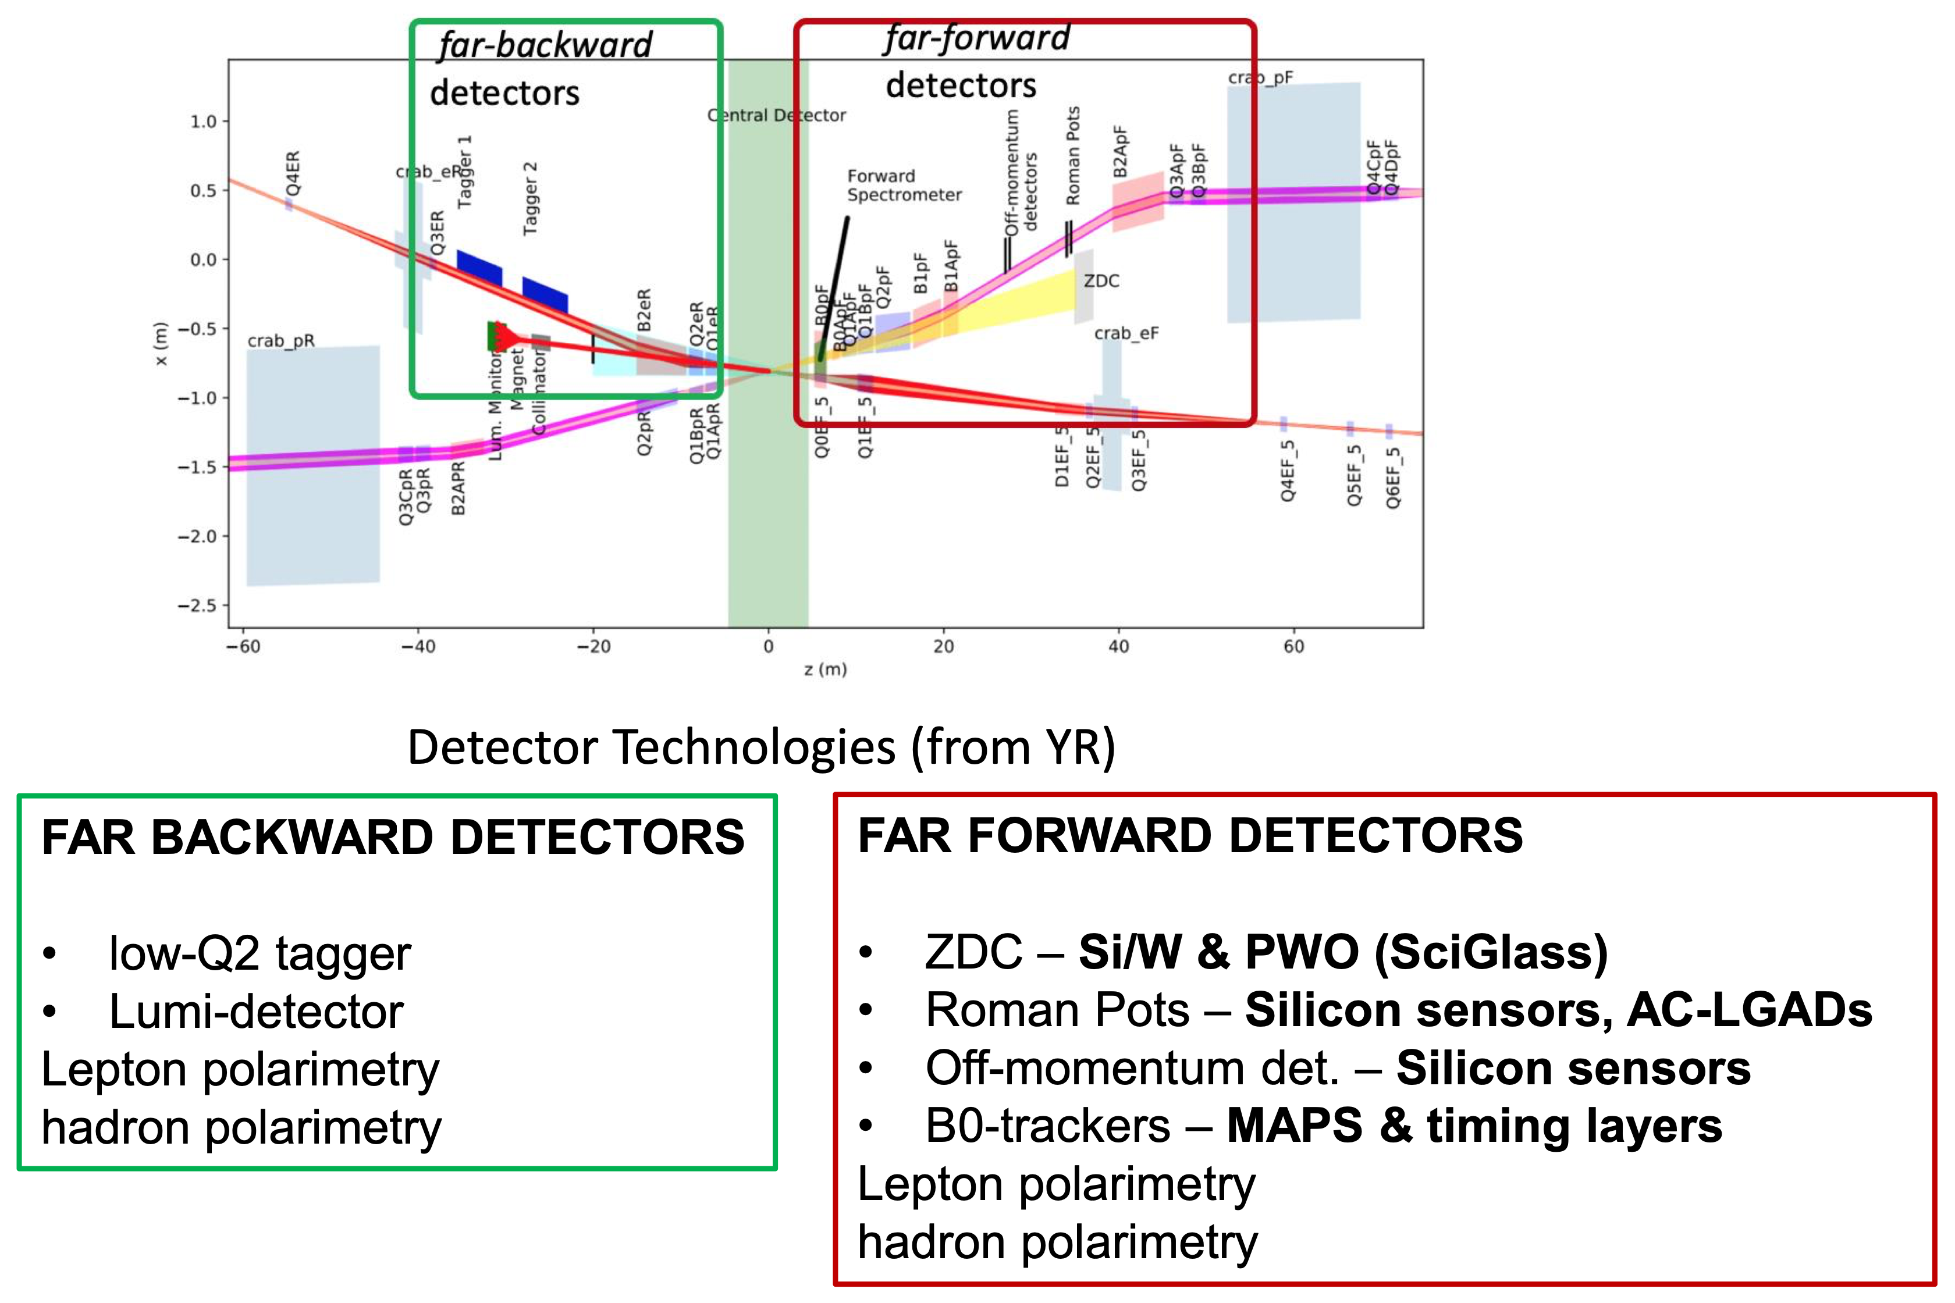
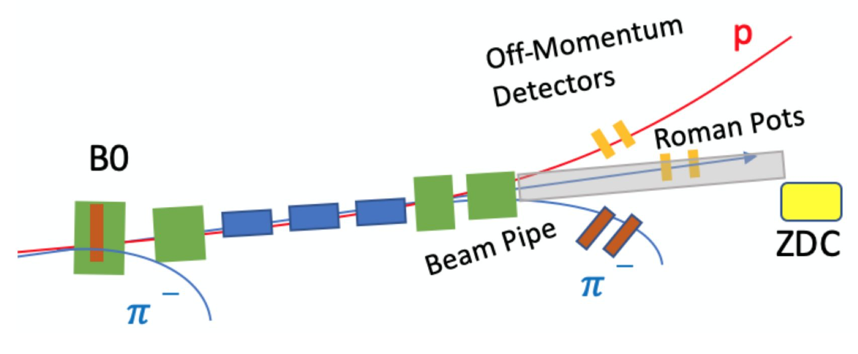
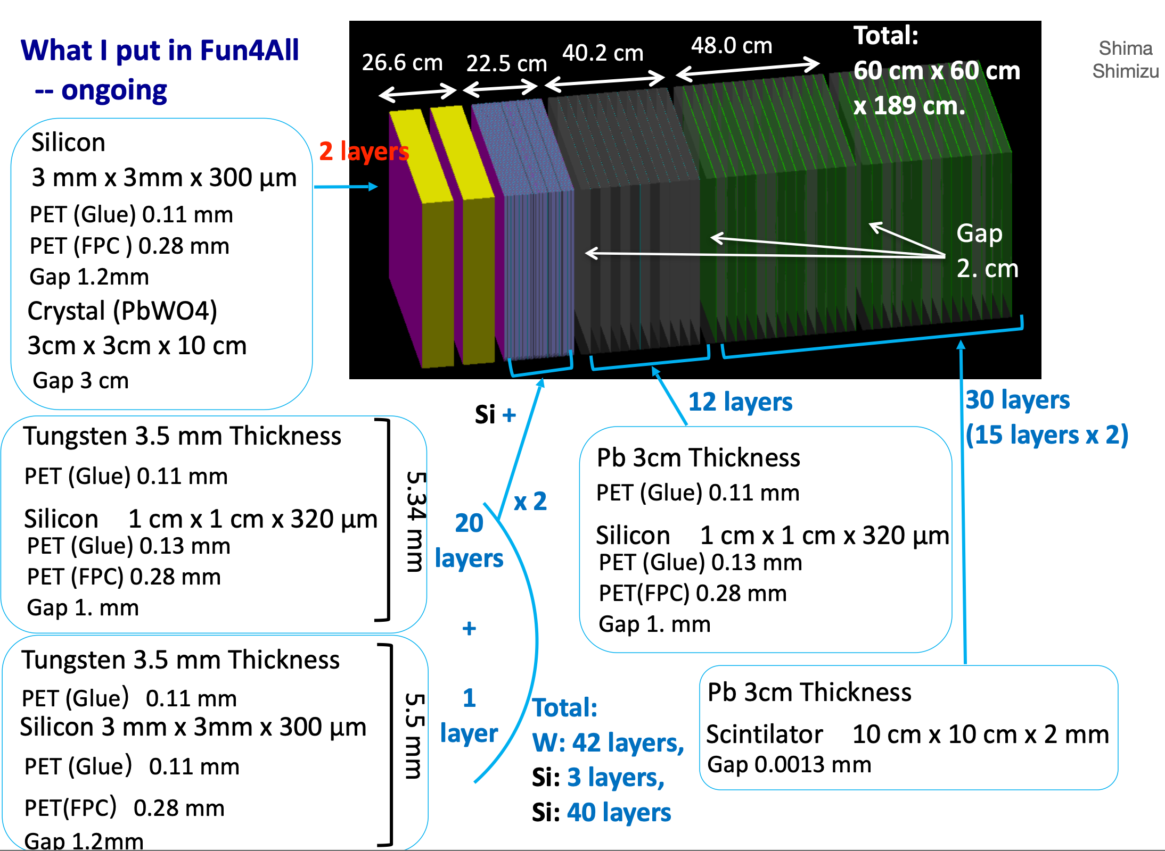
ECCE Far Forward / Back
Participating in coordinated meetings between all proto-collaborations, organized by EIC PM.

Slide 18
ECCE Physics Studies Focus: A First Look
Studies to demonstrate EIC NAS Study,
Yellow Report physics
Studies to show unique ECCE strengths
Origin of Nucleon Spin
Light-ion tagging
Confined motion of partons
Pion/Kaon structure
3D imaging quarks and gluons
Diffractive jets?
Nucleon mass
Nuclear modifications and in-medium evolution
  D/D* reconstruction and heavy-flavor in jets.
High gluon densities in nuclei
Quarks and gluons in the nucleus

Slide 19
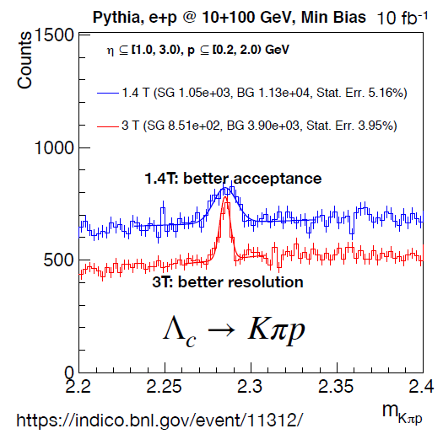
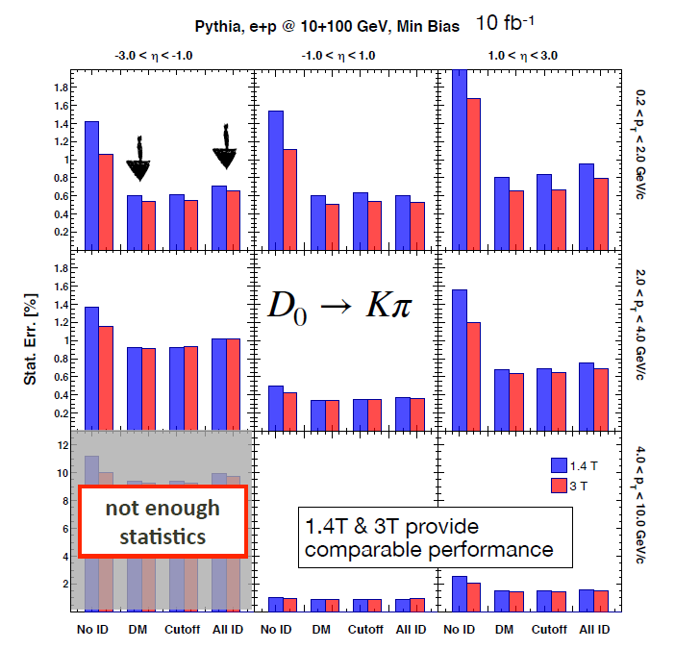
Heavy Flavor in ECCE
Recent Study by Wenqing Fan (LBNL)
Fast simulation of PID, based on YR specifications
Parallel effort ongoing with full detector G4 simulations

Slide 20
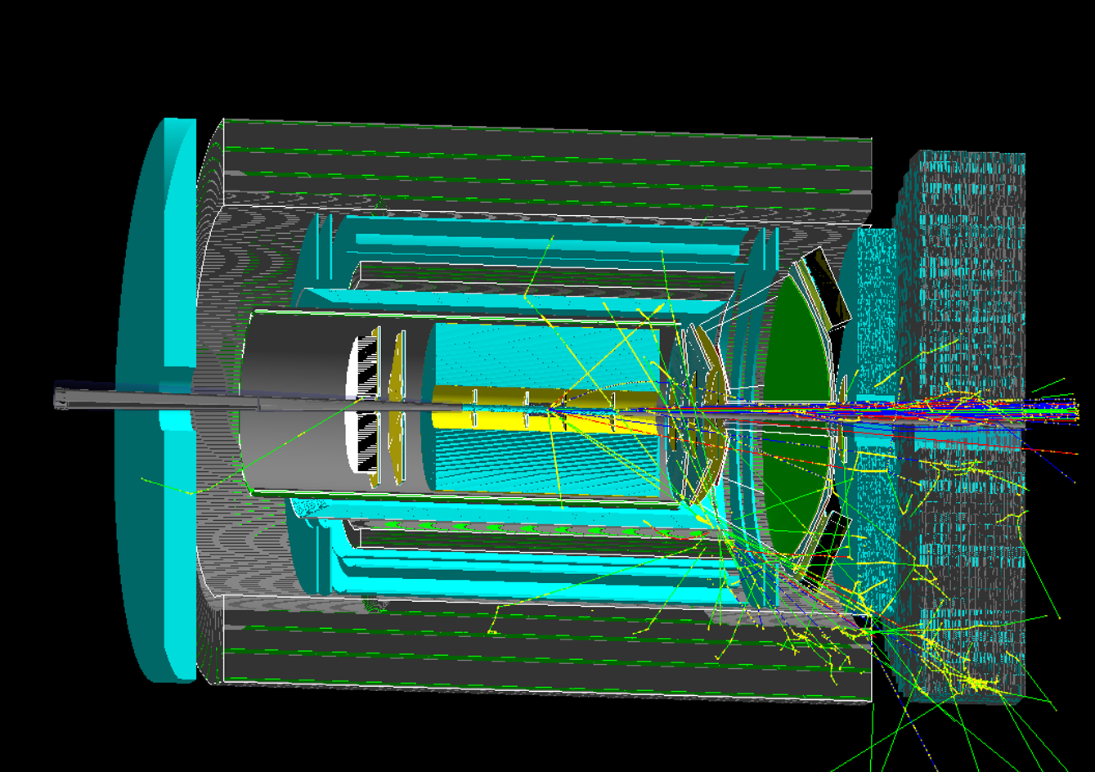
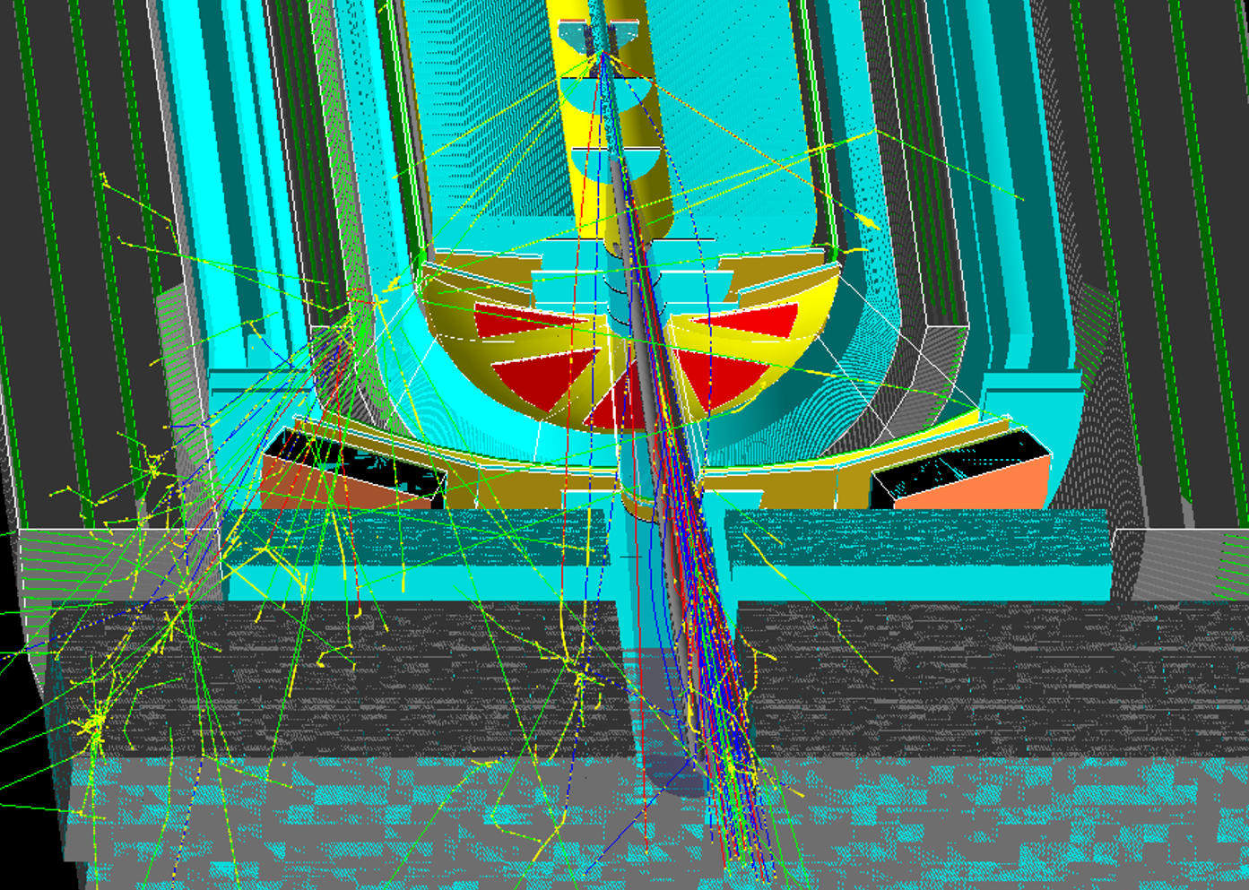
G4 Simulations
  https://ecce-eic.github.io
ECCE leverages the fun4all framework already used extensively for sPHENIX
e+p 18x275 GeV, 25 mrad, x=0.5, Q²=5000 GeV²
e⁻
jet
beam remnants propagating
through pipe w/25 mrad
crossing angle
First simulation campaign starting soon!

Slide 21
ECCE Future Highlights
May 20th - July 1st [~1.5 months]:
  First simulation campaign with a few detector configurations & initial analysis.
  Detector baseline set ~June 14th, first 10M event simulation campaign
  Debug the many things that won’t go right the first time :)
July 1st - Aug. 1st [1 month]:
  Large scale simulations production
  Drafting ‘collaboration structure’ part of the proposal by writing team.
Aug. 1st - Sep. 15th [1.5 months]:
  Analysis of simulation data to demonstrate physics extraction.
  Presentation at August 2-6 EIC UG meeting
Sep. 15th - Nov. 1st [1.5 months]:
  All physics ‘plots’ are done.
  Final evaluation of technology selection based on physics studies results.
  Compose narrative around simulation results and selected technologies.
Nov. 1st - Nov. 30th [1 month]:
  Proposal review by external colleagues.
  Final edits

Slide 22
Conclusions
The ECCE consortium is 77 institutions (& growing) working to design the EIC project detector based around the BaBar solenoid
By reducing cost and risk, ECCE plans to be ready for physics by EIC CD4a, as soon as possible at the start of machine operations.
The physics program spans the entirety of that outlined in the NAS study and the Yellow Report
The detector design process is fully underway, in tandem with a wide range of full physics simulations
  https://ecce-eic.org

Slide 23
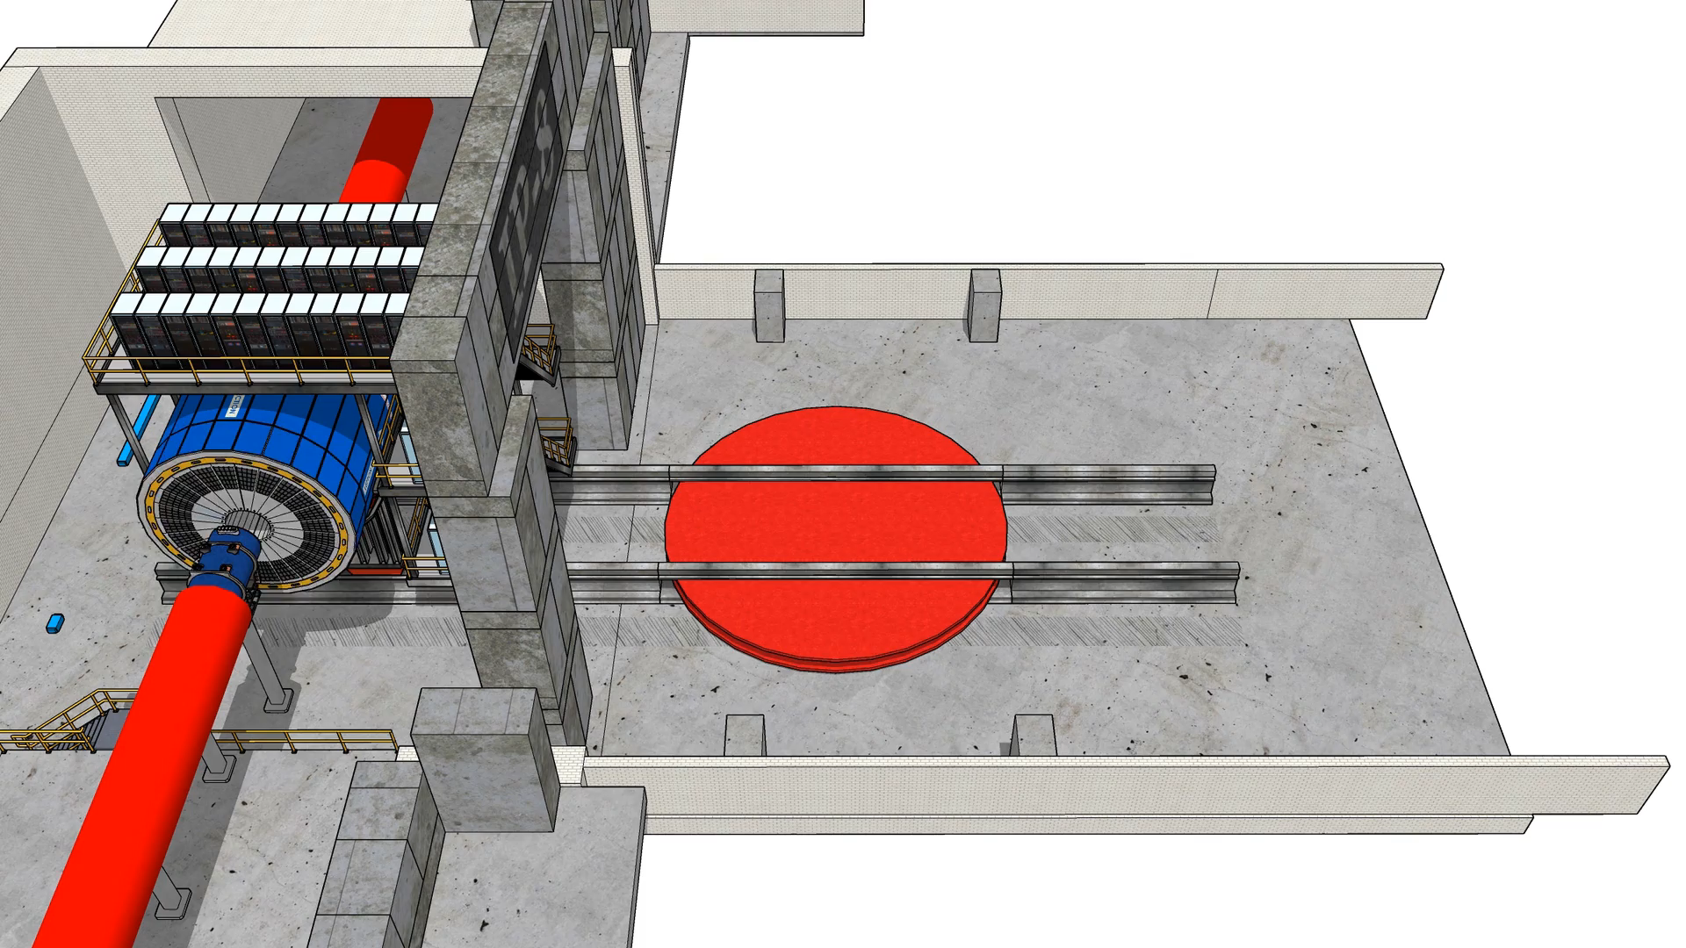

Slide 24
BACKUP

Slide 25





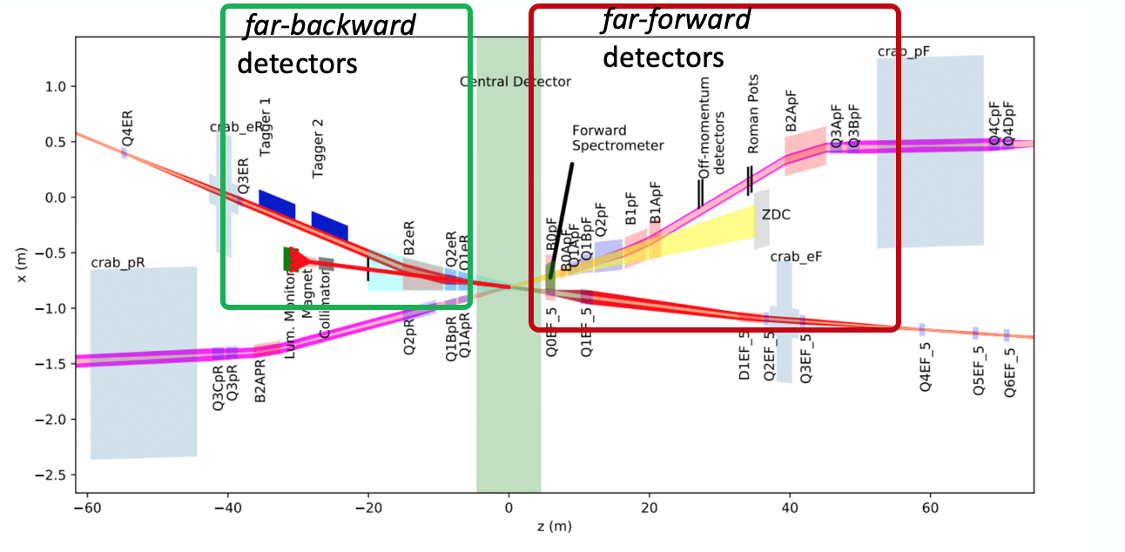
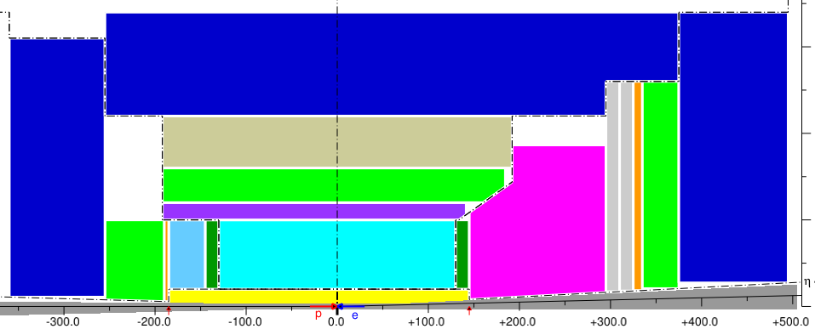





Technology Interests
BGU/Israel, MIT, ORNL, UIUC, IJCLab-Orsay, EIC-Japan, TAU/Israel, UVA, GWU, MIT-BATES, HUIJ/Israel
Glasgow U., ODU
Rutgers, ISU, GSU
EIC-Japan
ISU
Ohio U.
ORNL
Sejong U.
KyungpooU
Yonsei U.
Pusan U.
Ohio U.
ORNL
EIC-Japan
ISU
Ohio U.
ORNL,
IMP
UIUC, Charles U.
ODU, CUA, GSI-DIRC
SBU, UConn
GSU
SBU, ORNL, WI.Israel, Wayne State, MIT, Rice, ORNL, Wayne State
MIT, Rice, ORNL, Czech Tech. U., IMP, SCNU, Tsinghua, USTC
EEEMCal: AANL, CUA, Charles U., FIU, IJCLab, MIT, Lehigh U., UKY, JMU
Polarized Beam and polarimetry: MIT, UNH, SBU
Electronics: Columbia, ORNL
DAQ/Trigger: ISU, CU Boulder, OU, ORNL, SBU, UConn, LLNL
Artificial Intelligence: MIT, CNU, Brunel U.

Slide 26
AI Si Tracker Optimization |η|<1

Slide 27
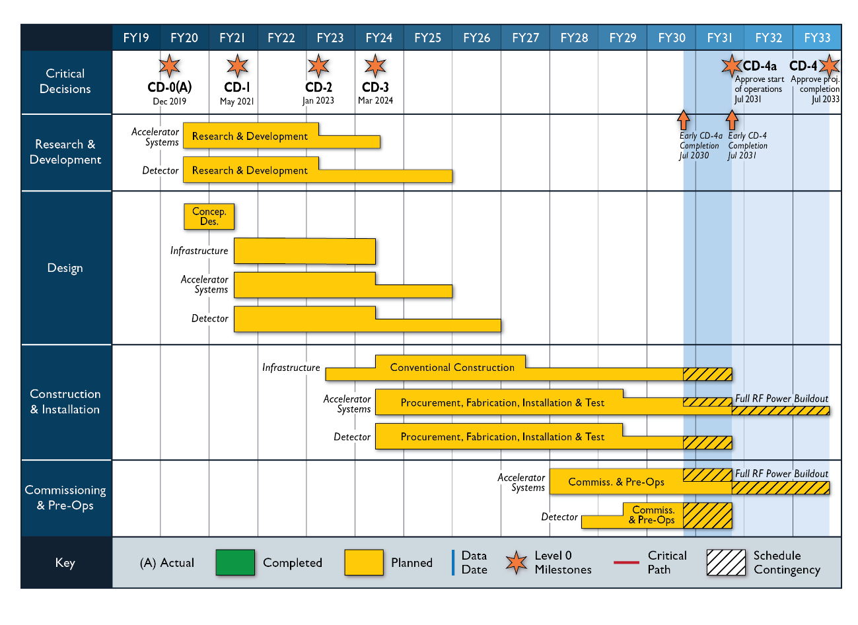
From Jim Yeck
3/30/21

Slide 28
ECCE Foundation
Develop a detector capable of delivering the full EIC science mission
  As outlined in the Yellow Report
Appropriate utilization and/or upgrades of existing detectors and infrastructure
  Reduce technical and schedule risks
  Reinvest savings in detectors

Slide 29
Central Barrel Space Constraints
Tracking all-Si maybe down to 50-60 cm,
Si + TPC = 80 cm
Tracking support structure 5 cm
Hadron particle identification DIRC only needs 10 cm,
RICH 50 cm but better for uniformity
EM Calorimetry 50 cm for high-resolution, 30 cm for less-resolution (or costly)
PID & EMCal support structure 10-15 cm likely enough
Function | Minimum [cm] | Maximum [cm] | Minimum [cm] | Maximum [cm]
Tracking (includes 5 cm support) | All-Si |  | Si + TPC
 | 65 |  | 85
Hadron particle identification | RICH |  | DIRC
 | 50 |  | 10
EM Calorimetry | 30 | 50 | High-Resolution to achieve P < 2 GeV
 |  |  | 50
PID & EMCal support structure | 10 | 15 | 10 | 15
Total | 145 | 165 | 155 | 160
Need to discuss the fit of all detectors in the existing magnet with bore 2.8 meter - will be a tour de force and will require optimization.
From 4th YR Workshop – talk on magnet

Slide 30
Prior Design Studies
Previous 2014/18 studies centered on BaBar solenoid
  2018 study in response to charge by
  BNL ALD
  (see talk by Christine Aidala)
  Flexible, complete G4 simulation framework already exists for ECCE studies
    Foundation for ECCE proposal work
arXiv:1402.1209
https://indico.bnl.gov/event/5283/

Slide 31
Example of ECCE Physics : Spin
Scattered Electron Backgrounds
Major requirements:
  Precision calorimetry in lepton endcap
  PID in barrel
ECCE:
  High resolution calorimetry in lepton endcap
  PID in barrel
  PID in forward endcap enables also TMDs
Yellow Report, Volume 2, 1/13/21 snapshot, Fig. 7.17 and 8.11
Yellow Report, Volume 2,
Fig. 7.17 and 8.11
Yellow Report, Volume 2,
Fig. 7.53
Yellow Report, Volume 2, Chapter 7

Slide 32
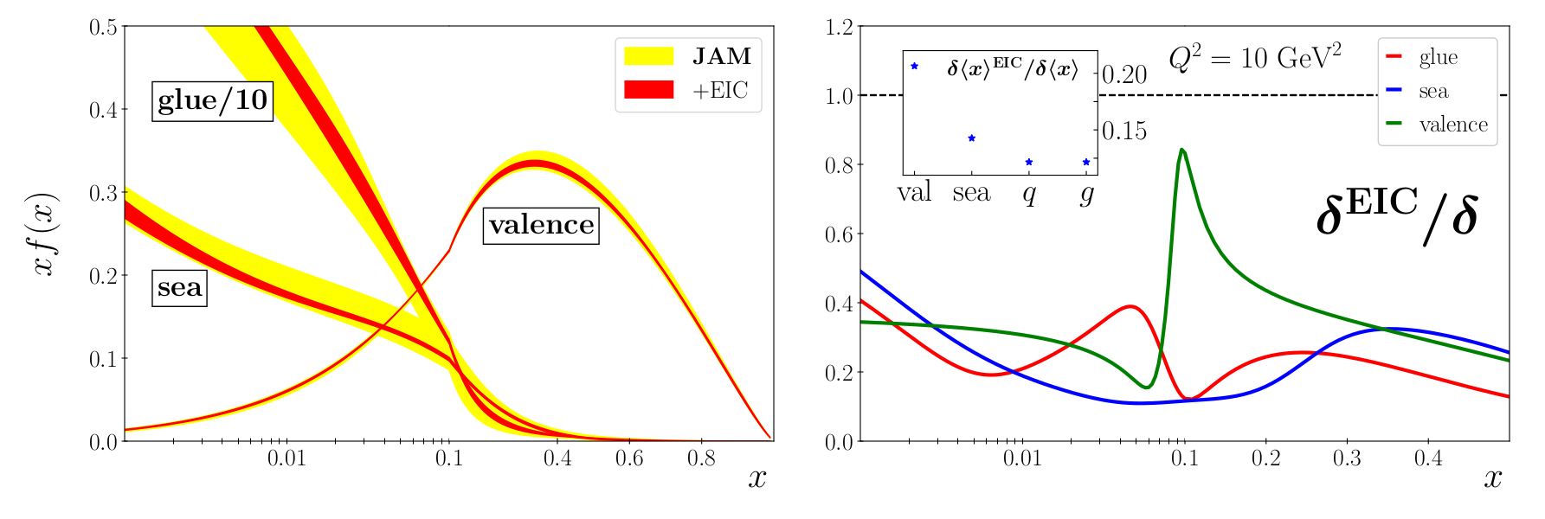
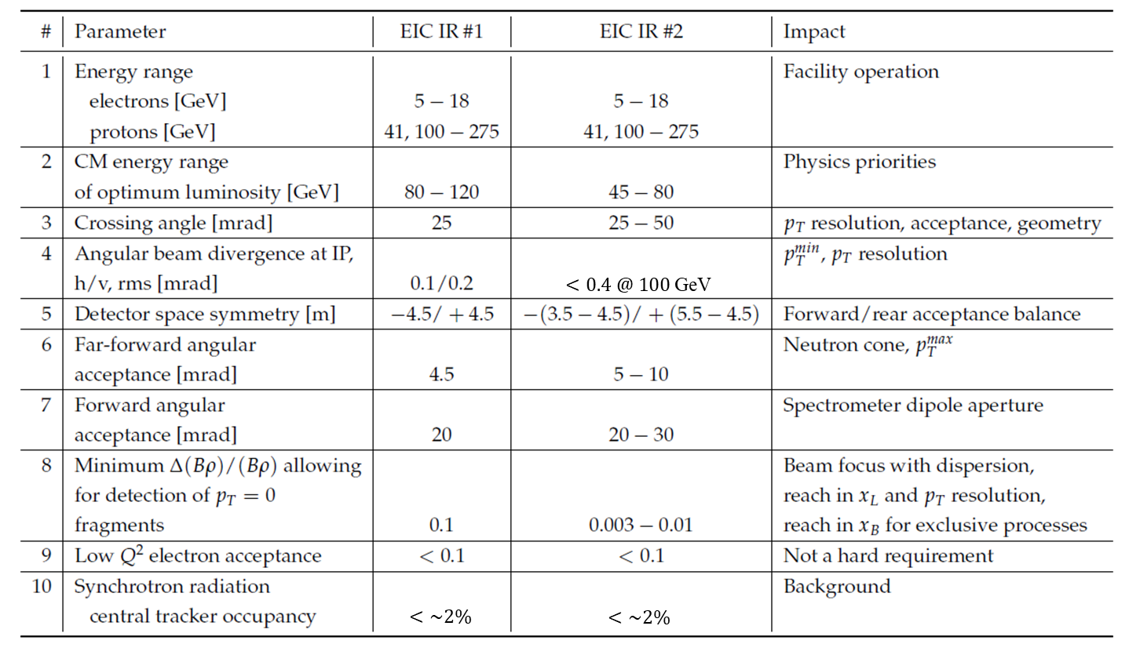
Example of ECCE Physics : Origin of Hadron Mass
Large reduction in pion (structure) pdfs through EIC
Yellow Report,
Volume 2, Fig. 7.24
Major requirements
  Far-forward detection to tag n and Λ (or Σº) (meson structure)
  Scattered electron detection in electron endcap
  Good hadron endcap and far-forward calorimetry (goal: 35%/E, <50%/E acceptable)
  For pion form factor: pion in hadron endcap
and to tag p (for DVCS/3D).
Yellow Report, Volume 2,Fig. 7.46
ECCE – physics reach enhanced in x_{L} and x_{B} with beam focus with dispersion – relevant for diffraction (e-p, e-A) and tagging (e-d, e-³He, etc), and exclusive measurements
From 4th YR Workshop – talks on complementarity (Y. Zhang, V. Morozov)

Slide 33
Example of ECCE Physics : Nuclei
Incoherent diffractive J/Ψ production in e-d tagging
di-hadron azimuthal angle correlation, nuclear glue ratio through inclusive and open charm
Inclusive diffraction in e-A
Yellow Report, Volume 2,
Fig. 7.63
Yellow Report, Volume 2,
Fig. 7.73
Yellow Report, Volume 2,
Fig. 7.69
Yellow Report, Volume 2, Fig. 7.30
ECCE – physics reach enhanced in x_{L} and x_{B} with beam focus with dispersion – relevant for diffraction (e-p, e-A) and tagging (e-d, e-³He, etc), and exclusive measurements
33

Slide 34

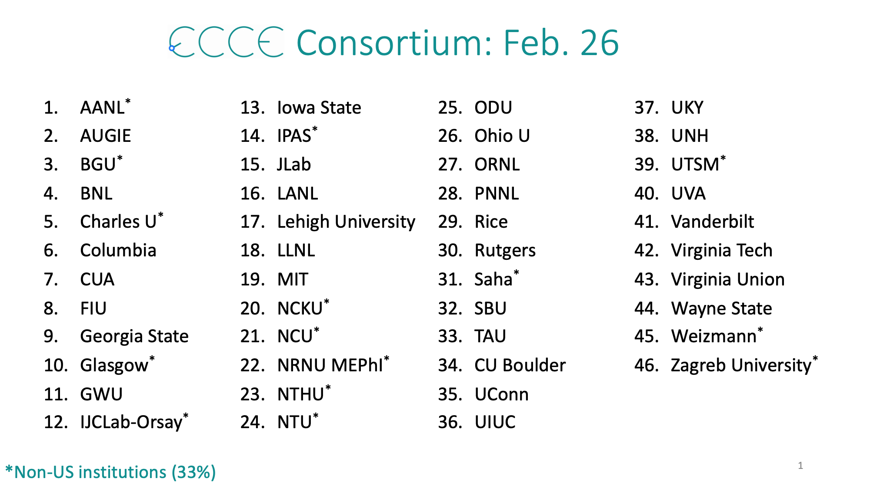
ECCE is Growing…

Slide 35
The EIC Call for Proposals
A joint BNL/JLab call for Collaboration Proposals for Detectors at the EIC has been issued, deadline December 1, 2021 Call Collaboration Proposals
  With input from DOE and EIC User’s Group
Detector 1 is within the scope of the project. US Federal funds are expected to support most but not all of the acquisition of Detector 1
Detector 2 is not within the Project scope. Routes to make Detector 2 and a second interaction region possible are being explored
Proposals should consider the siting scenario for the detectors described
in the CDR.
  Detector 1 is currently planned to be located at Interaction Point 6 (IP6) on the Relativistic Heavy-Ion Collider.
  Other siting options are welcome but proposals that deviate from the CDR will need to address the implications to the EIC project.

Slide 36
The Science
Detector 1 should be based on the “reference” detector described by the EIC User Group (EICUG) in the Yellow Report (YR) and CDR
  Must address the EIC White Paper and NAS Report science case
  The collaboration should propose a system that meets the performance requirements described in the EIC CDR and EICUG YR
  The design should be compatible with that of the accelerator and interaction region layout of the CDR
  Completion of detector construction must be achieved by Critical Decision (CD)-4A, the start of EIC accelerator operations.
Detector 2 could be a complementary detector that may focus on optimizing particular science topics or address science topics beyond those described in the White Paper and the National Academies of Science (NAS) 2018 report
  Completion at Critical Decision (CD)-4

Slide 37
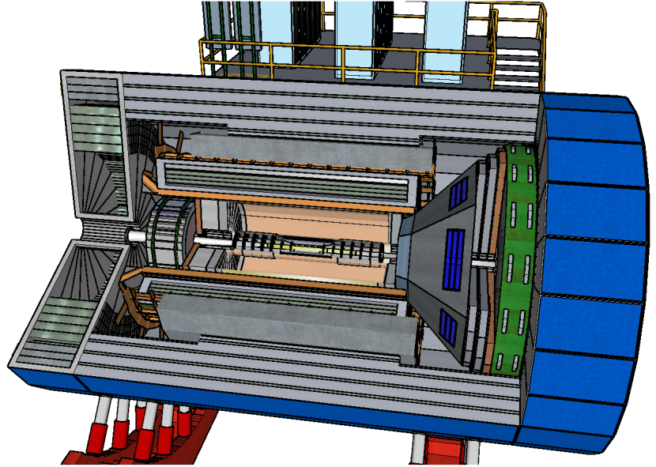
Major items for the ECCE Detector Concept
Optimization EEEMCal and DIRC
  DIRC prism on electron side has advantages for EMCal, DIRC and dRICH
Barrel detector configuration
  Global optimization to address physics requirement on both e/π and π/K/p; Tracking: best use of space for all Si option
Hadron endcap HCAL
  Alternative for improved resolution
Potential barrel option that may fulfil requirements and has some flexibility
System | Function | Thickness | Inner Radius | Outer Radius
All Silicon | Vertex/Tracking | 47 |  | 51
AC-LGAD | Tracking/timing | 8 | 51 | 59
Inner support for DIRC, EEEMCal |  | 10 | 59 | 69
DIRC | PID | 3.5 | 69 | 72.7
Outer support DIRC, EEEMCal |  | 3.5 | 72.5 | 76
TOF/AC-LGAD | Timing/tracking | 8 | 76 | 84
Barrel EMCal | EMCal, e/π separation | 50 | 84 | 134
Support for barrel EMCal |  | 6 | 134 | 140

Slide 38
Major items for the ECCE Detector Concept
Far Forward Region
  IP6: ready for detailed studies
  IP8: anticipate studies to start in June
    35 mr crossing angle and secondary focus.
Far Backward Region
  ready for detailed studies

Slide 39
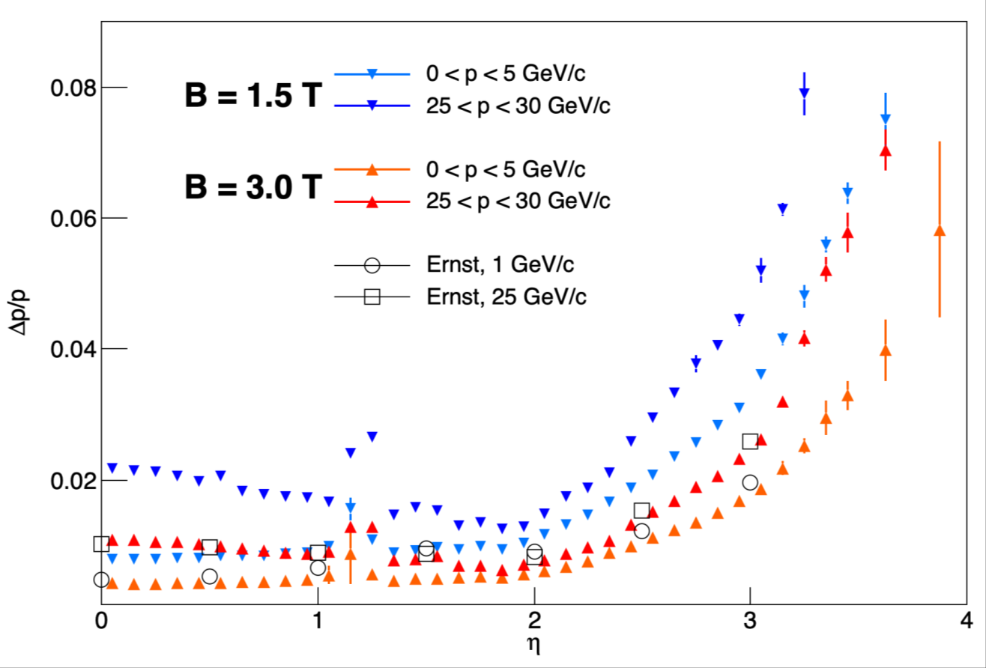
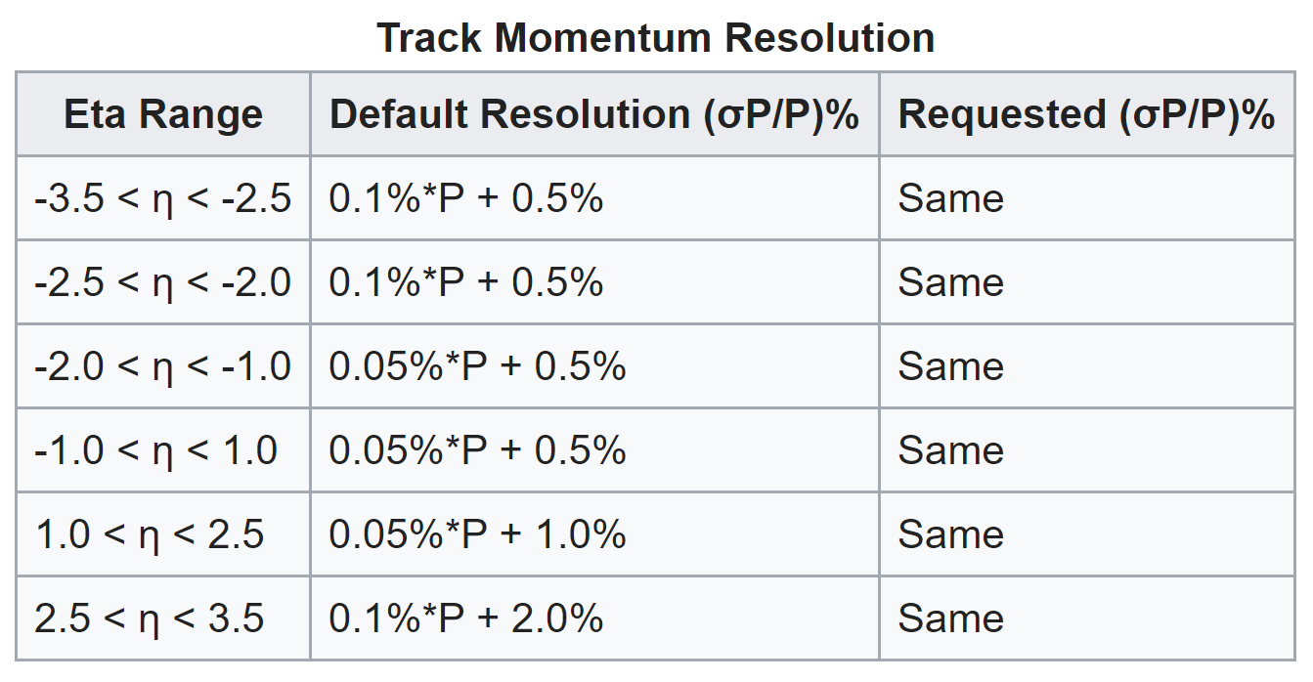
Challenges with B=1.5T
Resolution in forward region η > 2.5
  Jets and heavy flavor group requires higher resolution in forward hadron region.
Jets/HF WG (https://wiki.bnl.gov/eicug/index.php/Yellow_Report_Physics_Jets-HF)
Investigating options for field shaping.
However, lower field can also be useful in tagging and reconstruction of certain heavy mesons (D*) – resolution vs. acceptance/efficiency balance
39

