Slide 1
Announcements
04/28 No meeting due to Streaming Readout VIII
05/05 Update on Project eAST
Please contact Makoto Asai (asai@slac.stanford.edu) if you would like to contribute to the development.

Slide 2
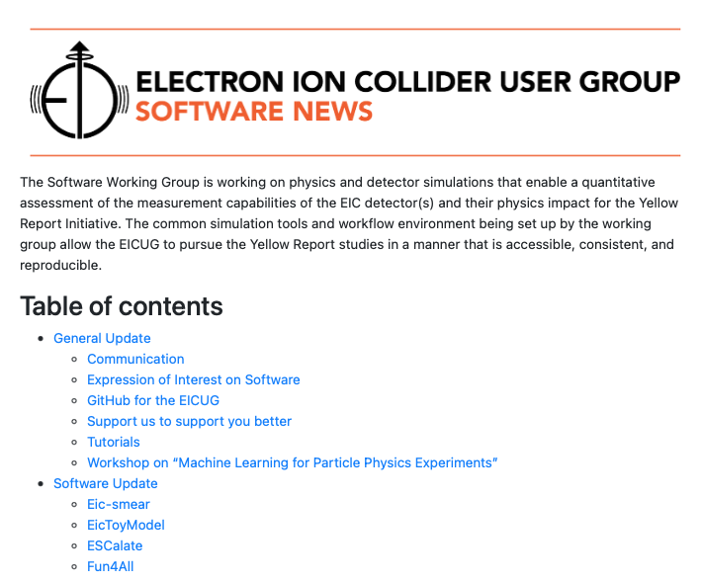
Software News
Example from July 31 2020
Software News
Anyone can contribute. This is a newsletter for the whole community.
Send your contributions by April 28 to eicug-software-conveners@eicug.org.
Newsletter gets out on April 30.
There will be two calls. One today and a reminder on April 26.
Lessons learned
Only a paragraph of few lines per topics. More content is strongly encouraged but is then content for https://eic.github.io and not the newsletter.
We will not wait for content. All late contributions will be part of the next newsletter.

Slide 3
Working Together
Anecdote Ian Shipsey (Oxford) presented at DIS2021 “Breakthroughs in Detector Technology. After his talk, he was asked about the role of software. Ian Shipsey replied in a poetic way "Software is the soul of the detector.” and pointed out in his answer the importance of great software for great discovery. He added that we need to work together, on a global scale and with other fields, to achieve this goal.
Common Software Effort
EIC User Group
Steering Committee
Software Working Group
Proto-Collaborations
CORE
ECCE
EIC@IP6
Simulations Working Groups

Slide 4
Tutorials
What next? Will share request for input later today.

