Slide 1
Electron-Ion Collider : roman pots readout Transimpedance preamplifier simulations (compared with voltage preamplifier)
Maxime Morenas
6 May 2021

Slide 2
Towards a transimpedance preamplifier
A smaller input impedance (than a voltage preamplifier)
to avoid long distance crosstalk

Slide 3
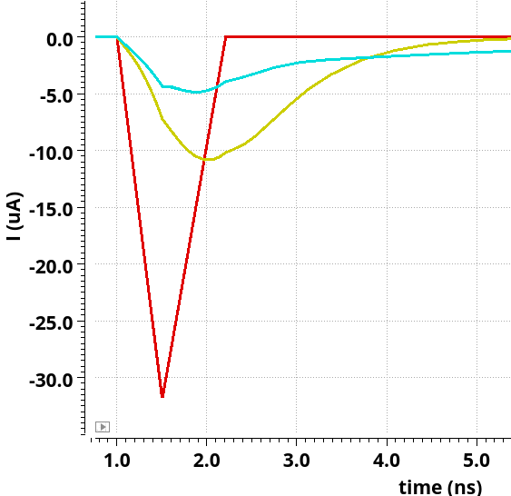
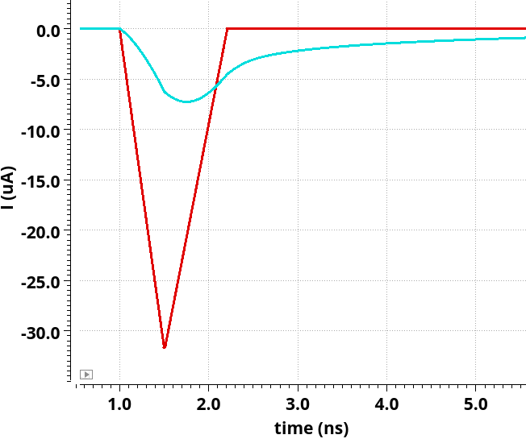
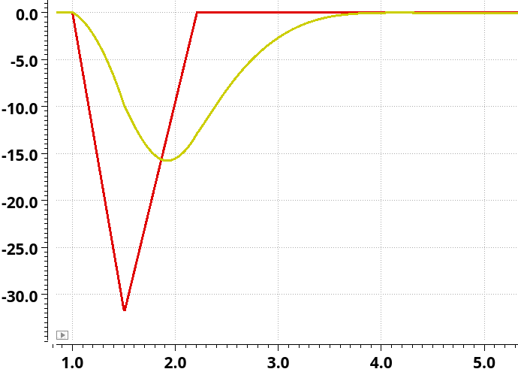
What current flows into the preamplifier ?
Charge deposited closest to the pad
Fastest and largest signal :
Size the upper limit of the bandwidth and input voltage before saturation
Voltage preamplifier
$$Z_{in} → ∞$$
~ 1 kΩ
Transimpedance preamplifier
$$Z_{in} →0$$
~ 100 Ω
?
With 1st order neighbours
Without
LGAD
input current
at 19 fC

Slide 4
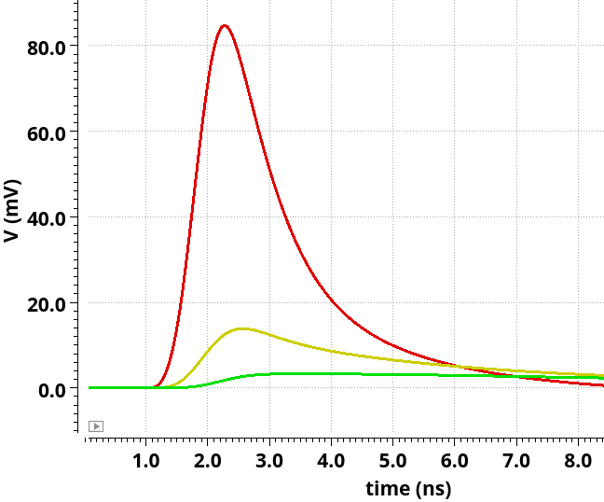
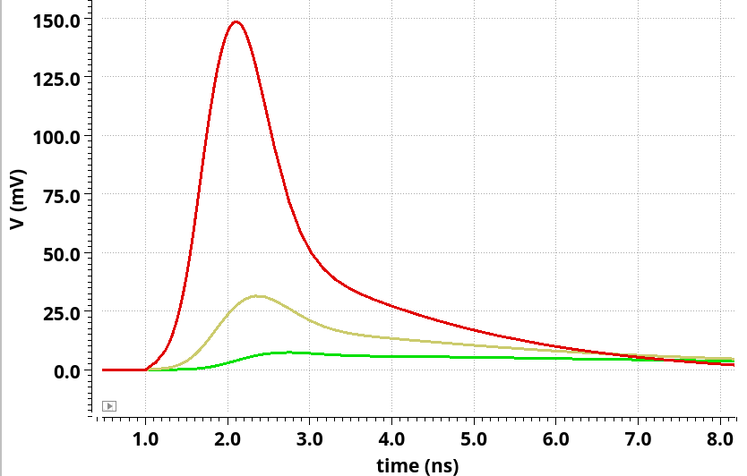
What is seen by neighbouring channels ?
From Nicolo Cartiglia
VPA
TZ
Crosstalk voltage :
at equivalent power
1st order 2nd order
VPA : 20 % 5 %
TZ : 16% 4 %
to be confirmed

Slide 5
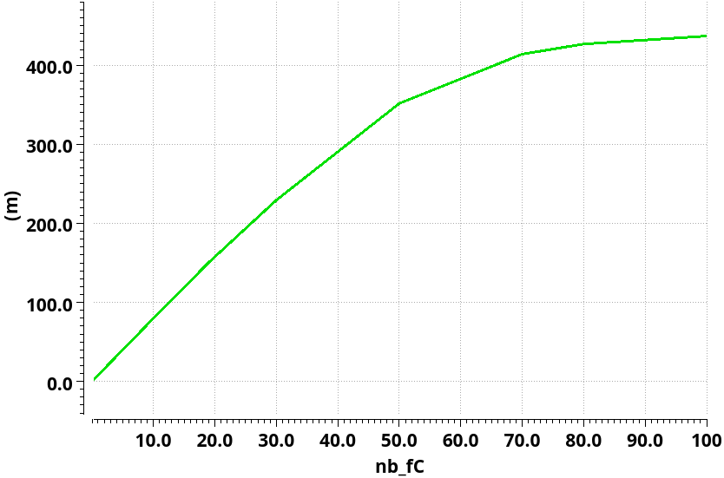
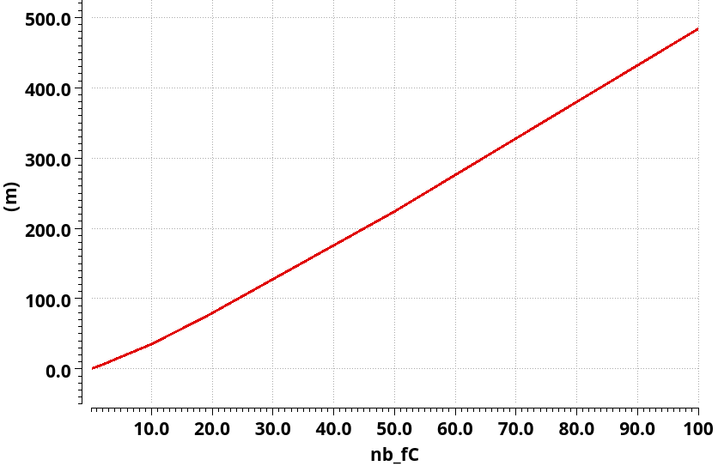
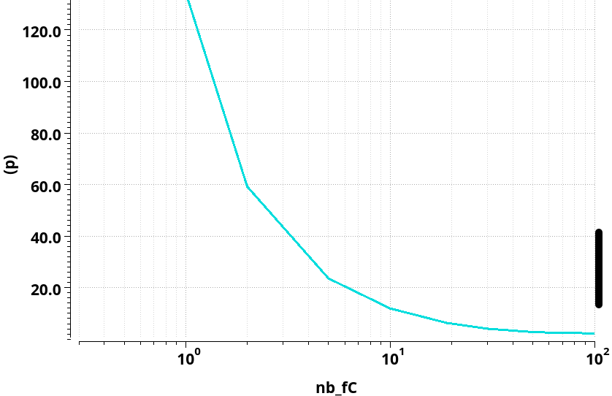
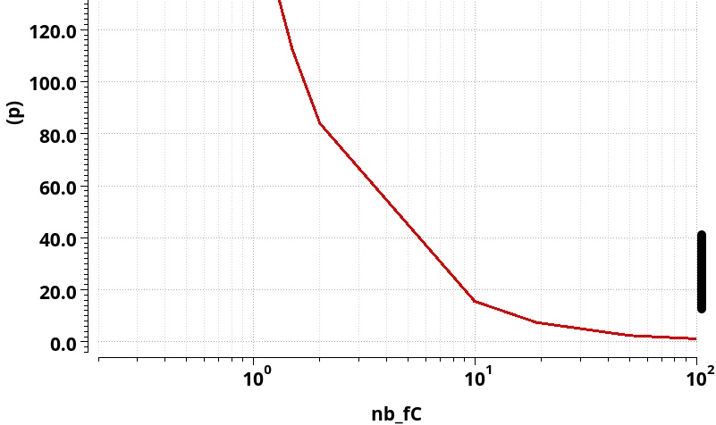
Simulation results : with LGAD signal with neighbours
VPA
TZ
Preamplifier linearity
150 mV at 19 fC
Preamplifier linearity
75 mV at 19 fC
Jitter [ps]
7 ps at 19 fC
Jitter [ps]
7 ps at 19 fC

Slide 6
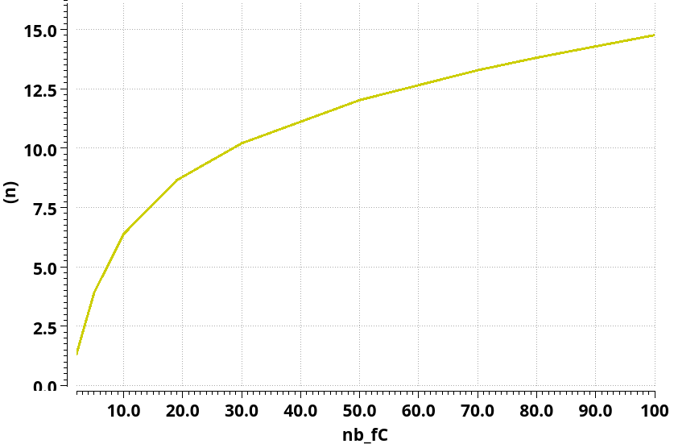
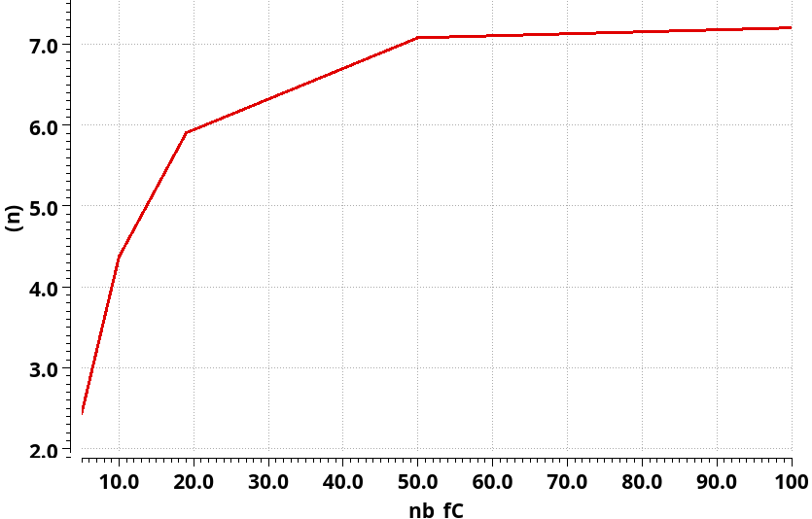
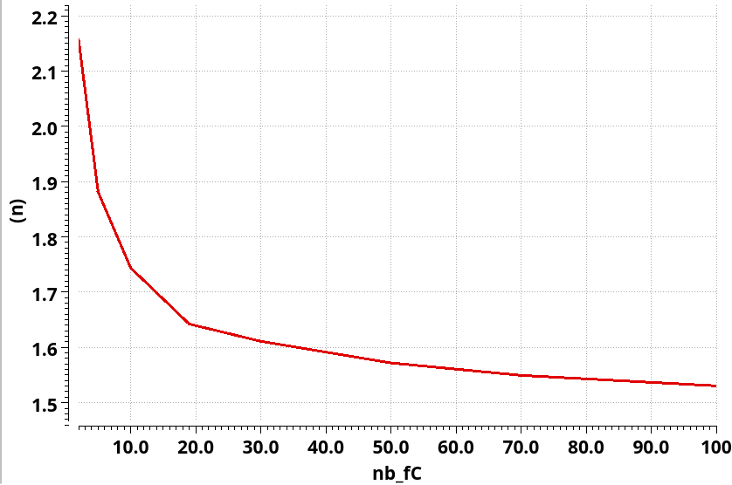
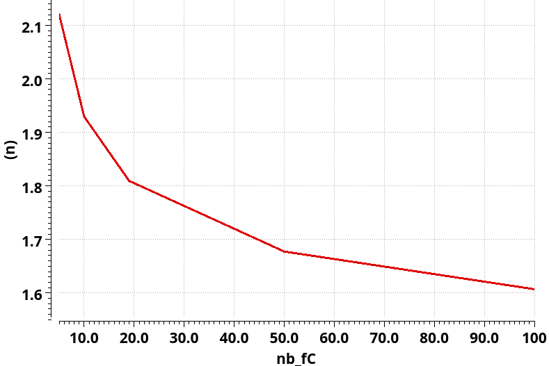
Simulation results : with LGAD signal with neighbours
VPA
TZ
TOT [ns]
5,9 ns at 19 fC
TOT [ns]
8,6 ns at 19 fC
Because smaller output PA amplitude
TOA [ns]
1,6 ns at 19 fC
RMS noise = 1,5 mV
→ Minimum threshold at 1,5 fC (7,5 mV)
TOA [ns]
1,8 ns at 19 fC
RMS noise = 1 mV
→ Minimum threshold at 1,5 fC (5 mV)

Slide 7
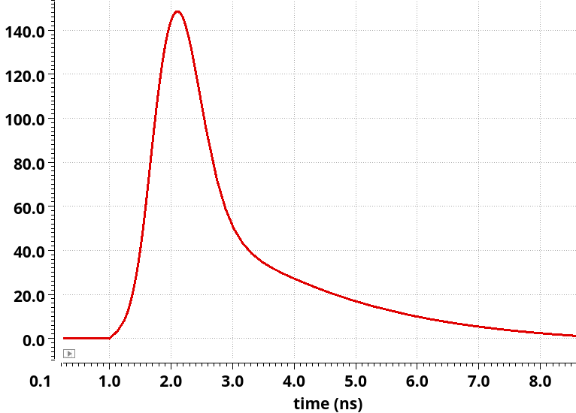
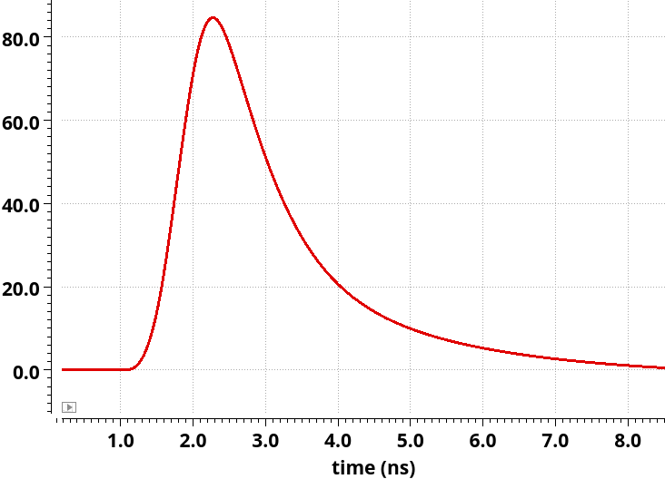
Typical signal response
Preamplifier output for 19 fC (MIP) injection charge
VPA
TZ

Slide 8
Conclusion
Similar response to be confirmed for voltage preamplifier and transimpedance architecture
Better crosstalk with TZ : may improve barycentering
Similar charge threshold (~1,5 fC) : charge integration still possible for neighbours channels
Jitter = 7 ps @ 19 fC
Next step : further TZ tuning + shaper simulations

Slide 9
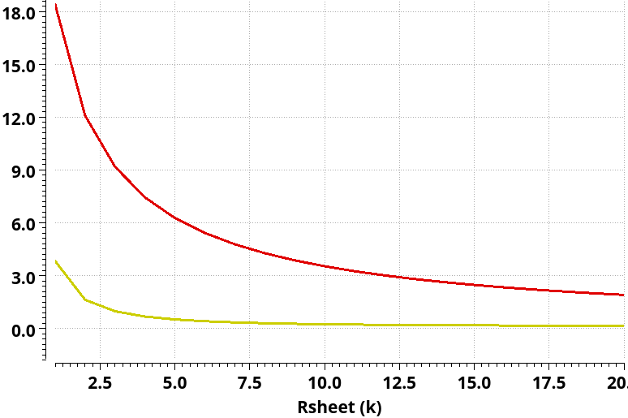
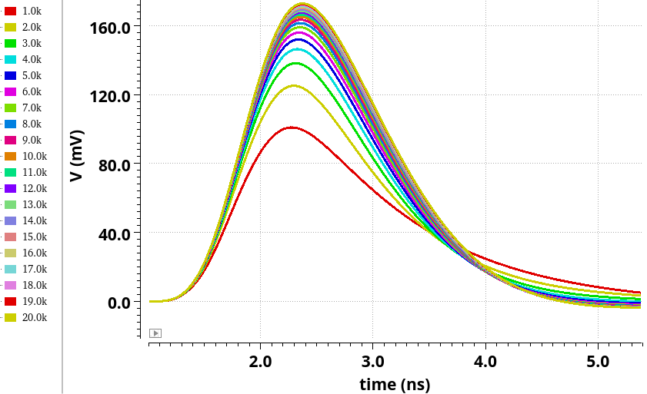
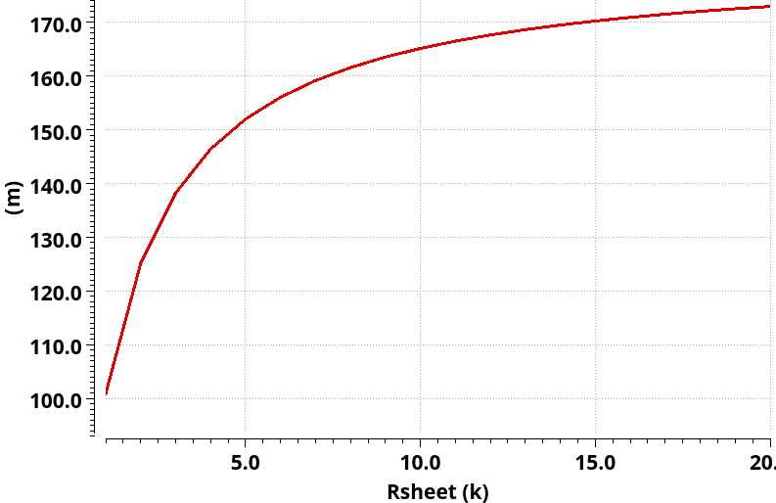
Sheet resistance influence on crosstalk for TZ
% main channel amplitude
1st order crosstalk
Preamplifier (n°1) output voltage :
2nd order crosstalk
$$↑R_{sheet}⇒ ↑out PA voltage$$
Preamplifier (n°1) output amplitude versus Rsheet
the higher the Rsheet,
the higher the SNR

