Slide 1
EIC Silicon Consortium (EICSC) Meeting
January 31, 2021

Slide 2
AGENDA
•Introduction and discussion of goals and current status - Leo - 10 min
•Silicon Development and testing of MLR1 submission – Ian, Xiangming - 10 min
•ITS3 detector development and infrastructure status – Giacomo - 10 min
•Examination of powering options – Alberto - 10 min
Q&A - 20 min
[short talks with links]
DISCUSSION ON TECHNICAL TASKS SUPPORTED BY LEO’S SLIDES - 30 min
•Organization of efforts in development of EIC specific sensors and infrastructure – discussion – all
•Tasks needing R&D and timeframes
•Distribution of tasks.
•Review of the areas of interest for the EICSC members
DISCUSSION ON PATH FORWARD SUPPORTED BY SOME SLIDES FROM LAURA - 20 min
•Continuation of YR activities and outreach into nascent collaborations
•Definition of path forward
•Organization and frequency of future meetings - frequency of meetings and draft agenda of next meeting
AOB - 10 min

Slide 3
Introduction
EICYR results as applies to consortium efforts.
Conceptual designs used as starting points.
Additional status points.

Slide 4
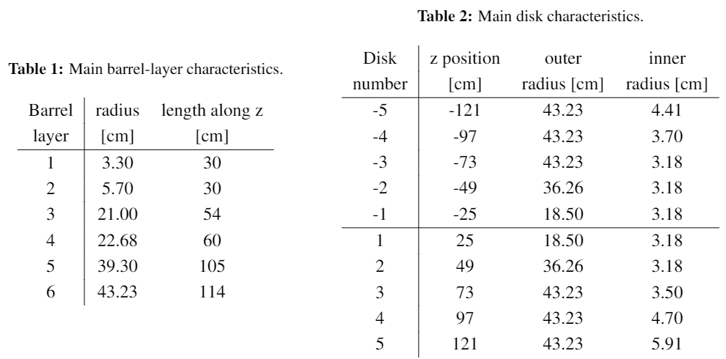
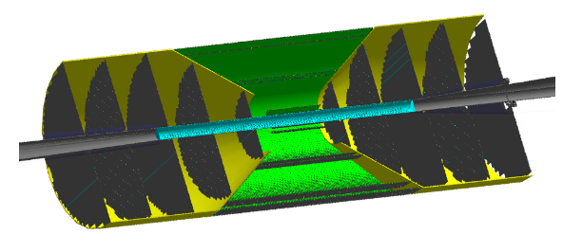
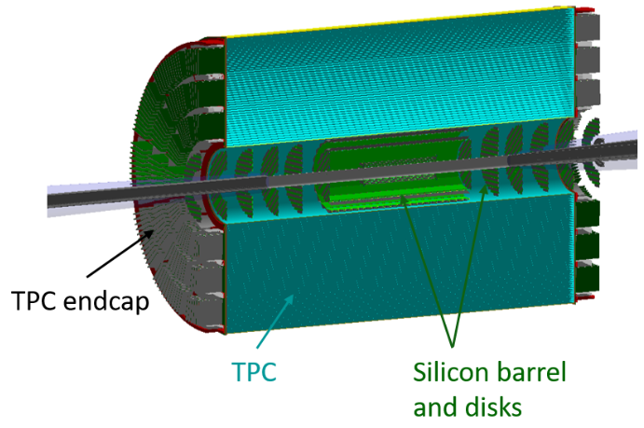
Some results from the YR exercise
Two tracking detector scenarios developed
All silicon concept:
Hybrid – Silicon + gaseous detector tracking:
Both of these scenarios require a large effort to construct ~ 10 m^2 of MAPS silicon detectors

Slide 5
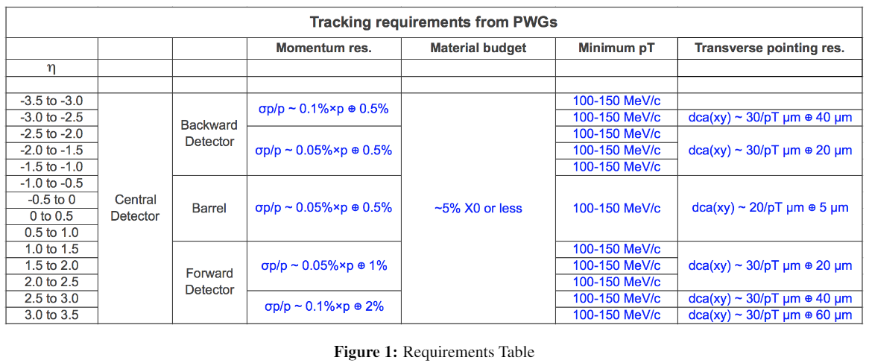
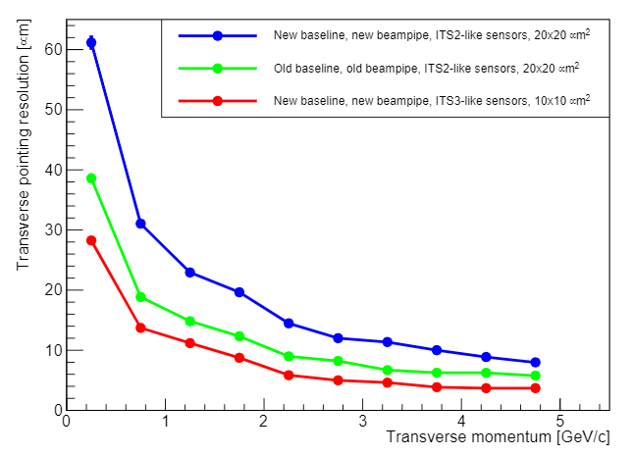
EICSC need
Tracking / Sensor requirements:
Currently only MAPS meet this requirement.
The newly defined size of the beam pipe shows the need for the sensor pixel size to be < 20 um to meet central tracking requirements.
Other sensor candidates either can not be modified to meet the requirements or do not appear to have sufficient support to be available by the time needed.
The path of using synergy with the CERN ITS3 effort is, in my opinion, the best path to success.
The EICSC goal of developing a full detector solution using sensors based on the ITS3 design is a critical and time sensitive effort for tracking at the EIC

Slide 6
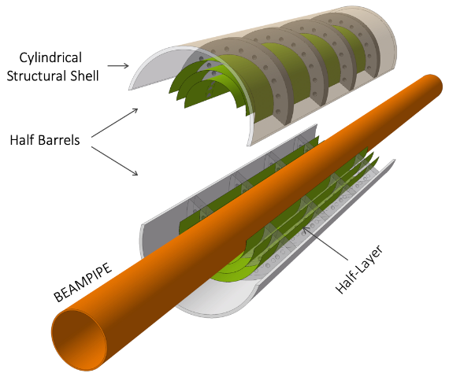
Yellow Report driven detector concepts
As part of the YR exercise, detector concepts were developed and optimized for EIC tracking.
These concepts drive the direction that is needed to move forward in sensor and detector development to realize these concepts. Conceptual layouts are presented below
Vertexing inner layers are based on the ITS3 development at CERN
BUT – the length of the inner staves and the diameters at which these layers sit are markedly different from the ITS3 base design
ITS3 length = 30 cm. This is set by the length of stitched sensors on a 12” wafer.
EIC length (hybrid) = 42 cm
ITS3 radii = 18 mm, 24 mm, 30 mm – these radii are set by the integer width of rows of stitched sensors.
EIC radii = 36.4 mm and 44.5 mm
EIC strawman design (modification of ITS3)
Reach larger radii by using 3 bent sections
Services exit from both sides of inner layers
Engineering work needs to begin
Services exit from one end

Slide 7
Yellow Report driven detector concepts
Staves and discs will be based on a forked EIC specific sensor design based on the ITS3 sensor. The primary concern is yield for long rows of stitched sensors. The plan is to assess yield in the first engineering run and adjust the EIC sensors to optimize yield for the number of stitched sensors in a row.
Staves – Use shorter lengths of stitched sensors to form staves. Power and signal will need to be propagated along the stave with flex PCBs over the stave length.
DC-DC converter?
Flex PCB for power/signal
Power/signal exit
Stitched
sensors
Stave support structure
Discs - could be formed with overlapping staves that conform to the disc diameters or with sensors mounted to half-disc low mass plates.
For both of these solutions we will need to optimize the stitched sensor layout on the wafers to provide the right number of stitched sensor lengths to give the proper needed lengths for each stave/disc. This needs study and optimization.

Slide 8
Additional Status points
The effort to get NDAs and framework IP sharing agreements in place to the silicon design institutions is still underway, but hoped and expected to complete soon.
As the YR effort winds down, the simulation and integrated detector design efforts should continue. This is a point we should discuss. There are no plans in place that I am aware of to coordinate this from the EUCUG management. We should consider extending these effort in a new (or even the same) framework.
The process by which detector collaborations form and answer the call to be delivered in March is not clear to me. But this will be critical to the manner in which we fit into the next steps in the development of an EIC detector. In the mean time, we should endeavor to make our efforts clear and available to the EIC interested parties. Laura will discuss this.

Slide 9
Task Discussion

Slide 10
Gross timeline (technical)
2021 –
Testing and characterization of MLR1
Sensor design for MLR2 or ER
R&D into powering, stave/disc construction, cooling, overall infrastructure
MLR2 submission
2022 -
Testing and characterization of MLR2
Sensor design for ER
R&D + prototyping into powering, stave/disc construction, cooling, overall infrastructure
ER submission
2023 -
Testing and characterization of ITS3 ER and assessment of yield
Assessment and planning for EIC sensor fork of ITS3 design
Fork off sensor design and work on EIC variant for staves and discs (may move to next year depending on results)
Detailed prototyping into powering, stave/disc construction, cooling, overall infrastructure
ER submission for EIC variant sensor for staves and discs (may move to next year depending on results)
Investigation of adaptation of ITS3 design for use in EIC inner layers (different radii, # layers, services from both ends to meet length requirements, etc.

Slide 11
2024 –
Testing and characterization of EIC ER and assessment of yield
Si design for EIC ER2
Detailed prototyping into powering, stave/disc construction, cooling, overall infrastructure using EIC ER1 prototypes.
ER2 submission for EIC variant sensor for staves and discs
adaptation of ITS3 design for use in EIC inner layers and integration of design into ER2 if necessary.
We are developing two detector concepts:
ITS3 like for the vertexing layers.
EIC variant for the staves and discs.
We will need to develop the capabilities to bring both detector concepts and the associated infrastructure to completion

Slide 12
Expanded task list for 2021 (applies to following years as well)
These tasks compliment and are in addition to robust participation in the ITS3 work packages to prepare for the EIC vertexing layers design.
2021
Testing and characterization of MLR1
design of testing system that extends into the testing of the next submissions. Beam testing, Latch-up testing, SEU testing, radiation tolerance testing (kRAD, NIEL), firmware, software, mechanical carriers, alignment stations, analysis, etc. This work is starting in ITS3, we can/should join this effort.
Sensor design for MLR2 or ER
Inclusion of other silicon design sites into the design process (in progress), Assessment of the testing results and incorporation into the new designs, significant digital design (in pixel logic, readout structures and architecture), design for stitching, significantly more complex structures and pixel layout studies, design for yield, etc.
R&D into powering, stave/disc construction, cooling, overall infrastructure
Take up DC-DC converter and serial powering R&D, studies of stave and disc design, cooling studies (air for inner layers, liquid? For outer layers and discs), investigation of on detector data multiplexing and implications for single point failure and redundancy studies, initial studies for carbon fiber designs for overall mechanical support structures, services routing studies, radiation length minimization, etc.
MLR2 submission
Detailed silicon design as per sensor design section, layout and DRC, integration into MLR, etc.

Slide 13
Thoughts on tasks
We need to develop a full set of detector infrastructure for both the ITS3 type vertexing layers and staves and discs based the EIC variant of the ITS3 sensor.
What is represented above constitutes a significant list of tasks that will need to map onto the areas of interest indicated by the consortium members.
There is time phasing of these efforts over the next years. This allows members to dig in and take ownership of significant parts of the effort and plan the multi-year effort.
It would probably not be possible to make these types of commitments in this meeting.
Propose that members look over these tasks and make proposals over the next few weeks by email to the consortium list.
We can schedule another meeting to integrate all of the proposals and try to cover all of the areas needed.
This effort entails joining at some level with the ongoing work packages for ITS3 development. The timelines for participation in ITS3 development and the EIC are not perfectly aligned. Nevertheless we need to soon become integrated into the full suite of development tasks both with ITS3 and supporting our own plans. We should discuss how to manage this in the framework of EIC preparation and funding agency support.

Slide 14
Areas of interest for EICSC members
Institute | Capabilities | Area of Contribution
UK groups total (please refer to UK EOI for details) | Extensive CMOS imaging sensors/MAPS design expertise for HEP and other scientific and commercial applications Lab and clean rooms fully equipped for silicon detectors R&D and large-scale trackers production at multiple sites; Experience with silicon detector characterization during R&D, and quality control (QC) and quality assurance (QA) during production Irradiation facilities (protons, x-rays); Engineering resources for full system DAQ development; Engineering resources and expertise for the development of ultralight support structures. | During the design/R&D phase: Collaboration with the ITS3 project for the development of an EIC MAPS sensor at the 65 nm node; Design and build of a readout system for characterisation and testing of the CMOS MAPS sensors; Characterisation and testing of the CMOS MAPS sensors, including bench and beam tests, data analysis, device simulations etc Irradiation studies of sensor and electronics performance; R&D on ultralight support structure prototypes; Physics performance studies for detector layout optimization During the construction phase Detector assembly, QC/QA at multiple sites.

Slide 15
ORNL | -electronics engineers experienced in design of high speed digital and analog readout systems; development of associated ASICs, multilayer and rigid-flex PCBs for complex circuits (including associated simulations and analysis), firmware, and delivery of fully integrated systems -electronics laboratories with advanced measurement equipment -irradiation test facility -mechanical engineers experienced in design and analysis of all aspects of detector mechanical systems including mechanical support structures -large scale carbon fiber mechanical design and fabrication facilities -laboratory space with clean rooms (will let you know classifications) -professional project management, project control, and ES&H teams with experience in coordinating very large projects -computer engineers with experience in on-the-fly data processing of very high data volumes -advanced high performance computing facilities | -participation in ITS3 MAPS sensor design, development, and characterization -design, development, production, and test of continuous parallel readout system with the on-the-fly data processing -power system design and development -cooling system design and development -mechanical support structure design and development -detector assembly -professional project management and project controls -production and analysis of detector performance simulations

Slide 16
LBNL | Silicon design Sensor prototype testing and characterization with HI and proton beams Carbon fiber composite structures design and fabrication Full spectrum electronics design and fabrication. Full spectrum mechanical design and fabrication Project management and leadership | Collaborating on the silicon design with the CERN based ITS3 team and other members of the EIC Silicon consortium with a particular focus on low power pixel circuitry, design for high yield in the stitching process and serial powering options. Work on the particular mechanical and electrical design of discs based on ITS3 type sensors. Work on the particular mechanical and electrical design of staves based on ITS3 type sensors. Targeted R&D on the reduction of the mass of the services needed for the sensors. Cooling of the staves and discs. Mechanical adaptation of the ALICE ITS3 stitched vertex detector design for the EIC beam pipe configuration. Mechanical support stability and deflection studies.

Slide 17
BNL Instrumentation Division | he BNL Instrumentation Division (https://www.bnl.gov/instrumentation/) has a number of facilities suited for the consortium work, including: The Integrated Electronics Laboratory with focus on the development (design) and testing of Application Specific Integrated Circuits (ASICs), signal processing and electronics, DAQ and controls, Printed Circuits Boards (PCBs). Extensive expertise in low-noise front-end, spectroscopic circuit design for radiation detectors, using process node down to 65 nm, Wide record of multichannel integrated circuits with sparsified readouts with data acquisition, including pixel detectors Recent extension on digital back-ends and digital on top design methodologies for higher data throughput and streamlined readouts and processing, State-of-the-art software ECAD design and verification tools, Assembly, testing and high-density interconnect infrastructure. The Silicon Detector Laboratory as a part of a series of laboratories and cleanrooms dedicated to the development of semiconductor detectors (Semiconductor Detector Laboratory) with the focus of this facility on the development and production of silicon detectors Cleanrooms and lab space dedicated to different parts of sensor processing, including post-processing, testing, calibration, metrology, and integration, Software, design, and verification tools for semiconductor detectors. The High-Density Interconnect and Electronics Assembly Laboratory A large cleanroom space with a multitude of tools for designing, fabricating interconnections and performing metrology and inspections – including computer-aided design software and high-tech interconnect equipment – for large international experiments. The Solid State Irradiation Facility (SSIF), with an 1150 Ci ⁶⁰Co source that can provide 1.17 and 1.33 MeV photons from 3 Gy/hr to 800 Gy/hr in addition to other irradiation possibilities existing at BNL, such as Tandem and NSRL (with focus on single event effect testing) | Design and testing of the EIC targeted sensor. Providing infrastructure and expertise for all collaborative efforts with the consortium upon availability of laboratory spaces, personnel and equipment.

Slide 18
JLAB | Silicon Tracker Experience: The JLab team gained experience from the CLAS12 SVT and Heavy Photon Search SVT projects can be extended to the current pixel tracker technology. JLab silicon groups were actively involved in all aspects of silicon tracker work including management plans, risk evaluation, general tracker simulation and design, R&D on silicon sensors and detector modules, readout and DAQ, mechanical support, tracker services (cooling, purging, power supplies), tracker safety and monitoring systems, data logging. The JLAB silicon teams have a successful experience of collaboration with silicon labs at FNAL and SLAC on these projects, following development, quality assurance and deliverables of critical detector components with different vendors. JLAB has essential expertise in silicon tracker integration, commissioning, and operation at high luminosity, track reconstruction, data validation and analysis. Infrastructure: JLab’s clean rooms were used for testing and assembling the silicon tracker. JLab has probe stations, wire-bonding stations, and test stations for the silicon project R&D. Beam Test: CEBAF provides a unique opportunity to satisfy various needs of the silicon tracker R&D in testing the functionality of the tracker modules, readout, DAQ, trigger etc. | Design Sensor Cabling Mechanical Support Structure FE Analysis Extensive experience with Carbon Fiber Module assembly Assembly and Integration Trigger Level 1 trigger Level 3 trigger improving efficiency and purity DAQ Design Readout Design Streaming Readout design and testing Simulations Full Geant simulation interfacing between engineering design CAD Model and software developers Background simulations of synchrotron radiation, beam gas interactions and other backgrounds to determine rates, radiation doses and occupancies Prototyping/Testing in clean room Beam test: Design the setup and carry on the test experiment and data analysis
CCNU Wuhan | Silicon sensor design, clean room assembly, wire bonding, etc. | silicon sensor design
IMP | sensor testing | sensor testing

