Slide 1



EIC Silicon Development: Update on Silicon Design with ITS3
04/02/2020
Iain Sedgwick
CMOS Sensor Design Group
Rutherford Appleton Laboratory
Notes:
The abstract pattern can be removed or repositioned if required. Be careful to ‘Send to Back’ so that it does not obscure any important information.

Slide 2
Background – ITS3
Notes:
The abstract pattern can be removed or repositioned if required. Be careful to ‘Send to Back’ so that it does not obscure any important information.

Slide 3
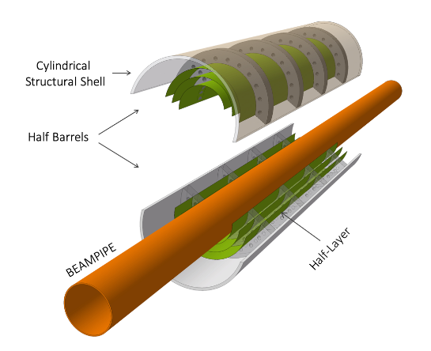
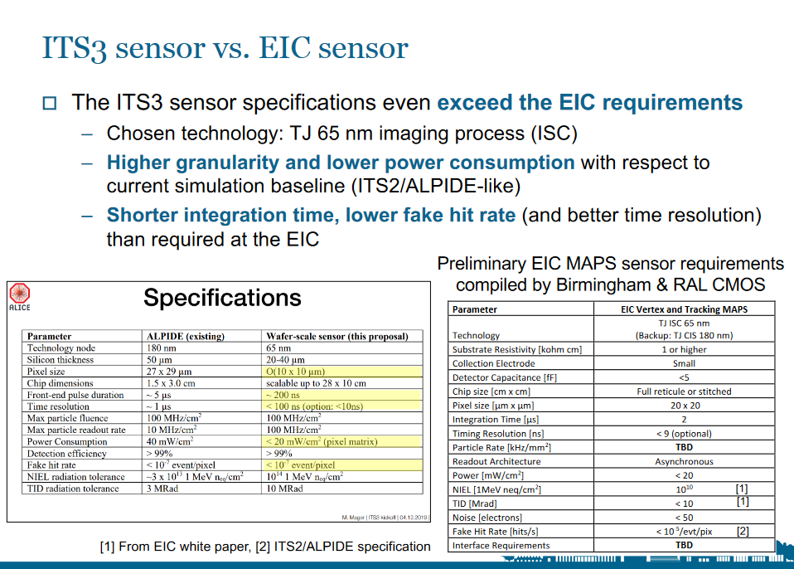
Working with ITS3 at 65nm
ITS3 Upgrade
  ALICE currently starting work on upgrade of inner vertex layers (https://cds.cern.ch/record/2703140/files/LHCC-I-034.pdf)
  Planning to use TowerJazz 65nm process, stitched and thinned sensors
  Strong similarity in specifications with EIC requirements
L.Gonella, https://indico.cern.ch/event/934314/contributions/3945506/attachments/2080297/3494044/EIC-UK-workshop-VTX.pdf

Slide 4
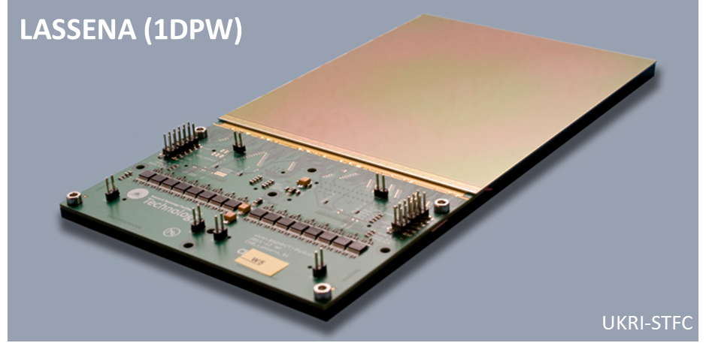
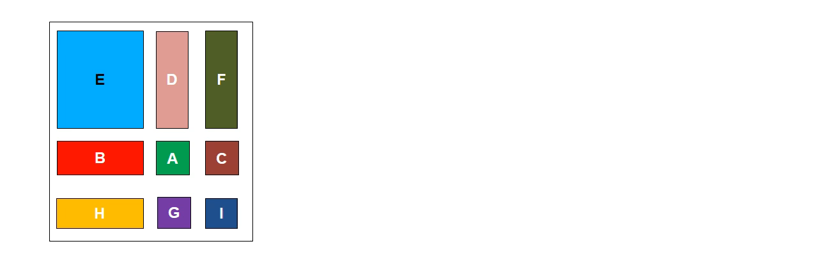
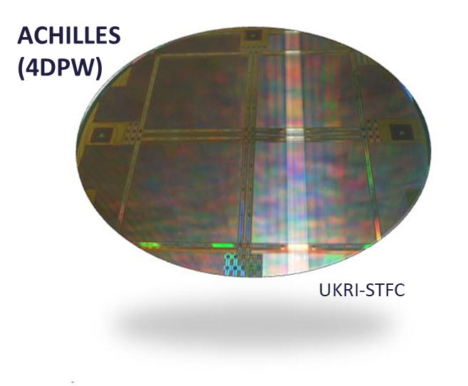
Stitching
Stitching
  Involves repeated exposure of sections of reticule to generate sensor larger than a single mask
  RAL has considerable experience of stitched designs

Slide 5
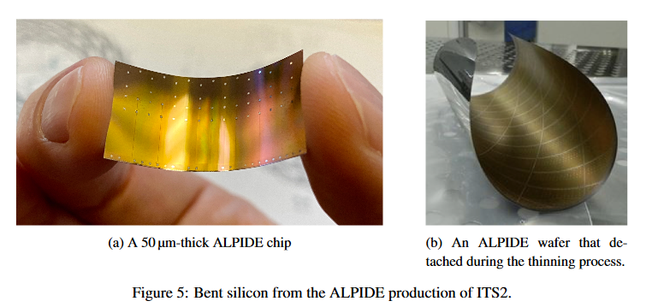
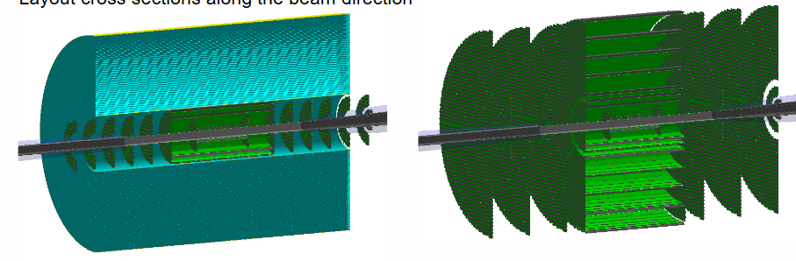
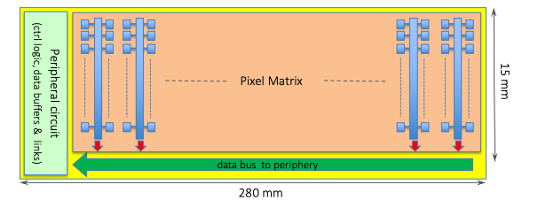
Thinning and ITS3 to EIC transition
https://indico.cern.ch/event/934314/contributions/3945511/attachments/2079907/3493937/EICUK_HW_Simulations_200727.pdf, H.Wennlöf
https://pos.sissa.it/373/040/pdf, M. Mager

Slide 6
MLR1
Notes:
The abstract pattern can be removed or repositioned if required. Be careful to ‘Send to Back’ so that it does not obscure any important information.

Slide 7
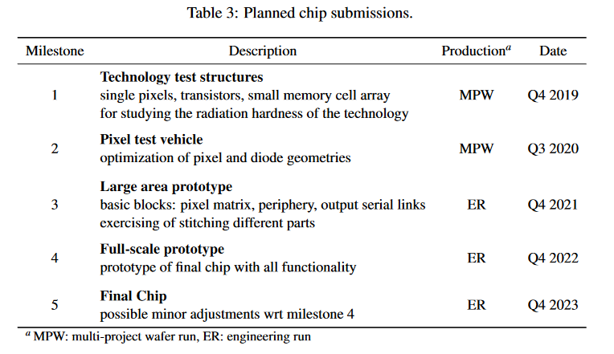
Current Engagement
Submissions
  ITS3 originally planned several MPWs
  Combined into 1 MLR (MLR1)
  Next submission will be another MLR (MLR2)
MLR1
MLR2

Slide 8
Current Engagement
MLR1 Blocks
  Transistor Test Structures (CERN)
  Pixel Test Structures (IPHC, DESY, CERN)
  Bandgap (NIKHEF)
  High Speed Structures (RAL)
  Ring Oscillator (CPPM)

Slide 9
MLR1 Blocks
First 65nm run
  Goal of MLR1 was test of transistor performance, pixel structures and circuit blocks
  Many groups submitted circuit blocks:
    Transistor Test Structures (CERN)
    Pixel Test Structures (IPHC, DESY, CERN)
    Bandgap/VCO (NIKHEF)
    High Speed Structures (RAL)
    Ring Oscillator (CPPM)

Slide 10
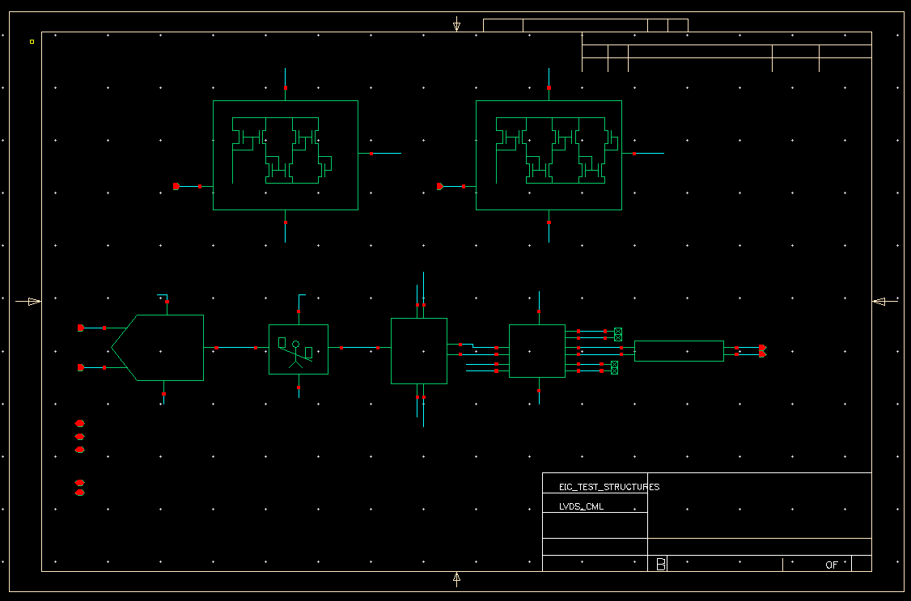
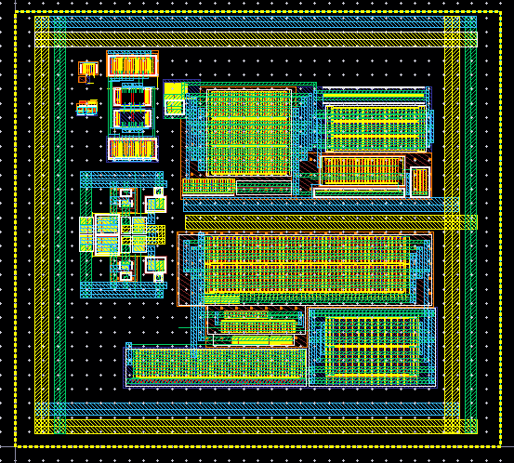
RAL Blocks at 65nm

Slide 11
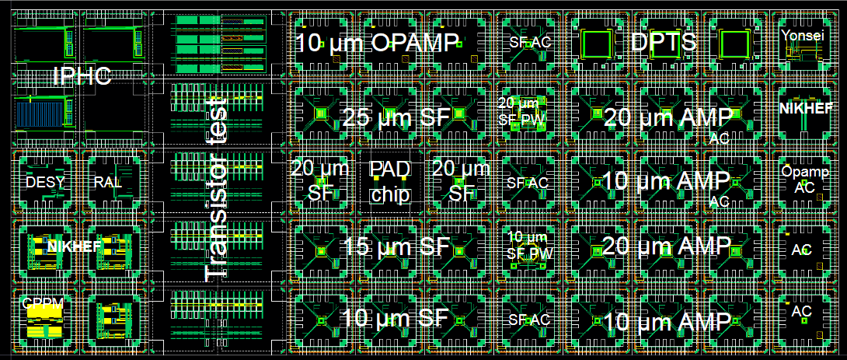
Complete MLR1
  Expected back May (very tentative!)
  Test workshop already held (https://indico.cern.ch/event/986665/)

Slide 12
MLR2
Notes:
The abstract pattern can be removed or repositioned if required. Be careful to ‘Send to Back’ so that it does not obscure any important information.

Slide 13
MLR2
Plans for MLR2
  CERN is working on an NDA so that more groups can access the process
  MLR2 will certainly involve combining these blocks into a larger chip
  Some suggestion that it could already be stitched
  Probably good to start thinking about outline EIC spec

Slide 14


Notes:
The abstract pattern can be removed or repositioned if required. Be careful to ‘Send to Back’ so that it does not obscure any important information.

