Slide 1
EIC All-Silicon Tracker: powering options
EIC Silicon Consortium meeting
February 4, 2021
Alberto Collu
LBNL

Slide 2
Outline
EIC tracker powering options document: general information
Document structure
Detector/power system requirements
Assumptions on sensors/modules
Powering options
Fixed voltage DC-DC converters
Serial powering
Preliminary material budget estimations and development time

Slide 3
EIC tracker powering options document: general information
Purpose of the document
Explore the range of available powering options for a EIC all-silicon tracker
Determine material budget figures for each configuration
Approach
Not detailed concerning the underlying technologies
Mainly oriented toward determining:
Material budget vs granularity trade-offs
Material budget improvements as compared to state-of-the-art developments
Status of the document
Main powering options detailed, preliminary material budget estimates available
Work in progress…
Link (viewable)
https://docs.google.com/document/d/1BpARebuEncQ4vZ_8tlbwXl-__ihd-m6sq5c-MrIW7j8/edit?usp=sharing
How to contribute: send me an email (albertocollu@lbl.gov)

Slide 4
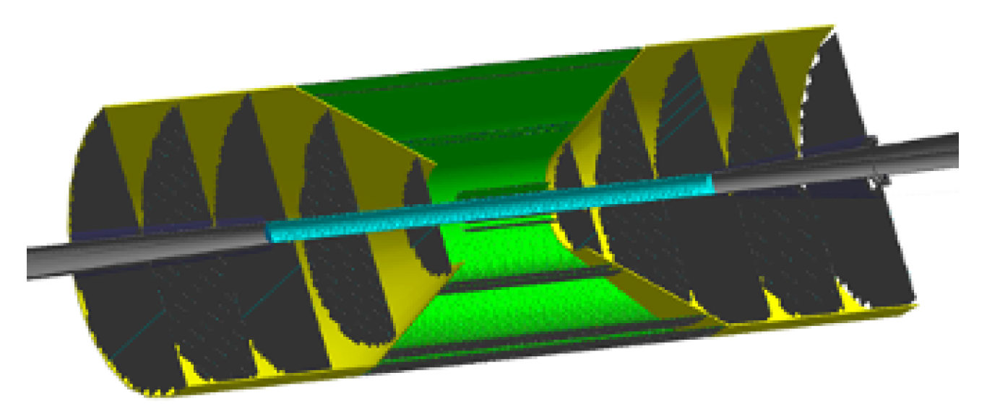
EIC silicon tracker requirements
Requirements that are most relevant to the studies that are included in the document
Detector geometry from YR
6 layer barrel (~7.5m²)
10 disks (~4.5m²)
Material budget per layer from Leo’s calculations
IL: 0.1% X₀
ML, OL: 0.55% X₀
Disks: 0.24% X₀
Other requirements
Magnetic field: up to 3T
Electrical: input voltage @ 1.2V +/-10%
Radiation hardness requirements (TID, NIEL, High LET fluence, …)
TBD but expected to be lower than ALPIDE sensor radiation hardness specs

Slide 5
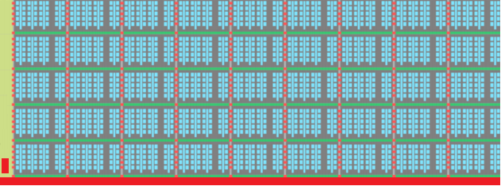
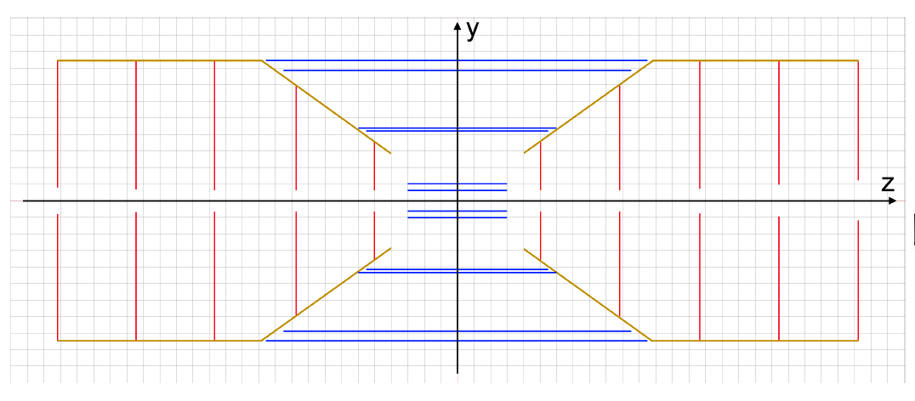
Assumptions on sensors/modules
Module dimensions: 300 mm x 30 mm
Each module is made of N sensors (N depends on yield)
All modules powered at 1.2V +/- 10%
Current figures:
Digital current: 0.5A (~50% of that of an ALICE ITS-2 module), due to:
~Similar functionality as ITS-2, improved architecture
Reduced input voltage 1.8V 🡪 1.2V
Reduced gate capacitance
Additional digital current pessimism: 0.15A
Analog current: 0.2A (~same as ALICE ITS-2 module)
Sensor N
Sensor 1
Sensor 0
Central Barrel (~7.5m²): ~830 modules
Disks side A (~2.25m²):
~250 modules
Disks side B (~2.25m²):
~250 modules

Slide 6
Fixed voltage DC-DC converter powering option
Based on the use of DC-DC converters near the detector volume
DC-DC converters are bulky:
PCB + ASIC + inductor + metallic shield + …
A large number (O(1000)) of DC-DC converters is required to power a 12m² tracker
Assumes that the detector is powered from both sides
Flexible Printed Circuits (FPC) to connect DC-DC converters to detector through gaps
Location and architecture of DC-DC converter circuitry dependent on:
Available space, radiation hardness requirements, material budget requirements, …
DC-DC conv
DC-DC conv
FPCs
FPCs
DC-DC conv
FPCs
FPCs
DC-DC conv
FPCs
FPCs
DC-DC conv
DC-DC conv

Slide 7
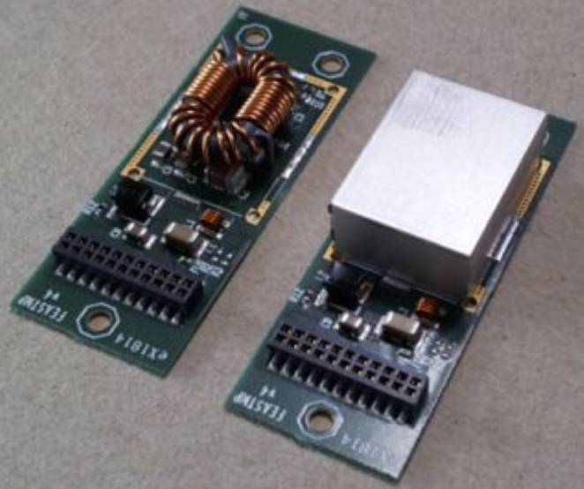
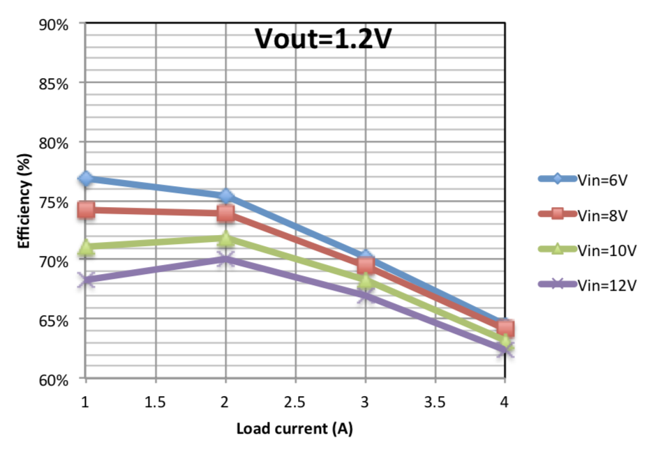
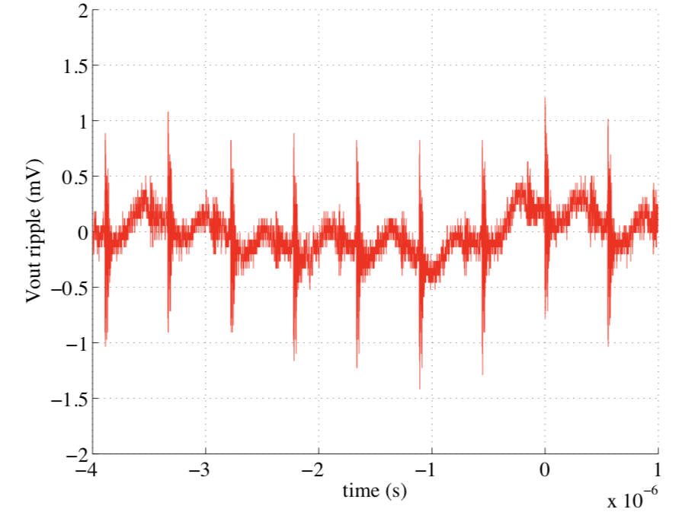
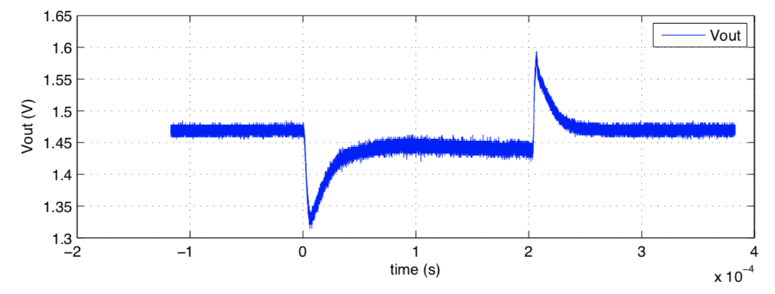
Fixed voltage DC-DC converter powering option
DC-DC circuitry on detector sides kept as simple as possible
Segmented into independent units each powering a set of sensor modules
Each unit: DC-DC converter(s) + current sense(s) + passive components/connectors
Baseline DC-DC converter CERN FEASTMP. Bulky but:
Testing for radiation hardness and in magnetic field not needed:
200MRad TID by design
Works in > 4T magnetic fields
Will work with sensors in TJ 65nm technology
Output voltage range 0.9-5V
Max output current 4A
Input voltage range 5-12V
ASIC, inductor
Shield
Interface connector
Good efficiency (> 60%)
Very low switching noise (<2mVpp)
2A step performance

Slide 8
Fixed voltage DC-DC converter powering option
Material budget impacted by granularity in different ways at different locations
Off-detector
(~10m away)
Outside the detector
(~1-10m away)
Detector sides
Inside the detector
Off-detector electronics
channel + sense (optional)
DC-DC converter
Units
Digital
Module 0
Module 1
Analog
mostly independent
from granularity
highly
dependent on granularity
mostly independent
from granularity
Not assessed
Lowest material budget/lowest granularity
Highest material budget/highest granularity
4 modules fully powered from a single DC-DC converter:
Disks: ~125 DC-DC converters
Barrel: ~210 DC-DC converters
Total PCB area: ~1.25m²
Digital and analog powered independently for each module
(ALICE ITS-2-like configuration):
Disks: ~1000 DC-DC converters
Barrel: ~1700 DC-DC converters
Total PCB area: ~3m²

Slide 9
Fixed voltage DC-DC converter powering option
Example implementation of an EIC tracker outer layer stave FPC
4 modules
2 FPCs back-to-back, powered from the forward and backward regions
Allows for a lower number of metal traces per FPC as compared to ITS-2
wider and shorter metal traces, hence lower material budget
Traces with equalized voltage drops 🡪 Identical and fixed voltage DC-DC converters
Module 1
DVDA DVDD Bias
Module 3
Bias DVDD DVDA
DVDA DVDD Bias
Module 2
Bias DVDD DVDA
Module 4
Factoring in the projected current figures for ITS-3-like sensors
Coverlay (50um)
~60% material budget
reduction
ALICE
ITS-2
FPC
stackup
Aluminum (100um)
Coverlay (50um)
EIC
FPC
stackup
Kapton (50um)
Aluminum (25um)
Kapton (50um)
Aluminum (100um)
Aluminum (25um)
Coverlay (50um)
Coverlay (50um)
More dramatic improvements can be achieved by integrating data/config FPC with power FPC

Slide 10
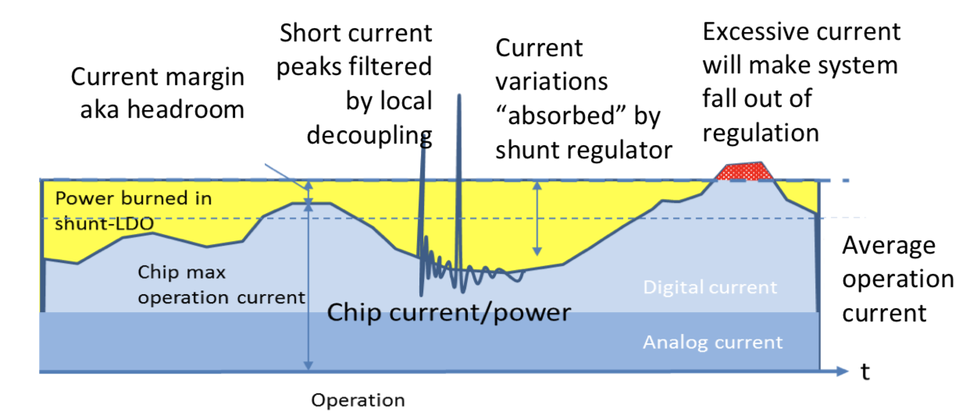
Serial powering option
Main features:
Modules are connected in series (GND_{N-1} 🡪 VDD_{N}) 🡪 Reduced number of FPC traces
Constant chain current forced by current source (off-detector)
Shunt LDOs integrated in each module drain excess current (I_{chain} - I_{module})
Current
Source
module 0
module 1
module N
https://indico.cern.ch/event/681247/contributions/2929073/attachments/1640109/2618527/SerialPowerACES2018.pdf
A serial powering scheme currently in use in the ATLAS experiment inner tracker
New powering circuits/schemes under development within the RD53 project

Slide 11
Serial powering option
Material budget scales ~linearly with granularity
Off-detector
(~10m away)
Outside the detector
(~1-10m away)
Detector sides
Inside the detector
Off-detector electronics
Connectors only
Module 0
Module 1
Module N
Each connection carries the same current regardless of the number of modules connected to it (fixed cable/FPC trace cross sectional dimensions)
Increasing granularity will increase the number of connections thereby linearly increasing material budget
Not assessed

Slide 12
Material budget figures and development time
 | Material budget (as a percentage of reference: ALICE ITS-2) |  |  | Development time
 | Analog/digital/ground cable mass (outside detector volume) | PCB surface (detector sides) | FPC power bus material budget (inside detector volume)
ALICE ITS-2 architecture (ITS-3 sensor modules) | 50% | 100% | ~66% | ~1.5 years
DC-DC converters | 3.125% - 6.25% | 87% - 208% | ~40% | ~1.5 years
Serial powering* | 8% - 32% | 5% - 20% | ~30 - 40% | ~5 years
*assumes 10% max voltage drop across cables + FPC traces
Fixed voltage DC-DC converter option could be the baseline:
Easier implementation, independent from sensor development, DC-DC converters available
Serial powering enables further reductions of material budget in/near detector volume

