Slide 1
Choosing Distributed Computing Tools is much easier than choosing MC generators
Fewer products available
Basic considerations in ATLAS
Systems are designed by and serves physics community
New features are driven by the experiment operational needs
Errors handling, monitoring and accounting are key components of distributed SW stack
There are several systems with very well defined roles which are integrated for distributed computing.
Combine all functionalities in one system or have several systems is an experiment choice
Edge service (is a relatively new layer)
Technology evolution should be addressed
Functionality is important as scalability
New physics workflows (ML,…), new strategies (“provisioning for peak”), computing model evolution….

Slide 2
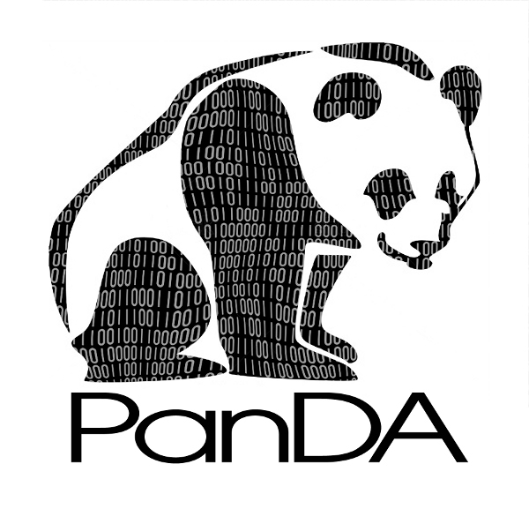
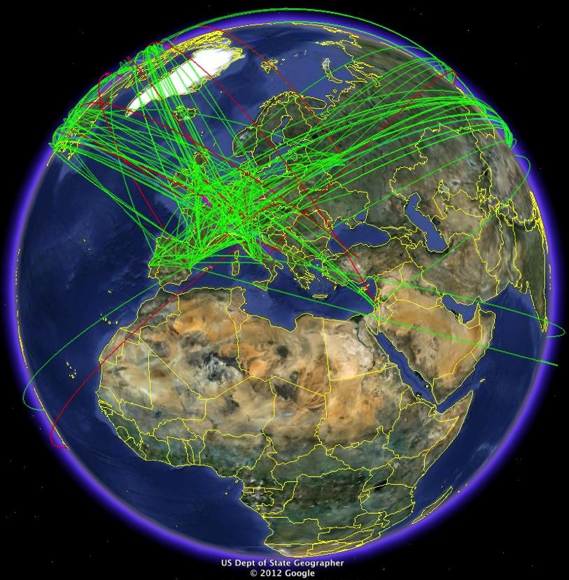
ATLAS distributed computing software stack
Data Management: bookkeeping and distribution of files & datasets - Rucio
Workflow Management: “translates” physicist requests into production tasks – ProdSys2
Information System PanDA Queues and resources/sites description - CRIC
Workload Management: submission and scheduling of tasks & jobs -PanDA
Distributed resources
Monitoring production jobs & tasks, shares, users - BigPanDA
Databases: Conditions and data processing (ORACLE, mySQL, PostgresSQL)
Dirac EGI, Dirac LHCb, Dirac Belle II, Dirac ν
AliEn
CRAB
Pegasus
Analytics ElasticSearch/Kibana – for PanDA and Rucio

Slide 3
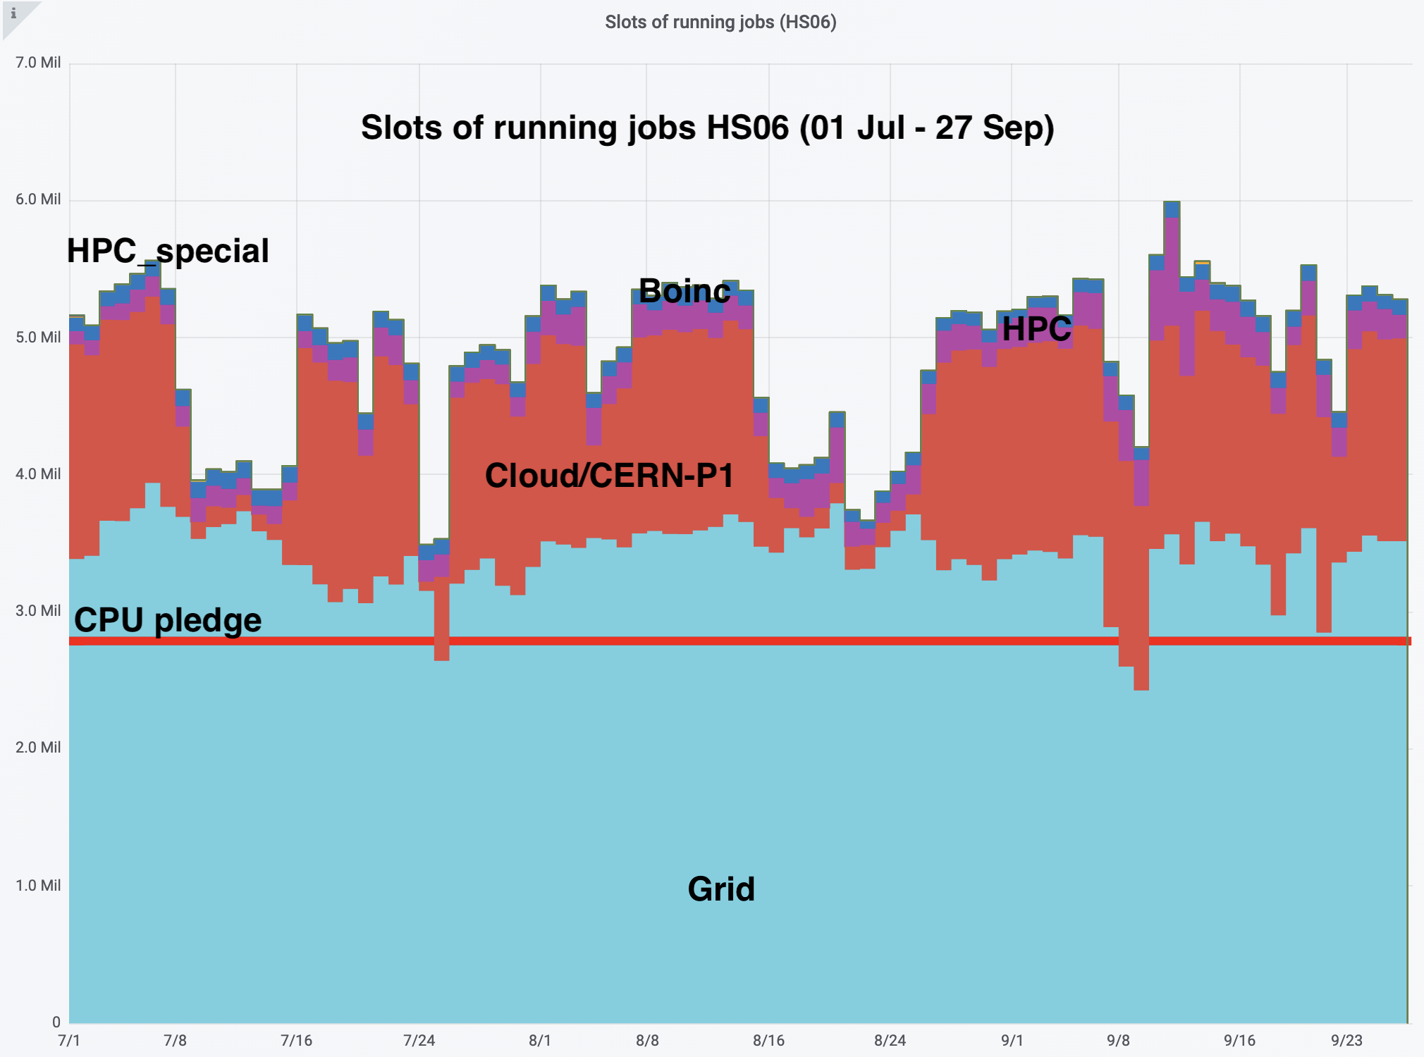
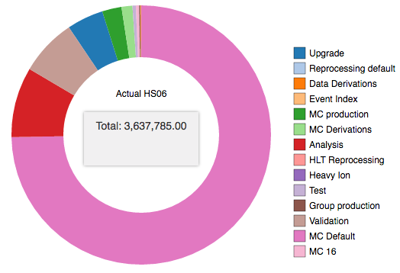
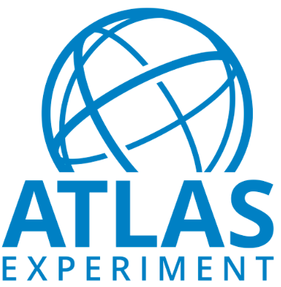
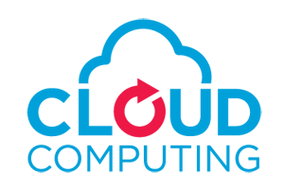
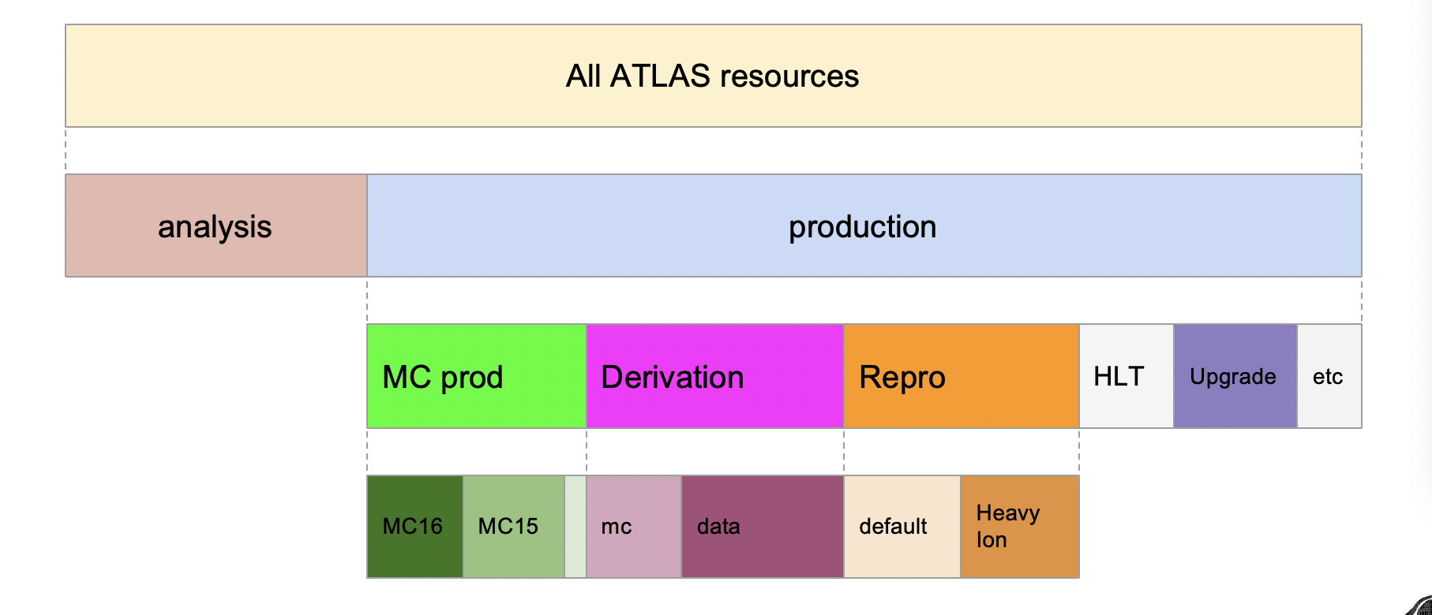
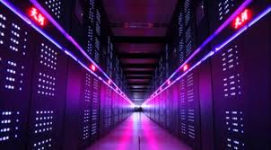
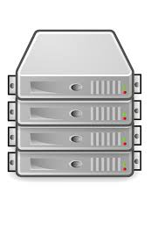
Workflow and Workload Management. ProdSys2/PanDA
Global ATLAS operations
Up to ~1.2M concurrent jobs
25-30M jobs/month at >250 sites
~1400 ATLAS users
Information
System
Physics Group
production requests
Distributed Data
Management
Meta-data handling
CRIC
Orchestrate all ATLAS
Workflows :
MC Production
Physics Groups WF
Data reprocessing
T0 spill-over
HLT processing
SW validation
User’s analysis
ART
AMI
Rucio
WFM
WMS
pyAMI
DEFT DB
PanDA DB
ProdSys2/ DEFT
Requests,
Production Tasks
JEDI
PanDA server
Tasks
Tasks
Jobs
Shares/priorities
Analysis tasks
Jobs
harvester
ATLAS
production requests
pilot
harvester
harvester
harvester
Pilot scheduler
ARC interface
ARC interface
condor-g
pilot
pilot
pilot
pilot
HPCs
OSG
NDGF
EGEE/EGI
Worker nodes
Support rich harvest of heterogeneous resources. Integrate WF and data flow
Workflows in ATLAS beyond PanDA : prompt data processing (T0), HLT, local physics analysis

Slide 4
 | CRIC | PanDA | Rucio | BigPanDA Monitoring
ATLAS | x | x | x | x
Belle II |  |  | x
CMS | x |  | x
COMPASS |  | x |  | x
DUNE | x |  | x
NICA | x | x | x | x
SKA | x |  | x
Vera Rubin |  | x | x | x
X - in production
X - selected
X - evaluation is in progress
X - ongoing discussion
PanDA, CRIC and BigPanDA monitoring in 2014-18
nEDM
BlueBrain
USQCD
BioEngineering
Molecular Dynamic

Slide 5
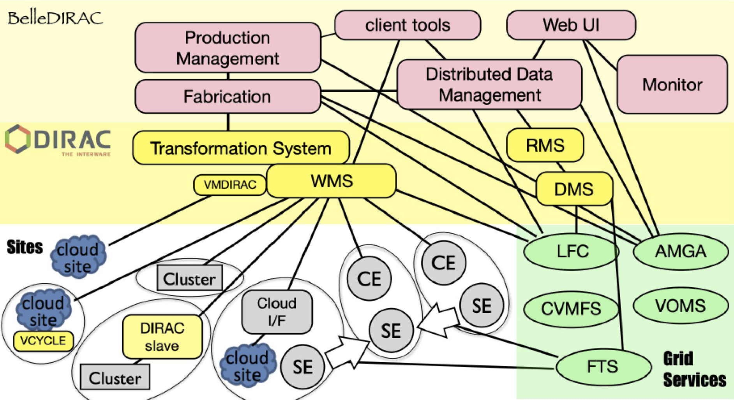
Belle II Distributed Software at BNL
Belle II Production System
N/A
N/A
Rucio
DIRAC is a distributed service, BNL owns and runs DDM, most BelleDIRAC expertise and the main BelleDIRAC services are at KEK

Slide 6
Belle II Distributed Software at BNL
DIRAC != BelleDIRAC
DIRAC is a toolkit to cover the basics, the KEK team wrote the BelleDIRAC extension to implement Belle II specific workflows for data and MC sim/reco/skimming + analysis tools
DDM is owned and run by BNL, moving to Rucio worked out well
Focus of BNL-Belle II effort is BelleDIRAC-DDM, not on vanilla DIRAC, though positive side-effects will come for both communities
Our expertise is in Rucio and BelleDIRAC-DDM, not core DIRAC!
Other thoughts and experience on DIRAC:
DIRAC has good community support, documentation and mailing lists, but remember DIRAC != BelleDIRAC
DIRAC configuration has a nice GUI, in practice getting an instance of BelleDIRAC up and running from scratch took weeks as dependencies are not well (at all) handled, configuration is complicated
In-house support is really critical here !!

