Slide 1
Updated proposal:
Precise measurements of very forward particle production at RHIC
-- RHICf experiment --
Yoshitaka Itow
(KMI/STEL, Nagoya University)
for the RHICf Collaboration

Slide 2
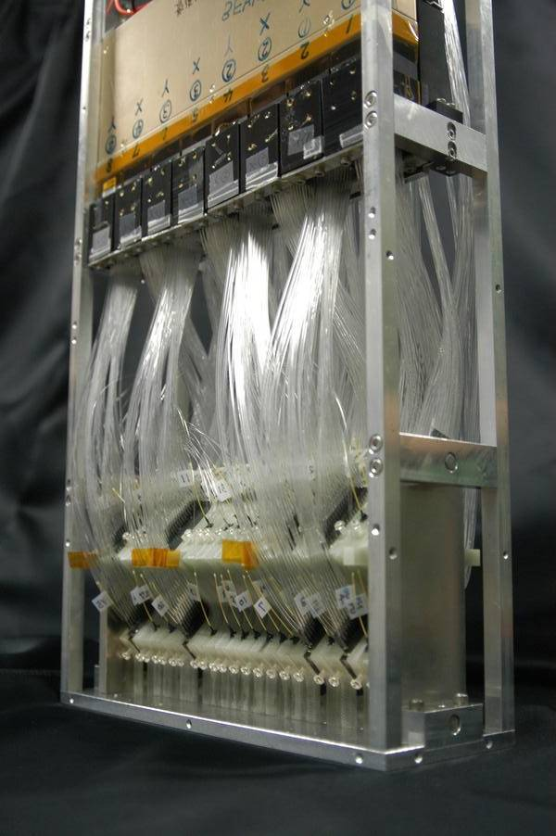
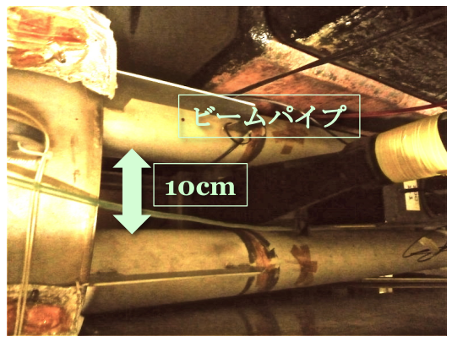
RHICf: neutral particle measurement at zero-degree of RHIC by a dedicated small calorimeter
LHCf detector
η>5.8
RHICf
p
18m
LHCf calorimeter
Front counter
Existing ZDC
29 cm
9 cm
IP
Beam pipe
Neutral particles
Manipulator

Slide 3
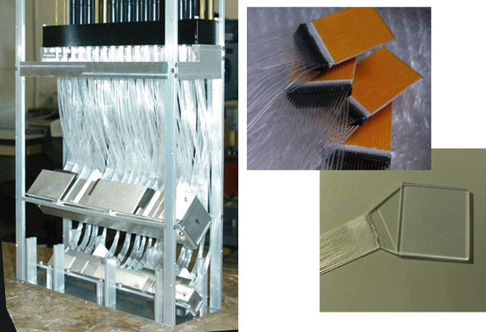
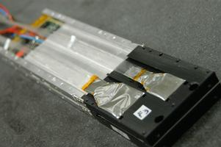
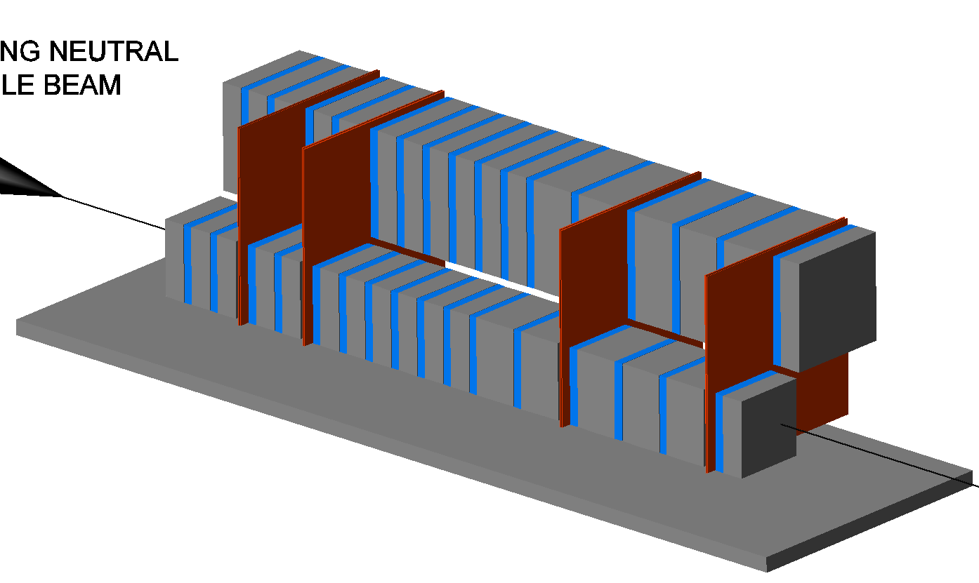
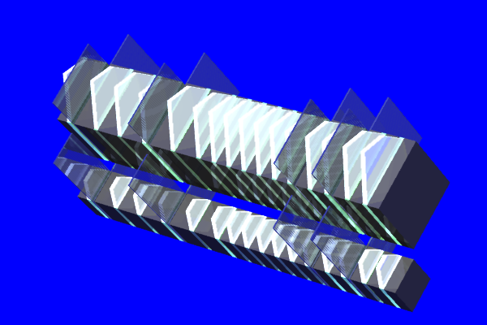
The LHCf detectors
Here we assume to use Arm2
Arm2
Arm1
44X₀,
1.6 λ_{int}
16 tungsten + pl.scinti. layers
25mmx25mm+32mmx32mm
4 Silicon strip tracking layers
16 tungsten + pl.scinti. layers
20mmx20mm+40mmx40mm
4 SciFi tracking layers

Slide 4
The RHICf Collaboration
Y.Itow, H.Menjo, T.Sako
  Nagoya University (Japan)
K.Kasahara, T.Suzuki, S.Torii
  Waseda University (Japan)
O.Adriani, L.Bonechi, R.D’Alessandro
  INFN/University of Firenze (Italy)
A.Tricomi
  INFN/University of Catania (Italy)
Y.Goto
  RIKEN/RIKEN BNL Research Center (Japan)
K.Tanida
  Seoul Natioanl University (Korea)

Slide 5
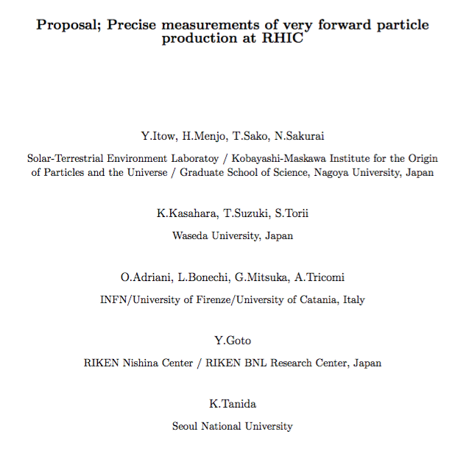
History
2011 First discussion
2013 LOI
2014 Proposal for RUN16 with PHENIX
2015 Proposal for RUN17 with STAR

Slide 6
Outline of the proposal
(original last year => update this year)
Physics motivations:
  To understand CR air shower interaction in a wide range of √s, combining also the results at LHC
  Precise measurements of spin asymmetry of forward particles
Technical issues:
  To install position sensitive electromagnetic calorimeters in front of one of the PHENIX STAR ZDCs using one of the existing LHCf detectors after the LHC 13TeV run (2015)
Beam conditions:
  510 GeV polarized p+p collisions with β*=10m
  1 day for physics and 1 day for contingency
  1-5 days for beam setup depending on the previous mode
  => 2 days in case of switching from 510GeV p+p small β*
  Data taking in RUN16 => RUN17

Slide 7
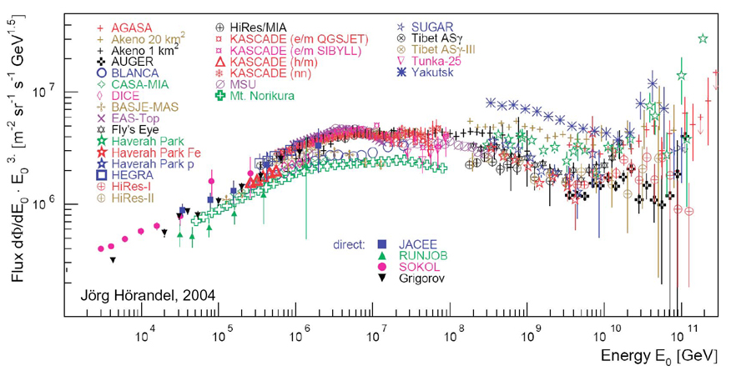
Motivation : cosmic ray interactions
TibetAS
HAWC
HEAT
AUGER, TA
Air shower
TALE
GZK
Knee
2nd Knee?
Ankle
0.5
7
14TeV
0.2
0.9
2.2
Colliders
Cosmic rays
10¹⁴
10¹⁷
10²⁰
eV
Need dedicated very forward measurement at hadron colliders
So far LHCf measured pp (7, 2.76, 0.9 TeV) and p-Pb(5TeV/n)
RHIC data at the low end is important for extrapolation to 10²⁰eV
RHIC can serve p-LI or LI-LI collisions ( LI: light ion, ex, Nitrogen).

Slide 8
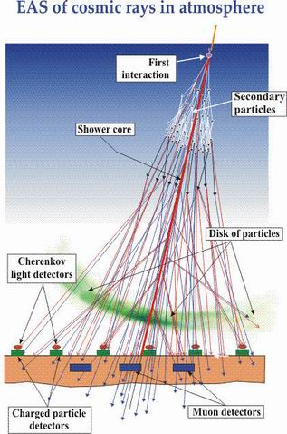
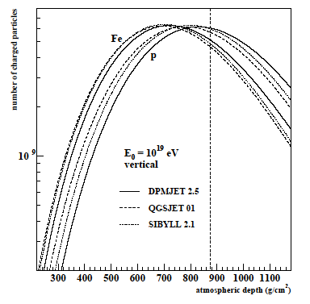
① Inelastic cross section
(TOTEM and others)
② Forward energy spectrum
( LHCf γ /π⁰ spectrum)
⑤ 2ndary interactions
(√s dependence )
③ Inelasticity k= 1-p_{lead}/p_{beam}
(LHCf forward neutron, n / γ ratio )
④ Nuclear effect
(shadowing, Cronin effect)
Composition error
SD E-scale error
#of particles
Atm. depth

Slide 9
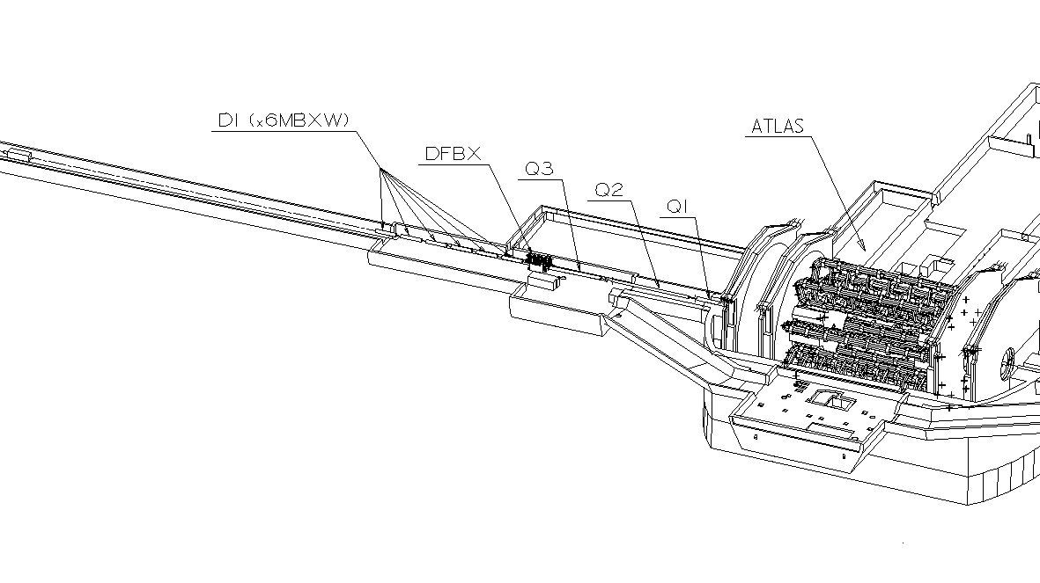
The LHC forward experiment
LHCf Arm#1
ATLAS
Two independent detectors at either side of IP1 (Arm#1, Arm#2 )
140m
Beam
Beam pipe
Charged particles (+)
Neutral
particles
96mm
LHCf Arm#2
Charged particles (-)
All charged particles are swept by dipole magnet
Neutral particles (photons and neutrons) arrive at LHCf
0 degree is covered ( 8.6 < | η | < infinity )
Carried out at LHC 0.9, 2.76, 7, and 13 TeV p+p and 5TeV p+Pb

Slide 10
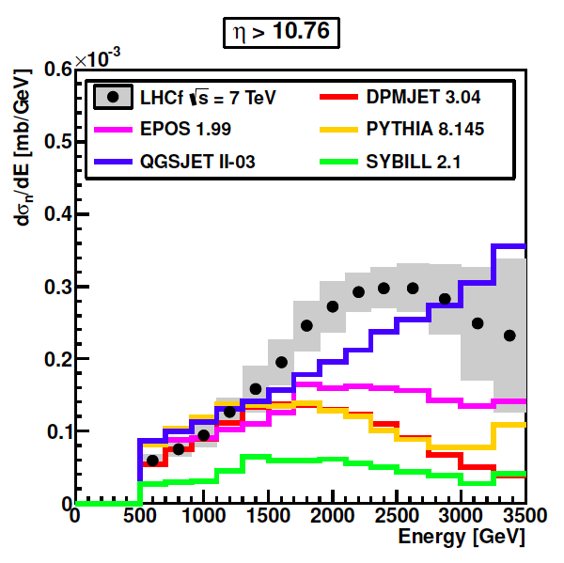
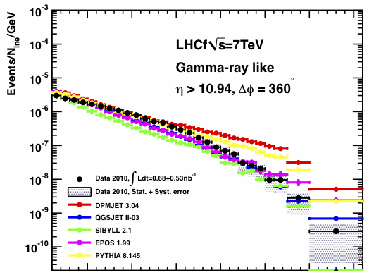
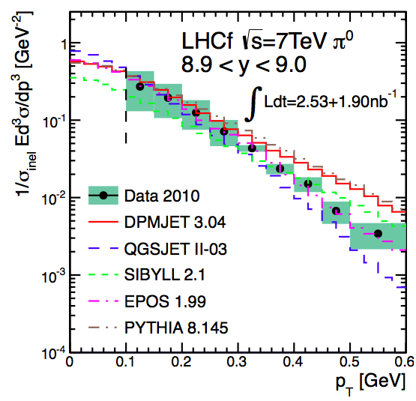
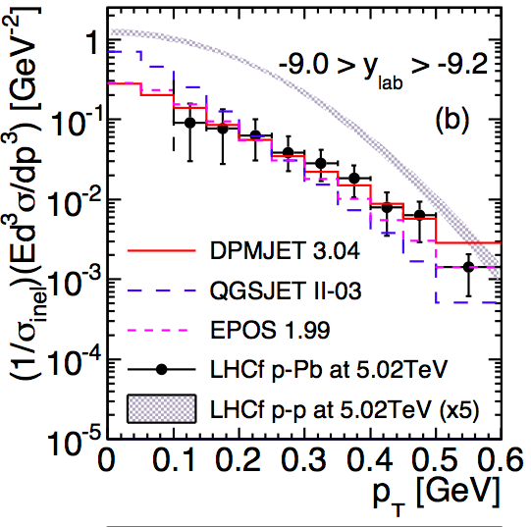
LHCf results summary
7 & 0.9 TeV pp
photon
η>10.94
PLB 703 (2011) 128-134
η> 10.76
PLB 715 (2012) 298-303
Preliminary
7TeV pp
neutron
Submitted PLB
7TeV pp
π⁰
PRD 86 (2012) 092001
5TeV pPb
π⁰
PRC 89 (2014) 065209

Slide 11
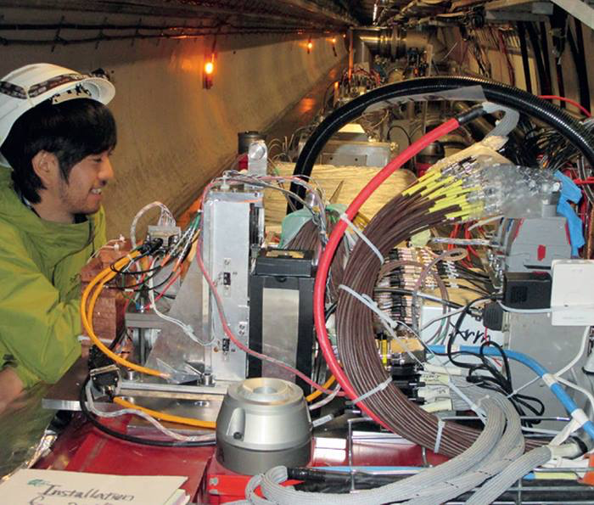
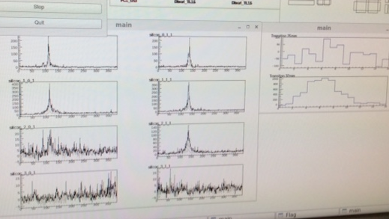
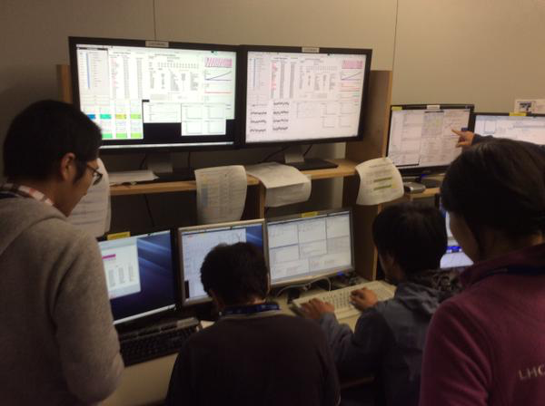
LHCf 13 TeV run (Jun 2015)
Completed data taking last Saturday.
Detectors removed this Monday.

Slide 12
Why RHIC ?
ZDC closer to IP, same PT acceptance as LHC
  RHIC ZDC @ z=18m @500GeVpp,
  LHC ZDC @ z=140m @ 7, 13 TeVpp
Rich experience and opportunity for p-A, A-A
  Understanding nuclear effect in air shower
Polarized proton collisions
  Precise spin asymmetry for forward neutrons
  Probe for forward productions
Feynman scaling in forward region; 0.5 TeV n 7 , 13 TeV

Slide 13
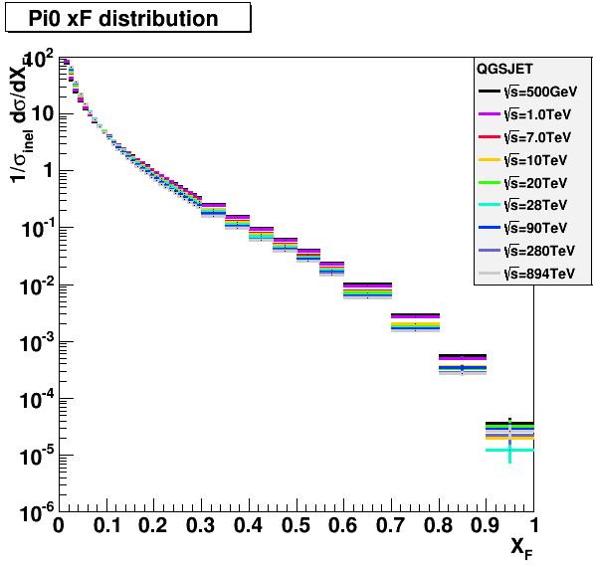
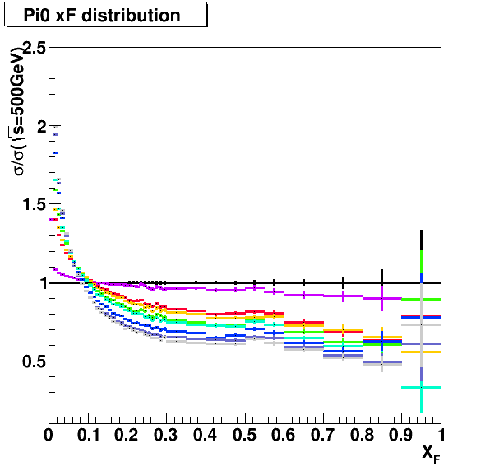
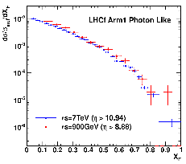
Feynman scaling : a key for extrapolation
Many models naturally include XF scaling violation
Important to extrapolate from LHC to GZK
Impact also on air shower structure； Xmax
LHC single gamma data
(900GeV pp / 7TeV pp)
Expected from models
(5TeV, 14TeV and 50TeV)
Data
Preliminary
0.9TeV (η>8.68)
7TeV scaled (η>10.94)

Slide 14
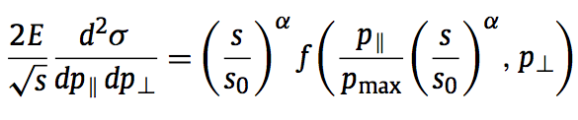
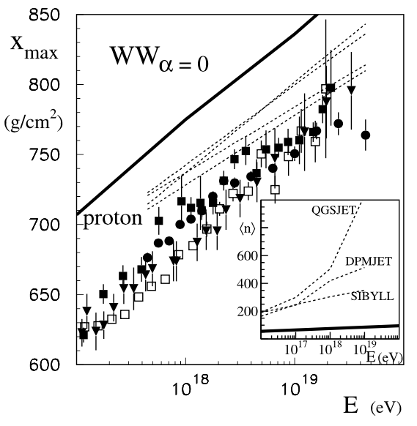
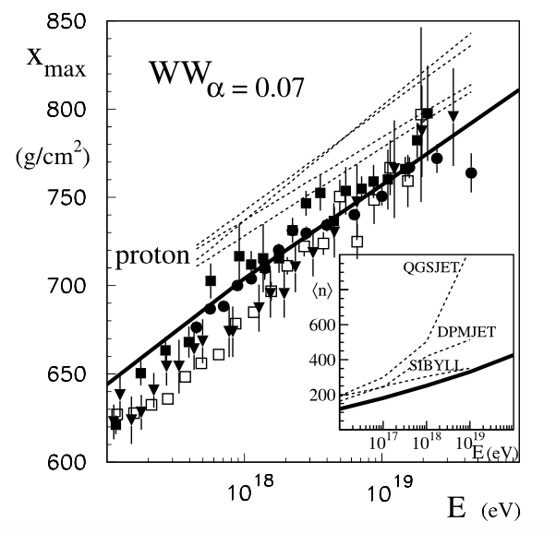
Feynman scaling violation and air showers
T.Wibig, Phys Lett B 678 (2009) 60
α ; scaling violation parameter
Air shower max for UHECR data

Slide 15
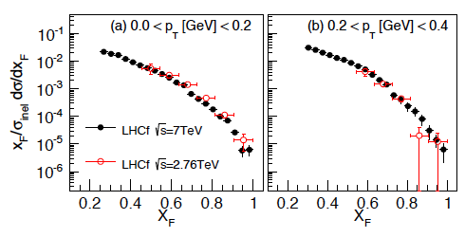
Feynman scaling in π⁰ production
preliminary
preliminary
LHCf π⁰ spectra at √s= 2.76 and 7 TeV (preliminary)
RHICf can add data at √s=510GeV, p_{T}<1GeV/c

Slide 16
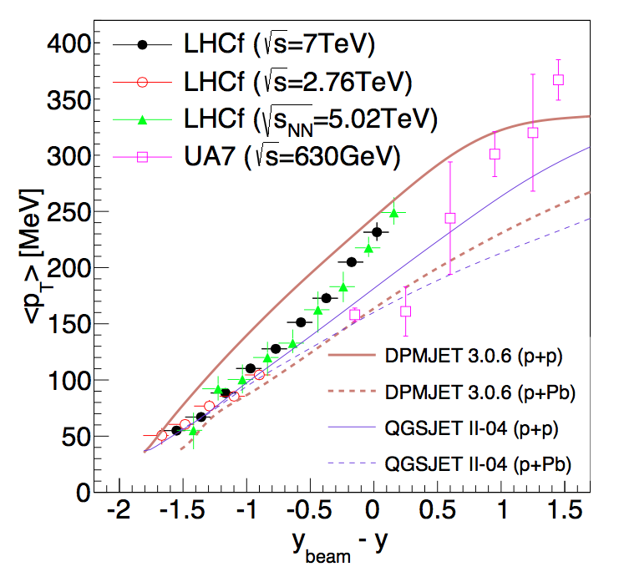
LHCf average P_{T} of π⁰
preliminary
RHICf

Slide 17
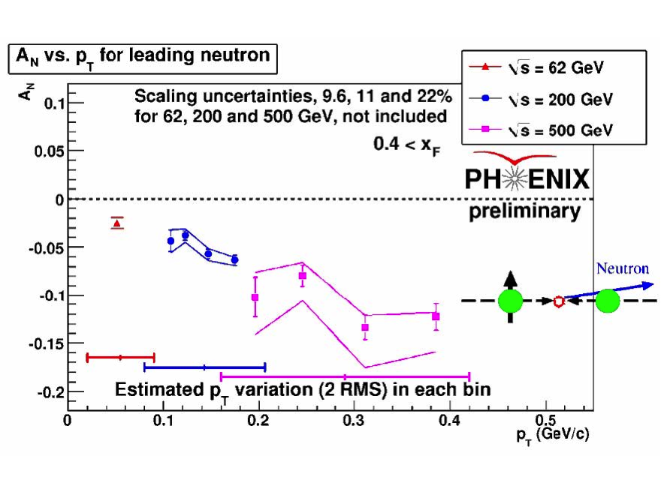
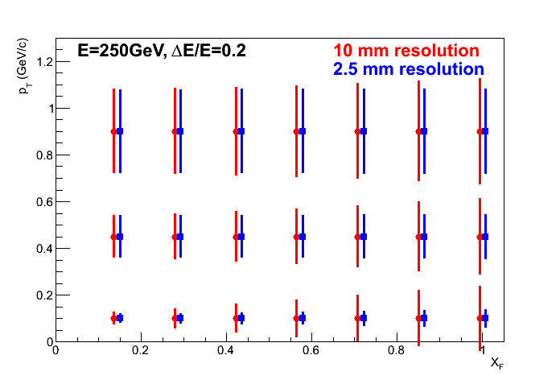
Spin asymmetry of forward neutron
Combination of ZDC (good E_{had} resolution) and RHICf detector (good position resolution) provide good p_{T} resolution in neutron measurements
With horizontal polarization, covering p_{T}<1GeV/c
Notes:
右図改訂版：12時間測定での中性子asymmetry測定。縦軸の統計精度は全て1%以内（絵にしにくいので1%くらいにしてある。楕円横幅は各Ptでの Pr精度を反映。binningは 0.1GeV/cきざみ。1GeVまで拡張可能。）

Slide 18
Impact of “RUN16 to RUN17”
RUN16 500GeV pp with PHENIX is no more possible because of their shutdown for upgrade
  Collaboration with the central detector is important to identify diffractive events
  Important to interface to machine signals and to determine luminosity in established way
  Discussion with STAR started
Availability of LHCf Arm1 and Arm2 detectors can change (we assume Arm2 here)
  LHCf operation at LHC 13 TeV p+p collisions successfully finished and detectors were uninstalled on this Monday
  Re-scheduling impact on future LHCf is being reviewed

Slide 19
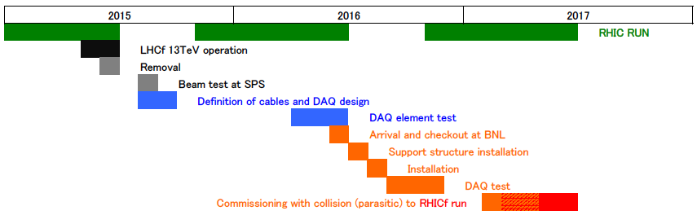
New time line for RUN17
Visit STAR during 2015 summer shutdown to define cabling, support structure and electronics installation
Shipping a LHCf detector from CERN to BNL to be ready in 2016 shutdown

Slide 20
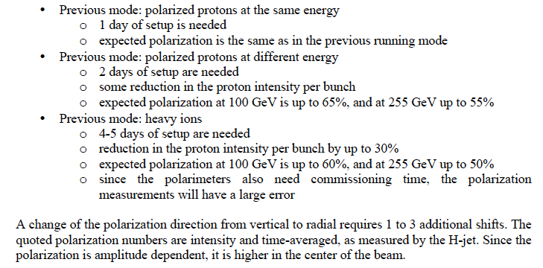
Beam setup time
(from “RHIC Collider Projections (FY2014-FY2018”)
Expected in RUN17
1day for β* setup, 1 day for polarization direction, 1 day for physics + contingency
=> 5 days of dedicated time needed

Slide 21
First discussion with STAR
29-May, 2015
  Presentation of RHICf ideas at the STAR management meeting
Answer from STAR council meeting
  “supportive” to host RHICf
To be discussed
  integration plan, DAQ and common operation
  Extend physics cases integrated with STAR detector
  Authorship, collaboration policy , etc.

Slide 22
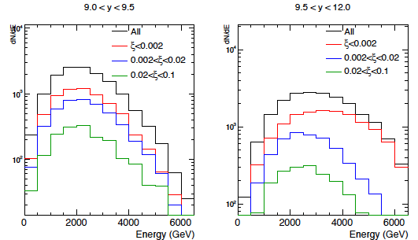
Diffractive mass tagging with a Roman pots
(joint operation with Roman pots)
single diffraction
detection by RHICf
zero degree
determination of ξ by RP
(ξ :fractional momentum loss)
Forward neutron ( PYTHIA8 13TeV pp)

Slide 23
Summary
RHICf : neutral measurement at RHIC zero-degree by one of LHCf detectors.
  Verify cosmic ray interactions at ~10¹⁴eV
  Spin asymmetry for forward (neutral) particles
  Don’t forget nuclear-effect study in p-A
RHICf 500 GeV pp gives similar acceptance as LHC 7 TeV.
  Good verification of Feynman scaling in similar condition with the same detector.
RUN17 with STAR
  Discussion just started. Basically positive.
  Every technical and management issues should be addressed soon.

Slide 24
Backup

Slide 25
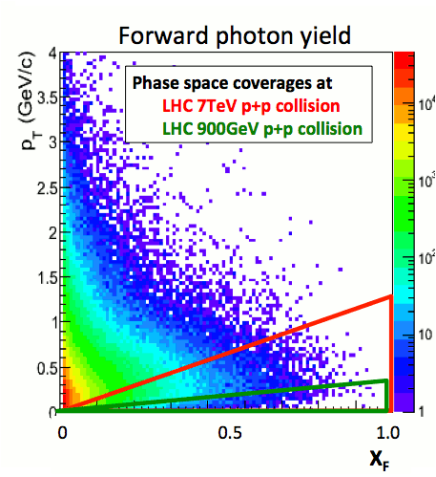
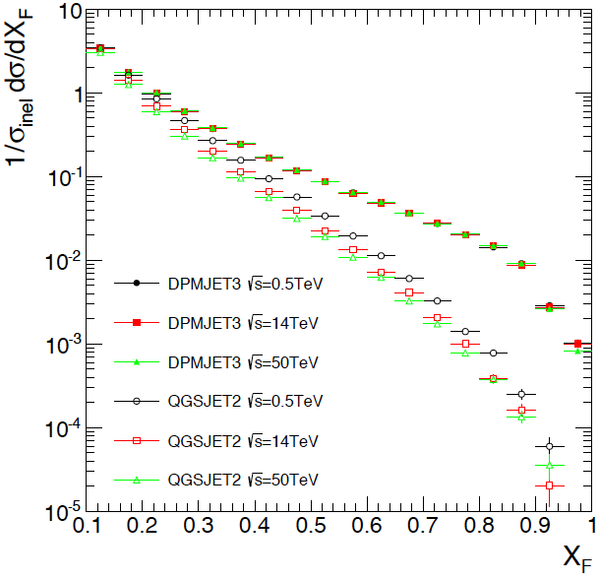
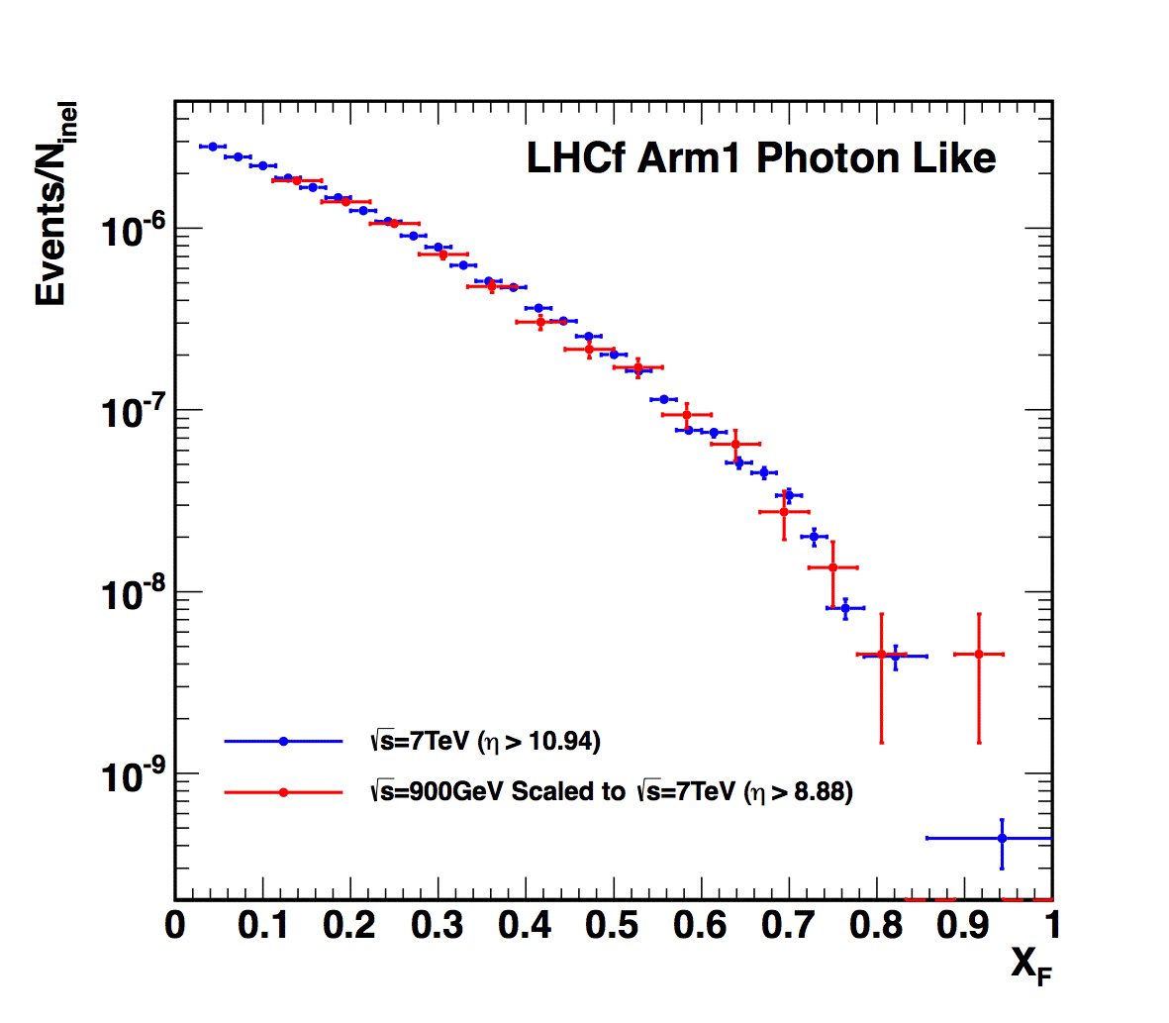
√s scaling : a key for extrapolation beyond the LHC
All π⁰ expected from models
(0.5TeV, 14TeV and 50TeV)
LHCf single photon data
(900GeV pp , 7TeV pp)
DPMJET3
QGSJET II
Preliminary
0.9TeV (η>8.68)
7TeV scaled (η>10.94)
Comparison done in the very limited phase space of 900GeV collisions
(green triangle in the phase space plot)

Slide 26
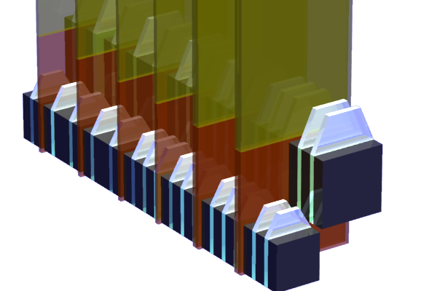
LHCf Arm2 Detector => RHICf Detector
Imaging sampling shower calorimeters
Two calorimeter towers
Each tower has 44 r.l. of Tungsten,16 sampling scintillators and 8 (4XY pairs) silicon strip sensors
Sensitive to photons, neutrons and photons from π⁰
Arm#2 Detector
25mmx25mm+32mmx32mm
4 XY Silicon strip detectors

Slide 27
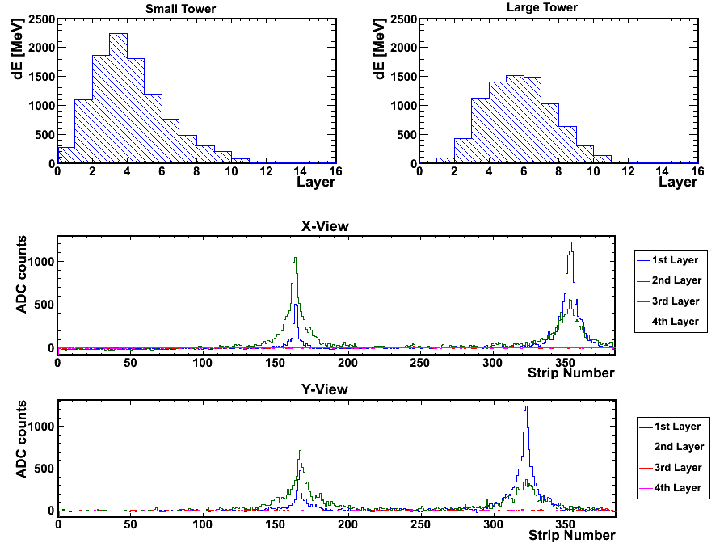
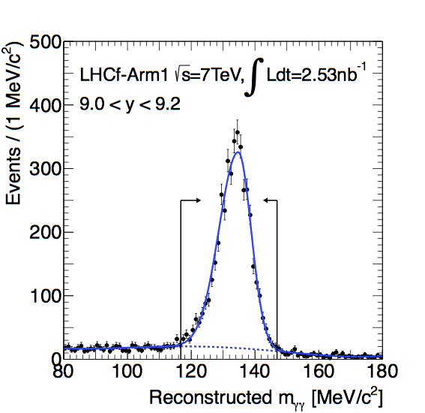
Event sample (π⁰ g 2γ ) at LHC 7TeV p+p
Longitudinal development measured by scintillator layers
25mm Tower
32mm Tower
Total Energy deposit
➔Energy
Shape
➔PID
➔600GeV
photon
➔420GeV
photon
Lateral distribution measured by silicon detectors
X-view
Hit position,
Multi-hit search.
Y-view
π⁰ mass reconstruction from two photon.
Systematic studies

Slide 28
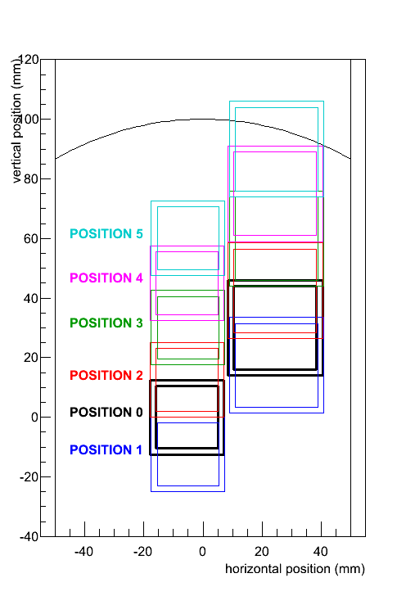
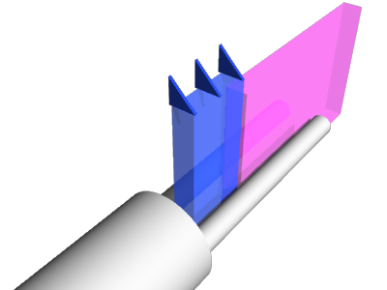
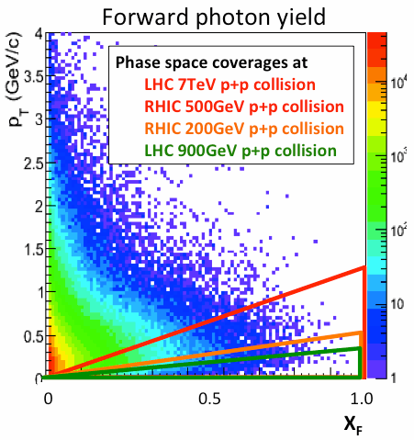
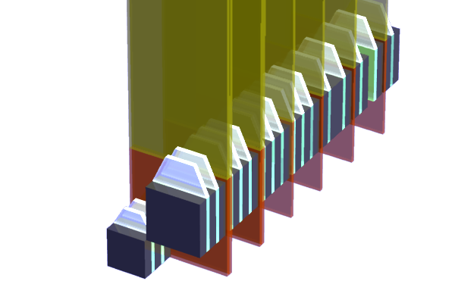
RHICf coverage
Installing the LHCf Arm2 detector at RHIC
limited by
beam pipe
vertically movable
ZDC
p_{T} (GeV/c)
IP
View from IP
Detector is moved up-down; wide p_{T} coverage and to avoid ZDC interference
x_{F}-p_{T} coverage identical to LHC 7TeV collision
Wider coverage and higher resolution in p_{T} than ZDC measurements (joint analysis between ZDC and RHICf)

Slide 29
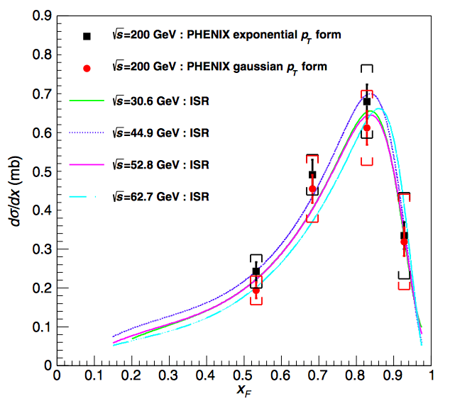
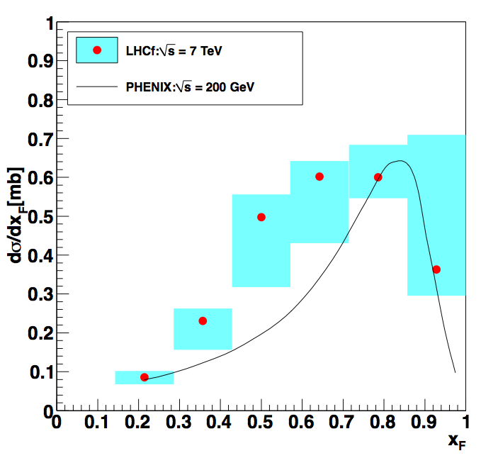
XF scaling of very forward neutron
A. Adare, et al., Phys. Rev. D, 88, 032006 (2013)
K.Kawade PhD thesis (2014)
Preliminary
RHIC PHENIX (200GeV),
ISR (30.6-62.7 GeV)
LHCf 7TeV neutron (Arm1 only)
0<P_{T}<0.11x_{F} GeV/c

Slide 30
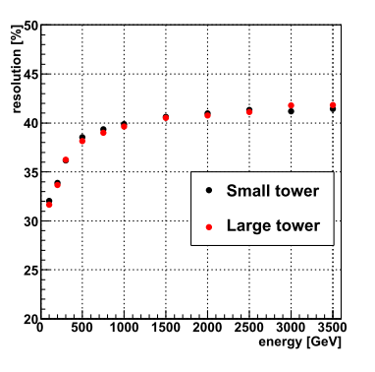
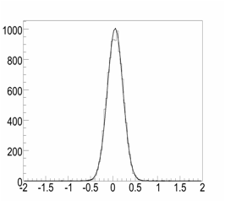
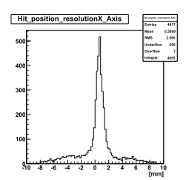
Detector performance
E_{had} resolution
Eγ resolution
4%
100
200
E(GeV)
200 GeV electrons
350GeV protons
σ_{x}=172 μm
Number of event
Position resolution
For hadron, Δx~2.5 mm
x-pos[mm]

Slide 31
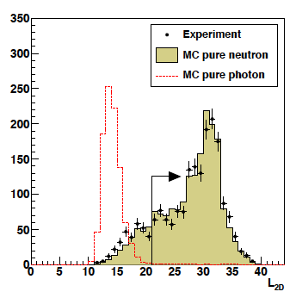
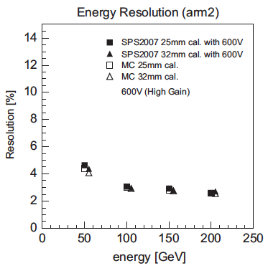
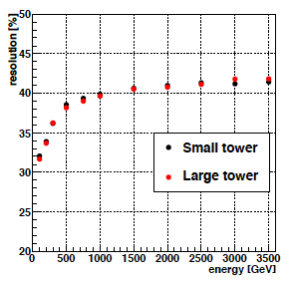
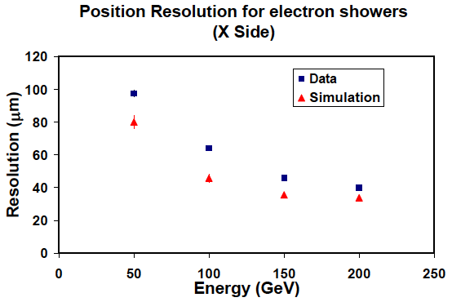

PID (SPS energy)
EM shower (SPS)
NIM, A671 (2012) 129-136
JINST, 5, P01012, 2010
Hadronic shower (LHC MC)
JINST, 9, P03016 (2014)
energy resolution (%)
energy resolution (%)
position resolution (μm)
position resolution (mm)

Slide 32





Hadron shower reconstruction
Check by SPS 350GeV p beam

Slide 33

LHC impact on UHECR air showers
UHECR MC (EPOS, QGSJET II) tuned by LHC data now
Shower max diff. improved ( 50 -> 20gcm² ), c.f. 100gcm² btw p - Fe
But yet LHCf results not fully implemented (due to its difficulty)
Another missing piece -> Nuclear modification factor
EPOS
0g/cm²
QGSJET-II
Xmax
T.Pierog, S.Ostapchenko,
ISVHECRI2012
10¹⁷
10²⁰
Notes:
----- 会議メモ (2014/06/17 13:26) -----
LHC data
Xmaxのポンチ絵
Energyを大きく

Slide 34

Expected Results (single photons)
6.26<η<6.49
6.87<η<7.40
7.40<η<7.83
8.27<η
Photon spectra at 4 rapidity samples
12 hours statistics (12 nb⁻¹ effective luminosity; 360nb⁻¹ delivered)
Statistical error is almost negligible except at the highest energy bins

Slide 35

Expected Results (single neutrons)
6.26<η<6.49
6.87<η<7.40
7.40<η<7.83
8.27<η
Neutron spectra at 4 rapidity samples
12 hours statistics (12 nb⁻¹ effective luminosity; 360nb⁻¹ delivered)
RHICf resolution not considered; true spectra
Statistical error is almost negligible

Slide 36

Expected Results (single neutrons)
6.26<η<6.49
6.87<η<7.40
measured energy
(resolution folded)
7.40<η<7.83
8.27<η
Neutron spectra at 4 rapidity samples
12 hours statistics (12 nb⁻¹ effective luminosity; 360nb⁻¹ delivered)
RHICf resolution taken into account, but ZDC joint analysis not considered
Statistical error is almost negligible

Slide 37

Expected Results (π⁰)
6.04<y<6.16
6.36<y<6.70
6.70<y<6.88
7.25<y<7.62
π⁰ spectra at 4 rapidity samples
<60GeV not detectable due to large opening angle of γγ
24 min statistics (12 nb⁻¹ effective luminosity; 12 nb⁻¹ delivered)
Statistical error will be negligible with a reasonable run time

Slide 38

Requested Beam Condition

Slide 39



Scaling violation and Air shower
(on going study)
DPM Original
DPM modified
Artificial scaling-violation function applied to DPMJET3 (perfect scaling model)
e+/- size
500GeV
7TeV
1TeV/500GeV
7TeV/500GeV
28TeV/500GeV
:
μ size
QGSJET II-04 π⁰
proton shower 10¹⁸eV

