Slide 1
Welcome to bi-weekly
Heavy Flavor Topical Group meeting
Jin Huang
Brookhaven National Lab
Hideki Okawa
Fudan University

Slide 2
General Information
MDC1 analysis on going: more in Cameron’s talk
  https://wiki.bnl.gov/sPHENIX/index.php/Heavy_Flavor_Topical_Group_Mock_Data_Challenge_1
  Thanks to all the nice studies done so far: Zhaozhong Shi (MIT), Ming Liu (LANL), Han sheng Li (Purdue), Sourav Tarafdar (Vanderbilt), Sebastian Tapia Araya (ISU), Dan Lis (UColorado)
  First set of plot as public note sPH-HF-2021-001: https://indico.bnl.gov/event/11336/
Full list of topics: https://wiki.bnl.gov/sPHENIX/index.php/Heavy_Flavor_Topical_Group#Study_plans
Recent HFTG status reports:
  Hugo Pereira da Costa at APS GHP (Apr. 13 16, 2021): https://indico.jlab.org/event/412
  10th sPHENIX Collaboration Meeting : https://indico.bnl.gov/event/10568/
  BUP (sPH-TRG-2020-001): https://indico.bnl.gov/event/9301/
Upcoming conference
  Yasser will give plenary talk SQM 2021 (May 17 22): https://indico.cern.ch/event/985652/

Slide 3
MatterMost
Lots of discussions are ongoing on Mattermost! Please join the topics you are interested in. We can also create a new group if your topic is not there yet.
  MDC1: https://chat.sdcc.bnl.gov/sphenix/channels/hf-mdc1
  Lc: https://chat.sdcc.bnl.gov/sphenix/channels/hf-lc
  HF triggering : https://chat.sdcc.bnl.gov/sphenix/channels/hf-track-trigger
  HF jet track counting tagger: https://chat.sdcc.bnl.gov/sphenix/channels/hf-jet-tc-tagger
  D⁰: https://chat.sdcc.bnl.gov/sphenix/channels/hf-d0
  Bs: https://chat.sdcc.bnl.gov/sphenix/channels/hf-bs
  D-D correlation: https://chat.sdcc.bnl.gov/sphenix/channels/hf-d0d0
  KFParticle: https://chat.sdcc.bnl.gov/sphenix/channels/kfparticle
  (related) Tracking software: https://chat.sdcc.bnl.gov/sphenix/channels/tracking-software
  (related) Tracking QA: https://chat.sdcc.bnl.gov/sphenix/channels/tracking-qa

Slide 4
MDC1 sample need some fix
Sebastian and Cameron pointed out the truth tracing was recently broken after tracking team updated the tracker IO object [ link to pull request ]
This is a serious problem that require reformat MDC1 output file to be compatible with new tracker IO object
  Pending on 2nd update [link to pull request] on tracker IO objects to run the reformat.
  This fix should avoid future problem of same kind [by “versioning” IO objects]
For now (next few weeks), we have to rely on archival build to read the truth association in the MDC1 HF production output
  For example, the ana.242 build on Mar 27 still works
  source /opt/sphenix/core/bin/sphenix_setup.sh -n ana.242

Slide 5
Special topic 1:
Beam use proposal - the 2021 version

Slide 6
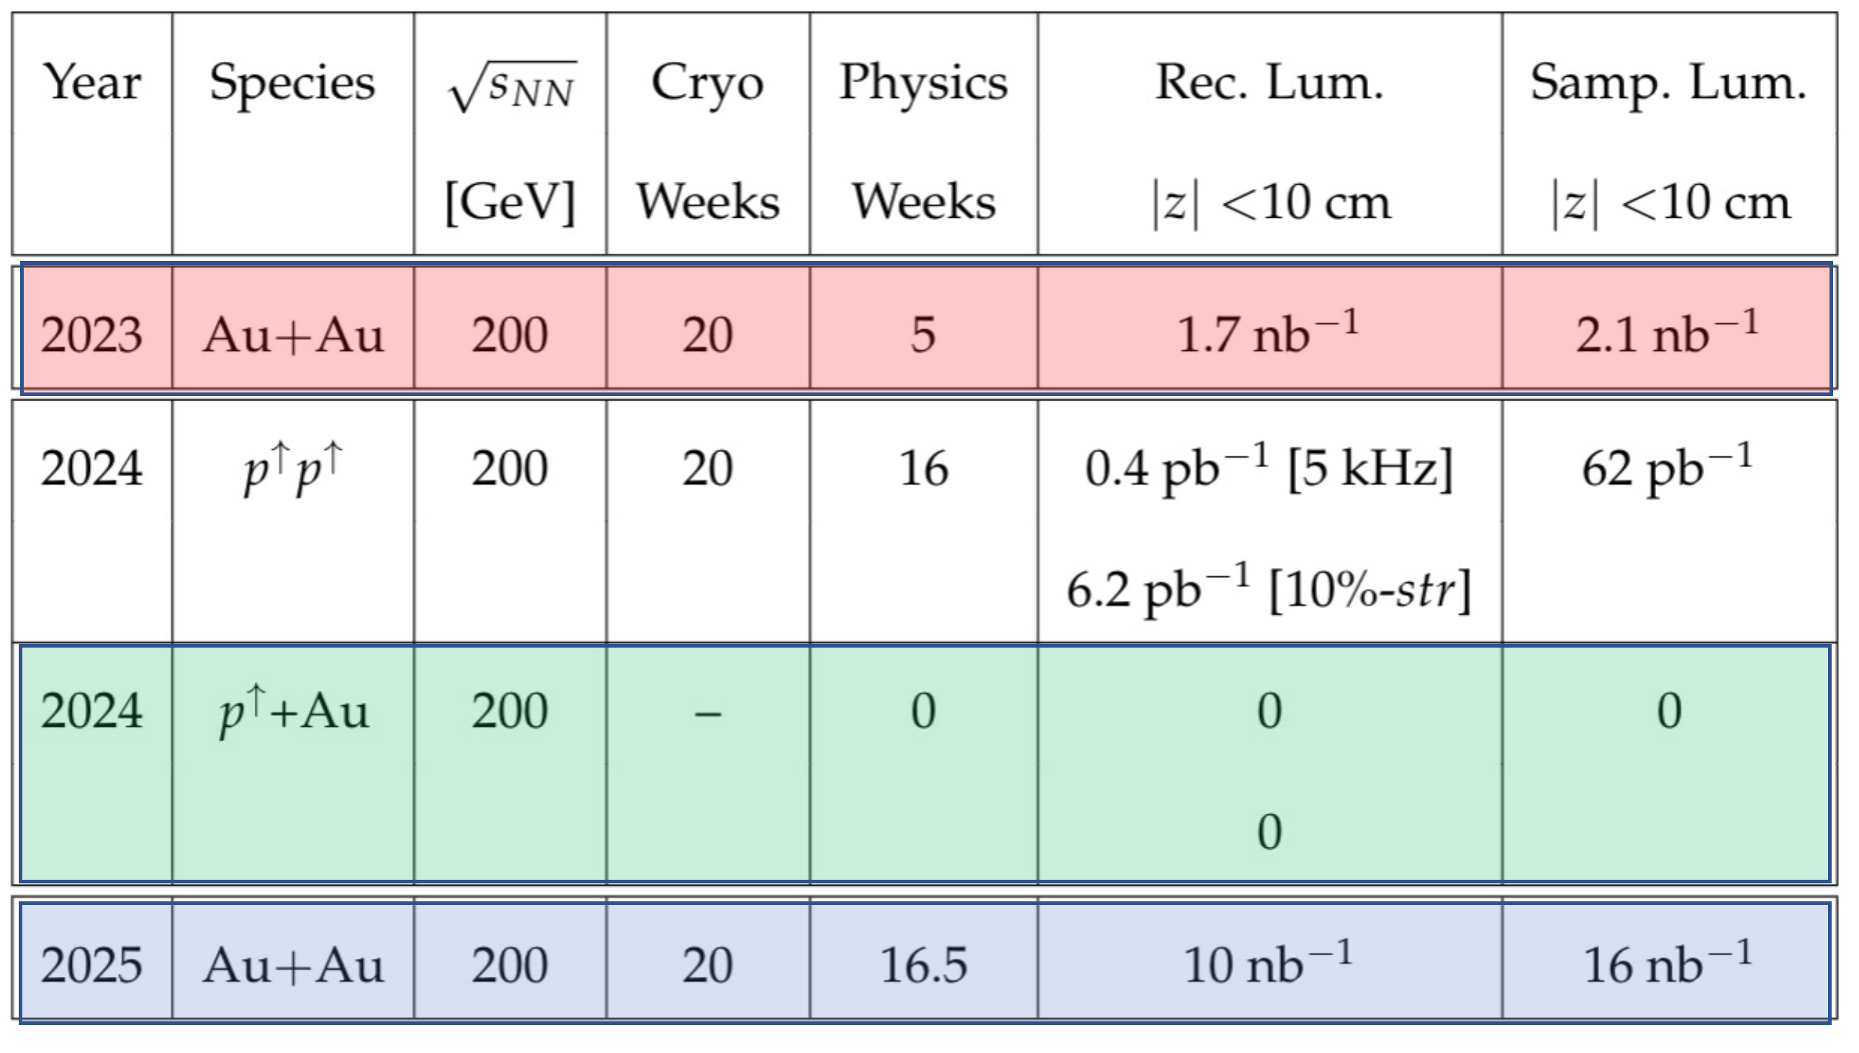
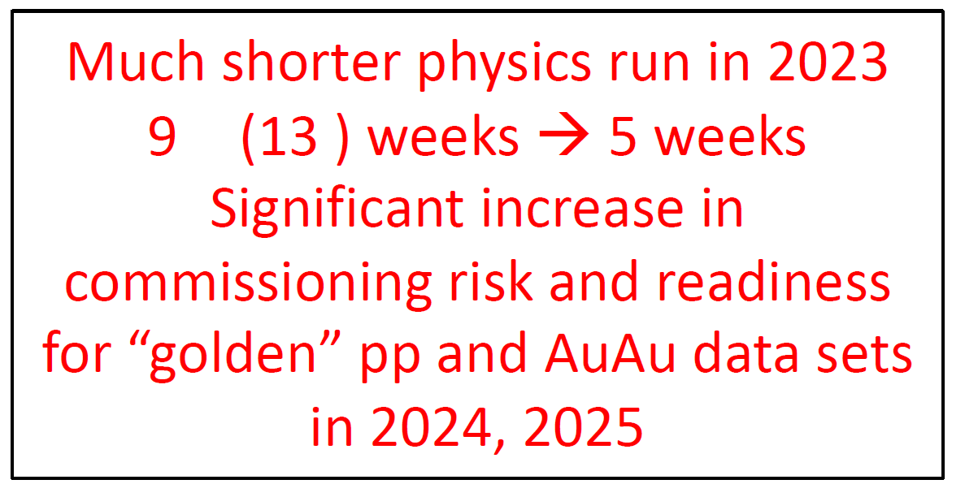

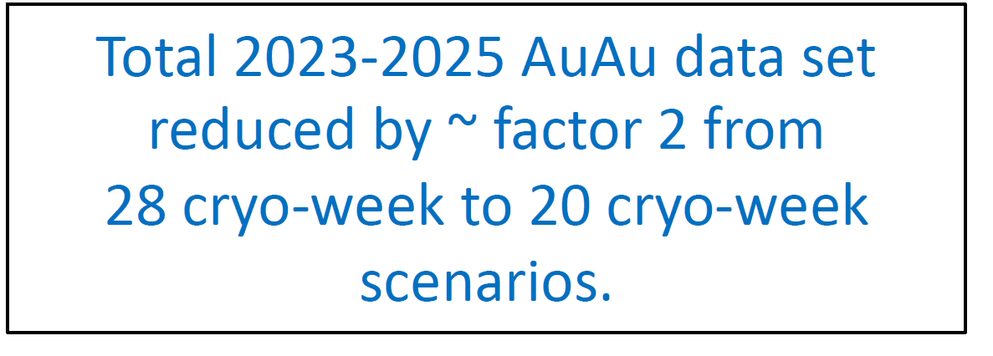
Beam use proposal 2021 version
sPHENIX BUP Task Force preparing addendum of the BUP2020 [sPH-TRG-2020-001]
Deadline for submission is May 30, 2021 for PAC meeting is June 22-23, 2021
Interim ALD Charge in 2021: sPHENIX BUP for 2023, 2024, 2025 for 20 & 28 cryo-weeks each
Focus: argue for 28 week run and 20-week runs would be not cost effective
Looking for TG input!
What 20-week runs would imply to the run plan?

Slide 7
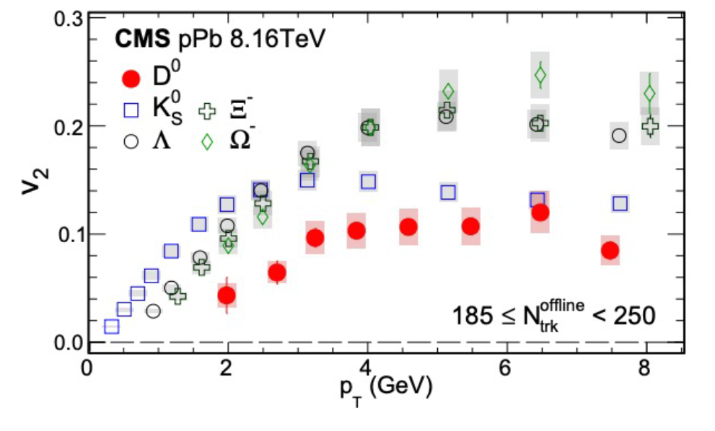
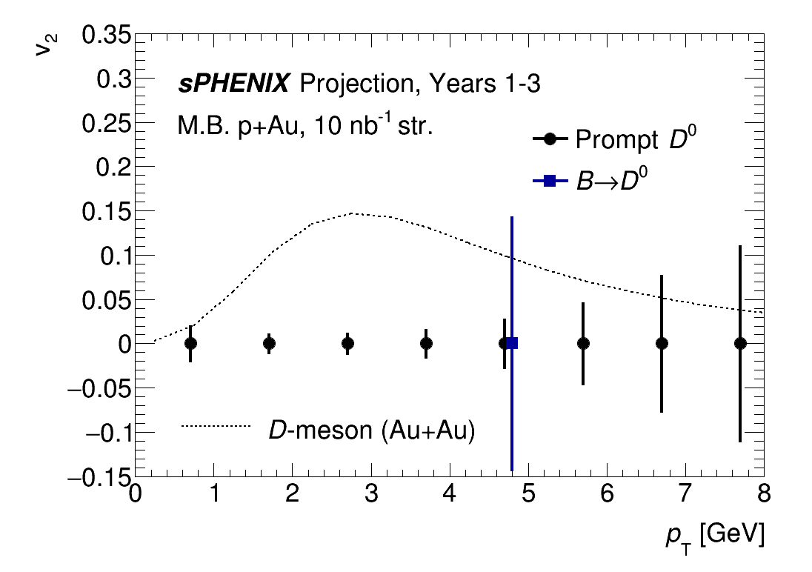
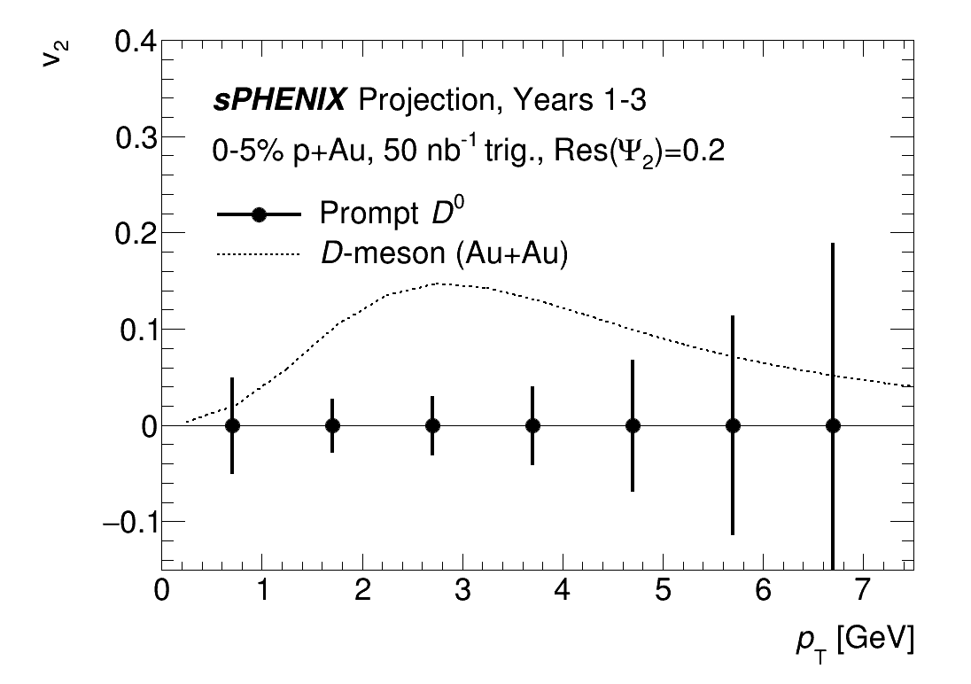
HF consideration 1: loss of pA physics
If have pA: do we see HF small system flow in central pA?
Likely good stat. for prompt D. Non-prompt D would be challenging but we could further look at B->HF-e channel
Projection assumed identical S/B for pA as in AA 60-80% from sPH-HF-2017-002

Slide 8
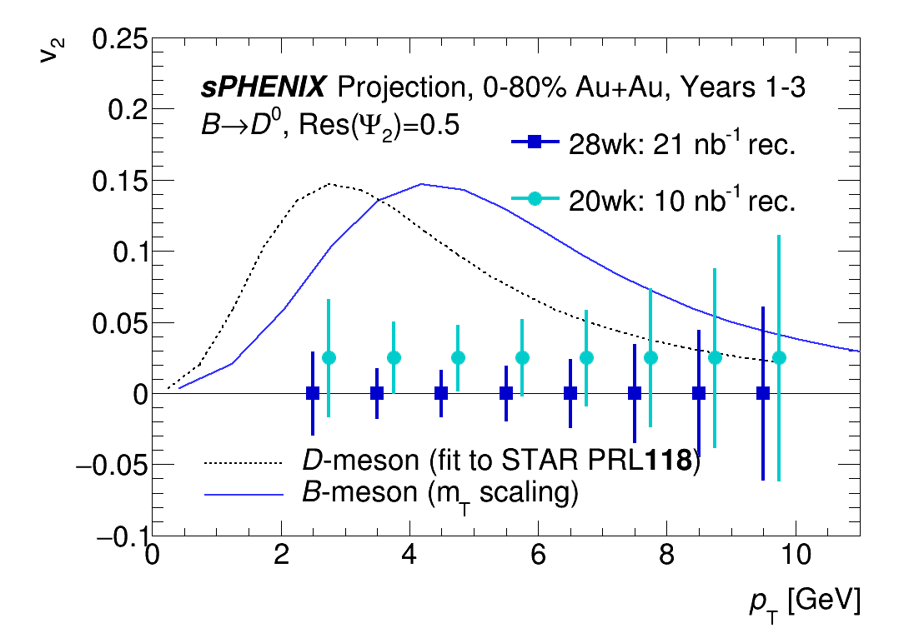
HF consideration 1: AuAu statistics
If AuAu statistics is halfed due to 20week runs, stat. hungry channel such as B->D v2 would see reduced impact
Projection based on scaling of statistical significance from [sPH-HF-2017-002, sPH-TRG-2020-001]

Slide 9
Special topic 2:
Please participate sPHENIX working group reorganization brainstorming
Thanks to Ming Liu for bringing up this topic to highlight today!

Slide 10
Email from the co-spokespersons:
As we get closer to the commissioning and data taking period we should continue the evolution of the collaboration structure, e.g., in terms of physics groups, overall physics coordination, physics object reconstruction, etc etc.
We would like to call a meeting on Fri, May 7, noon-2PM (*) to start this discussion. As many of you have experience both in the sPHENIX TGs and in other experiments, we look forward to suggestions on ideas and best practices sPHENIX should consider for its overall physics enterprise…. In particular, we look for input from the younger members of the collaboration
Some obvious topics to think about:
  What is the right number of physics/topical groups (PAGs in CMS jargon)?
  Which topical groups should be added/subtracted/merged?
  Should there be "physics object groups" (POGs in CMS jargon) responsible for objects like e.g., jets, e/gamma, tracks, centrality, HF?
  Do we need a formal mechanism coordinating the physics effort (e.g., CMS "Physics coordination" incl. PAG and POG conveners)? how should that operate?
  Should there be Physics Co-Coordinators? Number, term, charge?
  What is the mechanism for forming an author team?
  ....
In particular, we look for input from the younger members of the collaboration, but also from collaborators who served in leadership roles in the physics organizations of other RHIC collaborations and the LHC experiments.

Slide 11
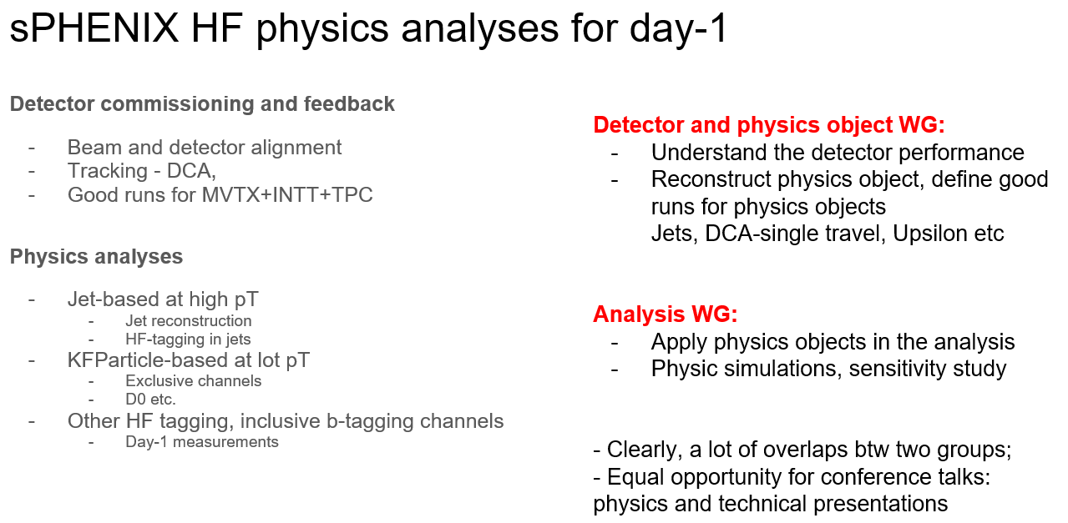
Participation of the brain storming
Inputs will be on individual level. Good to see many in HF TG to participate!
Thoughts from Ming,
Thanks for sharing!

Slide 12
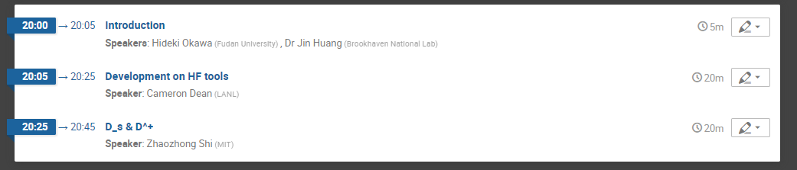
Today’s agenda:

Slide 13
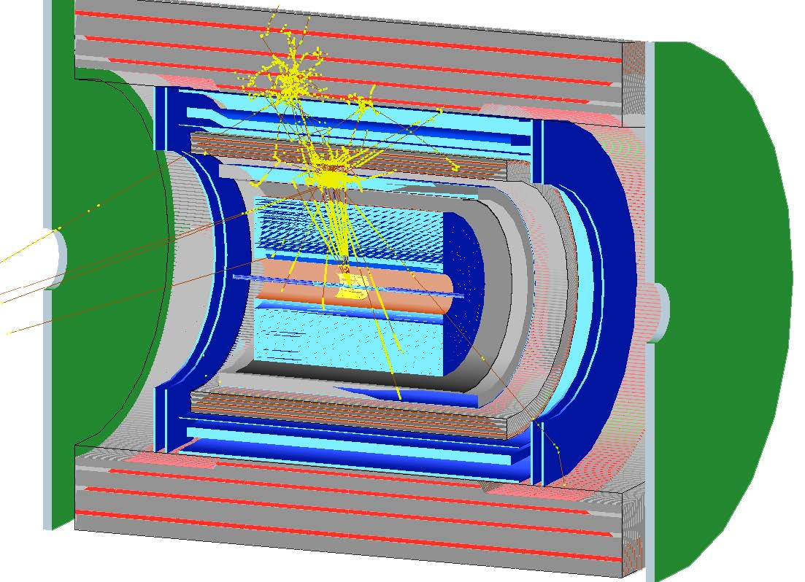
Extra information
b-jet, E_{T}~30GeV

Slide 14
Continue HF simulation sample with MDC1 setup
Taking advantage of MDC1 setup, continue producing high priority sample for HF TG
  Pending the tracking IO object fix as in the last slide
MB p+p background sample (thanks to suggestions from last TG meeting)
  Consider reweighted x-section with q^hat or q^hat binning to help building stat. into high pT/inv mass bins
  Start with 50M events (should be fraction time used in MDC1)
Pythia jet samples for pp will be produced this year.
  Inclusive : 10M
  c jets : 1M
  b jets : 1M

