Slide 1
SPHENIX bi-weekly
May 6 2015

Slide 2
I/O List valvebox and solenoid cryostat
ID
TAG | PREFIX/LOCATION | VARIABLE TYPE | DESCRIPTION | TYPE | SUBSYSTEM
HT70 | HELIUM PIPE | TEMPERATURE | HT70 SHIELD OUTLET PT103 | PT RTD | VALVEBOX
HT81 | HELIUM PIPE | TEMPERATURE | HT81 LIQUID HELIUM SUPPLY | ? | VALVEBOX
HT90 | HELIUM PIPE | TEMPERATURE | HT90 SHIELD OUTLET | ? | VALVEBOX
HTCLA | HELIUM PIPE | TEMPERATURE | HTCLA CURRENT LEAD FLOW EXIT | THERMOCOUPLE | VALVEBOX
HXCLB | HELIUM PIPE | TEMPERATURE | HXCLB CURRENT LEAD FLOW EXIT | THERMOCOUPLE | VALVEBOX
CT01 | CYLINDER MANDREL | TEMPERATURE | CT01 CYLINDER 180 L.U. CLTS-2B | CLTS2B | SOLENOID
CT02 | CYLINDER MANDREL | TEMPERATURE | CT02 CYLINDER 180 L.O.U. CLTS-2B | CLTS2B | SOLENOID
CT03 | CYLINDER MANDREL | TEMPERATURE | CT03 CYLINDER 90 CENTER CLTS-2B | CLTS2B | SOLENOID
CT04 | CYLINDER MANDREL | TEMPERATURE | CT04 CYLINDER 270 CENTER CLTS-2B | CLTS2B | SOLENOID
CT05 | CYLINDER MANDREL | TEMPERATURE | CT05 CYLINDER 0 L.O.U., CLTS-2B | CLTS2B | SOLENOID
CT06 | CYLINDER MANDREL | TEMPERATURE | CT06 CYLINDER 0 L.U., CLTS-2B | CLTS2B | SOLENOID
CT07 | CYLINDER MANDREL | TEMPERATURE | CT07 CYLINDER INTERNAL JOIN,CARBON GLASS | CGR1-2000 | SOLENOID
CT09 | CYLINDER MANDREL | TEMPERATURE | CT09 CYLINDER 180 L.U.CARBON GLASS, | CGR1-2000 | SOLENOID
MT01 | MAGNET COIL | TEMPERATURE | MT01 COIL 180 L.O.U. CARBON GLASS, | CGR1-2000 | SOLENOID
MT07 | MAGNET COIL | TEMPERATURE | MT07 COIL INTERNAL JOINT. CARBON GLASS, | CGR1-2000 | SOLENOID
MT08 | MAGNET COIL | TEMPERATURE | MT08 COIL END JOINT A. CARBON GLASS, | CGR1-2000 | SOLENOID
MT09 | MAGNET COIL | TEMPERATURE | MT09 COIL END JOINT B. CARBON GLASS, | CGR1-2000 | SOLENOID
HT01 | HELIUM PIPE | TEMPERATURE | HT01 VALVEBOX INLET CLTS-2B | CLTS2B | VALVEBOX
HT02 | HELIUM PIPE | TEMPERATURE | HT02 HELIUM MIX CLTS-2B | CLTS2B | VALVEBOX
HT03 | HELIUM PIPE | TEMPERATURE | HT03 COIL INLET CLTS-2B | CLTS2B | SOLENOID
HT04 | HELIUM PIPE | TEMPERATURE | HT04 COIL OUTLET CLTS-2B | CLTS2B | SOLENOID
HT05 | HELIUM PIPE | TEMPERATURE | HT05 FROM COIL TO VALVEBOX CLTS-2B | CLTS2B | CHIMNEY- VALVEBOX
HT06 | HELIUM PIPE | TEMPERATURE | HT06 HELIUM BATH CARBON GLASS, CGR1200 @ | CGR1200 | VALVEBOX
HT07 | HELIUM PIPE | TEMPERATURE | HT07 DEWAR WALL CLTS-2B | CLTS2B | VALVEBOX
HT08 | HELIUM PIPE | TEMPERATURE | HT08 SHIELD INLET CLTS-2B @ | CLTS2B | SOLENOID
HT09 | HELIUM PIPE | TEMPERATURE | HT09 SHIELD OUTLET CLTS-2B @ | CLTS2B | VALVEBOX
HT10 | HELIUM PIPE | TEMPERATURE | HT10 SHIELD TO VALVEBOX CLTS-2B | CLTS2B | VALVEBOX
HT91 | HELIUM PIPE | TEMPERATURE | HT91 VALVEBOX INLET, CARBON GLASS | CGR1200 | CHIMNEY-VALVEBOX
HT94 | HELIUM PIPE | TEMPERATURE | HT94 COIL OUTLET, CARBON GLASS | CGR1200 | SOLENOID

Slide 3
I/O List valvebox and solenoid cryostat
ID
TAG | PREFIX/LOCATION | VARIABLE TYPE | DESCRIPTION | TYPE | SUBSYSTEM
TS01 | TIE-ROD | STRAIN | STRAIN-GAGE RADIAL TIE ROD L.U. 22.5. | WK-06-250BG-350 | SOLENOID
TS02 | TIE-ROD | STRAIN | STRAIN-GAGE RADIAL TIE ROD L.U. 67.5. | WK-06-250BG-350 | SOLENOID
TS03 | TIE-ROD | STRAIN | STRAIN-GAGE RADIAL TIE ROD L.U. 112.5. | WK-06-250BG-350 | SOLENOID
TS04 | TIE-ROD | STRAIN | STRAIN-GAGE RADIAL TIE ROD L.U. 157.5. | WK-06-250BG-350 | SOLENOID
TS05 | TIE-ROD | STRAIN | TS05 STRAIN-GAGE RADIAL TIE ROD L.U. 202.5. | WK-06-250BG-350 | SOLENOID
TS06 | TIE-ROD | STRAIN | TS06 STRAIN-GAGE RADIAL TIE ROD L.U. 247.5. | WK-06-250BG-350 | SOLENOID
TS07 | TIE-ROD | STRAIN | TS07 STRAIN-GAGE RADIAL TIE ROD L.U. 292.5. | WK-06-250BG-350 | SOLENOID
TS08 | TIE-ROD | STRAIN | TS08 STRAIN-GAGE RADIAL TIE ROD L.U. 337.5. | WK-06-250BG-350 | SOLENOID
TS11 | TIE-ROD | STRAIN | TS11 STRAIN-GAGE RADIAL TIE ROD L.O.U. 22.5. | WK-06-250BG-350 | SOLENOID
TS12 | TIE-ROD | STRAIN | TS12 STRAIN-GAGE RADIAL TIE ROD L.O.U. 67.5. | WK-06-250BG-350 | SOLENOID
TS13 | TIE-ROD | STRAIN | TS13 STRAIN-GAGE RADIAL TIE ROD L.O.U. 113.5. | WK-06-250BG-350 | SOLENOID
TS14 | TIE-ROD | STRAIN | TS14 STRAIN-GAGE RADIAL TIE ROD L.O.U. 157.5. | WK-06-250BG-350 | SOLENOID
TS15 | TIE-ROD | STRAIN | TS15 STRAIN-GAGE RADIAL TIE ROD L.O.U. 202.5. | WK-06-250BG-350 | SOLENOID
TS16 | TIE-ROD | STRAIN | TS16 STRAIN-GAGE RADIAL TIE ROD L.O.U. 247.5. | WK-06-250BG-350 | SOLENOID
TS17 | TIE-ROD | STRAIN | TS17 STRAIN-GAGE RADIAL TIE ROD L.O.U. 292.5. | WK-06-250BG-350 | SOLENOID
TS18 | TIE-ROD | STRAIN | TS18 STRAIN-GAGE RADIAL TIE ROD L.O.U. 337.5. | WK-06-250BG-350 | SOLENOID
TS20 | TIE-ROD | STRAIN | TS20 STRAIN-GAGE AXIAL TIE ROD L.U. 75. | WK-06-250BG-350 | SOLENOID
TS80 | TIE-ROD | STRAIN | TS80 STRAIN-GAGE AXIAL TIE ROD L.U. 75 | WK-06-250BG-350 | SOLENOID
TS21 | TIE-ROD | STRAIN | TS21 STRAIN-GAGE AXIAL TIE ROD L.U. 195 | WK-06-250BG-350 | SOLENOID
TS81 | TIE-ROD | STRAIN | TS81 STRAIN-GAGE AXIAL TIE ROD L.U. 195 | WK-06-250BG-350 | SOLENOID
TS22 | TIE-ROD | STRAIN | TS22 STRAIN-GAGE AXIAL TIE ROD L.U. 315 | WK-06-250BG-350 | SOLENOID
TS82 | TIE-ROD | STRAIN | TS82 STRAIN-GAGE AXIAL TIE ROD L.U. 315 | WK-06-250BG-350 | SOLENOID
TS30 | TIE-ROD | STRAIN | TS30 STRAIN-GAGE AXIAL TIE ROD L.O.U. 75 | WK-06-250BG-350 | SOLENOID
TS90 | TIE-ROD | STRAIN | TS90 STRAIN-GAGE AXIAL TIE ROD L.O.U. 75 | WK-06-250BG-350 | SOLENOID
TS31 | TIE-ROD | STRAIN | TS31 STRAIN-GAGE AXIAL TIE ROD L.O.U. 195 | WK-06-250BG-350 | SOLENOID
TS91 | TIE-ROD | STRAIN | TS91 STRAIN-GAGE AXIAL TIE ROD L.O.U. 195 | WK-06-250BG-350 | SOLENOID
TS32 | TIE-ROD | STRAIN | TS32 STRAIN-GAGE AXIAL TIE ROD L.O.U. 315 | WK-06-250BG-350 | SOLENOID
TS92 | TIE-ROD | STRAIN | TS92 STRAIN-GAGE AXIAL TIE ROD L.O.U. 315 | WK-06-250BG-350 | SOLENOID

Slide 4
I/O List valvebox and solenoid cryostat
ID
TAG | PREFIX/LOCATION | VARIABLE TYPE | DESCRIPTION | TYPE | SUBSYSTEM
LVDT01 | COIL MANDREL ENDS | POSITION | LVDT AXIAL DISPLACEMENT | LVDT | SOLENOID
LVDT02 | COIL MANDREL ENDS | POSITION | LVDT AXIAL DISPLACEMENT | LVDT | SOLENOID
LVDT03 | COIL MANDREL ENDS | POSITION | LVDT AXIAL DISPLACEMENT | LVDT | SOLENOID
LVDT04 | COIL MANDREL ENDS | POSITION | LVDT AXIAL DISPLACEMENT | LVDT | SOLENOID
LVDT05 | COIL MANDREL ENDS | POSITION | LVDT AXIAL DISPLACEMENT | LVDT | SOLENOID
LVDT06 | COIL MANDREL ENDS | POSITION | LVDT AXIAL DISPLACEMENT | LVDT | SOLENOID
VA01 |  | VACUUM | CRYOSTAT PIRANI | new | VALVEBOX
VA02 |  | VACUUM | TURBO PIRANI | new | turbo
VA03 |  | VACUUM | CRYOSTAT COLDCATHODE | new | VALVEBOX
 |  | VACUUM | TUBRO COLD CATHODE | new | turbo
ZIT01 |  | VACUUM GATEVALVE POSITION | `
DV01 |  | DIFFERENTIAL VOLTAGE | CURRENT LEAD A |  | SOLENOID
DV03 |  | DIFFERENTIAL VOLTAGE | BUS BAR A |  | SOLENOID
DV05 |  | DIFFERENTIAL VOLTAGE | 1/2COIL A CLAMP |  | SOLENOID
DV06 |  | DIFFERENTIAL VOLTAGE | 1/2COIL B CLAMP |  | SOLENOID
DV08 |  | DIFFERENTIAL VOLTAGE | BUS BAR B
DV10 |  | DIFFERENTIAL VOLTAGE | CURRENT LEAD B |  | SOLENOID
DV11 |  | DIFFERENTIAL VOLTAGE | 1/2COIL A, DIVIDER |  | SOLENOID
DV12 |  | DIFFERENTIAL VOLTAGE | 1/2COIL B, DIVIDER |  | SOLENOID
PI01 |  | CURRENT | POWER SUPPLY CURRENT |  | POWER SUPPLY

Slide 5
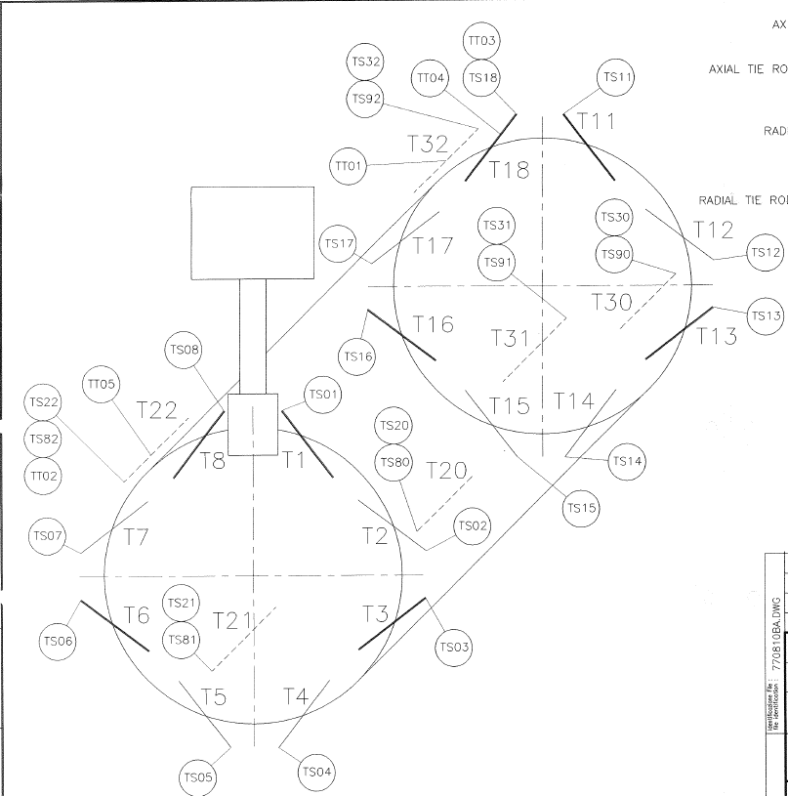
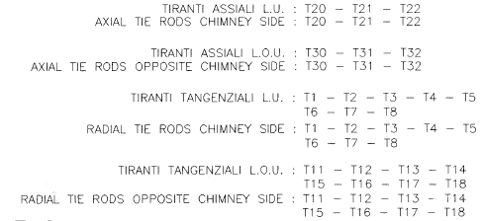
TIE-ROD STRAIN LOCATIONS

Slide 6
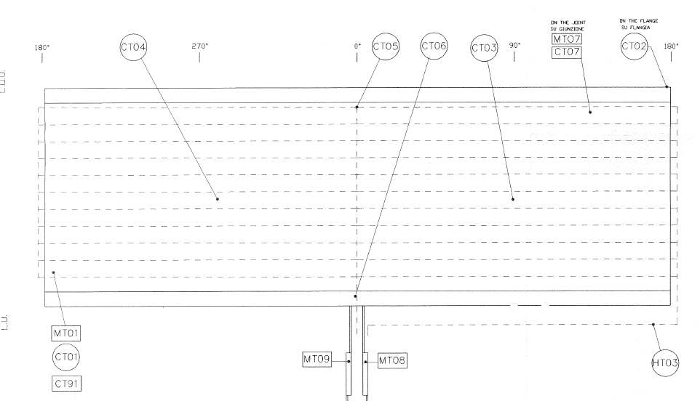
COIL TEMPERATURE LOCATIONS

Slide 7
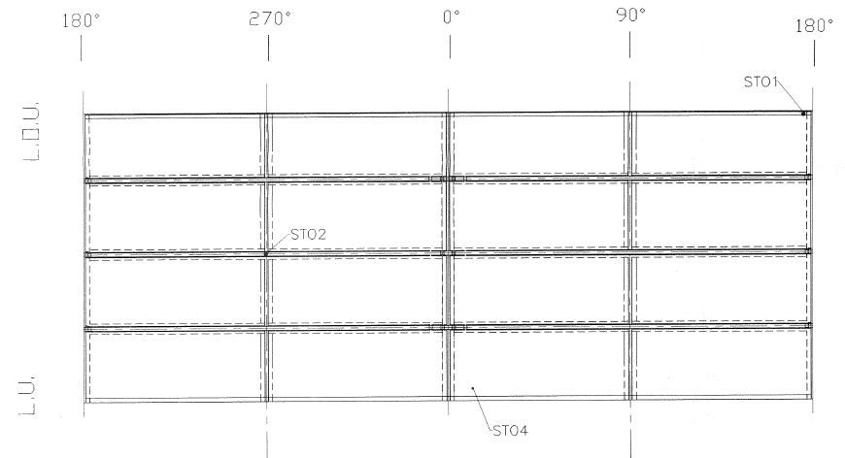
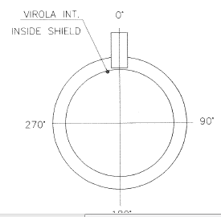
INNER SHIELD TEMPERATURE LOCATIONS

Slide 8
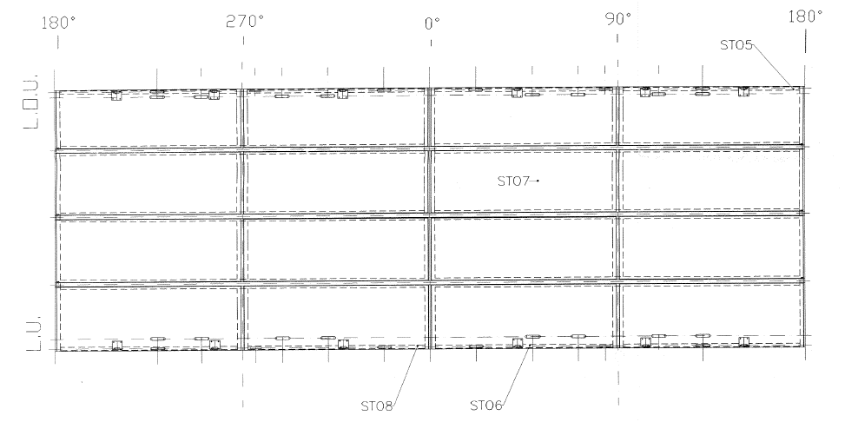
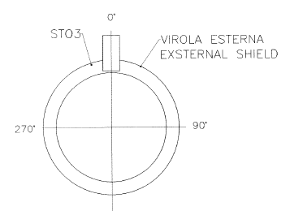
OUTER SHIELD TEMPERATURE LOCATIONS

Slide 9
I/O List Rest cryo system
TAG | PREFIX/LOCATION | VARIABLE TYPE | DESCRIPTION | TYPE
FT3331H | VALVEBOX | FLOW | CURRENT LEAD FLOW CONTROLLER | bronkhurst
FT3332H | VALVEBOX | FLOW | CURRENT LEAD FLOW CONTROLLER | bronkhurst
FT3330H | VALVEBOX | FLOW | SHIELD FLOW CONTROLLER | Sierra
FT3333H | EXTERNAL PIPING | FLOW | HELIUM FLOW FROM ERL | Sierra 20g/s; 18-36Vdc
PT3334 | EXTERNAL PIPING | PRESSURE | SUPPLY HELIUM AT ERL TAP | 100psia, diaphram
PT3335 | EXTERNAL PIPING | PRESSURE | RETURN HELIUM VAPOR AT ERL TAP | 100psia, diaphram
PTHP02 | VALVEBOX | PRESSURE | LIQUID HELIUM SUPPLY | 100psia, diaphram
PTHP03 | VALVEBOX | PRESSURE | PHASE SEPARATOR BATH PRESSURE | 100psia, diaphram
PT3336N | VALVEBOX | PRESSURE | NITROGEN BATH PRESSURE | 100psia, diaphram
PTHP01 | VALVEBOX | PRESSURE | WARM HELIUM GAS SUPPLY | 300psia, diaphram
PTXXX |  | PRESSURE |  | 300psia, diaphram
LTHL01 | VALVEBOX | LEVEL | LIQUID HELIUM PHASE SEPARATOR BATH | AMI
LIC3301N | LN2 GHE COOLER | LEVEL | LIQUID NITROGEN BATH, COOLER | Johnson Controls
cv01 | VALVEBOX | VALVE CONTROL | WARM GAS SUPPLY | WEKA CRYO
cv02 | VALVEBOX | VALVE CONTROL | LHE FILL VALVE IN SEPARATOR | WEKA CRYO
cv03 | VALVEBOX | VALVE CONTROL | LHE SUPPLY TO COOLDOWN MIXING | WEKA CRYO
cv04 | VALVEBOX | VALVE CONTROL | VAPOR RETURN FROM SEPARATOR | WEKA CRYO
cv07 | VALVEBOX | VALVE CONTROL | SHIELD RETURN | WEKA CRYO
cv08 | VALVEBOX | VALVE CONTROL | SYPHON SUPPLY FROM SEPARATOR | WEKA CRYO
cv09 | VALVEBOX | VALVE CONTROL | QUNECH DUMP VALVE | WEKA CRYO
N3364A | LN2 GHE COOLER | VALVE CONTROL | LN2 BATH FILL VALVE | SOLENOID

Slide 10
Purchases Controls/Instrumentation
Rack components: Rack, terminal strips, 28V power supply
PLC system: New Quantum PLC and I/O
7 x Lakeshore 218S
6 x Pressure transducers
Flowmeter Sierra 640i Measure helium flow from ERL compressor loop during cooldown

Slide 11
PLC: QUANTUM CHASSIS
Item | Description | Qty | spares | Unit Price($) | Subtotal
140DDI35300 | 32 channel DI module | 1 | 1 | 569.6 | 1139.2
140DDO35300 | 32 channel DO module | 1 | 1 | 682.8 | 1365.6
140ACI04000 | 16 channel AI card | 2 | 1 | 1731.28 | 5193.84
140ACO02000 | 4 channel AO card | 3 | 1 | 1081.48 | 4325.92
140DRA84000 | Relay card |  | 1 | 569.6 | 569.6
NIO-QUCM+002 | Ethernet communication | 4 | 0 | 1857 | 7428
140CPU65100 | CPU module | 1 | 0 | 5544 | 5544
TSXMCPC002M | flash memory for program file | 1 | 0 | 1680 | 1680
140CPS11420 | power supply module | 2 | 0 | 765.2 | 1530.4
140CRP31200 | remote I/O head module | 1 |  | 840 | 840
140CRP31200 | remote I/O adapter module | 1 |  | 840 | 840
140XTS00200 | removable terminal stripe | 12 |  | 27.74 | 332.88
140XBP01000 | 10 slot backplane | 2 |  | 370.4 | 740.8
Total Cost Estimate: $31530.24

Slide 12
Purchases Mech
LN2 gas cooler dewar[ordered]
New Spring relief valve, 2xH size or 1x J size
Trapped volume reliefs
Coaxial VJ modifications
ERL Interface VJ spools
  #1 Liq Helium supply, with 2 manual valves, relief, 1/2T bayonet, instrument taps, purge valve
  #2 Vap Helium return, with manual valves, relief, 1/2P bayonet, instrument taps, purge valve
1/2T LN2 VJ supply line from tap to LN2 gas cooler

Slide 13
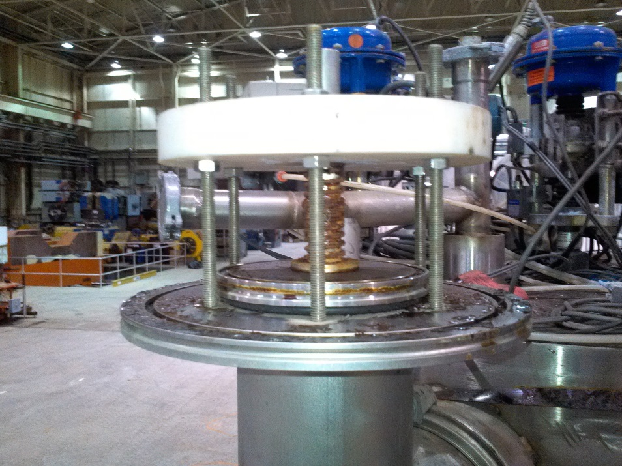
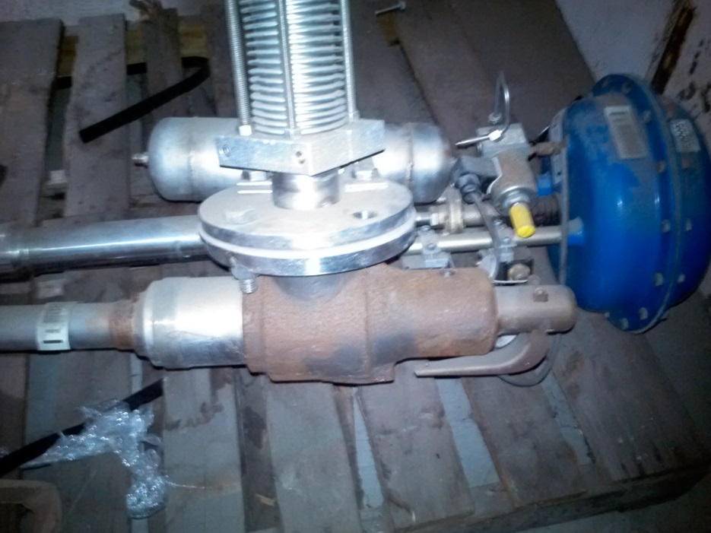
Spring Relief Plate
Replace with a dead lift plate without spring
New ASME UV Spring Safety relief J size
Or 2 x H size

Slide 14
sPHENIX
LESHC 15-0X
MAY 22 2015
LESHC –PSSC REVIEW
SOLENOID LOW POWER COLD TEST
BLDG 912

Slide 15
Purpose of Review
Asking for Equivalency for the pressure system of the solenoid
Review for the low power test and setup for this
Review modifications to interface with ERL cryogenic system and addition of LN2 helium gas cooler subsystem

Slide 16
AGENDA
A: SOLENOID History and Design
  Cryostat assembly --
  Coil Design
  Coil tie-rods support system
  Coil Cooling circuit
  Thermal shield circuit
  Valvebox and chimney
B: SOLENOID Documentation
  Engineering and QA DOCS from ANSALDO
  Structural calcs
  Relief Calcs
C: Solenoid location and assembly work in Bldg 912
D: Cryogenic system to cool solenoid
  LN2 helium gas cooler, 300K to 90K
  ERL plant: Tie ins to ERL cryogenic system
    ERL Cryogenic systems mods and interface to solenoid
    P&ID’s
E: Low current <100A test at 4.5K
  POWER SUPPLY, etc
  Measurement and instrumentation
  Cryogenics cooldown and 4.5K test
  Cold Test Plan

Slide 17
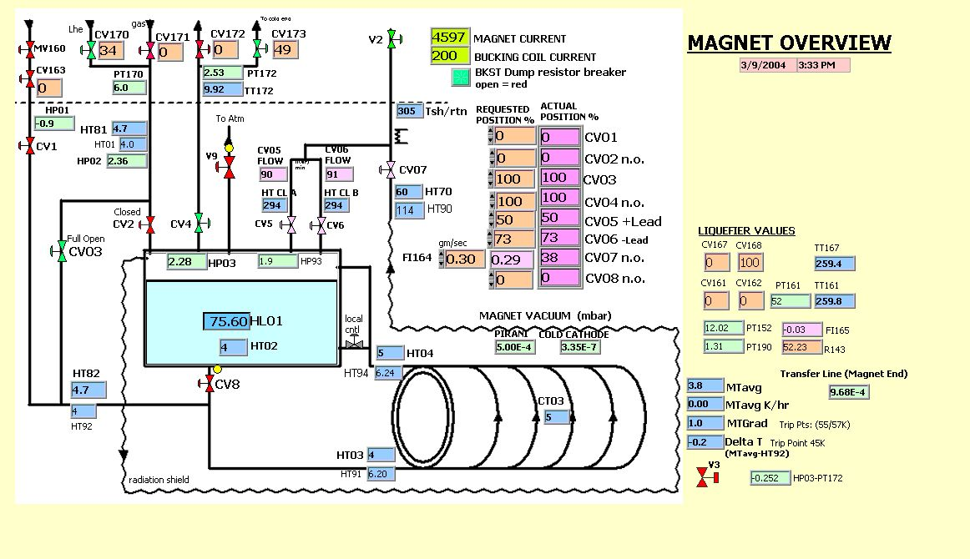
A: SOLENOID History and Design
SLAC: BaBar Solenoid/valvebox screen
Design for siphon mode cooling
Started out with siphon mode operation
Stayed with forced flow mode

Slide 18
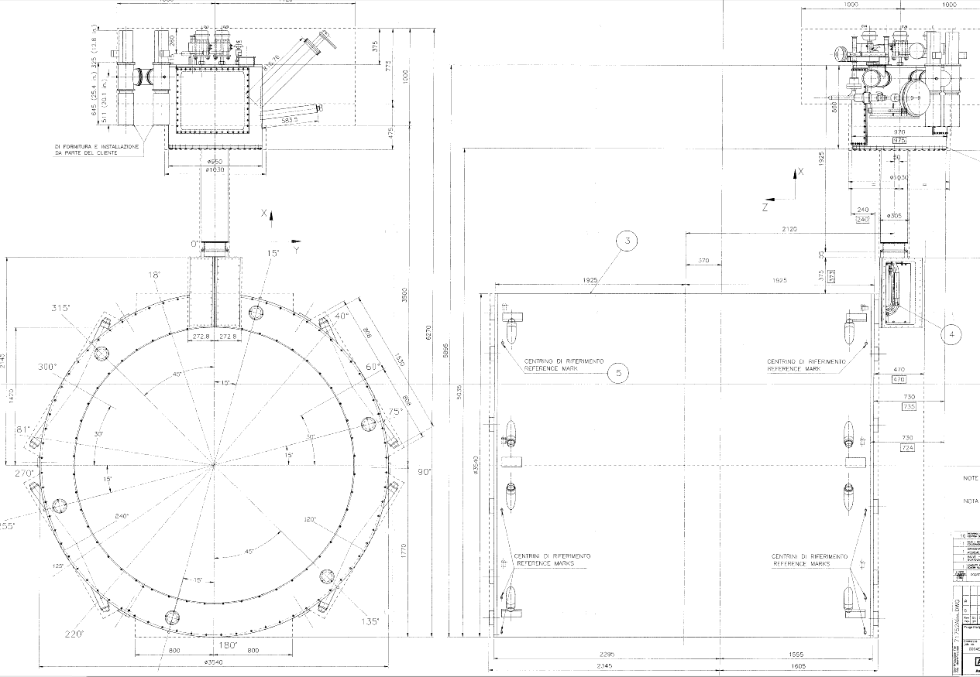
A: SOLENOID History and Design
Cryostat Assembly

Slide 19
A: SOLENOID History and Design
Solenoid Cryostat
Coil
  SC winding
Coil Mandrel
  Aluminum 5058
  Wall: mm
  OD Diameter: mm
  Cooling tubes welded
  11 parallel tubes
  20 mm dia
Tie Rods
  Supports the coldmass
  Inconel 718
  6 x Axial Tie-rods
  16 x radial Tie-rods
Cryostat Vacuum Vessel
  Wall: Aluminum 5058, 35 mm/50mm
  OuterWall: OD 3.540 m, L=3.790m
  InnerWall: ID 2.840 m, L=3.790m
  Annular End Flanges: Al-5058, 50mm
  Tie-rods attachments
Copper Tubing
Thermal Shields
  8 x panels
  Inner diameter
  Outer diameter

Slide 20
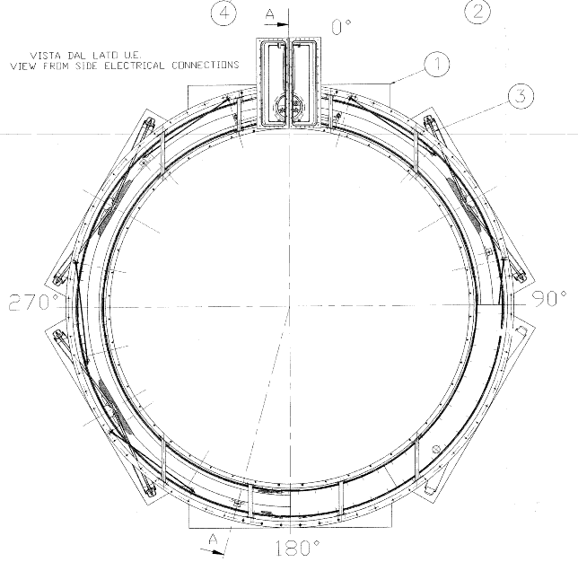
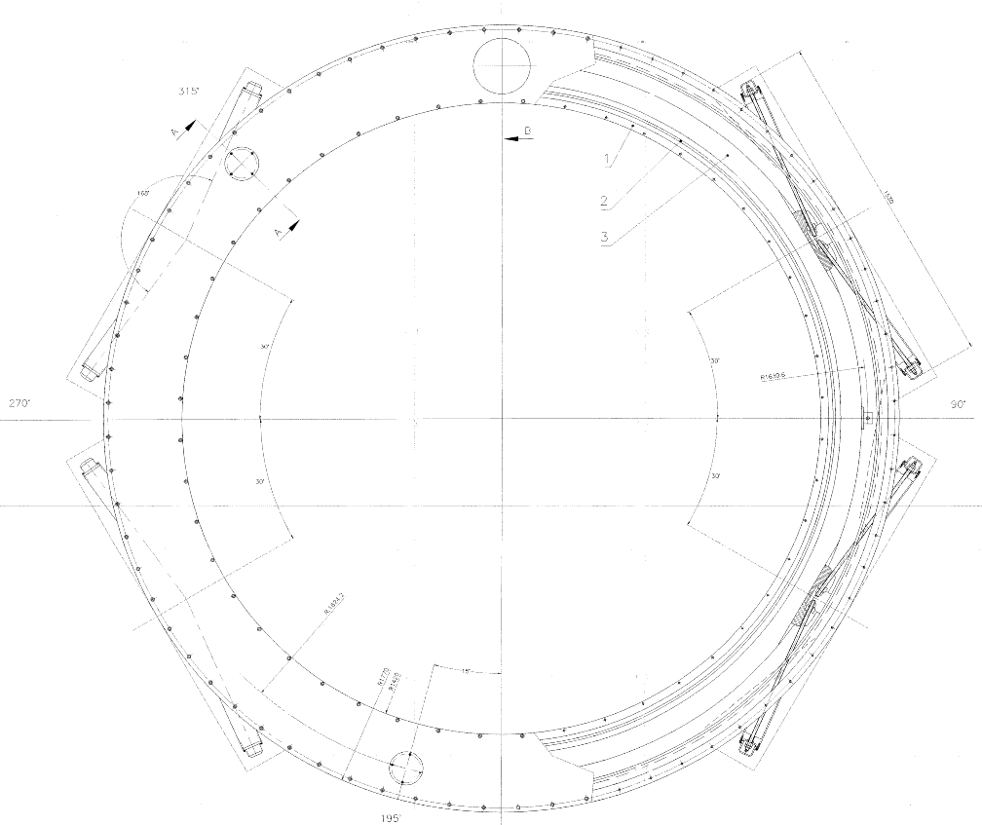
A: SOLENOID History and Design
Cryostat Cross Section

Slide 21
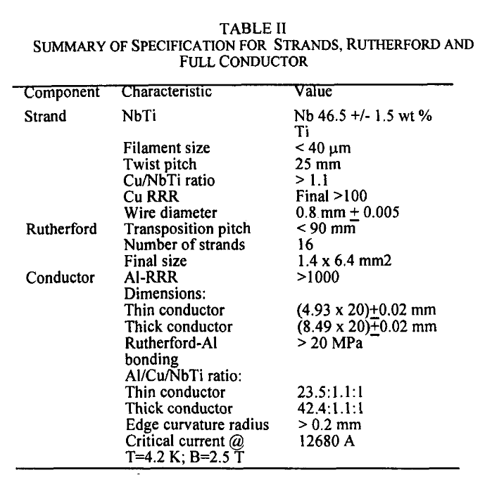
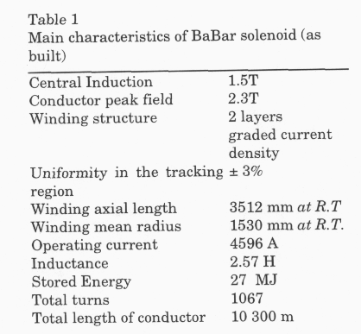
A: SOLENOID History and Design
Coil

Slide 22
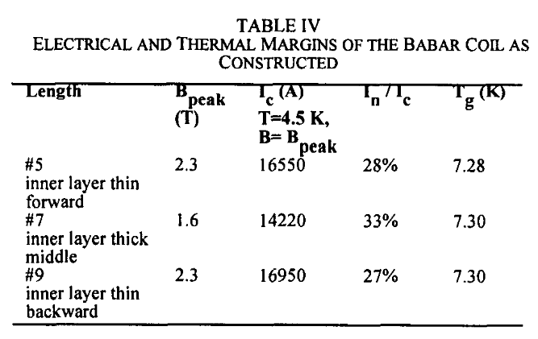
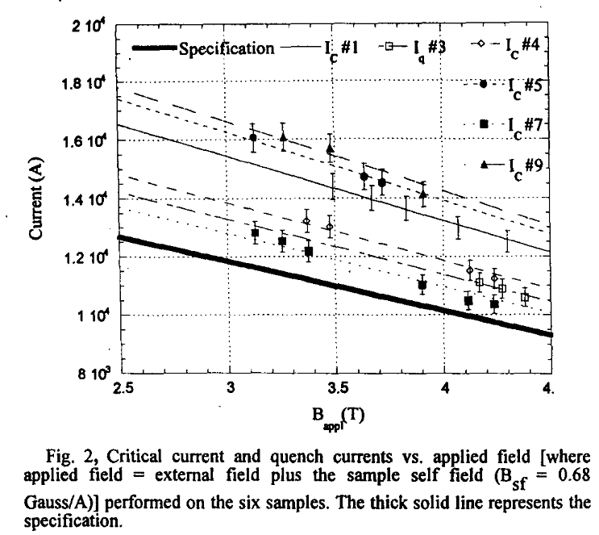
A: SOLENOID History and Design

Slide 23
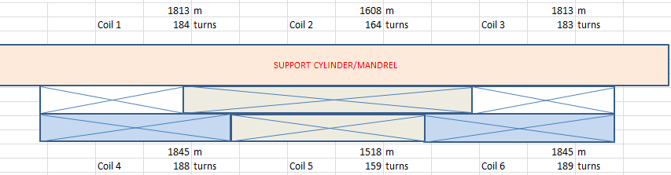
A: SOLENOID History and Design

Slide 24
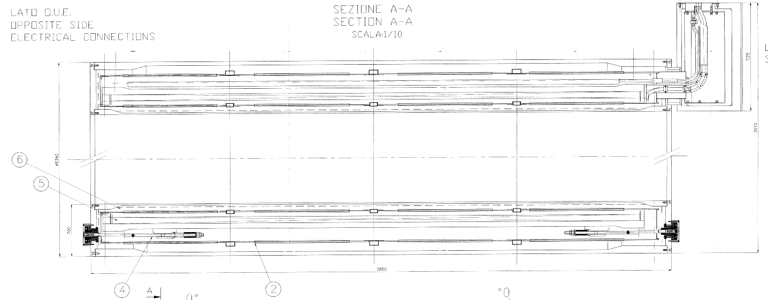
A: SOLENOID History and Design
Cryostat Cross Section

Slide 25
A: SOLENOID History and Design
Tie –Rod Assembly, Radial

Slide 26
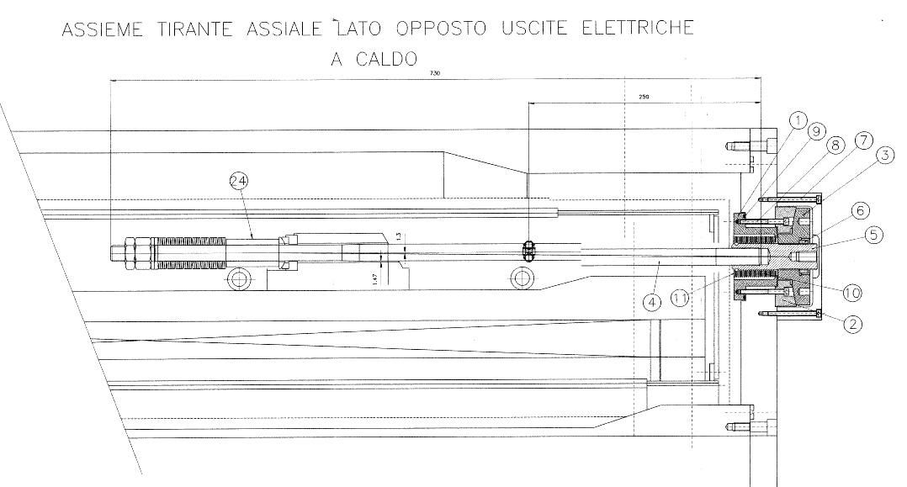
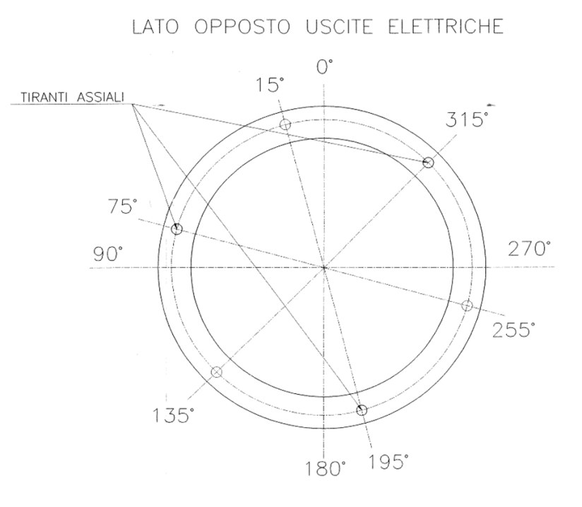
A: SOLENOID History and Design
Tie –Rod Assembly, Axial, Non lead end

Slide 27
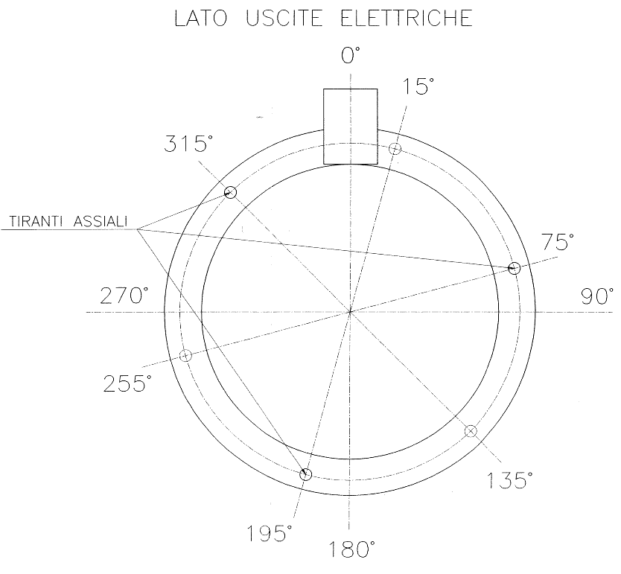
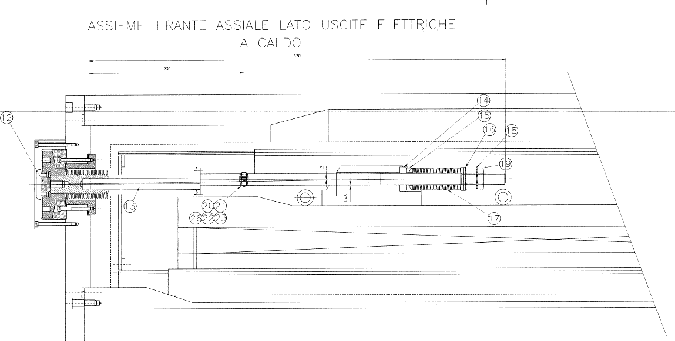
A: SOLENOID History and Design
Tie –Rod Assembly, Axial, lead end

Slide 28
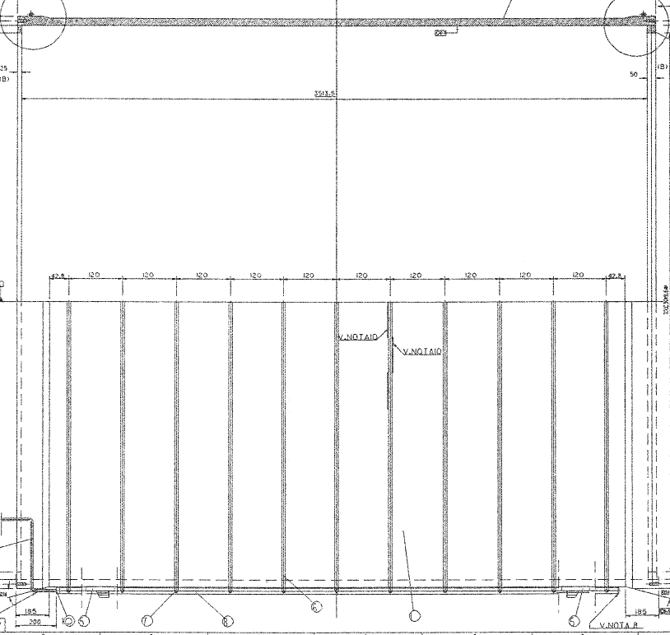
A: SOLENOID History and Design
Solenoid Cryostat Mandrel Cooling
Aluminum Cooling tubes
30 mm x 5mm W
Welded to Aluminum mandrel
11 parallel circuits
Headered together

Slide 29
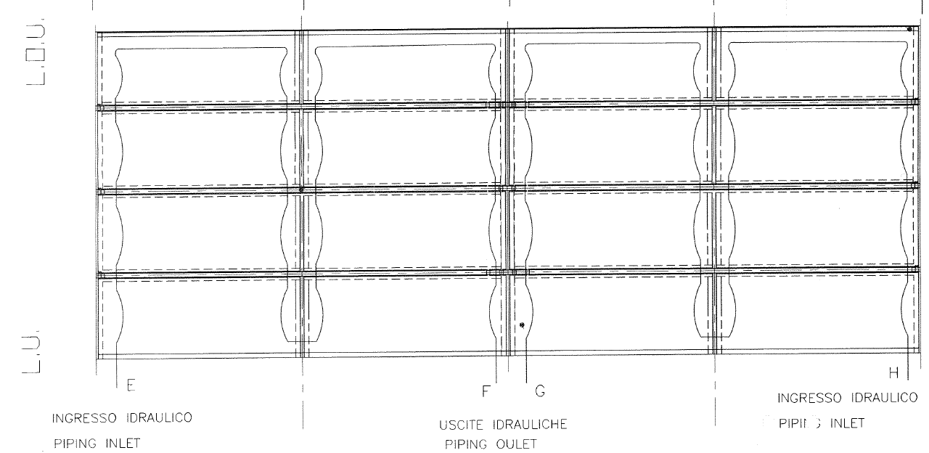
A: SOLENOID History and Design
Solenoid Cryostat Thermal Shield
Copper 12mm tube
Shield the Coil on inner and outer diameter

Slide 30
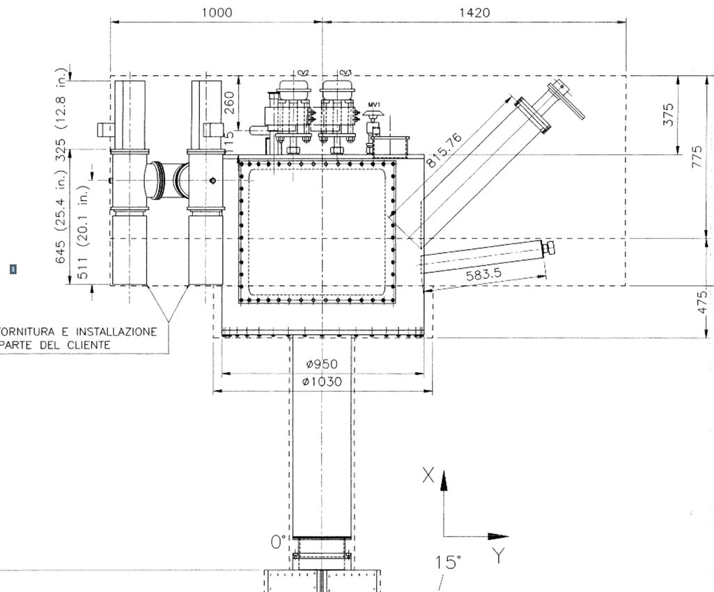
A: SOLENOID History and Design
Valvebox Cryostat Vessel
Vacuum vessel+
  Design pressure:
  internal 1 barg [psia], external 1 atm
  Design Temperature: 300K
  Diameter: 970 mm, 38.25inch
  Length: 860 mm, 33.85 inch
  Wall: 10 mm, 0.393 inch
  End plate: wall 20mm,
  Volume: 635Liters
  Stainless Steel 304
Chimney
  Diameter: 273 mm, 10.75inch
  Length: 1065 mm, 42 inch
  wall 9.3 mm, ”
  Volume: 63 Liters
  Stainles Steel 304

Slide 31
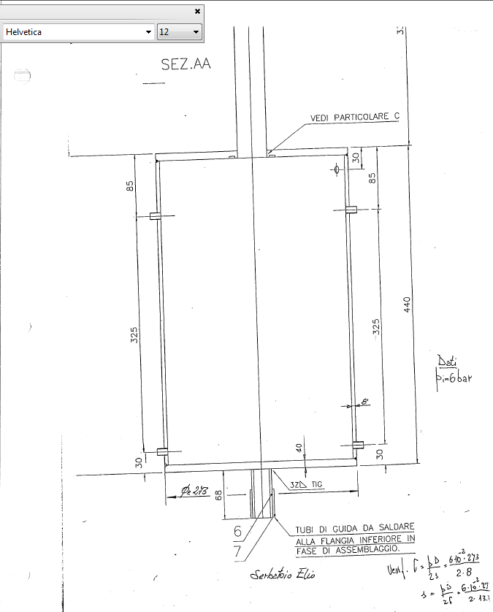
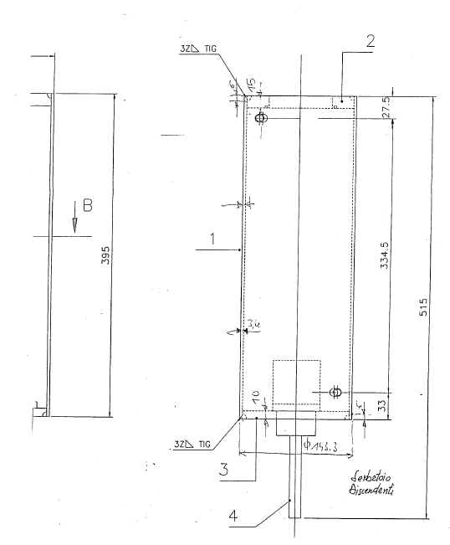
A: SOLENOID History and Design
Phase separator & Current Lead Pot

Slide 32
A: SOLENOID History and Design
Valvebox Internals
Phase separator
  Design pressure: 6 bara [87 psia]
  Design Temperature: 4K to 300K
  Diameter: 273 mm, 10.75 inch
  Length: 440 mm, 17.325 inch
  Cylinder 10.75x 0.366” wall 10 NPS sch40
  End plate: wall 30mm, 1-3/16”
  Volume: 26 Liters
  Stainless Steel 304L
Internal Piping
  Stainless Steel tubing
    10mm, 12 mm, 14mm, 16mm
  Copper Tubing
    10mm, 18mm, 22mm
    Used to cool the SC current cables
    Thermal shield
Current Lead Pots
  Design pressure: 6 bara [87 psia]
  Design Temperature: 4K to 300K
  Diameter: 141.3 mm, 5.5625 inch
  Length: 367 mm, 14.45 inch
  Cylinder: 14.45” x 1/8” wall
  End plate: wall 30mm, 1-3/16”
  Volume: 2 x 6L =12 Liters
  Stainless Steel 304L
Valvebox Thermal Shield
  Copper sheet
  Copper Tubing

Slide 33
A: SOLENOID History and Design

Slide 34
  B: SOLENOID Documentation
  Engineering and QA DOCS from ANSALDO
ENGINEERING STRUCTURAL PRESSURE VESSEL
  Cryostat Vacuum vessel Engineering Calcs
  Valvebox Vacuum Vessel Engineering Calcs
    Phase separator Engineering calcs
    Current Lead Pot Engineering calcs
    6000 A Current Lead pot engineering calcs
RELIEFS CALCS
  Helium circuit
    Line Rupture CGA S-1.3 §4.9.1.1
    Fire CGA S-1.3 §5.3.5
    Loss of vacuum with helium small leak CGA S-1.3 §4.9.1.1
    Loss of vacuum with air. Lehmann and Zahn.
    NO calculation for heat released during Quench
  Vacuum Vessel
    Loss of vacuum CGA 341 §6.4.2

Slide 35
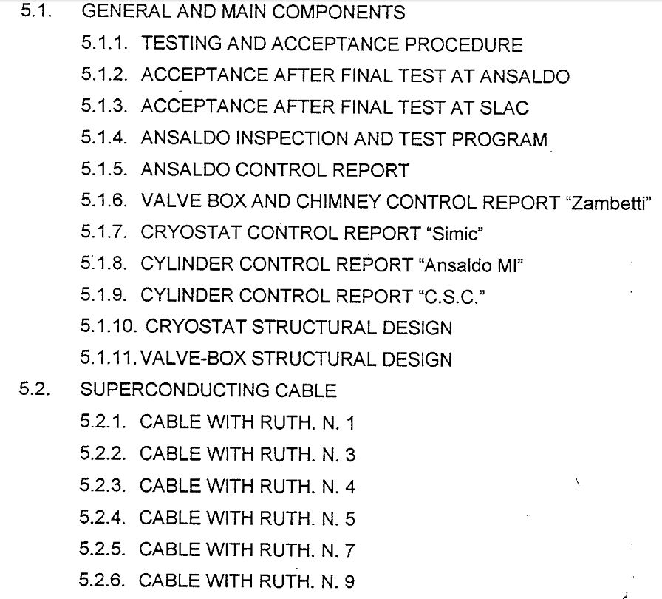
  B: SOLENOID Documentation
  Engineering and QA DOCS from ANSALDO
    ANSALDO QA BINDER 5

Slide 36
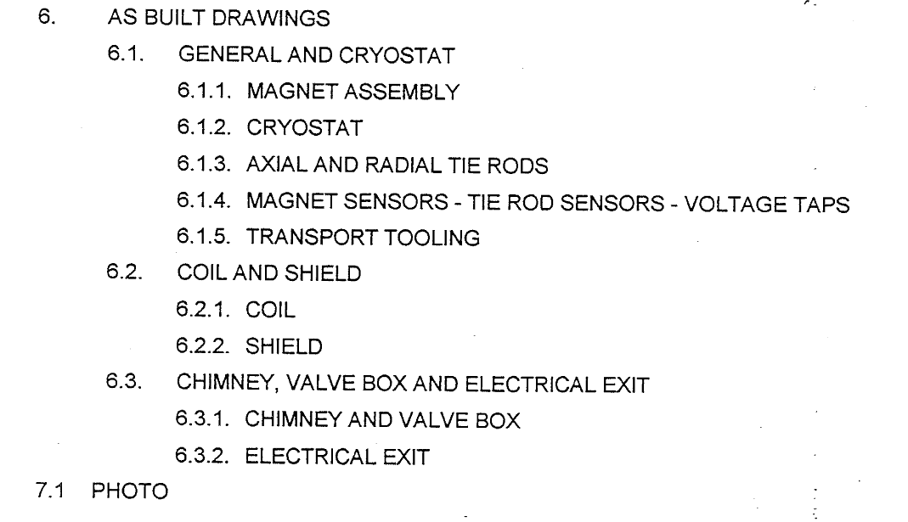
  B: SOLENOID Documentation
  Engineering and QA DOCS from ANSALDO

Slide 37
B: SOLENOID Documentation
Engineering and QA DOCS from ANSALDO
SECTION 5.1 QA Binder
SOLENOID VACUUM CRYOSTAT ENG CALCS BY ANSALDO
VALVEBOX VACUUM VESSEL / PHASES SEPARATOR ENGINEERING CALCS BY ANSALDO
RELIEF CALCS
2.3.1 CURRENT LEADS: American Magnetics Inc.
2.3.2 TIE ROD BELLOWS: ??
2.3.3 TIE RODS: ??
2.3.4. CARTRIDGE HEATERS:
2.3.5 VALVE POSITIONER: SIEMENS documentation
2.3.6 VALVE LIST
2.3.7 CRYOGENIC VALVES: WEKA Manufacturing QA documentation
2.3.8 CHECK VALVE: CIRCLE SEAL K220T1-4PP
2.3.9 SAFETY VALVE: CARRARO SP=4BAR, J orifice, CS30J-IF1L-E
2.3.10 RUPTURE DISK: FIKE, 6 BARA +/-0.25 BAR. AVE 6.07, 6.13,6.07, 6.02. TUV CERT ISO6718

Slide 38
B: Engineering and QA DOCS from ANSALDO
HELIUM VOLUME RELIEFING SYSTEM
CALCULATIONS | Load | Results |  | Setpoint
Fire CGA S-1.3 §5.3.5 | 16 kW | 420 SCFM Air equivalent |  | 6 bara
Loss of vacuum due to helium leak CGA S-1.3 §4.9.1.1 |  | 9.7 SCFM Air equivalent |  | 6 bara
Loss of vacuum to air. Lehmann and Zahn | 50 kW | 1339 SCFM Air equivalent |  | 6 bara
  cryogenic quench dump valve, CV9
  Burst disk FIKE 1.5” (DN40)
    MNFA: 1.44 in2
    CAPACITY: 56,000 W @ 6 bara (88 psia), 7.6K
  Relief Valve [Purchase new one]
    J orifice, 1604 SCFM AIR@15C @ 4.4 barg (79 psia)
    CAPACITY: 63,000 W @ 4.4 barg (79 psia), 7.3K

Slide 39
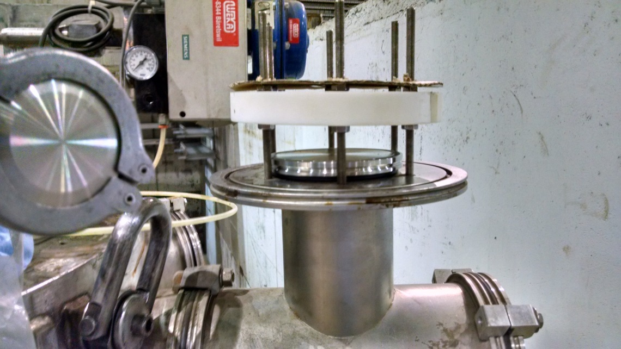
B: Engineering and QA DOCS from ANSALDO
RELIEF CRYOSTAT INSULATING VACUUM VOLUME
  Lift Plate spring loaded 100 mm diameter
INSULATING VACUUM, SOLENOID CRYOSTAT +CHIMNEY + VALVEBOX
Standard | Water Volume L | Flow Area mm^2 | Lift Plate/ Nozzle Size | Setpoint | Heat Load
CGA 341 §6.4.2 | 11575 | 3935 | DN 100 7800 mm^2 | 1.6 bara | 125 kW @15 psig

Slide 40
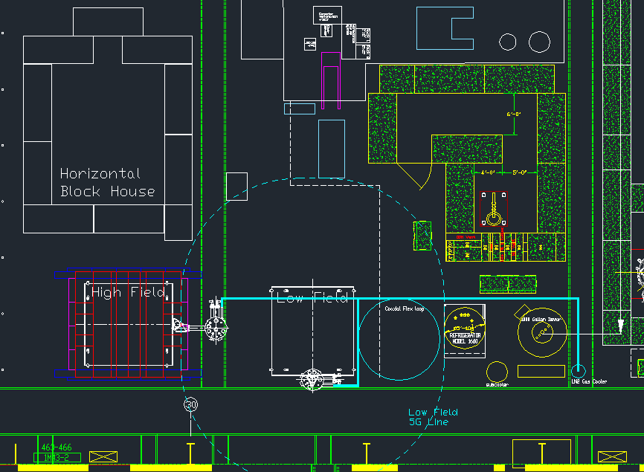
C: Solenoid location & assembly Bldg912
LOCATION

Slide 41
C: Solenoid location & assembly Bldg912
VALVEBOX/CHIMNEY SUPPORT STRUCTURE

Slide 42
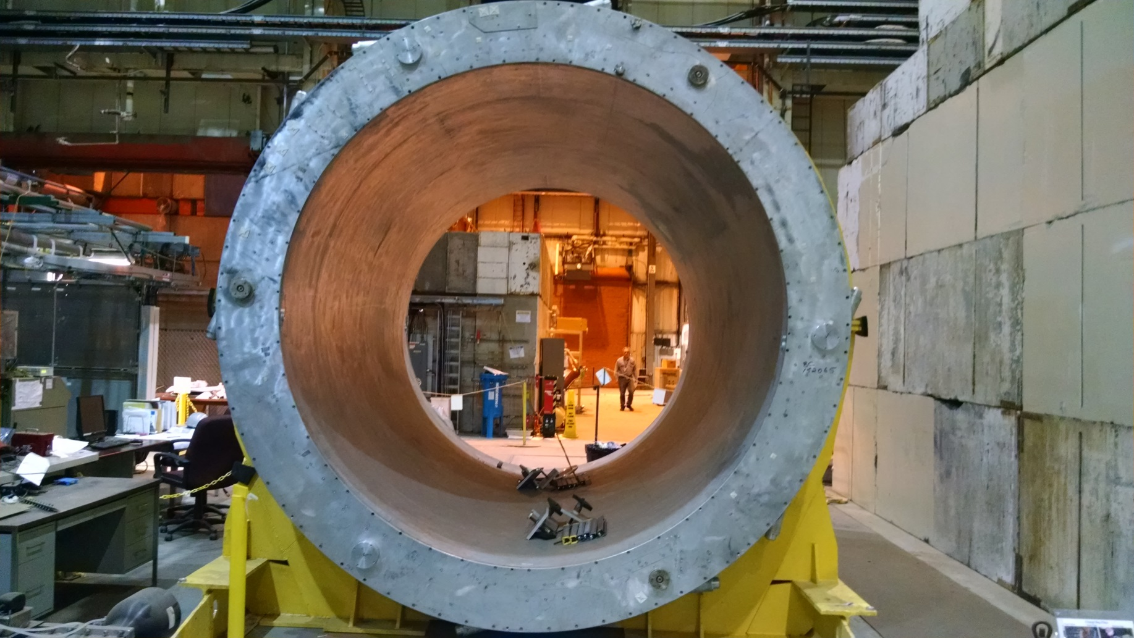
C: Solenoid location & assembly Bldg912

Slide 43
C: Solenoid location & assembly Bldg912
ODH
LIQUID HELIUM INVENTORY IS LESS 100 LITERS
ERL CRYOGENIC SYSTEM DICTATES HELIUM INVENTORY
LN2 SUPPLY TO LN2 HELIUM COOLER WILL BE
FROM 11,000 GALLONS STORAGE DEWAR
N2 BOIL-OFF VAPOR FROM LN2 HELIUM COOLER
WILL BE PIPED TO OUTSIDE OF BUILDING

Slide 44
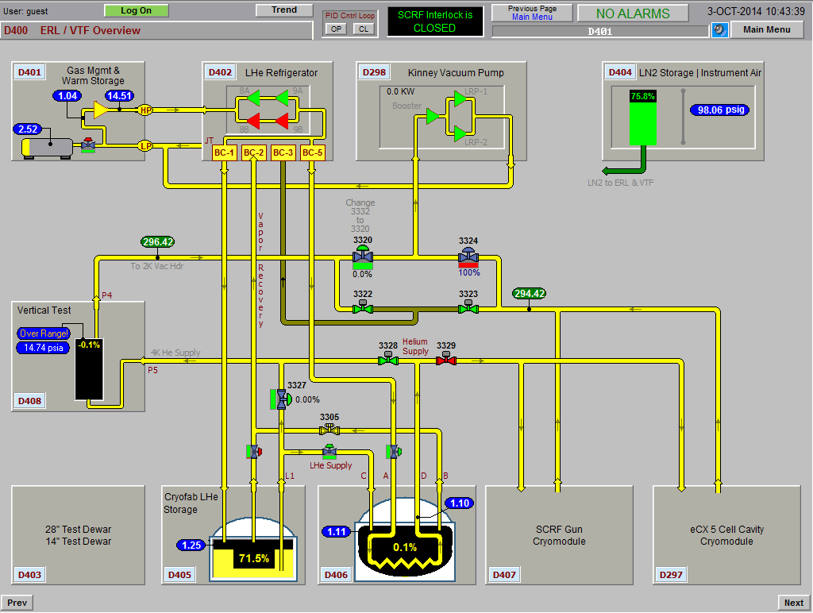
D: Cryogenic system to cool solenoid
Taps to VTF side
Taps on VTF side: need to add bayonets/isolation valves/reliefs/
Pressure sensors

Slide 45
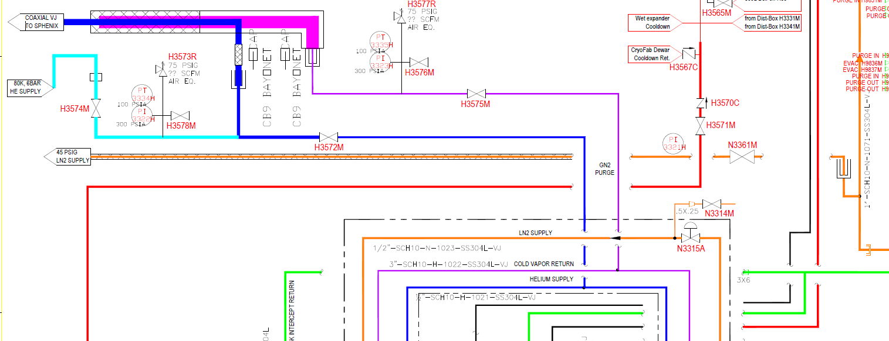
D: Cryogenic system to cool solenoid
Taps to VTF side & LN2 bayonet

Slide 46
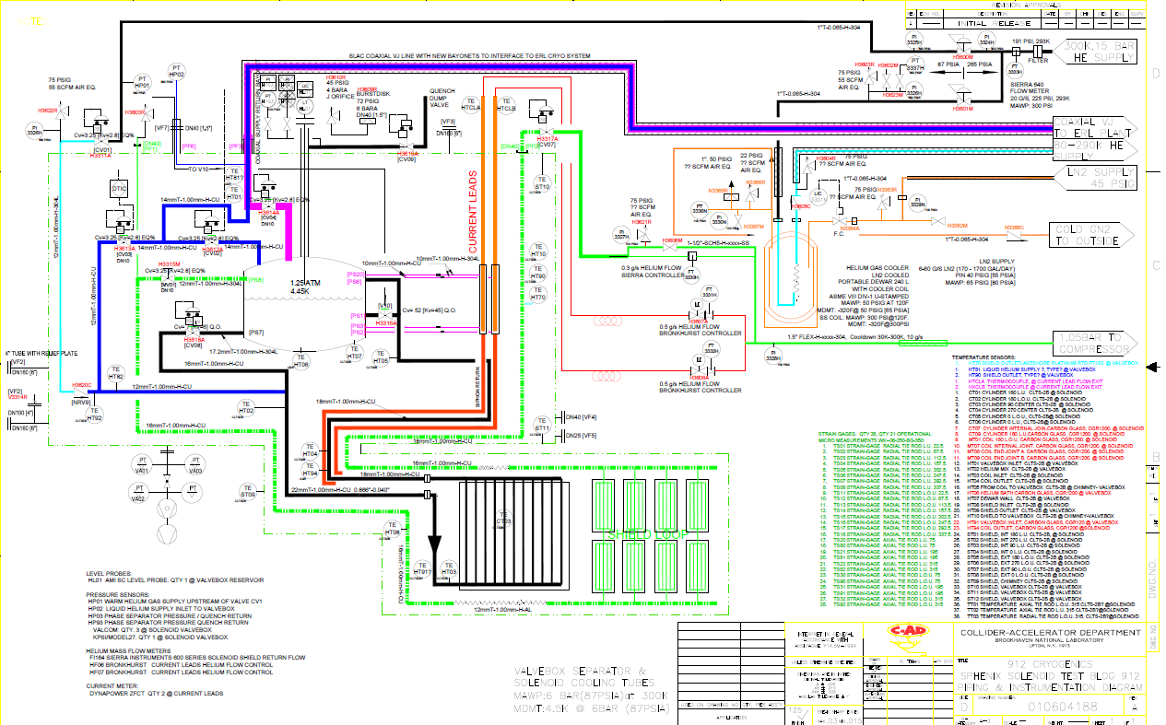
D: Cryogenic system to cool solenoid
Solenoid Valvebox P&ID with LN2 Cooler

Slide 47
D: Cryogenic system to cool solenoid
Circuits
ERL cryogenic system: Vertical Test Facility Side Taps
  Liquid helium supply
    Add tap: manual isolation valve and ½” bayonet, Relief
    Tee-in the 80K helium gas supply from LN2 GHe Cooler
  Cold vapor return
    Add tap: manual isolation valve and ½” bayonet, Relief
Co-Axial Line to Solenoid Valvebox
  Shortened and modified to interface to ERL CRYO
  Liquid Supply and Vapor return
Warm gas supplies from ERL compressor
    #1 Warm gas line to LN2 Gaseous helium Cooler coil loop inlet
    #2 Warm gas line to valvebox warm mixing valve, CV01
Shield / lead cooling return
  Braided Flex line, warm line.
  Returns to ERL compressor suction line
VJ flex helium line from GHe Cooler LN2 Dewar to tee-in at interface of liquid helium supply for Coax VJ line
LN2 Supply Line to GHe Cooler LN2 Dewar bath
Vent line for N2 boil-off to outside of building

Slide 48
D: Cryogenic system to cool solenoid
240 LN2 DEWAR GHe Cooler
240 Liter LN2 dewar with SS304L coil
  Cools helium gas from 300K to 85K.
Model CLPB240-GC Gaseous Helium Chiller Dewar
Volume: 240 liters, net
Dimensions: 24” o.d. x 59” height
Design Pressure, LN2 Bath: 65 psia (MAWP is 50 psig)
Design Specification. LN2 Bath (Inner Vessel): ASME U stamp
Ghe Coil size: 1/2” o.d. tube x 50 ft length rolled to 20” diameter, ss304L
Design pressure of coil: 300 psig
Coil Inlet & Outlet connection: 1/2” Swagelok fitting located at top
LN2 Fill port: CGA295 fitting with optional ½” npt solenoid valve (non vacuum jacketed)
Vent port (LN2 bath): 1” Swagelok fitting (no shutoff valve supplied)
Relief devices (LN2 Bath): 22 psig relief valve & 50 psig burst disc to comply with ASME Sec VIII, Div. 1 requirements
Material of Construction: Stainless steel
Base: Four 4” diameter casters
Documentation supplied: U-1A form, ASME calculations, MTRs of inner vessel and coil, Pressure test certificate for coil assembly, Relief valve sizing calculation and Jacket relief size calculation

Slide 49
D: Cryogenic system to cool solenoid
CONTROL LOGIC
  DTIC
    Cooldown down gradient control
    Mixing of warm gas with cold gas [valve

Slide 50
E: Low current <100A test at 4.5K
Location 912, between cryo plant and (56MHz) test blockhouse
Test Current: 100A
No Quench protection
Cooling by ERL cryoplant, 80K- 4.5K
LN2 Precool with helium flow loop, 300K-80K
Siphon Mode Operation
Forced Flow Operation

Slide 51
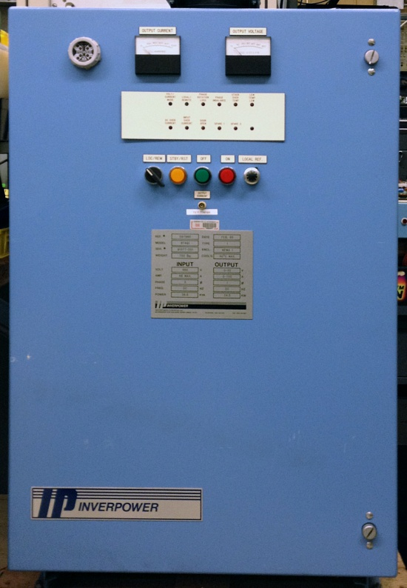
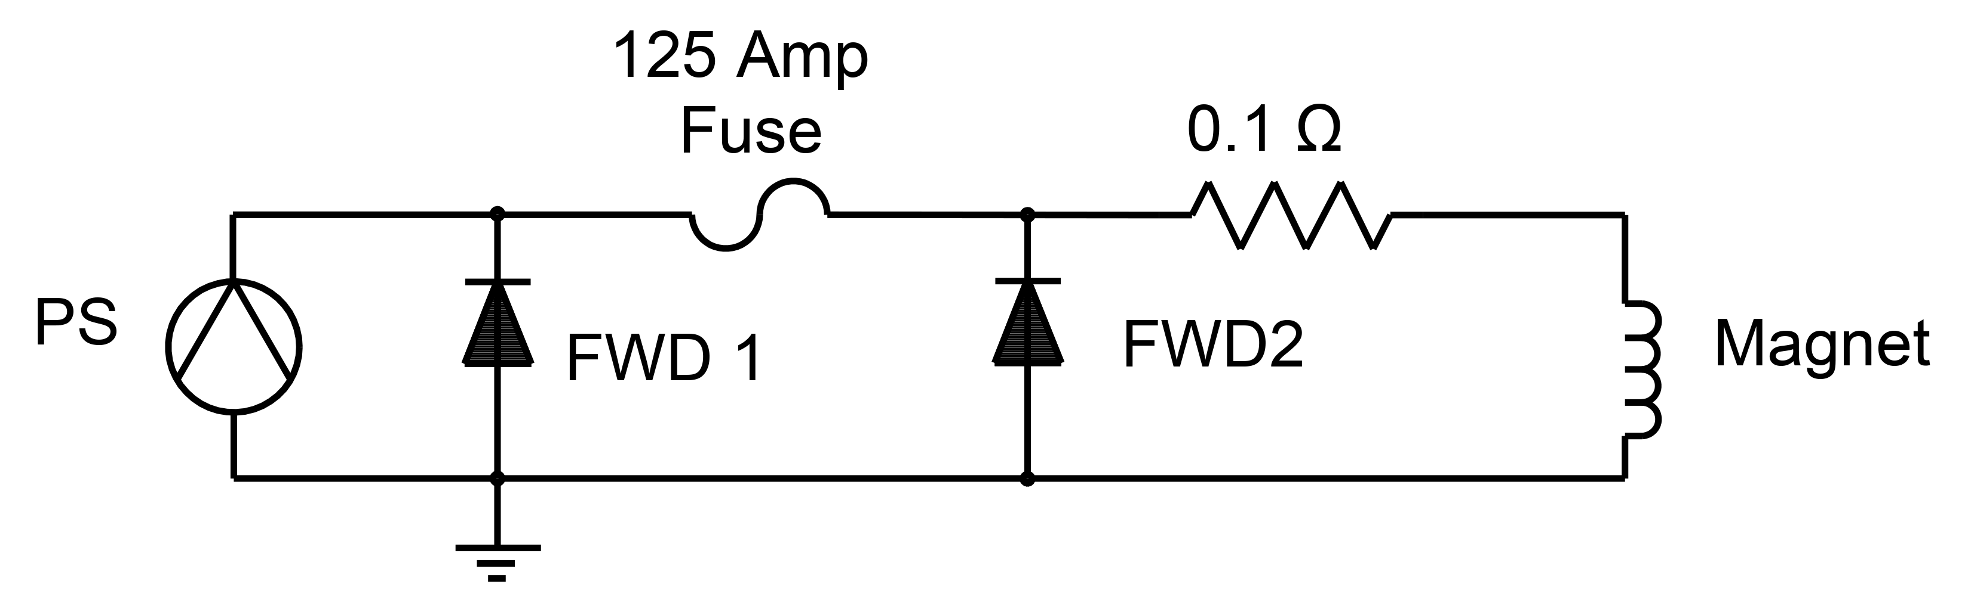
E: Low current <100A test at 4.5K
POWER SUPPLY
Circuit Details
Freewheeling Diode FWD 1 is internal to power supply. FWD 2 is added externally downstream of fuse.
Fuse rated at 125 Amps. Maximum operating current is 100 Amps, which is 80% of fuse rating.
0.1 Ω resistor added to reduce decay time and make stabilization of the power supply easier. Time constant, neglecting cable resistance is 25 seconds.
Peak voltage required at 2.5 Amps/second is 6.25 Volts for the magnet and 10 Volts for the resistor. This is about half the voltage available from the power supply.
Power Supply Ratings
Output Power: 700 Amps, 35 Volts
Input Power: 480 VAC, 3φ, 46 Amps max
Weight: 700 lbs.
Air Cooled
Preparation for sPhenix
BNC for analog current set point
Current loop compensation for 2.5 Hy / 0.1 Ω
External Interlock available, if needed.

Slide 52
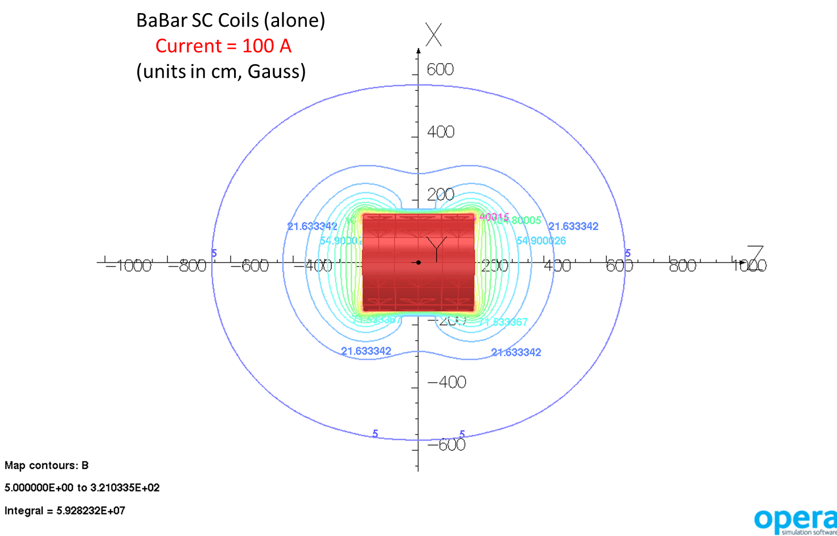
E: Low current <100A test at 4.5K
Field Map at 100A
5 Gauss Line at 6.6 meter
Center Field 271 Gauss
Peak Field 320 Gauss @Coil edge

Slide 53
E: Low current <100A test at 4.5K
Solenoid Cold Test Summary
A. Electrical Checkout at Room Temperature
1. Measure lead resistances to ground with meter.
2. Hipot to ground at 520 V of magnet leads.
3. Impulse test at 400 V of separate layers and full coil.
4. DC voltage series resistance measurements at 1 A.
5. 1 A level shift test to check data acquisition system.
6. Connect magnet to power supply.
7. Ramp magnet to 2 A (or more if possible - TBD) at 0.1 A/s and measure magnet total
voltage and inner and outer layer voltages in order to determine the inductances.
8. Checkout of Quench Detector (QD) - validate stop signal
a. Half Coil Difference (Δ)– inner and outer layer voltage difference
difference;
b. Current Derivative (I_{dot})– total coil voltage and L(dI/dt) difference
9. Vacuum leak check of cryostat.
10. Set slow logger for 1 min intervals - monitor LHe level, temperatures, and strains.
11. Notify cryogenics personnel to start cooldown.
B. Cooldown
  Cooldown from 300K to 90K
    Temperature gradient controlled at 20K [40K limit]
  Cooldown from 90K to 4.5K
    10% left in thermal contraction.
    Supply 5K directly
C. Electrical Checkout at 4.5 K
1. Measure lead resistances to ground with meter.
2. Hipot to ground at 520 V of magnet leads.
3. AC voltage tap measurements at 1 A.
4. Impulse test at 400 V of separate layers and full coil.
5. Connect magnet to power supply. Use inductance result of Part A.7 as starting point for
power supply regulation.
6. Set fast data logger at 1 kHz sampling rate (1 ms intervals). Slow data logger at 1 s
intervals. Monitor LHe level, temperatures, strains, and voltages of magnet, coils, SC leads,
and gas-cooled leads. Adjust lead flow if necessary.
7. Ramp to 10 A at 1 A/s. Determine the total, inner, and outer inductances and adjust I_{dot}
QD and Delta QD as necessary to balance for the difference in the inner and outer layer
inductances ; determine the I_{dot} QD voltage threshold. Adjust lead flow if necessary.
8. Ramp to 25 A at 1 A/s. Verify results from C.7. Shut off power supply (manual QD trip) and
analyze voltage tap data signals for proper operation of instrumentation and hardware.
Adjust lead flow if necessary.
9. Repeat C.8 at 50 A. Adjust lead flow if necessary.

Slide 54
E: Low current <100A test at 4.5K
Solenoid Cold Test Summary
D. Ramp Testing
Set Delta QD at 50 mV. Set I_{dot} QD at pre-determined threshold.
Fast data at 1 KHz. Slow logger at 1 s. 1 A/s ramp rate.
1. Ramp to 100 A at 1A/s. Verify inductances. Monitor leads
and adjust flow if necessary. Shut off power supply. Analyze voltage tap data signals.
2. 5 power cycles from 0 A to 100 A at 1 A/s.
3. 1 hour at 100 A. Monitor leads and coil voltages.
4. If no QD trip occurs, warm up magnet to room temperature.
5. If QD trip occurs, analyze voltage tap signals to determine nature of trigger event.
If signals show no anomalies, repeat ramp test to 100 A.
6. When tests have been completed, set slow logger to 1 min. Monitor LHe level,
temperatures, and strains.
7. Notify cryogenics personnel to start warmup to room temperature.
E. Warmup to Room Temperature
Monitor LHe level, temperatures, and strains. Slow logger at 1 min.

Slide 55
EXTRA MATERIAL
ADDITIONAL SLIDES

Slide 56
SLAC: BaBar Solenoid/valvebox screen

Slide 57
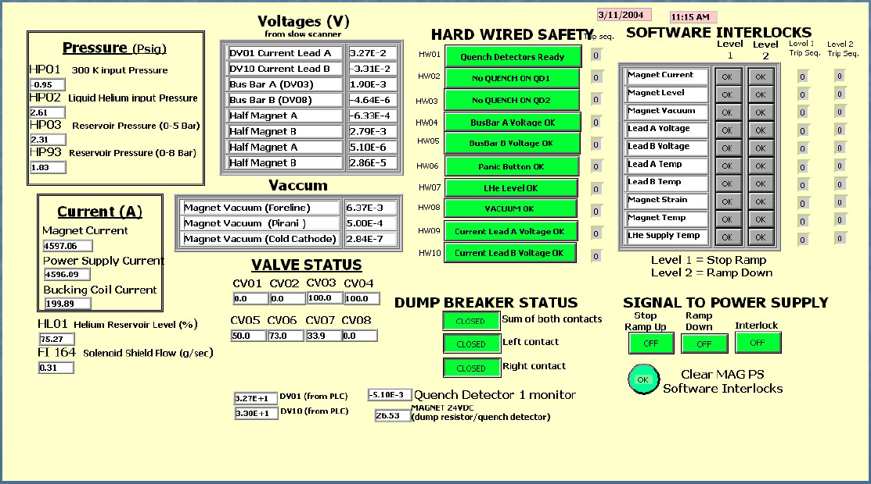
SLAC: BaBar Solenoid screen

