Slide 1
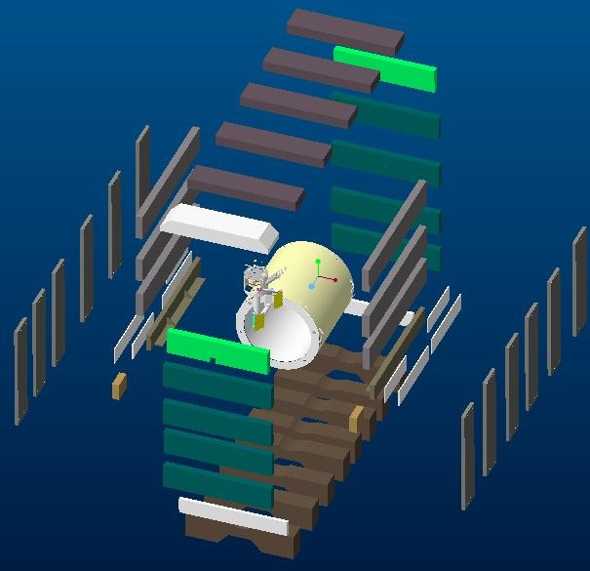
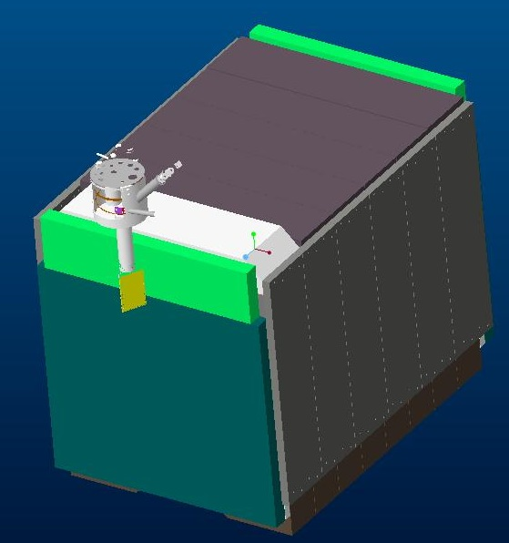
sPHENIX COLD TEST

Slide 2
sPHENIX COLD TEST

Slide 3
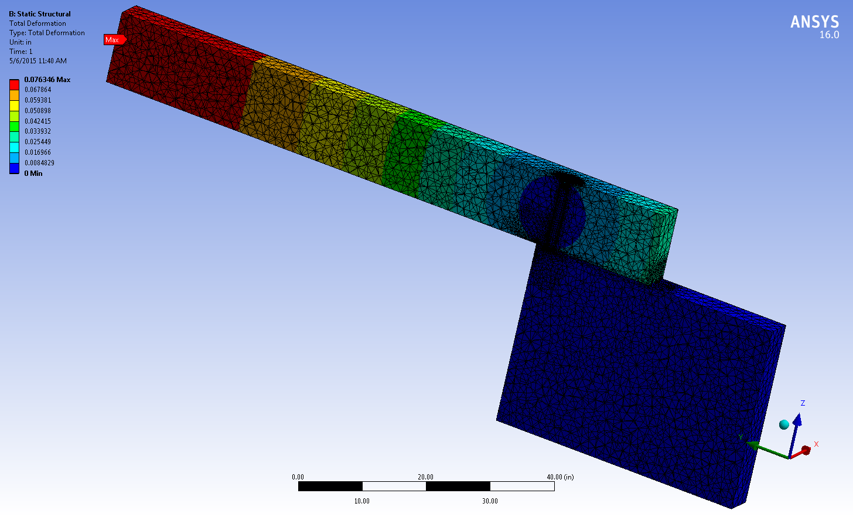
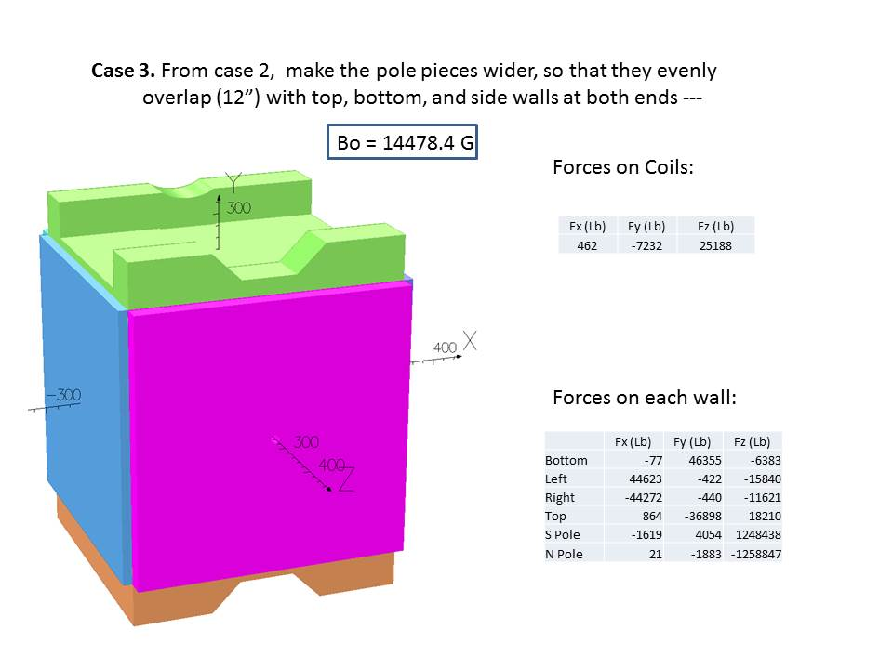
sPHENIX COLD TEST
 | Uniform Load
 | Steel side plate
 | Height= | 11.75
 | Width= | 40.50
 | center= | 5.88
 | Ixx= | 5475.04
 | Total lengtht of structure= | 156.00
 | load per in | 2122.18
 | Max deflection of wall= | 0.10
Pole Steel Deflection

Slide 4
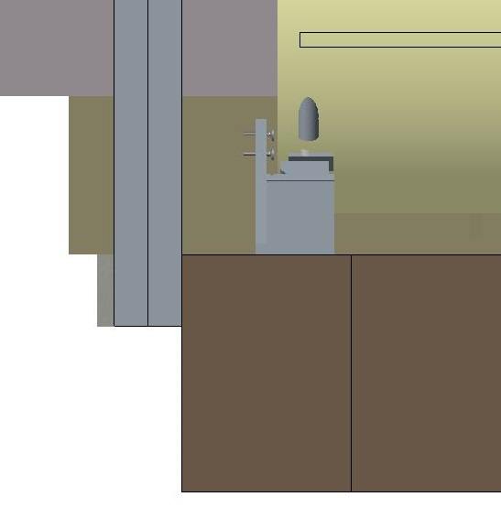
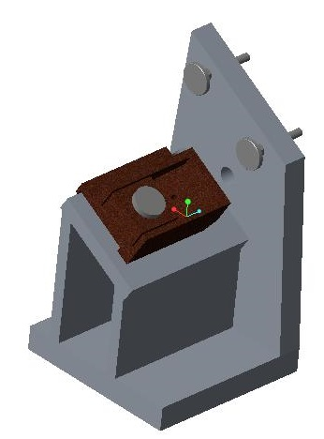
sPHENIX COLD TEST
ALL IN ONE SUPPORT

Slide 5
sPHENIX COLD TEST
 |  |  |  |  |  | model | feet to be cut | cutting/weld | # of holes | # of tapped holes | welding | machining | rigging
1 | 220 | 2 | 28 | 2 | bottom of the side wall filler pieces | 2in-iron1&2.prt | 41 | 41 | 20 |  |  |  | 4
2 | 187.25 | 6 | 47.5 | 2 | outer side wall cut to 179 lg | iron21.prt | 8 | 8 | 60 |  |  |  | 4
3 | 179 | 6 | 42 | 10 | outer side wall | IRON7.prt |  | 0 | 160 |  |  |  | 20
4 | 180 | 6 | 26 | 2 | Shim for bottom of end wall | iron14.prt | 34 | 34 | 32 |  |  |  | 4
5 | 220 | 8 | 28 | 2 | Bottom of the side wall | iron-gussett.prt |  | 0 | 24 |  |  |  | 4
6 | 246 | 11.75 | 40.5 | 8 | pole tips cut to 180"lg | IRON16.PRT | 27 | 27 | 128 |  |  |  | 16
7 | 33 | 11.75 | 28 | 2 | side filler pieces cut from item 2 |  | 10 | 10 | 32 |  |  |  | 4
8 | 167.5 | 11.75 | 40.5 | 2 | Top of the poletips one gets a hole for the chimney | IRON17.PRT | 2 | 2 | 40 |  |  |  | 4
9 | 252 | 12 | 42 | 6 | Side Pieces uncut | IRON2.PRT |  | 0 |  | 70 |  |  | 12
10 | 183.5 | 17.375 | 40 | 4 | Roof center pieces cut to 180 lg | IRON3.PRT | 13 | 13 |  | 80 |  |  | 8
11 | 187.5 | 18 | 44.5 | 1 | Roof end piece opposite chimney cut to 180 lg | iron19.prt | 4 | 4 |  | 30 |  |  | 2 | 10000
12 | 187.25 | 25 | 47.5 | 1 | Roof end piece chimney side needs machining | IRON15.PRT |  | 0 |  |  |  |  | 2 | 20000
13 | 180 | 30 | 42.1 | 8 | Base | iron1.prt |  | 0 |  | 200 |  |  | 16
 |  |  |  | 12 | supports |  |  |  |  |  | 96 | 288 | 0
 |  |  |  |  | assembly |  |  |  | 64 |  | 80 |  | 240
 |  |  |  |  |  |  | totals: | 140 | 840 | 950 | 176 | 720 | 850 | $409,092.64

