Slide 1
Athena DAQ WG report
EICUG Meeting August 4th, 2021
Conveners:
Jeff Landgraf (BNL), Alexandre Camsonne (JLAB)

Slide 2
Athena DAQ Overview
Clock Distribution
(Front End Boards
on/near detector)
Front End Processors
(Electronics in DAQ room)
DAQ Network /
Computing (COTS)
Tape (SDCC)
Detector
Front End Boards
(on/near detector)
Detector
Front End Boards
(on/near detector)
Detector
(etc…)
We envision a triggerless streaming DAQ system following the outline described in the Yellow Report
Gets rid of many latency constraints
Gets of the need for a hardware trigger
Amplifies the need for robust zero-suppression / data compression

Slide 3
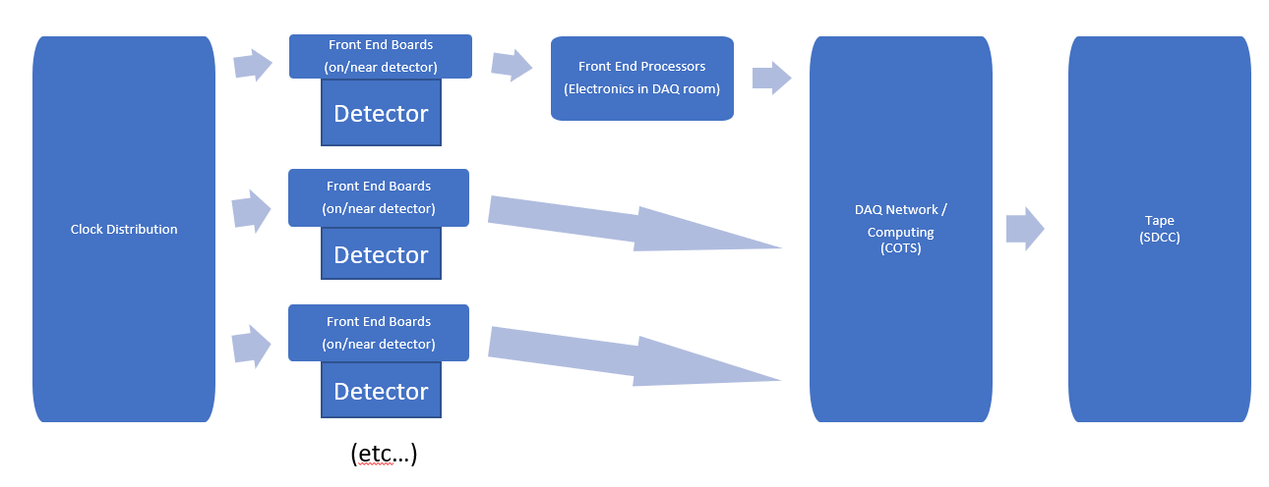
Clock Distribution:
Function:
Distribute a synchronized clock,
Synchronize detector timing with bunch structure,
Tag data with BX to synchronize detector data
share other information between detectors
bunch polarization
“prescaling”
Promising Technology:
lpGPT ecosystem
Attainable specs:
100Mhz clock rate (variable within reasonable parameters due to beam energy)
~5ps clock jitter
20gps transfer speeds

Slide 4
Front End Boards (FEB)
The collider performance:
~500KHz of collisions
~60-100Gbps zero suppressed data
~15 KB/event
~100 bytes/bunch crossing
We have an enormous number of channels but the Silicon MAPS readouts test the relevance of the concept of channel.
Challenging data compression scheme
Noise reduction
Zero suppression
Background elimination
Detector | Readout Technology | Channel Count
Silicon Tracking | Si MAPS | 37B
GEM/MMG Layer | GEM | 217K
Cylindrical MPGD * | GEM | 60M
HP-DIRC | MAP/MT | 100-330k
ECAL | SiPM | 1.7K
HCAL | SiPM | 24K
HCAL imaging | Si MAPS | 480M
dRICH | PMT/SiPM | 350K
mRICH | PMT/SiPM | 330K
B0 | Si MAPS | 32M + 320K
Off-Momentum | AC-LGAD (eRD24) | 750K
Roman Pots | AC-LGAD (eRD24) | 500K
ZDC | LGAD + ASIC eRD27 | 225+366
TOF | AC-LGAD | 15M

Slide 5
Front End Processors (FEP):
Consist of:
FELIX boards
Crates with FPGA based boards (ATCA, open VPX)
Function:
Aggregation of links from the FEBs
Data Compression
High level trigger processing
Event identification
Pattern recognition
Tracking
In general the FPGA processing has tradeoffs
Pro: Low latency, deterministic timing, well suited to Neural Nets / ML Algorithms
Con: Harder to program and adapt than CPUs, quickly become obsolete
Some of the disadvantages are mitigated by solutions such as the FELIX boards
The details of the aggregation, and the need for data compression in specific parts of the system will define the needs of the front end processors of the system

Slide 6
DAQ Network and Computing:
Commercial Off-the-shelf hardware / networks
The problem of data transport is easily manageable with a small farm
Many experiments CERN experiments, sPHENIX have higher rates
Event identification is not built into the hardware architecture of the streaming readout so new schemes will need to be built for:
Event identification, tracking, and accounting
Scalers
Data formatting and event building
High level triggering
Background reduction
Event tagging
Online QA
System control and configuration

Slide 7
Conclusions
Data compression will be key to the goal of taking all collision data
Zero-suppression
Noise management
Tracking or pattern recognition
Machine learning algorithms
Data transfer should be easily attainable with using a small farm
Much smaller data rate than CERN / sPhenix upgrade
The tasks of event identification, and event selection will not come automatically from the hardware architecture and must be inserted deliberately into the system using a High Level Trigger located either in the front end processing, COTS computing, or both.

