Slide 1
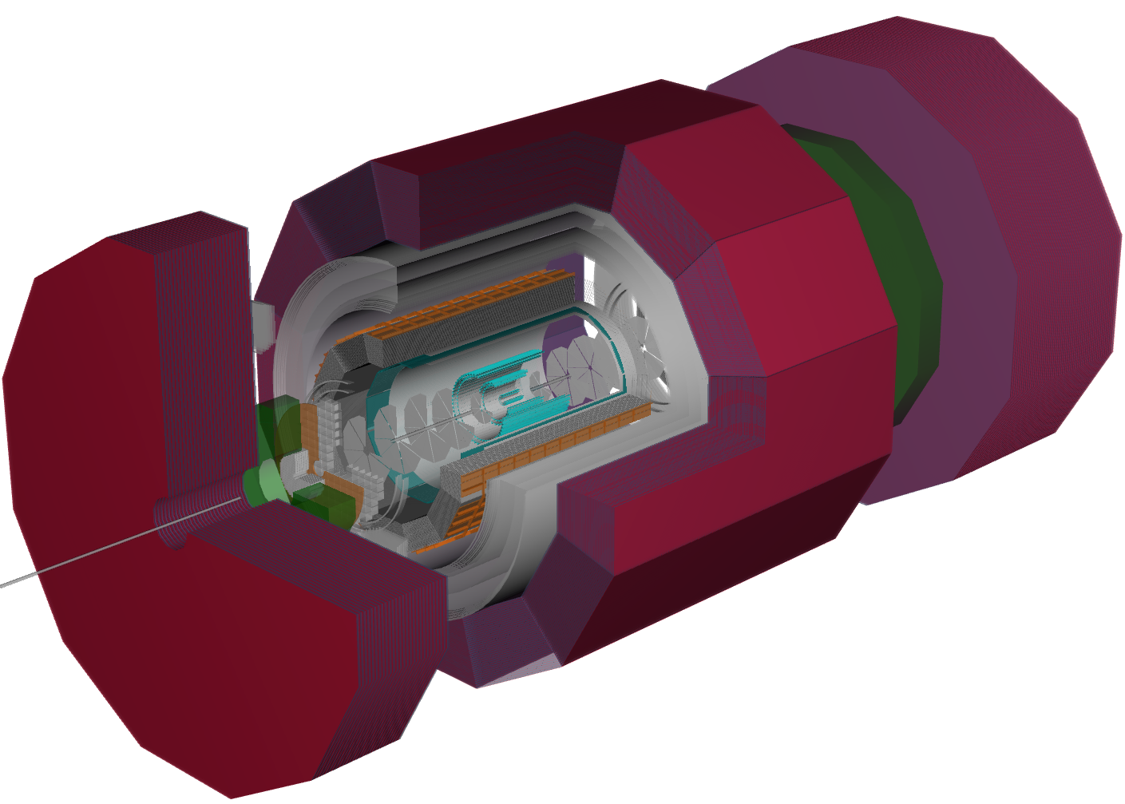
PID
TK Hemmick, R Preghenella, F Geurts for ATHENA

Slide 2
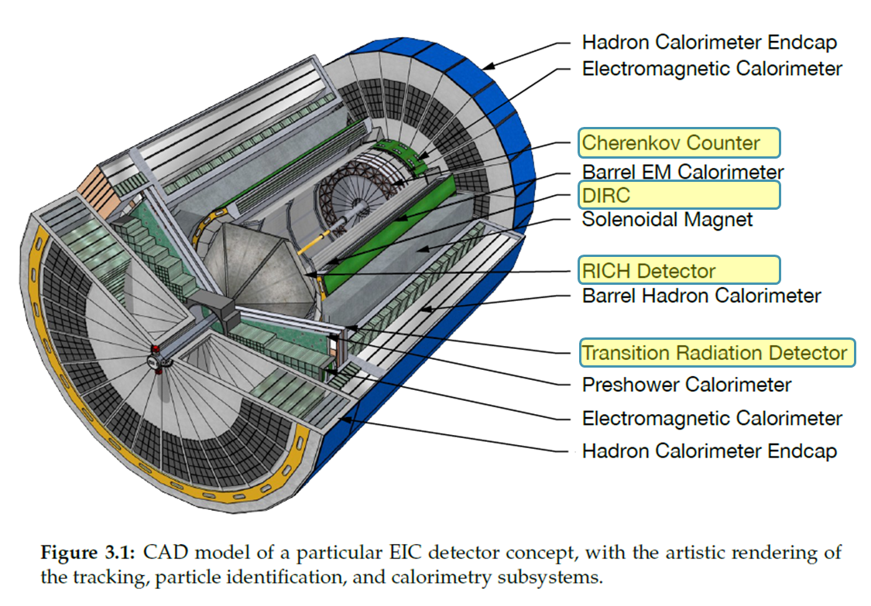
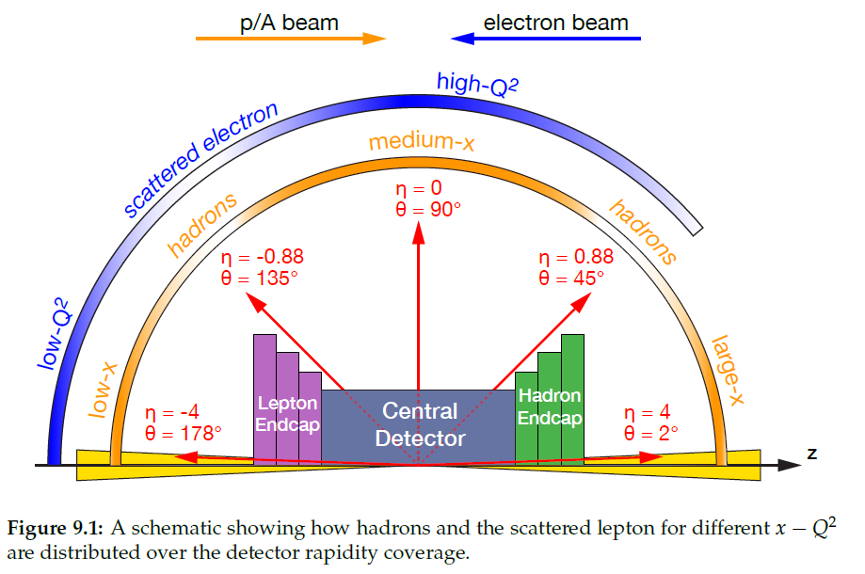
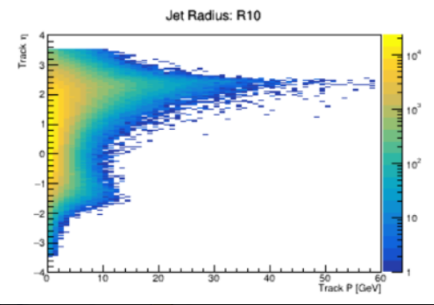
Yellow Report Detector
Strategy
Implement Minimal Config
mRICH Backward
DIRC Barrel
dRICH Forward
Define Competing Design(s)
Alternatives
Additions
Demonstrate efficacy for all technology beyond minimal
ATHENA in DD4HEP
ATHENA models closely the Yellow Report Concept.
PID is challenging in Asymmetric System.
Varied Technology w/ η

Slide 3
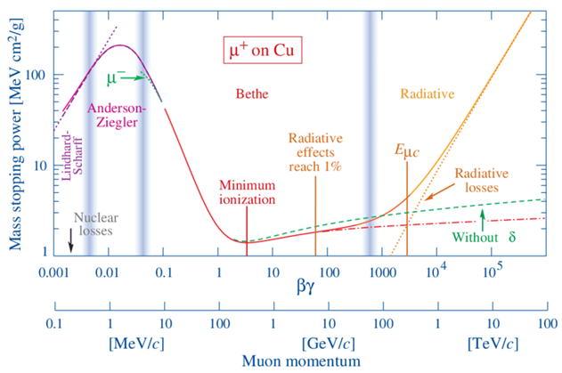
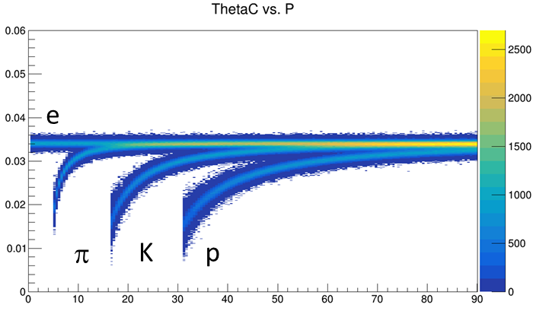
PID ~ Velocity
p = mγβ E = mγ velocity(β) measurement yields mass.
Direct measurement:
Record signal time at multiple locations, calculate v.
“Fast” detector = low transit time spread (most easily achieved at small transit time)
Velocity-dependent interaction(s) with detector:
Specific Ionization (aka $\frac{dE}{dx}$)
Cherenkov Radiation: $\cos{θ_{C}=\frac{1}{nβ}}$
θ_{C} measured wrt track direction.
Thus dependent upon deliverables from tracking
Bremsstrahlung: $P= \frac{q^{2}γ^{4}}{6πε_{0}c}\left({\dot{β}}^{2}+\frac{{\left(\vec{β}∙\dot{\vec{β}}\right)}^{2}}{1−β^{2}}\right)$
Transition Radiation: $I=\frac{Z^{2}e^{2}γω_{p}}{3c}$
eID mechanisms

Slide 4
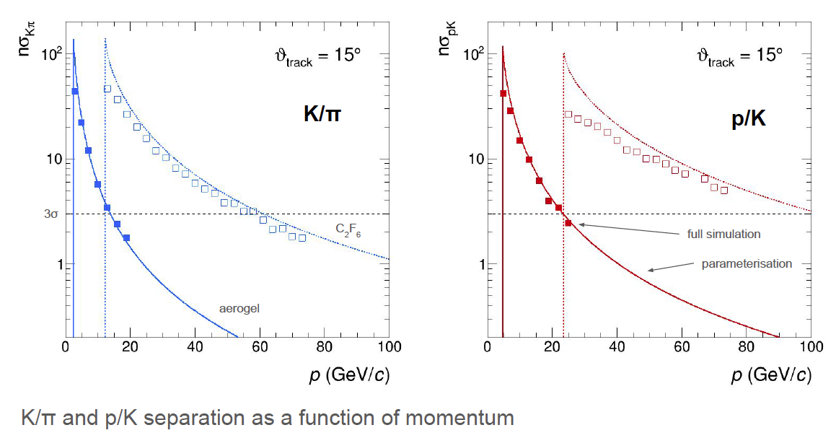
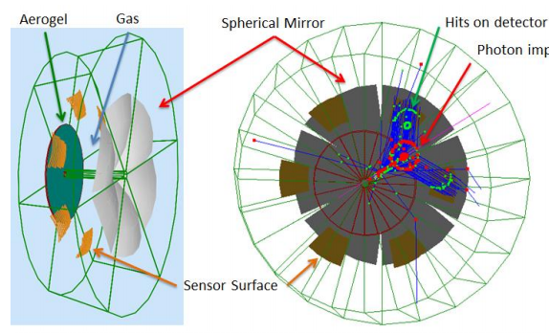
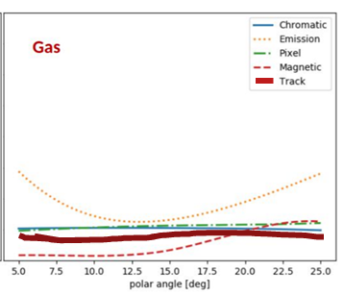
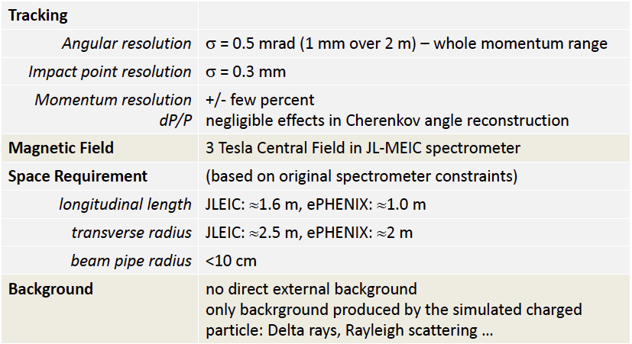
Hadron End: Dual RICH (dRICH)
Cherenkov radiator
○ Refractive Index
n = 1.02 (aerogel) 1.0008 (C₂F₆)
○ Length of the radiator
L = 4 cm (aerogel) , 160 cm (C₂F₆)
Mirrors
Photon Detector
3 mm pixel size; 200-500 nm MAPMT
Particle Generation
Originate from the vertex
Exquisite detail in simulation.
AI-based optimization.
Uses constant external angular resolution assumption.
Similar external constraint assumed as deduced for separate gas & aerogel RICHes
Tracking maybe tolerates ~2X sim (0.5 – 1.0 mrad)
NOTE: PMTs to the side makes optical aberration (“Emission”) dominant

Slide 5
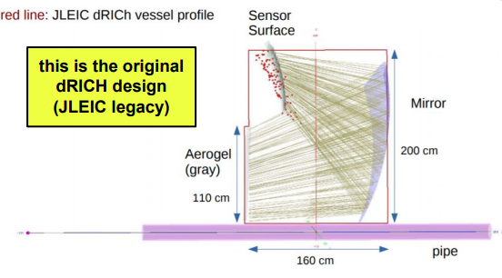
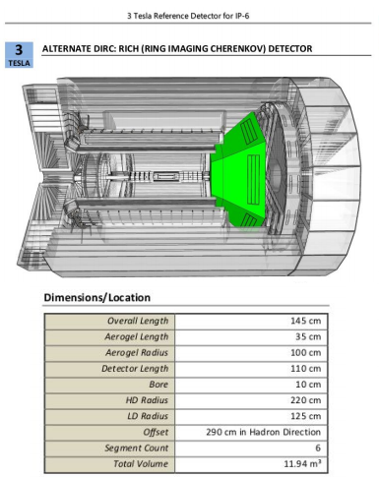
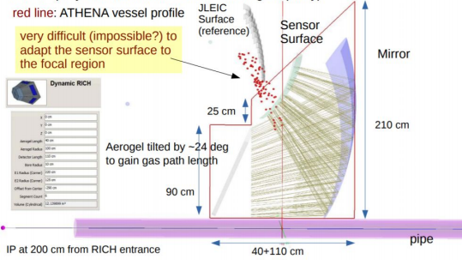
dRICH in ATHENA
“Menagerie” Implementation
Much work has gone into refining the optics beyond the menagerie.

Slide 6
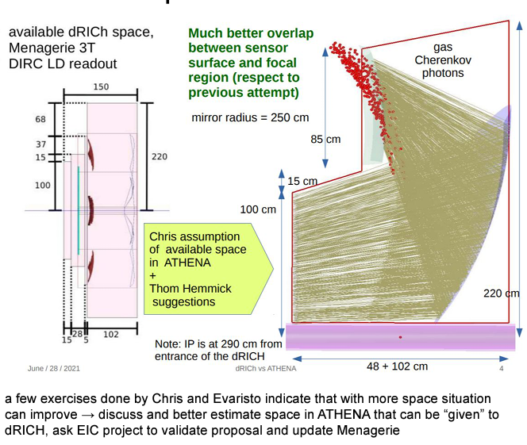
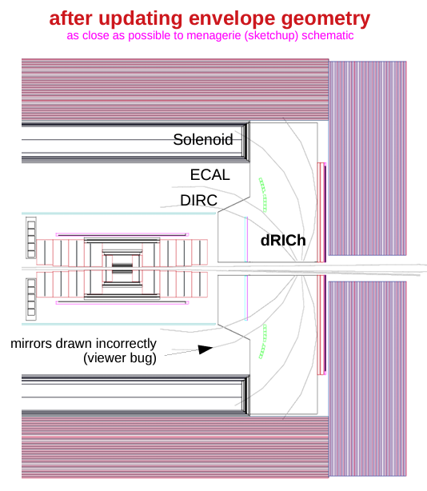
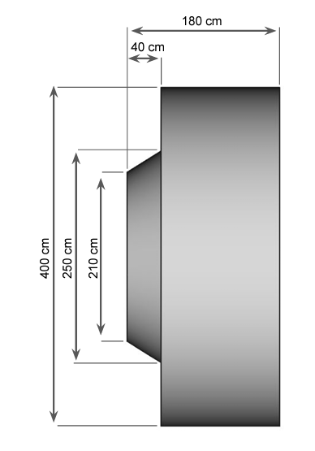
Current dRICH Model
Dramatic improvement of optical performance.
Present studies target the full system performance:
Internal RICH parameters
External Detector influence.
Cautionary Note:
Nominally RICH runs with 1 atm “heavy gas” (fluorocarbons: CF₄, C₂F₆, C₄F_{10,} C₄F₈O, …)
Environmental Considerations threaten this future.
Even if you scavenge gas, you still must buy it.
3 bar Ar foreseen as a viable substitute for C₂F₆
Requires safety engineering.

Slide 7
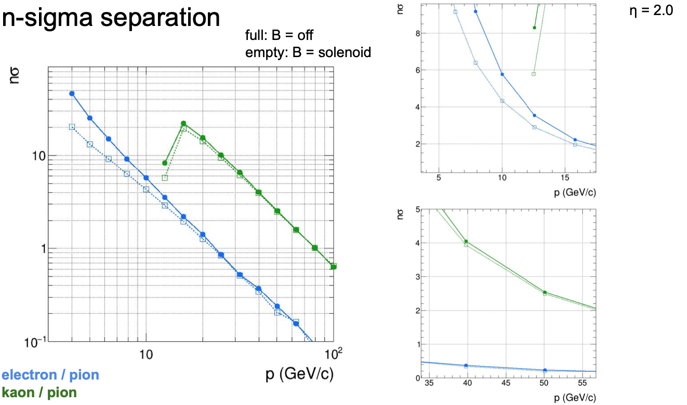
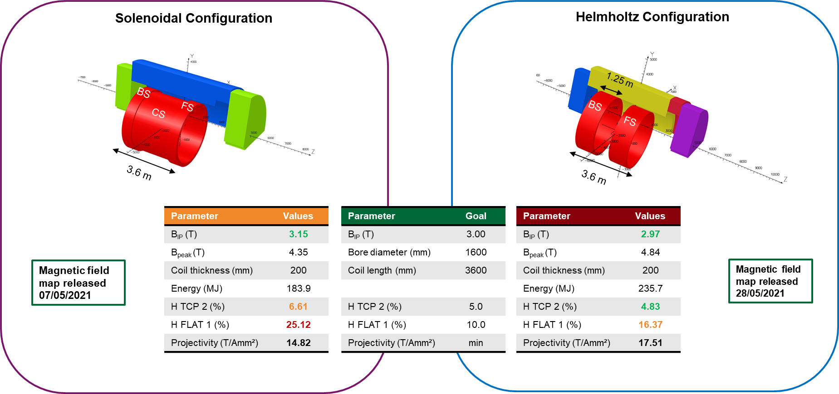
Magnet Optimization
Competing Optimizations:
Homogeneity in the barrel.
Projectivity in the End Cap
Impact dominant at:
lowest momentum.
Lightest mass (e-π has most impact)
Detailed simulations show non-zero but tolerable impact.

Slide 8
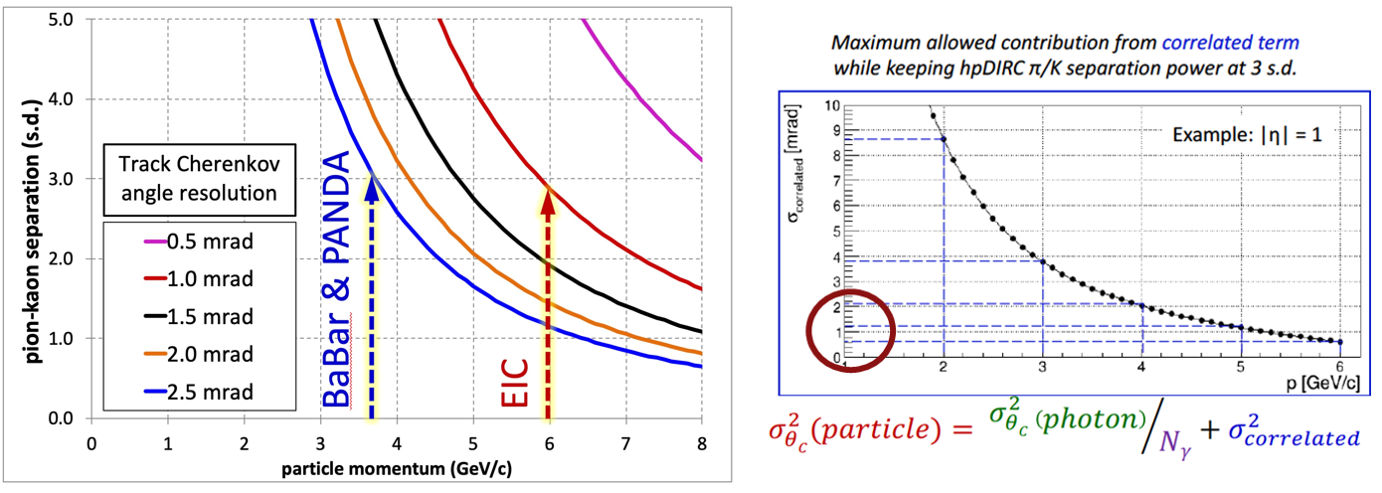
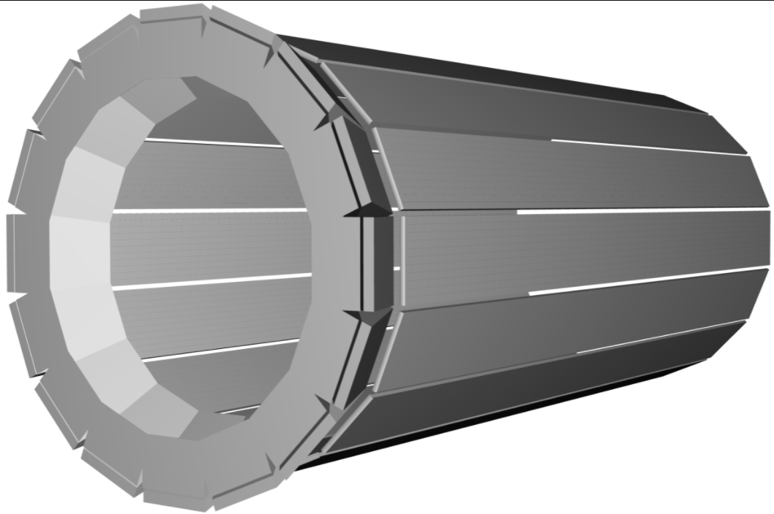
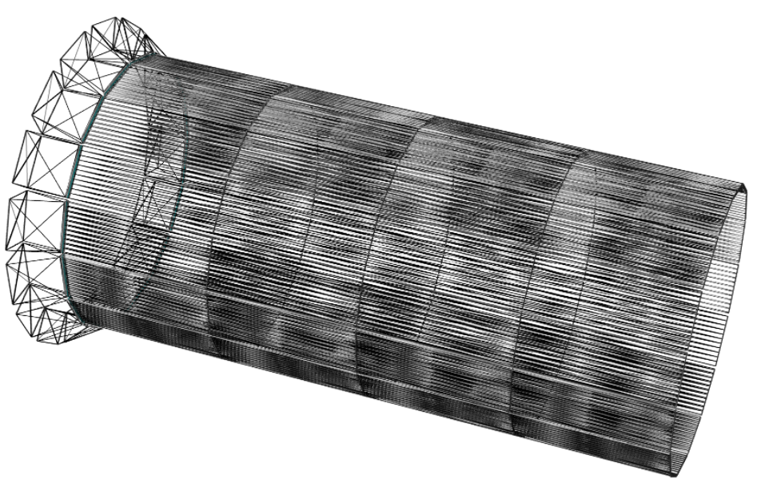
hpDIRC in Barrel Region
At normal incidence, Cerenkov light is internally reflected for $n>\sqrt{2}$
Original BaBar DIRC was effectively “proximity focused”
hpDIRC section creates focused ring improving resolution.
π-K to 6 GeV/c
Strict requirements on “correlated terms”, (e.g. angular resolution of tracking)
DIRC in DD4HEP

Slide 9
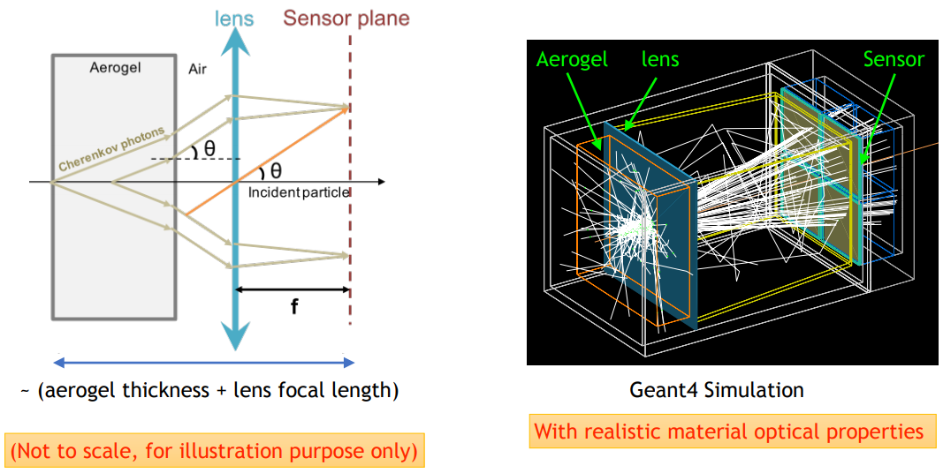
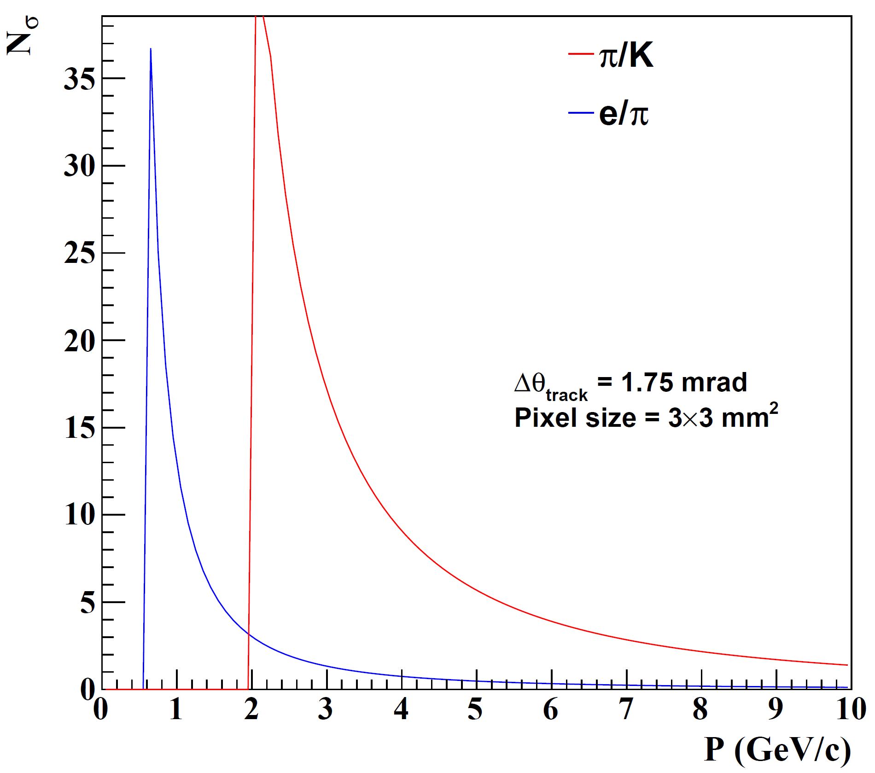
Electron Arm: Modular RICH (mRICH)
Cherenkov radiator
(Aerogel) refractive index, n = 1.03
Length of the radiator, L = 3cm
lens with focal length, 𝑓= 6”
Photon Detector
3 mm pixel size
Hadron ID requirements relaxed…aerogel only
Additionally require eID ~ 4GeV/c
Modular RICH focused by Fresnel Lens
Sharp image improves resolution.
Transmission of lens combats dispersion
Provides TOF with suitable readout device (LAPPD)
NOTE: Similar performance to aerogel in dRICH

Slide 10
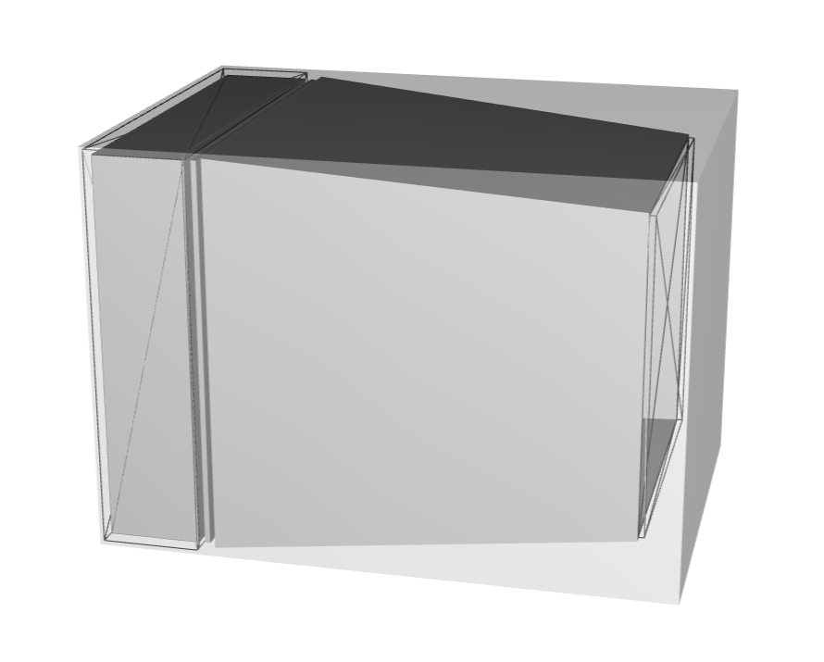
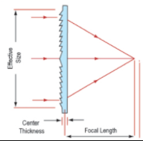
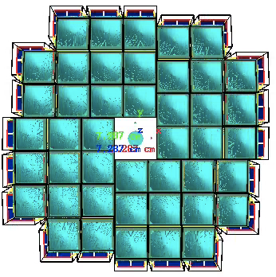
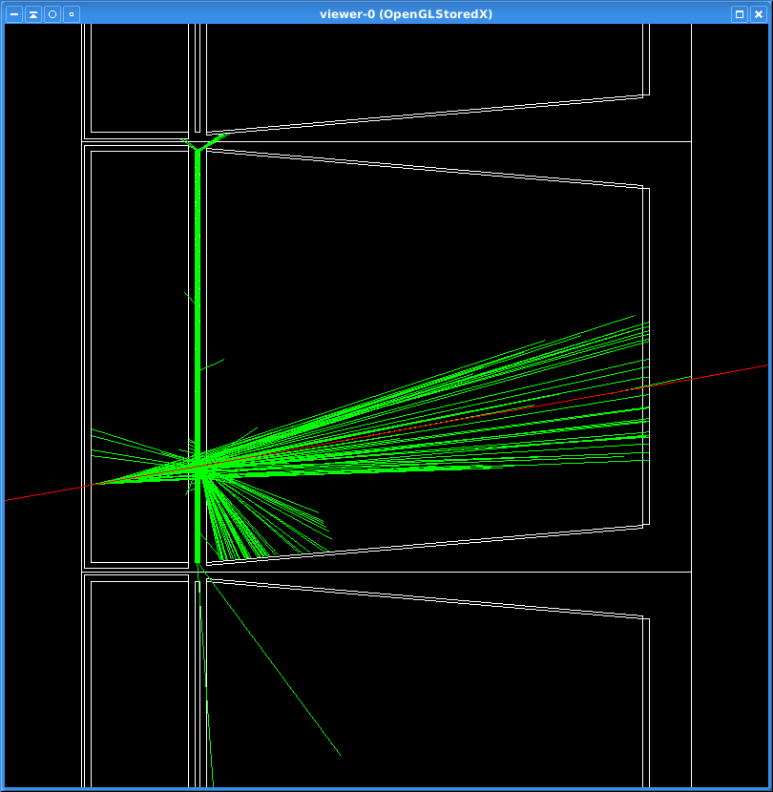
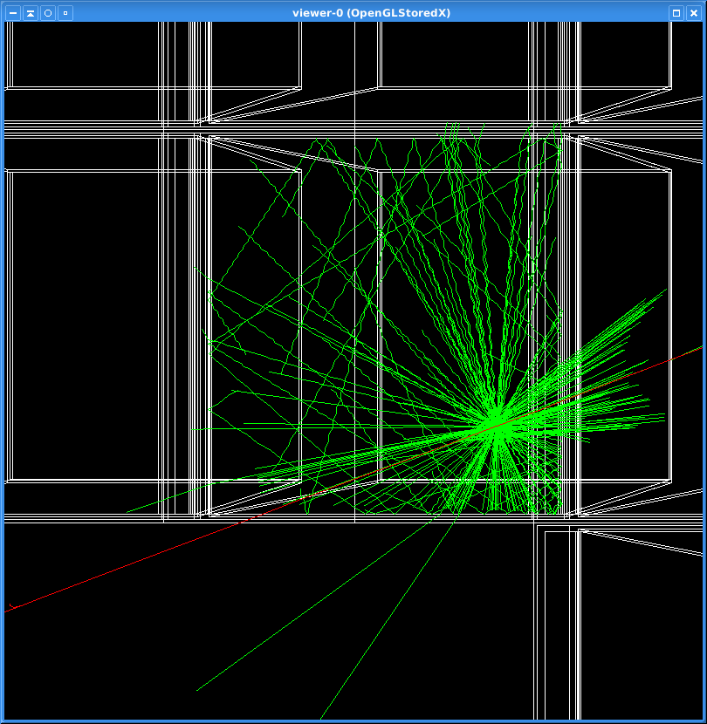
mRICH in Backward Region
Cherenkov Photons in DD4HEP
Implemented as a pseudo-projective array:
Detector envelope ~planar in Zed.
Individual modules tilted toward nominal collision point.
Advanced stage of implementation in DD4HEP
Test Beam Implementation:
LAPPD Readout
TOF for particle & Cherekov Light

Slide 11
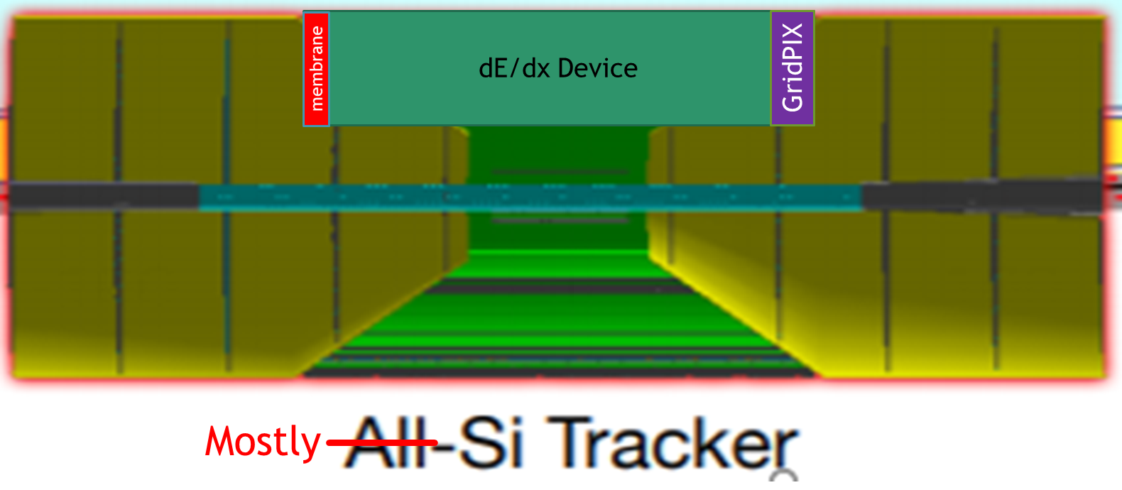
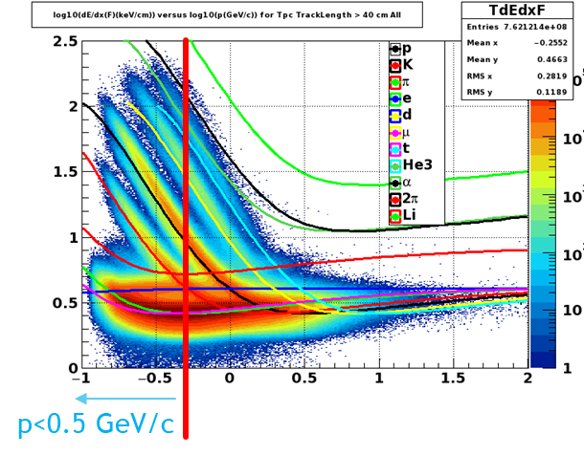
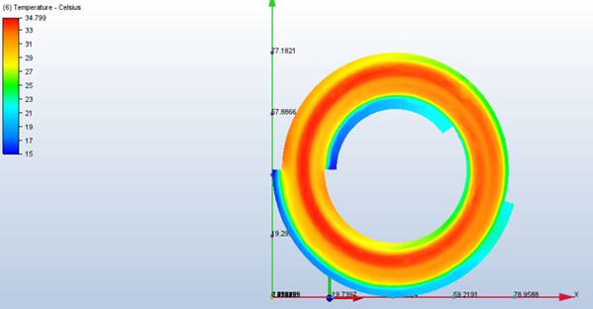
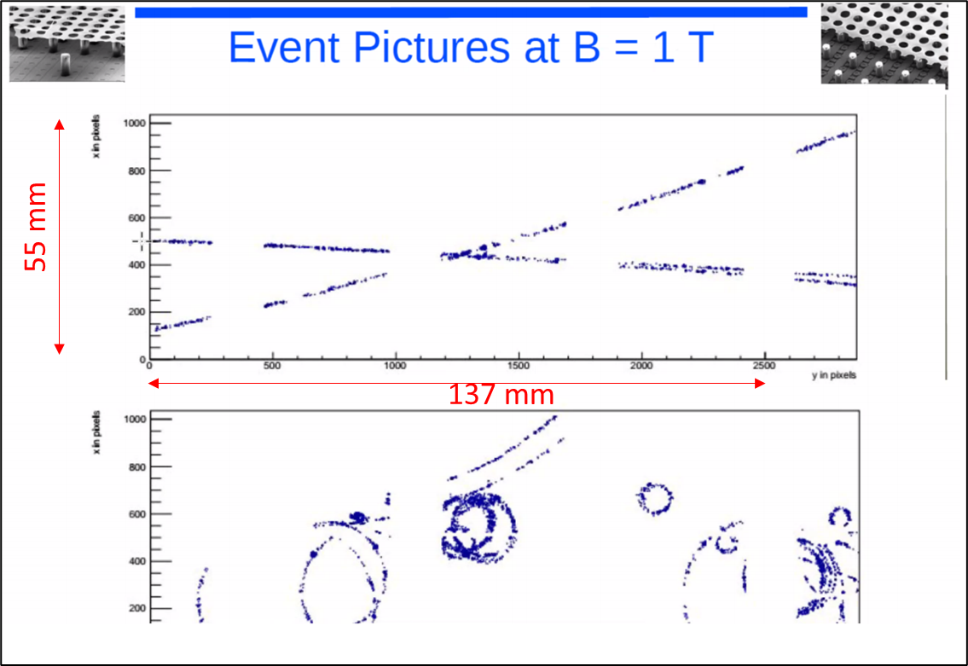
Beyond the Baseline Options: Low p in Barrel via GridPIX
The opportunity:
DIRC has low-p limitations:
Curl Up (0.45 GeV/c)
Kaon threshold (0.47 GeV/c)
Desired: PID at low radius.
First Option: dE/dx measurement
Separations large
1.6X pi-K
2.25X K-p
GridPIX is ultimate dE/dx device.
Avalanche grid in front of 55 x 55 μm² pixels.
>90% efficiency for single electrons.
Established; Robust; Excellent tracking
Topological Decays added to physics program
Challenge is removing the heat.
Pessimistic
Optimistic
Test Beam
<40ºC
6% R.L.

Slide 12
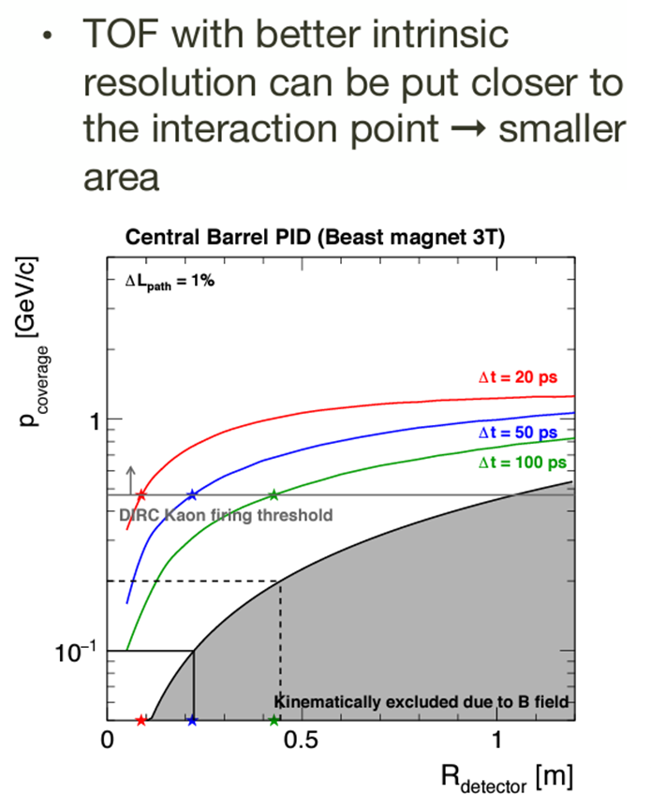
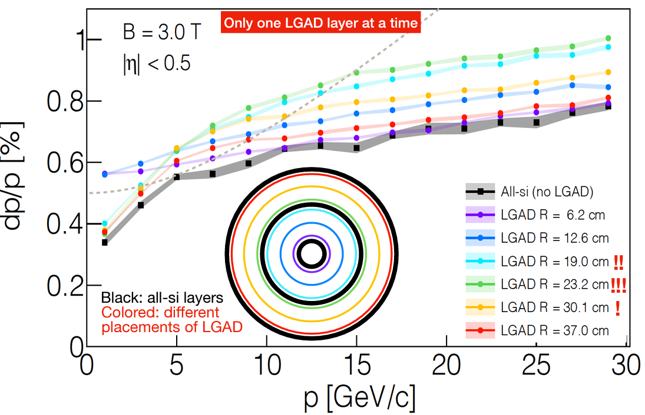
Beyond the Baseline Options: Low p in Barrel by TOF
Assumes LGAD Layer(s)
~20 psec/layer
Competition with Multiple factors:
Radius, Resolution, Kinematic limit
Low-p goal | TOF Radius | $$σ_{t}≡\frac{Δt(p=0.45\frac{GeV}{c})}{3}$$ | Tracking Impact?
100 MeV/c | ~22 cm | 17 psec | Yes
200 MeV/c | ~43 cm | 33 psec | No
Maximal
Tracking
Impact

Slide 13
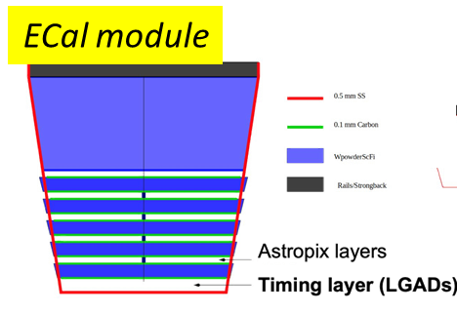
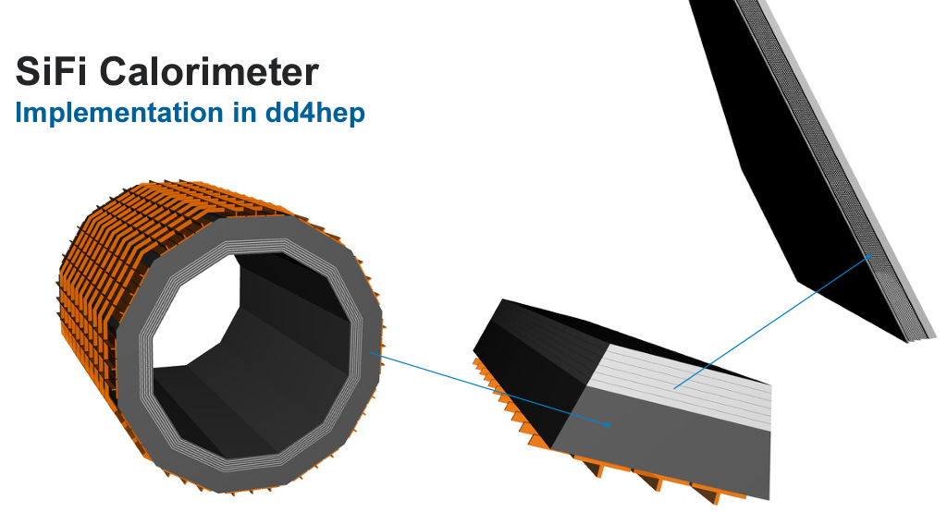
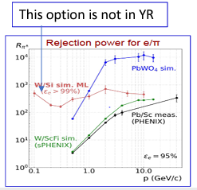
EMCAL with Intrinsic TOF
TOF Opportunity!
The opportunity:
Imaging calorimeter dramatically improves e-π separation at low momentum.
To allay costs ATHENA proposes hybrid solution:
Initial few layers are imaging (Astropix)
Late shower W-power SciFi
Calorimetric considerations start with absorber.
LGAD as the opening layer adds TOF capability at the largest radius (~20 psec)

Slide 14
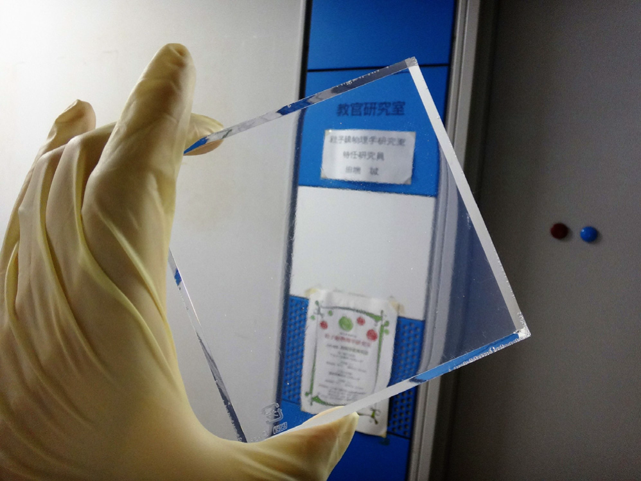
Aerogel-RICH layout
SiPM HPK 13360 3050CS
3x3 mm² pixel
Dark rate ~ 50 kHz/mm²
50 ps time resolution
Aergoel n=1.03, p.d. @ R=1.2 m, HPK 13360 3050CS (pixel 3x3 mm², DCR 50 kHz/mm², 90% fill factor)
single particle events
uniform energy distribution
isotropic angular distribution
origin from (0, 0, 0)
one particle per event: e⁻ π⁻ μ⁻ K⁻ p
10 k events/particle
Pythia8 pp collisions
√s = 14 TeV
c-cbar biased processes
100k events
Pythia8 Xe-Xe collisions
√s = 5.76 TeV
minimum bias
1k events
The opportunity:
DIRC has p-K up to 6 GeV/c
Jet physics wants 10 GeV/c
Aerogel RICH can extend range
SiPM
Single layer aerogel
Hydrophobic aerogel
L=2 cm
d ~ 20 cm
Baseline layout:
no focusing
n=1.03 aerogel layer
Photodetector (SiPM HPK 13360 3050CS)
$σ_{θ_{c}}$ (p.e.) = $\sqrt{σ_{θ_{c}}^{2}\text{ (}\text{chromatic}\text{)}\text{+}σ_{θ_{c}}^{2}\text{ (}\text{geometric}\text{)}\text{ +}σ_{θ_{c}}^{2}\text{ (}\text{pixel}\text{)}\text{ +}σ_{θ_{c}}^{2}\text{ (}\text{noise}\text{)}}$ = 7.2 mrad
1.1 mrad | 6.1 mrad | 3.7 mrad

Slide 15
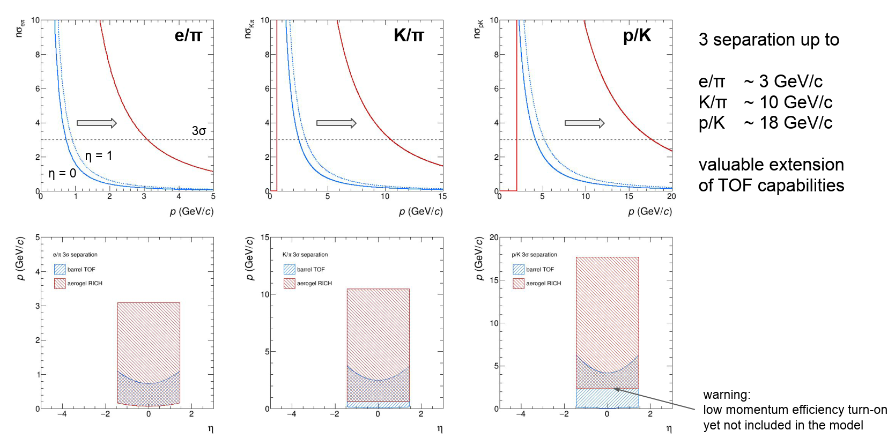
Barrel RICH results in the fast parametric model
R. Preghenella

Slide 16
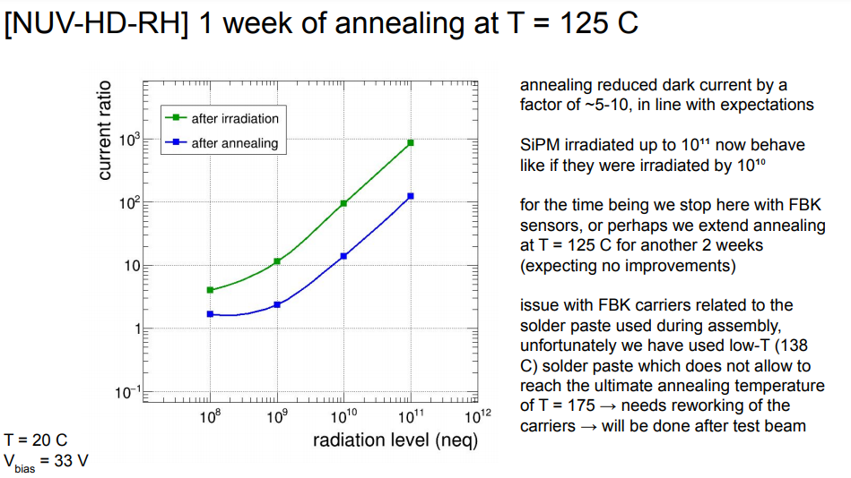
SiPM for RICHes? R&D Required
The ATHENA 3T magnetic field is excellent for physics.
3T is challenging for most single photon detector technologies
SiPM can suffer radiation damage
Limited impact to calorimeters (~pedestal shift)
Significant impact to RICH (single photon signals!)
Is annealing helpful?
Dark Rate drops ~1 order of magnitude following annealing
138º anneal limited by solder.
High annealing temp in the future.
Basic Concept:
Cooling system (e.g. fluid) doubles as heater.
First results promising.
Higher Temperature annealing to be tried in the future.

Slide 17
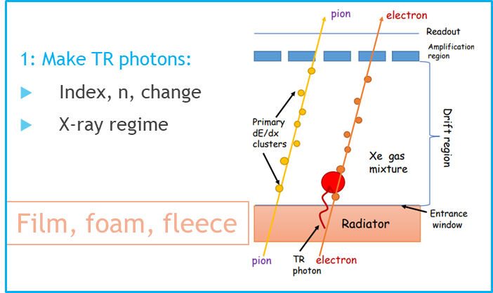
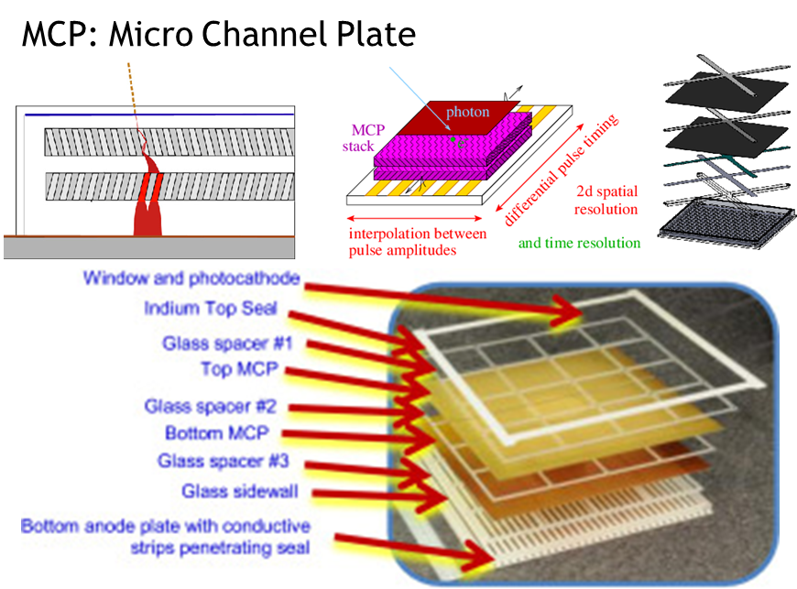
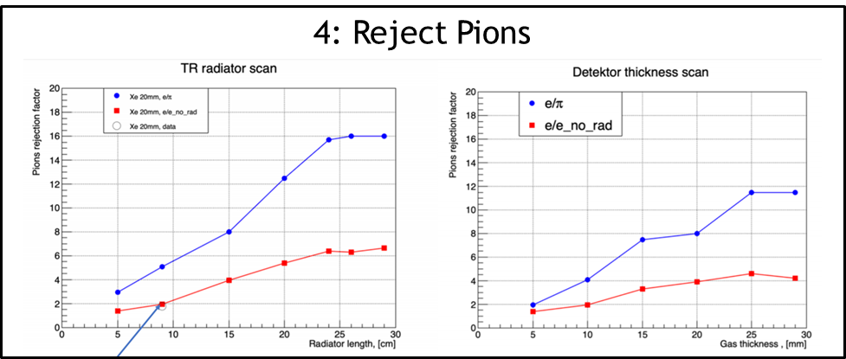
More Opportunities: TRD & Endcap TOF
The opportunity:
Improved eID Backward
Vector meson → e⁺e⁻ Forward
Transition Radiation Detector
The opportunity:
dRICH can miss softest particles
TOF will not miss them
LAPPD has best σ_{t}~5 psec.
NOTE: Possibility in backward direction to combine TOF with mRICH

Slide 18
Summary
ATHENA ongoing development is simulated in stages:
Minimal configuration:
mRICH Backward; DIRC Barrel; dRICH Forward
Performance and Physics reach of minimal challenged by simulated options
Low p PID in the barrel
GridPIX; LGAD TOF
High p PID in the barrel (beyond DIRC)
Barrel RICH;
Low p in the Forward Endcap
LAPPD TOF measurement
eID in the Endcap(s)
TRD
Detector configuration final decision based upon realistic Monte Carlo
Physics impact leads to down-select.
Baseline simulations nearly ready.
Some options in advanced stage.

