Slide 1

CORE Far-Forward Detectors
EICUG Annual Meeting
1-5 August 2021
https://indico.bnl.gov/event/11463
Charles Hyde
Old Dominion University
Norfolk VA
https://eic.jlab.org/CORE

Slide 2

IP8
Forward Dipole:
ionBXSP01
Far-Forward,
Off-Momentum
Tracker $z∈\left[24, 36\right]$m
  ZDC: $z≈36$m.
Secondary focus: z=45 m.
  x_{L} acceptance up to 0.99 at p_{T} = 0, and up to 0.997 at p_{T} = 1 GeV (P=275 GeV)
Far Backward: 0° tagger (AKA low-Q² tagger).
  After first downstream-electron dipole.

Slide 3
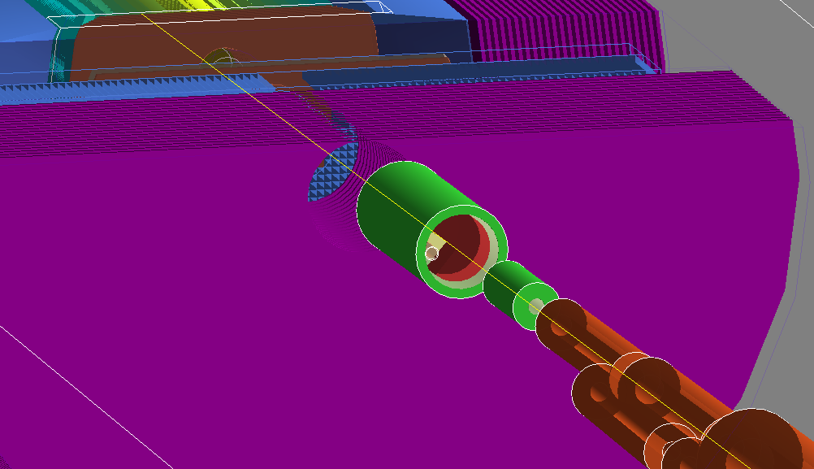

IP8 (first) Forward Dipole
Forward Dipole: ionBXSP01
  Approx. [7,20] mrad partial acceptance
  Fixed Si Tracker disk layers
    Pile-up (up to 500 KHz from ep physics)
    Beam-Gas calculations in progress (eRD21)
    Marginally compatible with MAPS
    At least one AC-LGAD layer
  20 cm PbWO₄ EMCal
    10 cm for nuclear decay photons
    20 cm for pi0
Quan Wang (KU) eRD27

Slide 4
IP-8 Optics with Secondary Focus
Neutrons ±7mrad
Protons ±5mrad
  Δp/p = 0, x_{L}=1
  𝑝_{T} ≤ 1.37 GeV
Protons ±7mrad
  Δp/p = –0.5, x_{L}=0.5
  𝑝T = 0.96 GeV

Slide 5
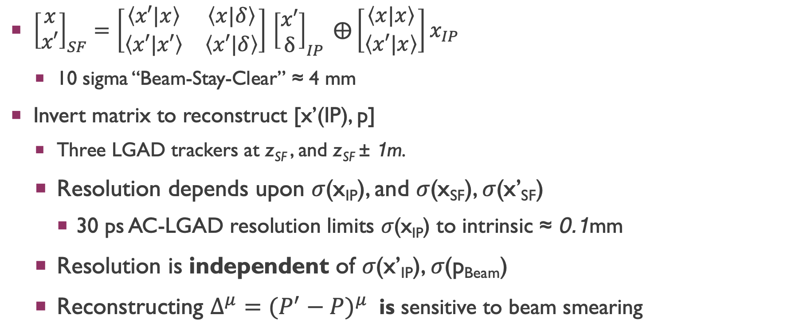
First Order Optics @ Secondary Focus
Jentsch
Acceptance study
${\left[\begin{matrix}x \\ x′\end{matrix}\right]}_{SF}=\left[\begin{matrix}\left\langle x′|x\right\rangle & \left\langle x|δ\right\rangle \\ \left\langle x′|x′\right\rangle & \left\langle x′|δ\right\rangle \end{matrix}\right]$ ${\left[\begin{matrix}x′ \\ δ\end{matrix}\right]}_{IP} ⨁\left[\begin{matrix}\left\langle x|x\right\rangle \\ \left\langle x′|x\right\rangle \end{matrix}\right]x_{IP}$
  10 sigma “Beam-Stay-Clear” ≈ 4 mm
Invert matrix to reconstruct [x’(IP), p]
  Three LGAD trackers at z_{SF} , and z_{SF} ± 1m.
  Resolution depends upon 𝜎(x_{IP}), and 𝜎(x_{SF}), 𝜎(x’_{SF})
    30 ps AC-LGAD resolution limits 𝜎(x_{IP}) to intrinsic ≈ 0.1mm
  Resolution is independent of 𝜎(x’_{IP}), 𝜎(p_{Beam})
  Reconstructing $Δ^{μ}={(P^{′}−P)}^{μ}$ is sensitive to beam smearing
x_{L} ≈ (1–x_{B})

Slide 6
ZDC
ALICE/FOCAL inspired design
High resolution PbWO₄ EMCal in two layers 10X₀ & 15X₀:
First layer for nuclear decay photons.
  ²⁰⁸Pb*: every decay cascade has at least one photon ≥ 2.6 MeV.
  →Boost to ≥ 260 MeV.
Total absorption
  Decay photons from 𝜋⁰
  Up to ~full beam energy 275 GeV
W/Si
Pb/Si
Pb/Sci
PbWO₄

Slide 7
ZDC Neutron Resolution: (Shima Shimizu, eRD27)
W/Si
Pb/Si
Pb/Sci

Slide 8
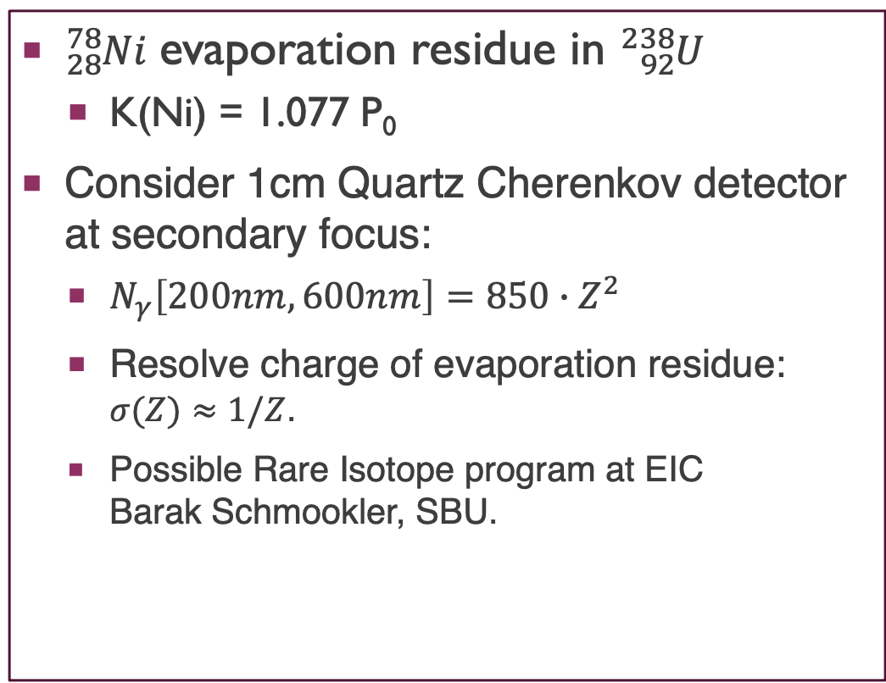
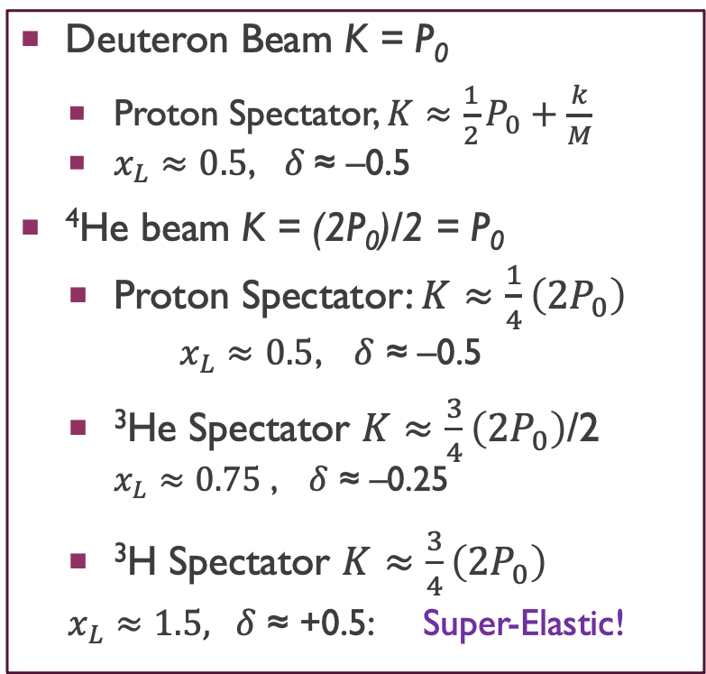
RigiDity of Off-Momentum Particles: K = P/Q
Deuteron Beam K = P₀
  Proton Spectator, $K≈\frac{1}{2}P_{0}+\frac{k}{M}$
  $x_{L}≈0.5$, 𝛿 ≈ –0.5
⁴He beam K = (2P₀)/2 = P₀
  Proton Spectator: $K≈\frac{1}{4}\left(2P_{0}\right)$
  $$x_{L}≈0.5\text{, }\text{δ}\text{ ≈ –0.5}$$
  ³He Spectator $K≈\frac{3}{4}\left(2P_{0}\right)$/2
    $x_{L}≈0.75$ $\text{, }\text{δ}\text{ ≈ –0.25}$
  $\text{3}\text{H} \text{Spectator} K≈\frac{3}{4}\left(2P_{0}\right)$
  $x_{L}≈1.5\text{, }\text{δ}\text{ ≈ +0.5}$: Super-Elastic!
${}_{28}^{78}{Ni}$ evaporation residue in ${}_{92}^{238}U$
  K(Ni) = 1.077 P₀
Consider 1cm Quartz Cherenkov detector at secondary focus:
  $N_{γ}\left[200nm,600nm\right]=850∙Z^{2}$
  Resolve charge of evaporation residue: $σ(Z)≈1/Z$.
  Possible Rare Isotope program at EIC
  Barak Schmookler, SBU.

Slide 9
Options for the Off-Momentum Detectors
Fixed Detectors outside the vacuum envelope
  Simpler. Less interference with ZDC. More options for Detectors
  Mutiple scattering in beam pipe from shallow crossing angles
    Vacuum pipe fills main dipole aperture of 40 cm bore
    Zig-zag beampipe envelope at +20mrad, –100 mrad angles → all particles exit at ≤ 100 mrad
Fixed Detectors inside the vacuum envelope
  Profile is large to avoid envelope of particles to be detected at RP position of 45 m.
Roman Pots inside the vacuum envelope
  Perhaps needed to cover full ion range from 41 MeV to 275 MeV

Slide 10
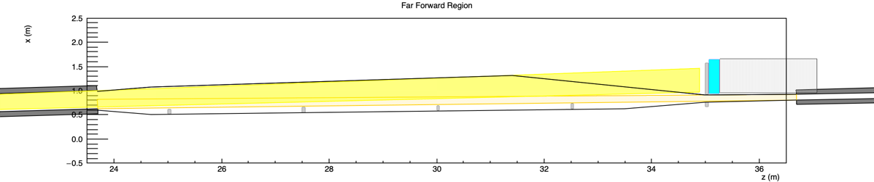
Concept for Fixed Off-Momentum Trackers in vacuo
±7 mrad neutron cone
PWO
ZDC-HCal
ionBXDS01A
ionBXDS01B
±5 mr, 𝛿=0 Secondary Focus envelope
𝛿<–0.1, ≤±5mr envelope (at IP) exits forward beam envelope at ≤ 20 mrad
Particles tracked in up to 3 stations at z= 25.0, 27.5, 30.0, 32.5, 35.0 m
  Exit window 100 mr to final tracking station and ZDC.
minor ZDC conflict with ionBXDS01B (to be resolved…)

Slide 11
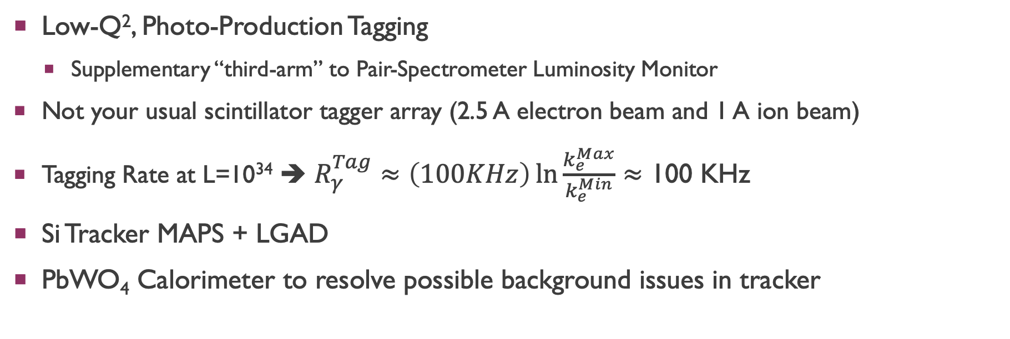
Far BacKWard
Low-Q², Photo-Production Tagging
  Supplementary “third-arm” to Pair-Spectrometer Luminosity Monitor
Not your usual scintillator tagger array (2.5 A electron beam and 1 A ion beam)
Tagging Rate at L=10³⁴ ➔ $R_{γ}^{Tag}≈\left(100KHz\right)\ln{\frac{k_{e}^{Max}}{k_{e}^{Min}}}≈$ 100 KHz
Si Tracker MAPS + LGAD
PbWO₄ Calorimeter to resolve possible background issues in tracker

Slide 12
Open to New Ideas,
Collaboration with
ECCE, ATHENA, and OThers
Thank you
With support from
DOE, BNL, SURA-CNF, SBU-CFNS

