Slide 1
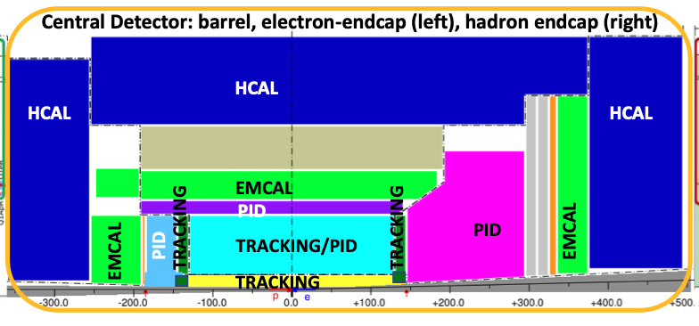
EIC reference detector layout
We need inputs from you about
The tracking detector technologies.
work on the corresponding simulation configuration and evaluation.
Detector integration.

Slide 2
The most relevant and urgent questions in the tracking sector
Who wants to join the tracking simulation now?
Physics requirements: heavy flavor, jets, SIDIS, Inclusive, Exclusive, Diffractive and tagging, precision electroweak, the other topics?
Better to merge into a table of the specific tracking requirements.
Integration between gas and silicon detectors:
e.g., integrations in the barrel, forward and rear regions.
Joint mechanical design for the barrel, forward and rear tracking detectors?
Costs and risks:
Complementary options to mitigate the costs and risks?
Any risks for the proposed detector technologies to be able to fit in the EIC timeline?

Slide 3
Detector Technology Matrix
Technology options: silicon (MAPS, …), gas (MPGD, …)
Kin & Tech | Rear Si | Rear Gas | Barrel Si | Barrel Gas | Fwd Si | Fwd Gas
Tech. Candidate
Institution/consortium
Geometry
R&D/Cost/schedule
Simulation status

