Slide 1
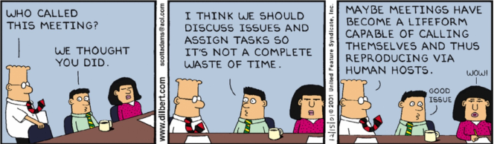
ECCE 10th
Bi-Weekly Meeting
On behalf of the ECCE Steering Committee
Or Hen, Tanja Horn, John Lajoie

Slide 2
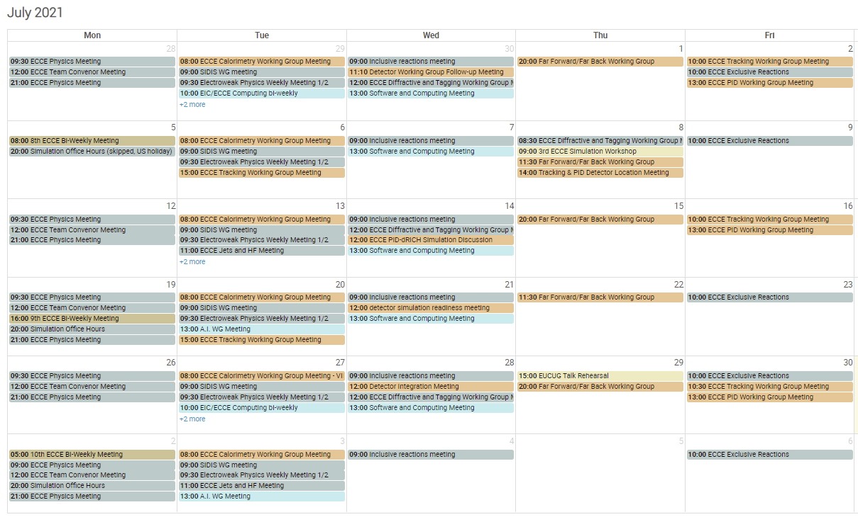
It’s Been Another Busy Month!
65 ECCE meetings and one workshop in July!
https://indico.bnl.gov/category/339/calendar

Slide 3
ECCE Consortium
Website:
https://www.ecce-eic.org/
Mailing Lists:
https://lists.bnl.gov
ecce-eic-public-l
ecce-eic-ib-l
ecce-eic-dei-l
ecce-eic-det-l
ecce-eic-phys-l
ecce-eic-prop-l
Indico:
https://indico.bnl.gov/category/339/

Slide 4

Consortium
80 Institutions
courtesy of Or Hen

Slide 5
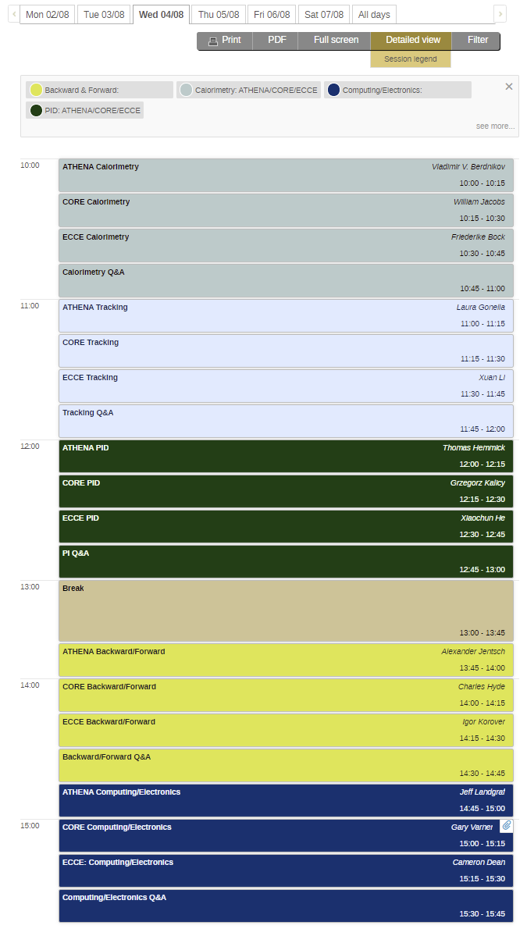
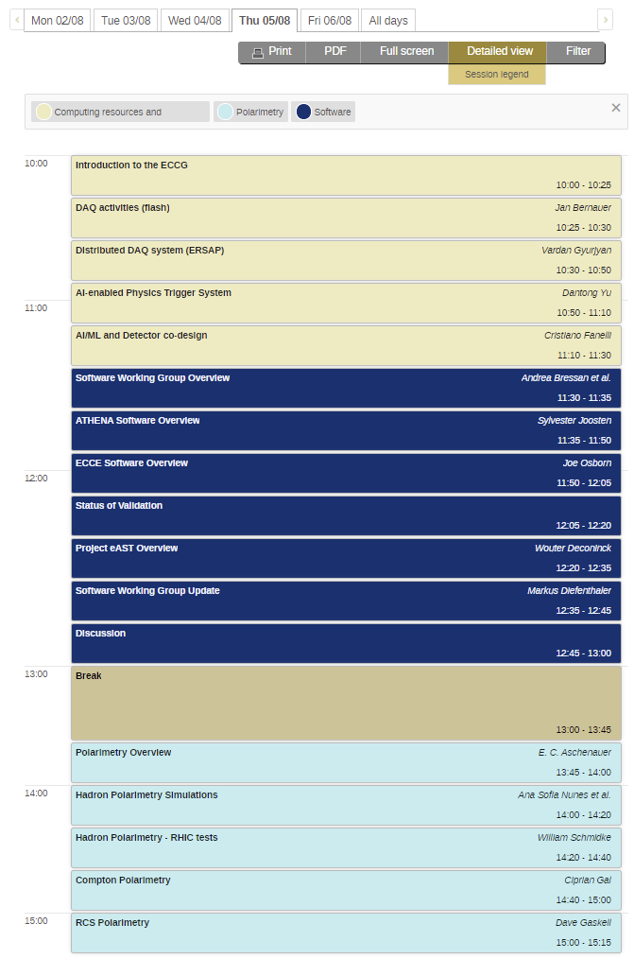
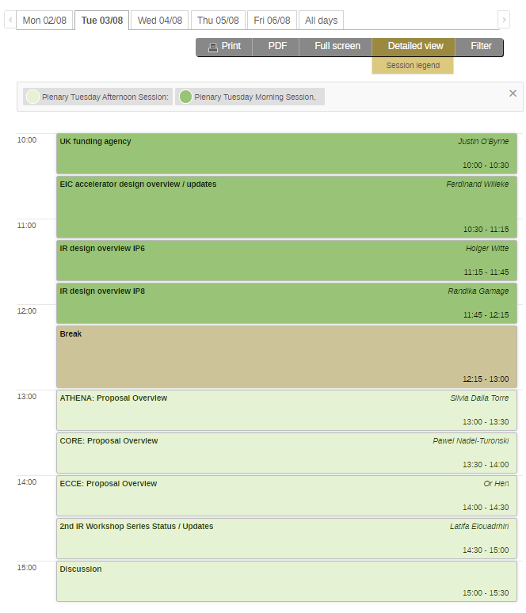
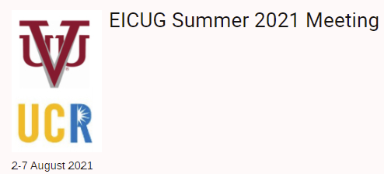
2021 EICUG Summer Meeting
Great showing by our ECCE collaborators!
Looking forward to having the hard work of the consortium showcased to the EIC community!

Slide 6
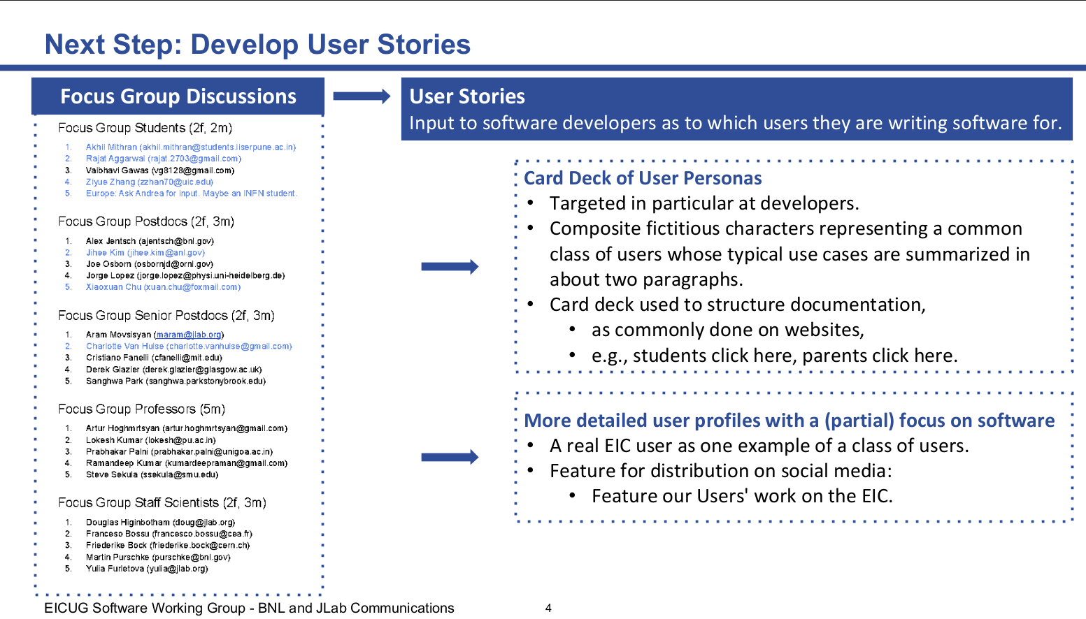
ECCE in the News!
EIC Software Working Group User-Centered Design
User interviews to be published on BNL and JLab websites:
Tuesday, August 3:
  Rachel Montgomery
  (University of Glasgow)
  Vaibhavi Gawas
  (Indian Institute of Technology at Madras).
Thursday, August 5:
  Alexander Jentsch
  (BNL)
  Prabhakar Palni
  (Goa University).
Important outreach to put a human face on the exciting science we work so hard to do!

Slide 7
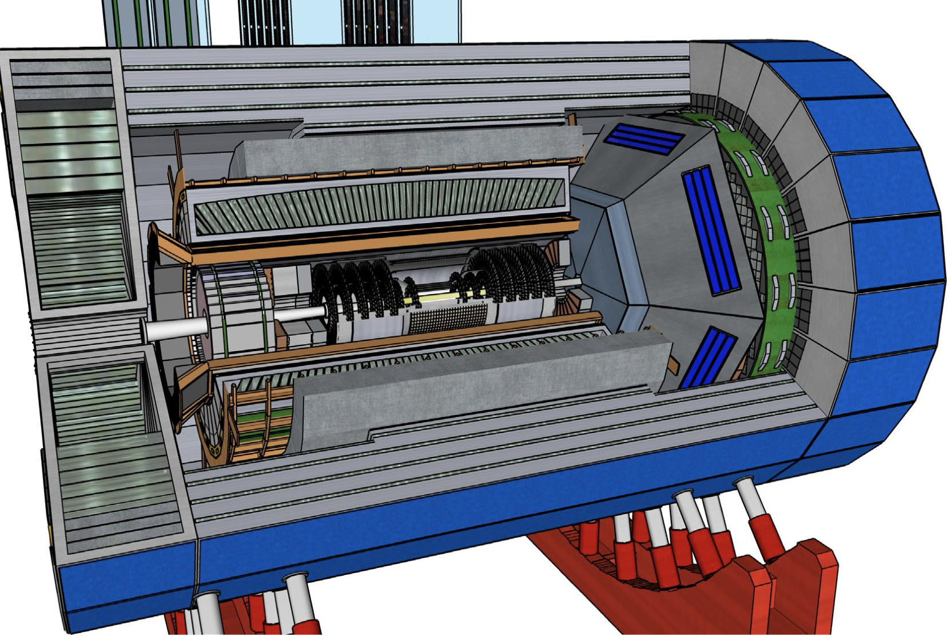
ECCE Detector W.I.P.
ELECTRON ENDCAP
Tracking: Large area μRWELL
Electron Detection:
  Inner: PbWO4 crystals (reuse some)
  Outer: SciGlass (backup PbGl)
h-PID: mRICH & AC-LGAD
HCAL: Fe/Sc (STAR re-use)
CENTRAL BARREL
Tracking: MAPS Si for vertexing and endcaps
(design to be optimized)
Electron PID: SciGlass (alt: PbGl or W(Pb)/Sc shashlik)
(plus instrumented frame)
h-PID: hpDIRC & AC-LGAD
HCAL: Fe/Sc (sPHENIX re-use)
HADRON ENDCAP
Tracking: Large area μRWELL
PID: dual-RICH & AC-LGAD
Calorimetry: standard Pb/ScFi shashlik (PHENIX re-use)
longitudinally separated HCAL
(other options under study)

Slide 8
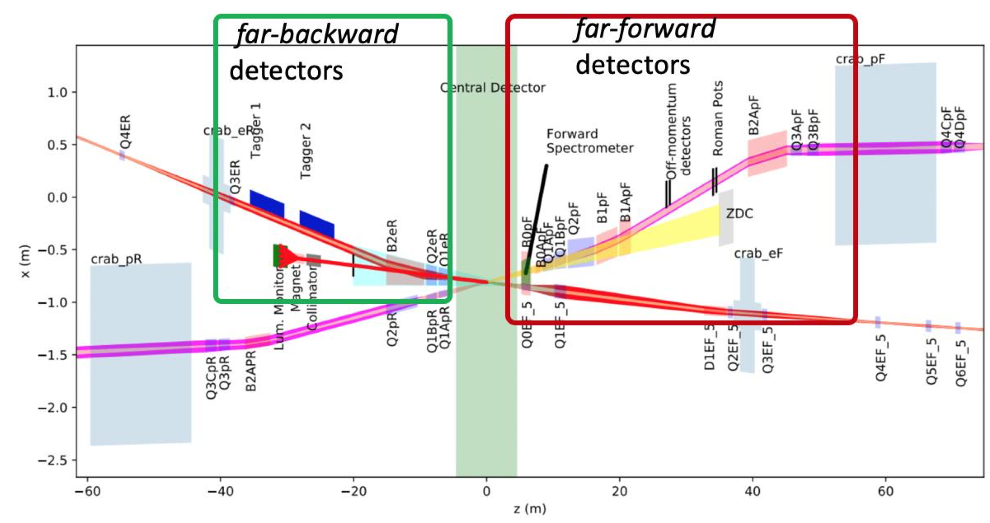
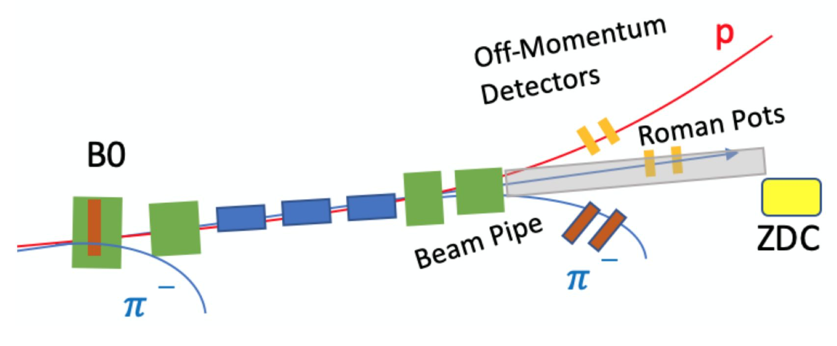
Far Forward/Backward
Detector | Proposed Technology | What R&D is needed | Interested groups | Costing
Zero-Degree Calorimeter (ZDC) | Combined function EMCal+HCAL based on ALICE FoCal* | More detailed simulations with realistic considerations | EIC-Japan, Kansas U. | Leverage experience from ALICE FoCal for baseline estimates
Roman Pots | AC-LGADs | Mostly engineering considerations (cooling structural support, impact of material on other detectors)** | IJC-Orsay, Rice U., LGAD consortium, … | Preliminary estimate available from eRD24 (for silicon and ASICs)
Off-Momentum Detectors | AC-LGAD | Optimal placement – possible dual implementation as horizontal RP system near B1apf, and outside beam pipe near B2pf** | LGAD consortium, … | Same as for RP
B0 Spectrometer | Fine granularity silicon for tracking (MAPS or similar); silicon preshower, compact EMCal |  | LANL on the silicon sensors, …., PWO crystals may be available | See project template spreadsheet/BOE
Low Q2 Tagger | EMCal, Timepix telescope |  | U. Glasgow | See project template spreadsheet/BOE
IP6 Beamline now implemented in G4 with proper coordinate system and 0.5m shift
(detector space from -4.5 to 5.0m)

Slide 9
Developing the ECCE Detector
Focus in the past two weeks has been with the Detector and Physics Teams working to develop the ECCE concept for the second simulation campaign:
Full Detector Team Meetings:
  July 21st: https://indico.bnl.gov/event/12484/
  July 28th: https://indico.bnl.gov/event/12485/
Implementation of very detailed G4 simulation geometry and detector response wrapping up!
Moving from technology selection to mechanical integration

Slide 10
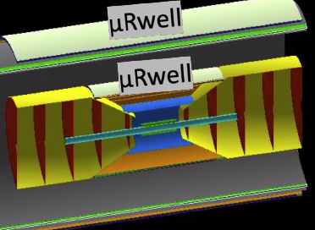
Remaining Major Design Issues
ECCE inner tracking system
  https://lists.bnl.gov/pipermail/ecce-eic-det-l/2021-July/000206.html
  Baseline for continuing detector studies:
    Inner Si vertex layers based on ITS-3 (2 or 3 layers)
    Middle Si layers based on ITS-2 or ITS-3
    Outer tracking layers based on μRwell
    Five discs forward/backward (20 μm ITS-3 like MAPS)
  Performance to be optimized by AI studies
  Working to coordinate with EICSC, JLab, and
  consortium members with substantial expertise
TOF/t0
  Required for low-momentum PID
    ~200MeV to 2 GeV
    Barrel needed for t0
  Alternatives to AC-LGADs?

Slide 11
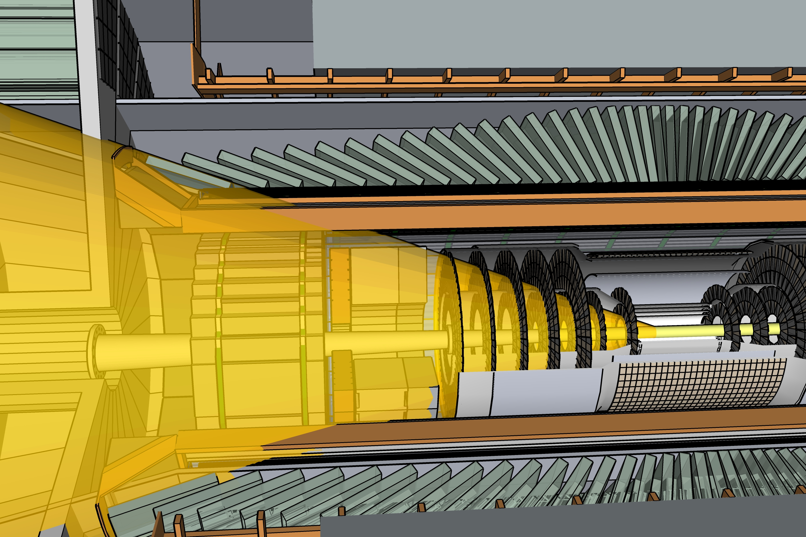
Mechanical Integration
Evolve design of support structures
DIRC (GSI-DIRC)
Close gap between BEMC and EEMC
LANL and LBNL in
collaboration with JLab
EEMC (IJCLab-Orsay)
Forward detector support structures
(dRICH, calorimeters, …)
Assistance from ORNL engineers
EIC Project :
Support for barrel EMCal and a universal frame that holds the DIRC and detectors "within" (backward EMCal, mRICH, etc.)
Support for forward Hadron Calorimeter, and how to split for maintenance mode, looking at similar for the backward HCal.
BEMC (MIT, CUA)

Slide 12
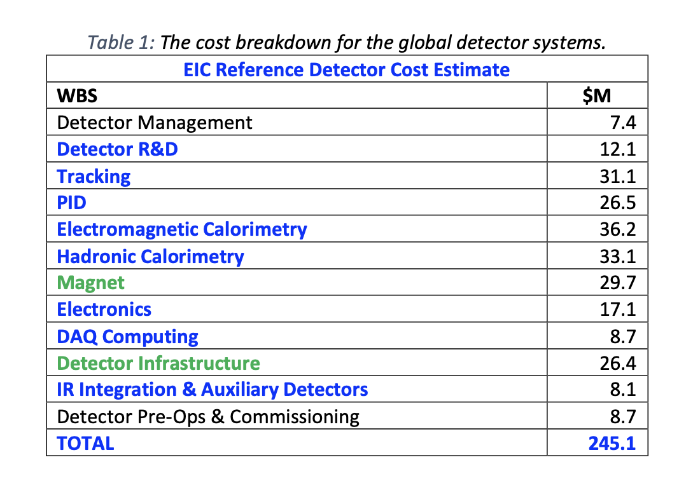
ECCE Cost and Schedule
Revised costing template made available by the project:
  https://indico.bnl.gov/event/10974/contributions/49222/
  Includes labor costing table, a few bug fixes
ORNL actively working with DWG convenors to develop cost, schedule and risk estimates
  Corresponding efforts in DAQ/Electronics and Infrastructure
Costs shown in $US(2021). In-kind of ~$90M assumed in total.

Slide 13




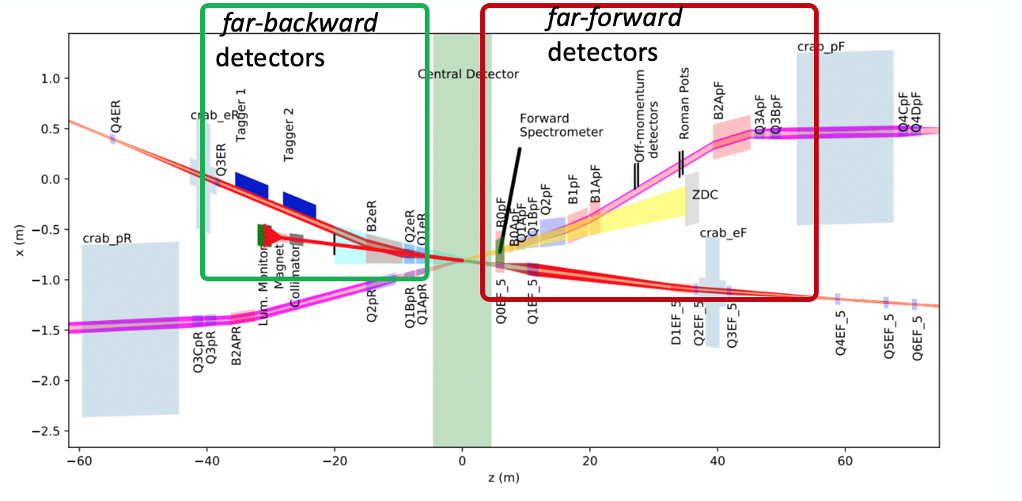
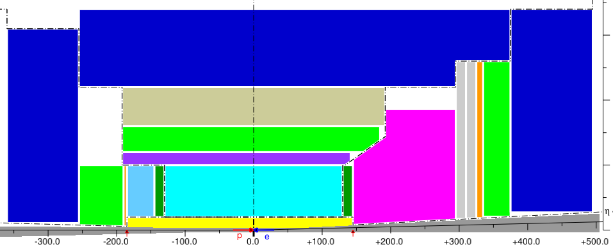








ECCE International
EEEMCal: AANL, CUA, Charles U., FIU, IJCLab, MIT, Lehigh U., UKY, JMU
BGU/Israel, MIT, ORNL, UIUC, IJCLab-Orsay, EIC-Japan, TAU/Israel, UVA, GWU, MIT-BATES, HUIJ/Israel
Polarized Beam and polarimetry: MIT, UNH, SBU
Glasgow U., ODU
Rutgers, ISU, GSU
Electronics: Columbia, ORNL
EIC-Japan
ISU
Ohio U.
ORNL
Sejong U.
KyungpooU
Yonsei U.
Pusan U.
Ohio U.
ORNL
The Steering Committee is engaging with our international partners and discussing the potential for in-kind contributions to ECCE.
These discussions are aimed at better understanding the local funding situation and how we might help build the required support within the local scientific community. Of course, participation in the EIC is a long-term issue that will ultimately lead to agreements at the ministerial level.
Following the Expressions of Interest, for the proposal we are looking for Expressions of Intent.
EIC-Japan
ISU
Ohio U.
ORNL,
IMP
DAQ/Trigger: ISU, CU Boulder, OU, ORNL, SBU, UConn, LLNL
UIUC, Charles U.
ODU, CUA, GSI-DIRC
SBU, UConn
GSU
SBU, ORNL, WI.Israel, Wayne State, MIT, Rice, ORNL, Wayne State
Artificial Intelligence: MIT, CNU, Brunel U.
MIT, Rice, ORNL, Czech Tech. U., IMP, SCNU, Tsinghua, USTC
CENTRAL
  Tracking:
  Silicon: China, Czech Republic, Japan
  Calorimetry
  PWO and SciGlass: Czech Republic, Armenia, France
  Forward Calo/Dual Readout: China, Japan, South Korea
  Particle ID
  DIRC: GSI/Germany
FAR FORWARD – FAR BACKWARD
  Roman pots: France
  Off momentum: Israel
  ZDC: Japan
  Luminosity monitors: Israel
  Low Q2 tagger: UK

Slide 14
Timeline
Today, August 2nd
July 1st - Aug. 1st [1 month]:
  Large scale simulations production (June concept) DONE ☺
Aug. 1st - Sep. 15th [1.5 months]:
  Second large scale simulations production (July concept)
  Analysis of simulation data to demonstrate physics extraction.
Sep. 15th - Nov. 1st [1.5 months]:
  All physics ‘plots’ are done.
  Final evaluation of technology selection based on physics studies results.
  Compose narrative around simulation results and selected technologies.
Nov. 1st - Nov. 30th [1 month]:
  Proposal review by external colleagues.
  Final edits
Only 8 more bi-weekly meetings until the proposal is due!
Extension of large scale simulations

Slide 15
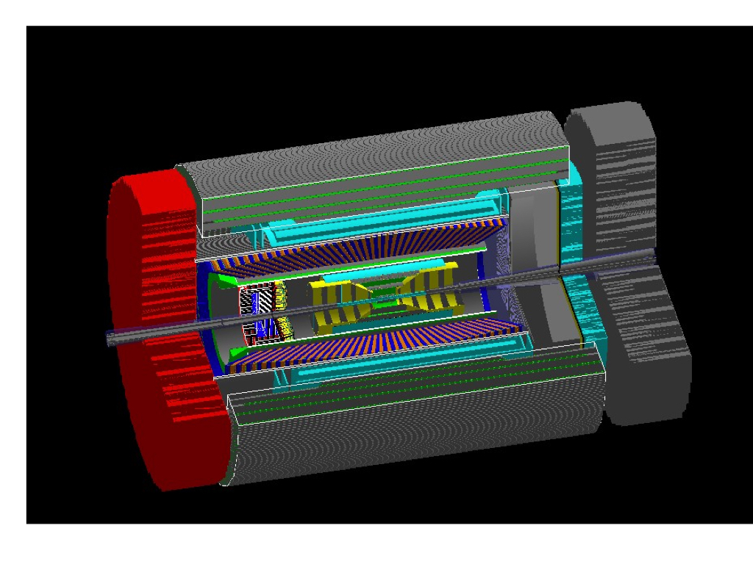
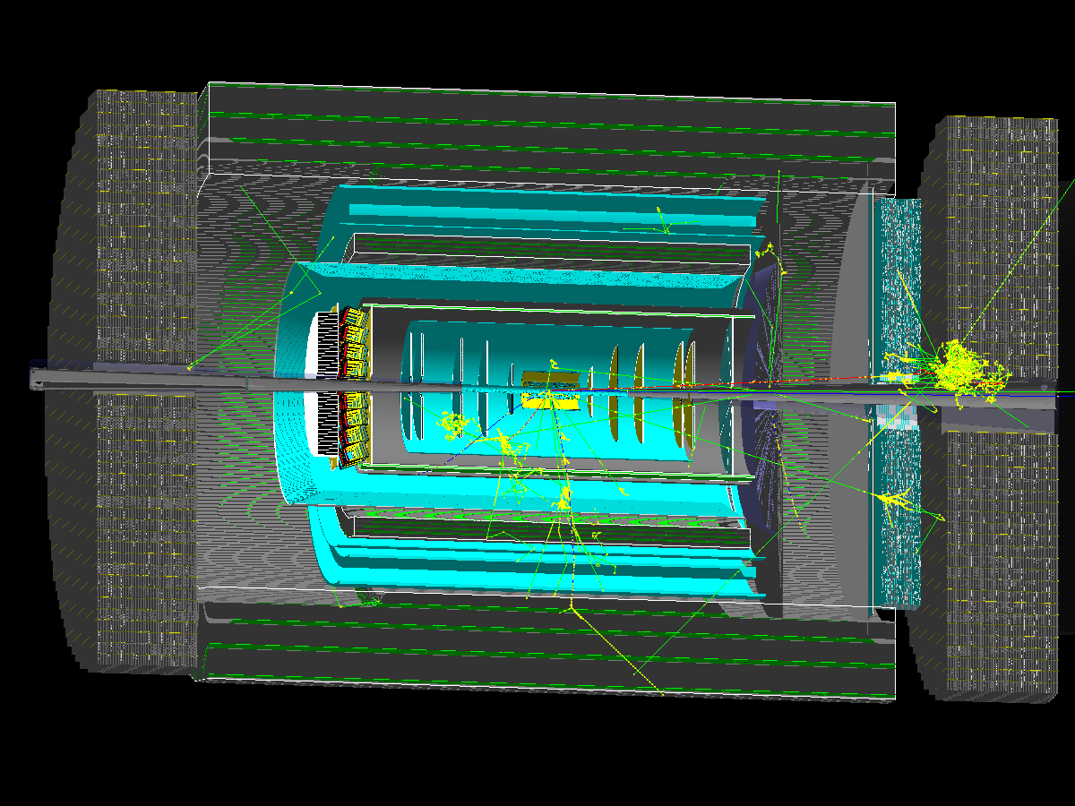
G4 Implementation
July concept
June concept
The ECCE simulation geometry for the second campaign is highly advanced!
Courtesy of Nathaly Santiesteban

Slide 16

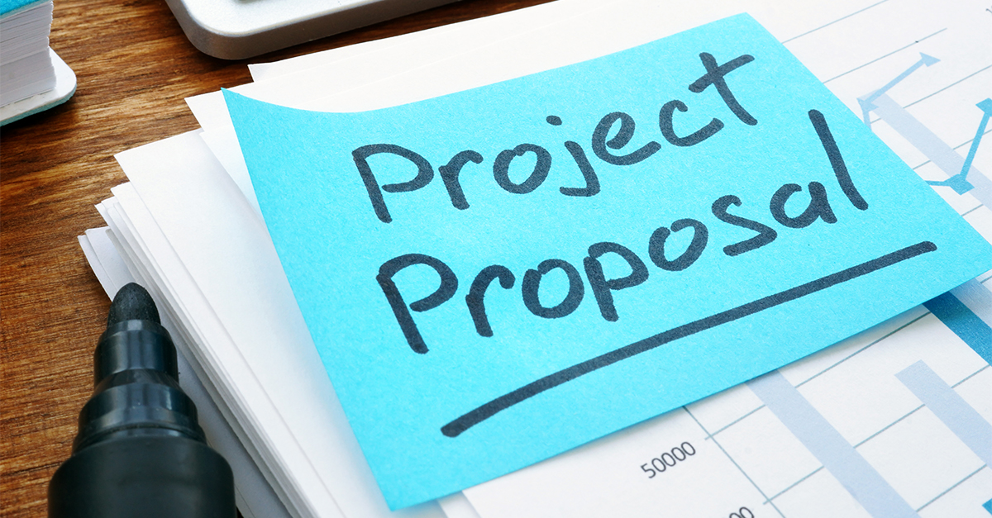
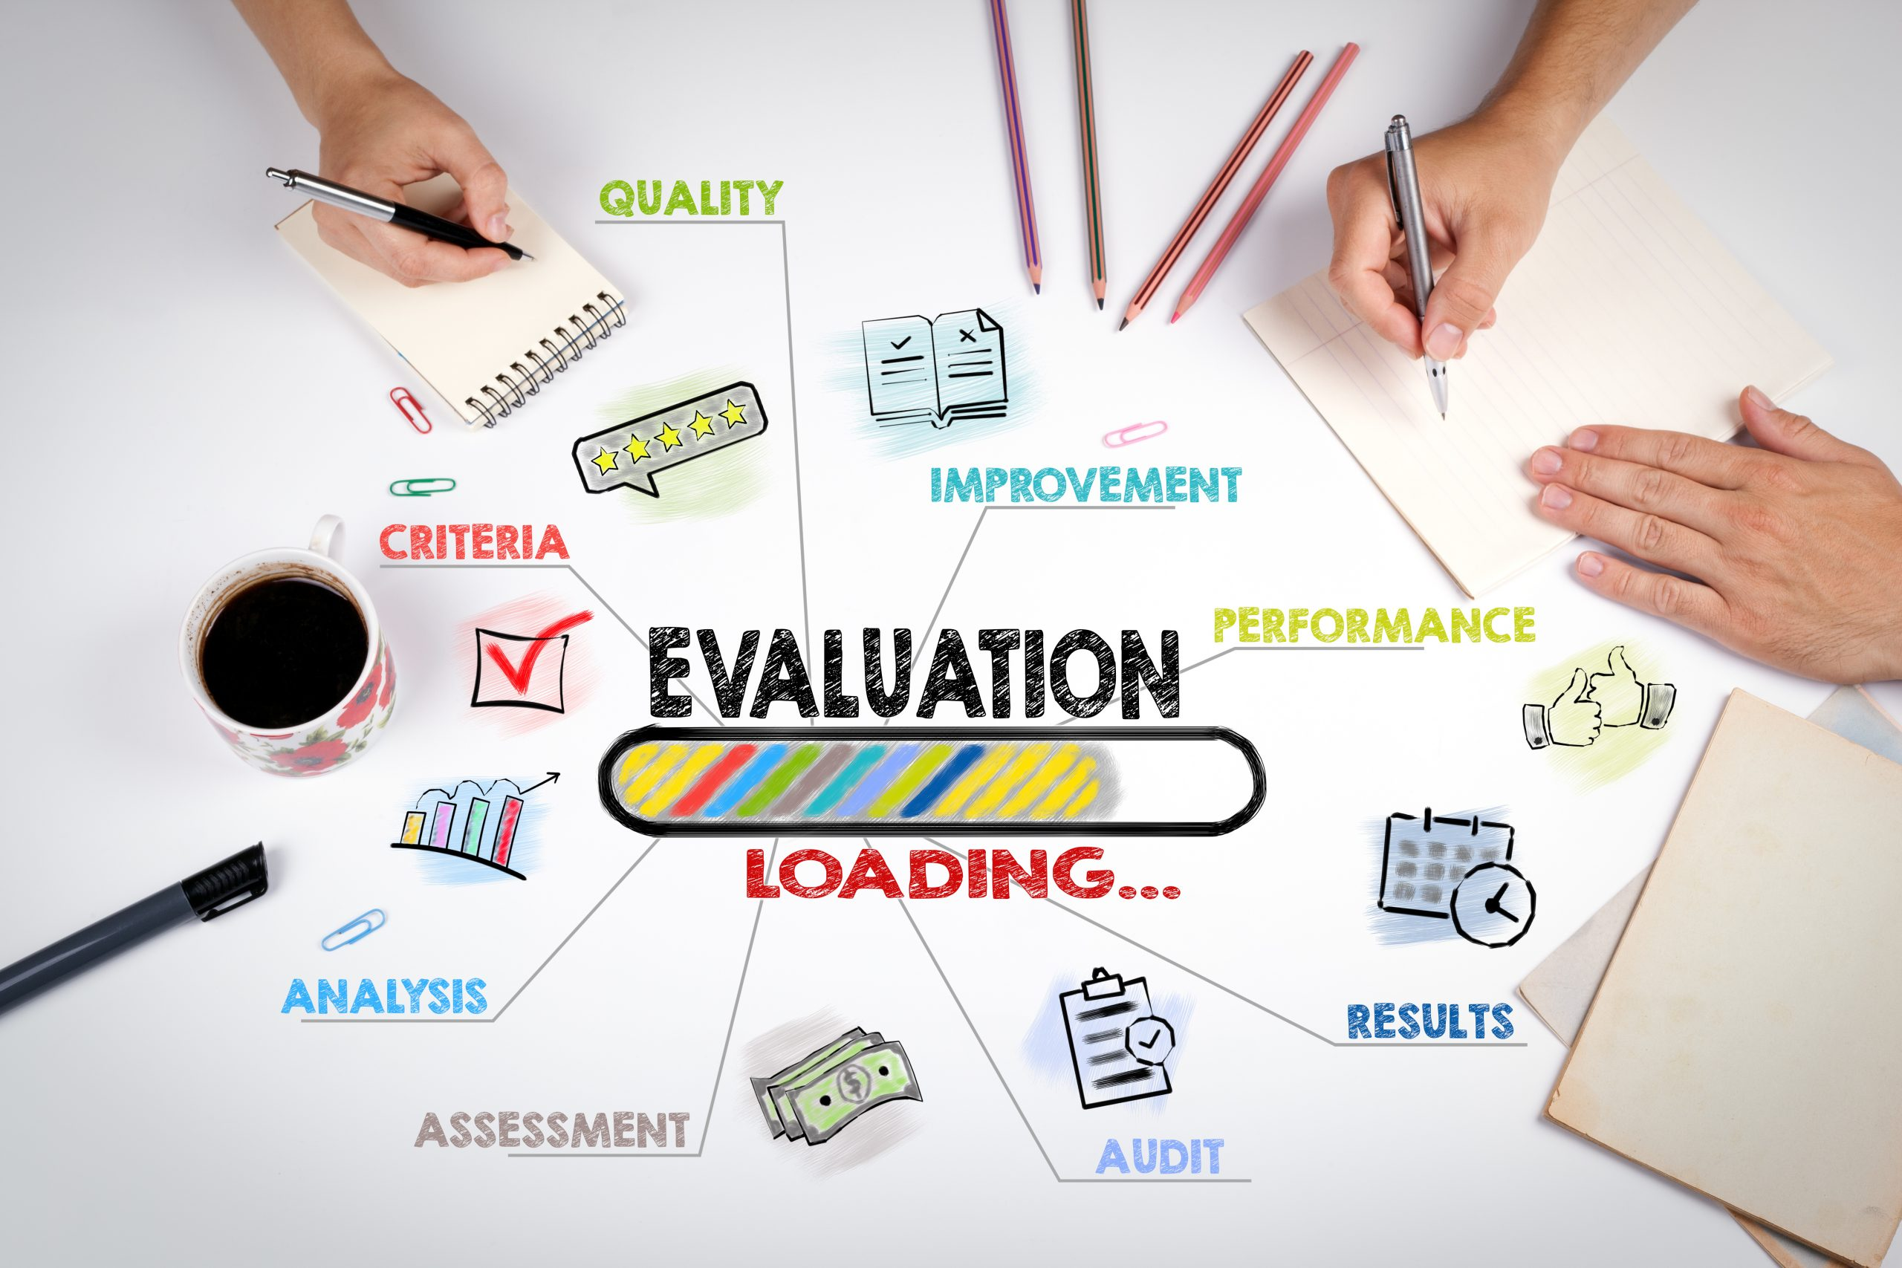
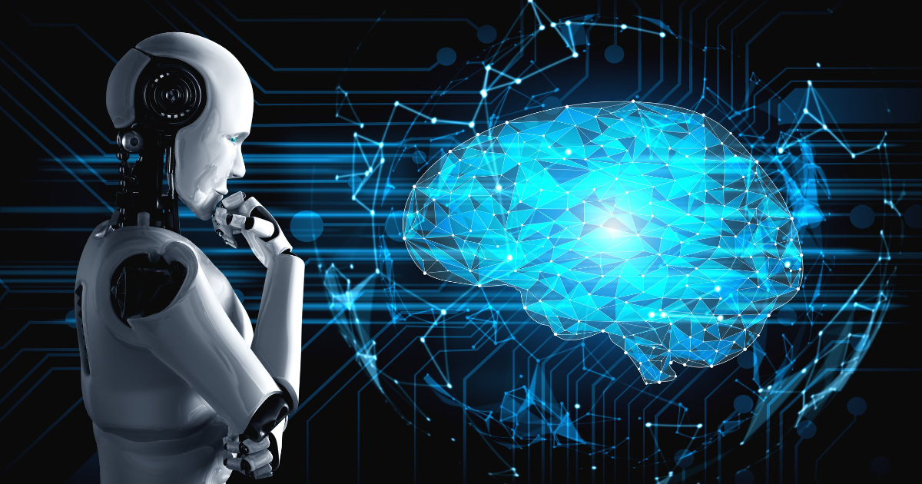
Team Reports
DE&I Working on Code of Conduct
  Report discussion today
  Moving towards a ratification by the consortium
Proposal Committee:
  Tools for handling collaborative documents
  Templates for ECCE notes
  Work beginning on collaboration portion of
  proposal document
Physics Team:
  Generator inputs for simulation campaigns
  Analysis and evaluation code
Computing Team:
  Framework for additional AI optimization studies
  Managing the simulation infrastructure

Slide 17
ECCE Physics Godparents
Steering committee contacting potential physics godparents
Would like to contact a slate of candidates contemporaneously
The SC realizes this needs to be resolved soon

Slide 18
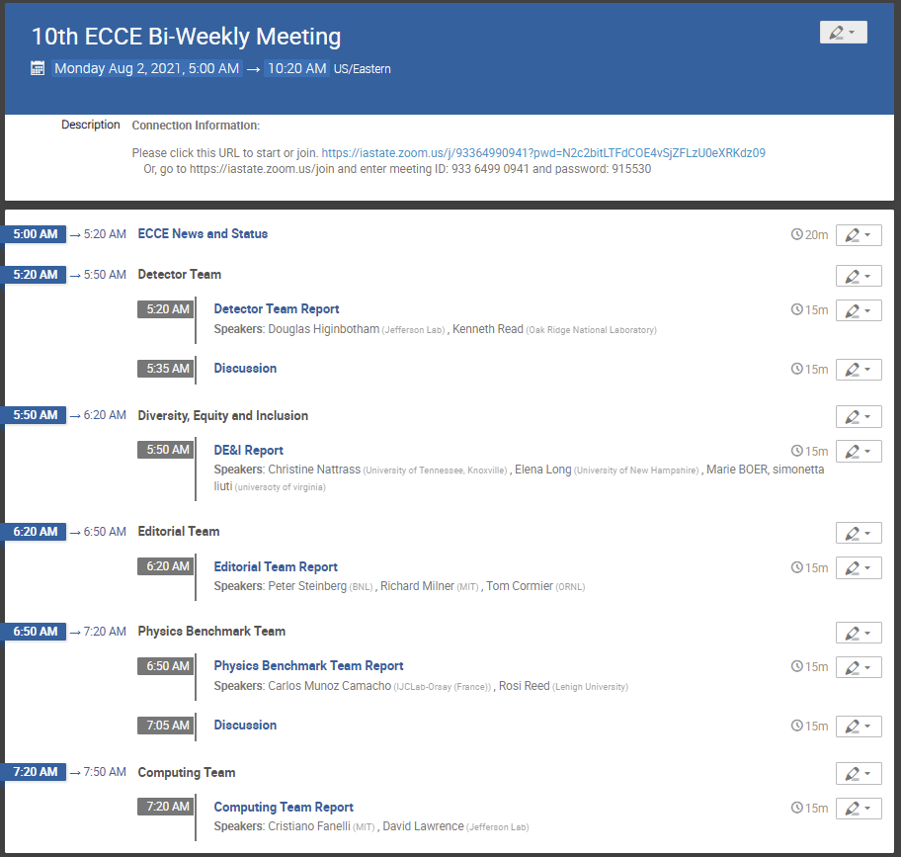
Agenda
Looking forward to reports from the teams and working groups.
Note especially the DE&I discussion of the CoC – this will continue at subsequent bi-weekly meetings.

Slide 19
BACKUP

Slide 20
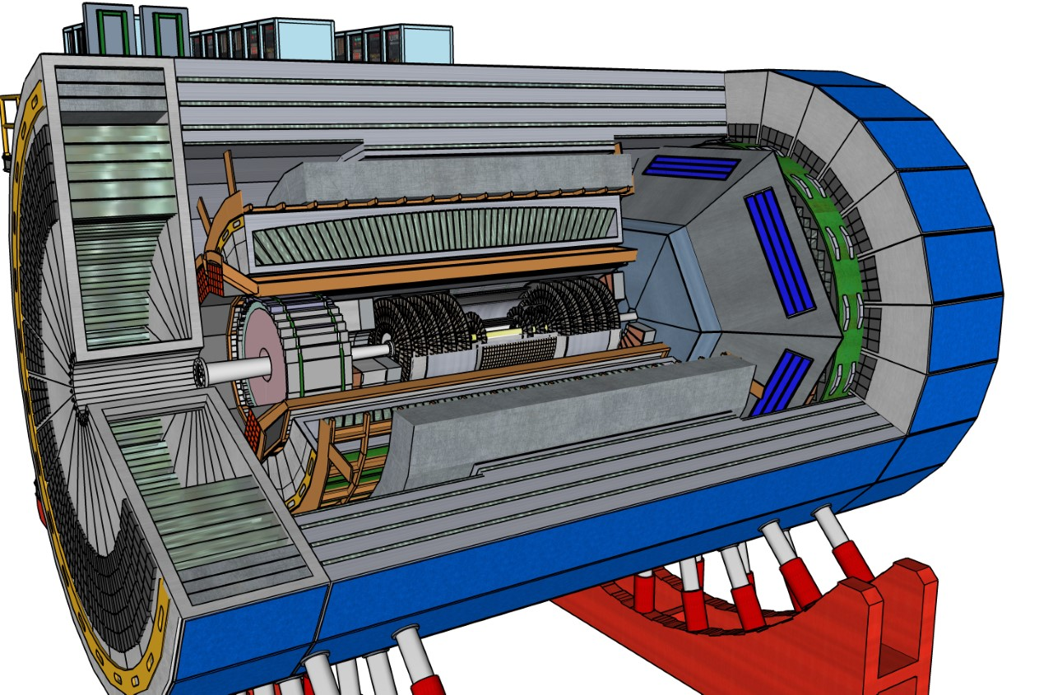
ECCE Resources
ECCE Website
  https://www.ecce-eic.org/
ECCE Indico
  https://indico.bnl.gov/category/339/
ECCE Indico Calendar
  https://indico.bnl.gov/category/339/calendar
ECCE Wiki
  https://wiki.bnl.gov/eicug/index.php/ECCE

Slide 21
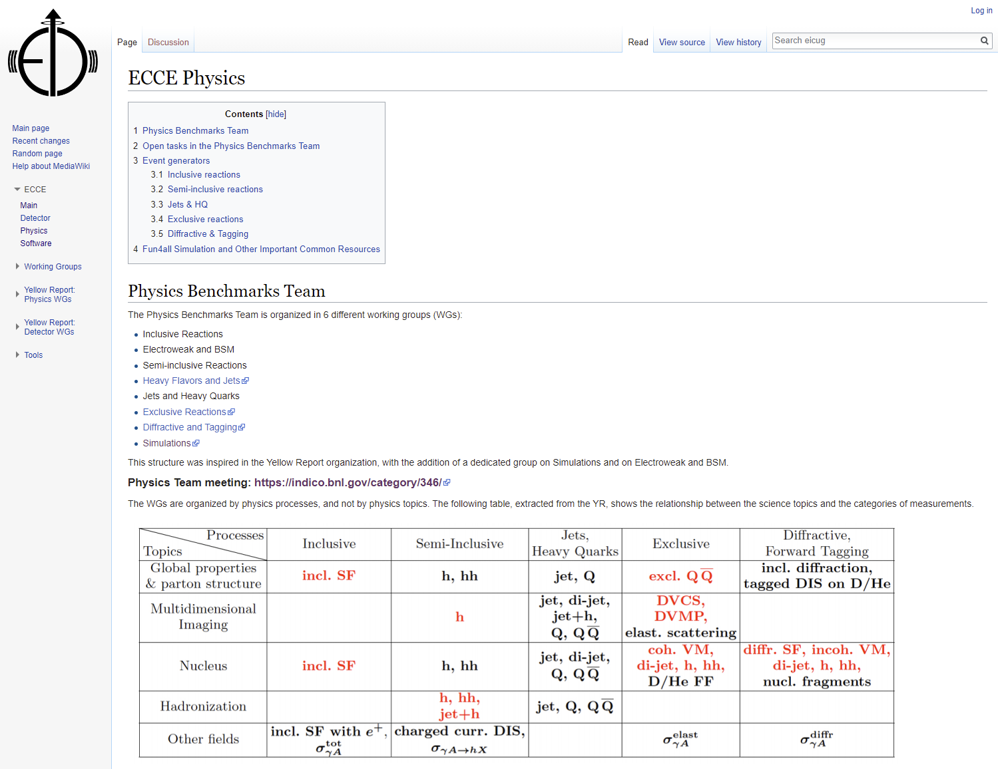
Wiki and Open Task Lists
WG’s asked to maintain a list of
open tasks in the ECCE Wiki:
This is the place to start when
looking to get postdocs/students
started in ECCE
WG’s will keep lists updated
as new opportunities arise
https://wiki.bnl.gov/eicug/index.php/ECCE

