Slide 1
psTOF R&D (eRD10) Outline for FY2016
Bob Azmoun, Mickey Chiu, Edouard Kistenev, Eric Mannel, Andrey Sukhanov, Thomas Tsang, Craig Woody
Brookhaven National Laboratory
Ihnjea Choi, Chong Han, David Hjelmstad, Yakov Kulinich, Matthias Grosse-Perdekamp
University of Illinois at Urbana-Champaign
Marcus Alfred, James Lindesay
Howard University
Marcel Demarteau, Robert Wagner, Yunqi Xie
Argonne National Laboratory
Dave Kawall
University of Massachusetts at Amherst
John Harris, Richard Majka, Nikolai Smirnov
Yale University

Slide 2
Accomplishments
Simulation Studies of psTOF (Chong,Matthias)
Pythia + parameterized response
Occupancy (low channel count = lower cost)
TOF with other detectors
Start time aspects (Mickey)
Prototype Results (Ihnjea,Matthias)
Cosmic Test Stand
XX ps?
Preamps (Mickey,Andrey,Ihnjea)
SPICE and lab studies
mRPC detailed detector Simulation (Mickey)
Halfway done

Slide 3
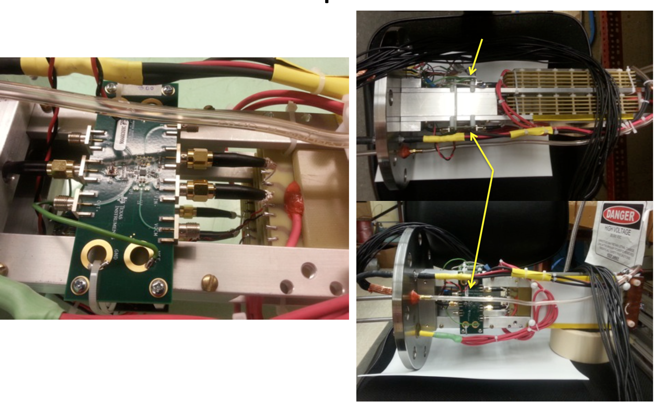
Test Stand at UIUC
Currently using LMH6554 (4 GHz GBW)
Results under study

Slide 4
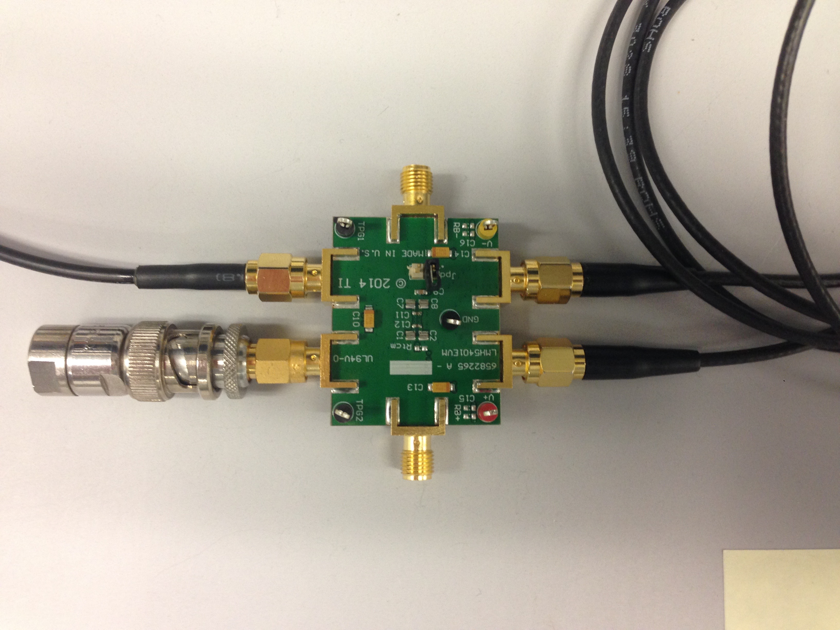
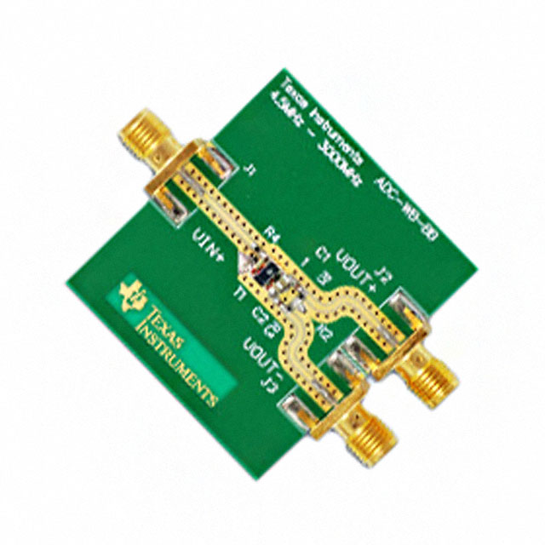
Preamp Test Chain at BNL
TI ADC-WB-BB
(Balun)
TI LMH5401EVM Eval Board
(Needs +/- 4 V, or +4 V)
Signal Generator
(HP 33250A)
Scope
(TDS3450
500 MHz)
LMH5401: 8 GHz GBW (gain*bandwidth product)
Andrey has now modeled it in Spice
Eval board is set for single-ended to differential, 4 V/V
I tested that, converted board to differential to differential 20 V/V, then retested.
Balun is used to convert from single-ended 50 ohm to 100 ohm differential

Slide 5
For Fiscal 2016
Improved prototypes
Better gas, smaller gaps, what else?
Replacement of glass with better materials?
Preamp boards (not TI eval modules)
Would like to request continued funding for our post-doc at UIUC
Beam Test at FNAL
Simulation?
Electron ID using TOF+TPC dE/dx (solves pion contamination in e channel)
Continue previous study, but with full Geant4 study?
LAPPD?

Slide 6
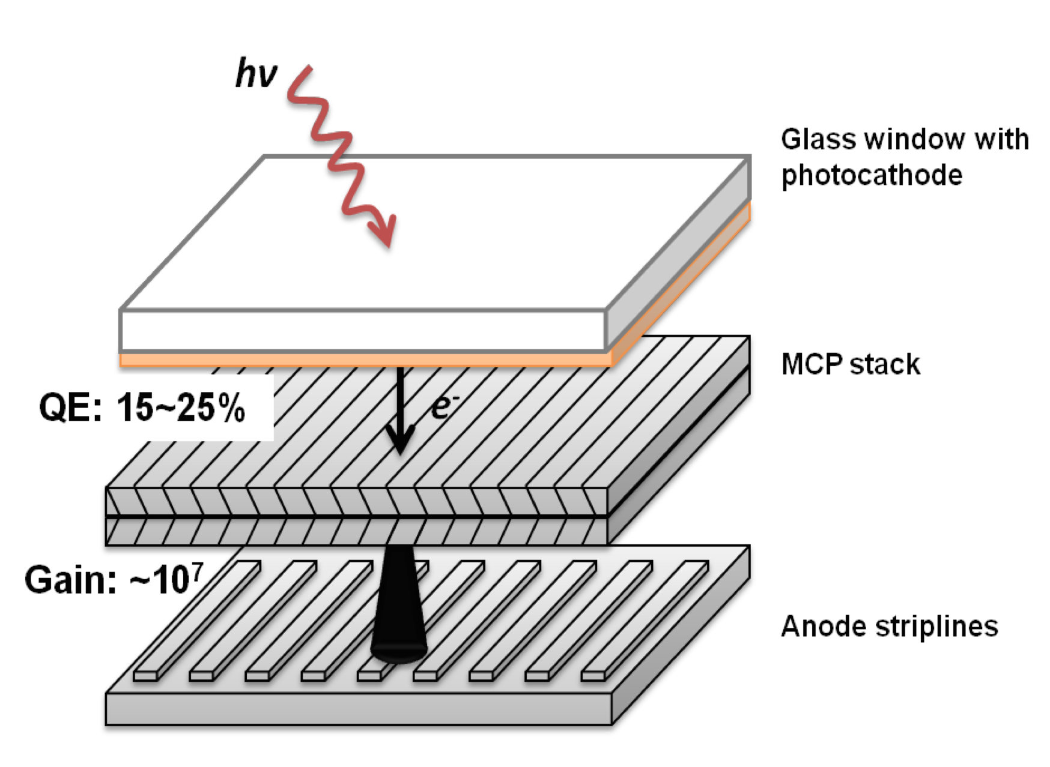
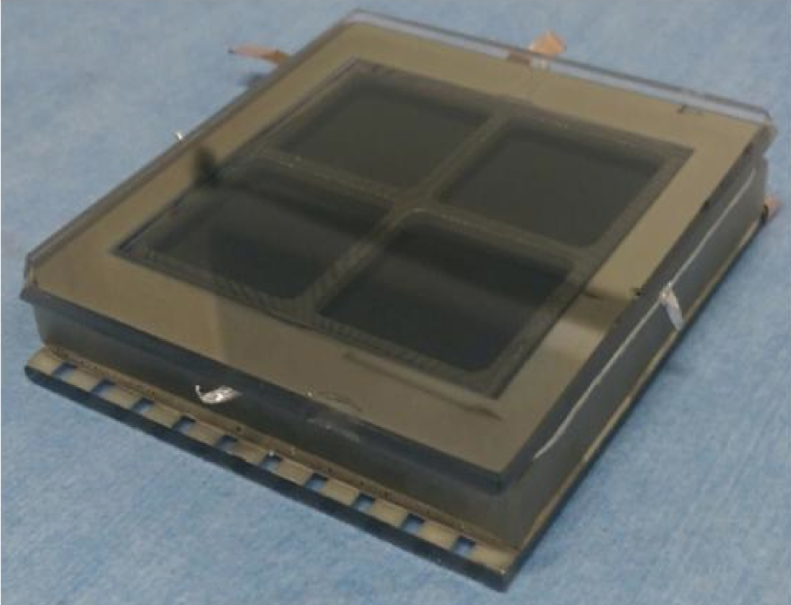
LAPPD Pad Readout Option
(Argonne, Yale)
Resistive Anode
Replace stripline anodes with resistive anode layer, such as graphite

Slide 7
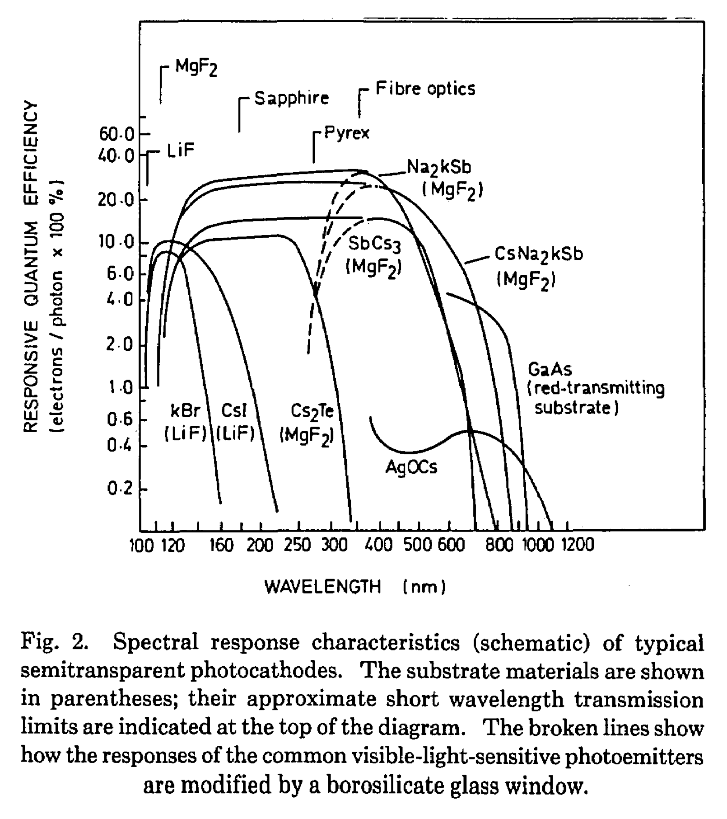
Optimization of Photocathode for UV
Optimize in UV for all our applications (Cerenkov).
Best case would be without a window and CsI, similar to RD2011-6.
Need to test operation of MCP-PMT in gas. The LAPPD MCP-PMTs have only been operated in vacuum

