Slide 1
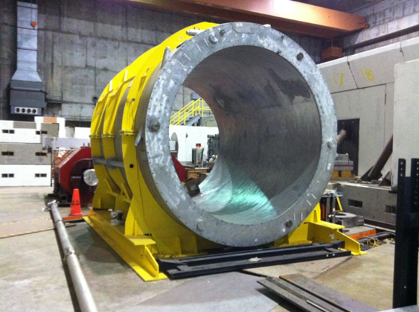
sPhenix Solenoid Magnet History and Design
May 22, 2015
M. Anerella

Slide 2
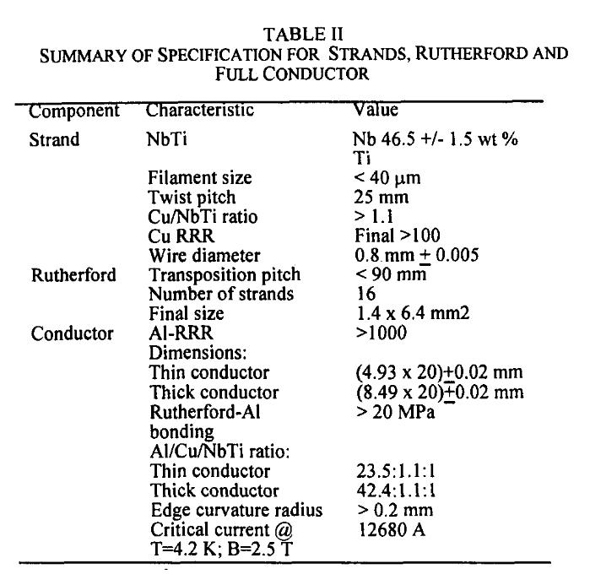
Conductor Specifications
Heavily stabilized
~ 300% margin

Slide 3
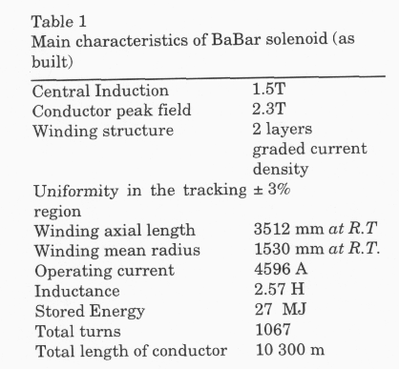
Solenoid Coil Specifications
Pasquale Fabbricatore, April 15, 2015 email*:
the external layer is done with 188 (thin)+159 (thick) + 189 (thin) =536 turns The inner layer: 184 (thin)+164 (thick) + 183 (thin) =531 turns
* And also “as-built” notes on coil drawing
MIITS rating:??
How much will it heat without dump resistor 160K?
Peak temperature in conductor: 450K?
How much will it heat with dump resistor working, 50K?

Slide 4
Magnet Specifications
Coil Mandrel
Aluminum 5083
Wall: mm
OD Diameter: 3060mm
Cooling tubes welded
11 parallel tubes
20 mm ID, 30 mm OD
Tie Rods
Supports the cold mass
Inconel 718
6 x Axial Tie-rods
16 x radial Tie-rods
Cryostat Vacuum Vessel
Wall: Aluminum 5083, 35 mm/50mm
OuterWall: OD 3.540 m, L=3.790m
InnerWall: ID 2.840 m, L=3.790m
Annular End Flanges: Al-5083, 50mm
Tie-rods attachments
Copper Tubing
Stainless tubing
Thermal Shields, Aluminum
8 x panels
Inner diameter
Outer diameter
Needs work

Slide 5
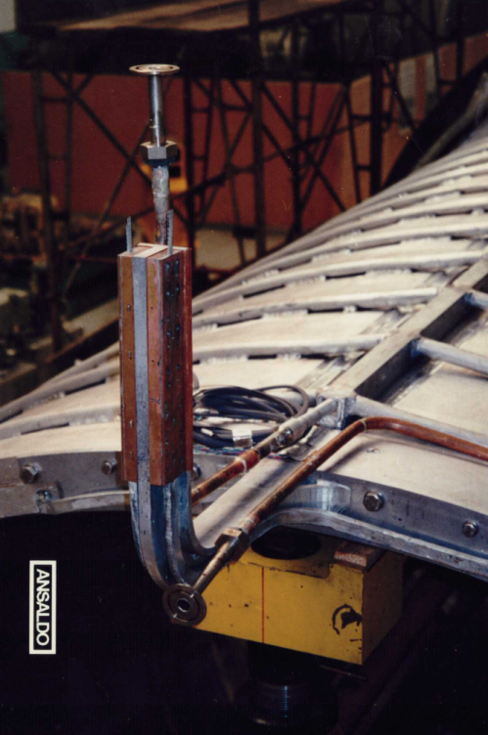
Coil Construction
Coils wound into an external aluminum support cylinder
Internal splices: 1.5 m weld of aluminum edges + 0.2 m gap then 0.3 m solder of aluminum faces on both sides of weld
Coils epoxy impregnated into support cylinder after winding
Exiting leads: aluminum removed and NbTi soldered to heavy copper stabilizer leads (overlapping aluminum)

Slide 6
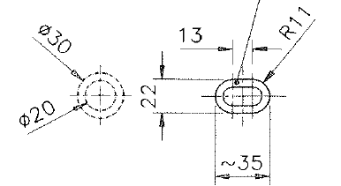
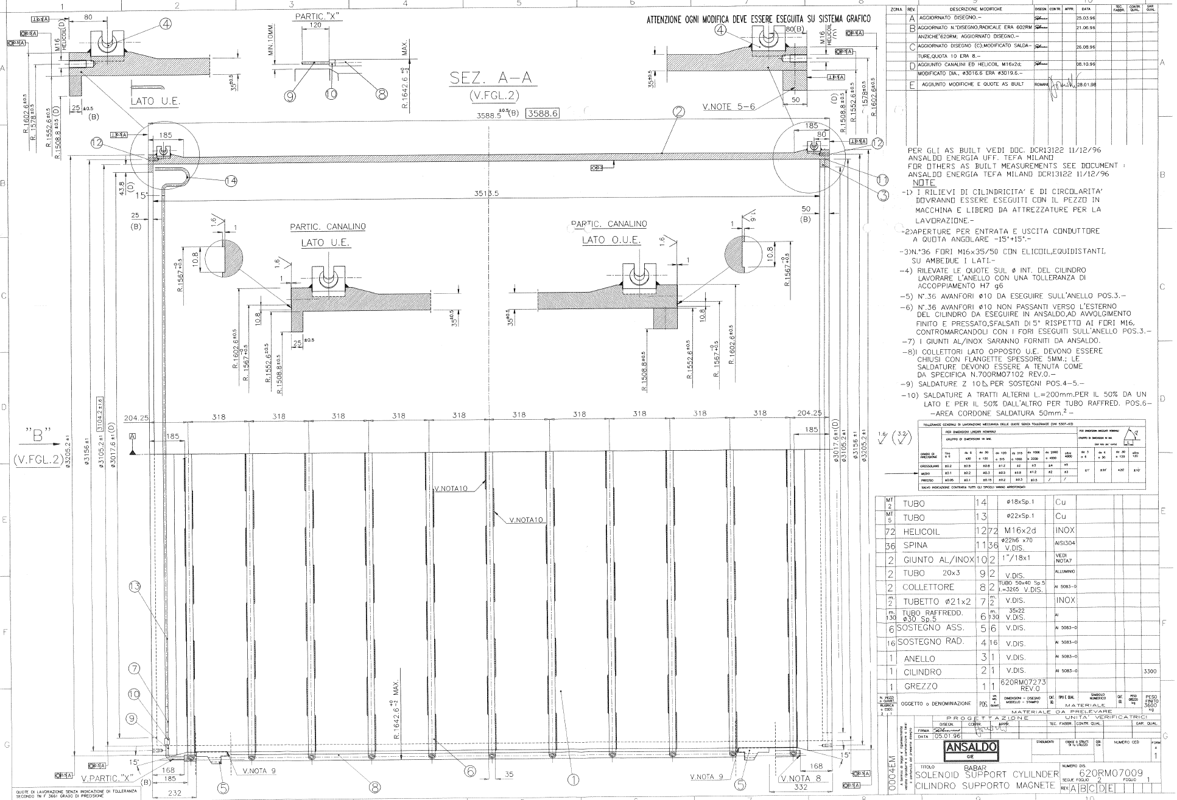
Coil Cooling
Coils are in insulating vacuum
Conductively cooled via external support cylinder
Aluminum Cooling tubes
Ø30 mm x 5mm thick, flattened to 22 mm
Stitch welded to Aluminum mandrel
11 parallel circuits
Manifolds top & bottom

Slide 7
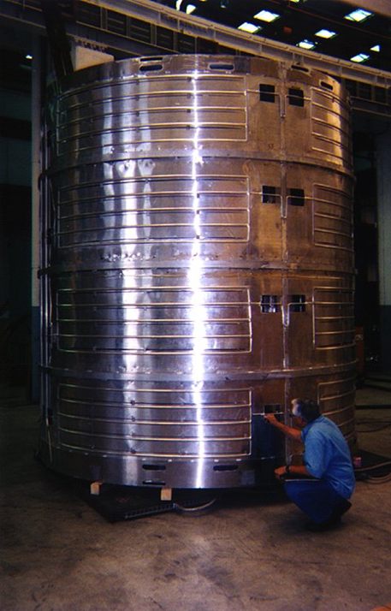
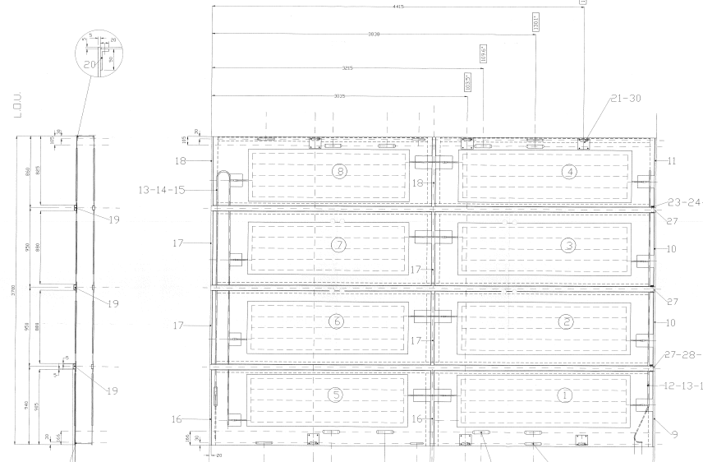
Outer Heat Shield (similar construction for Inner Heat Shield)

Slide 8
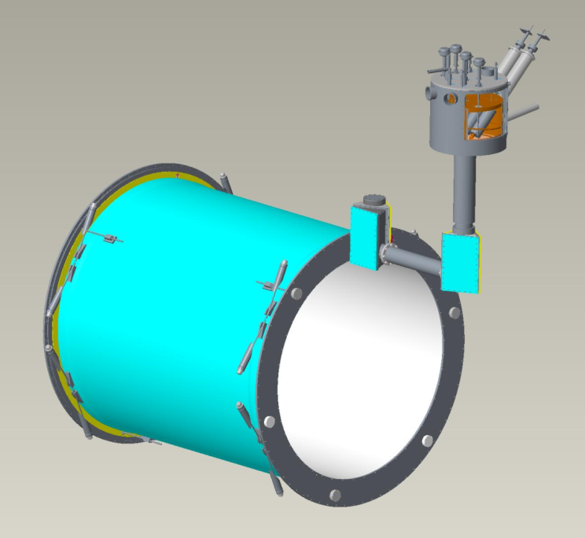
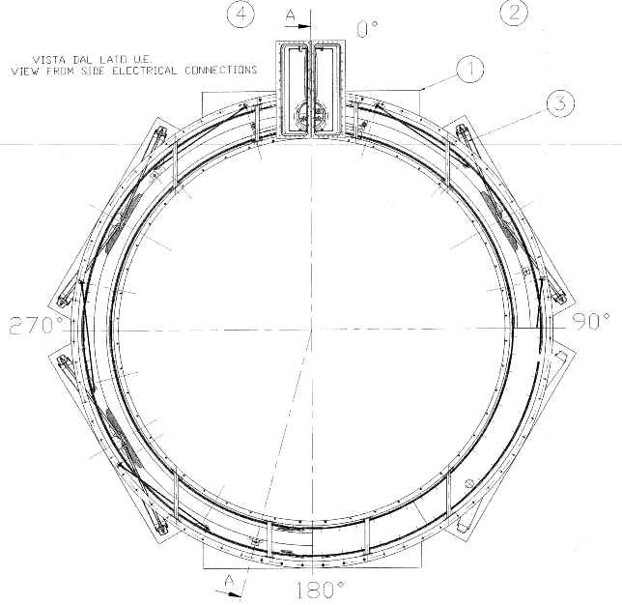
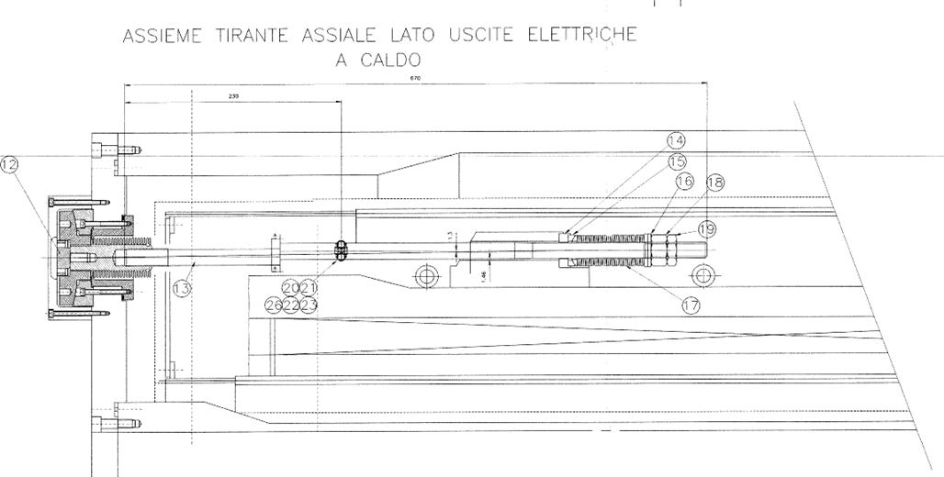
Coil Mechanical Support
Inconel Tie Rods:
8 tangential, 3 axial, at each end
Upper tangential rods (8 total) loose at 300K
Lead End axial rods (3) loose at 300K
Thermal contraction of Al at 4K tightens rods, shifts coil
Motion accommodated by spherical, belleville washers

Slide 9
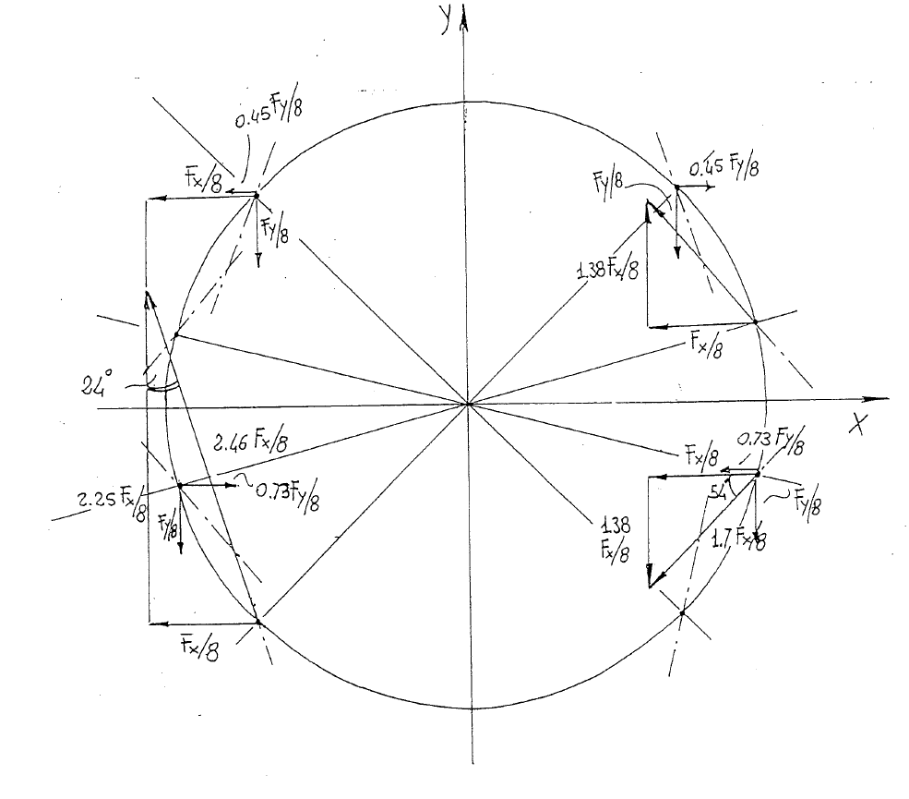
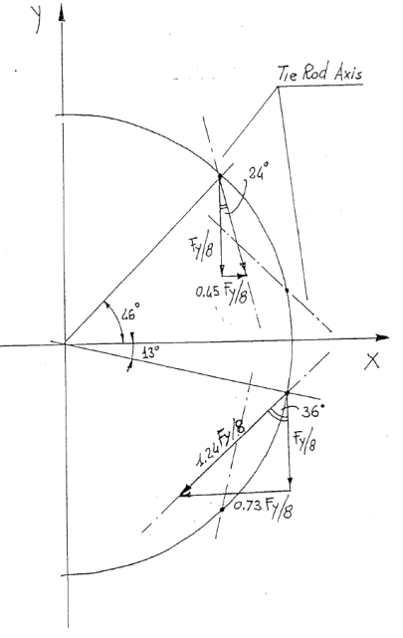
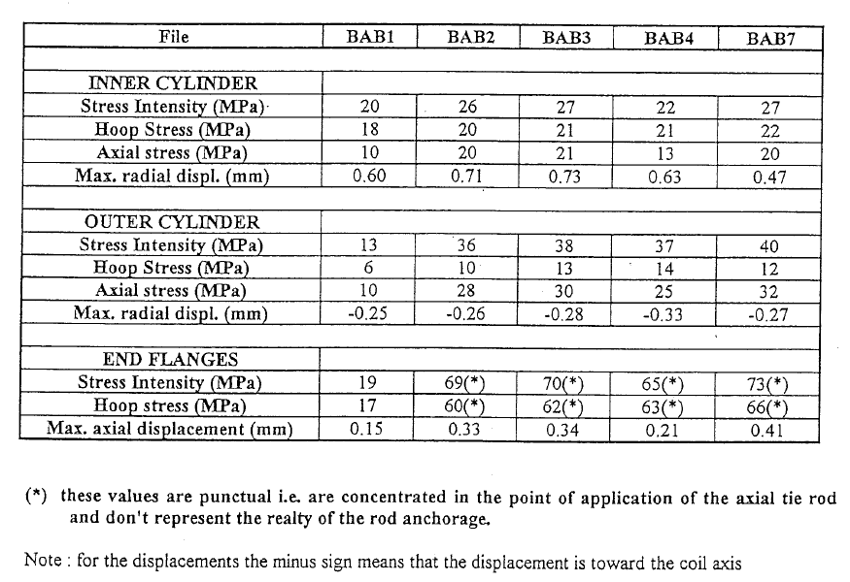
Support Loading
horizontal
vertical

Slide 10
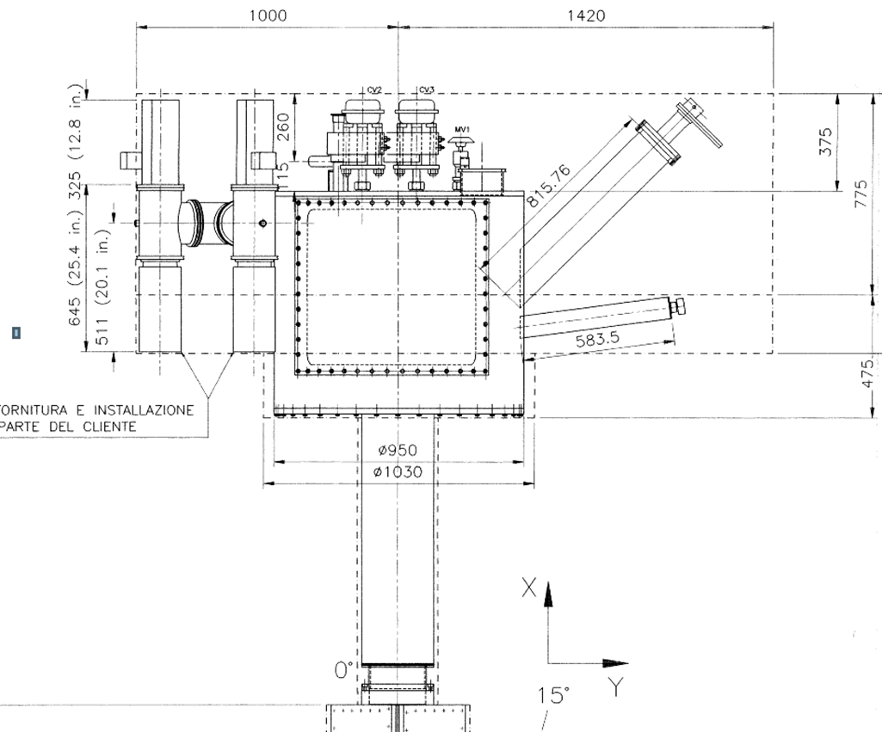
Valve box
Vacuum vessel+
Design pressure:
internal 1 barg [psia], external 1 atm
Design Temperature: 300K
Diameter: 970 mm, 38.25inch
Length: 860 mm, 33.85 inch
Wall: 10 mm, 0.393 inch
End plate: wall 20mm,
Volume: 635Liters
Stainless Steel 304
Chimney
Diameter: 273 mm, 10.75inch
Length: 1065 mm, 42 inch
wall 9.3 mm, ”
Volume: 63 Liters
Stainless Steel 304
Needs work

Slide 11
Back-up slides

Slide 12
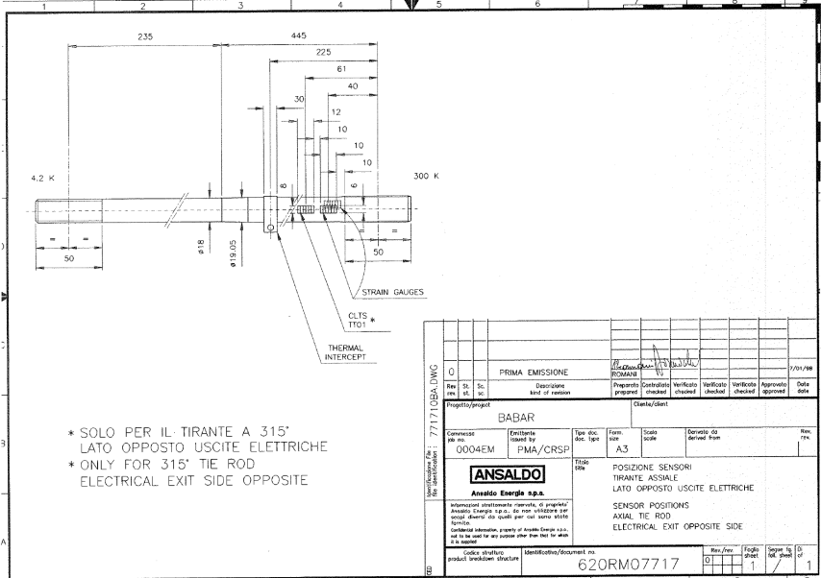
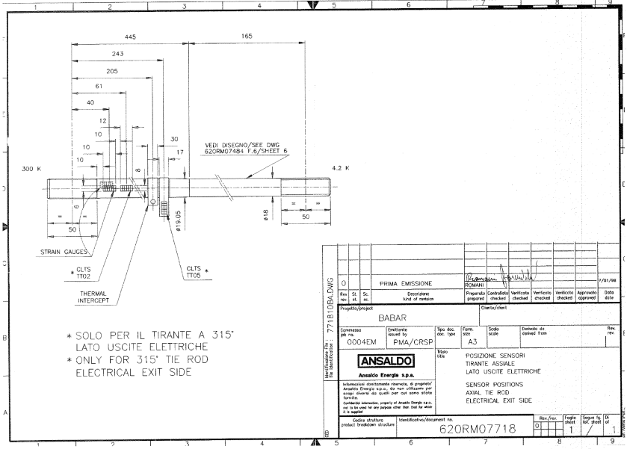
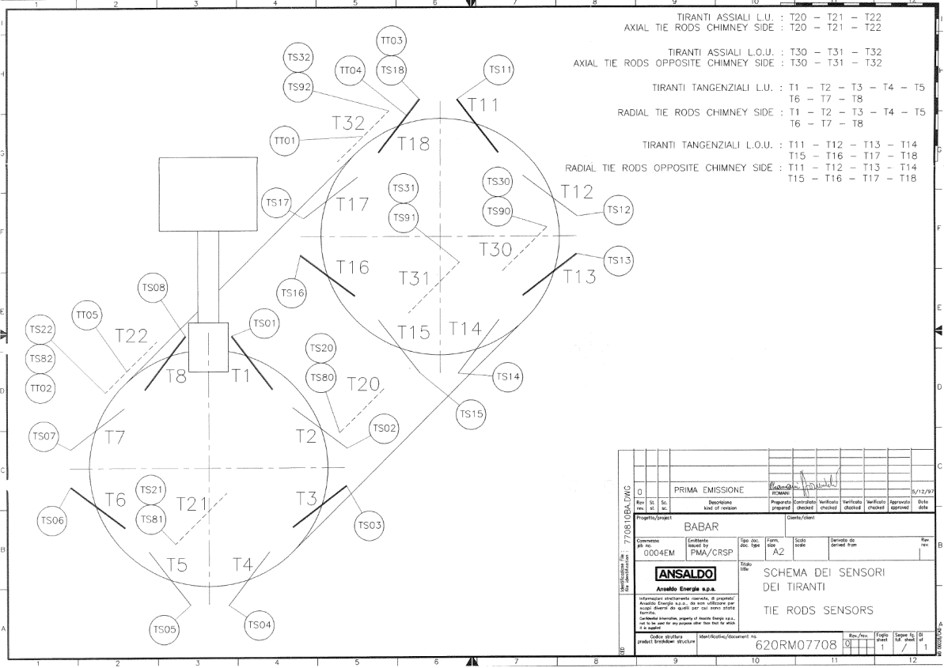
Tie rod strain gauge installations

Slide 13
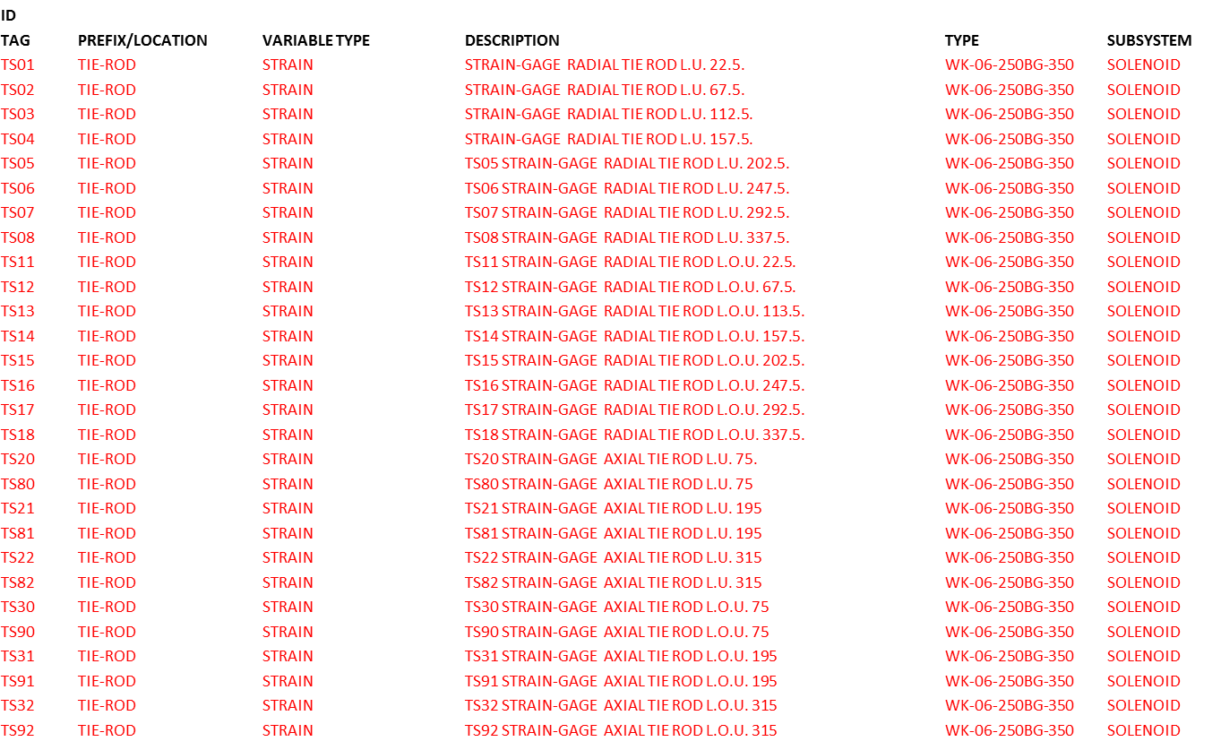
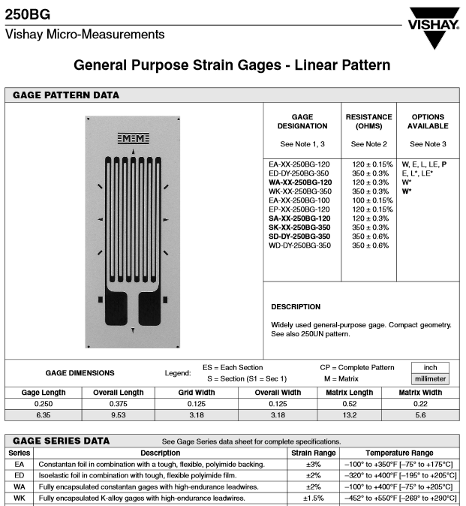
Strain Gauge Info
SC Solenoid Magnet is at SLAC
BNL heat shield shipping restraints are fabricated & received at SLAC
SLAC has:
Installed BNL restraints
Tightened coil supports
SLAC will:
Rig magnet onto truck

Slide 14
Incoming inspections & tests
300K Coil Electrical Testing:
R, L and Q
Impulse test
520V Hypot
Instrumentation inspections; voltage taps, strain gauges, etc.
Mechanical Inspections:
Visual (damage or other shipping incidents)
Helium circuit vacuum leak check
Cryostat vacuum leak check
Coil position alignment (by re-tightening tie rods by prescribed amounts)

