Slide 1
sPhenix Low Power Test Setup May 20, 2015
Piyush Joshi
Superconducting Magnet Division

Slide 2
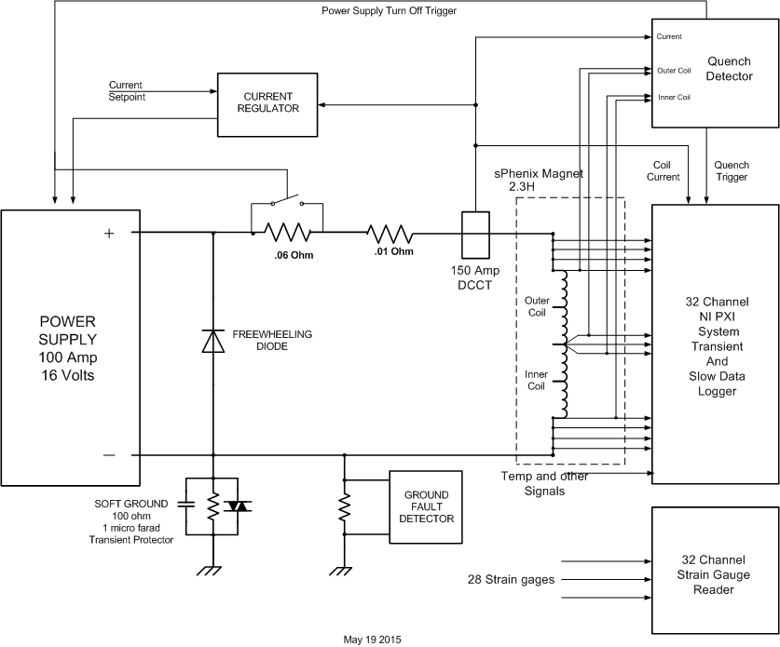
Low Power Test Setup
1

Slide 3
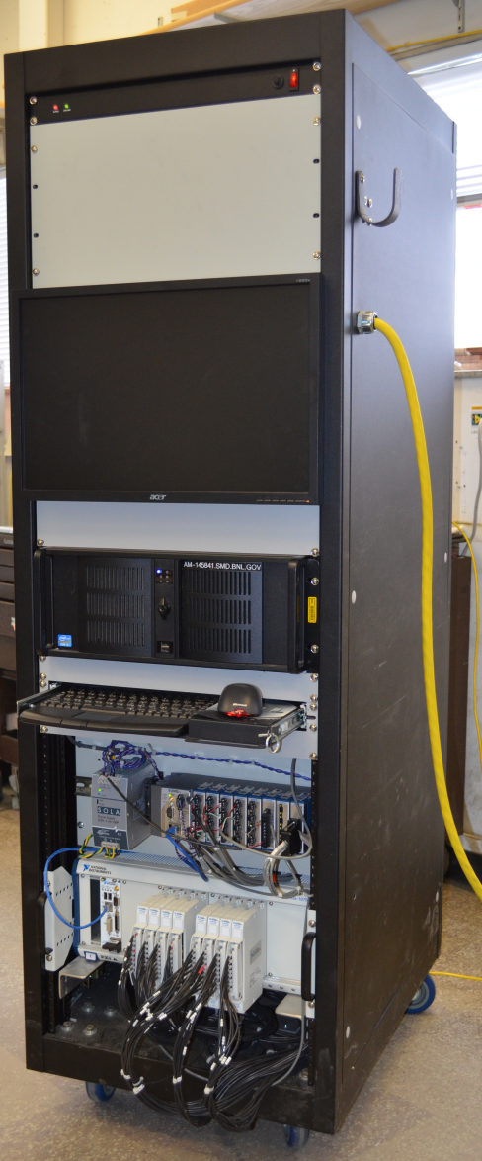
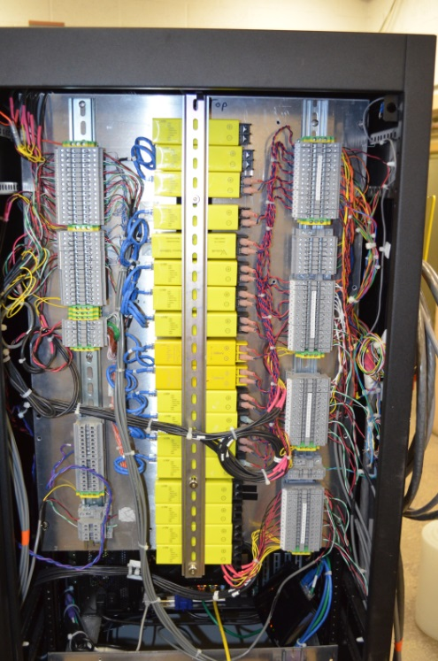
Test Setup Components
100A, 16V PS
Quench Detector
Isolators
Slow Data Logger
Fast Data Logger
2

