Slide 1
PMG Agenda
Project Status – Ed O’Brien
Installation Update – Russ Feder
Integration testing (pre and post installation testing) – John Haggerty

Slide 2
sPHENIX Calendar
ESRC Magnet Review May 17
ESRC TPC(Dry Run/Review) Jun 7/21
INTT PRR Jun 15
Annual sPHENIX MIE Review Jul 14-15
ESRC Calorimeters(Dry Run/Review) Jul 12/26
ESRC IHCal/EMCal/TPC/MVTX/INTT Installation(Dry Run/Review) Sep 13/27
ESRC MBD and beam pipe(Dry Run/Review) Oct 4/18
ESRC MVTX/INTT(Dry Run/Review) Nov 1/15
MIE Early completion Feb 7, 2022
I&F Early completion Oct 12, 2022

Slide 3
High Priority Issue
Additional technicians
We have excellent two techs provided by CAD (EMCal factory, racks) that we’d like to keep through the 2021 shutdown and Run 2022. We need an additional 1 MT for the EMCal and 1 ET for the racks.
We have a tech going out on paternity leave any time now. We need an additional MT for installation work in 1008 to cover while he is out.
Additional visitors
Right now we have permission to have 7 visitors on site. We’d like to increase that number to 12 by mid-July.
Place Procurements.
Some sPHENIX procurements seems stuck in PPM. We had our key buyer (Emily) leave last week along with a 2nd buyer that was working on an important req for us.
See next slide

Slide 4
Key Procurements in PPM
Columbia Univ – LL1 Trigger/MBD electronics $300k
RFQ - Calorimeter signal cables $1500k
RFQ – Rack Platforms for carriage $330k
SBU – EMCal installation fixture $72k
MIT – MVTX FY21-22 design & fab $572k
Coming in June RFQ - IHCal installation fixture $150-200k

Slide 5
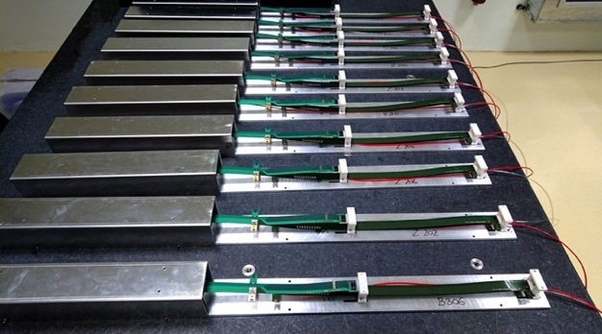
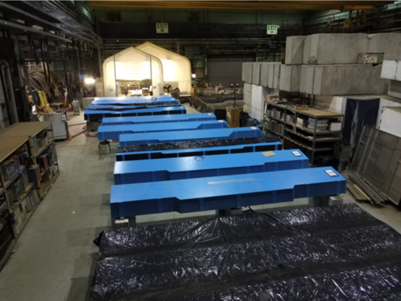
sPHENIX Status
The OHCAL Sectors are complete. Electronic burn in tests continue until we are ready to install them in early June
EMCal blocks for >58% complete at UIUC. All but final 12% of blocks are started. EMCal Sectors 38% complete at BNL. Testing and calibration ongoing.
TPC Fee board revision for production boards underway. Contract placed with vendor for production board assembly.
TPC Fee slice test starting at BNL.
All R1, R2, R3 TPC pad planes at SBU
GEM Module framing for TPC under fab at WSU, Vanderbilt, Temple, Weizmann.
Major computer orders placed (Buffer boxes, EBDCs)
84/84 MVTX “Gold+ Silver ” staves produced at CERN. 100% complete.
31/112 INTT staves complete
MIE Early completion date Jan 2022. Unchanged in March and April
sPHENIX MVTX Staves @CERN
BNL HCal Factory in Bldg 912
TPC Wagon Wheel w/ R1, R2, R3 @ SBU

Slide 6
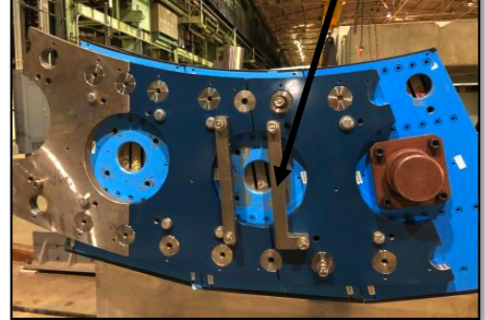
1008 I&F Status
Carriage/cradle parts arrive at BNL in 3 deliveries May 18-25.
sPHENIX installation in 1008 begins next week.
1008 Track reinforcement done in 1008 Assembly Hall.
Work on IR track reinforcement starts after the beginning of the 2021 shutdown in mid-July and ends Nov 1.
XY Carriage tables, Carriage Hydraulics complete
Magnet flux return Pole tip/end cap awarded in production
sPHENIX Beam Pipe at vendor for modification.
Large Support Rings in production
Platform, EMCal installation fixture with BNL PPM.
Engineering design work continues at a fast pace
LHe cryo components to be completed by this summer. LN2 piping in production.
Meetings held with CERN group that will be performing the magnet mapping in 2022.
The I&F Early Completion date has been unchanged throughout the pandemic.
3.5 months of float from RHIC Run 2023 start and I&F early completion. Expect a loss of 20 working days float when Run-22 & shield wall move added to P6.
3 OHCal Sector Assembly Test @ BNL

Slide 7
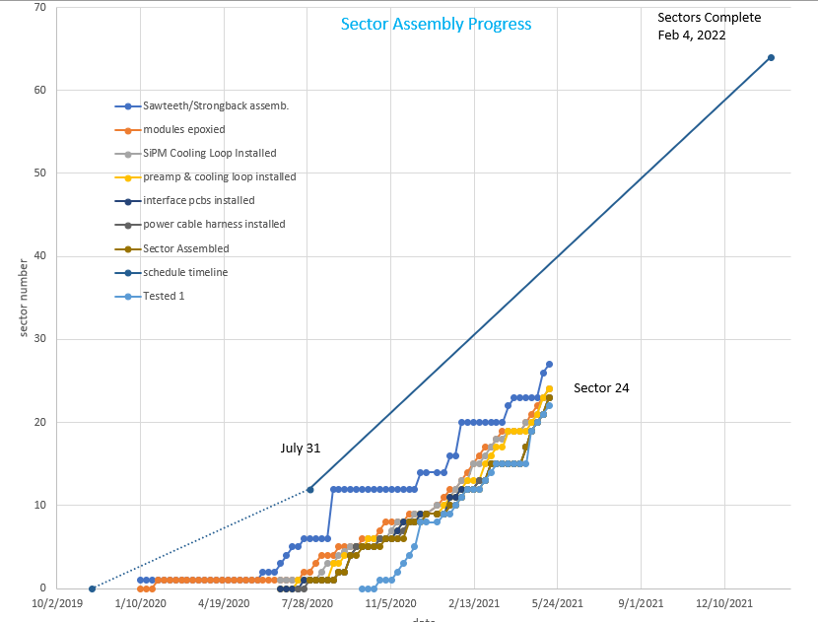
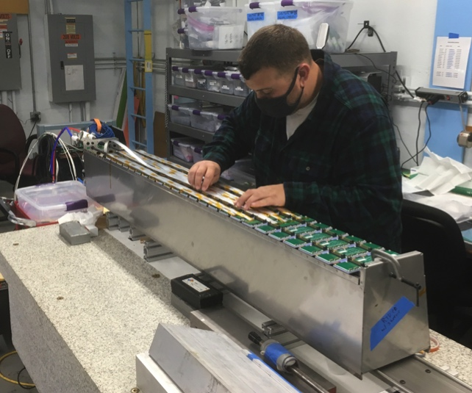
EMCal Progress Tracking – Sector Assembly
Sectors 1-23 complete
Sector 24 being tested
Sectors 25-26 being assembled
On the required production slope for the last month

Slide 8
sPHENIX Operations During the Pandemic
BNL was in min safe mode from the end of Mar 2020 to mid-June 2020. During that period no sPHENIX work took place on BNL site.
We have gradually increased the sPHENIX on BNL-site workforce from mid-June to late Sept.
sPHENIX FTE threshold has been at 30 FTEs since late Sept with the total including sPHENIX visitors. We have ~80% of our workforce approved to be on site. However managers, engineers and designers that can work remotely continue to do so.
We have increased the onsite personnel threshold in January to 35 FTEs to accommodate the influx of visitors to BNL working on sPHENIX. The FTE threshold is currently at 30 due to earlier uptick in COVID in NY Suffolk county Nov-Mar. Would like to get threshold to 40 by mid-July (including visitors) and 45 FTEs by Sept.
COVID mitigation plans continue to be implemented
sPHENIX has assigned a Task Coordinator to optimized the personnel on site and tasks performed each day.
We’re in daily communication with BNL safety personnel to make sure that all continues to go smoothly.
All institutions with sPHENIX fab responsibilities have reopened with low density labor practices implemented.

Slide 9
sPHENIX 2 PEMP Notables in 2021
NP: Complete infrastructure and facility upgrades in Building 1008 to enable the planned start of installation of the sPHENIX calorimeters. (Objective 2.3)
Complete 1008 Assembly Hall track reinforcement by 31-May-2021 ✔ Completed ahead of schedule
BHSO/SC: Effectively plan, execute, and successfully deliver SC projects equal to or less than $50 million that have been delegated to the Laboratory Director by SC under DOE O 413.3B [Super Pioneering High Energy Nuclear Interaction (sPHENIX)]. Clearly demonstrate successful accomplishment of key milestones in FY 2021 (adjusted for schedule impacts created by the COVID-19 pandemic) in accordance with SC guidance. (Objective 7.1)
EMCal Preproduction Blocks complete 1-Dec -2020 ✔ Completed ahead of schedule
1st OHCal Sector ready to install 15-Apr-2021 ✔ Completed ahead of schedule
EMCal Scintillating Fiber Acquisition complete 31-May-2021 ✔ Completed ahead of schedule
EMCal Sector Assembly 50% Complete 15- Aug-2021
PEMP Notable #1 complete. PEMP Notable #2 requires meeting one final milestone. On track to complete the last milestone on schedule.

Slide 10
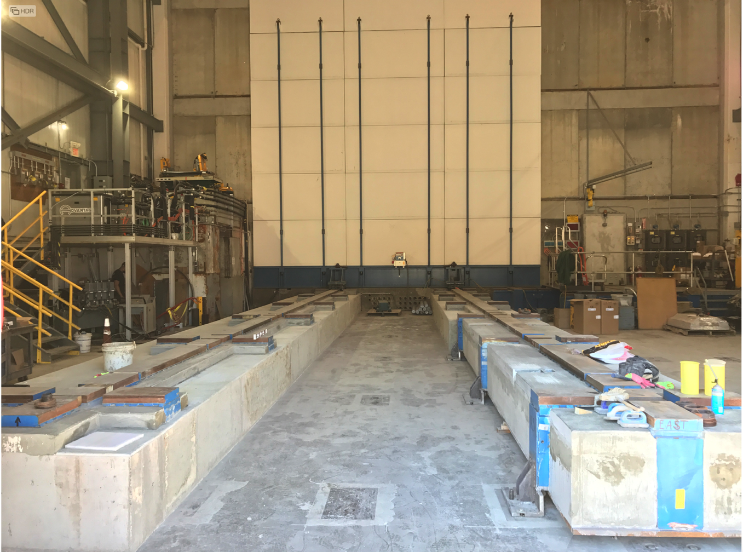
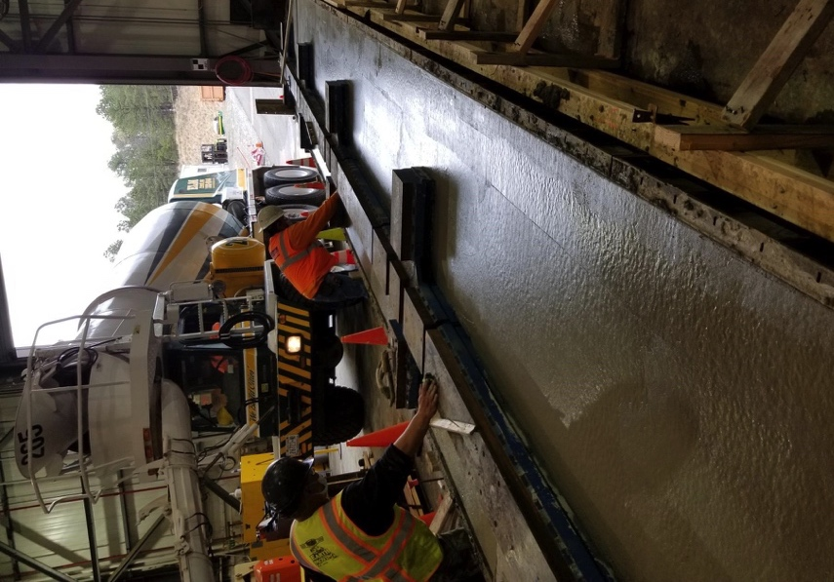
Track Reinforcement in 1008 Assembly Hall
Assembly Hall Tracks Complete
Pouring South track
Drying North Track

Slide 11
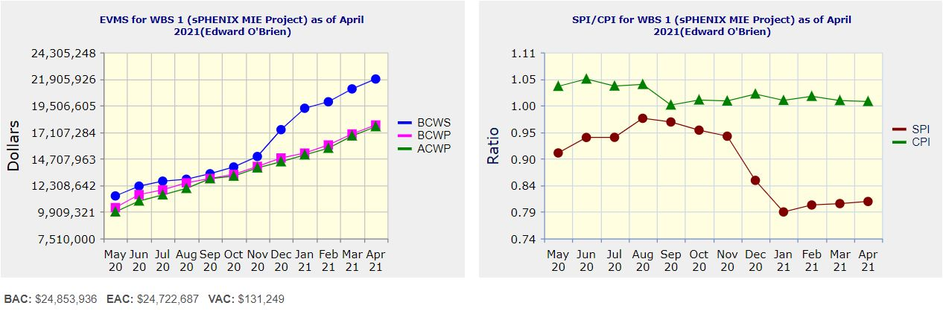
Performance Indices – sPHENIX MIE
Cumulative SPI | Cumulative CPI
0.81 | 1.01
Cumulative BCWS (Scheduled) | $21,909,322
Cumulative BCWP (Performed) | $17,759,620
Cumulative ACWP (Actual) | $17,606,065
DOE SPI or CPI Value Thresholds
0.90 to 1.15
0.85 to 0.89 or 1.16 to 1.25
<0.85 or >1.25

Slide 12
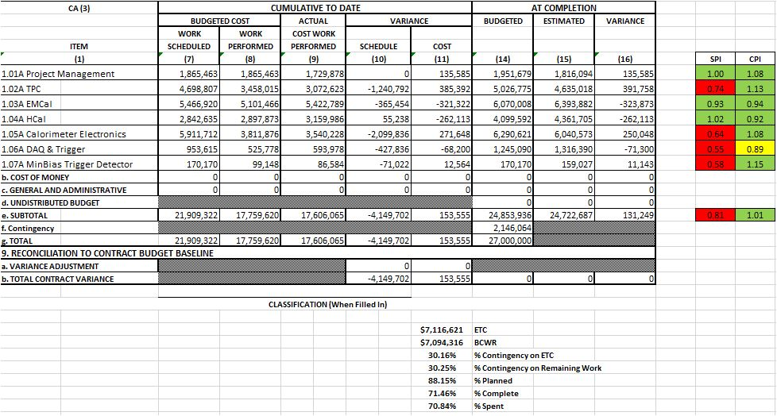
Cost Performance Report (CPR) – sPHENIX MIE
DOE SPI or CPI Value Thresholds
0.90 to 1.15
0.85 to 0.89 or 1.16 to 1.25
<0.85 or >1.25
*Highlights in table above takes variance $ into consideration, not just Indices

Slide 13
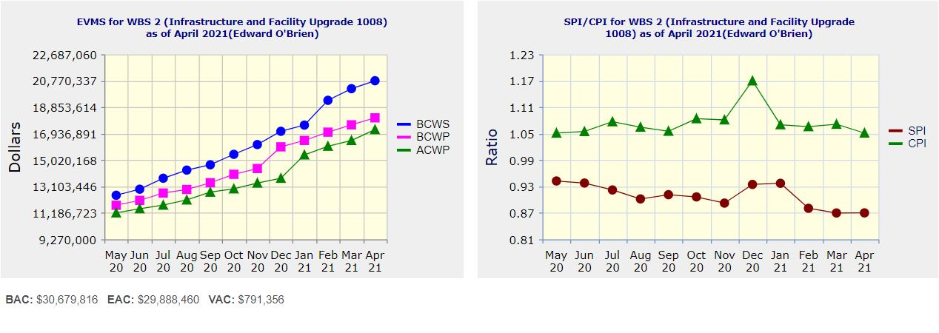
Performance Indices – 1008 Infra and Facility Upgrade
Cumulative SPI | Cumulative CPI
0.87 | 1.05
Cumulative BCWS (Scheduled) | $20,778,364
Cumulative BCWP (Performed) | $18,085,332
Cumulative ACWP (Actual) | $17,233,288
DOE SPI or CPI Value Thresholds
0.90 to 1.15
0.85 to 0.89 or 1.16 to 1.25
<0.85 or >1.25

Slide 14
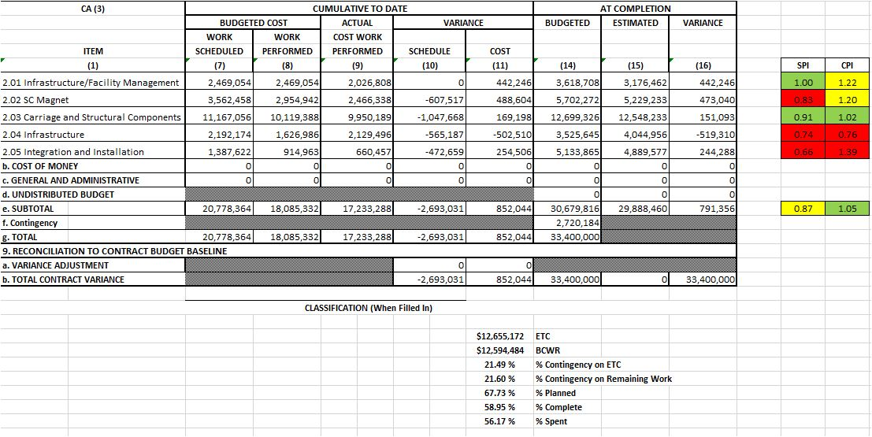
Cost Performance Report (CPR) – 1008 Infra and Facility Upgrade
DOE SPI or CPI Value Thresholds
0.90 to 1.15
0.85 to 0.89 or 1.16 to 1.25
<0.85 or >1.25
*Highlights in table above takes variance $ into consideration, not just Indices

Slide 15
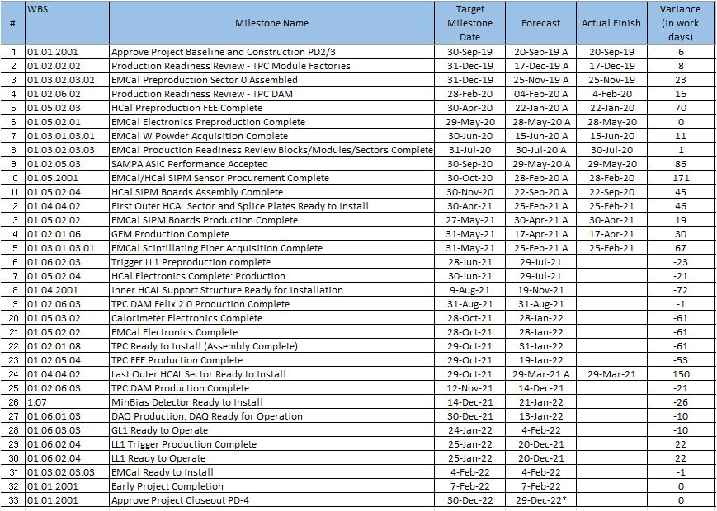
Milestones Status – sPHENIX MIE

Slide 16
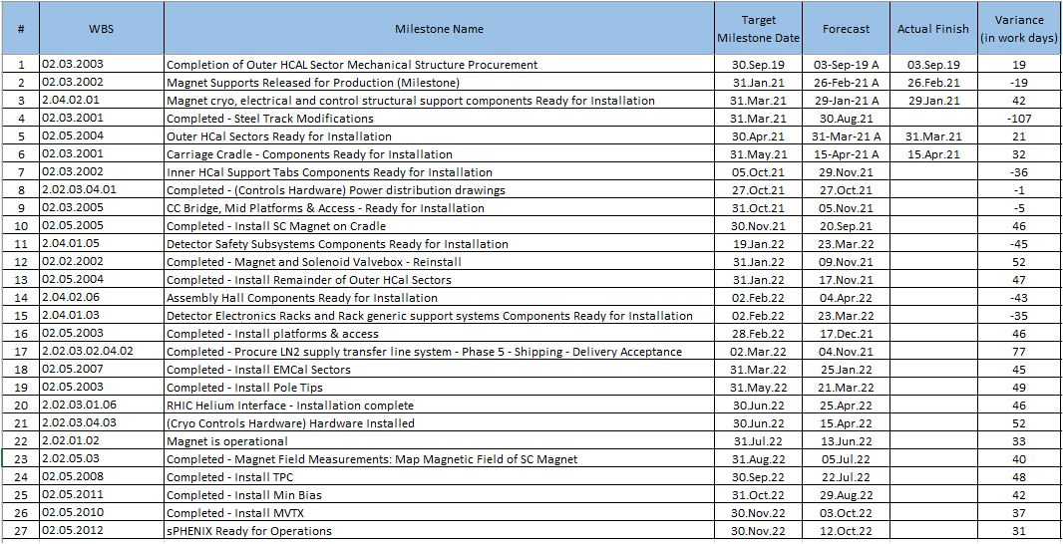
Milestones Status – 1008 Infra and Facility Upgrade

Slide 17
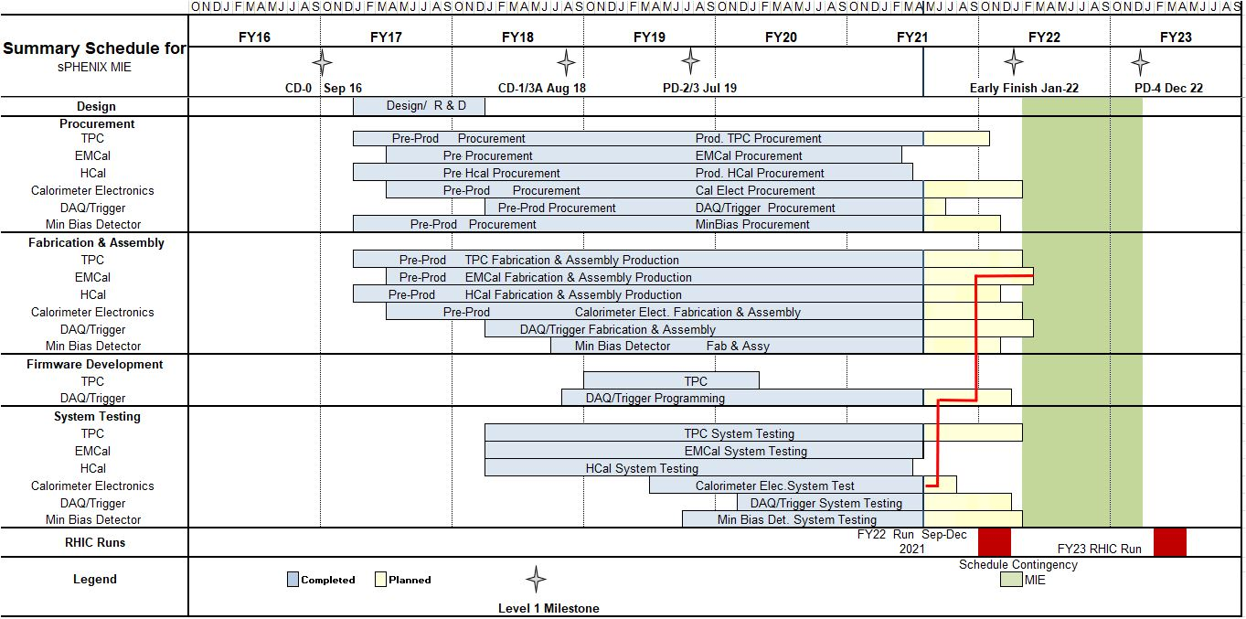
Summary Schedule – sPHENIX MIE

Slide 18
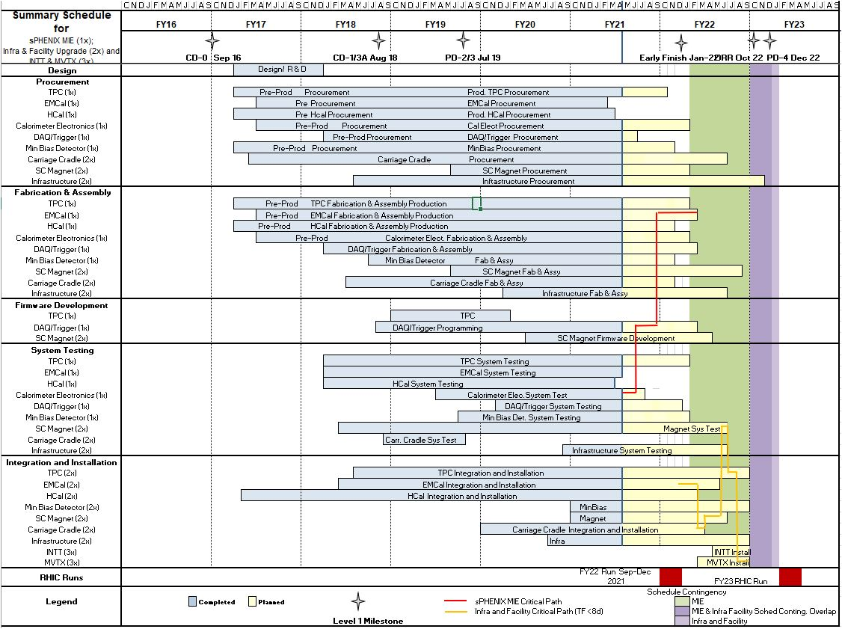
Summary Schedule – sPHENIX MIE and 1008 Infra and Facility Upgrade

Slide 19
Outer HCal and EMCal Installation
 | Fabrication Complete | Installation Date | Delta (wk)
OHCal Sector 1 & Splice Plates | Week 8, 2021 | Week 23, 2021 | 14
OHCal Sector 13 | Week 5, 2021 | Week 34, 2021 | 29
SC Magnet Coil | 2018 (testing at BNL) | Week 37, 2021 | >100
OHCal Sector 14 | Week 5, 2021 | Week 41, 2021 | 36
OHCal Sector 32 | Week 17, 2021 | Week 46, 2021 | 29
EMCal Sector 1 | Week 14, 2020 | Week 1, 2022 | 91
EMCal Sector 32 | Week 26, 2021 | Week 5, 2022 | 31
EMCal Sector 59 | Week 52, 2021 | Week 10, 2022 | 10
EMCal Sector 64 | Week 5, 2022 | Week 11, 2022 | 6

Slide 20
TPC and Electronics Installation
 | Fabrication Complete | Installation Date | Delta (wk)
TPC | Week 3, 2022 | Week 26, 2022 | 23
OHCal Cabling | Week 3, 2022 | Week 5, 2022 | 2
EMCal Cabling | Week 3, 2022 | Week 5, 2022 | 2
Digitizers | Week 44, 2021 | Week 17, 2022 | 25
Trigger & Timing Systems | Week 4, 2022 | Week 17, 2022 | 13
Beampipe | Week 8, 2022 | Week 32, 2022 | 24
TPC, EMCal and OHCal on-detector electronics are installed as part of detector fabrication
Digitizer, Trigger and Timing installed after roll-in during April 2022
EMCal & HCal cabling starts only after Upper Platform in placed and essential cryogenics work is underway

Slide 21
Summary
sPHENIX Assembly about to start in 1008
Construction is proceeding on sPHENIX final detector components at a wide variety of sites.
Continued great progress in sPHENIX factories: OHCal sectors complete, 58% of EMCal Blocks and 38% EMCal sectors complete. TPC, electronic, DAQ/Trigger, MBD all making good progress.
Assembly Hall track work is done.
Production complete or underway for carriage/cradle, XY tables, Magnet End caps, Large support rings, beam pipe mod, hydraulics, LHe and LN2 components.
We have a large team of engineers and designers working remotely, and effectively on the design of the sPHENIX MIE.
We currently have 30 FTEs allowed on site. By mid-July we’d like to increase this to 40 FTEs (including visitors) and 45 FTEs by Sept.
We have seen a recent slow down in vendor deliveries due to the pandemic Nov-Feb but deliveries improving in March - May. Some key components have become scare.
Early completion dates of MIE and 1008 I&F held constant in April.

Slide 22
Back - Up

Slide 23
Work for Rack Electrical Tech
1)Sensor installation on carriage racks
2)Rack system prototype development assistance
a)Running cables
b)Signal integrity checks over long runs
c)Terminating cables
d)Wiring panels
3)Power distribution validation of low power systems for global interlock controls.

Slide 24
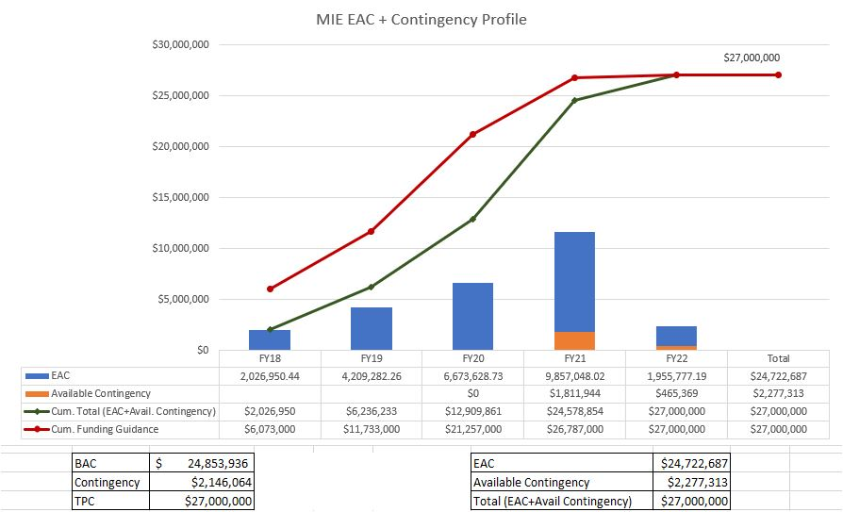
EAC and Contingency Profile – sPHENIX MIE

Slide 25
Baseline/Contingency Log - MIE

Slide 26
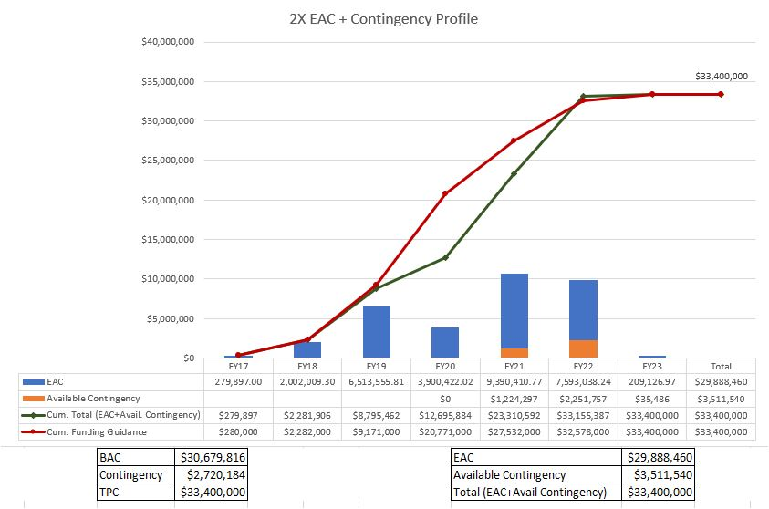
EAC and Contingency Profile – 1008 Infra and Facility Upgrade

Slide 27
Baseline/Contingency Log - 1008 Infra and Facility Upgrade

Slide 28
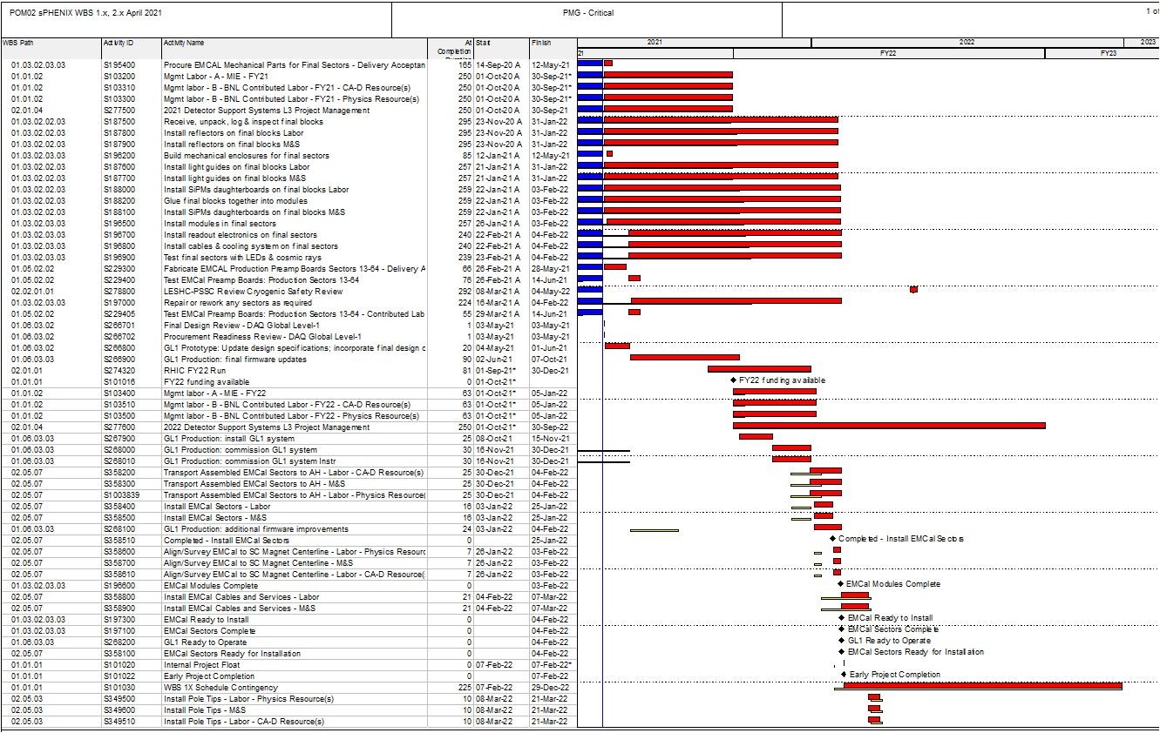
Critical Path (1x, 2x and 3x Combined)

Slide 29
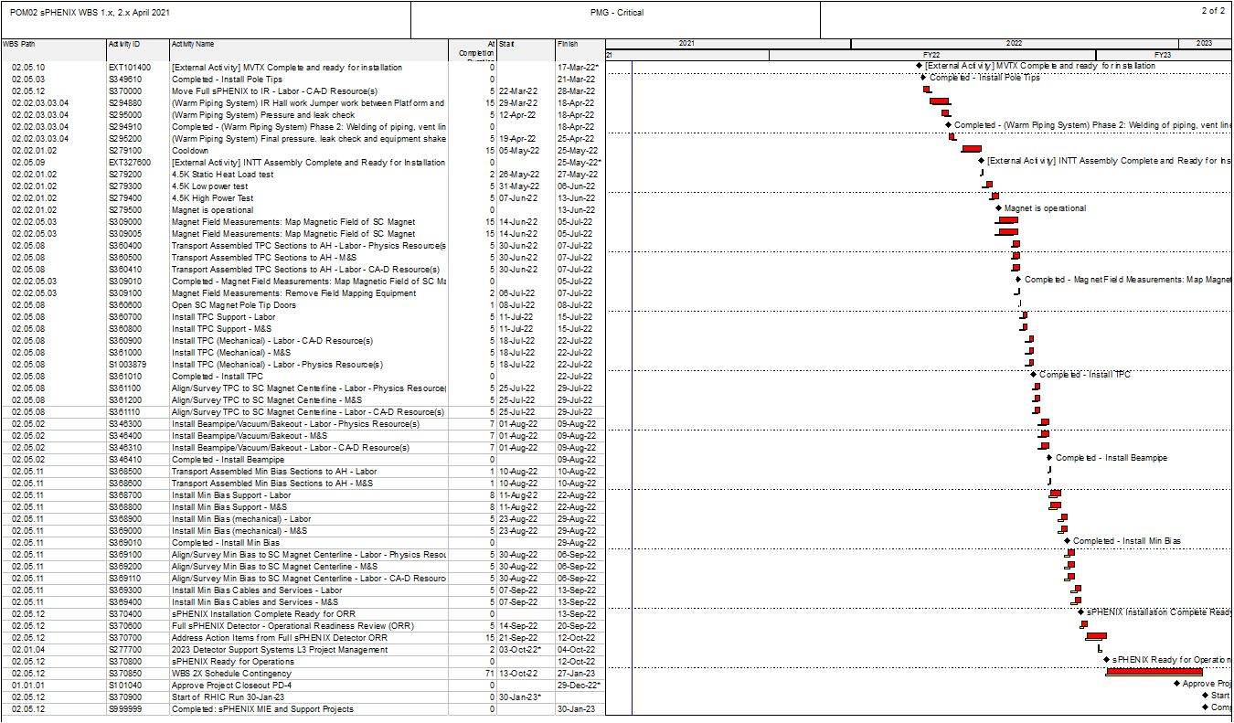
Critical Path (1x, 2x and 3x Combined)

Slide 30
MIE Variance Report
SV Report for WBS 1.0 sPHENIX MIE Project
April 2021
Cumulative BCWS $21,909,322
Cumulative BCWP $17,734,234
Cumulative ACWP $17,606,065
SV = -$4,175,088
CV = +$128,169 SPI = 0.8094
CPI = 1.0073

Slide 31
MIE Variance Report - TPC
WBS 1.2.1 TPC Mechanics
Description – None. The activity, S120100 Production of GEM foils, which has had prior SV, is now complete.
Impact – None.
Corrective – None. The order is complete.
WBS 1.2.2 TPC GEM Modules R1
Description – Two activities were delayed by late arrival of TPC R1 padplanes. These are S125500 TPC R1 modules build, with SV = -$18,320 and S125600 TPC R1 Modules test, with SV = -$18,320. The total SV resulting is -$36,641. The R1 padplane, the smallest of the three types, were all delivered last month.
Impact – None as yet. The rest of R1 module construction is proceeding. Pad planes are to be attached to the modules as a late step in the module assembly sequence. Positive float remains. Corrective – The R1 pad planes have been delivered. The two above activities are now proceeding and will not impede overall TPC construction.
WBS 1.2.5 TPC Front End Electronics. Description – There are six activities with significant SV. They are:
activity S136500 TPC FEE Cooling System, SV = -$57,393,
activity S141500 TPC FEE Production components (optical transceivers), SV =-$22,999,
activity S141800 TPC FEE Production Components, SV = -$46,432
activity S142500 TPC FEE Low Voltage Power system, SV = -$123,533,
activity S143200 TPC FEE Production boards and assembly, SV = -$175,244,
and
activity S143250, TPC FEE components, SV = -$116,301.
The net SV is -$541,901.
Impact – None as yet.
Corrective – All the items covered by these activities are being ordered, with one exception, the optical transceivers. The manufacturer announced in February that it is replacing this part with a newer and less expensive version; the new variant will have to be the one purchased by sPHENIX and thus also will need to be tested in magnetic field, although no issues are expected based on technical input from the manufacturer. The required design and procurement reviews are complete. The cooling system requires a series of machined parts, for which the procurement is placed, and manufacturing is ongoing. The TPC FEE production components are on order and around 80% in hand. The TPC FEE Low Voltage power supplies are under contract and partially delivered, with the vendor scheduling all remaining deliveries over the next month. The TPC production board and assembly procurement is progressing, with a vendor identified. The TPC FEE components, mostly the quad transceivers, will be ordered later in the spring because they are added to the assembled boards by hand after the automatic board assembly is complete, thus their delivery schedule does not impede that for the boards.
WBS 1.2.1 TPC Mechanics
Description – None. The activity, S120100 Production of GEM foils, which has had prior SV, is now complete.
Impact – None.
Corrective – None. The order is complete.
WBS 1.2.2 TPC GEM Modules R1
Description – Two activities were delayed by late arrival of TPC R1 padplanes. These are S125500 TPC R1 modules build, with SV = -$18,320 and S125600 TPC R1 Modules test, with SV = -$18,320. The total SV resulting is -$36,641. The R1 padplane, the smallest of the three types, were all delivered last month.
Impact – None as yet. The rest of R1 module construction is proceeding. Pad planes are to be attached to the modules as a late step in the module assembly sequence. Positive float remains. Corrective – The R1 pad planes have been delivered. The two above activities are now proceeding and will not impede overall TPC construction.
WBS 1.2.5 TPC Front End Electronics. Description – There are six activities with significant SV. They are:
activity S136500 TPC FEE Cooling System, SV = -$57,393,
activity S141500 TPC FEE Production components (optical transceivers), SV =-$22,999,
activity S141800 TPC FEE Production Components, SV = -$46,432
activity S142500 TPC FEE Low Voltage Power system, SV = -$123,533,
activity S143200 TPC FEE Production boards and assembly, SV = -$175,244
activity S143250, TPC FEE components, SV = -$116,301.
The net SV is -$541,901.
Impact – None as yet.

Slide 32
MIE Variance Report -TPC
Corrective – All the items covered by these activities are being ordered, with one exception, the optical transceivers. The manufacturer announced in February that it is replacing this part with a newer and less expensive version; the new variant will have to be the one purchased by sPHENIX and thus also will need to be tested in magnetic field, although no issues are expected based on technical input from the manufacturer. The required design and procurement reviews are complete. The cooling system requires a series of machined parts, for which the procurement is placed, and manufacturing is ongoing. The TPC FEE production components are on order and around 80% in hand. The TPC FEE Low Voltage power supplies are under contract and partially delivered, with the vendor scheduling all remaining deliveries over the next month. The TPC production board and assembly procurement is progressing, with a vendor identified. The TPC FEE components, mostly the quad transceivers, will be ordered later in the spring because they are added to the assembled boards by hand after the automatic board assembly is complete, thus their delivery schedule does not impede that for the boards.
WBS 1.2.6 TPC Data Aggregator Modules
Description – Three activities contribute to the SV:
activity S147300 FELIX 2.0 production board, SV = $30,262,
activity S147370 FELIX 2.0 board optical components, SV =-$93,719, and
activity S148400 EBDC computers and peripherals, SV =-$244,769.
Impact – None
Corrective – The EBDC computer prototype passed all tests. The production order is now awarded to a vendor. The FELIX production board order is submitted; the components are in hand and thus the activity is 80% complete, and only board preparation and assembly remains; these activities are underway. The FELIX optical components are fiber optics and specialized connectors to group and route signals from the TPC FEE cards (WBS 1.2.5) to the FELIX boards. The topology of these connectors must accommodate a board used to reprogram the FEE cards in case of radiation-induced single event upsets (SEUs); the architecture of this board was determined at the beginning of March. This fiber topology was updated, the bill of materials for the fiber optic components was revised, and submissions started to Procurement in April.

Slide 33
MIE Variance Report -TPC
WBS 1.2.7 TPC Support Systems
Description – There are three areas of effort. The TPC Lasers delivery has started but only the first articles have been delivered, SV =-$176,986. The TPC Gas System has procured and received some 60% of the components but still needs to place requisitions for the balance, SV =-$44,121. The TPC Cooling system has not procured the high value elements including the chiller/re-circulator, SV =-$73,653.
The total SV for these key items is -$294,760, some 5% smaller than the prior month due to several components being procured during April.
Impact – These are all items being procured well ahead of their needed installation in order to allow for more time to test them on the bench and adjust settings.
Corrective – The Preliminary Design reviews are complete and all three of these subsystems have moved to acquiring first articles. Operation of the first laser under the necessary field conditions was demonstrated. The Final Design reviews and the Procurement Readiness reviews for the laser system, which has the remaining items with multi-month procurement lead times, were held in March. The procurement for the chiller/re-circulator has now been placed with a vendor.

Slide 34
MIE Variance Report -EMCal
WBS 1.3.1 EMCal Blocks
Description – There are four main items causing the SV. The S171800 Epoxy is only 48% complete, SV =-$42,088. Molds S172500 are behind schedule, SV =-$6,272. The S175200-S176600 Blocks for Sectors 35-49 are not complete, SV =-$74,945, nor is their shipping to BNL, SV =-$25,952.
The total SV for these items is -$149,256.
Impact – None
Corrective – The Epoxy must be bought within a few weeks of use, due to shelf-life issues. It is a commodity item and is purchased on an as-needed basis. The delayed Blocks were caused by personnel absences due to the COVID-19 pandemic. Block production resumed over the summer of 2020 and returned to planned production rates in the Fall. This particular SV will persist until about 2 weeks before the Project is complete, at which time Block production will be complete. The Early Completion date for the MIE project was adjusted in January 2021 to reflect this.
WBS 1.3.2 EMCal Modules and Sectors
Description – The S187400 Production Light Guide contract is only 61% complete, SV = -$93,650. The S195400 Mechanical parts for Final Sectors are only 85% complete, SV = -$43,762. The S196100 Cooling System for Final Sectors was only 33% complete, SV = -$55,131. The total of these SVs is -$192,543, some 18% less than the prior month.
Impact – None
Corrective – The light guide production was suspended at the vendor until QA and tooling-fixture issues were examined and resolved. These issues were addressed over October-December and production deliveries have resumed at the planned rate and ahead of when they are needed to produce sectors. The light guide vendor has several more machine shops supplying him now to maintain his delivery rate. The mechanical parts are being delivered somewhat ahead of schedule, with all but the sawteeth/strongbacks in fact being complete; the sawteeth delivery schedule is about a month ahead of need-by date. The cooling system components are being manufactured by a local small company at a pace about 2 months ahead of need-by date.

Slide 35
MIE Variance Report - HCal
WBS 1.4.2 Outer HCal Mechanics
Description – None.
Impact – None.
Corrective – None needed, work is complete.
WBS 1.4.4 Outer HCal Sector Assembly and Testing
Description – The S209800 – S210200 assembly and testing of the production Outer HCal Sectors was completed ahead of schedule, SV = $55,238.
Impact – None.
Corrective – None needed, work is complete ahead of schedule. Some part of the positive schedule variance will persist until September 2021 which is the planned completion date for this effort.

Slide 36
MIE Variance Report – Cal Electronics
WBS 1.5.2 Calorimeter Front End Electronics
Description – Eight separate activities contribute substantially to this SV. They are:
activity S229300 EMCal preamplifiers only 50% delivered, SV = -$274,821,
activity S231800 EMCal internal cables are only 90% complete, SV = -$28,819,
activity S233200 EMCal external cables are not complete, SV = -$205,854
activity S233250 EMCal trunk signal cables are not complete, SV = -$486,153,
activity S234000 EMCal Bias power supplies completed early, SV = $31,136,
activity S234100 EMCal LV power system sectors 13-64 only 60% complete, SV =-$15,708,
activity S244400 HCal External cables are only 50% complete, SV = -$50,970, and
activity S244450 HCal trunk signal cables not complete, SV =-$93,319. The total SV for these activities is -$1,124,508.
Impact – none except for the EMCal preamps, which are needed by the EMCal sector production line.
Correctives – Half of the EMCal preamplifiers are now delivered and the EMCal sector fabrication line is back on track.
The vendor for the EMCal internal cables has been delivering them regularly on a schedule well in advance of the need for them during EMCal sector construction. The Procurement readiness review was held in January for the external/trunk cable orders, EMCal and HCal, and procurement documents have been delivered to the Procurement group. Potential vendors indicate they can meet the requested delivery schedule for these cables.

Slide 37
MIE Variance Report – Cal Electronics
WBS 1.5.3 Calorimeter Digitizers
Description – There are three activities contributing to this SV. They are
activity S252700 Digitizer Parts, SV = -$569,972,
activity S252800 Digitizer Boards, SV = - $149,785,
and
activity S252900 Digitizer Assembly, SV = -$231,066,
for a total SV = -$950,823. Impact – None presently. SV improved by $109K this month. The EMCal and OHCal sector production lines have an adequate number of digitizers to perform all needed QA during remaining detector construction. Therefore, the remaining digitizers are only needed by the completion of the MIE project.
Corrective – The contract for the production digitizers is placed. The vendor indicates they are placing orders for production quantities of all parts but that world-wide supply chains have led to more lead time than foreseen pre-COVID. An initial delivery of some 16% of the parts occurred this month. We continue to monitor the progress by this vendor.

Slide 38
MIE Variance Report –DAQ/Trigger
WBS 1.6.1 Data Acquisition
Description – Four activities contributed to this SV, including
activity S255900 Production boards not complete, SV = -$121,503,
activity S256700 crates not complete, SV = -$74,284,
activity S258700 jSEB slow control boards not complete, SV = -$19,181,
and
activity S259500 Buffer Box procurement not complete, SV = -$62,270,
for a total SV = -$277,238.
Impact – None. These items do not affect the production schedule for any other MIE items.
Corrective – Procurement documents are being prepared but are not yet complete for the four items which are not complete.
WBS 1.6.2 Local Level-1 Trigger
Description – Activity, S263600 Preproduction Local Level-1 trigger, is not complete, resulting in SV = -$69,641.
Impact – None
Corrective – The prototype Local Level-1 trigger board has been under full-speed testing for several months. Results to date indicate it will meet all requirements, completing the above activity. A review held in late February determined that a few small revisions to the board are needed. These revisions are proceeding. The production manufacture is still expected during 2021 based on the existing board assembly house and Bill of Materials. That production will complete this level-3 WBS.

Slide 39
MIE Variance Report –DAQ/Trigger
WBS 1.6.3 Global Level-1 Trigger
Description – Activity S267600 Production of final GL1 is not complete, SV =-$32,673.
Impact – None
Corrective – The prototype Global Level-1 Trigger is being used as part of an extended test of electronics for sPHENIX. This test requires multiple front-end cards to operate, respond to triggers and timing signals, and send data to the production DAQ computers correctly over an extended period. This test is continuing as of the end of April. Assuming a positive outcome, the production Global Level-1 Trigger will be assembled using the existing blueprints.
WBS 1.6.4 Timing System
Description – Activity S270300 Production of Timing System is not complete, SV =-$48,284.
Impact – None
Corrective – The prototype Timing System is being used as part of an extended test of electronics for sPHENIX. This test requires multiple front-end cards to operate, respond to triggers and timing signals, and send data to the production DAQ computers correctly over an extended period. This test is continuing as of the end of April. Assuming a positive outcome, the production Timing System will be assembled using the existing blueprints.

Slide 40
MIE Variance Report - MBD
WBS 1.7 Min Bias Trigger Detector
Description – Activity S273500 Min/Bias production digitizers is not complete, SV = -$17,143, and activity S273600 MBD Shaper/Disc Board is not complete, SV = -$53,879, for a total of -$71,022.
Impact – None
Corrective – The digitizers needed for the MBD are part of the larger digitizers order noted above for WBS 1.5.3 A final design review and production readiness review were held for the MBD shaper/discriminator board in February, no required changes were identified, and the board approved for production procurement. This procurement is being placed with the vendor who prepared and tested the prototype versions. Completion by December 2021 is anticipated.

Slide 41
I&F Variance Report – Management/Infrastructure
WBS 2.1 Management WBS 2.4 Infrastructure
Description –
The WBS 2.1 Management has BCWP = $2,469,054, ACWP = $2,026,808, CV = $442,246 and CPI=1.22
The WBS 2.4 Infrastructure has BCWP = $1,626,986, ACWP = $2,129,496, CV = -$502,510 and CPI = 0.76.
Engineering management time for Infrastructure was budgeted in WBS 2.1 but has been charged to WBS 2.4. About $230K of labor charges are involved.
Were this $230K instead charged to the planned account, i.e. increasing ACWP in WBS 2.1 by $230K and reducing ACWP in WBS 2.4 by the same $230K, the WBS 2.1 CPI would be 1.09 and that for WBS 2.4 would be 0.86.
A further reduction in time charged to WBS 2.1 (specifically WBS 2.1.2) occurred because a very senior cryogenics engineer has been moved to the EIC project. His work on the I&F Upgrade is being covered by another engineer who is supervising the cryogenics work and charging time as planned to WBS 2.2.3. A positive CV of $203K results due to avoided labor charges in WBS 2.1. Setting aside this CV, i.e. lowering the BCWP in WBS 2.1 by $203K, would further reduce the WBS 2.1 CPI to 1.00.
The remaining negative CV in WBS 2.4 of about -$275K results chiefly from two cost overruns in materials. The first overrun (in WBS 2.4.2.2) results from the Beryllium beampipe, which must be lengthened in order to fit within the sPHENIX envelope and then re-coated with Non-Evaporable Getter (NEG) material for vacuum reasons. Some $137K has been invoiced and paid but only $12K progress can be claimed due to the very low baseline estimate for this work, which assume a much simpler re-working. This results in $125K of cost overrun.

Slide 42
I&F Variance Report – Management/Infrastructure
WBS 2.1 Management and WBS 2.4 Infrastructure
The other main contributor to the negative CV in WBS 2.4 results from the track reinforcement work (WBS 2.4.2.6), which will ultimately cost more than $800K above the earlier baseline estimate. The initial paid invoice for this work in the Assembly Hall in Bldg 1008 plus associated support labor is $160K of which only $55K corresponds to progress in the baseline that can be claimed, resulting in $105K in cost overrun. This will overrun increase as further invoices are paid for this work.
Impact – None. The labor charges for WBS 2.4 are continuing and are indeed for work on the I&F Upgrade. The avoided labor charge for WBS 2.1.2 will continue as the engineer in question will remain with the EIC effort.
Corrective – None. The cost overruns for the beampipe and track reinforcement work are not recoverable.

Slide 43
I&F Variance Report – SC Magnet
WBS 2.2 Magnet Systems
Description – The WBS 2.2 Magnet has BCWP = $2,954,042, ACWP = $2,466,338, CV = $4,688,604, and CPI = 1.20
Examination at WBS 2.2 at Level-3 shows that the cost variance derives largely from WBS 2.2.4 (power supply & quench detector) and from WBS 2.2.5 (field measurements.) In both cases the ACWP is entirely comprised of “Actual” charges (both labor and M&S), incurred prior to baselining, plus only M&S charges since baselining. There are nearly $425K of planned labor charges that did not occur, because work was done more efficiently than expected, or was performed but not charged to the magnet accounts. This breaks down to $275K in WBS 2.2.4 and $150K in WBS 2.2.5
Impact – None
Corrective – None. The work is done. This positive CV will persist.

Slide 44
I&F Variance Report Installation/Integration
WBS 2.5 Installation Description – The WBS 2.5 Installation has BCWP = $914,963, ACWP = $660,457, CV = $254,506 and CPI = 1.39
About $50K in positive CV is due to less cost incurred than planned for the OuterHCal installation fixture in design and fabrication labor and M&S charges. This fixture is delivered and fully invoiced. It was found that an earlier design from the sPHENIX MIE for assembling OHCal structures could be re-used for the I&F Upgrade.
About $170K in positive CV results in engineering, design and fabrication effort that did not need to be expended to create a specialized installation fixture for the cradle carriage. Standard rigging equipment already in hand was found to suffice after the carriage cradle design matured and its manufacturing decided. This view has been proved out at the vendor’s factory. Thus, these charges will not be incurred.
About $40K in positive CV results from avoided costs via a reorganization of how the InnerHCal is to be assembled and transported.
Impact – None.
Corrective – None. The positive CV will persist since the finished work was done for less cost than planned.

