Slide 1
DIRC Based PID for the EIC
EIC PID Meeting, Jefferson Lab
11 May 2015
Charles Hyde
Old Dominion University

Slide 2
BNL Generic Detector R&D Project eRD4
DIRC-based PID for the EIC Central Detector T. Cao¹, R. Dzhygadlo², T. Horn³ (co-PI), C. Hyde⁴ (co-PI), Y. Ilieva¹ (co-PI), G. Kalicy⁴, P. Nadel-Turonski^{5,*} (co-PI), K. Park⁴, K. Peters², C. Schwarz², J. Schwiening² (co-PI), W. Xi⁵, N. Zachariou¹, and C. Zorn⁵.
¹⁾ University of South Carolina, Columbia, SC 29208
²⁾ GSI Darmstadt, Germany
³⁾ The Catholic University of America, Washington, DC
⁴⁾ Old Dominion University, Norfolk, VA
⁵⁾ Thomas Jefferson National Accelerator Facility,
^{*)} turonski@jlab.org

Slide 3
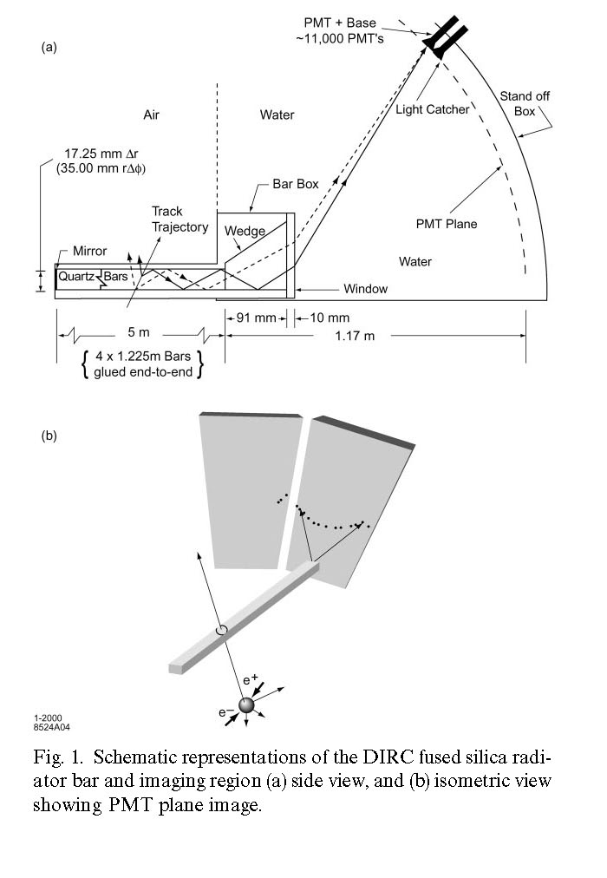
DIRC Projects Worldwide
BaBAR (Completed)
PANDA: Design phase
Barrel and EndCap DIRCs
BELLE-2: Construction
LHCb (2018?)
Super-B (Cancelled)
Reflective focussing optics (FDIRC)
JLab Glue-X (Hall-D):
modified FDIRC)
BaBAR bar-boxes approved
EIC Barrel, Ion Endcap?
BaBAR-DIRC, NIM A453

Slide 4
EIC DIRC R&D
What are the ultimate performance limitations of DIRC?
Lens vs Mirror Focussing
Compact Expansion Volume (EV)
Performance of Timing sensors
B-field Response of μChannel Plate PMT
Noise levels of SiPMT
Timing Resolution
BaBAR achieved 3σ π-K separation up to 4 GeV/c
Can we push to 6 GeV/c?

Slide 5
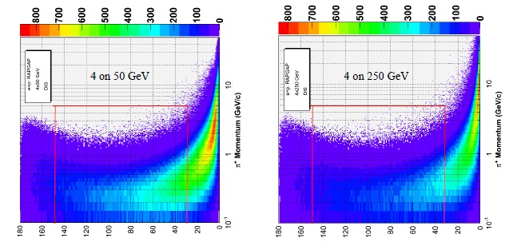
Inclusive pions from DIS
At 90°: p<3 GeV/c
At 30°: p < 5 GeV/c

Slide 6
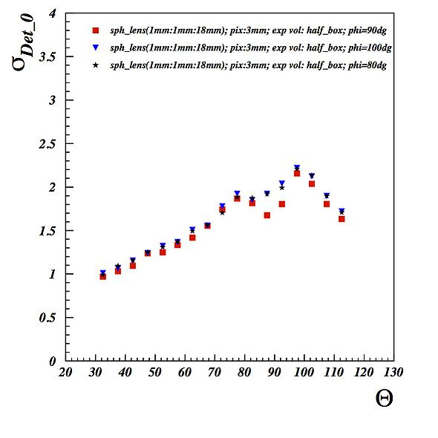
Simulation Results
Triple Lens
1 mr ➔ K/pion separation to 6 GeV/c
2 mr ➔ K/pion separation to 4 GeV/c (BaBAR)

Slide 7
High B-Field Test Facility
Cool Down of 5 Tesla Frost Magnet

Slide 8
Initial Results
dd

Slide 9
B-field Response @ 0° (single Photo-Electron)

Slide 10
Angular Dependence

Slide 11
Work In Progress
Simulations…
New B-field Tests Summer 2015
In Beam tests at CERN PS
3-component spherical lens
May 2015
June-July (2 weeks) 2015

