Slide 1
Naming proposal
Silvia Dalla Torre (INFN, Trieste)
Abhay Deshpande (Stony Brook University)
Olga Evdokimov (UIC)
Yulia Furletova (JLAB)
Barbara Jacak (UC Berkeley)
Alexander Kiselev (BNL)
Franck Sabatié (CEA Saclay)
Bernd Surrow (Temple University)
13 May 2021, EIC@IP6 bi-weekly meeting

Slide 2
EIC@IP6 Naming Competition
The community has submitted many (24) proposals for the name of the collaboration:
https://sites.temple.edu/eicatip6/eicip6-naming-competition
The vote poll ( google) was created and distributed on Wednesday to ALL members of EIC@IP6 last week Wednesday via eic-ip6-public-l mailing list
The poll was closed yesterday Wed, May 12 at midnight ( see results)
Total 155 participants!

Slide 3
Proposed Names: ( 1stchoises only / all votes/ All votes weighted)
#1 ePIC – electron Proton/Ion Collisions ( 10/ 26/75)
#2 EPIC – Electron Proton and Ion Collider experiment (38/ 84/257)
#3 EPIC – Eic exPerIment of Chromodynamics (6 / 23/62)
#4 EPICA – Electron on Proton and Ion Collider Apparatus, or Electron-Proton/Ion Collider Apparatus (3/27/57)
#5 ERICA - Electron and Relativistic Ion Collider Apparatus (6/ 29/75)
#11 NICE – New Ion Collider with Electrons experiment (4/ 17/41)
#12 SPICE – Spin Ion Collisions with Electrons experiment (1/22/49)
#13 DICE – Dynamical Ion Collisions with Electrons experiment (0/6/9)
#14 ICE – Ions Colliding with Electrons experiment (1/7/12)

Slide 4
Proposed Names: ( 1stchoises only / all votes/ All votes weighted)
#6 ARES – A Robust Eic Spectrometer (Ares being the greek god of war and the son of Zeus and Hera) - ( 12/ 41/110)
#7 ATHENA – A Totally Hermetic Electron-Nucleus Apparatus (Athena was Zeus’s favorite child) - ( 30/ 66/201)
#8 PERSEI – Precision Experiment Recording the Scattering of Electrons and Ions
- ( 4/ 14/33)
#18 ELEIDA – ELEctron Ion Detector Apparatus (Eleida is a name meaning “rare beauty”)
-( 2 / 19 / 40)
#20 POSEIDON – Physics On a Solenoidal Electron-Ion collider Detector Of Nuclear interactions
-(2 / 20 / 51)
#9 IONE – ION Electron collider detector (Greek name meaning Violet [flower]; name of a sea nymph)- (4/ 22/ 52)

Slide 5
Proposed Names: ( 1stchoises only / all votes/ All votes weighted)
#10 THEIA – THe EIc Apparatus – (1/ 16/33)
#15 HELIX – Hermetic ELectron-Ion eXperiment (7/34/ 86)
#16 SiMPLECS, SiMPLECS@3T, SiMPLECS@EIC – Silicon and MPgds for Large Experiment with Calorimeters and Solenoid (at 3 Tesla) – (1/1/4)
#17 PEIPE – Polarized Electron Ion Proton Experiment ( 0/2/2)
#19 ENSUEX – Eic Nucleon Structure Ultimate Explorer (1/ 4 / 10)
#21 NEREID – Nuclear Experiment Researching Electron-Ion collision Detection (1/ 5 / 11)
#22 XeIeX – eXperiment for Energetic Ion-Electron interaXions ( 1 / 4/ 8)
#23 EIC@IP6 -keep historical name ( 11 / 32 / 85 )
#24 or IP6@EIC ( 3/ 19 / 46 )

Slide 6
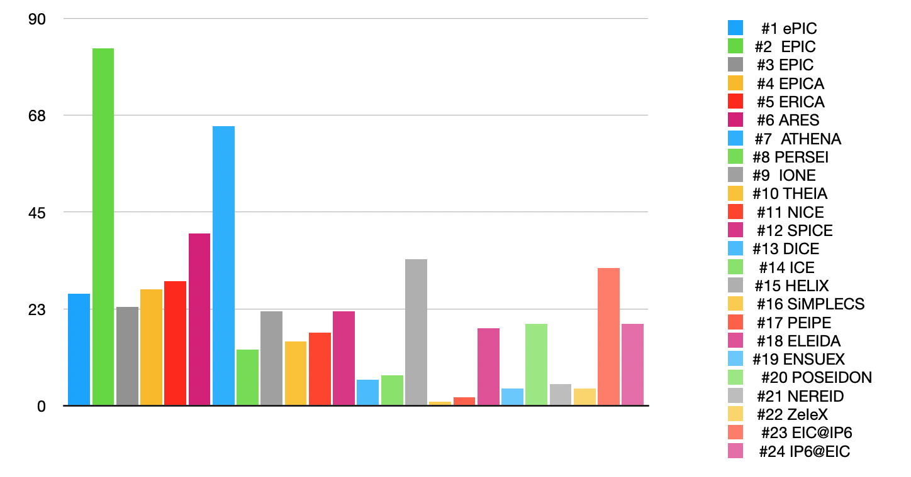
All votes( 1+2+3+4 choices without ranking )
EPIC
ATHENA
EIC@IP6
ARES
HELIX

Slide 7
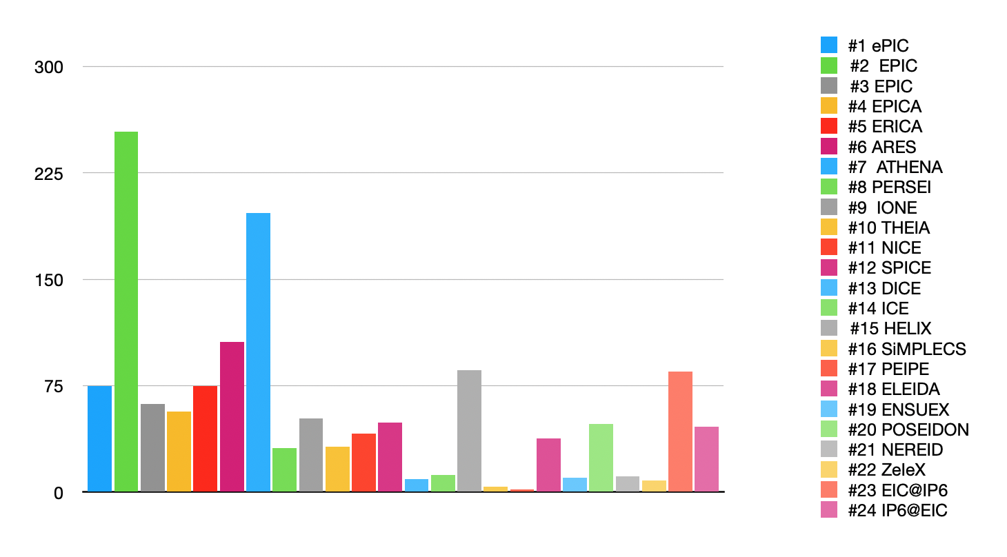
Weighted votes( 1st x 4 +2nd x3 +3rdx2 +4thx1)
ATHENA
EIC@IP6
EPIC
ARES
HELIX

Slide 8
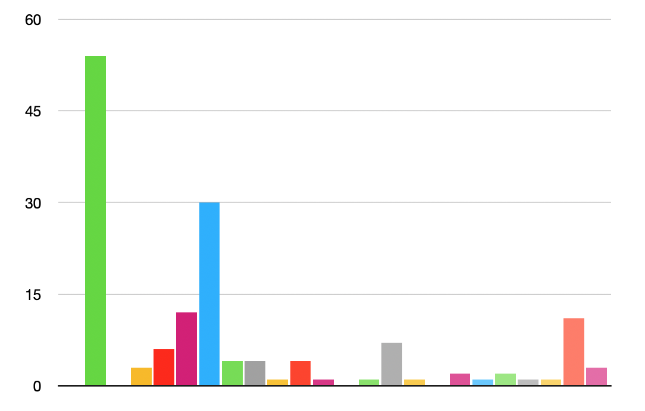
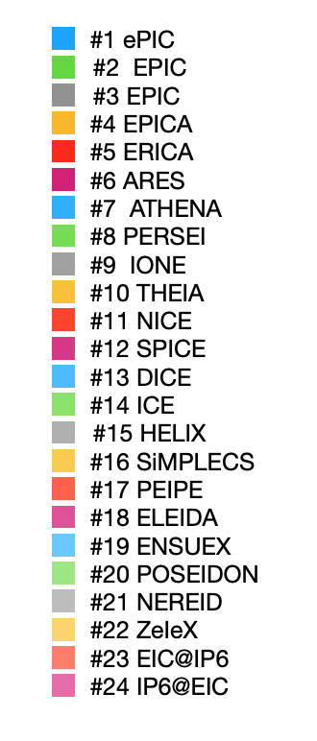
Only 1st choices
Adding together all EPIC proposals
EPIC
ATHENA

Slide 9
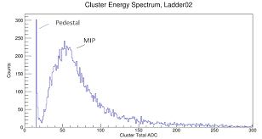
=> #25 MIP- Multifunctional Interaction Point experiment ;-)
base
MIP
EPIC
ATHENA

Slide 10
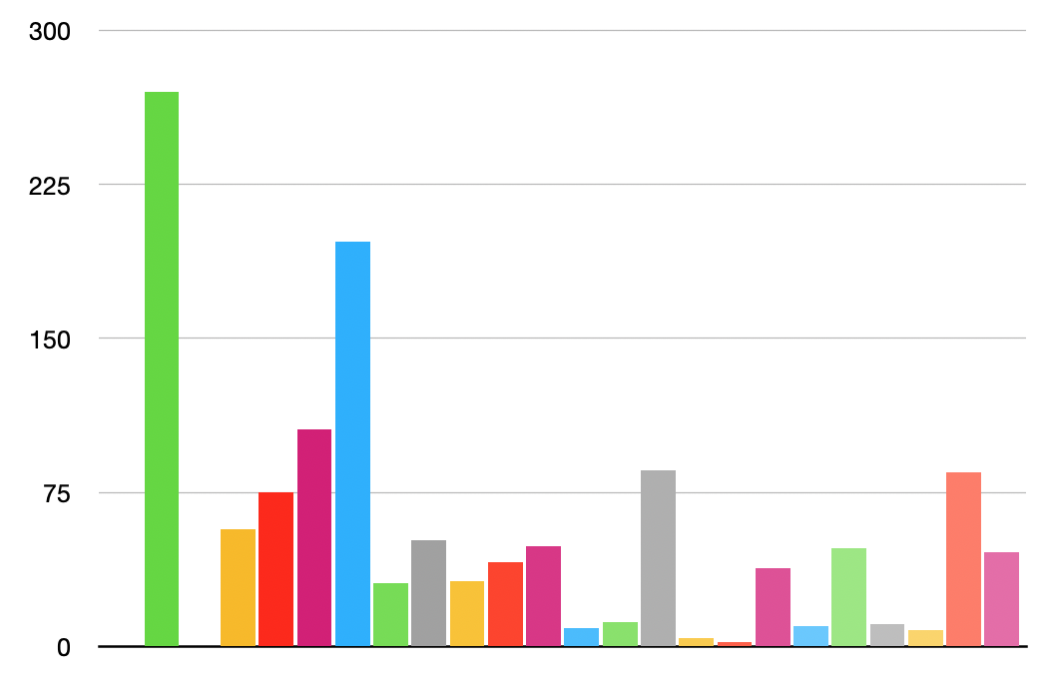
Weighted votes
Keep weighs for #2 and add only 1st choices for #1 and #3
( to be fair with other names)
EPIC
ATHENA

Slide 11
Our proposal: 2nd round ( EPIC vs ATHENA)
Poll will be sent today ( right after the meeting)
Collect votes until Monday.
Announce on Tuesday or Wednesday
Only 1st choices
Weighted
Threshold
EPIC
ATHENA
EPIC
ATHENA

