Slide 1
CAD/NX Studies for an EIC Silicon Tracking Detector
Brian Eng / James Fast
May 25, 2021

Slide 2
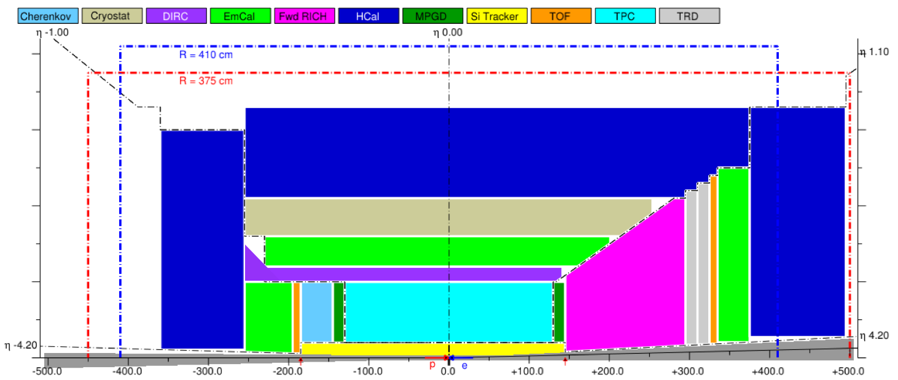
“Sandbox” Model
Silicon Trackers
(both barrel & disks)
From Alexander Kiselev
Only has detectors in/around solenoid

Slide 3
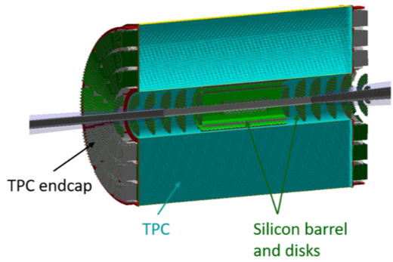
Hybrid Design
From Silicon Consortium
Hybrid refers to Silicon + outer tracker (e.g. TPC) for central tracking

Slide 4
AutoCAD
Starting to figure out how many services needed
Quickly abandoned (too many gaps)

Slide 5
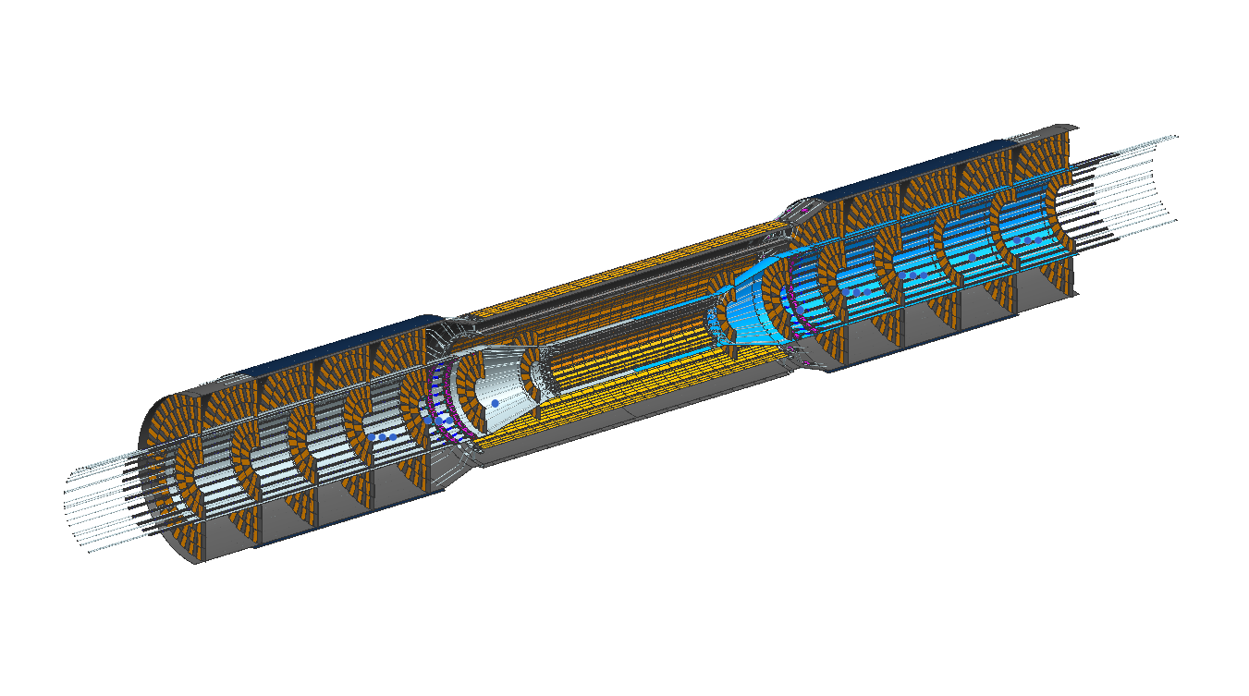
NX Model
From Jim Fast
Starting to get some details added

Slide 6
NX Demo

Slide 7
What’s Next?
Need to better parameterize detector to be able to edit in SketchUp
  Change position, radii, etc
Adding more services in

