Slide 1
ECCE Simulations
Status Report Cameron Dean and Jin Huang
07/02/2021 Tracking Meeting

Slide 2
Overview
Production has started!
We have 4 initial samples to check detector response and output info:
5M single electron events from BNL
5M single pion events from BNL
5M low q^2 events from SIDIS PWG from Bates
4M high q^2 events from SIDIS PWG from Jlab
1, 2, and 4 are in S3 storage
3 is in production

Slide 3
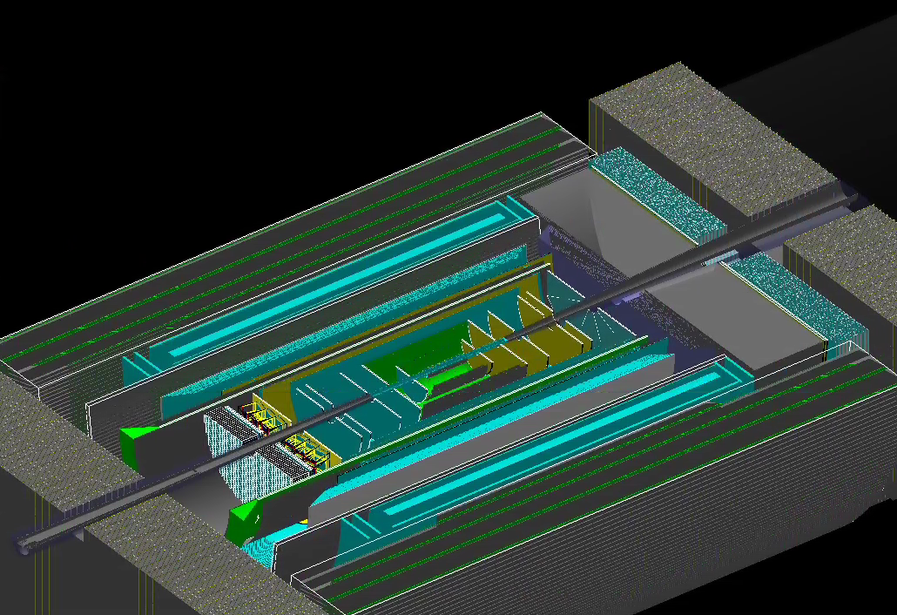
ECCE June 2021 Concept (Barrel)
Detector | Component Name | Brief description
Beam pipe | Central Beam Pipe | Be pipe
Beam pipe | Central Beam Chamber | Beam chamber Mar2020 model
Tracking | Barrel vertex | ITS3
Tracking | Barrel silicon
Tracking | Barrel MPGD
Tracking | h-going silicon layers
Tracking | e-going silicon layers
Tracking | h-going GEM
Tracking | e-going GEM
Tracking | Support barrel
Calorimetry | Backward EMCal | Hybrid
Calorimetry | Backward HCal | STAR
Calorimetry | Barrel EMCal | sPHENIX
Calorimetry | Barrel HCal | sPHENIX
Calorimetry | Forward EMCal | PHENIX
Calorimetry | Forward HCal | new
PID | e-going TOF
PID | h-going TOF
PID | barrel TOF
PID | mRICH
PID | dRICH
PID | hpDIRC

Slide 4
Production setup and location
Production setup corresponds to June 23rd 2021
Output locations: eicS3/eictest/ECCE/MC/new/5f210c7/General/particleGun/singleElectron eicS3/eictest/ECCE/MC/new/5f210c7/General/particleGun/singlePion eicS3/eictest/ECCE/MC/ana.14/5f210c7/SIDIS/pythia6/ep_18x100lowq2 eicS3/eictest/ECCE/MC/ana.14/5f210c7/SIDIS/pythia6/ep_18x100highq2
Evaluators:
DST and evaluator production was split into 2 macros
Evaluators are located in <Output locations>/eval_00000
Of most interest to tracking group: tracking evaluator and event evaluator
S3 access is bundled with latest ECCE build: source /cvmfs/eic.opensciencegrid.org/ecce/gcc-8.3/opt/fun4all/core/bin/ecce_setup.sh –n
Everyone has read access, check with mcs3 ls eicS3

Slide 5
Timeline
Item | Task | Required by | Assignee | Status
1 | Create top-level submission scripts | 27/5/21 | Cameron | Complete
2 | Add site-specific production scripts | 1/6/21 | Cameron & co. | Complete
3 | Beta-test production scripts at each site | 14/06/21 | Cameron & co. | Complete
4 | Debug zombie files | 14/06/2021 | Cameron & co. | Complete
5 | Complete detector subsystem simulation setup | 14/06/2021 | Detector WG | Complete
5.1 | tracking | 14/06/2021 | Xuan and Nilanga | Complete
5.2 | PID | 14/06/2021 | Greg and Xiaochun | Complete
5.3 | Calorimeter | 14/06/2021 | Friederike and Yongsum | Complete
5.4 | Far forward | 14/06/2021 | Michael, Igor and Yuji | Complete
6 | Discuss implementation/placement of ECCE | 17/6/21 | All | Complete
7 | Relay production requirements for Campaign 1 | 17/6/21 | Physics WG | In progress
8 | Full detector integration in simulation and reconstruction | 18/6/21 | Simulations WG | Complete
9 | Update top-level submissions with PWG info | 18/6/21 | Cameron | In progress
10 | Define production site tasks | 21/6/21 | Prod. Managers | In progress
11 | Start 10M particle gun and/or SIDIS events | 22/6/21 | Prod. Managers | Complete
12 | Analyse 10M particle gun events and SIDIS events | 25/6/21 | Physics, Computing WGs | In progress
13 | Meet with PWGs regarding particle gun and SIDIS sim validation | 29/6/21 | Detector & Physics WG | Not started
14 | Physics Generation Campaign 1 | 31/6/21 | Simulations WG | Not started

Slide 6
Summary
June 2021 concept has been released
Initial particle productions have been launched at all sites
First sets of data are on S3
Feel free to copy the evaluator files out of S3 storage to local machines mcs3 cp <file or path> <output path>
There will be a workshop on July 8th to discuss data access along with detector and physics goals for ECCE
PWGs are relaying their requests, June 2021 concept will have several hundred million events to validate detector concept
Next detector concept foreseen for end of July (July 2021 concept, final large simulation campaign)

