Slide 1
International relations & accelerator technologies
EIC Associate Director for Accelerator Systems and International Partnership
Andrei Seryi
EIC Technical Director and
Deputy Project Director
Ferdinand Willeke
2nd PSQ@EIC Meeting:
Precision Studies on QCD at EIC
July 19, 2021

Slide 2
Outline
EIC brief overview
Examples of EIC accelerator technology
  For electron and hadron rings
  For polarization
  For interaction region
  For high current beams
  For cold beams
EIC R&D areas
EIC Accelerator international collaboration
Many thanks to many EIC project team members for materials used in this presentation

Slide 3
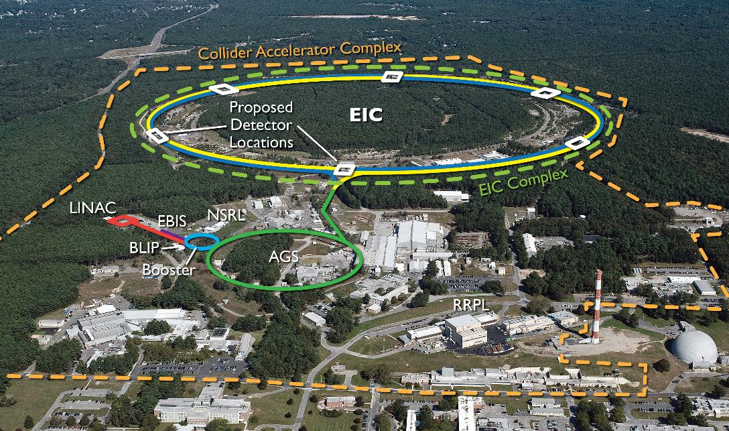
EIC Design Overview
EIC CDR: https://www.bnl.gov/ec/files/EIC_CDR_Final.pdf

Slide 4
EIC project requirements
The EIC is a Nuclear Physics Collider Designed to meet NSAC and NAS requirements
Collide polarized electrons and wide range of hadrons
  Polarized protons and deuterons, otherwise unpolarized
  In long term, possibly polarized positrons, ³He
Center of Mass Energies 20 GeV – 140 GeV
Maximum Luminosity 10³⁴ cm⁻² s⁻¹
Hadron Beam Polarization >70%
Electron Beam Polarization >70%
Ion Species Range p to Uranium
Number of interaction regions up to two
NSAC – U.S. Department of Energy Nuclear Science Advisory Committee
NAS – U.S. National Academies of Sciences, Engineering, and Medicine

Slide 5
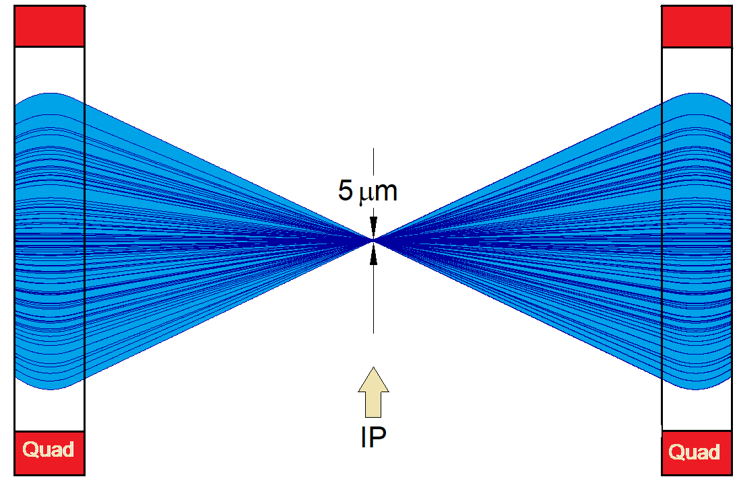
EIC achieves high luminosity L = 10³⁴ cm⁻²s⁻¹
Large bunch charges N_{e} ≤ 1.7·10¹¹, N_{p} ≤ 0.69·10¹¹
Many bunches, n_{b}=1160
  crossing angle collision geometry
  large total beam currents
  limited by installed RF power of 10 MW
Small beam size at collision point achieved by
  small emittance, requiring either:
- strong hadron cooling to prevent emittance growth
  and strong focusing at interaction point (small β_{y})
  flat beams σ_{x}/σ_{y} ≈ 10
Strong, but previously demonstrated beam-beam interactions
Δν_{p} = 0.01 demonstrated in RHIC
Δν_{e} = 0.1 demonstrated in HERA, B-factories
Strong focusing β_{y} =5 cm

Slide 6
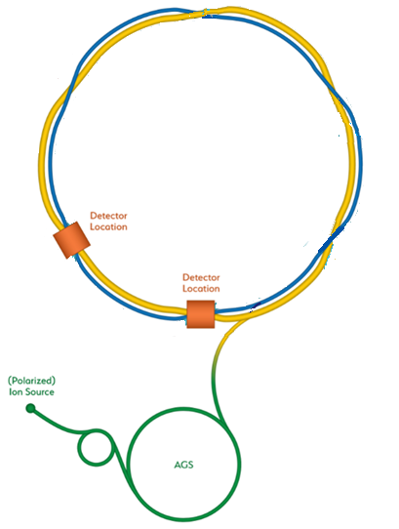
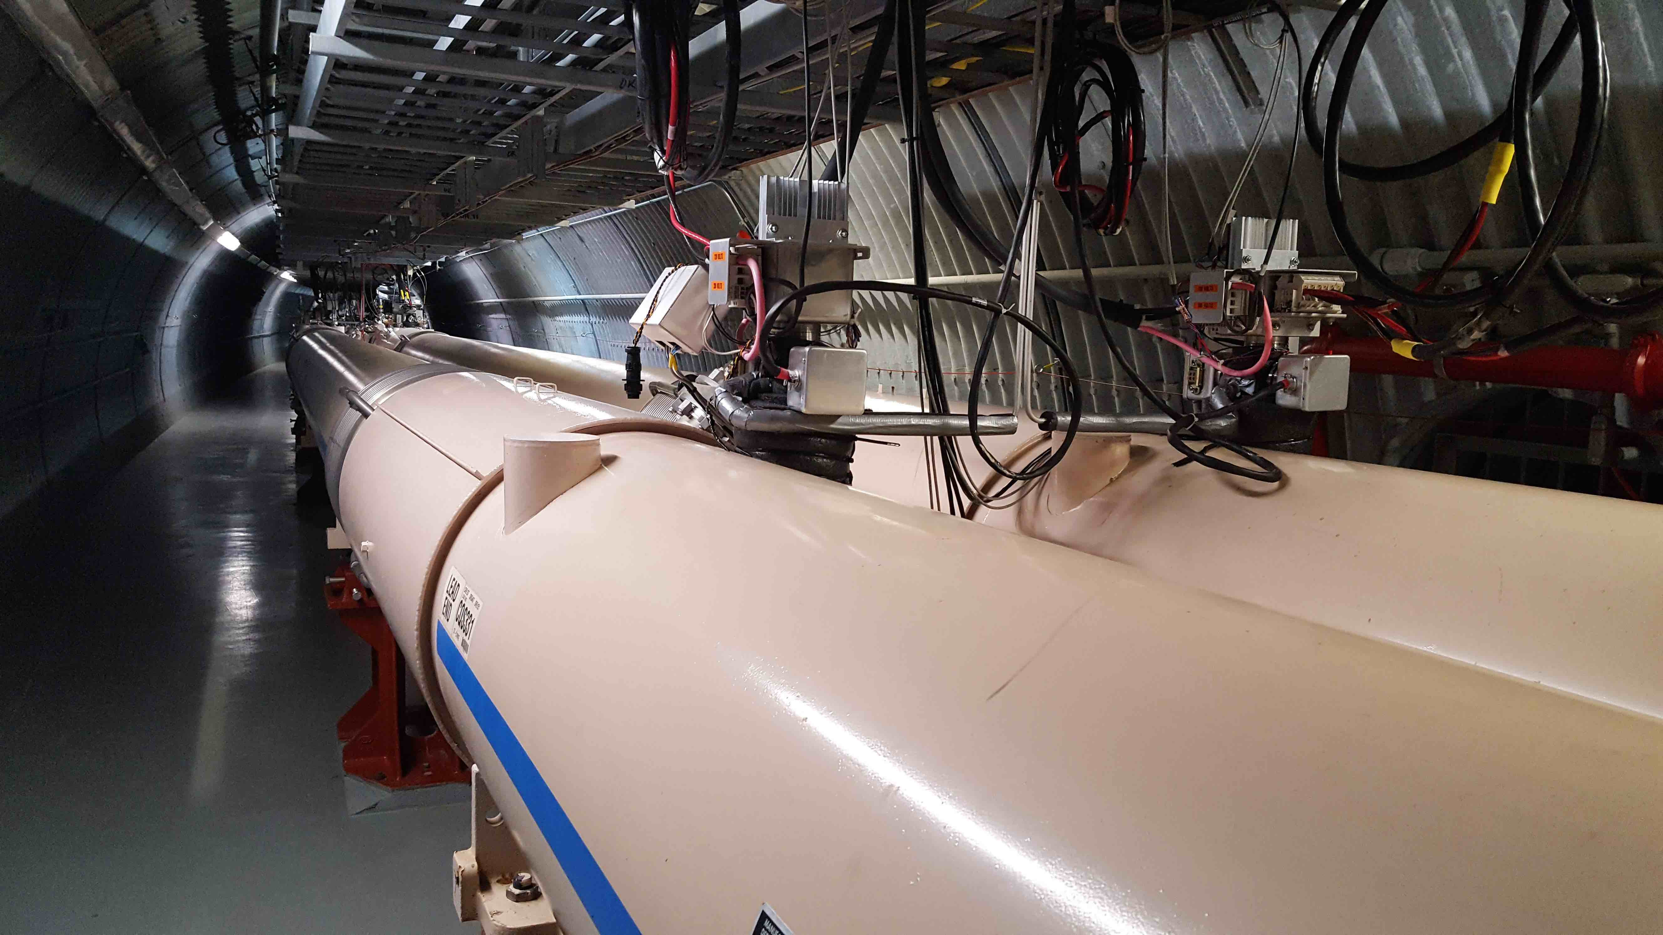
From RHIC to the EIC: RHIC
Existing RHIC facility
  Hadron collider (h=360)
  6-100 GeV/u ions
  100-250 GeV polarized protons
  Two independent rings
    Asymmetric operations include e.g. d-Au collisions
Constructed 1990-2000
Will operate to ~2025
C = 3833.845 m
h = 360
B_{max,dipole} = 3.5 T (SC)
19-cell FODO arcs

Slide 7
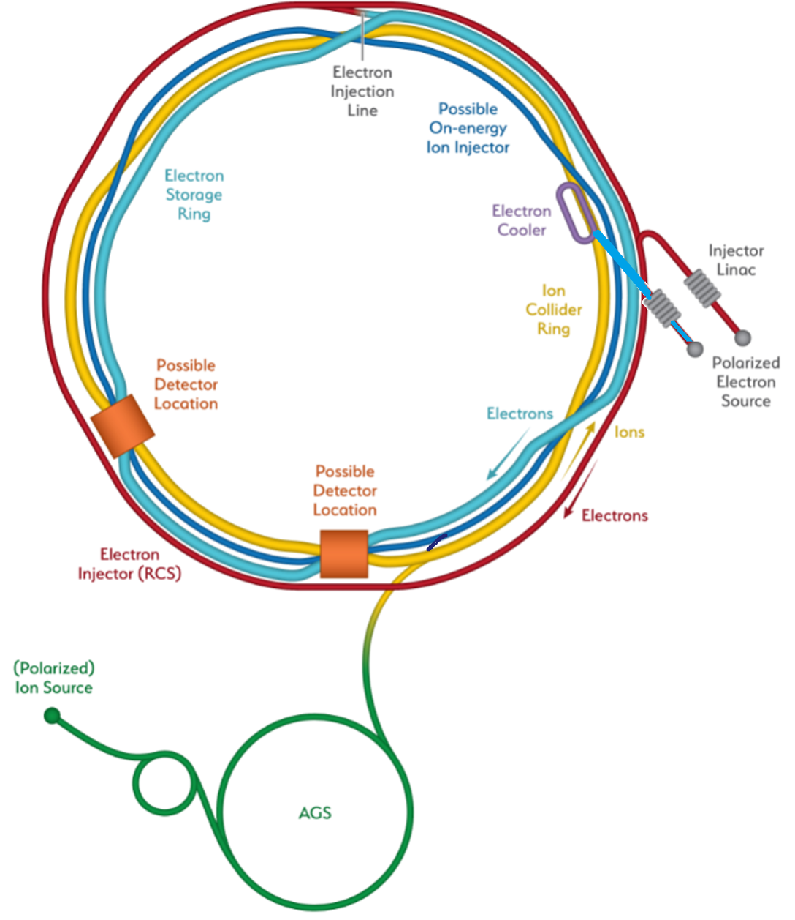
From RHIC to the EIC: EIC
Electron-Ion Collider
  Lepton-hadron collider
  Add electron storage ring
  Add electron injectors
    Full-size rapid-cycling synchrotron
  Add “strong” electron cooling (ERL and insertion)
  Add new detector
Construction ~2023-2030
Hadron Storage Ring
Electron Storage Ring
Electron Injector Synchrotron
Possible on-energy Hadron
injector ring
Hadron injector complex

Slide 8
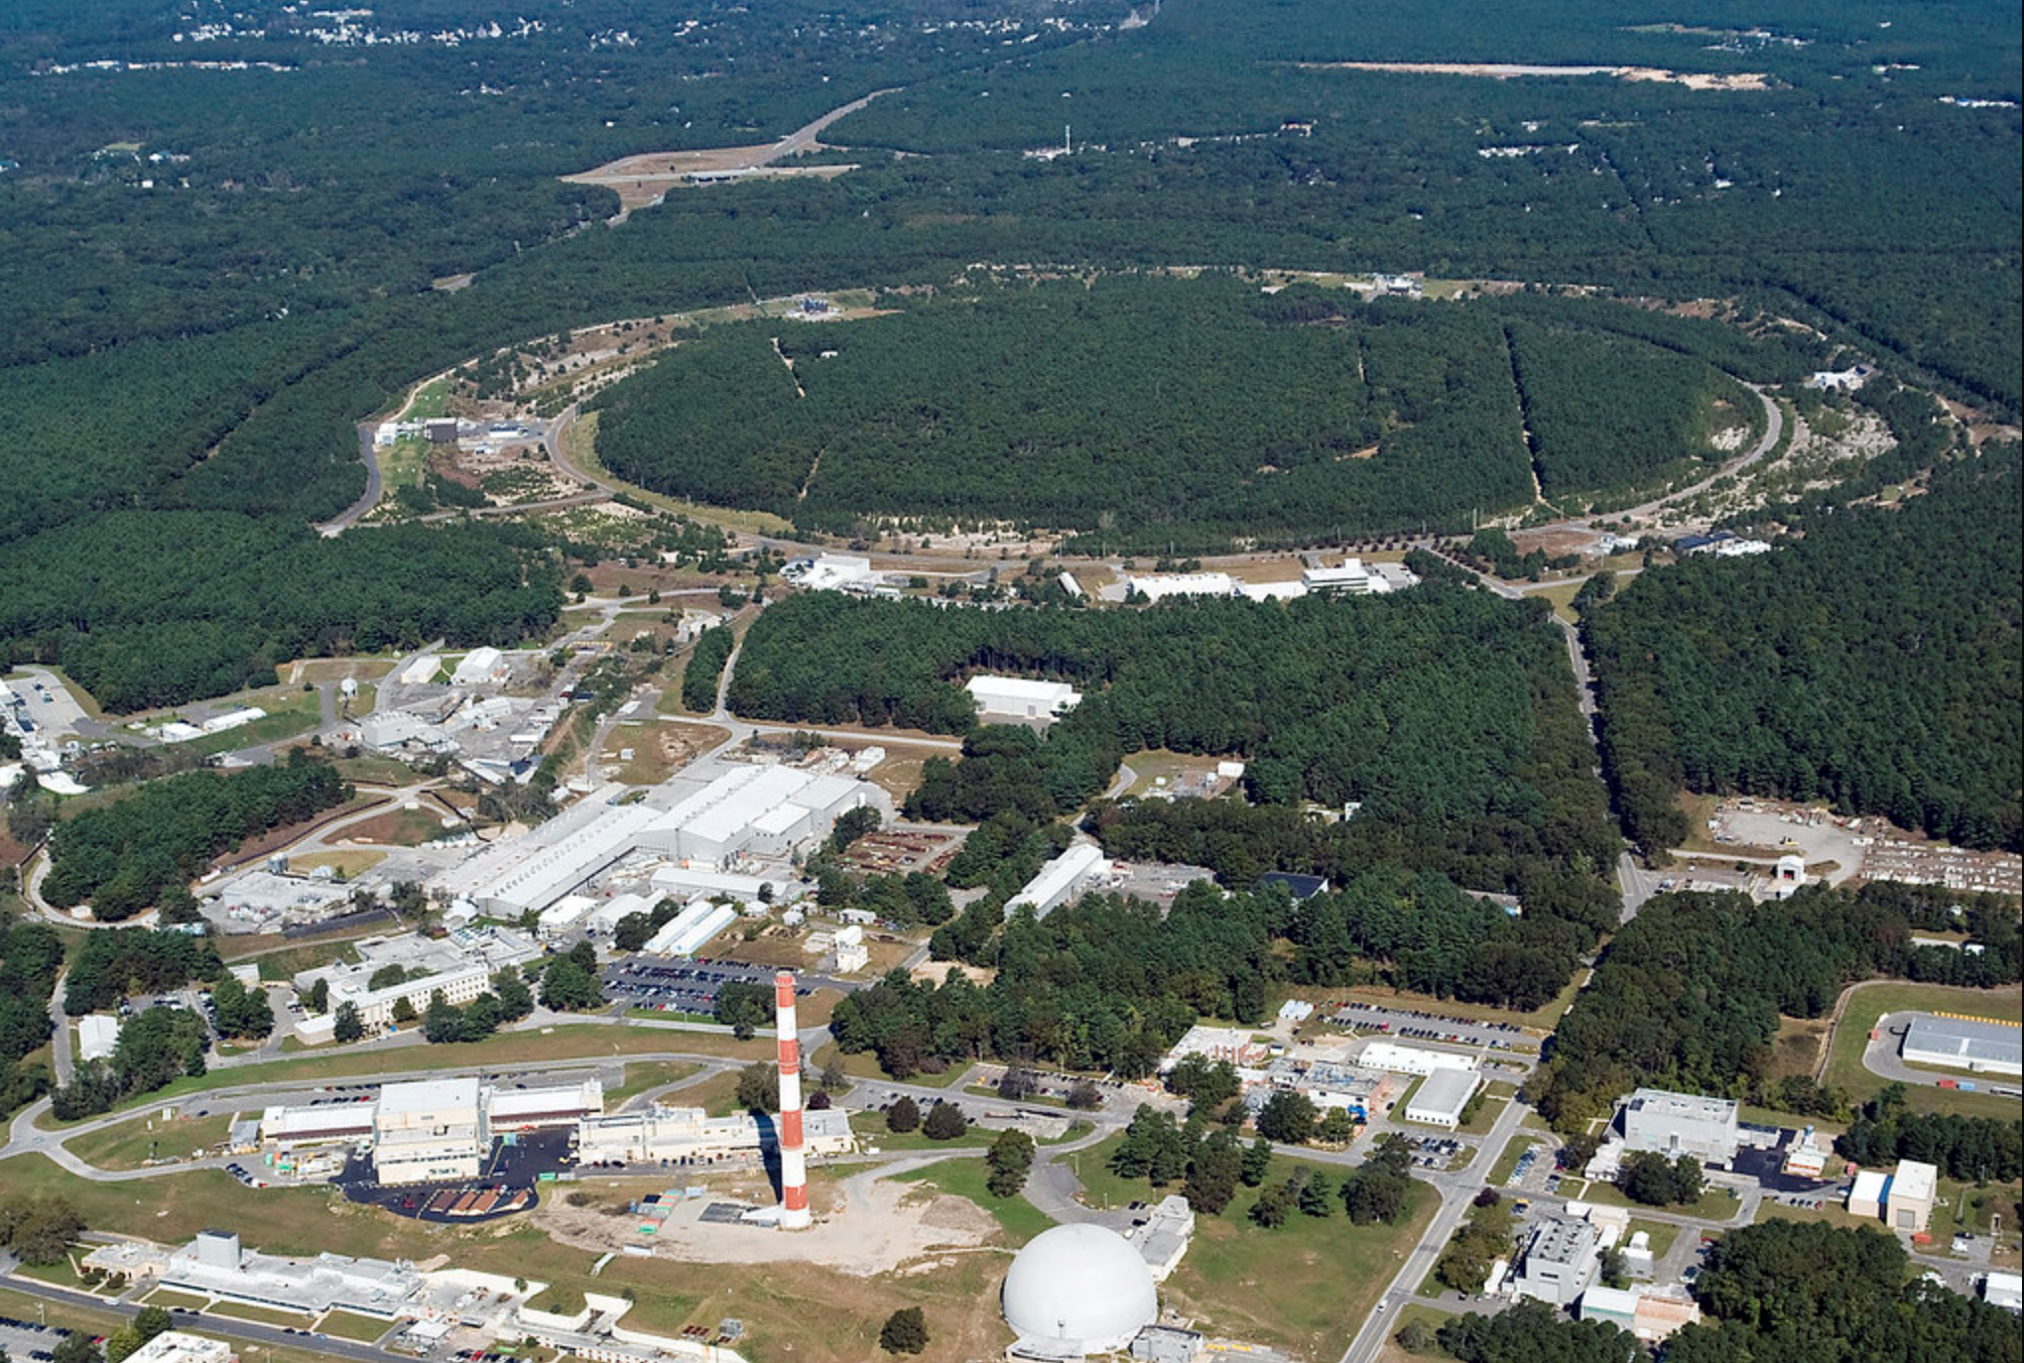

EIC Design Concept
Design based on existing RHIC facility
RHIC is well-maintained, operating at its peak
Hadron storage ring 40-275 GeV (existing)
  Many bunches (max 1160)
  Bright beam emittances (for hadrons)
  Need strong cooling
Electron storage ring 2.5–18 GeV (new)
  Many bunches (max 1160)
  Large beam current (2.5 A) ➔10 MW SR power
Electron rapid cycling synchrotron (new)
  1-2 Hz
  Spin transparent due to high periodicity
High luminosity interaction region(s) (new)
  Luminosities up to 10³⁴ cm⁻² s⁻¹
  Superconducting magnets
  25 mrad crossing angle with crab cavities
  Spin rotators (longitudinal spin)
  Forward hadron instrumentation
EIC

Slide 9
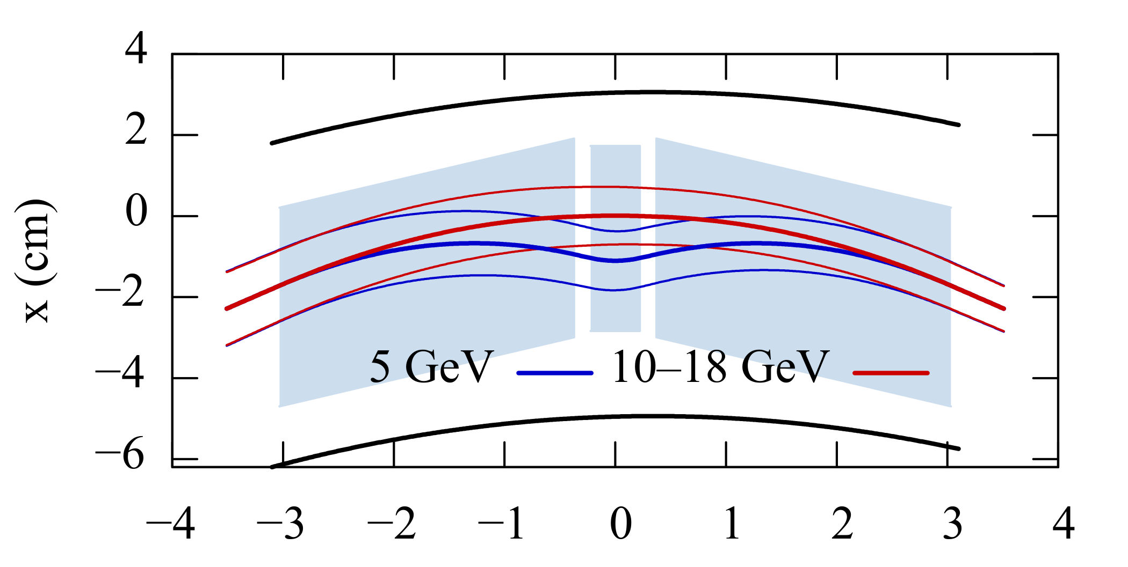
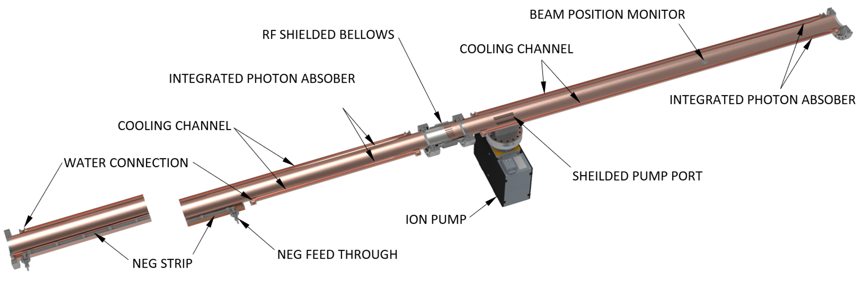
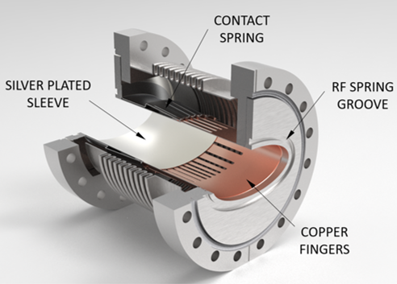
Electron Storage Ring
ESR super-bend: arc dipoles split into 3 segments
Above 10 GeV, all segments powered uniformly to reduce SR power
At 5 GeV, short center dipole provides a reverse bend to increase damping decrement
z(m)
Vacuum chamber:
OFS Copper
Multichannel extrusion
Pumping:
distributed NEGs
RF Bellows
RF shielded bellows

Slide 10
Ion source
Ions from He to U have been already generated in the Electron-Beam-Ion-Source ion source (EBIS), accelerated and collided in RHIC
EBIS can generate any ion beam from ³He to U for the BNL EIC
Existing EBIS provides the entire range of ion species from He to U in sufficient quality and quantity for the EIC
Ion Pairs
in the RHIC Complex
Zr-Zr, Ru-Ru (2018)
Au-Au (2016)
d-Au (2016)
p-Al (2015)
h-Au (2015)
p-Au (2015)
Cu-Au (2012)
U-U (2012)
Cu-Cu (2012)
D-Au (2008)
Cu-Cu (2005)

Slide 11
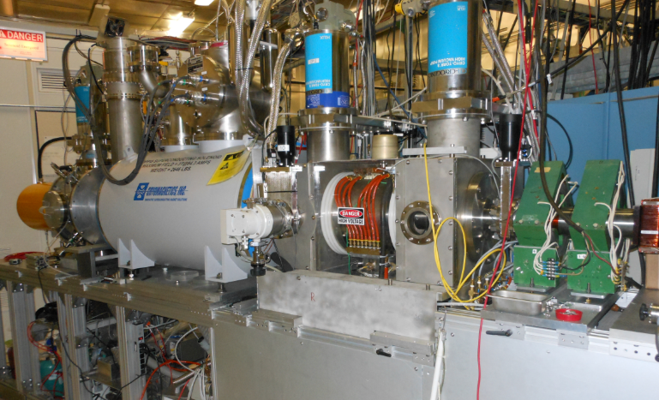
Optically pumped polarized ion source (OPPIS)
Used for RHIC p↑+p↑ program from 2000
Protons pickup polarized electrons in an optically pumped Rb vapor cell
Electron polarization of H atoms is transferred to protons in a magnetic field reversal region (Sona-transition)
H⁻ ions are produced then by passing through Na-cell
Polarized protons are obtained by charge exchange injection of H⁻ into the Booster
Several upgrades and modifications over years increasing polarization and intensity
up to 84% polarization
reliably 0.5 - 1.0 mA (max 1.6 mA)
up to 1・10¹² H⁻/pulse polarized H⁻ ions

Slide 12
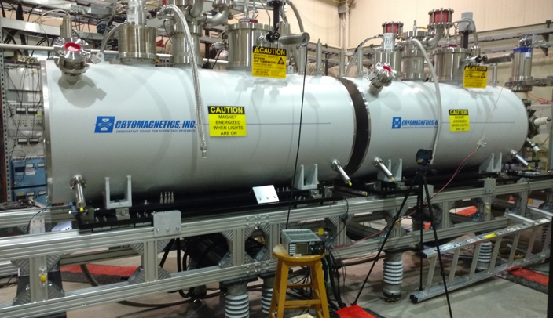
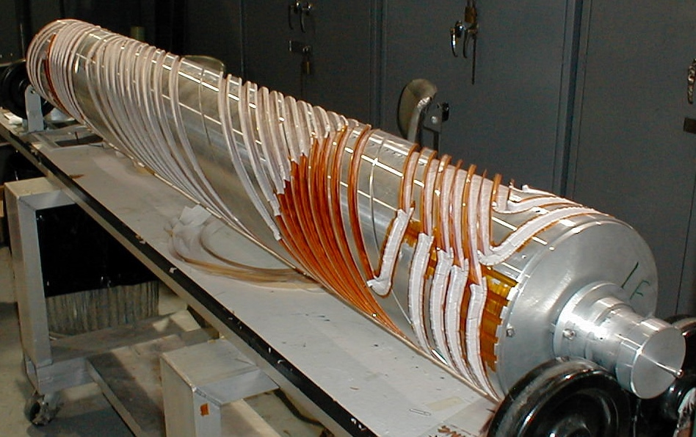
EIC Hadron Polarization
Existing p Polarization in RHIC achieved with “Siberian snakes”
RHIC near term improvements: proton polarization 60% → 80%
³He polarization of >80% measured in source
80% polarized ³He in EIC will be achieved with six “snakes”
Acceleration of polarized Deuterons in EIC 100% spin transparent
Need tune jumps in the hadron booster synchrotron
Magnet field in Snake
2.6 m
Particle orbit and spin trajectory
Electron beam ion source EBIS with polarized ³He extension
AGS
partial
snake

Slide 13
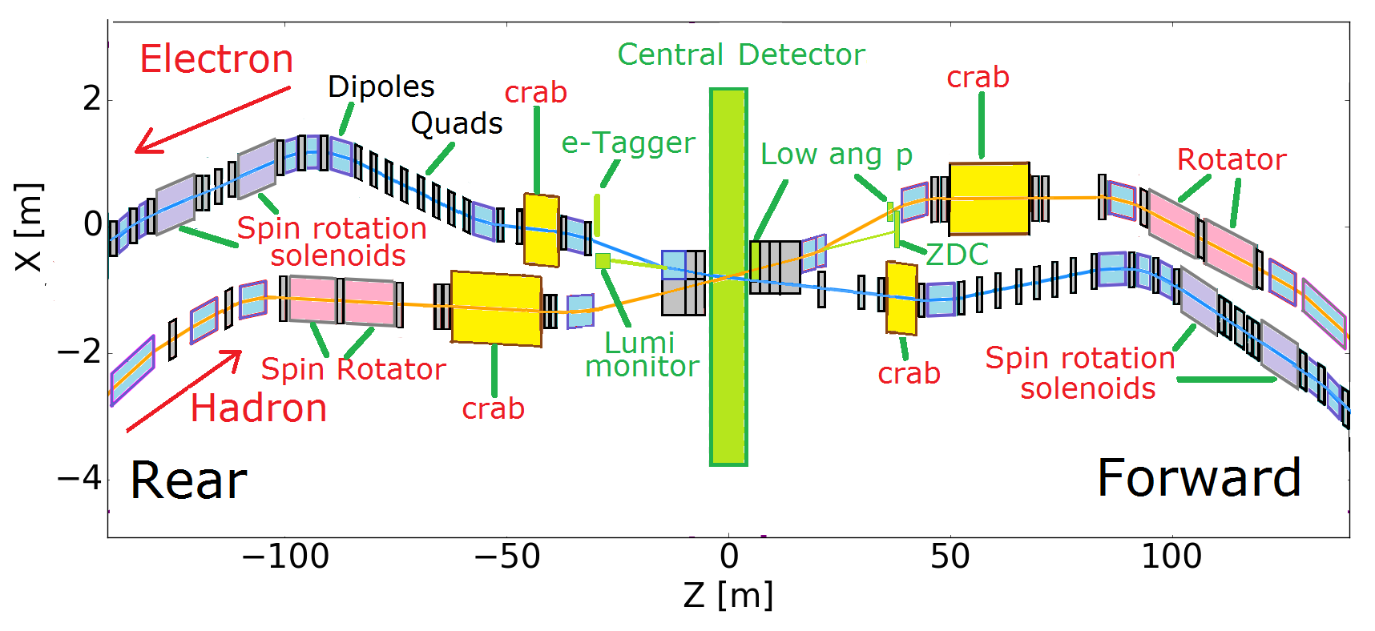
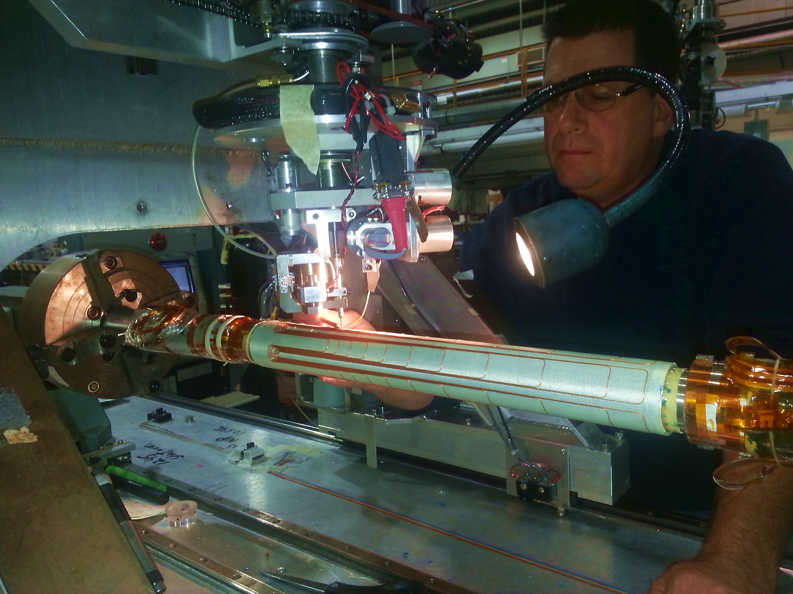
Interaction Region
Beam focused to β_{y} ≤ 5 cm @ σ_{y}= 5 μm, gives L=10³⁴ cm⁻² s⁻¹
Space for crab cavities and spin rotators
Managing SR and impedance
Final focus magnets based on conventional NbTi superconducting magnets using collaring and direct wind technology
Peak magnetic fields below 6T (NbTi sufficient)
Direct wind s.c. coil production in progress

Slide 14
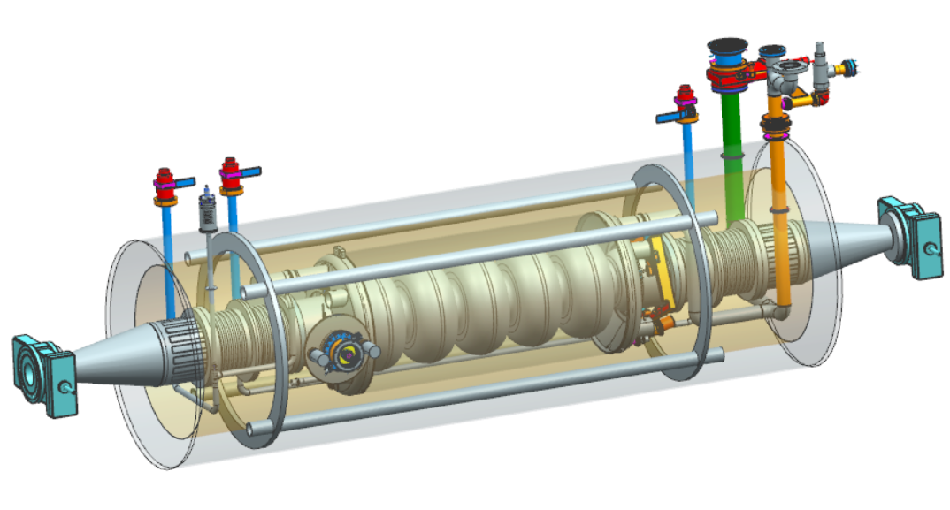
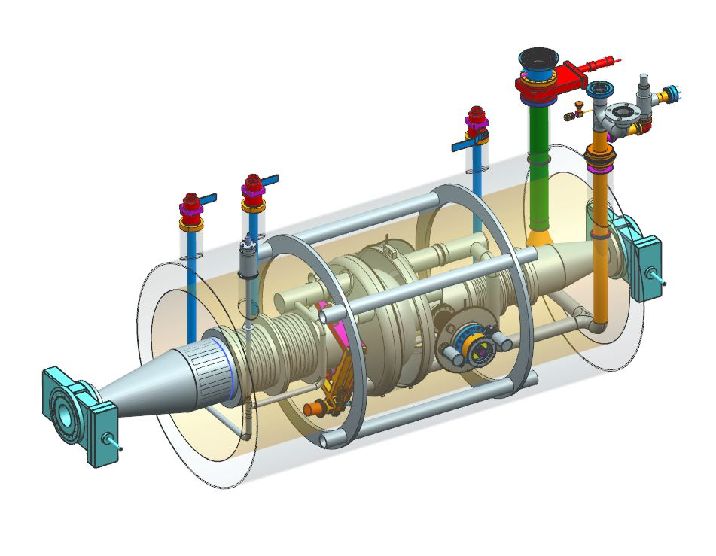
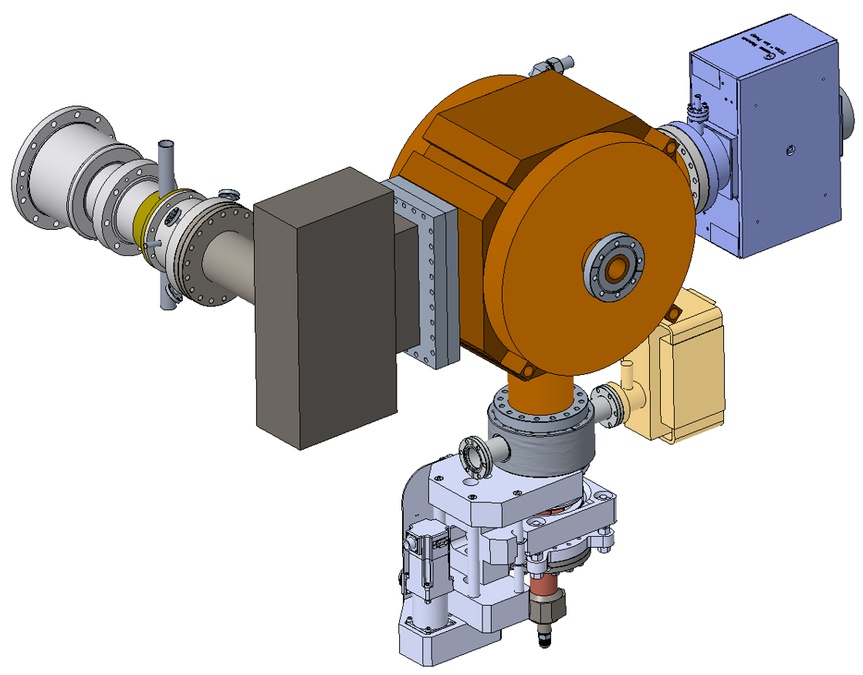
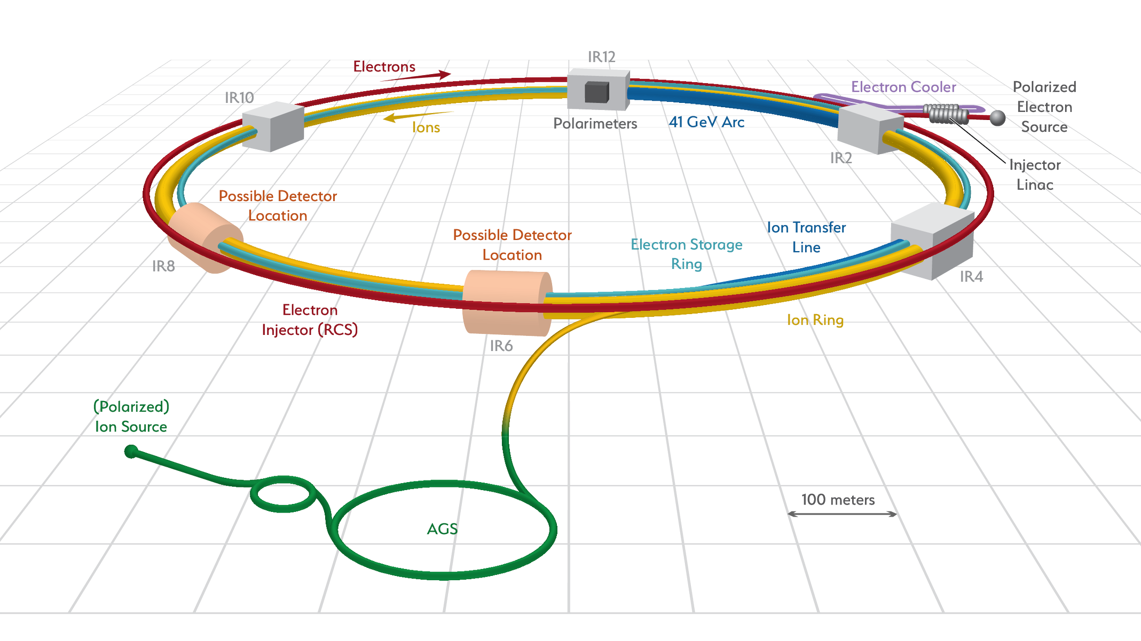
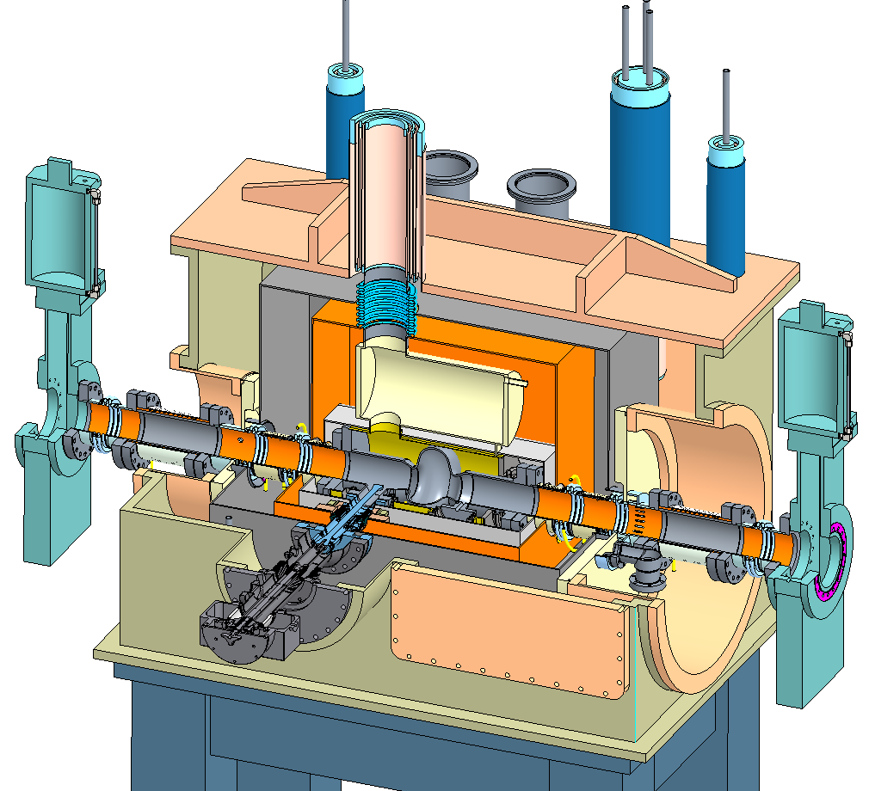
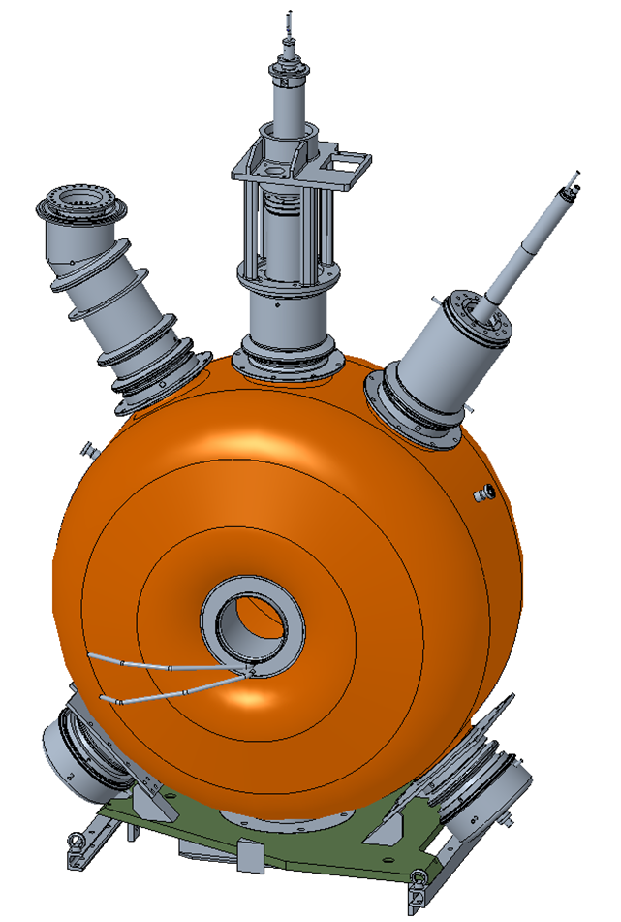
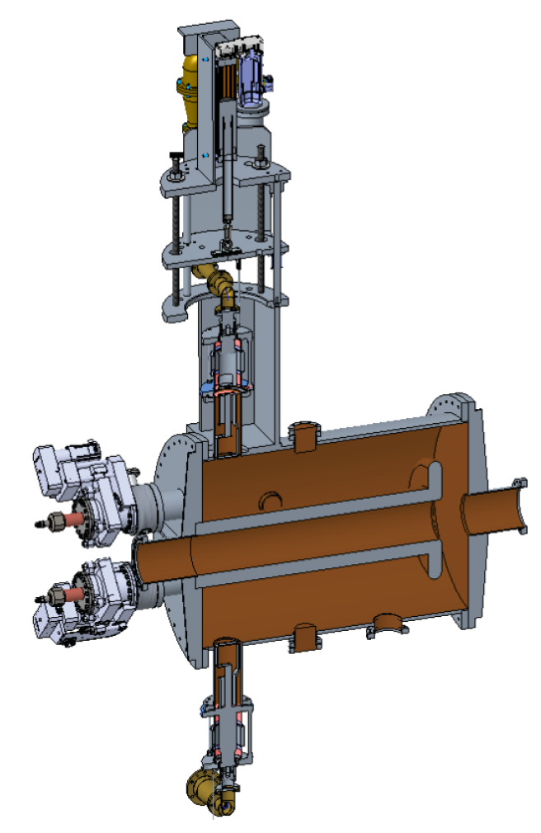
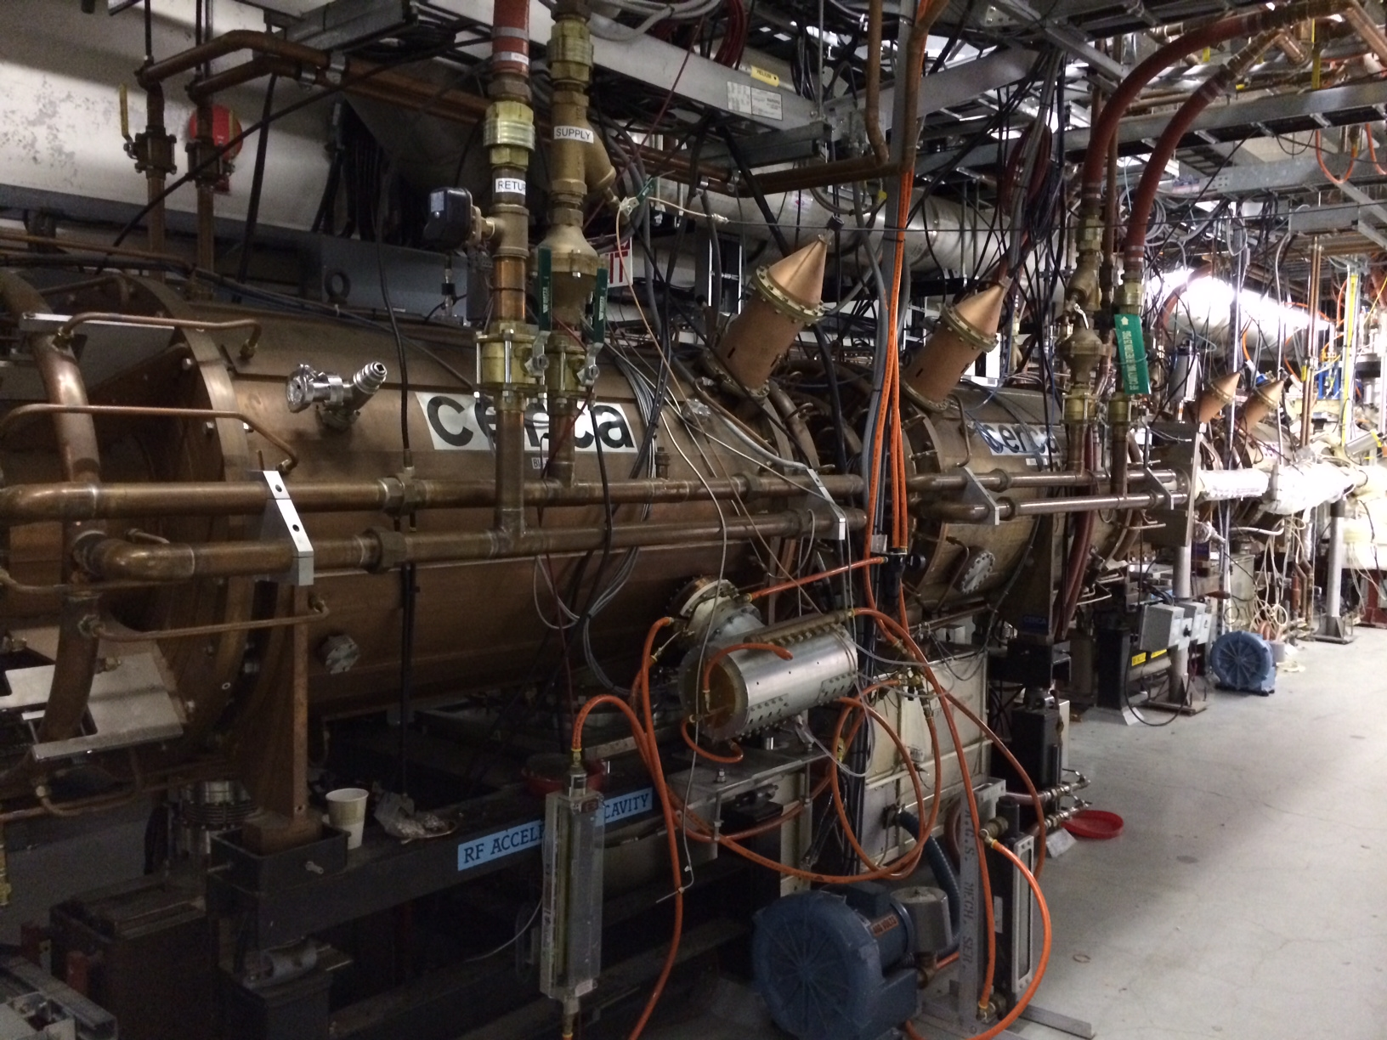
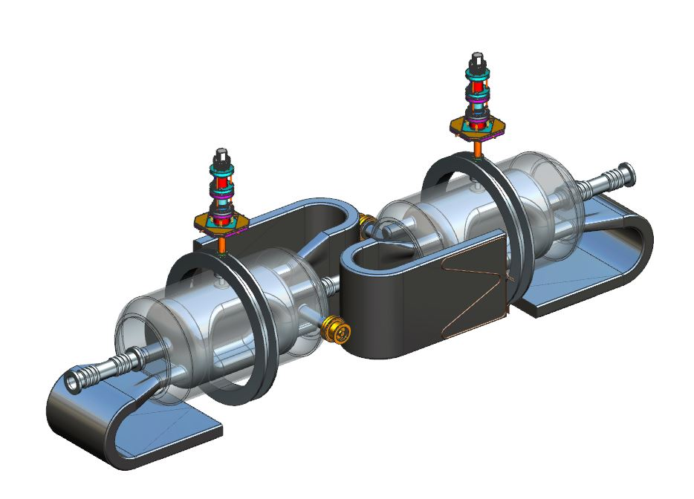
EIC RF systems
Hadron - 591 MHz bunch compression cavity
Hadron Cooling - 591 MHz acceleration cavity
Electron - 591 MHz electron storage cavity
Injector - 571 MHz bunch compression cavity
Electron - 1773 MHz 3rd harmonic cavity
Hadron - 197 MHz bunch compression cavity
Rapid Cycling Synchrotron - 591 MHz acceleration cavity
Hadron – 24.5 MHz acceleration cavity
Hadron – 49.2 MHz and 98.5 MHz bunch splitter cavity
Both rings –crab cavities

Slide 15
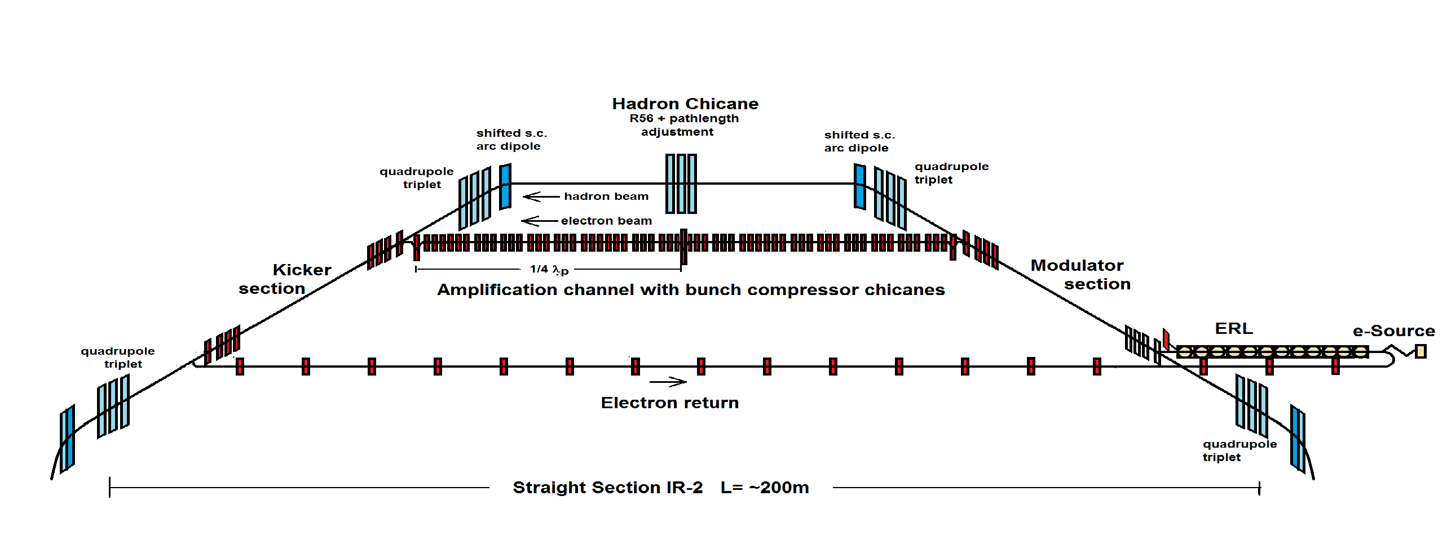
EIC Strong Hadron Cooling
Coherent Electron Cooling with μ-bunching amplification
The EIC cooler requires up to 150 MeV electron beams with average electron beam current of ~100 mA => 15 MW
Requires use/design of a world-class SRF energy-recovery linac (ERL)
Electron/hadron beams separate and rejoin each other
  Adjustable R₅₆ for electrons to tune amplification
Electron source/accelerator must be extremely “quiet” (no substructure)
  avoid amplification of “shot noise”, electron beam structure not from hadrons

Slide 16
EIC R&D Scope
Electron Fast Kicker
Cooler Electron Source
ESR (arc)
Vacuum Chamber
Cooler SRF
ESR Cavity
500kW FPC
Polarized e⁻ Source
HOM Damper
Proton Injection Fast Kicker
Crab Cavity
IR Magnet
IR
Vacuum Chamber

Slide 17
EIC Accelerator Collaboration Opportunities
EIC is international from its conception
Collaboration on EIC design and construction –mutually beneficial, providing a gateway to EIC science, advancing accelerator science and technology
Collaboration development mechanisms:
  Bi-lateral meetings
    Level 1- management, L2/3 – technical experts
  Partnership workshop
    First workshop hosted by Cockcroft Institute, 7-9 October 2020
      365 participants, 26 countries, 6 continents – truly global event
    Next workshop to be hosted by TRIUMF, ~October 2021
      Will primarily focus on areas where collaborations already emerged

Slide 18
EIC Accelerator Collaboration Opportunities
Possible contributions to the EIC accelerator could include the full range of accelerator design & hardware
  E.g. IR magnet design and construction, luminosity monitoring, RF R&D and construction, normal conducting magnets, critical vacuum components, feedback systems, polarimetry, contributions to the 2nd IR, beam-dynamics calculations, etc.
Time to engage is now
  Before CD2 need solid understanding of expected contribution
Decision on scope – balance of
  Opportunities/risks for the project (limit in-kind to 5-10%)
  Strategic interests of partners and the host
  Timeline for opportunity development vs project schedule

Slide 19
Accelerator outreach – summary
Approach: bi-lateral meetings & partnership workshops
Cockcroft, UK - Acc partnership workshop in Oct 2020; TRIUMF, Canada ~October 2021
Sample WBS scope as seed for discussion of possible in-kinds identified
Bi-lateral meetings now expand from EIC L1 management to L2 & L3 EIC experts for detailed technical discussion of possible in-kind scope
  Examples: Crab Cavity system information exchange meeting with UK and Canada, meetings with INFN-Accelerator collaboration on HSR vac. system, with CERN on ESR vac. sys., etc.

Slide 20
Summary
The EIC will be a discovery machine, providing answers to long-elusive mysteries of matter related to our understanding the origin of mass, structure, and binding of atomic nuclei that make up the entire visible universe
EIC project is underway aiming to start physics in about a decade
EIC will be state of the art collider pushing the frontiers of accelerator science and technology
The EIC project will work closely with domestic and international partners to deliver the EIC construction project and then begin EIC operations
Collaboration in EIC design, construction and scientific exploration is welcome!

