Slide 1
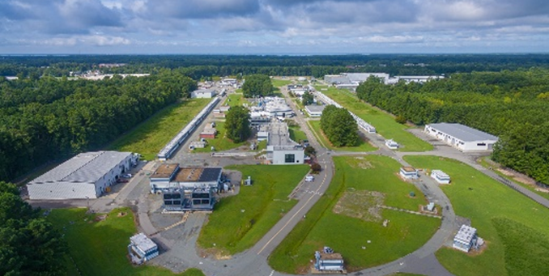

Future Nuclear Physics Opportunities at CEBAF
Bob McKeown
PSQ@EIC Workshop
July 19, 2021

Slide 2
Outline
Current Program
Future Opportunities
- Higher Luminosity/Acceptance
- Positron Beams
- Higher Energy
Accelerator Upgrade Options
Summary

Slide 3
PAC Approved experiments (status at May 13, 2021)
Topic | Hall A | Hall B | Hall C | Hall D | Other | Total
Hadron spectra as probes of QCD | 0 | 2 | 1 | 4 | 0 | 7
Transverse structure of the hadrons | 7 | 4 | 3 | 1 | 0 | 15
longitudinal structure of the hadrons | 1 | 3 | 7 | 1 | 0 | 12
3D structure of the hadrons | 5.5 | 9 | 6.5 | 0 | 0 | 21
Hadrons and cold nuclear matter | 9 | 6 | 7 | 1 | 0 | 23
Low-energy tests of the Standard Model and Fundamental Symmetries | 3 | 1 | 0 | 1 | 1 | 6
Total | 25.5 | 25 | 24.5 | 8 | 1 | 84
Total Experiments Completed | 9.0 | 9.7 | 7.3 | 1.5 | 0 | 27.5
Total Experiments Remaining | 16.5 | 15.3 | 17.2 | 6.5 | 1.0 | 56.5

Slide 4
12 GeV Experiments by PAC Days (status at May 13,2021)
 | Hall A | Hall B | Hall C | Hall D | Other | Total
Hadron spectra as probes of QCD | 0 | 219 | 11 | 740 | 0 | 970
Transverse structure of the hadrons | 152.5 | 125 | 146 | 25 | 0 | 448.5
Longitudinal structure of the hadrons | 19 | 170 | 211 | 33 | 0 | 433
3D structure of the hadrons | 361 | 812 | 225 | 0 | 0 | 1398
Hadrons and cold nuclear matter | 240 | 305 | 205 | 15 | 0 | 765
Low-energy tests of the Standard Model and Fundamental Symmetries | 547 | 180 | 0 | 79 | 0 | 806
Total Days | 1319.5 | 1811.0 | 798.0 | 892 | 0 | 4820.5
Total Days - (includes MOLLER) | 845.5 | 1811 | 798 | 892 | 0 | 4347
Total Approved Run Group Days (includes MIE) | 1319.5 | 1036 | 755 | 692 | 0 | 3802.5
Total Approved Run Group Days (includes MOLLER) | 845.5 | 1036 | 755 | 692 | 0 | 3329
Total Days Completed | 256.5 | 323 | 173.0 | 206 | 0 | 958.5
Total Days Remaining | 589 | 713 | 582 | 486 | 0 | 2370

Slide 5
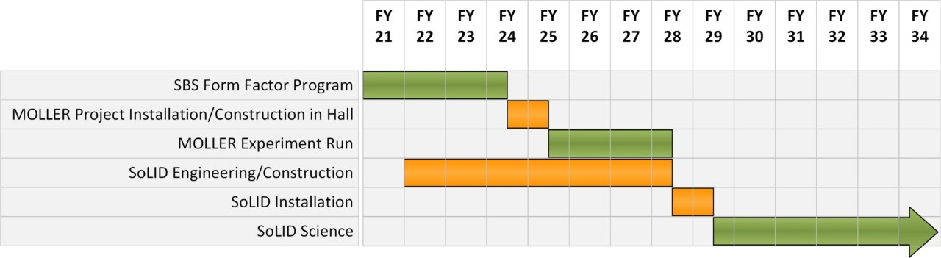
Jefferson Lab 12 GeV Vision:
Luminosity Frontier
CEBAF has a long program ahead that is complementary to the envisioned EIC program
CEBAF will remain the prime facility for fixed target electron scattering at the luminosity frontier
Approved Hall A Program – projected schedule:

Slide 6
Projected Hall D Schedule
Activity, experiment running | 2021 | 2022 | 2023 | 2024 | 2025 | 2026 | 2027 | 2028 | 2029 | 2030
Run PRIMEX-η
Run SRC
Installation CPP
Run CPP-NPP
Run GlueX-II
Installation FCAL2
Run GlueX-II+JEF
Installation KLF (K_{L} beam)
Commissioning, Run KLF
Back to photon beam
Installation of REGGE
Commissioning, Run REGGE
scheduled
(E. Chudakov)

Slide 7
Projected EIC Schedule

Slide 8

Higher Luminosity Physics
Double Deeply Virtual Compton Scattering (DDVCS)
Access GPD’s away from x=± ξ
Cross section 100x smaller than DVCS
Requires large acceptance, high luminosity detector with superb muon detection
Two Letters of Intent submitted to PAC
$$ep→e^{′}p^{′}μ^{+}μ^{−}$$

Slide 9
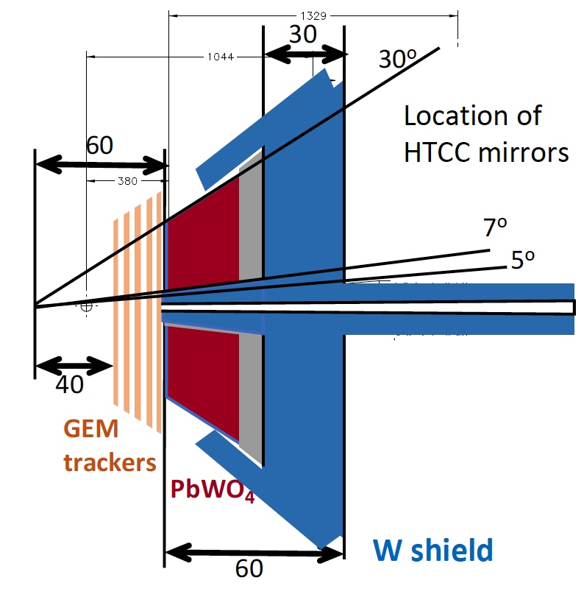


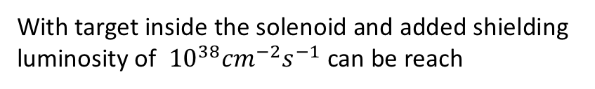
Two Options for DDVCS
CLAS12 Upgrade ⇒ 𝜇-CLAS12
SoLID with Muon detectors
Will handle $few ×{10}^{37}{cm}^{−2}s^{−1}$luminosities
Can run at luminosities $>{10}^{37}{cm}^{−2}s^{−1}$
Muon detector
Muon detector
Calorimeter is for electron detection. The shielding in front of the CLAS12 forward detector converts it into a muon detector.
With target inside the solenoid and added shielding luminosity of ${10}^{38}{cm}^{−2}s^{−1}$can be reach

Slide 10
Jlab Positron Working Group
(E. Voutier)

Slide 11
Physics with Positron Beams
(E. Voutier)

Slide 12
CLAS12 Proposal
(E. Voutier)

Slide 13
Hall C Proposal
(E. Voutier)

Slide 14
Positron Beam → New Dark Sector Opportunities
Key Idea: positron annihilation off atomic electrons opens new
dark sector production
channels
  Enhanced yield
  Unique kinematics
  permits inference
  of A’ mass & model-
  independent
  searches
Two proposed experimental configurations with thin and thick targets yield complementary sensitivity
Thin target: Model-independent
search for new forces
Thick target/active dump: Powerful probe of dark matter production
Figure credits: Battaglieri et al. 2105.04540
14

Slide 15
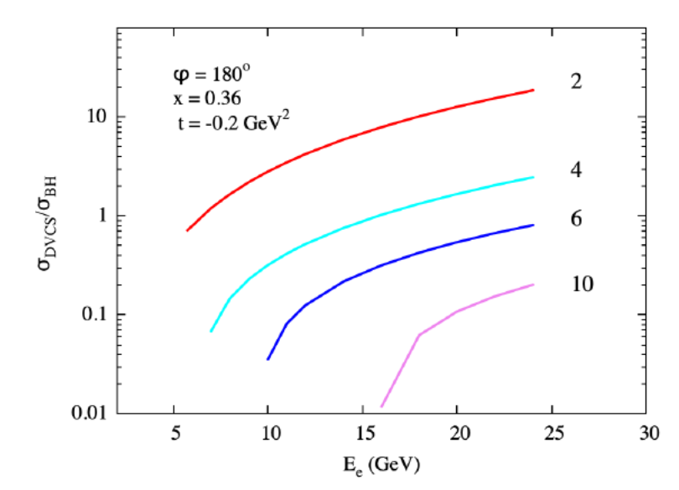
Femtography at 24 GeV Beam Energy
Q² = 2, 4, 6, 10 GeV²
DVCS cross section grows with electron energy relative to BH contribution
Higher Q² , lower x for
SIDIS

Slide 16
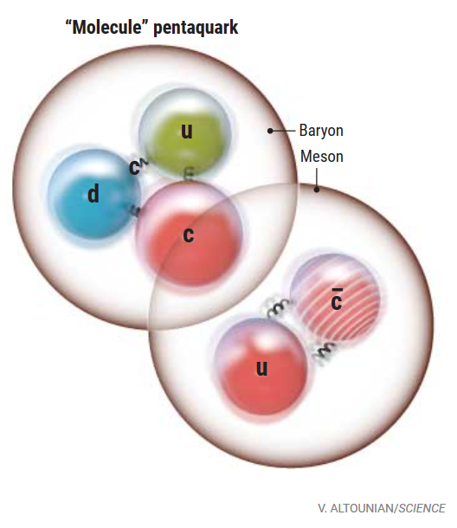
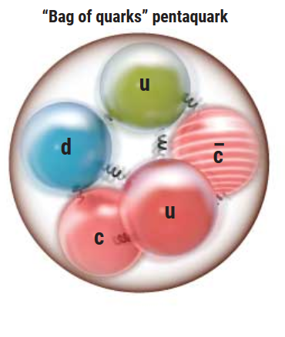
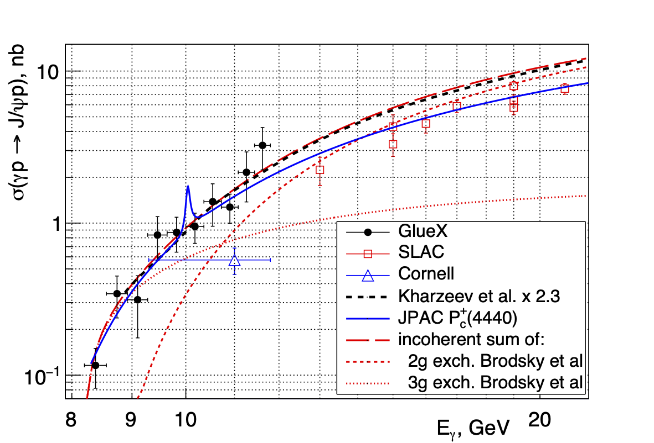
Threshold Charmonium Production
Proton mass decomposition… mass radius?
Connection to pentaquarks at LHCb
Connection between GlueX -> SOLID -> CEBAF energy upgrade…
GlueX (current): PRL…
SoLID 12 GeV (2029+)
CEBAF Energy Upgrade

Slide 17
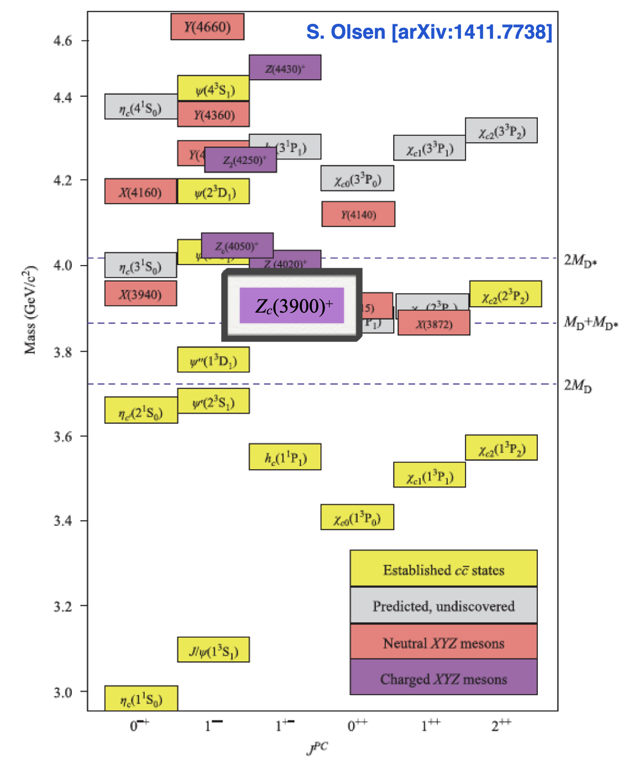
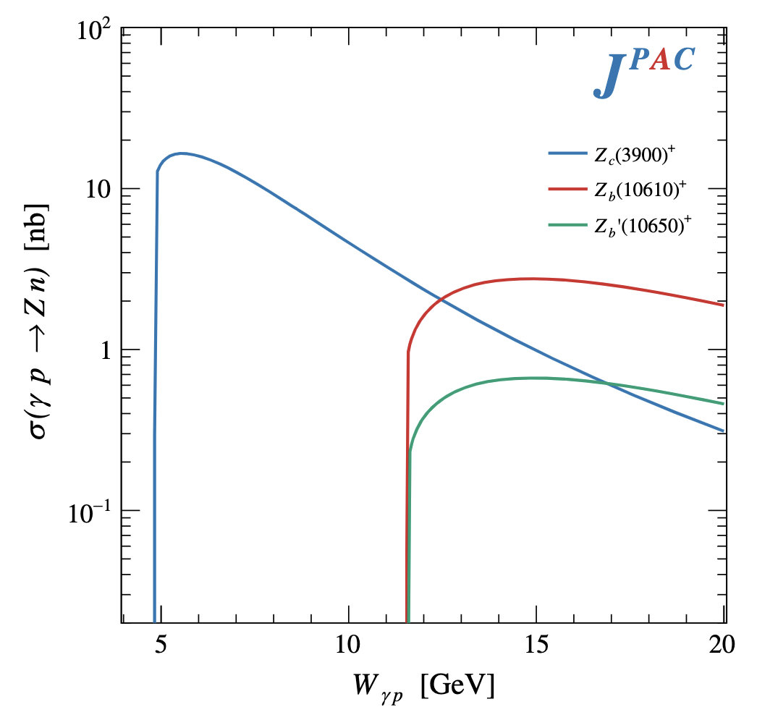
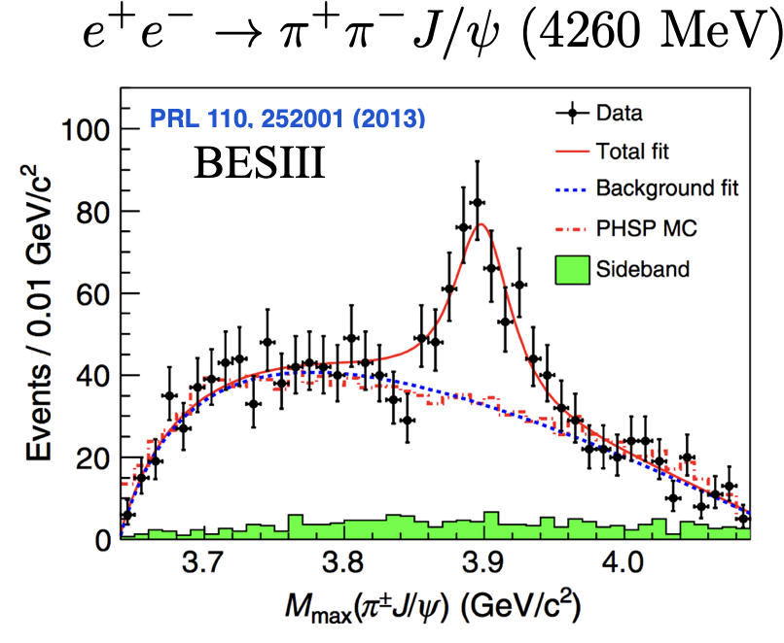

Exclusive XYZ production
Unexpected XYZ structures observed in charmonium, with many models for interpretation: resonant states, meson molecules, re-scattering, etc.
Novel photoproduction mechanism, with models suggesting enhanced production near threshold for X and Z states
Unique access with high luminosity, CEBAF energy upgrade
$$γp→Z^{+}n$$
CEBAF 24 GeV
EIC?

Slide 18
Realization of Polarized Positrons at CEBAF
(E. Voutier)

Slide 19
CEBAF Energy Upgrade
  Start with 12 GeV CEBAF as a baseline
  NO new SRF (1090 MeV per linac)
  Remove the highest pass recirculation arcs (Arc 9 and Arc A) and replace them with a pair of FFA arcs
  FFA= Fixed Field Alternating Gradient
Arc 9
  Recirculate as many times as feasible to get to 20-24 GeV:
    4.5 passes with the current CEBAF (Arcs 1-8)
    At least 6+ passes through FFA arcs
Arc A
(A. Bogacz)

Slide 20
Update 2012 White Paper
12 GeV program accomplishments
Planned program approved by PAC
Future opportunities, including CEBAF upgrades
- Writing committee appointed:
J. Arrington, W. Brooks, I. Cloet, H. Gao,
X. Ji, C. Keppel, J. Napolitano,
S. Stepanyan, A. Szczepaniak,
J. Stevens, N. Toro, X. Zheng
Due Dec.1 at Prog. Part. Nucl. Phys. for publication
Inform NP community of future opportunities

Slide 21
Summary
CEBAF has a long program ahead that is complementary to the envisioned EIC program
Upgrades for higher luminosity, polarized and unpolarized positron beams, and higher energies up to 24 GeV are envisioned
CEBAF will remain the prime facility for fixed target electron scattering at the luminosity frontier

