Slide 1


Near-Threshold Production of Heavy Quarkonium
Yuxun Guo
University of Maryland
Jul 21 2021
Based on 2103.11506 in collaboration with Xiangdong Ji and Yizhuang Liu.

Slide 2
Outline
Introduction
Gravitational form factors
QCD interaction of a color dipole
Photoproduction of J/ψ
Polarization and spin asymmetry
Conclusions and outlook

Slide 3
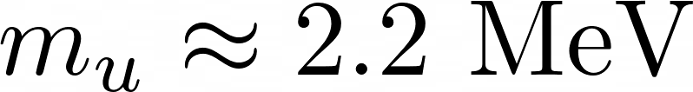
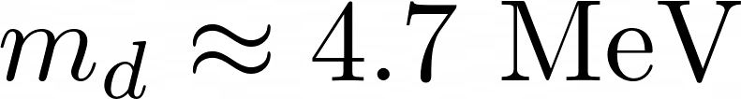
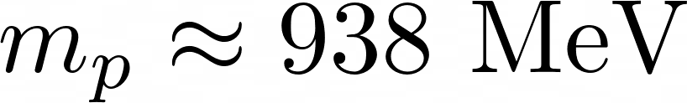
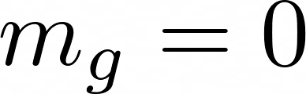
Introduction to proton mass
-mass without mass
Most of the proton mass comes from dynamical energy!

Slide 4
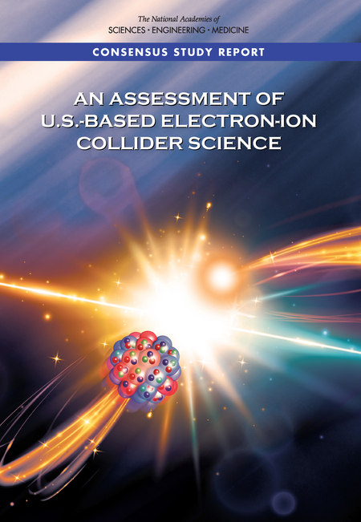
Introduction to proton mass
-importance scientific goal of EIC
Finding 1:
An EIC can uniquely address three profound questions about nucleons--neutrons and protons--and how they are assembled to form the nuclei of atoms:
How does the mass of the nucleon arise?
How does the spin of the nucleon arise?
What are the emergent properties of dense systems of gluons?

Slide 5
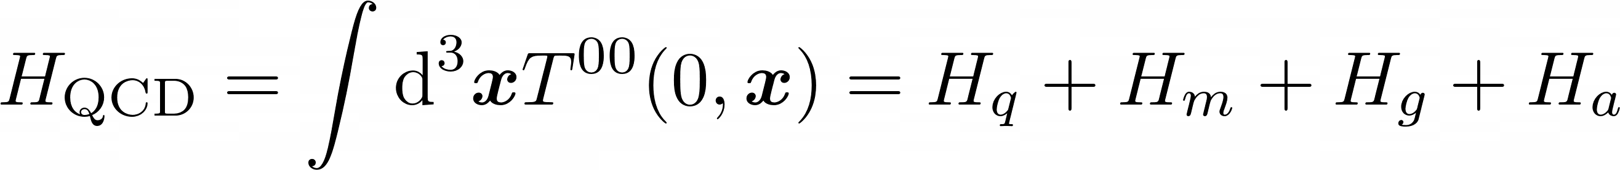
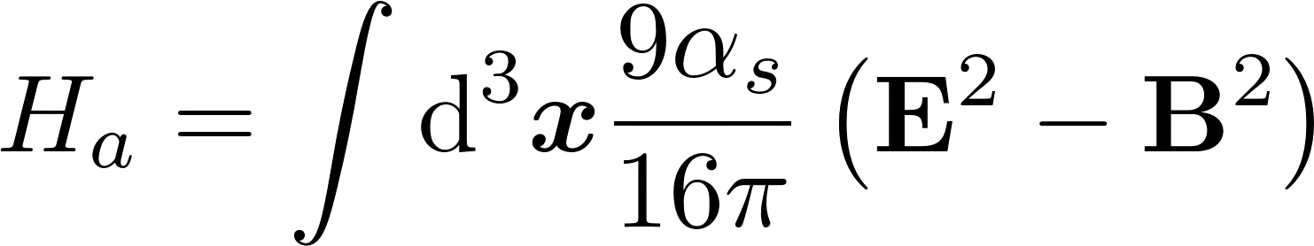
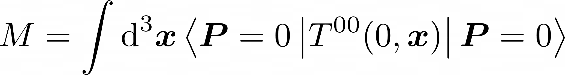
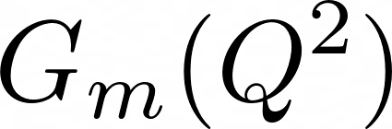
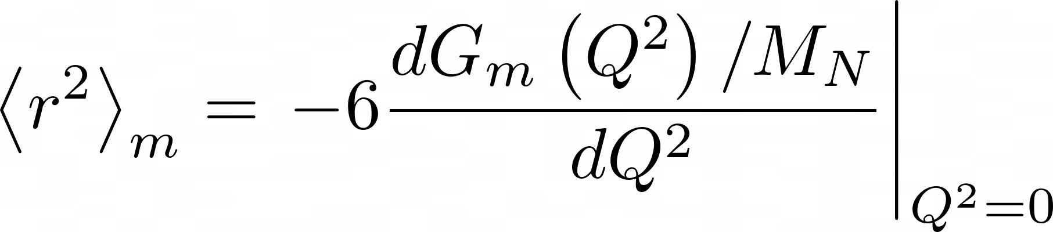
Two important points
X. Ji (1995),
X. Ji, Y. Liu and A. Schafer (2021)
Quantum anomalous energy (QAE)
Mass radius
Quark energy
Quark mass
Gluon energy
QAE
D. Kharzeev (2021), X. Ji (2021)
mass
mass form factors
(Breit frame)
mass radius

Slide 6
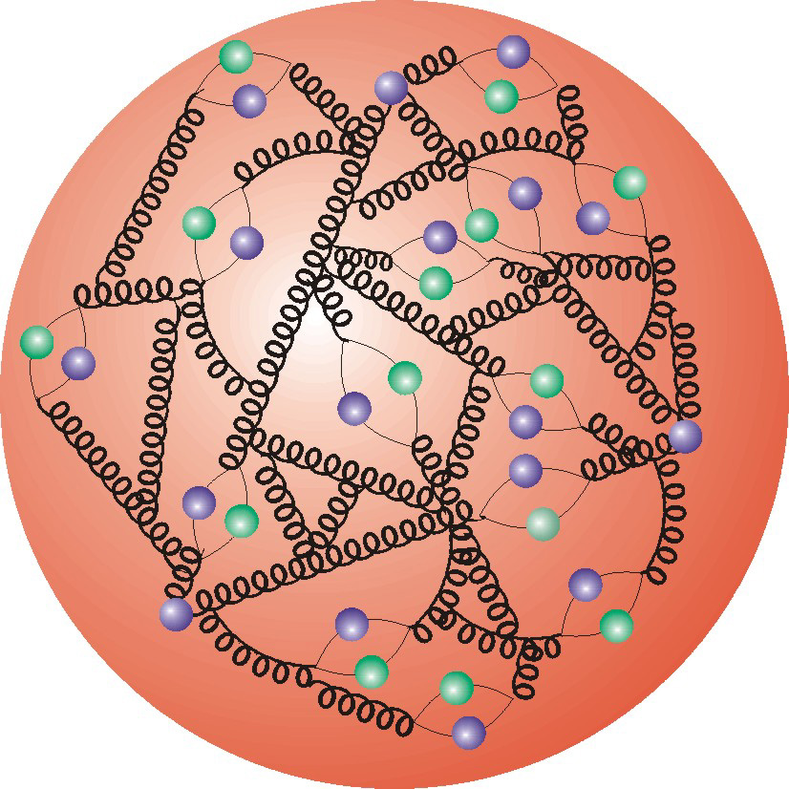
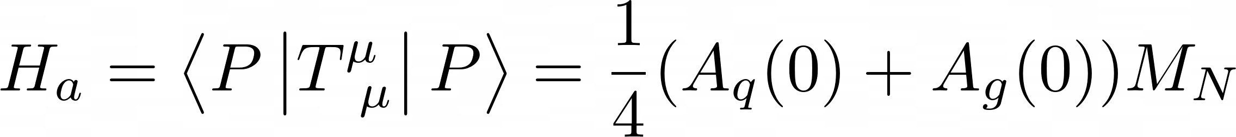
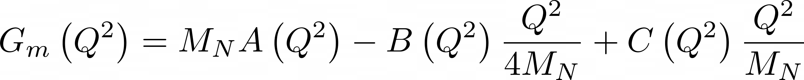
Gravitational form factors
Matrix element of EMT can be written into gravitation form factors.
X. Ji (1996)
Importance to mass structure
QAE
Mass form factors

Slide 7
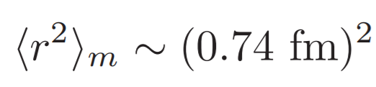
Lattice calculation
Hagler et. al. (2008), Shanahan et. al. (2018)
Gravitational form factors calculated with lattice QCD.
Dominated by gluon contribution

Slide 8
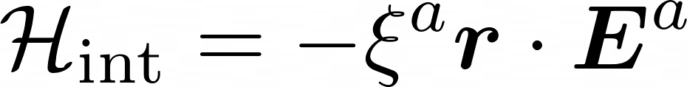
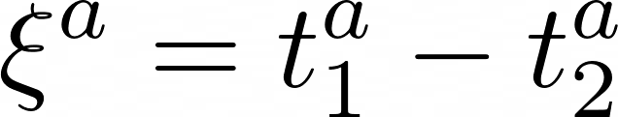
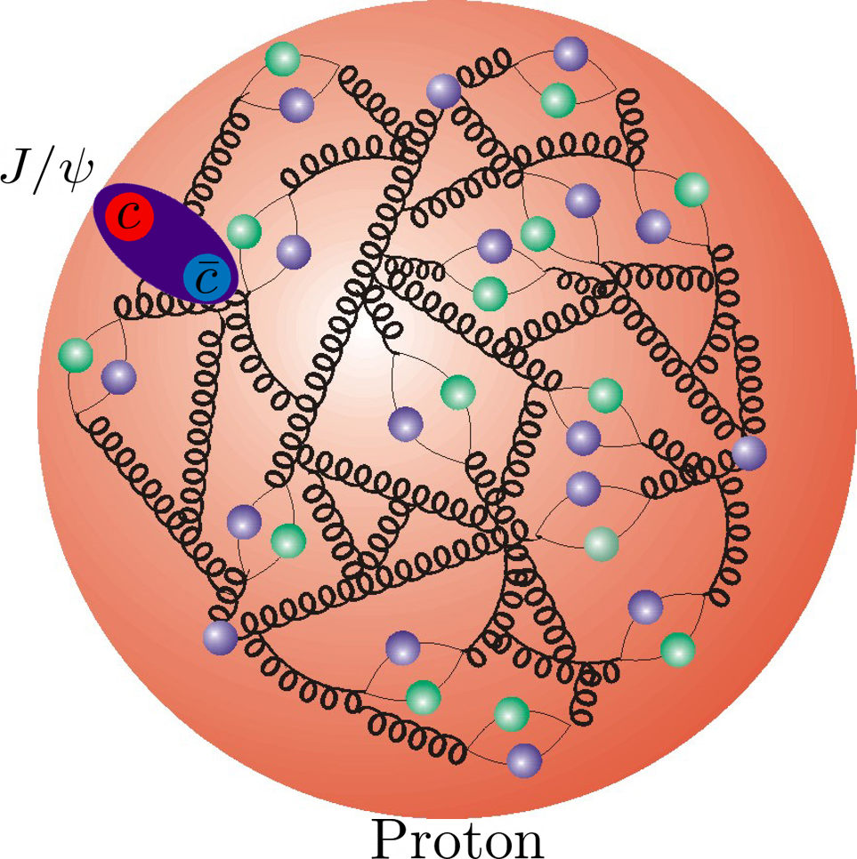
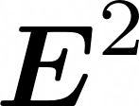
Color dipole as a probe
D. Kharzeev (1996),
M.B. Voloshin (1979)
with
Quadratic Stark effect in QCD – measures the color electric field
The quarkonium needs to be small;
The relative motion in the quarkonium is slow;
Perturbatively calculable;
Heavy quarkonium is needed!

Slide 9
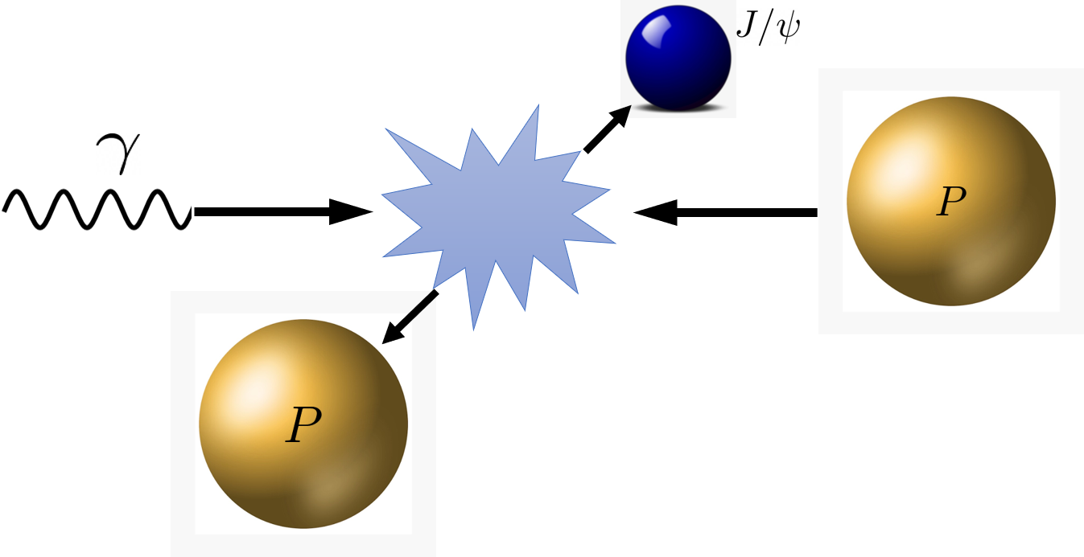
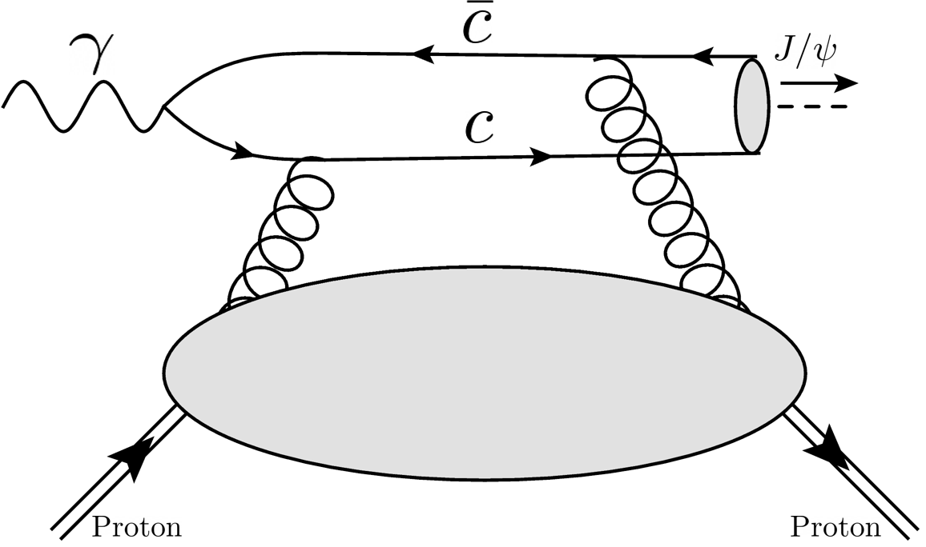
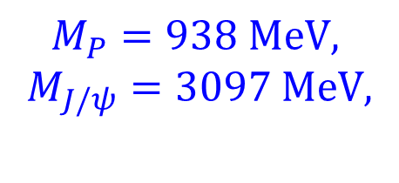

Heavy quarkonium production
Near threshold, J/ψ slowly goes through the proton and measures the distribution inside.
$$M_{P}=938 MeV,$$
$$M_{J/ψ}=3097 MeV,$$
$$W_{th}=4.035 GeV$$
$$E_{th}^{γ}= 8.210 GeV$$

Slide 10
Previous works
Vector dominance model
Dispersive analysis
Holographic QCD
pQCD analysis at large momentum transfer
D. Kharzeev (1996),
D. Kharzeev et. al. (1999),
O. Gryniuk and M. Vanderhaeghen (2016)
O. Gryniuk et. al. (2020)
Y. Hatta and D.-L. Yang (2018)
Y. Hatta, A. Rajan and D.-L. Yang (2019)
K. A. Mamo and I. Zahed (2020,2021)
P. Sun, X.-B. Tong and F. Yuan (2021)

Slide 11
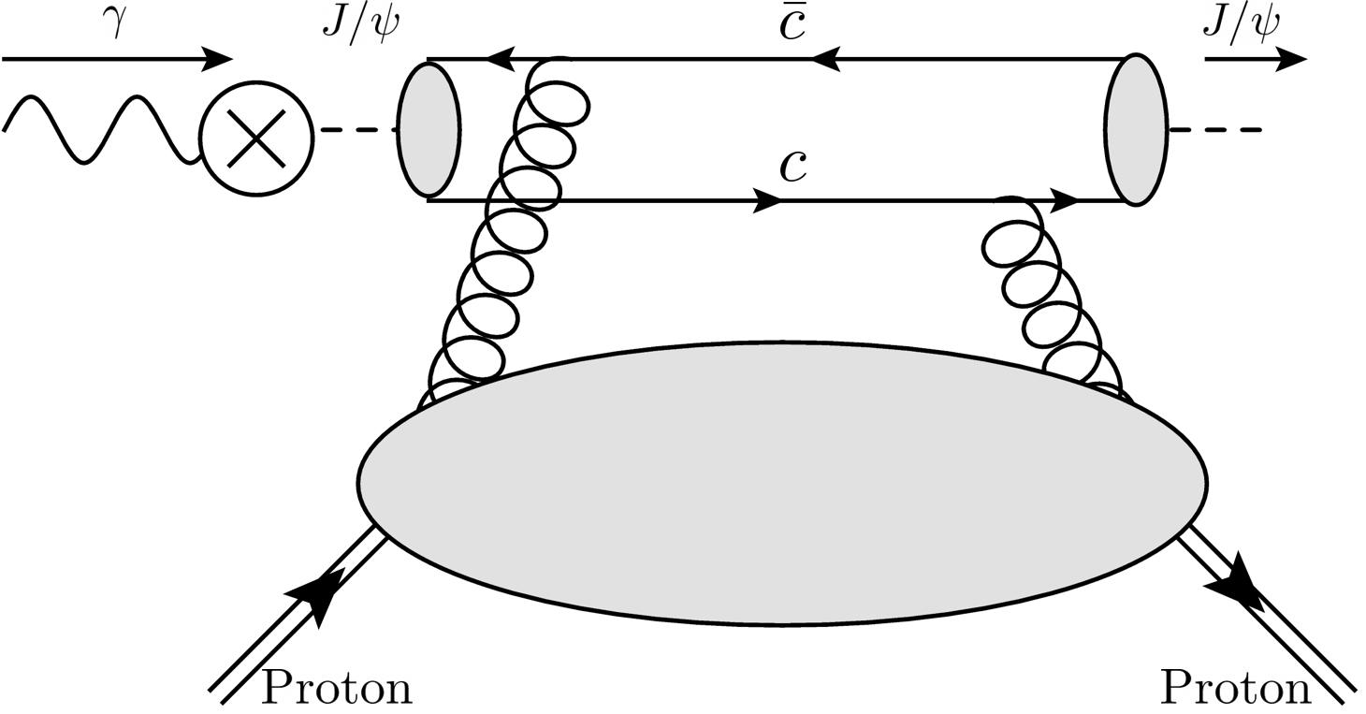
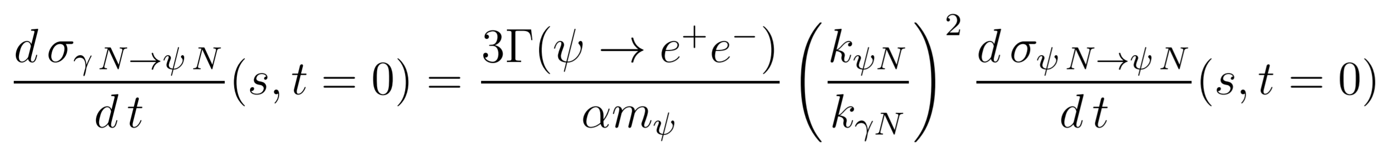
Vector dominance model
V. Barger et. al. (1975),
D. Kharzeev et. al. (1999)
In VDM, the photoproduction σ is extrapolated to t=0, and matched to J/ψ-proton forward scattering σ.
Distribution

Slide 12
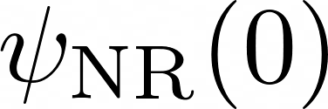
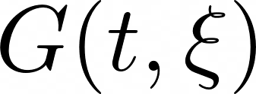
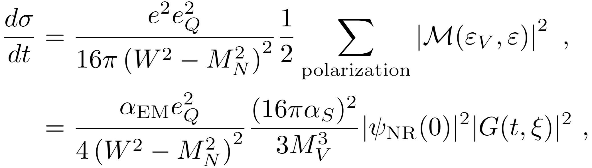
QCD factorization
YG, X. Ji and Y. Liu (2021)
The cross section can be analyzed using QCD factorization in the heavy quark limit near the threshold.

Slide 13
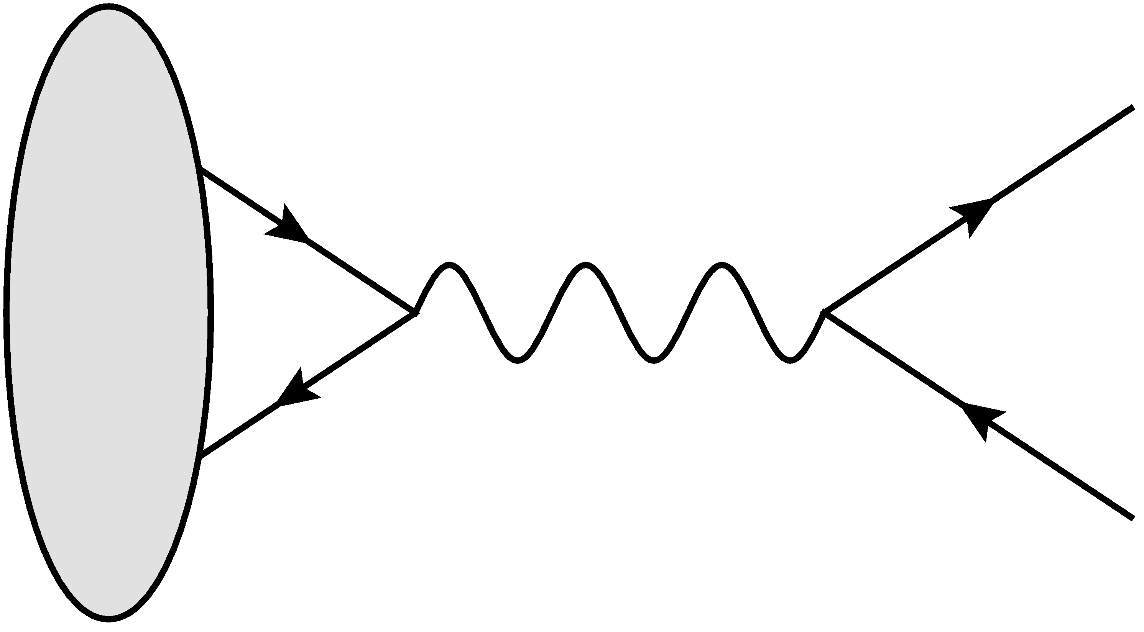



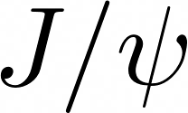

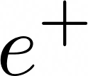
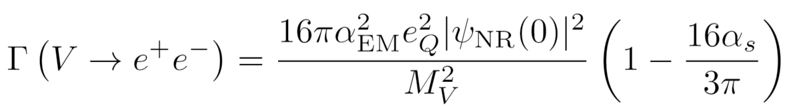
Distribution amplitude
: Non-relativistic distribution amplitude of J/ψ
To the leading order of , J/ψ can be estimated as hydrogen like system.
Higher order terms can be analyzed with NRQCD.
R. Van Royen and V. F. Weisskopf(1967)
B. Gittelman et. al. (1975)
G. T. Bodwin et. al. (2006)

Slide 14
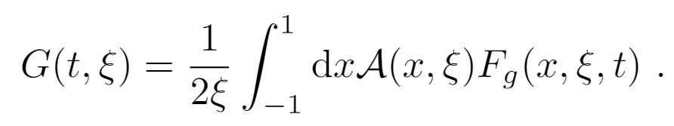
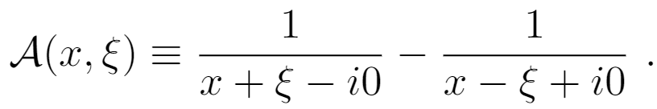
Hadronic matrix element
:Hadronic matrix element
Hard Kernel:
Gluon GPD:
Consistent with leading twist result in deeply virtual meson production.
J. Koempel et. al. (2011)

Slide 15
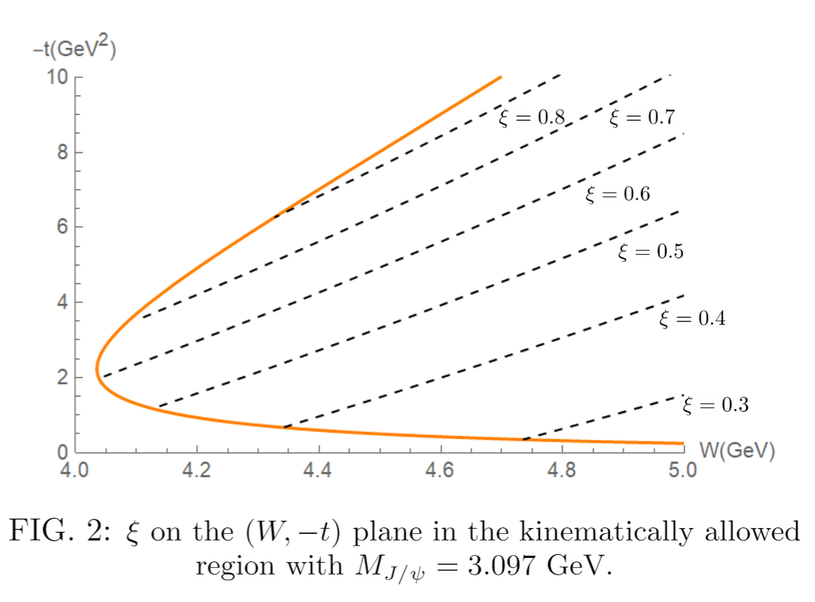
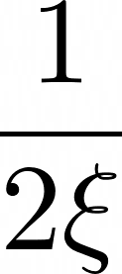
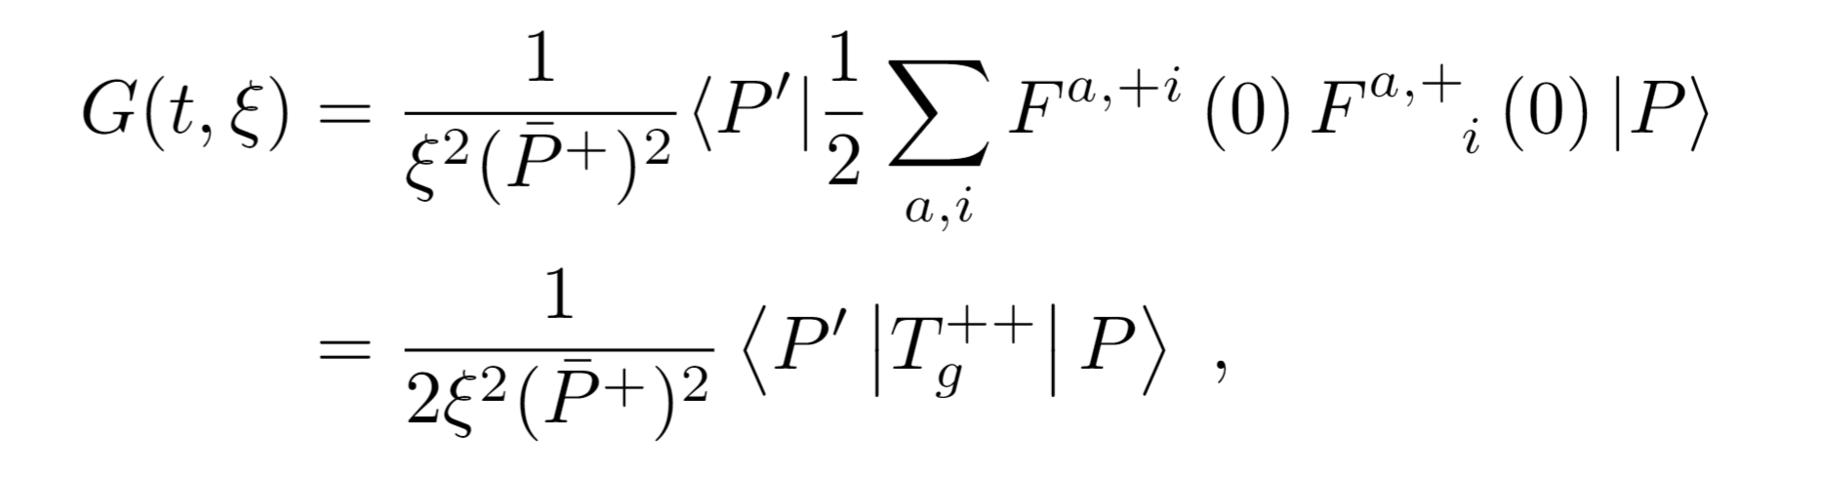

Kinematics near threshold
t and $ξ$ are large near threshold.
Taking the leading moment of x,
Measurement of the gravitational form factors.

Slide 16
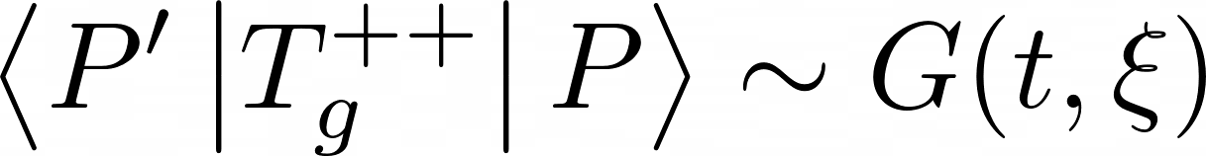
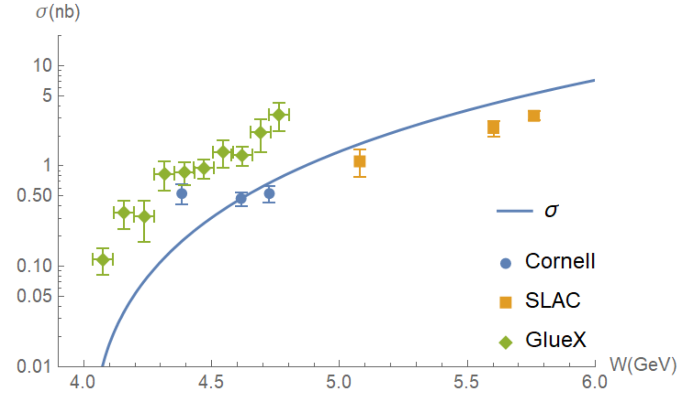
Connect lattice results with exp.
Lattice calculated form factors
cross section
QCD works quite well!

Slide 17
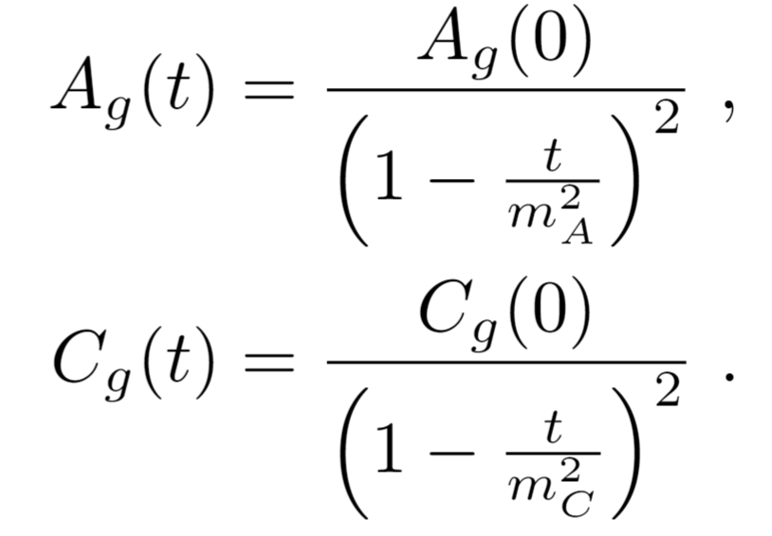
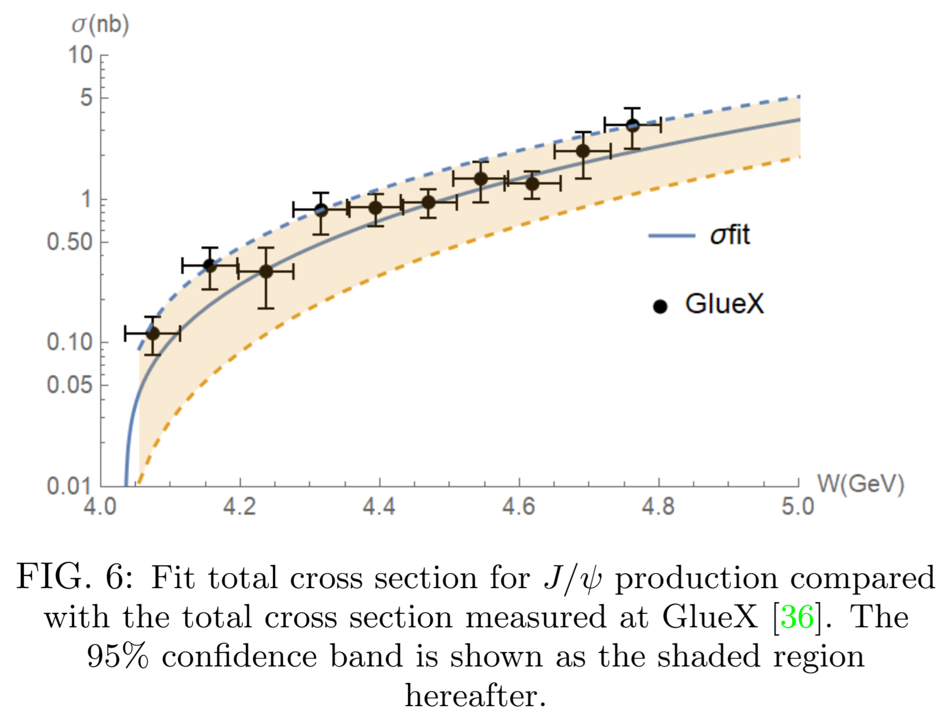
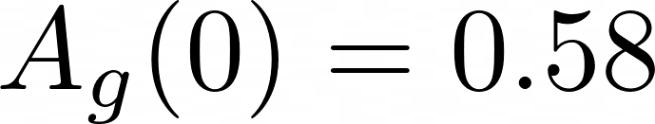
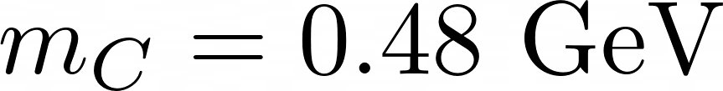
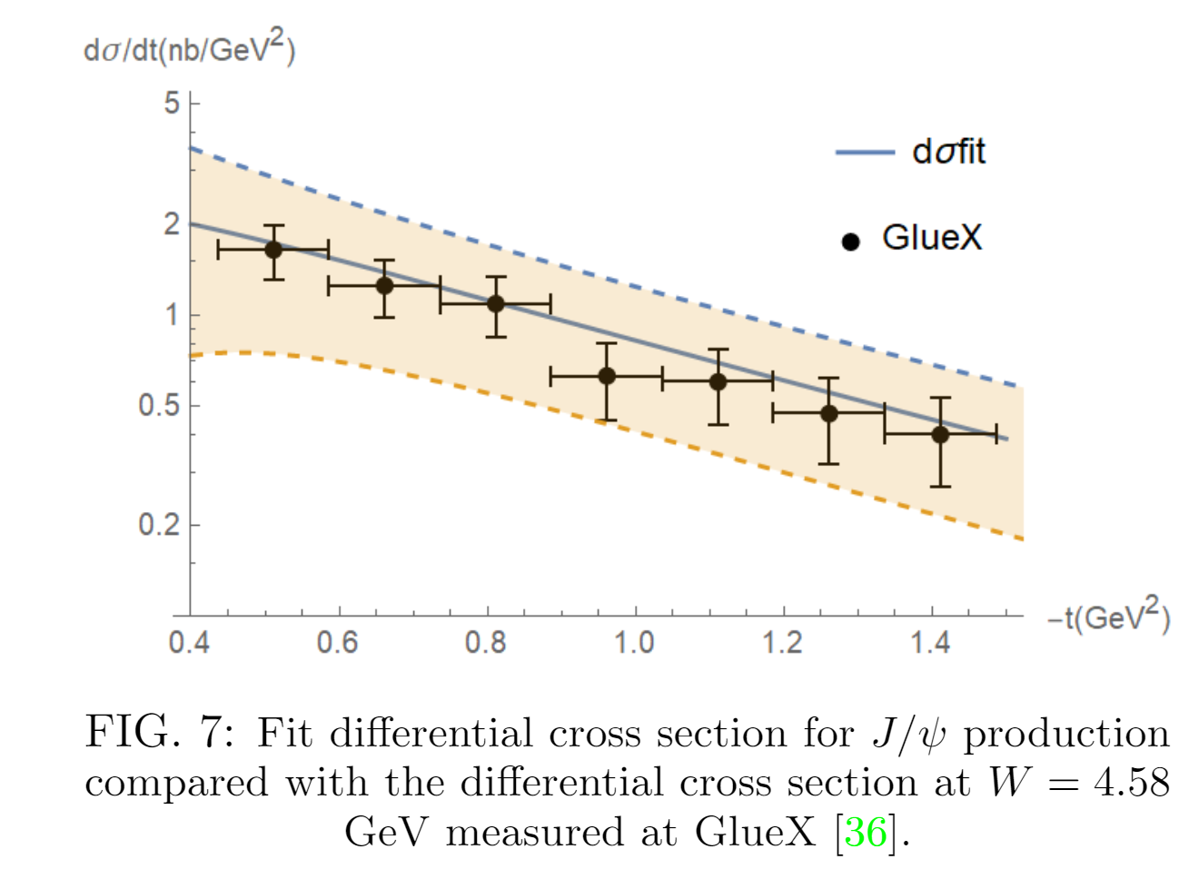
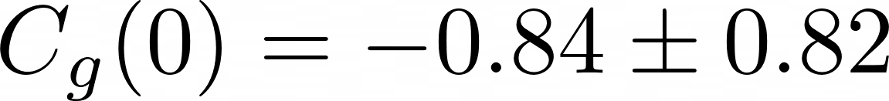
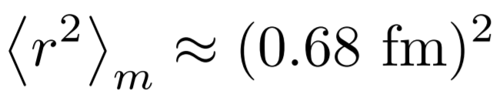
Fitting gravitational form factors
Fixed
Fit

Slide 18
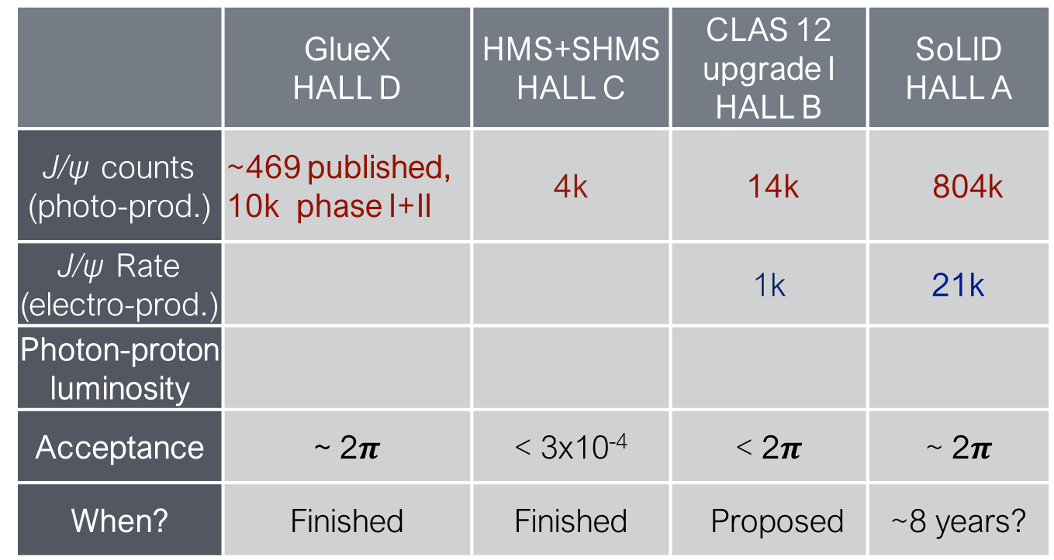
More J/ψ data at JLab
Z.-E. Meziani
 | GlueX HALL D | HMS+SHMS HALL C | CLAS 12 upgrade I HALL B | SoLID HALL A
J/ψ counts (photo-prod.) | ~469 published, 10k phase I+II | 4k | 14k | 804k
J/ψ Rate (electro-prod.) |  |  | 1k | 21k
Photon-proton luminosity
Acceptance | ~ 2$π$ | < 3x10⁻⁴ | < 2$π$ | ~ 2$π$
When? | Finished | Finished | Proposed | ~8 years?
More data at JLab will allow much more precise measurements of gravitational form factors.

Slide 19
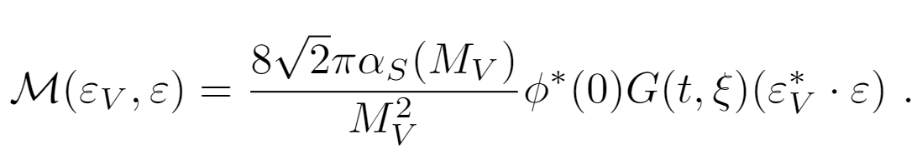

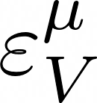
Polarization measurement
The leading amplitude before summing over polarizations reads
Photon polarization and vector meson polarization are factored out.
The proton polarizations are contained in the hadronic matrix element -- polarization measurements provide more information on the gravitational form factors.

Slide 20
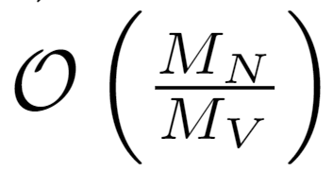
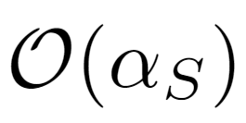
Conclusions
Factorization formula to the leading order in the heavy quark limit.
Measurements of the gluonic gravitational form factors .
Proton polarization measurements can be helpful.
Outlook
Higher order correction in and
Higher twist effects including three-gluon exchange
Factorization theorem to higher/all order

