Slide 1
LEReC cooling (with an eye towards the future)
Alexei Fedotov
RHIC Retreat
September 16, 2021

Slide 2
Outline
LEReC performance summary
LEReC cooling studies (APEX) in 2021
Future cooling studies
Future high-current R&D
Run-22 plans and beyond
2

Slide 3
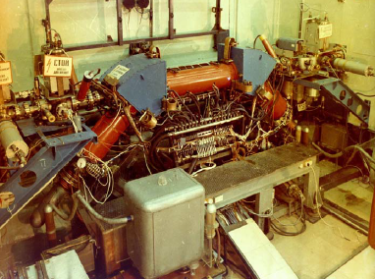
Electron coolers
The method of electron cooling was first presented by
G.I. Budker
(Novosibirsk) at Symposium
in Saclay, 1966.
First experimental
electron cooling demonstration at NAP-M storage ring (Novosibirsk, Russia, 1974).
High Voltage DC coolers: (1974 - ): all DC electrostatic accelerators; all use magnetic field to confine electron beam (magnetized cooling).
FNAL Recycler cooler: Pelletron electrostatic generator (4MeV electrons), transport of electron beam without continuous magnetic field.
RF acceleration (High Energy approach): BNL LEReC electron cooler (2019-21): First RF-linac based electron cooler. Also, first cooler without any magnetization of electrons, first two-beam electron cooler, first electron cooler in a collider.
A. Fedotov, RHIC Retreat, September 16, 2021
3

Slide 4
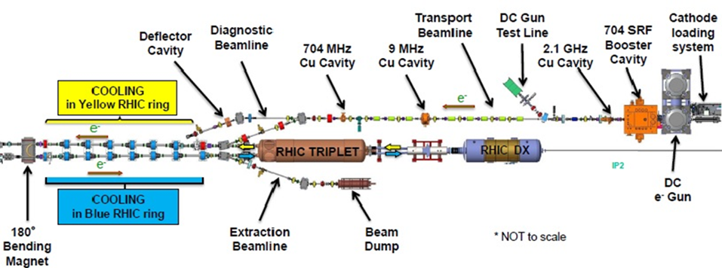
Distinctive features of LEReC
LEReC is fully operational electron cooler which:
utilizes RF-accelerated electron bunches
uses non-magnetized electron beam (there is no magnetization at the cathode and there is no continuous solenoidal field in the cooling section)
LEReC approach to cooling is directly scalable to high-energies
LEReC offers unique capability for experimental studies of various cooling topics which are relevant to high-energy coolers
A. Fedotov, RHIC Retreat, September 16, 2021

Slide 5
LEReC roadmap to cooling a collider
Production of 3-D high-brightness electron beams ✓
RF acceleration and transport of electron bunches maintaining “cold” beam ✓
Control of various contributions to electron angles in the cooling section to a very low level required for cooling ✓
Velocity matching of electron and ion beams ✓
First electron cooling demonstration in longitudinal plane✓
Establishing cooling in 6-D✓
Matching electron and ion velocities in both Yellow and Blue RHIC rings✓
Achieving cooling in both Yellow and Blue Rings simultaneously using the same electron beam✓
Demonstrating longitudinal and transverse cooling of several ion bunches (high-current 9MHz CW e-beam operation) simultaneously ✓
Cooling ion bunches in collisions, in both Yellow and Blue RHIC rings using CW electron beam ✓
Successful operation for RHIC Physics program during 2020-21 ✓

Slide 6
Cooling in a collider
After 6D electron cooling of hadron beams was successfully commissioned in both collider rings in 2019, our focus shifted towards operational aspects of cooling of full RHIC physics stores with ion bunches in collisions.
Application of electron cooling technique directly at collision energy of hadron beams brings several challenges, such as:
Control of ion beam distribution, not to overcool beam core (especially when ion beam space charge is significant)
Interplay of space-charge and beam-beam in hadrons
Effects on hadron beam from electrons (“heating”)
Ion beam lifetime with cooling (as a result of many effects)
Optimization between cooling process and luminosity improvement
The final optimization was performed during operation for physics by choosing parameters which result in largest luminosity gains (not necessarily higher electron beam current or stronger cooling)

Slide 7
Cooling optimization for luminosity
Luminosity optimization with cooling included:
Finding optimum angular spread of electrons in cooling sections to provide sufficient transverse cooling.
Optimization of electron and ion beam sizes in the cooling sections.
Finding optimum working point in tune space for colliding ion beams in the presence of electron beam.
Finding optimum electron current to reduce effects on ion beam from electrons and at the same time still provide sufficient cooling.
Longer stores with cooling.
With cooling counteracting longitudinal IBS and preventing debunching from the RF bucket, the ion’s RF voltage could be reduced resulting in smaller momentum spread of ions and improving ion lifetime.
Once the transverse beam sizes were cooled to small values, the dynamic squeeze of ion beta-function at the collision point was established.

Slide 8
LEReC operational experience
Stable 24/7 running of high-current electron accelerator and stable cooling was provided over many weeks of collider operation in 2020 and 2021.
Reliable operation was ensured by implementation of laser position feedbacks, intensity feedback, energy feedback, automatic cooling section orbit correction and feedback.
Operational electron current based on optimization between cooling and other effects, including ion beam lifetime effects, was: 15-20 mA (for Au ions at 4.6 GeV/n in 2020) and 8-20 mA (for Au ions at 3.85 GeV/n in 2021).
Very robust photocathodes with initial Quantum Efficiency: 8-9%
Cathode lifetime: 6-10 days

Slide 9
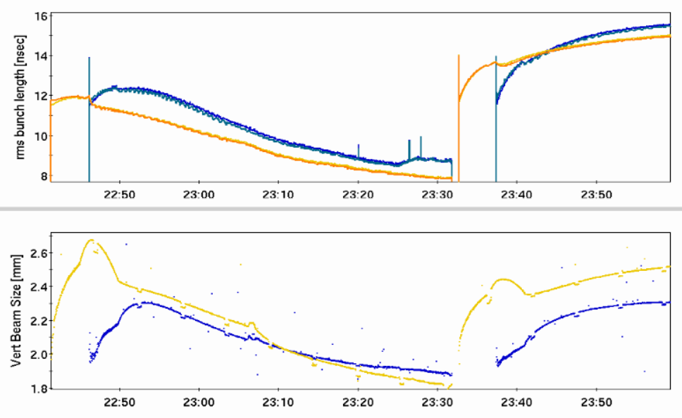
Physics stores (111x111 ion bunches at 4.6 GeV/n) with and without cooling of ions in Yellow and Blue RHIC rings - rms bunch length (top) and rms beam size (bottom)
Cooling ON
Cooling OFF
Time

Slide 10
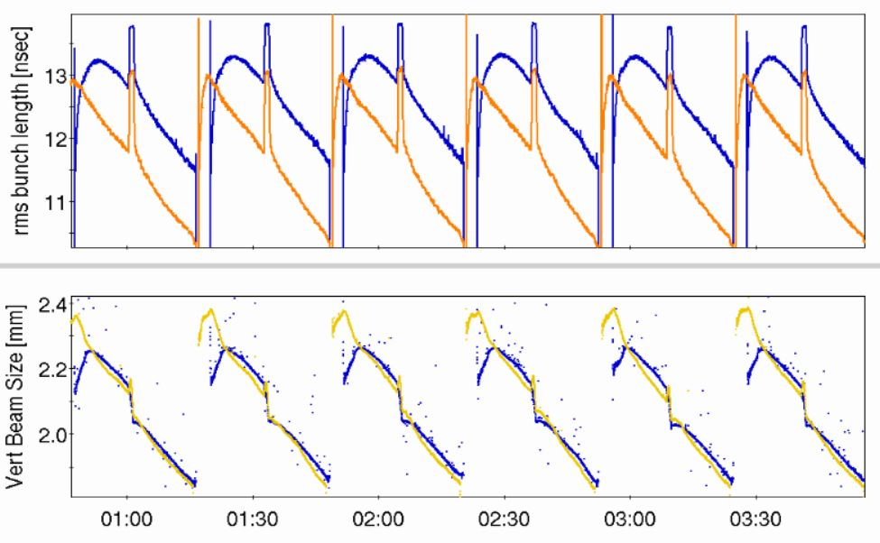
2021 operation for physics (several physics stores), 1.6 MeV electrons, 111x111 Au ion bunches at 3.85 GeV/n, rms bunch length (top) and rms beam size (bottom)
Time

Slide 11
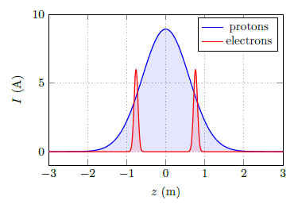
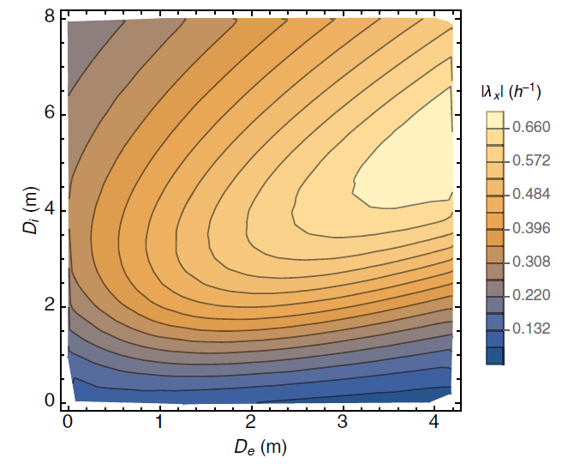
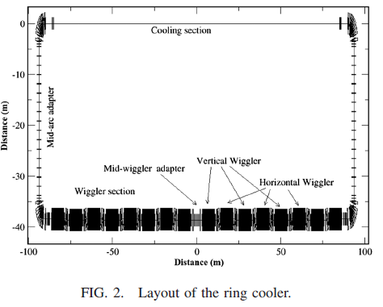
Importance of LEReC cooling studies for future high-energy coolers, including EIC
Electron cooling using bunched electron beams (LEReC-type cooler) is proposed for:
Pre-cooling of protons at 24GeV for EIC.
Cooling protons directly at collision energy of 41GeV in EIC.
A. Fedotov, S. Benson et al., “Low energy cooling for EIC”, BNL-220686-2020-TECH (2020)
Cooling of protons at the highest energy of 275GeV using storage ring electron cooler.
H. Zhao, J. Kewisch, et al., “Ring-based electron cooler for high energy beam cooling”, Phys. Rev. Ac. Beams 24, 043501 (2021)
Dispersive cooling (275GeV, EIC):
Horizontal cooling rate
electron storage ring

Slide 12
Cooling studies directly relevant to EIC coolers
Emittance growth of ion beam (“heating”) due to interaction with bunched electron beam
Coherent excitations of ions and circular attractors
Recombination of ions without continuous magnetic field in cooling section
Cooling of ion bunch with electron bunches overlapping only small portion of ion bunch
Dispersive cooling (redistribution of cooling decrements), to provide stronger transverse cooling
Effects of the presence of the electron beam on the ion beam lifetime
Understanding of these effects is of critical importance for future high-energy coolers.
Being a protype for high-energy coolers, LEReC offers unique opportunity to explore these effects in great detail.
The studies above started under APEX program in 2021.

Slide 13
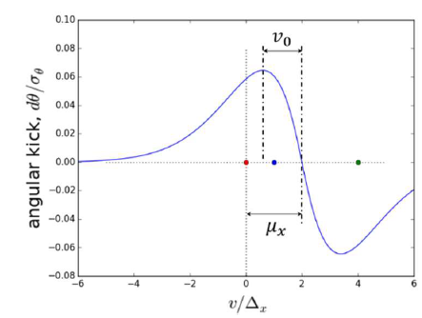
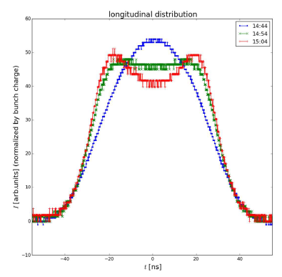
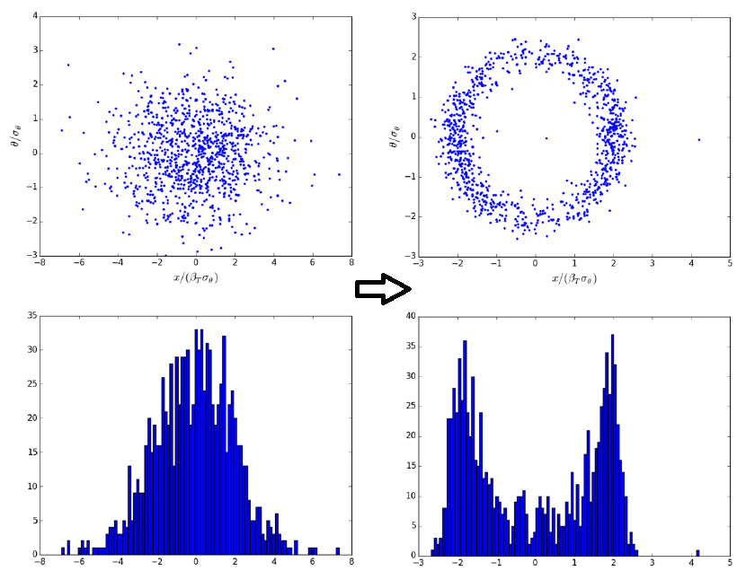
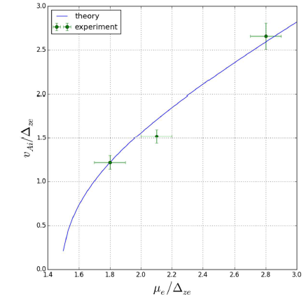
Example of APEX studies: Coherent excitation of ions
A coherent offset in the velocity distribution of the electron bunch shifts the friction force w.r.t. the zero ion’s velocity
Friction force
APEX measurements
When the coherent shift is larger than the velocity at which the friction force’s first derivative is changing sign, then the net force acting on an ion with small amplitude excites the oscillations, resulting in creation of a circular attractor in the phase space.
As a result, small ion
amplitudes can increase
rather than being damped
(“heating”).
This effect is also
applicable to CeC.
Longitudinal distribution
Initial and final distributions
(simulations)
Radius of attractor vs
coherent offset
13

Slide 14
Cooling studies using APEX during 2021 RHIC run
The following APEX studies were performed in 2021:
Heating of ions due to interaction with bunched electron beam – significant data was accumulated, but some questions still remain - few more experiments still needed
Coherent excitations and circular attractors in electron coolers – attractors were measured in longitudinal plane, good agreement between experiments and theory, completed
Recombination of ions without continuous magnetic field in cooling section – no anomalous enhancement (as reported in standard low-energy coolers) was measured, completed
Cooling of ion bunch electron bunches overlapping only small portion of ion bunch – started, few more measurements needed
Dispersive cooling (redistribution of cooling decrements) – started. Detailed benchmarking of theory (dependance on various parameters) is needed
Machine learning for cooling rate optimization - completed

Slide 15
LEReC Run-22: Planned cooling studies
Cooling studies which are essential for future high-energy coolers, including EIC:
Dispersive cooling (redistribution of cooling decrements) -started. Detailed benchmarking of theory (exploration of various parameters) is needed. Several APEX sessions: min 2x8=16 hours
Heating of ions due to interaction with bunched electron beam – significant data was already accumulated, but few more experiments still needed: min 2x4=8 hours
Short electron macro-bunches: Cooling of ion bunch electron bunches overlapping only small portion of ion bunch – started, min 2x4=8 hours
Lifetime of ions in the presence of electron bunches, including setup and studies for different working points: min 2x8 =16 hours
Total estimate: min request of 48 hours, could be spread over 4 separate APEX sessions (require Au ions at 3.85 or 4.6GeV).
Additional hours may be needed, depending on initial results. Possibly could be done in 2023 if available time during 2022 run will not be sufficient.

Slide 16
LEReC-based source/accelerator R&D
High-current electron sources is important area of research. They are also required for various cooler designs of the EIC. For example, electron coolers for pre-cooling at low energy in EIC (at 24 GeV and 41 GeV) require stable operation at around 100mA current. Also, the Strong Hadron Cooler (SHC) for EIC requires 100mA source of electrons.
High-current source R&D:
LEReC Gun is designed to operate at high current. Many R&D items critical to high-current source operations could be explored (next slide).
Other accelerator studies:
LEReC accelerator could be used for other R&D studies.
Electron beam dynamics: Micro-bunching, effects of mergers, CSR, beam halo, ion trapping and clearing, as well as effects relevant to space-charge dominated beam transport.
Testing high-current high-power electron beam diagnostics: Various high-power instrumentation devices could be tested in LEReC. Examples of previously considered diagnostics include Beam Induced Fluorescence monitor, BNNT screen and wire scanner.

Slide 17
LEReC-based R&D: High-current source studies
Explore Gun operation with high-current: 50, 75, 100mA, possibly higher. Determine limitation of the Gun.
Reaching current of 100mA for high Gun voltage of 400kV – this requires 40kW of power which goes above rating of a single inverter (35kW), thus very important R&D is to learn how to use two inverters in parallel. If successful it will allow either for Gun operation at voltages above 400kV or currents above 100mA.
Gun and HVPS stability at high currents; long-term stability and what are the issues and limitations. Try to find reasons and remedies for gun trips at high current.
Explore what does it take to operate Gun 24/7 with high-current
Explore operation with active cathode on center vs cathode off center.
Explore large cathode area vs small active area. Explore various laser spot sizes on the cathode.
Explore cathode QE at various laser power with and without cathode stalk cooling. For EIC applications, cathode cooling and high laser power on cathode is an important R&D. For LEReC, QE drop by a factor of 4 during operation was compensated by increase in laser power by a factor of 4. For EIC, to cover QE drop from 8 to 2%, would require laser power on the cathode up to 10W, thus cathode cooling.
Explore Gun voltage limitations: can one have stable high-current operation at 400kV,425kV. 450kV?
Further Gun improvements: Improve the gun vacuum by increase NEG pumps, change Kr line design, develop NEG coated beamline.
High-charge high-peak current (beam halo and losses), upgrade of laser system to allow ramping of high-current for fixed electron bunch charge. Otherwise, if electron bunch charge is ramped up at fixed laser frequency, this results in a strong mismatch of beam optics for different bunch charges, and high beam losses.
Test multialkali photocathodes using different growth methods such as sputtering. Change the substrate material to get larger crystal multialkali cathode, test cathodes lifetime during high-current operation
Other studies…

Slide 18
LEReC Run-22: Planned high-current tests
Explore Gun operation at high-current: 50mA and above.
Determine limitation of the Gun. This is needed to plan required Gun
upgrades during the 2022 long shutdown.
Few shifts: 4-6 hour each. Could be done during Maintenance days, need only IR2 to be closed. These tests should be done after all cooling studies (APEX at low energy) are completed (later in Run-22) to minimized possible risks to various accelerator hardware. Schedule during some Maintenance days or during last weeks of the run.

Slide 19
LEReC Run-22 Plan
Cooling studies (with Au ions):
Using APEX time (about 48 hours will be requested). Will require setup for Au at 3.85 GeV, electron energy 1.6MeV.
Will be using 28MHz RHIC RF.
High-current R&D studies (without ions):
Using Machine Development time, possibly at the end of some Maintenance days or when IP2 is closed while long access to other IP is scheduled. Requires running high-current electron beam through RHIC cooling sections to the high-power beam dump.

Slide 20
LEReC plans for 2022 long shutdown and beyond
Option 1: If, as a result of 2022 cooling studies, it is found that further cooling studies are needed.
This requires keeping LEReC accelerator intact.
Run-23: Cooling studies and high-current R&D.
Option 2: If all essential cooling studies are completed during Run-22.
In such a case, to simplify high-current setup, LEReC can be taken apart and converted into injector for “high-current R&D”. Such conversion allows to decouple high-current tests from RHIC running (no need to run e-beam through RHIC beam pipe). However, with such conversion, all unique features of LEReC as a cooler will no longer be available for future high-energy cooling studies
Converting to simplified injector will require major work in RHIC tunnel:
Moving high-power beam dump to injector section (area modifications)
Possibly removing SRF and 2.1 GHz RF cavities from present Injector section
Major RF and vacuum work during 2022 shutdown.

Slide 21
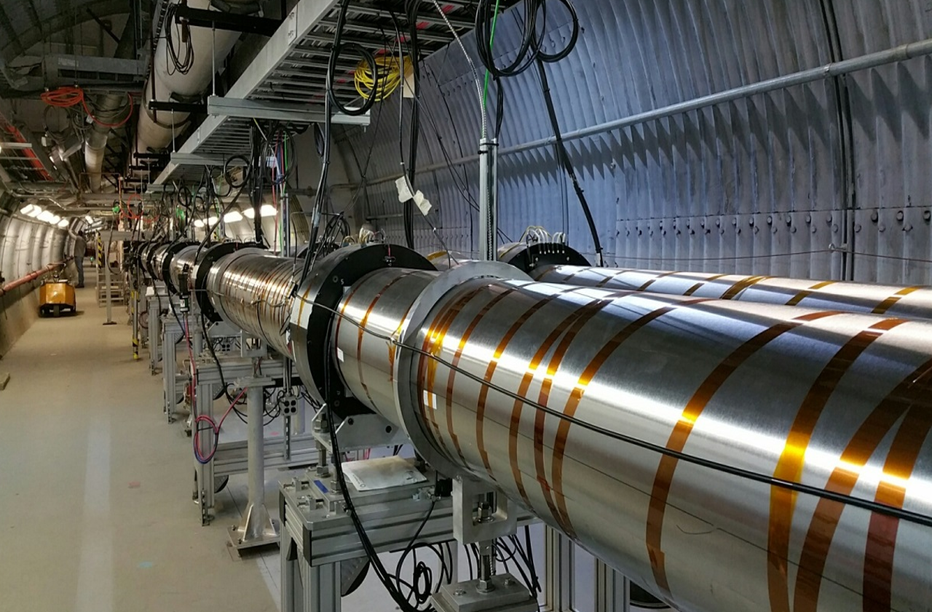
Summary
LEReC successfully operated for RHIC physics program in 2020 and 2021, making it the world’s first operational electron cooler to cool ions directly at collision energy.
LEReC offers unique opportunity to study various aspects of electron cooling using short electron bunches, as well as effects relevant to the ion beam dynamics.
Several dedicated cooling experiments were already performed in 2021, with more cooling studies planned during Run-22.
The plan is to start high-current accelerator R&D during Run-22.
Planned electron cooling and high-current studies are directly relevant for EIC coolers, both for regular and coherent electron cooling.

Slide 22
Acknowledgement
LEReC project greatly benefited from help and expertise of many people from various groups of the Collider-Accelerator and other Departments of the BNL.
Special thanks go to LEReC systems experts and to RHIC operators who maintained outstanding performance of LEReC accelerator during RHIC operations.
Work supported by the U.S. Department of Energy.
Thank you!

