Slide 1
Common file format
Dmitry Romanov Kolja Kauder Whitney Armstrong Sylvester Joosten Markus Diefenthaler Sergey Furletov

Slide 2
Major bullets
Inspired by ZEUS output format (others are studied)
CERN ROOT as the main storage
Flat file format
Ability to read and analyze data without additional libraries + reasonably easy
Compatibility with uproot (python) and other languages ROOT IO
Versioning and schema evolution
Metadata
Original info (this file can be used as an input to a software)
Thread safety What it is not?
Is NOT finalized set of fields (we need to start with something and then evolute)
Is NOT an event data model

Slide 3
The document
Google docs link
Includes sections for:
Naming conventions
Design considerations
File layout,
Metadata and schema evolution
Schema versioning
Run information
Redundancy
Ambiguosity
Original information
Values for missing fields
Units
Fields to start with (Currently there are 81 fields + metadata)
Supporting software

Slide 4
Flaws
Lost momentum. Actually the documentation format was ready the last summer (no significant changes since then)
Fall, Winter – everybody consumed by YP preparation
Winter, Spring – everybody consumed by proto-collaboration soft
Current value names are biased towards fast simulation
The spirit needs body - the documentation needs some realization

Slide 5
Software of interest
EIC-Smear
Delphes
IP6 Sofware (DD4Hep + Gaudi)
Fun4All
EAST (or too early?)
How to correctly implement the format with write/read of 81 fields + metadata in all these software?

Slide 6
Software tools needed to push the project
Small library for IO, that provides: (the library should not be mandatory)
IO stub (writing from C++ structs with correct metadata)
Format validation (if applied to some root file, tells how it differs from the format)
Very well unit tested
The library then used for:
EIC software as IO API
File conversion for the other software (Delphes)
File validator
Benchmark, validation, examples

Slide 7
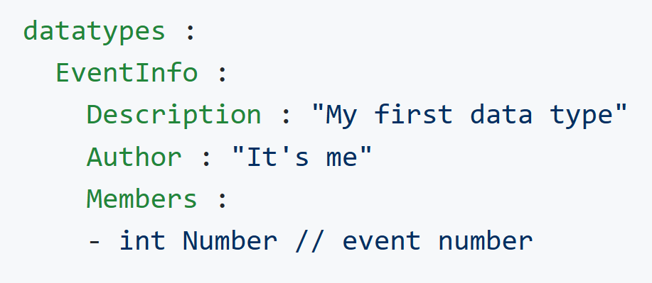
PODIO
https://github.com/AIDASoft/podio
PODIO, or plain-old-data I/O, is a C++ library to support the creation and handling of data models in particle physics. It is based on the idea of employing plain-old-data (POD) data structures wherever possible, while avoiding deep-object hierarchies and virtual inheritance.
Generate C++ classes (and there is python also) from scheme. Supports ROOT I/O
Serialization API
POD – Plain Old Data or passive data structure, represented only as passive collections of field values,
without using object-oriented features

Slide 8
Future
Open to discussion and future changes
Manpower/volunteers needed (initially 2 students where assigned to write the library, but disappeared)
Finish the library
Do benchmarking and validation examples

Slide 9
{x, y, z}
Vector<double> Point_x Vector<double> Point_y
Vector<Point> point.x

