Slide 1



Work Progress
J/ψ mass reconstruction
and channel selection
Xinbai Li, Wangmei Zha
USTC ECCE HF working group
29/6/21

Slide 2
Outline
J/ψ mass reconstruction
Channel selection and luminosity
Resolution with different rapidity or p_{T} cut
180 million events J/ψ peak
J/ψ dynamic distribution from MC data
Plan

Slide 3
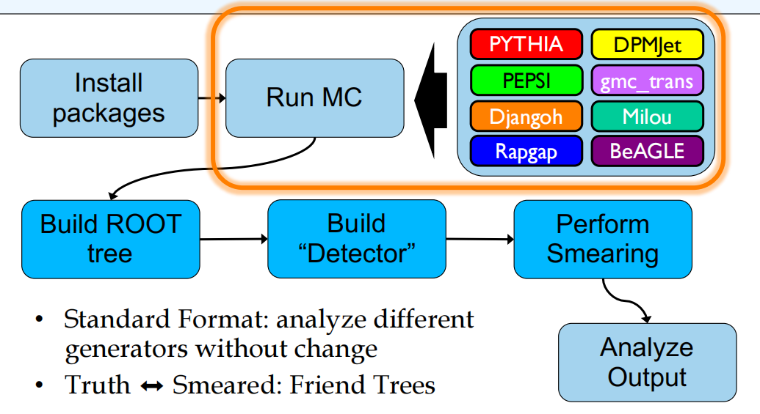
J/ψ mass reconstruction
1

Slide 4
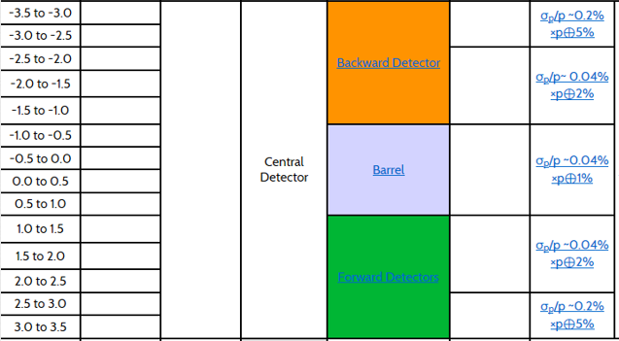
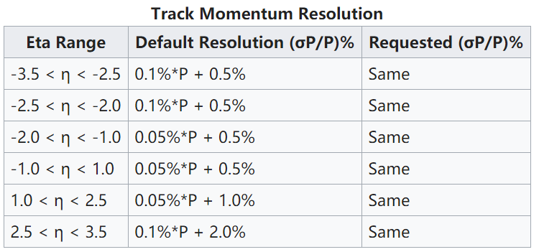
J/ψ mass reconstruction
pythiaeRHIC < input.data.eic > out.txt
input-file is same with the yellow-report AllInclusive Ping (MSEL = 2)
smear detector Matrix1 Matrix2_B1.5T Matrix2_B3T (perfect PID)
reconstruct J/ψ by J/ψ→e⁺ e⁻
Matrix1
Based on the Detector Matrix from June 16
Matrix2
2
Based on the Detector Matrix from November 21 2020

Slide 5
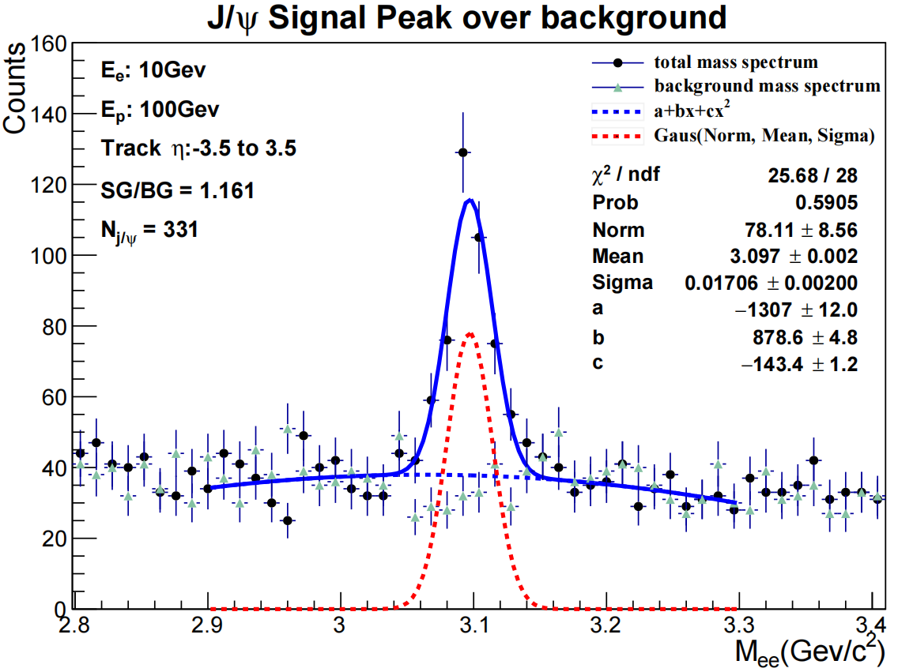

J/ψ mass reconstruction(different detector)
Method: unlike sign - like sign;
Set : no channel selection.
Detector: Matrix1 Luminosity: 4.327e(-7)fb⁻¹
45million events 331 jpsi and 285 backround 3sigma
$$\frac{S}{\sqrt{S+B}}=13.3364$$
3

Slide 6
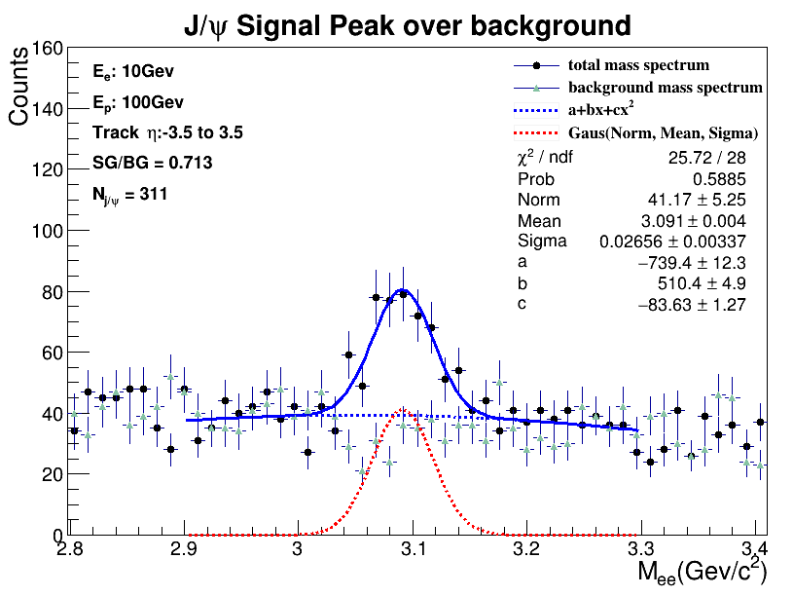

J/ψ mass reconstruction(different detector)
Method: unlike sign - like sign;
Set : no channel selection.
Detector: Matrix2_B1.5T Luminosity: 4.327e(-7)fb⁻¹
45million events 311 jpsi and 436 backround 3sigma
$$\frac{S}{\sqrt{S+B}}=11.3789$$
4

Slide 7
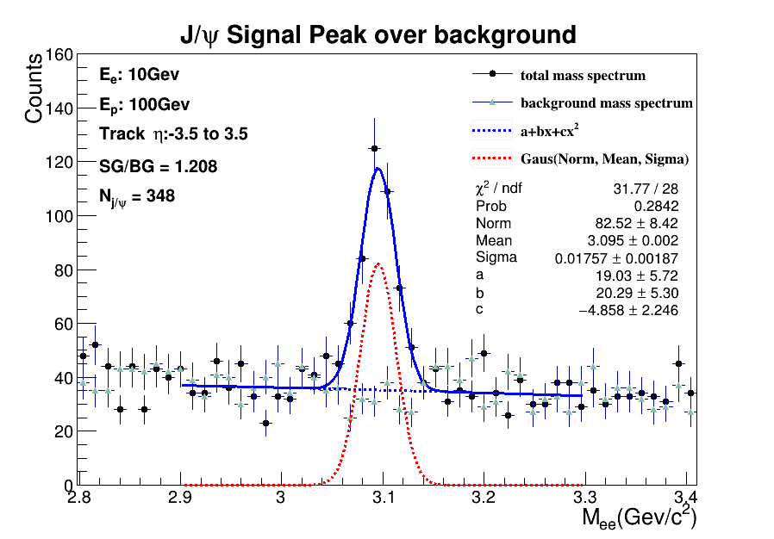

J/ψ mass reconstruction(different detector)
Method: unlike sign - like sign;
Set : no channel selection.
Detector: Matrix2_B3T Luminosity: 4.327e(-7)fb⁻¹
45million events 348 jpsi and 288 backround 3sigma
$$\frac{S}{\sqrt{S+B}}=13.7991$$
5

Slide 8
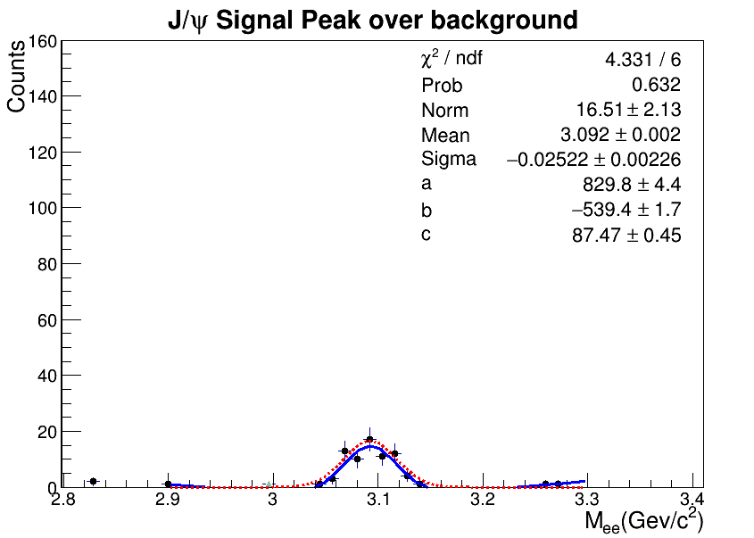
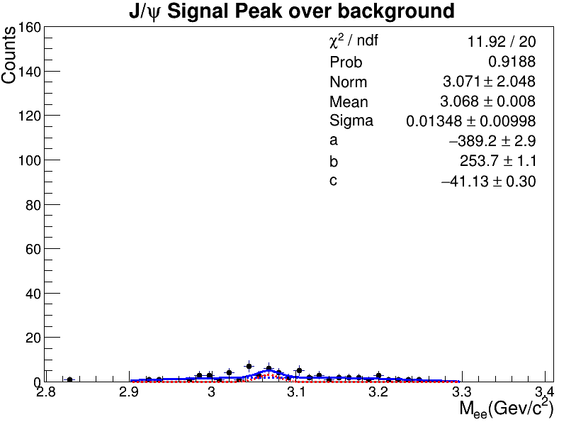
Resolution with ηcut
Detector: Matrix2_B1.5T Luminosity: 4.327e(-7)fb⁻¹
-1<η<1
1<η<3.5
45 million events(Matrix2B1.5T) is not enough for all inclusive simulation, we need larger luminosity(more events).
It’s better to learn signal with channel selection.
6

Slide 9
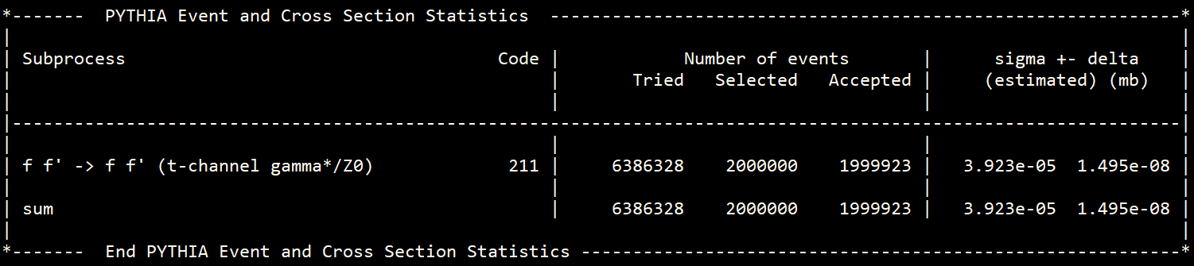

Channel selection and luminosity
If we select such channel in Pythia8, the cross section is small. And large luminosity is easier to achieve.To achieve 10fb⁻¹ luminosity needs about 0.4 billion events.
Same with pythiaeRHIC, if we select two channels as following the cross section is
To achieve 10fb⁻¹ luminosity needs about 8 million events.
7

Slide 10
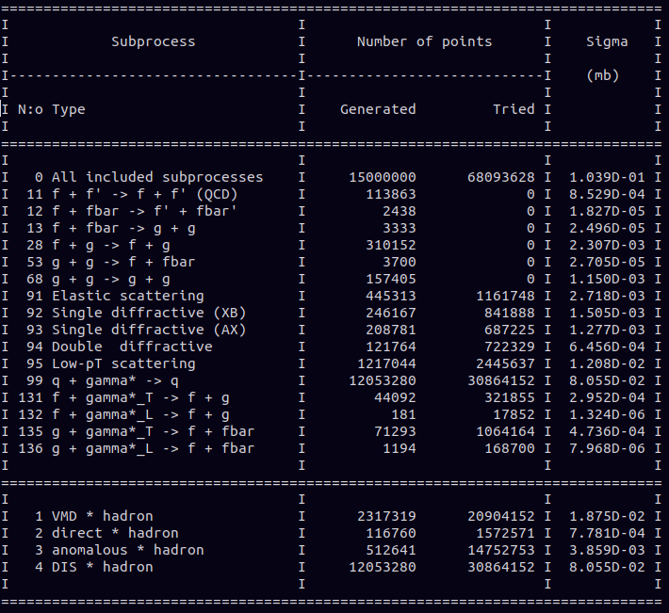
Channel selection and luminosity
all inclusive
to achieve 10fb⁻¹ luminosity needs 10¹⁵ events
8

Slide 11

Channel selection and signal study
0.2million events Matrix1
and Matrix2B1.5T
reaction channel selected
J/ψ decay to e⁺ e⁻ selected
signal study
resolution change with pt, rapidity cut
5million events Matrix2B1.5T
reaction channel selected
9

Slide 12
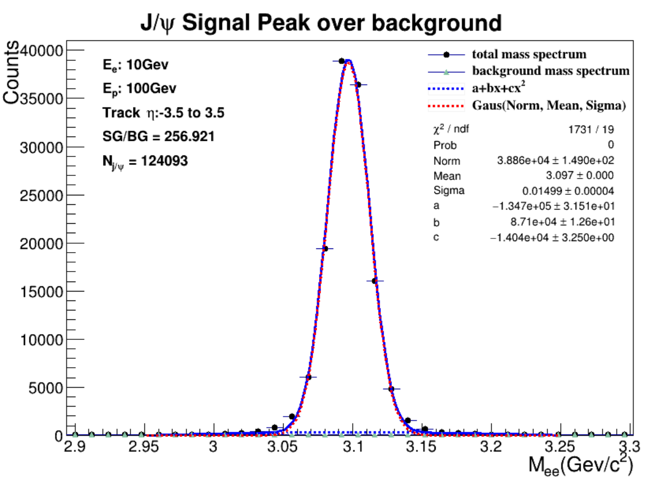
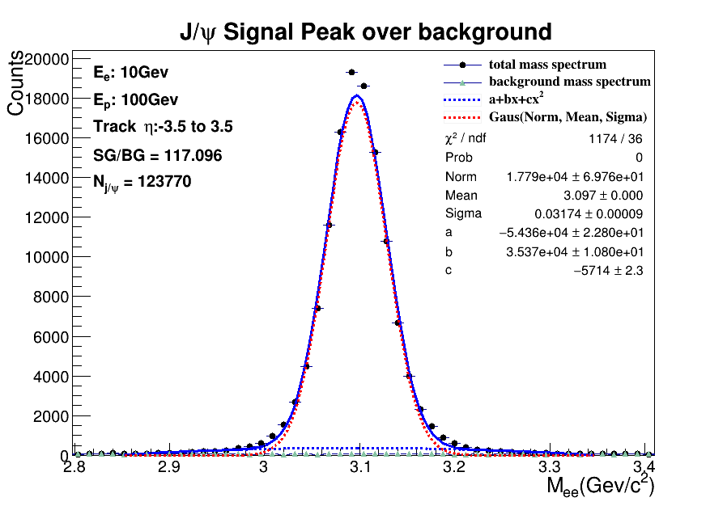
Reaction and decay channel selected, 0.2million events
0.2 million events
reaction and decay channels selection
Luminosity: 0.264 fb⁻¹
Matrix1
Matrix2B1.5T
10

Slide 13
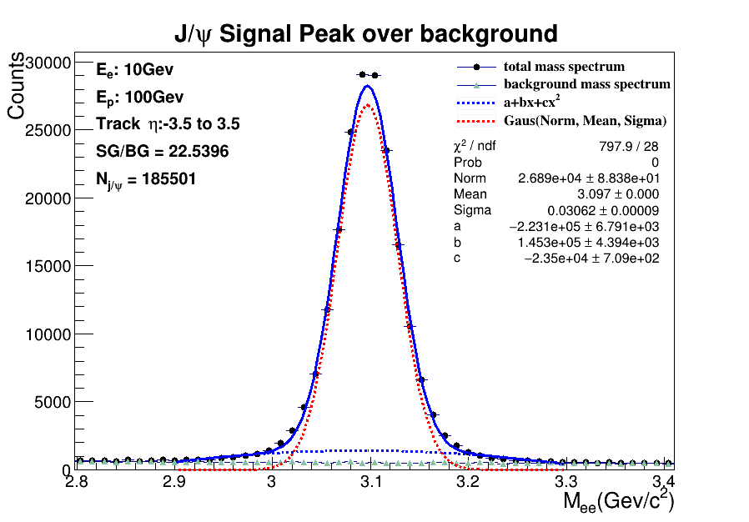
Reaction channel selected, 5million events B=1.5T
5 million events
Matrix2_B1.5T
reaction channels selection
Luminosity: 6.594 fb⁻¹
11

Slide 14
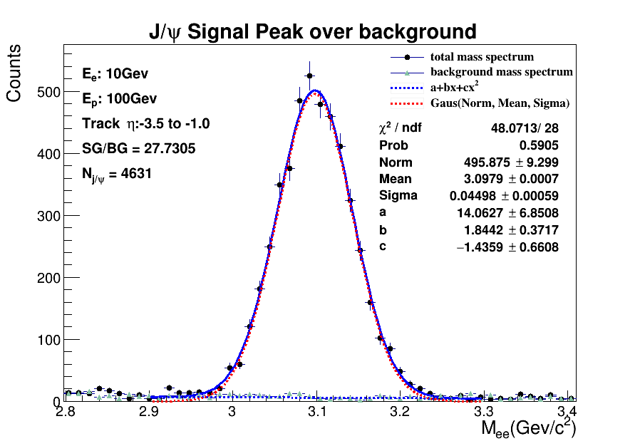
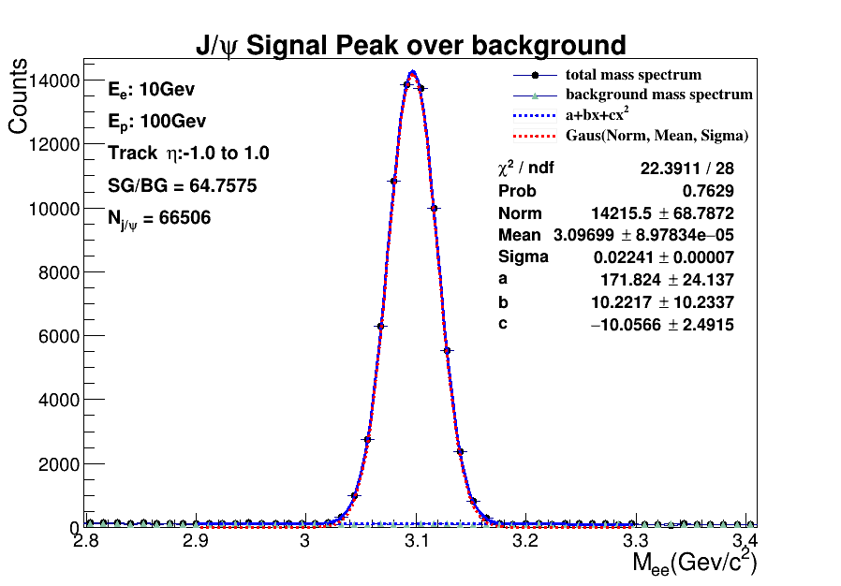
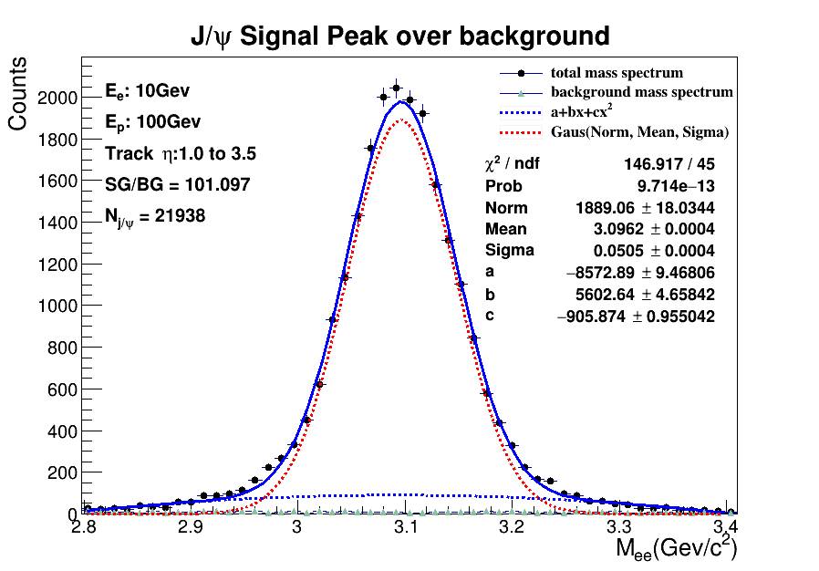
Resolution with trackηcut
5 million events with channel selected
is the best cut of them with the smallest sigma
So if someone simulate not enough J/ψ , maybe he can extend the η cut range like (-1.5, 1.5).
12

Slide 15
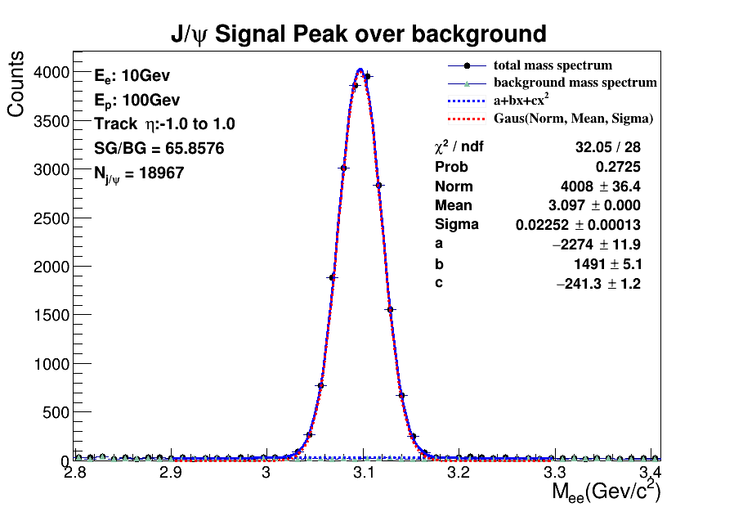
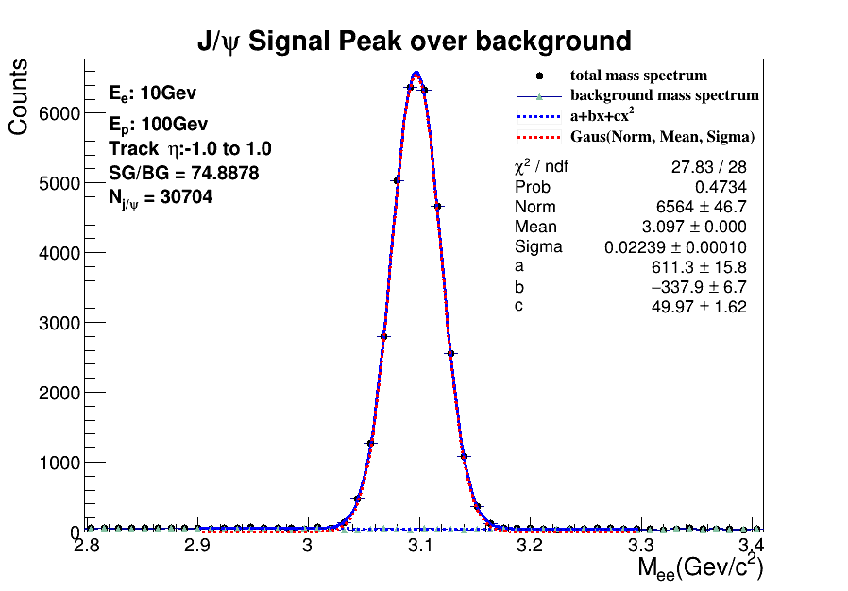
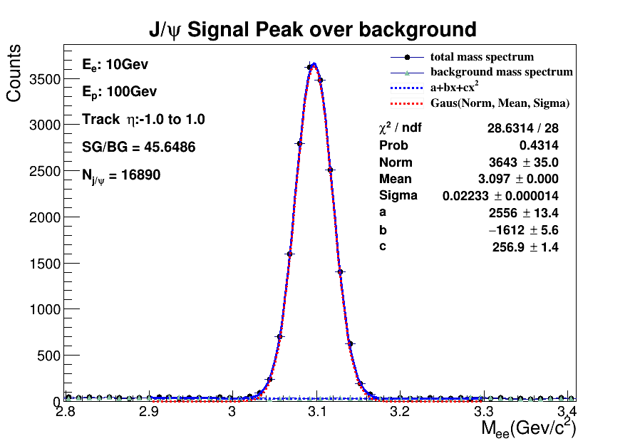
Resolution with pair rapidity cut
rapidity∈(-1,-0.3)
rapidity∈(-0.3,0.3)
rapidity∈(0.3,1)
5 million events with channel selected
Matrix2_B1.5T
, these three rapidity cuts seem so similar. Sigma does not change much for different rapidity intervals of (-1, 1).
13

Slide 16
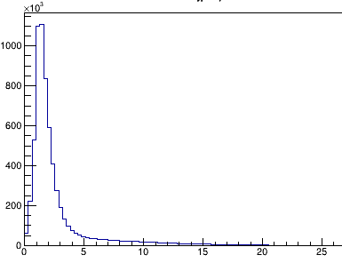
Resolution with pair p_{T} cut
p_{T} cut | [ 0, 1 ] | （ 1, 2 ] | （ 2, 3 ] | （ 3, 5 ] | [ 0, 5 ]
mean | 3.09668 | 3.09691 | 3.09749 | 3.09717 | 3.09701
sigma | 0.02244 | 0.02212 | 0.02239 | 0.02682 | 0.02228
signal | 9880 | 27266 | 10991 | 10846 | 54462
5 million events with channel selected
Matrix2_B1.5T.
Pt of electron pair
cut for both unlike-sign and like-sign
all signal: 185501 ηcut(-1,1):66506
ηcut(-1.5,1.5) p_{T}[0,5]:98260
mean: 3.09677 sigma: 0.02764
14

Slide 17
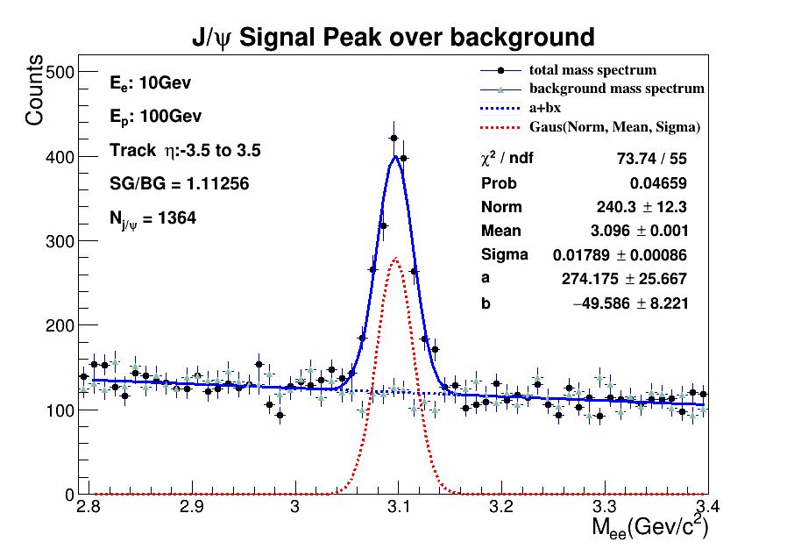
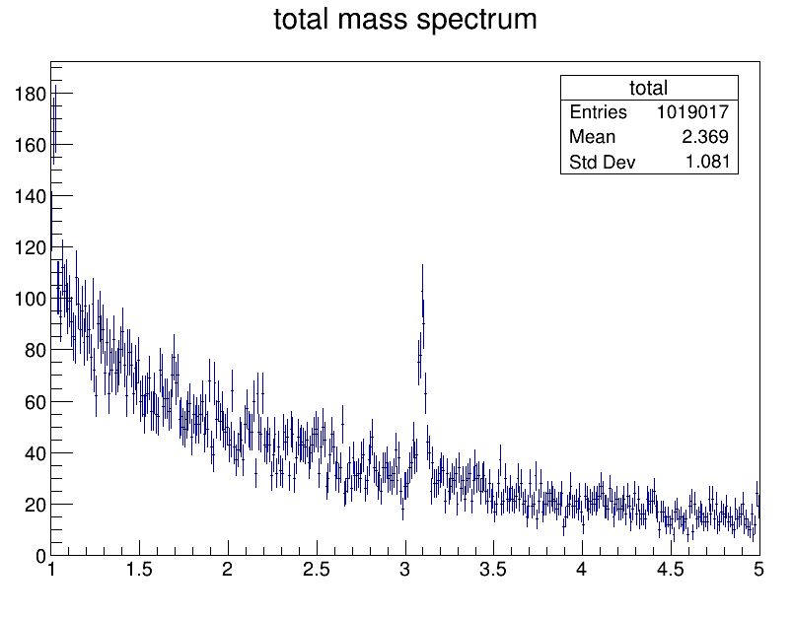

180 million events J/ψ peak
$$\frac{S}{\sqrt{S+B}}=26.8018$$
180 million events all inclusive Matrix2_B3T Luminosity: 1.731e(-6)fb⁻¹
35426 J/ψ produced in process, J/ψ→e⁺ e⁻ branch ratio is about 5.97％
35426× 5.97％ ≈ 2115. 1364 / 2115 ≈ 64.5％ .For we select final state electron and we require both electrons’ momentums are smeared.
15

Slide 18
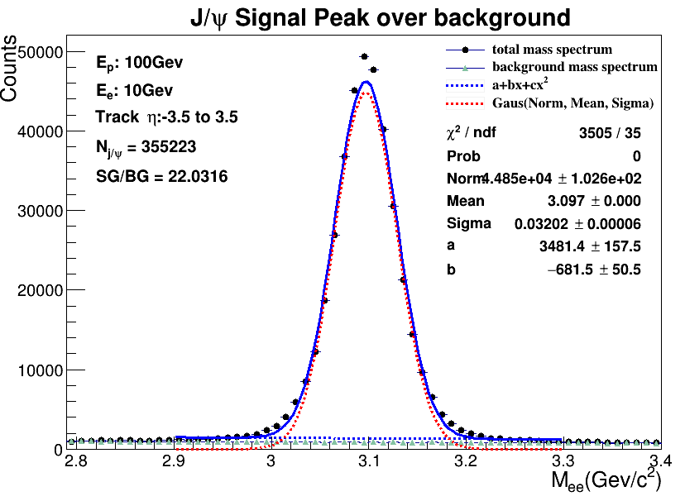
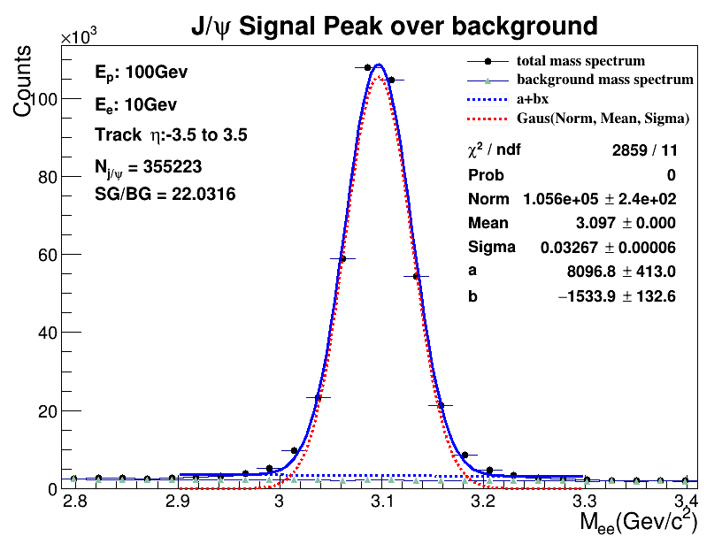
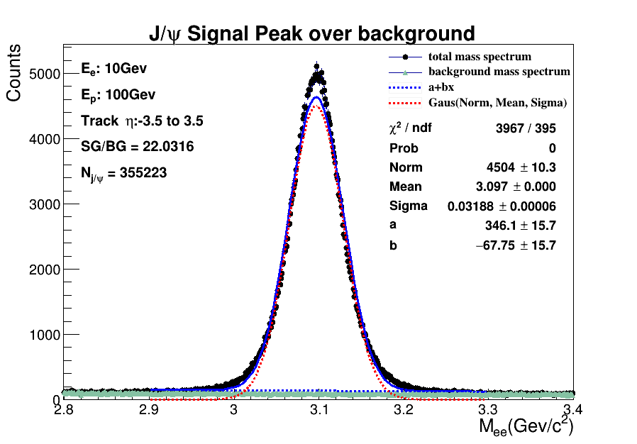

10 million events J/ψ peak(event filter)
372113
372113
$$\frac{S}{\sqrt{S+B}}=596.621$$
$$\frac{S}{\sqrt{S+B}}=596.621$$
bin width 0.01
bin width 0.024
10million events
reaction selection
Matrix2B1.5T
Luminosity: 13.189 fb⁻¹
gaussian function may not fit the data well.
372113
$$\frac{S}{\sqrt{S+B}}=596.621$$
bin width 0.001
16

Slide 19
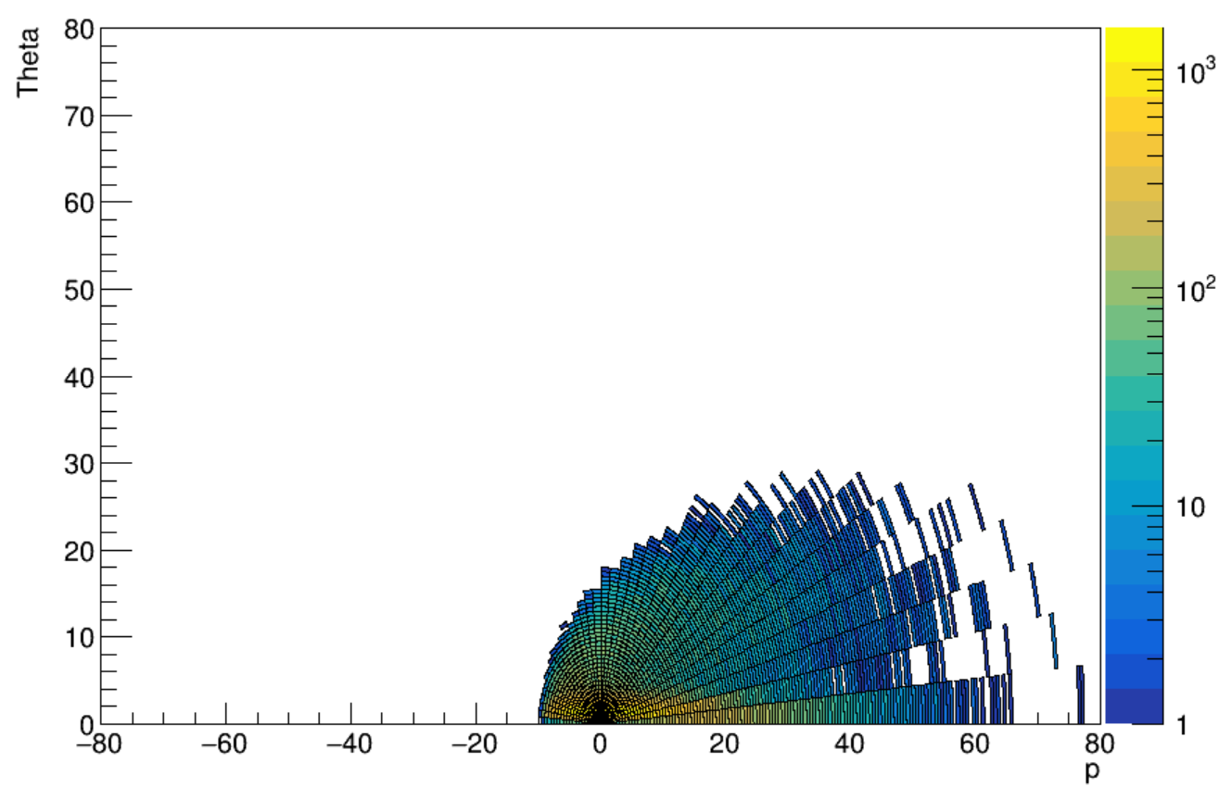
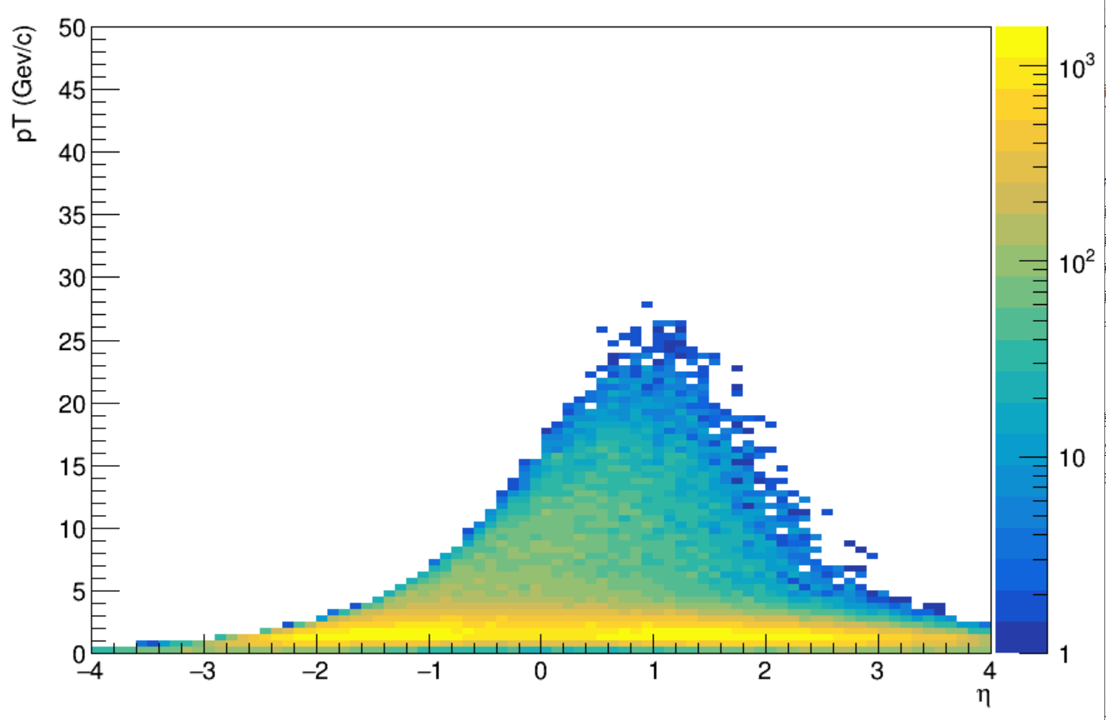
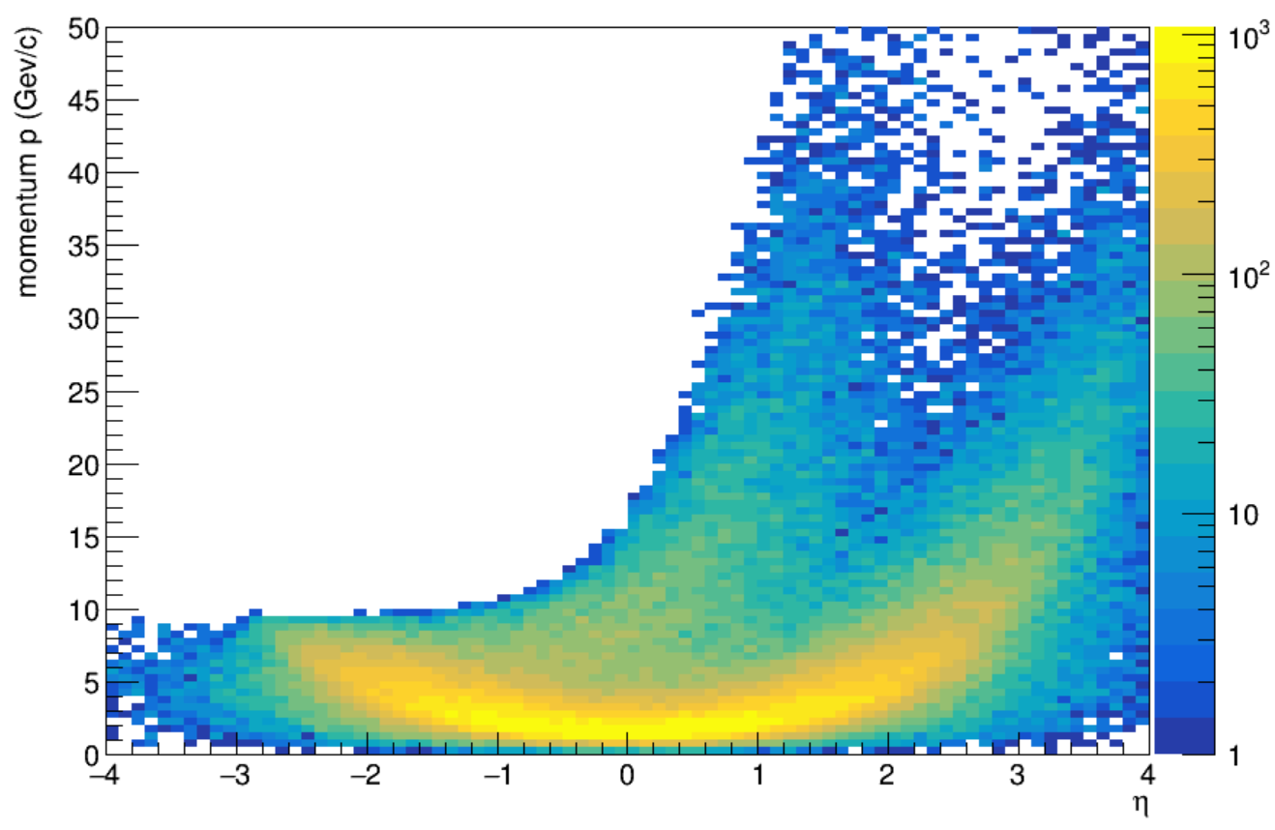
J/ψ dynamic distribution from MC data
0.2million events J/ψ
reaction channel selected
decay channel selected
J/ψ→e⁺ e⁻
Luminosity: 0.264 fb⁻¹
17

Slide 20
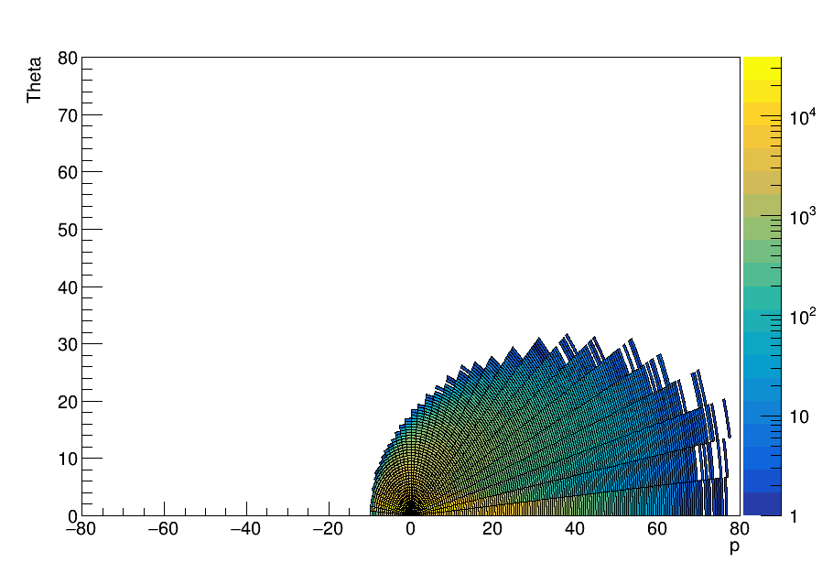
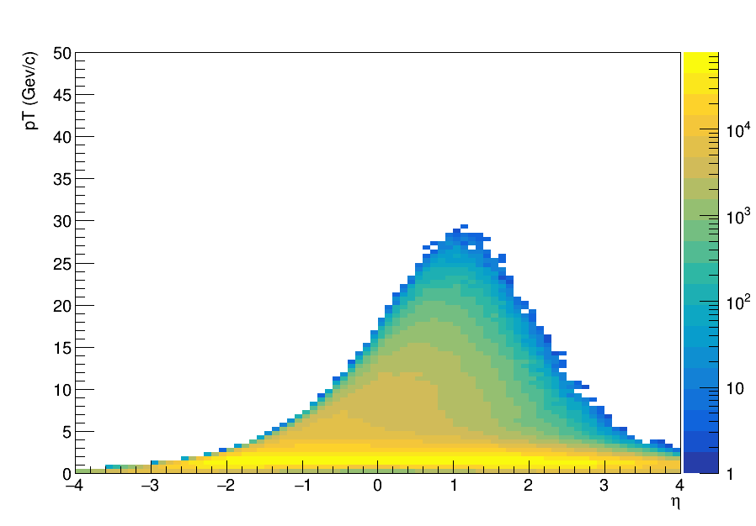
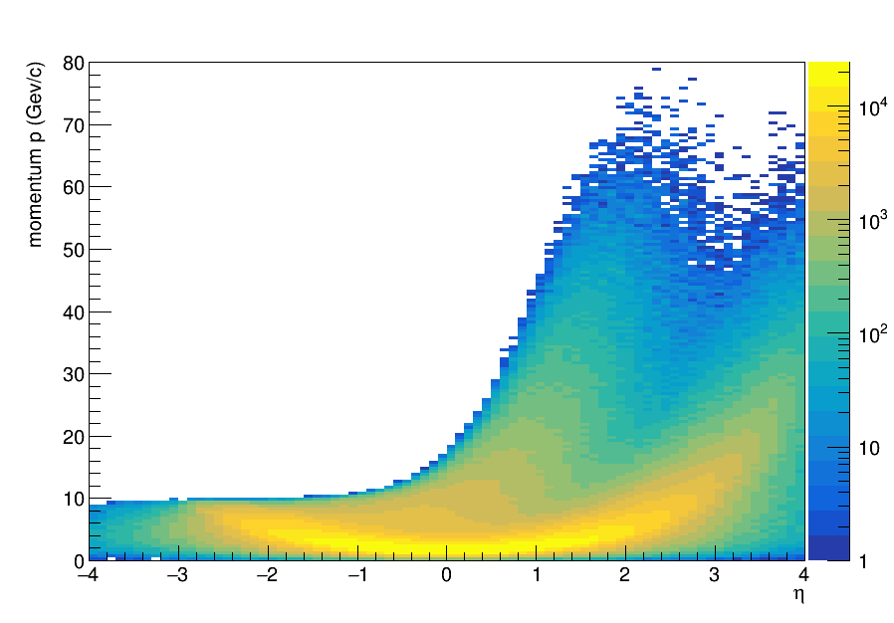
J/ψ dynamic distribution from MC data
5million events J/ψ
reaction channel selected
Luminosity: 6.594 fb⁻¹
18

Slide 21
Summary and Plan
We simulated 180 million all inclusive events and 10 million events with event filter, try different cuts to signal and draw J/ψ dynamic distribution. we also try to smear with different detectors and compare the results.
Using Matrix2B1.5T leads to larger sigma; Under trackηcut from -1 to 1, sigma does not change much with different pair p_{T} intervals and rapidity intervals.
PID for electron in smearing.
Use new detector paraments put in June/21.
BNL account for next simulation work.
Thanks for listening. If you have any ideas or confusion, please contact me by email ustclxb@163.com
19

