Slide 1

Jets in DIS Events with ECCE
John Lajoie
Iowa State University

Slide 2
Jets in DIS Events
This started as an exercise to try to bring myself up to speed with the requirements for jet finding in DIS events.
My starting goal was to think about how we might calibrate the HCALs in the central barrel.
In HI we used gamma + jet events, less clear to me what the standard should be at the EIC…
Jets are also highly prized at the EIC for TMD studies
Access to TMD quantities w/o fragmentation
As it turns out, there are a lot of details that make this substantially more complicated that I anticipated…

Slide 3
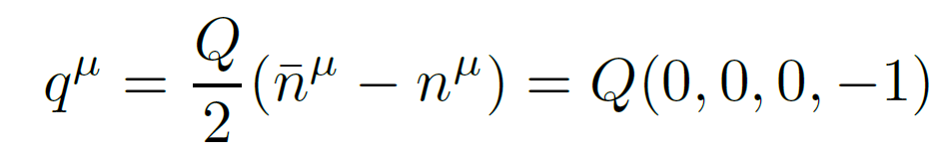
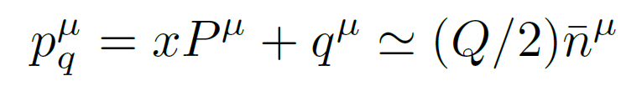
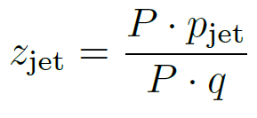
Breit Frame
z-axis
The Breit frame is the frame in which the (spacelike) virtual photon carries only momentum (E=0) along the –z axis.
We can always define this frame in terms of a boost and a rotation based on knowledge of the incoming beam and the scattered electron.
In the Breit frame, the jet associated with the struck quark is at negative rapidity, while jets associated with the target proton are at positive rapidity.
The quantity z_{jet} is the fraction of the scattered quark momentum carried by the jet (good to LL level).
Fraction of scattered quark momentum carried by jet.
arXiv:2006.10751v2

Slide 4
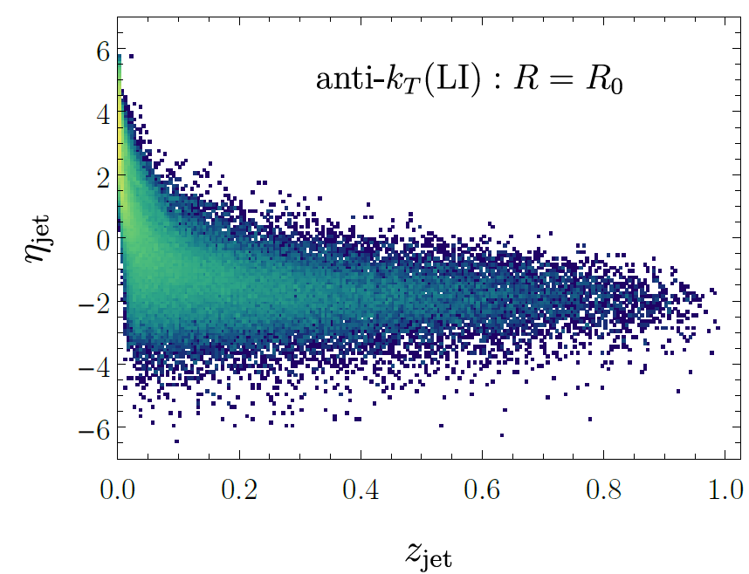
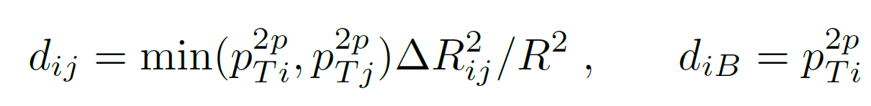
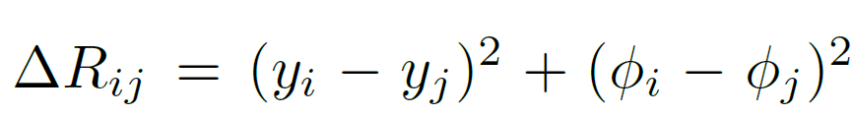
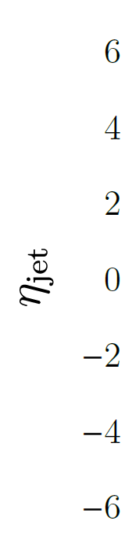
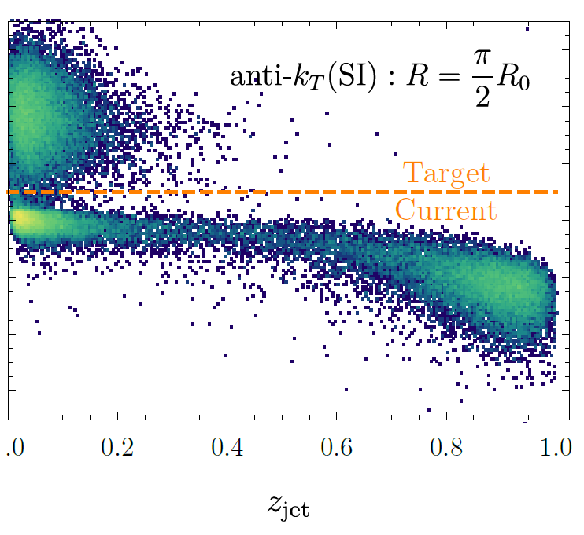
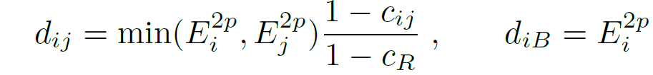

Jet Algorithms
Pythia8, 10x100, Q>10, R=0.8
Longitudinally Invariant anti-k_{T}:
Cannot properly capture jets enclosing the y=infinity axis.
Spherically Invariant anti-k_{T}
Developed for e⁺e⁻; not longitudinally invariant, does not fully separate beam remnant and current jets.
arXiv:2006.10751v2

Slide 5
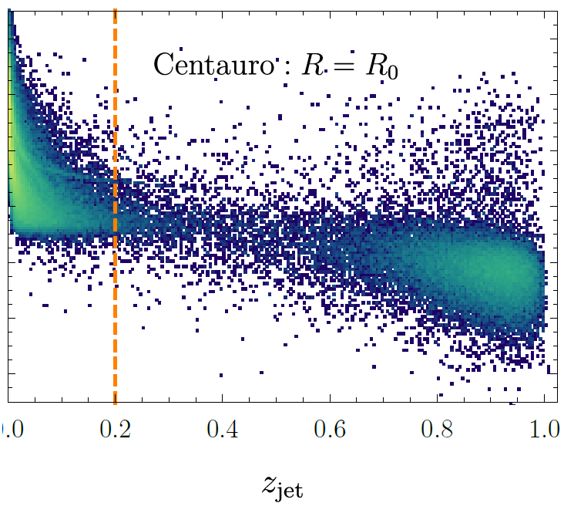
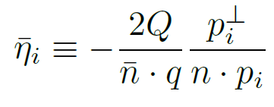
Centauro Algorithm
Pythia8, 10x100, Q>10, R-0.8
A compromise – Longitudinally invariant, but matches the spherical algorithms behavior in the backward hemisphere (negative rapidity). This allows it to properly capture the current jet and separate it from the beam remnant jets.
arXiv:2006.10751v2

Slide 6
Jet Constituents and Tranformations
Working in the Breit frame requires a number of transformations:
For calorimeter cluster/tower jets:
Reconstruct x,Q² from the scattered electron in the lab frame
Get truth electron from event generator by matching Q², then look in SvtxTrack for its measured partner (by truth_track_id())
Verify electron by |(E/p) – 1.0| < 0.2 with matched cluster in CEMC or EEMC
Boost to make the virtual photon E=0:
Rotate so the virtual photon momentum is along the –z axis
Exclude cluster/towers associated with scattered electron
For truth particles:
Transform from the event generator frame to the lab frame
Use transform stored with the data: PHHepMCGenEvent->get_LorentzRotation_EvtGen2Lab()
Exclude particles |η|>4.0, p_{T}<200MeV in the lab frame
Exclude muons, neutrinos, scattered electron
Transform to the Breit frame using “measured” transform

Slide 7
Events
Using high-Q² Pythia6 events from SIDIS WG, 10x100:
/gpfs/mnt/gpfs02/eic/DATA/YR_SIDIS/ep_10x100/ep_noradcor.10x100highq_run001.root
Using the ECCE-EIC/macros current as of 8/18/2021 (~July concept)
Centauro algorithm from fastjet-contrib:
http://fastjet.hepforge.org/contrib
Running Fastjet 3.4.0
Look for scattered electron in EEMC and CEMC
Jets constructed from:
CEMC, HCALIN, HCALOUT, FEMC, FHCAL clusters
SvtxTrack tracks (full coverage)
NOTE: all four-vectors transformed as massless particles at present!
Primary Jets uses full particle id
Jet finding done with R=0.8
Might be a bit large, but done to match Centauro paper
NOTE: calo jet coverage does not include EEMC, EHCAL

Slide 8
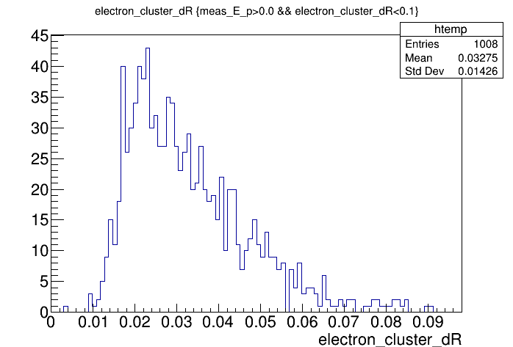
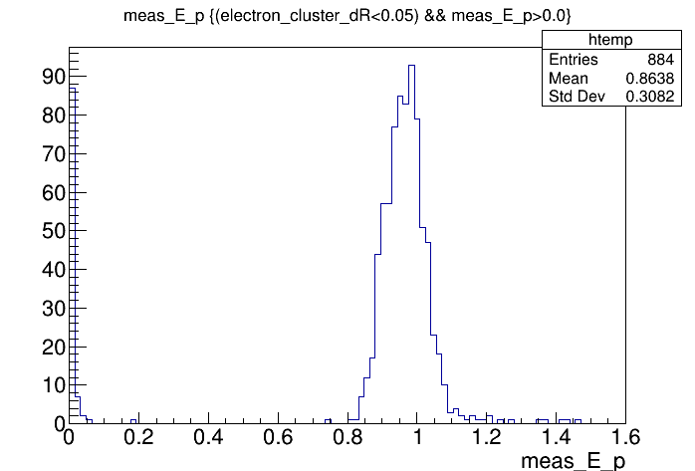
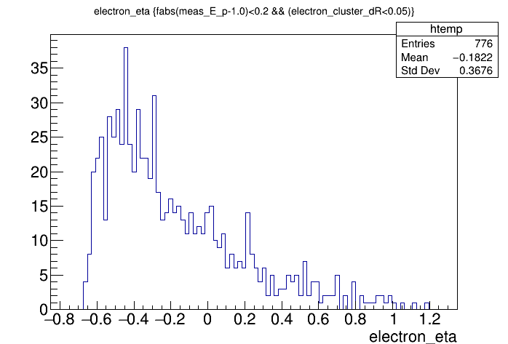
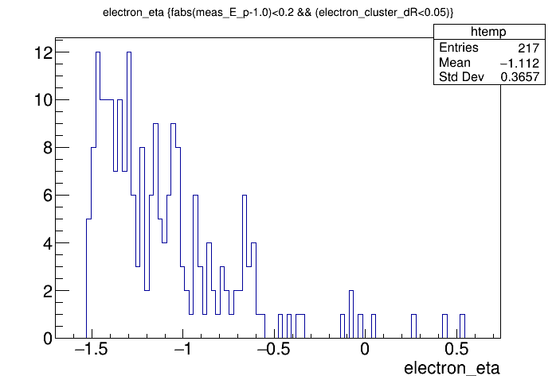
Scattered Electron ID/Kinematics
High-q events (Q²>100):
Offset in matching to electron cluster?
Low-q² check – electron acceptance makes sense.

Slide 9
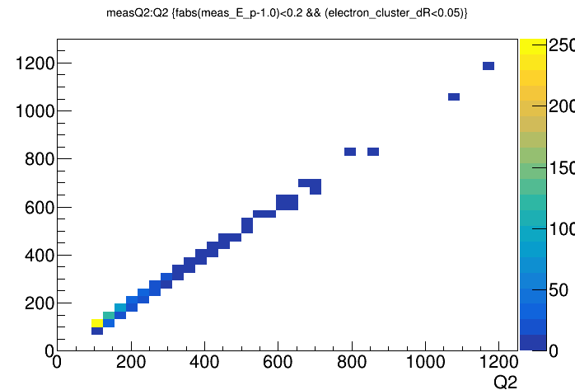
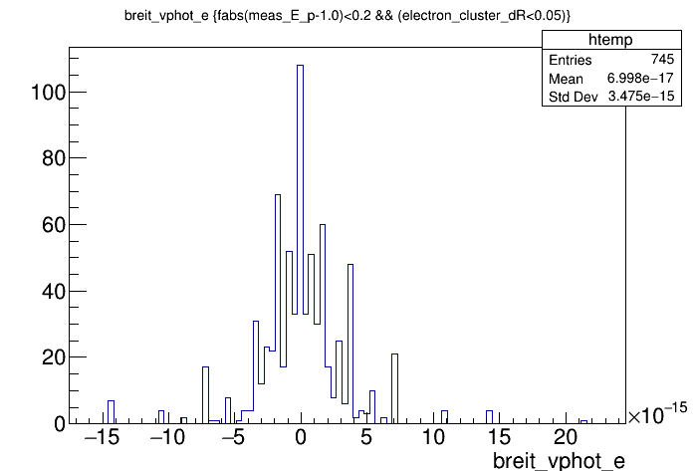
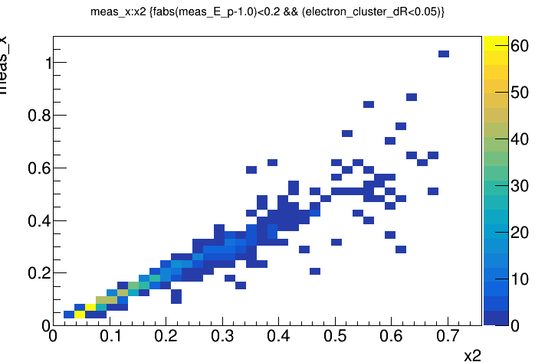
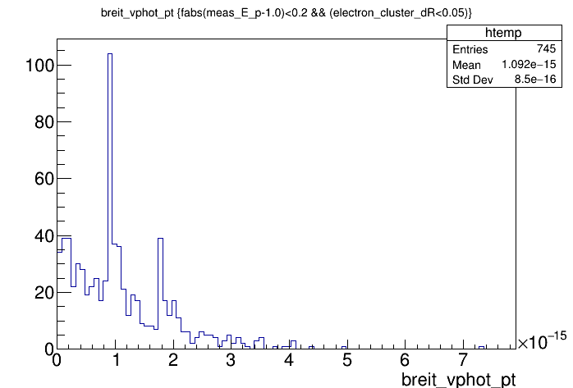
Sanity Checks
Measured Q2
Kinematics of the virtual photon after transformation to Breit frame – the energy and p_{T} are zero within round-off error.
HepMC Q2
Measured x2
HepMC x2

Slide 10
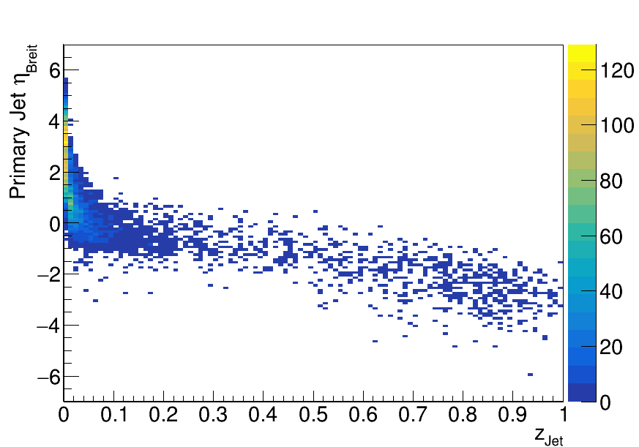
Centauro Jets Comparison
Pythia6, 10x100, Q>10, R=0.8 (2k events)
Pythia8, 10x100, Q>10, R-0.8
Looks good – same features as in Centauro paper.
NB: No p_{T} cuts!

Slide 11
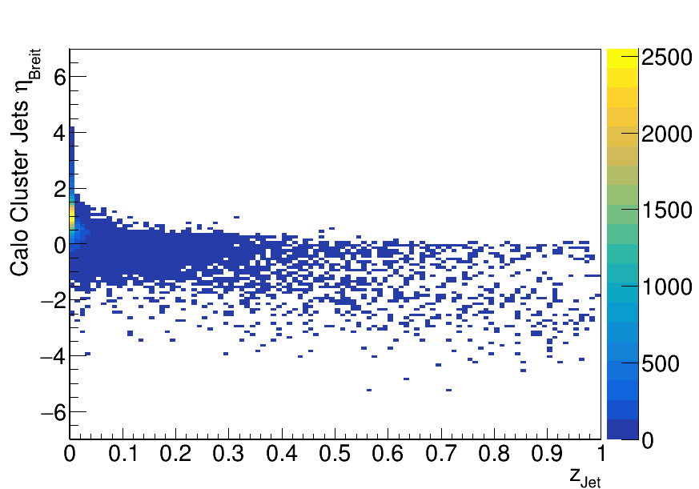
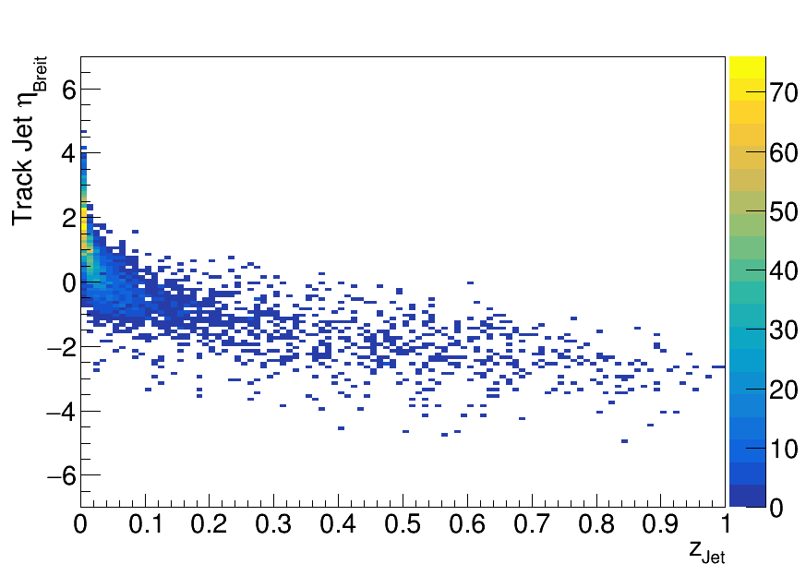
Centauro Jets
Pythia6, 10x100, Q>10, R=0.8 (2k events)
Track jets seem much better defined compared to calorimeter cluster jets.
Presence of noise clusters?
Track jets seem to be missing energy (low z_{Jet}) – missing neutral fraction?

Slide 12
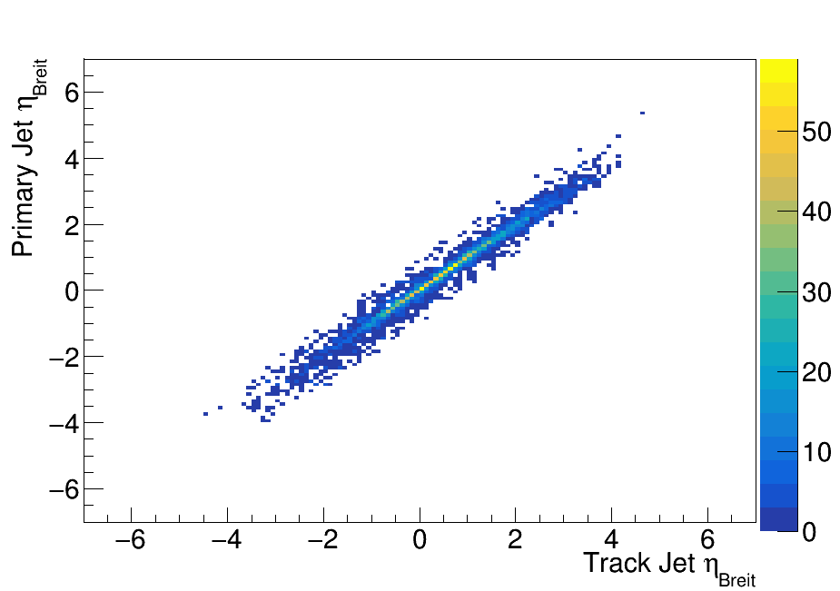
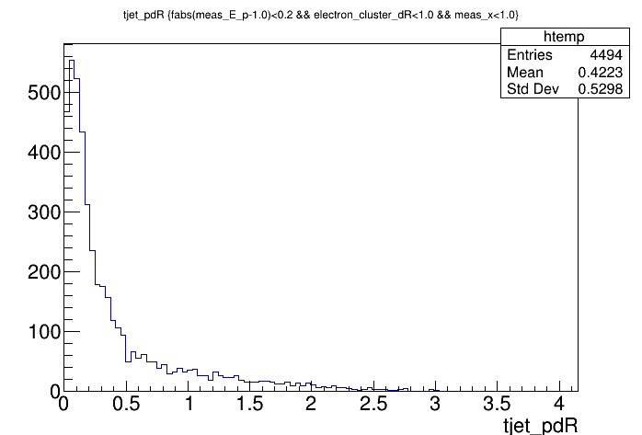
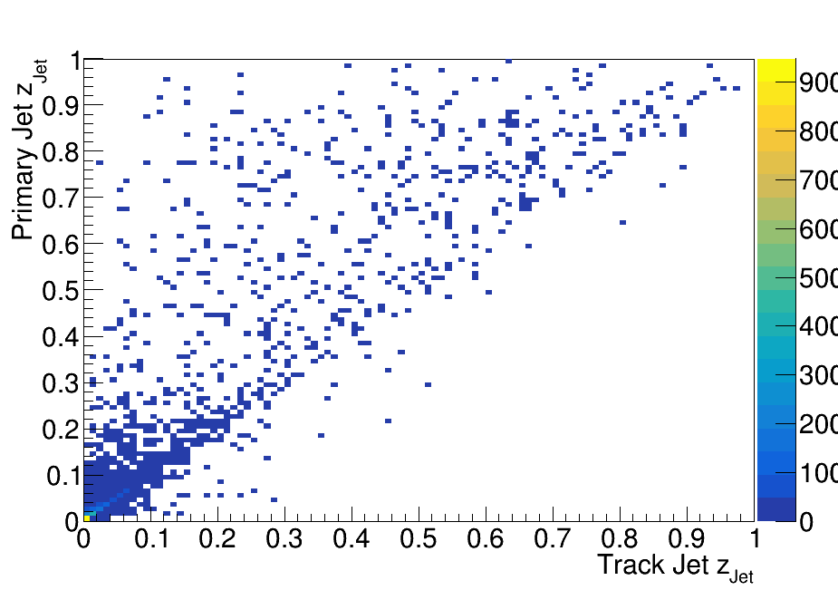
Track Jets Compared
Reasonable matching between track and primary jets.
Correlation seen between jet eta, z in Breit frame – although z_{Jet} does show missing energy.

Slide 13
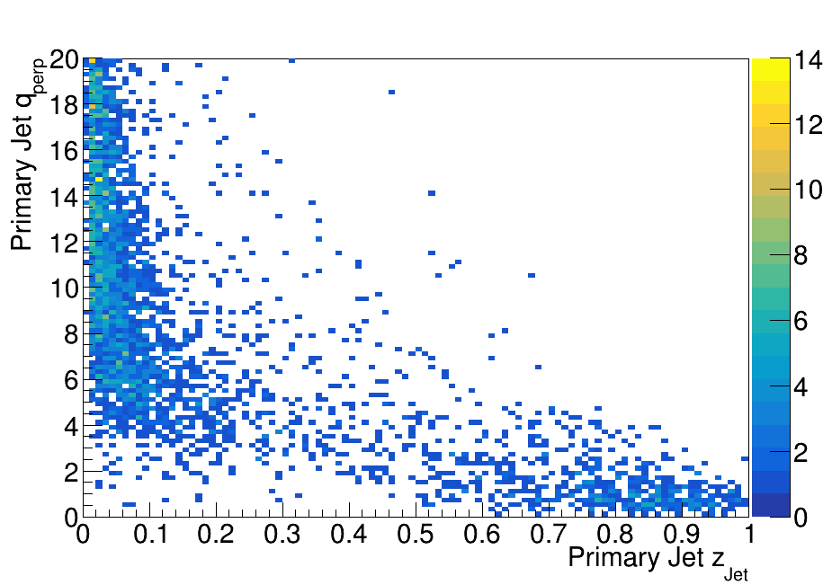
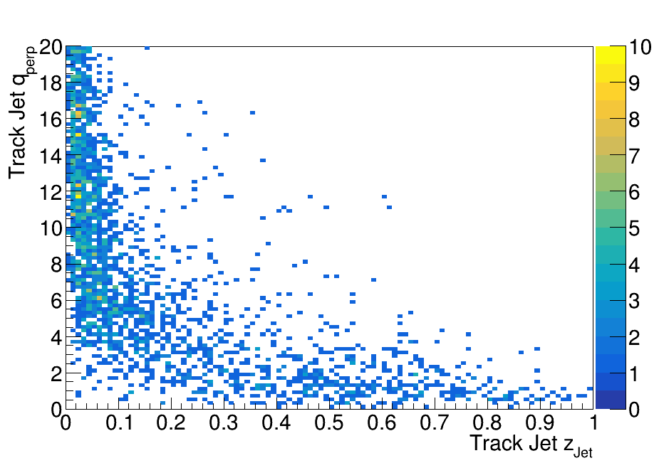

Centauro Jets for TMD’s
Pythia6, 10x100, Q>10, R=0.8 (2k events)
arXiv:2006.10751v2
$$q_{T}=p_{Jet}^{⊥}/z_{jet}$$
This is the transverse momentum of the jet with respect to the scattered quark direction.

Slide 14
(Intermediate) Conclusions
I’ve got the transformations correct and can move between the lab, head-on and Breit frames.
Centauro algorithm up and running:
Separate evaluator to run jet finding
Non-trivial to integrate into fun4all jets framework as it requires and event-dependent transformation
Results for Pythia6 in ECCE simulations agree well with Centauro paper
Very good correlation between the jets found with tracks and the jets found with primary particles

Slide 15
To Do:
To Do:
Add clusters to track jets to improve measure of z_{Jet}
Add clusters not associated with tracks
Need to check “noise” clusters (energy cut?)
Maybe expand to a pseudo particle flow approach
Combine tracks and associated clusters
Performance plots for TMD’s w/Jets
Showcase ECCE performance
Still don’t have a clear idea of how to calibrate the calorimeter jet response

Slide 16
BACKUP

Slide 17
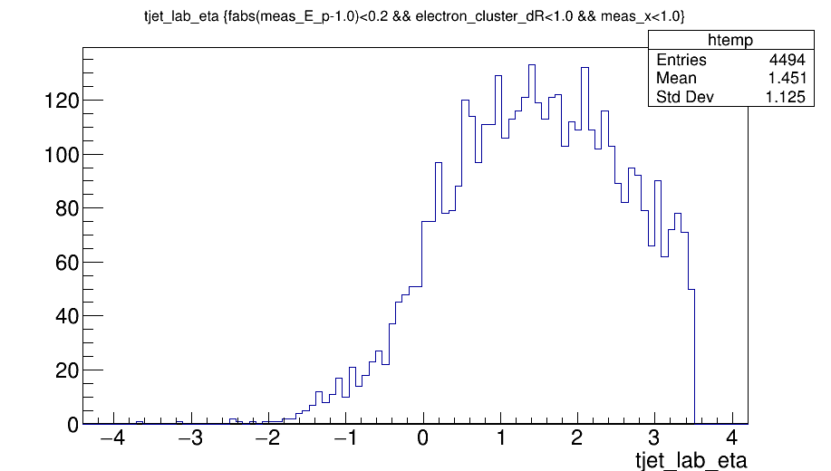
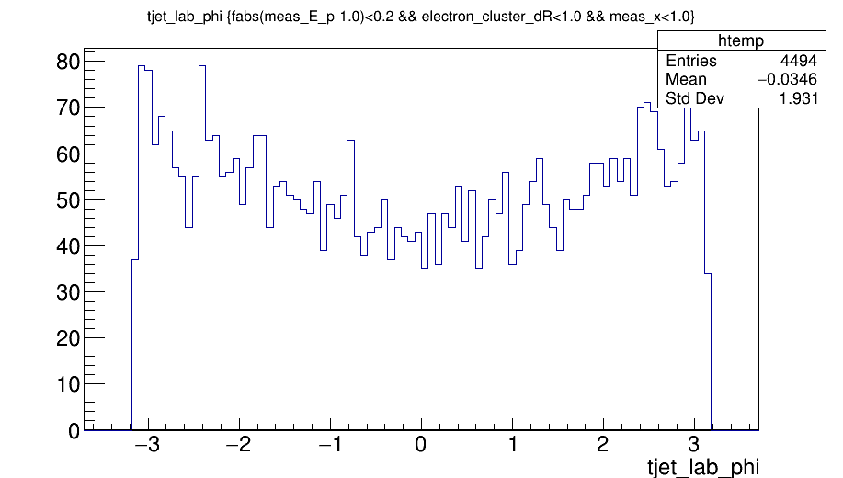
Track Jet Distributions in Lab Frame

