Slide 1



Work Progress
J/ψ mass reconstruction
and eID(EOP)
Xinbai Li, Wangmei Zha
USTC ECCE HF working group
31/8/21

Slide 2
Outline
Update the mass spectrum plots
eID(EOP)
TOF(fast simulation)
Gap between unlikesign and likesign
Cut to improve J/ψ significance
Summary and Plan

Slide 3
Update some plots
Files:
fast simulation: similar input comfiguration files with /gpfs02/eic/DATA/YR_SIDIS/ep_18×275/inputcards/, only change the ep energy
smear: Add tof in Matrix02_B1_5T, set the paraments as:
full simulation:
/gpfs02/eic/DATA/ECCE_Productions/MC/prop.2/c131177/SIDIS/pythia6/ep-10x100/eval_00000/*.g4tracking_eval.root
and /gpfs02/eic/DATA/ECCE_Productions/MC/prop.2/c131177/SIDIS/pythia6/ep-10x100/eval_00001/*.g4event_eval.root
 | η range | path length | time resolution
forward | -1.5>η>-3.5 | |250(cm) / cos(Θ)| | 20 (ps)
barrel | 1.5>η>-1.5 | 50 / sin(Θ) | 20
end | 3.5>η>1.5 | |150 / cos(Θ)| | 20
1

Slide 4
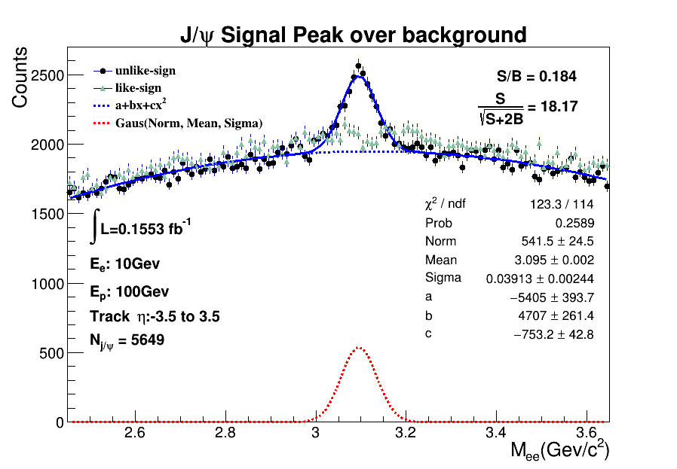
Update some plots
0.124
fast-simulation
matrix2-B1_5T
2

Slide 5
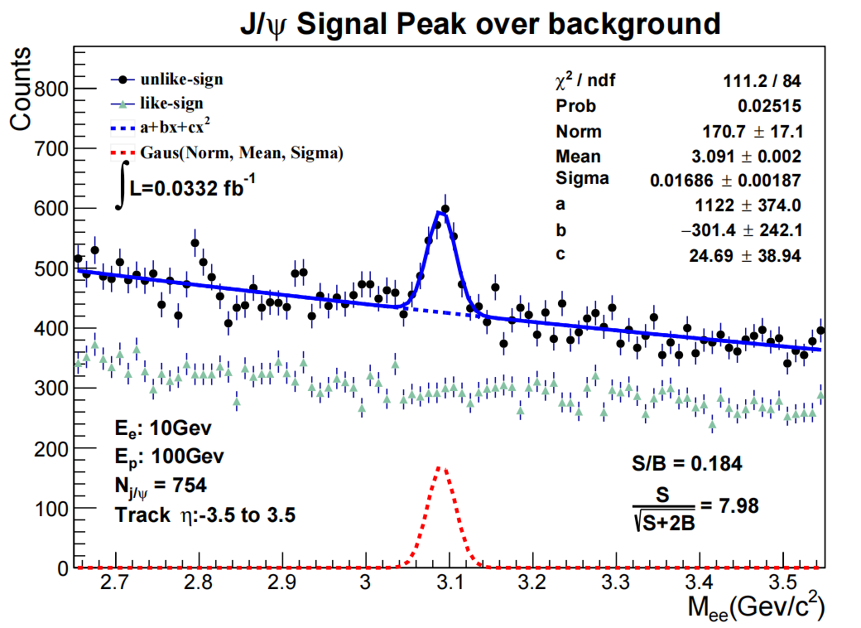
Update some plots
1. full-simulation
2. perfect eID
3. using track evaluator files
4. not good S/B
problem:
gap between unlike-sign and like-sign
3

Slide 6
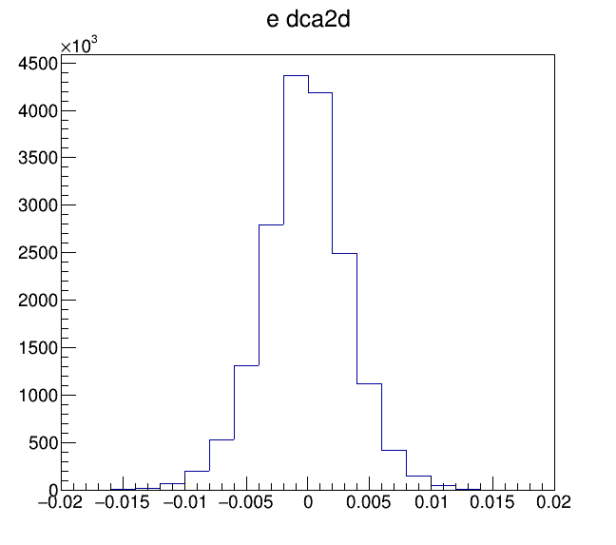
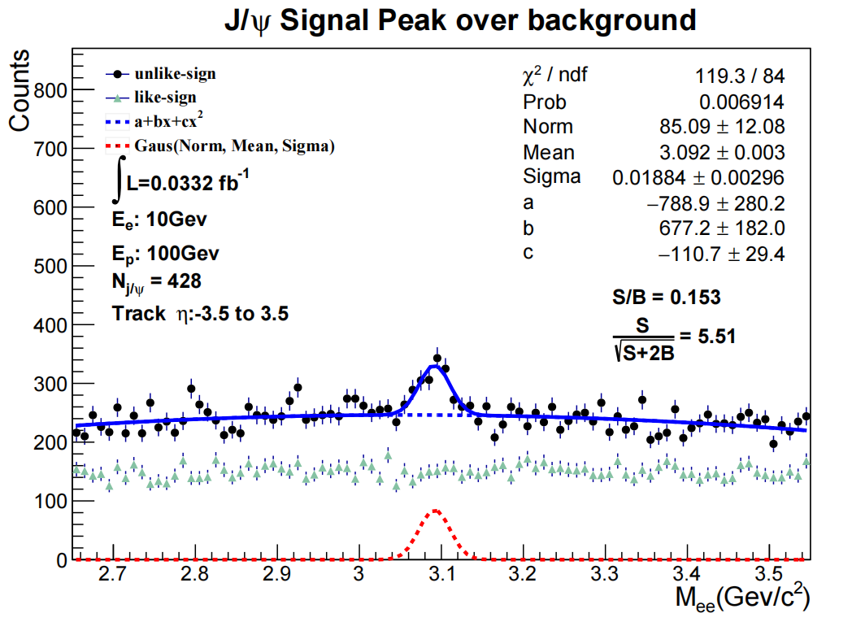
Update some plots
with dca2d cut |dca2d|<0.005
4

Slide 7
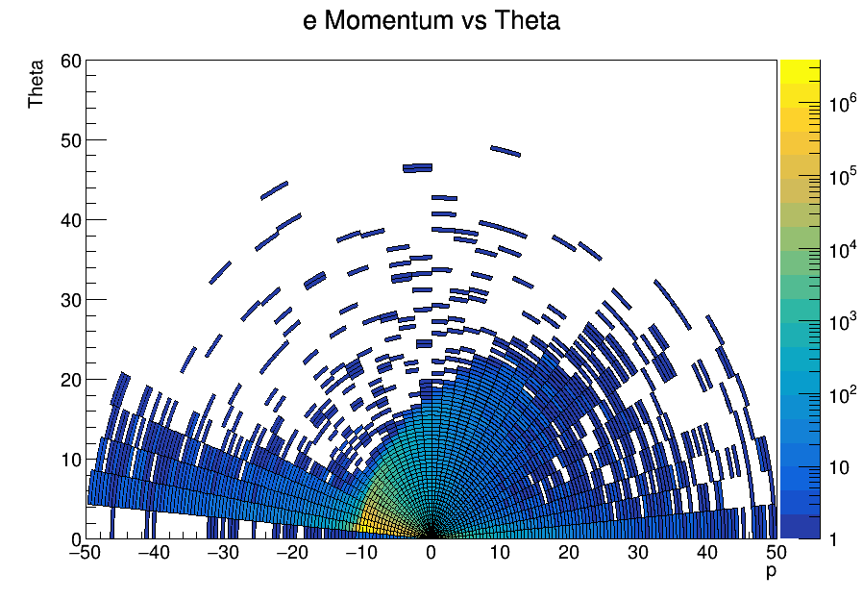
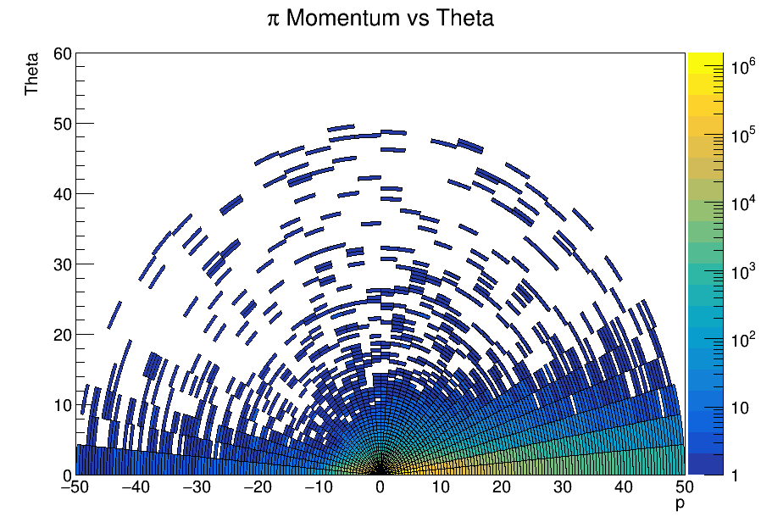
eID(EOP)
electron and pion dynamic distribution
momentum vs theta (polar plots)
5

Slide 8
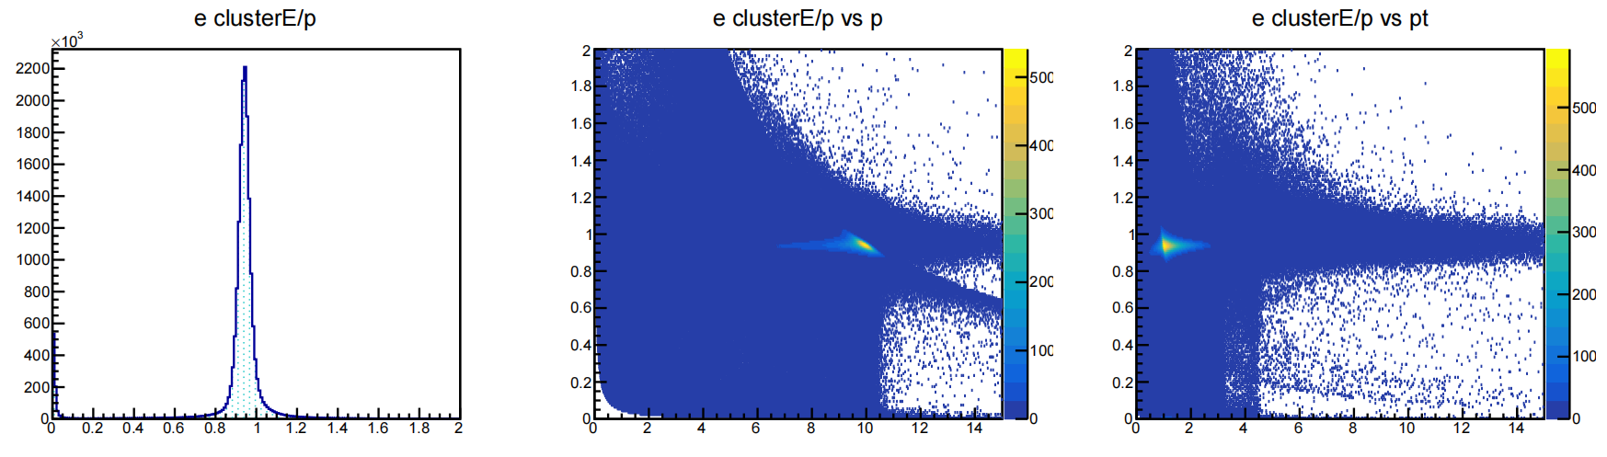
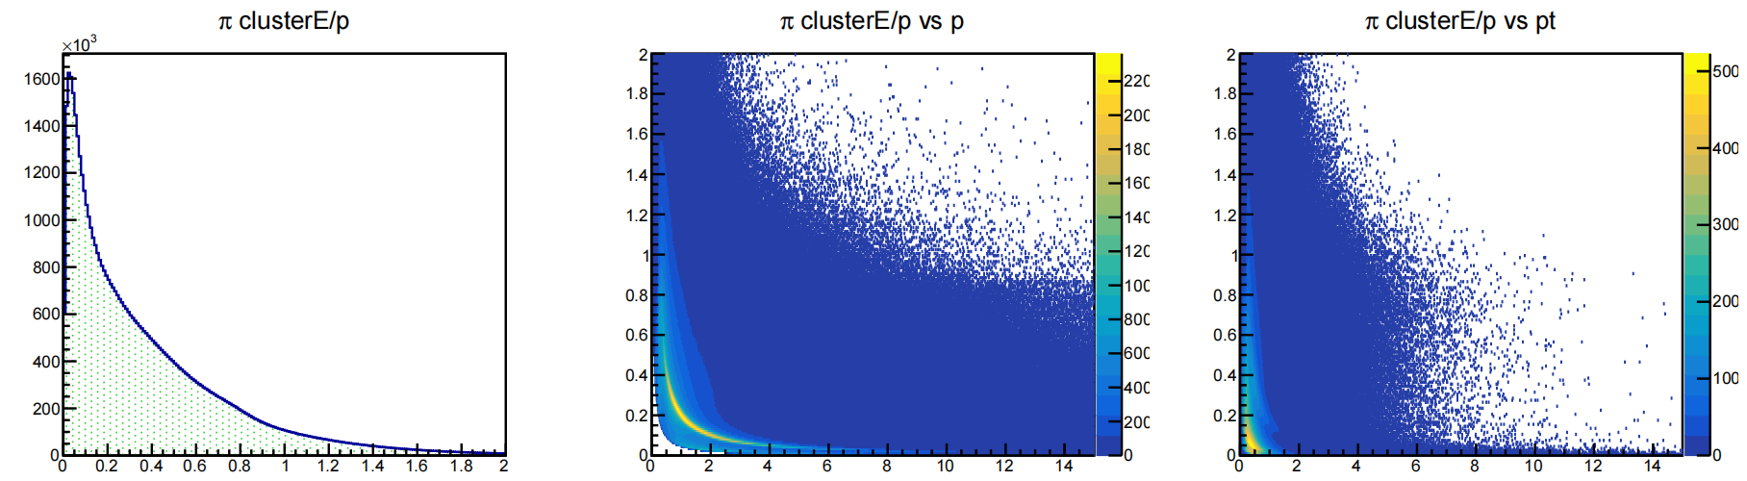
eID(EOP)
6

Slide 9
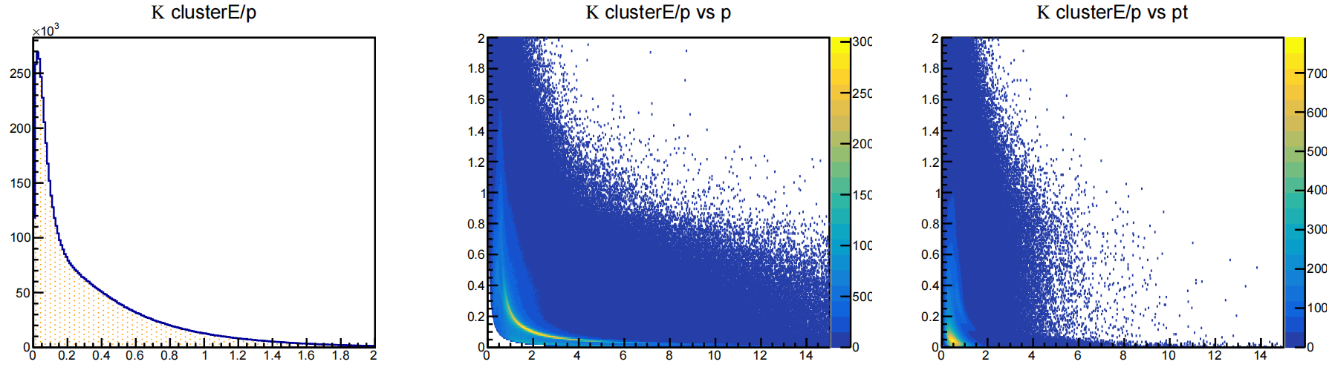
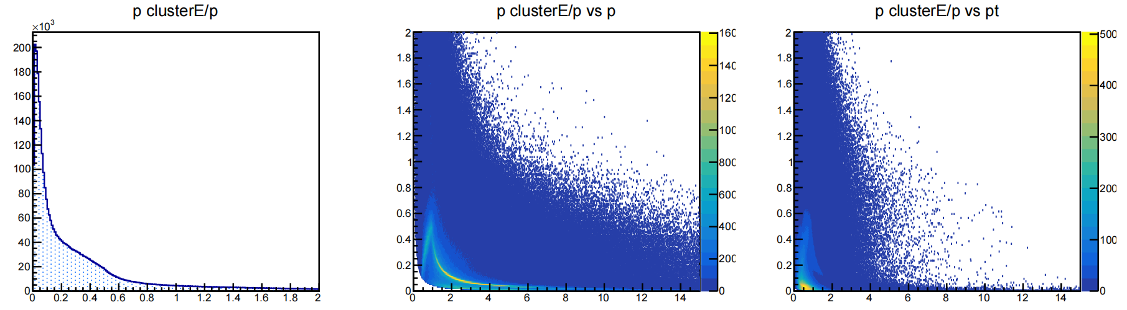
eID(EOP)
7

Slide 10
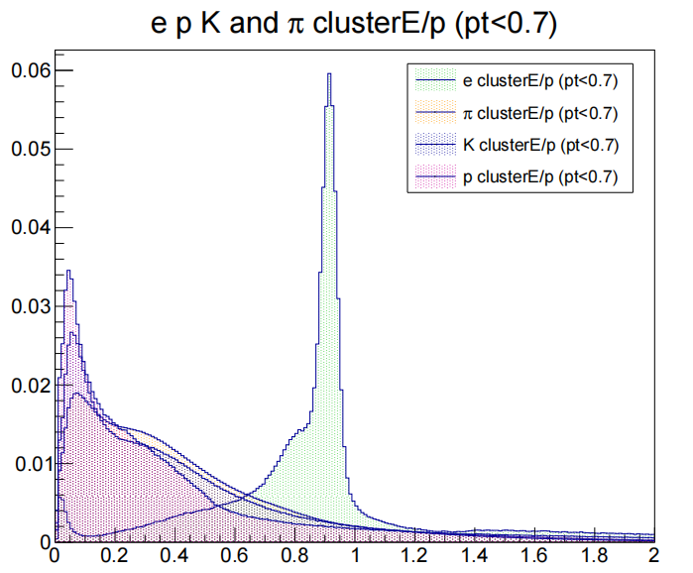
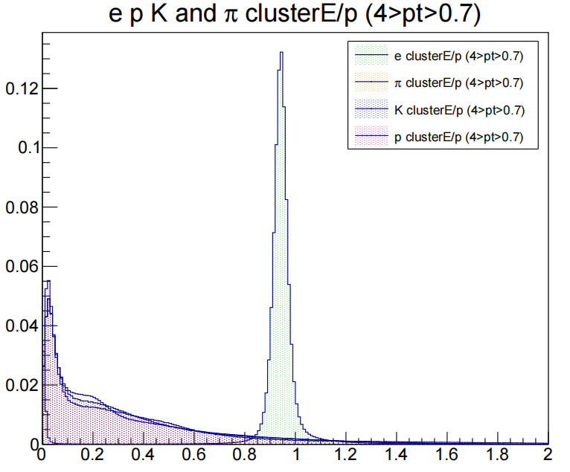
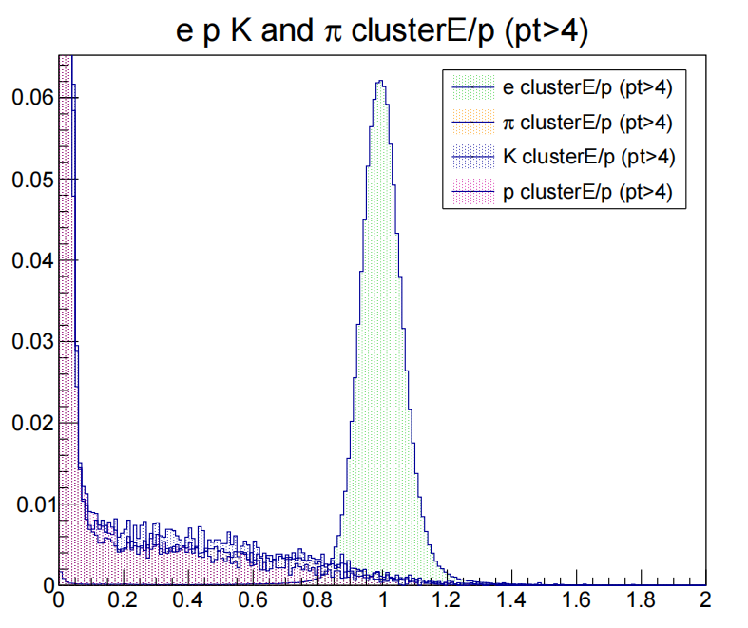
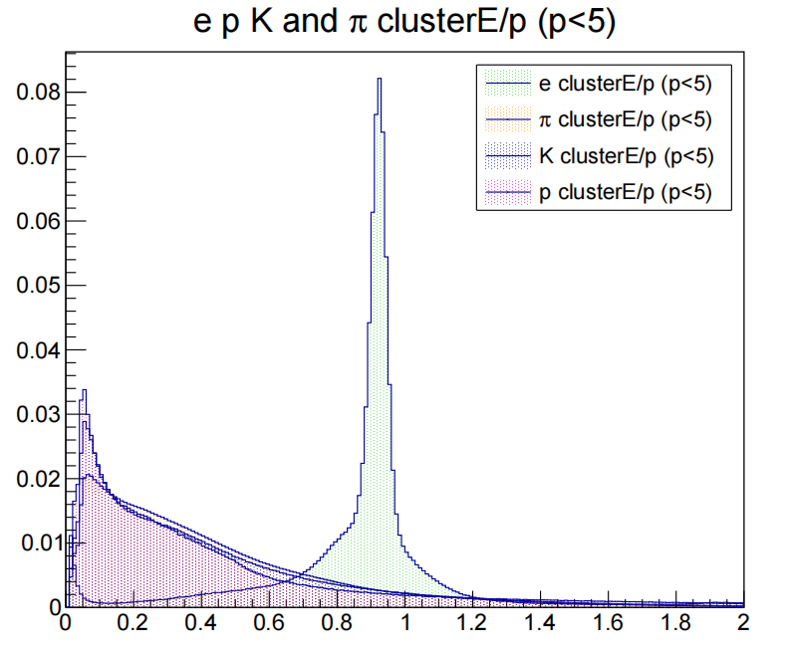
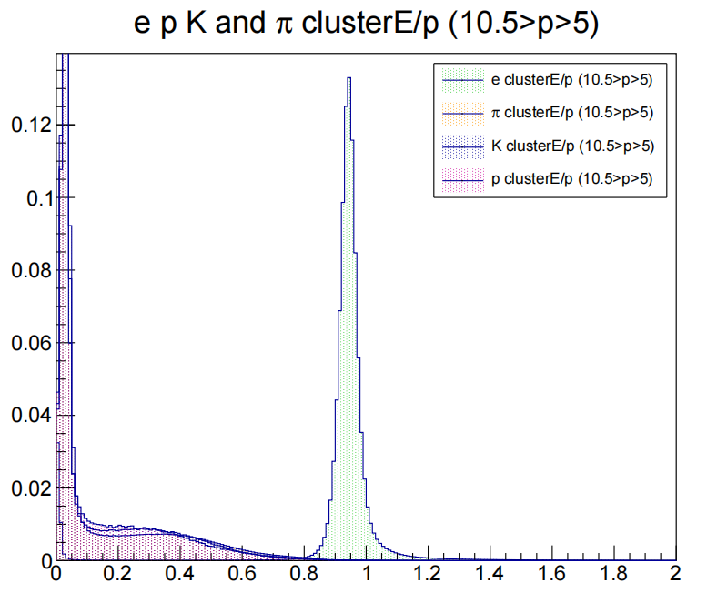
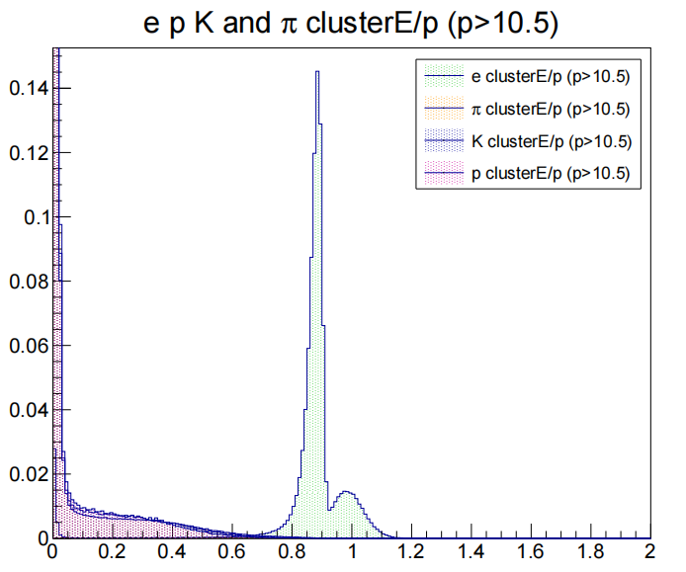
eID(EOP)
EOP distribution in different tranverse momentum regions（Normalization）
EOP distribution in different momentum regions（Normalization）
8

Slide 11
eID(EOP)
define purity = nume / (nume + numpi + numk + nump)
where nume, numpi, numk, nump means number of electron, pion, kaon, proton
momentum range | eop cut | purity
p < 5(GeV/c) | 0.86 < eop < 1 | 0.34
5 < p < 10.5 | 0.7 < eop < 1.4 | 0.99
10.5 < p | 0.82 < eop < 1.2 | 0.99
p_{T} range | eop cut | purity
p_{T} < 0.7(GeV/c) | 0.85 < eop < 0.95 | 0.24
0.7 < p_{T} < 4 | 0.85 < eop < 1.2 | 0.95
4 < p_{T} | 0.7 < eop < 1.4 | 0.99
9

Slide 12
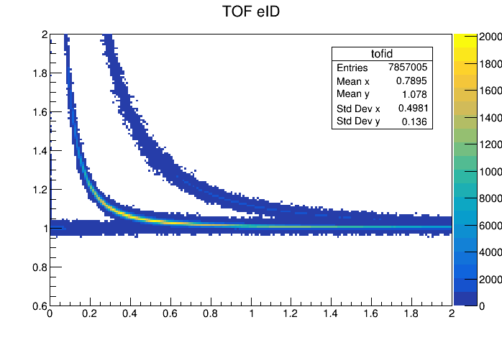
TOF(fastsimulation)
p < 0.4(GeV/c)
|1/β-1|<0.04
survival possibility:
e: 99.5%
π: 0.1%
purity: 98.3%
10

Slide 13
Gap between unlikesign and likesign
Why there is a gap?
How can we eliminate it?
find same track in mcpart with tracker, get its bcid, find same bcid in hepmc with mcpart, get its mother’s bcid, and get its mother’s pdg.
see mother particle of the pair around J/ψ peak
perfect eID
most backround comes from a(an) e⁺/ e⁻ of π⁰ decay pairs with a scattering e⁻
mothers of pair:
111 (π⁰)
11 (e⁻)
hypothesis: gap comes from inequlity of e⁺/ e⁻ of π⁰ decay
unlikesign is more than likesign ==> number of e⁺> e⁻
production
π⁰ —> e⁺ + e⁻ + γ
×
tracker acceptance （and efficiency？）
need to prove it
11

Slide 14
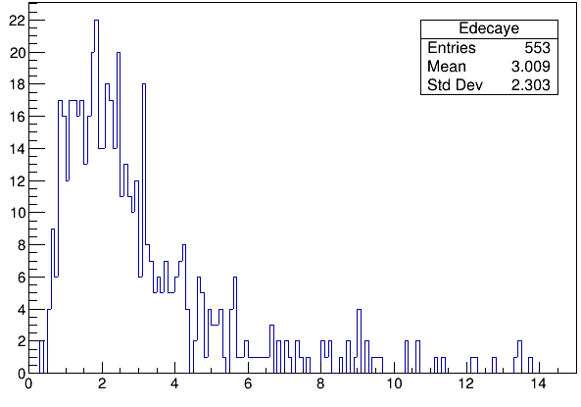
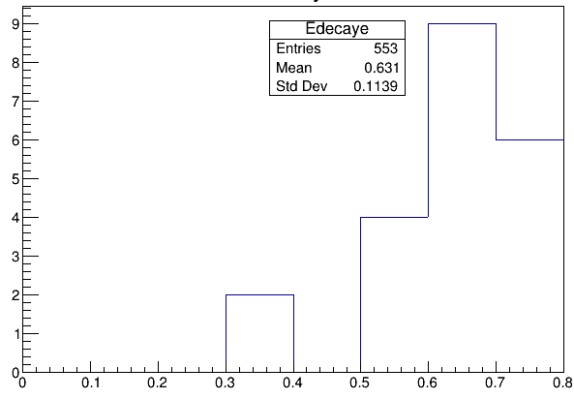
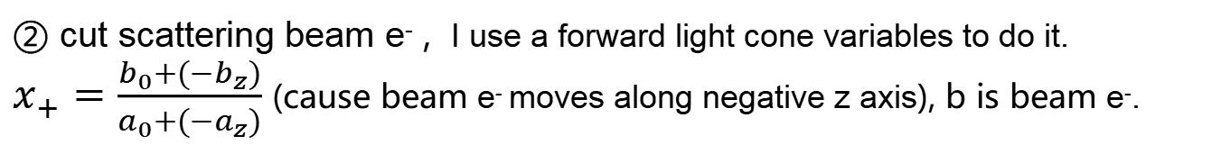
Cut to improve J/ψ significance
① cut e⁺/ e⁻ of π⁰ decay, π⁰ has a small mass 0.135(GeV), so I think most e⁺/ e⁻ of π⁰ decay may have a lower energy than which of J/ψ decay.
② cut scattering beam e⁻ , I use a forward light cone variables to do it.
$x_{+}=\frac{b_{0}+(−b_{z})}{a_{0}+(−a_{z})}$ (cause beam e⁻ moves along negative z axis), b is beam e⁻.
①
if the invariant mass of a unlikesign di-electron pair is in ±3σ region of J/ψ mean,
we select the e⁺ and e⁻ of J/ψ decay, their energy distribution :
12

Slide 15
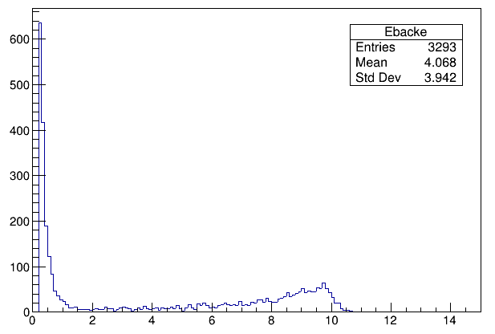
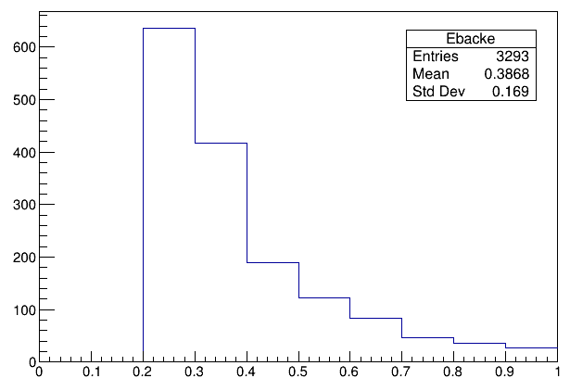
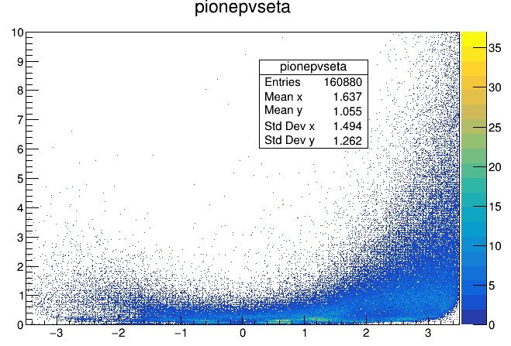
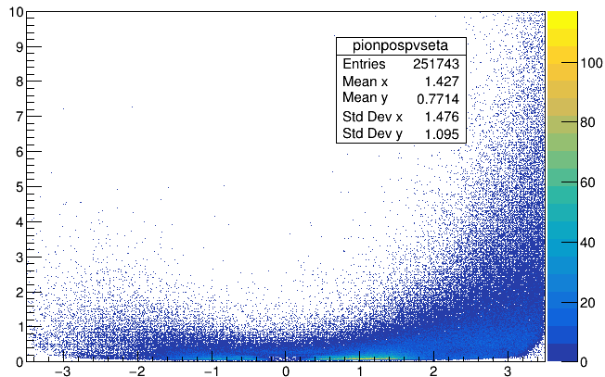
Cut to improve J/ψ significance
other e⁺ and e⁻ energy distribution:
from π⁰ (or other)decay
scattering beam e⁻
cut: E>0.6
another way to do ① is VETO: sign the e⁺ and e⁻ in π⁰ peak in mass spectrum and cut them off when you reconstructe J/ψ. (not do yet, it should perform better).
** about track acceptance: (need more analysis)
0.16million
0.25million
13

Slide 16
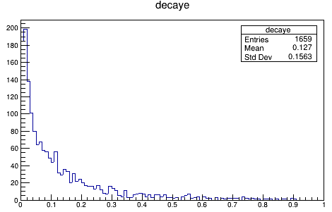
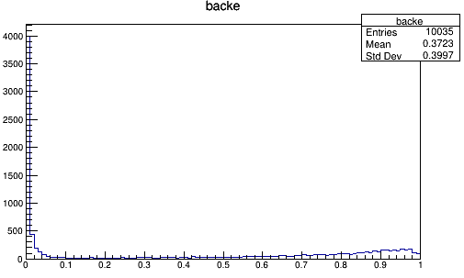
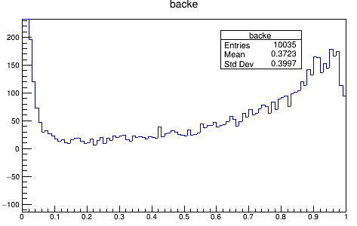


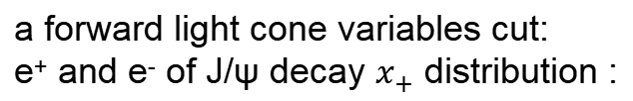
Cut to improve J/ψ significance
②
a forward light cone variables cut:
e⁺ and e⁻ of J/ψ decay $x_{+}$ distribution :
other e⁺ and e⁻ $x_{+}$ distribution :
scattering beam e⁻
scale
cut: $x_{+}<$ 0.5
14

Slide 17
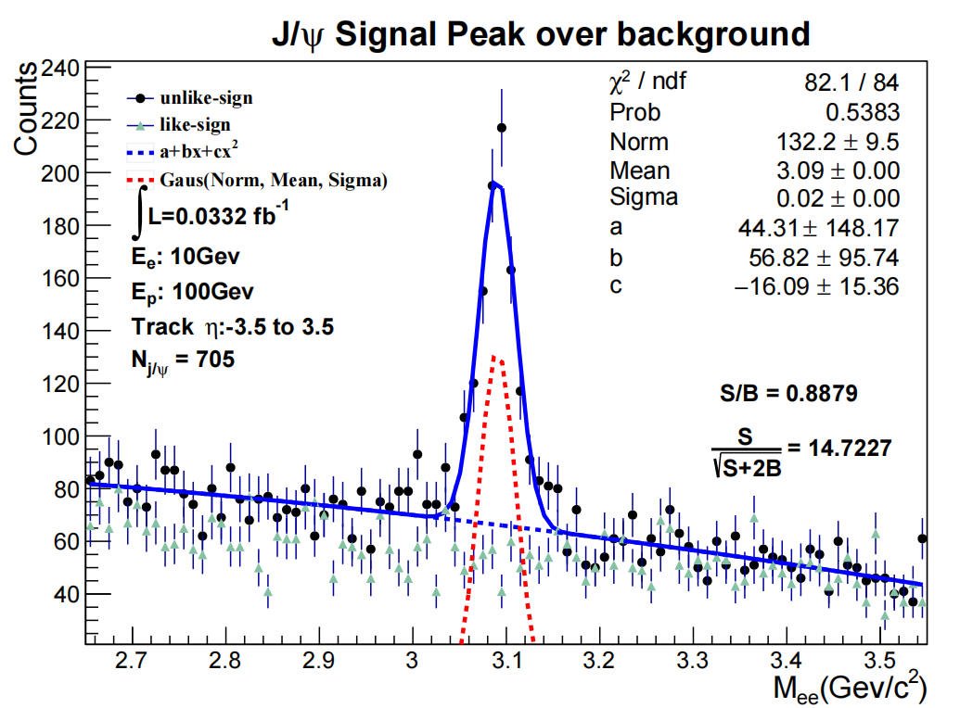
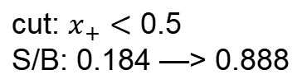
Cut to improve J/ψ significance
cut: $x_{+}<$ 0.5
S/B: 0.184 —> 0.888
only cut the beam scattering electron
15

Slide 18
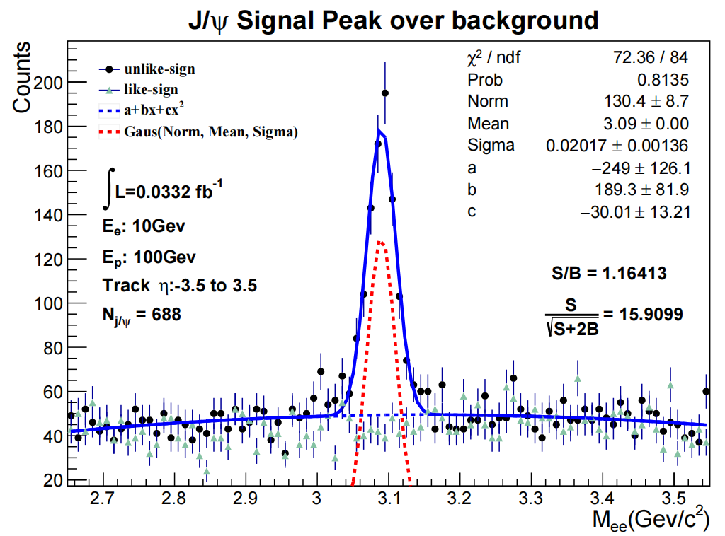
Cut to improve J/ψ significance
cut: E>0.6
S/B: 0.888 —> 1.164
also cut some e⁺ and e⁻ of low mass hardon decay
16

Slide 19
Summary and Plan
J/ψ mass spectrum
find out the source of the gap
do an eID using EOP
see the TOF performance in eID in fast simulation
find a good cut to improve the significance
need to do:
find the reason of more e⁺ than e⁻ of π⁰ decay in tracker
wait the tpc and cherenkov data in evaluator files to do eID in low momentum
more study of the backround
try to add the dca_3d cut in reconstruction
17

