Slide 1
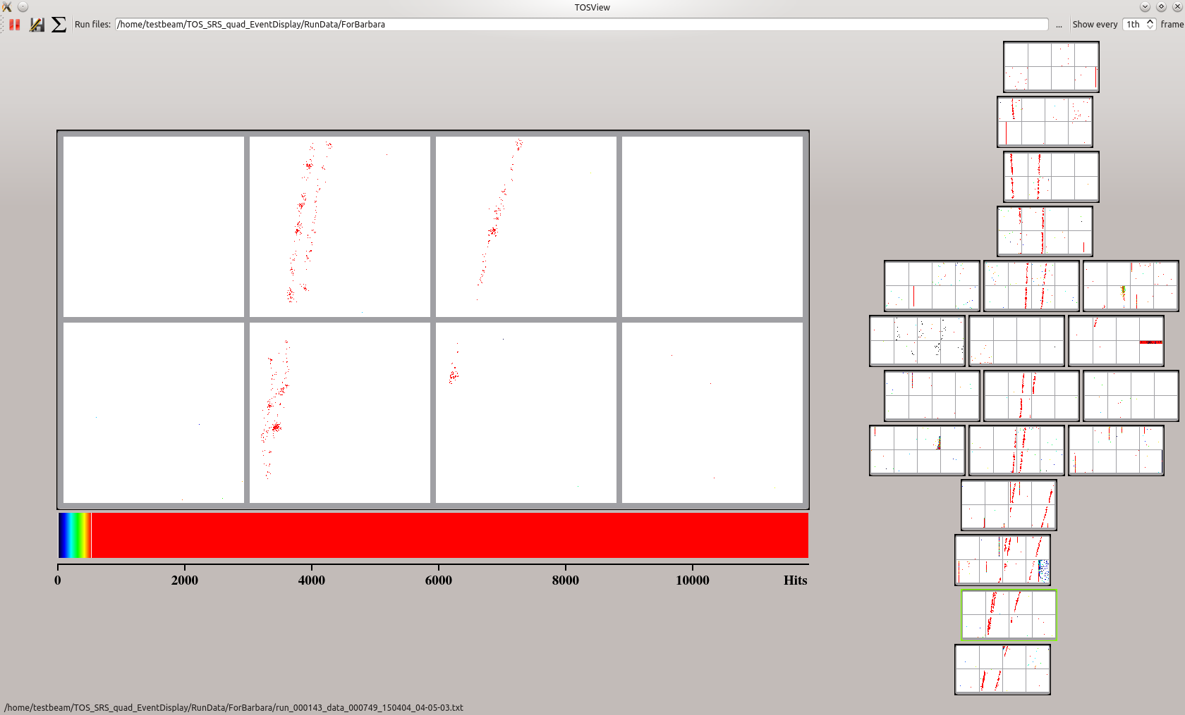
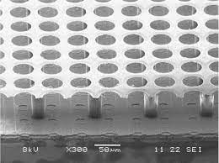
Low Momentum PID @ High B-field
TK Hemmick, K Dehmelt, (SBU) N Smirnov, (Yale) J Kaminski (Bonn)

Slide 2
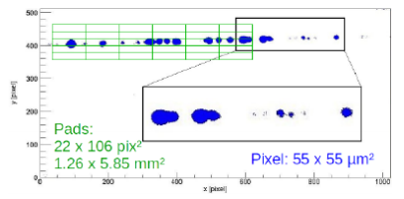
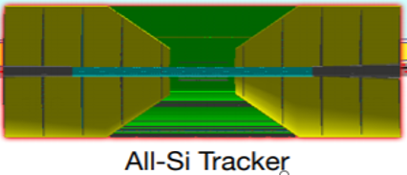
Low Momentum PID
High magnetic field curls low(er) momentum particles.
Option #1: We don’t care about them. (bad option)
Option #2: Lower the B-field for “special runs”. (poor option)
Option #3: PID on these particles BEFORE they curl up.
dE/dx Device
membrane
GridPIX
Mostly

Slide 3
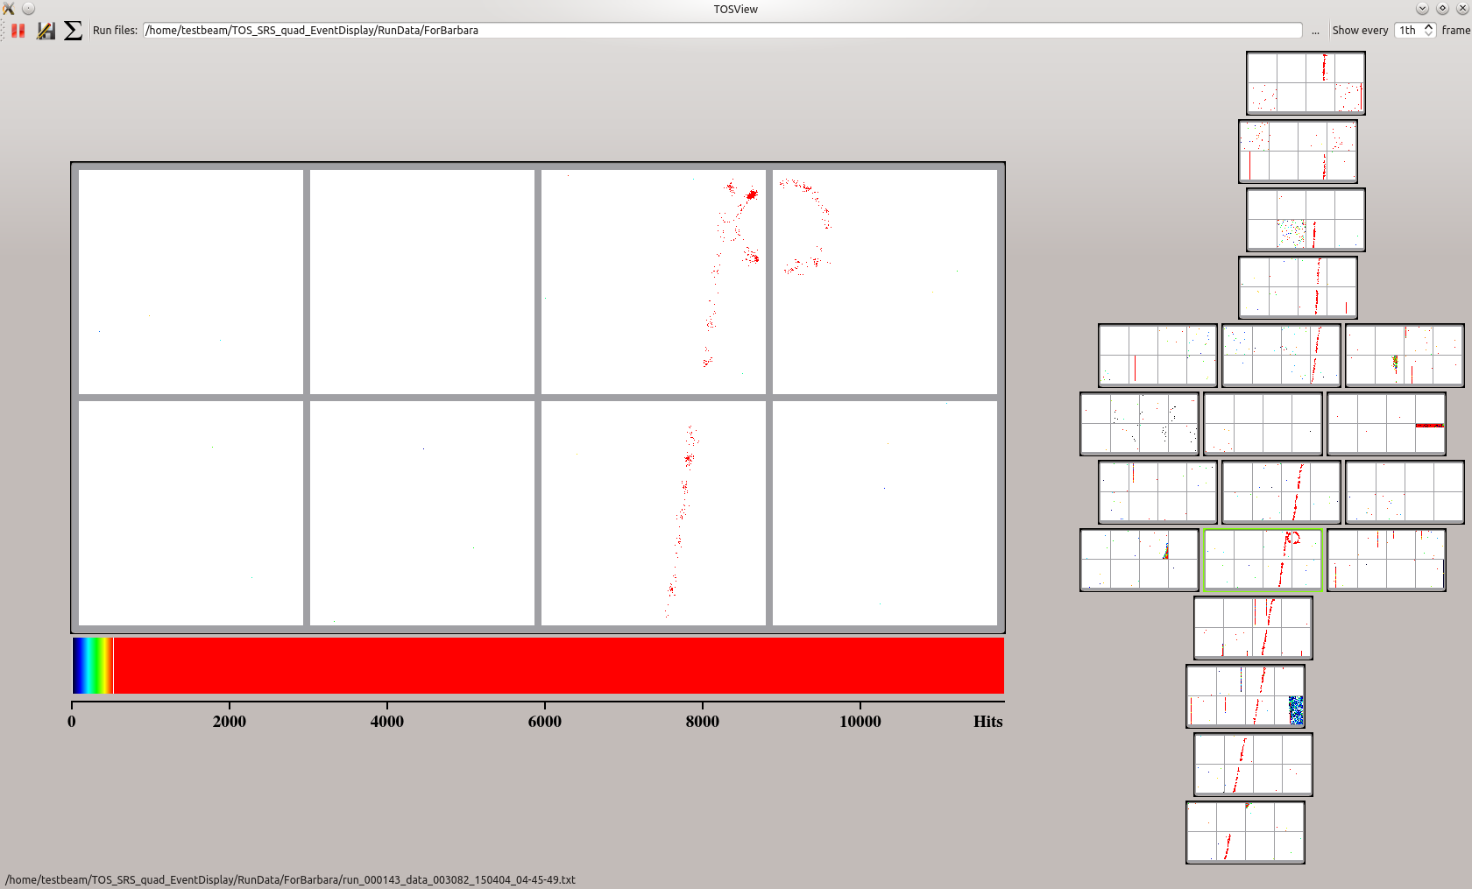
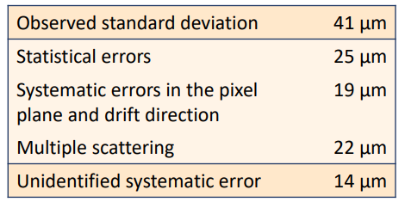
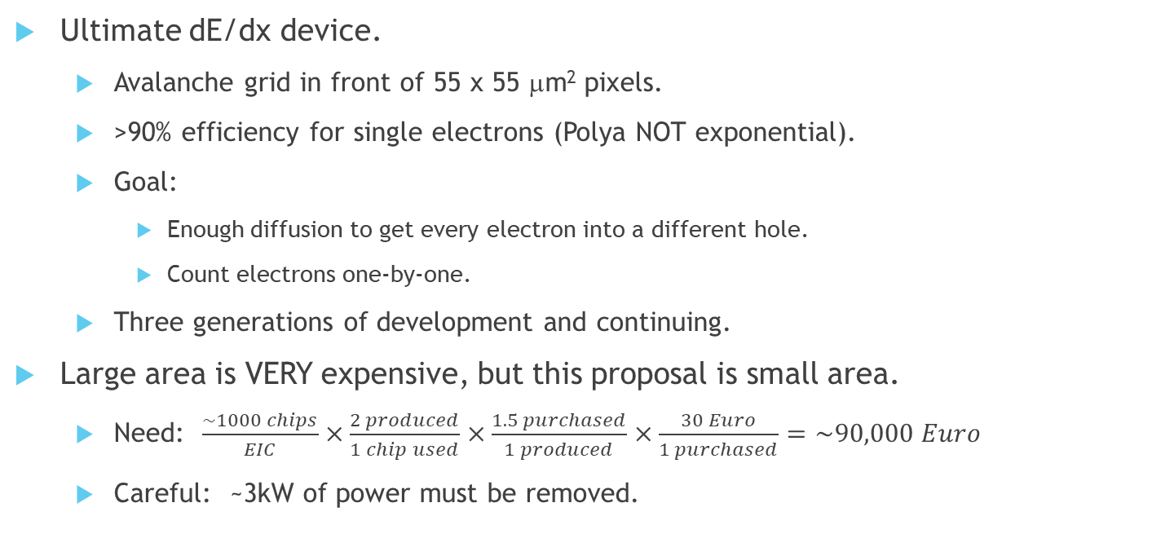
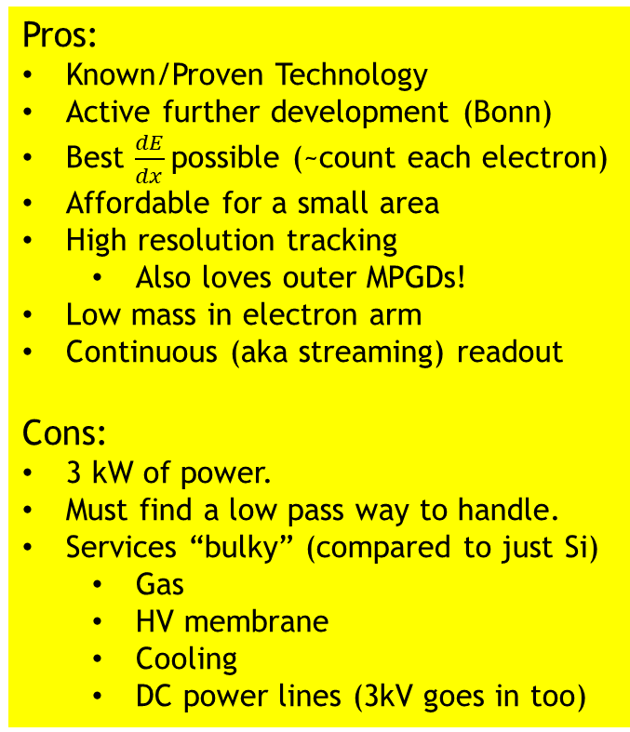
GridPIX Overview
3D e-by-e tracking
Pros:
Known/Proven Technology
Active further development (Bonn)
Best $\frac{dE}{dx}$possible (~count each electron)
Affordable for a small area
High resolution tracking
Also loves outer MPGDs!
Low mass in electron arm
Continuous (aka streaming) readout
Cons:
3 kW of power.
Must find a low pass way to handle.
Services “bulky” (compared to just Si)
Gas
HV membrane
Cooling
DC power lines (3kV goes in too)
Ultimate dE/dx device.
Avalanche grid in front of 55 x 55 μm² pixels.
>90% efficiency for single electrons (Polya NOT exponential).
Goal:
Enough diffusion to get every electron into a different hole.
Count electrons one-by-one.
Three generations of development and continuing.
Large area is VERY expensive, but this proposal is small area.
Need: $\frac{\sim 1000 chips}{EIC}×\frac{2 produced}{1 chip used}×\frac{1.5 purchased}{1 produced}×\frac{30 Euro}{1 purchased}=\sim 90,000 Euro$
Careful: ~3kW of power must be removed.

