Slide 1
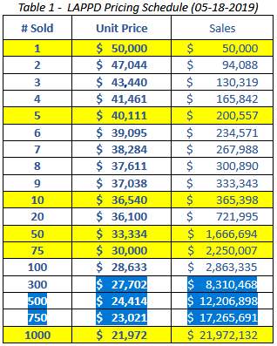
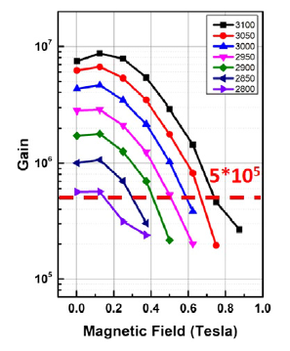
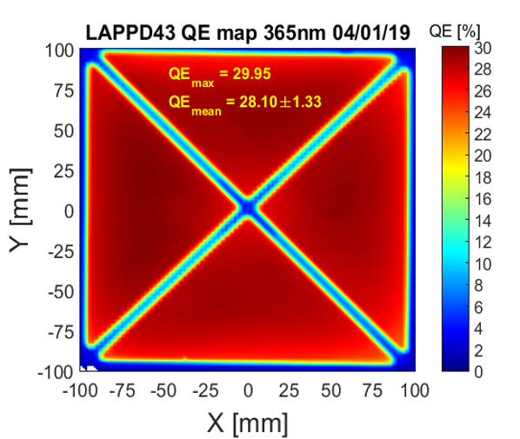
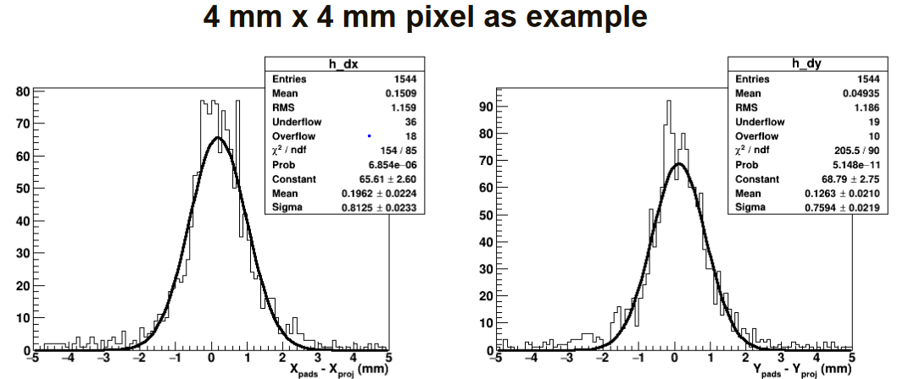
About LAPPD (reminder)
MPC-PMT characterized by:
Large size (20 x 20 cm²)
Reasonable cost
Fine time resolution:
~ 32 ps per single photoelectron
(V. Vagnoni , private comm.)
NOW good control of the QE, reproducibility & uniformity
Still magnetic field issues open
Already commercialized with strip r-o electrodes (GEN 1)
Prototyping for resistive anode with capacitively coupling to any r-o pattern (GEN 2) → sub-mm space res. with adequate pad size

Slide 2
WHY ?
Not yet a fully consolidate option for photon detector in Cherenkov detectors @ EIC
INFN is undertaking a systematic effort to validate SiPMs
Nevertheless:
Stopping points?
Adequate only for Forward RICH ?
LAPPDs, a possible option
Also synergies with TOF measurements

Slide 3
LAPPD, our plans
INFN lab activity will only start in the last trimester of 2021
New postdoc
Dedicated electronics
Nevertheless, LAPPD option has to enter as alternative in ATHENA proposal (aa consolidation element)
During the proposal period we can provide:
Data for simulation
Data for costing
Ready to collaborate in any form with other EIC physicists aiming at demonstrating LAPPD as valid option for single photon detection at EIC

