Slide 1
Ladder from Taiwan
Test & Inspection
Rachid Nouicer, Milan Stojanovic

Slide 2
Bench Test South Side

Slide 3
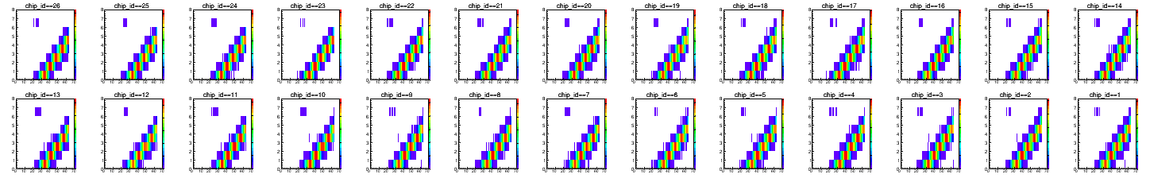
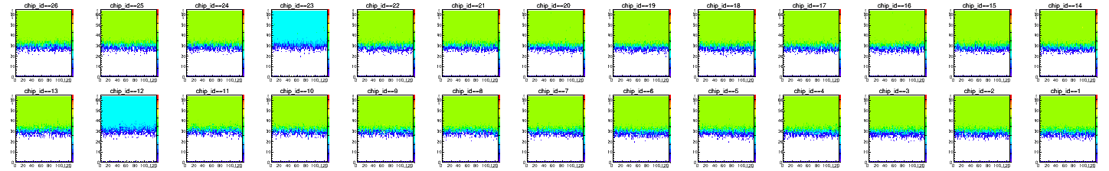
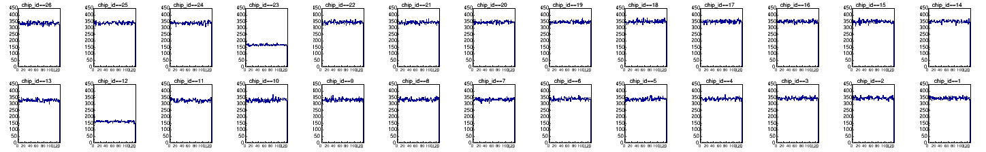
South Side (Modul 51) – Bias = 100V at BNL
Current A = 140 nA Current B = 110 nA
Calibration
Amplitude vs Channel
Number o entries

Slide 4
Bench Test North Side

Slide 5
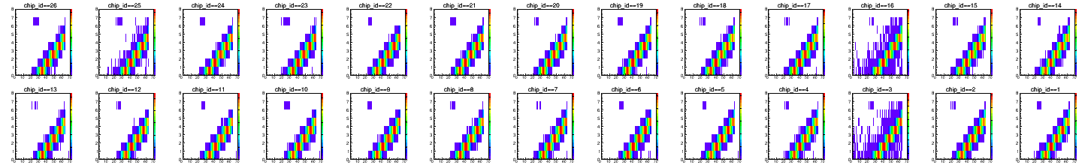
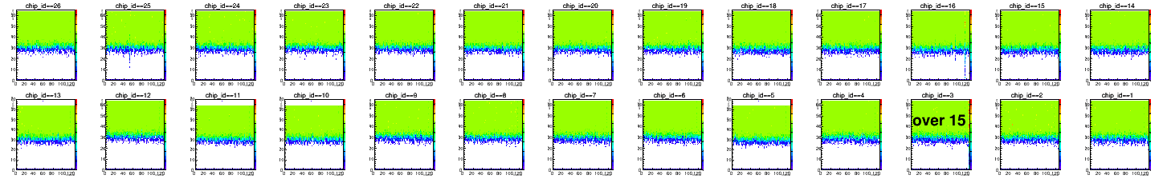
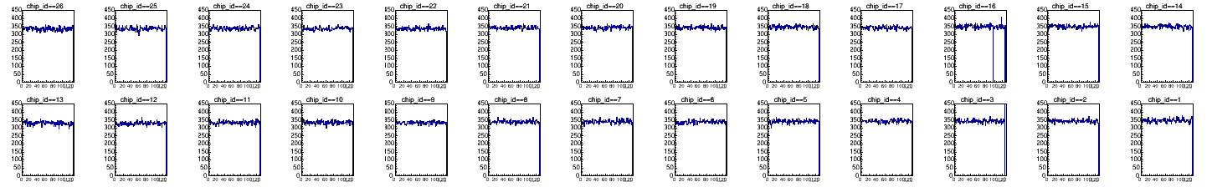
North Side (Module 264) – Bias = 100V at BNL
Current A = 220 nA Current B = 2.3 μA
Calibration
Amplitude vs Channel
Number o entries

Slide 6
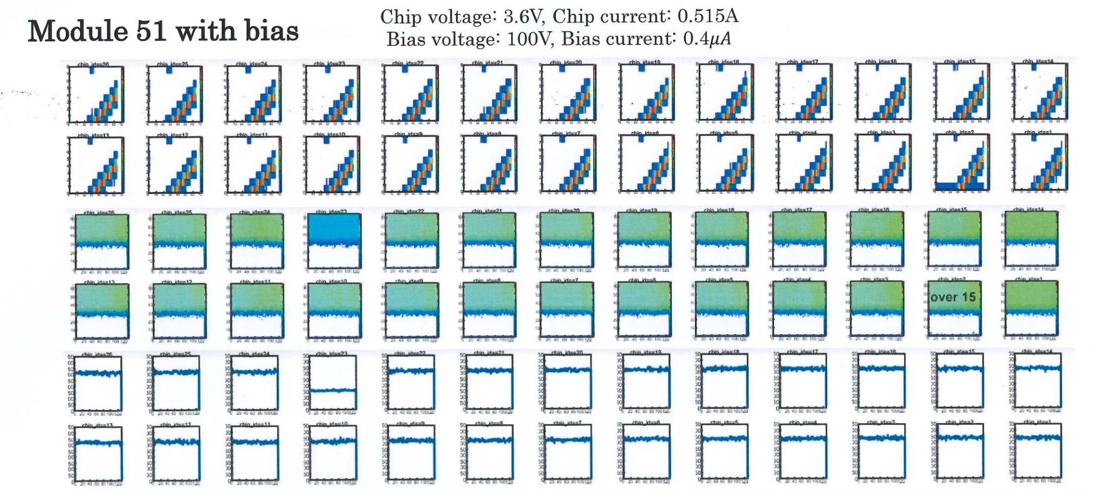
South Side (Module 51) – Bias = 100V at Taiwan

Slide 7
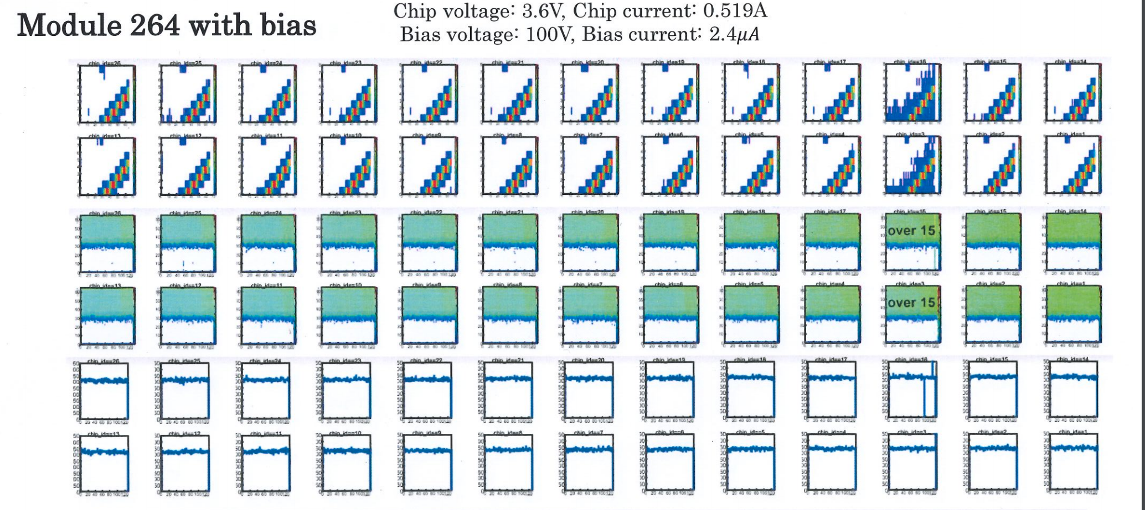
North Side (Module 264) – Bias = 100V at Taiwan

Slide 8
Visual Inspection at BNL

Slide 9
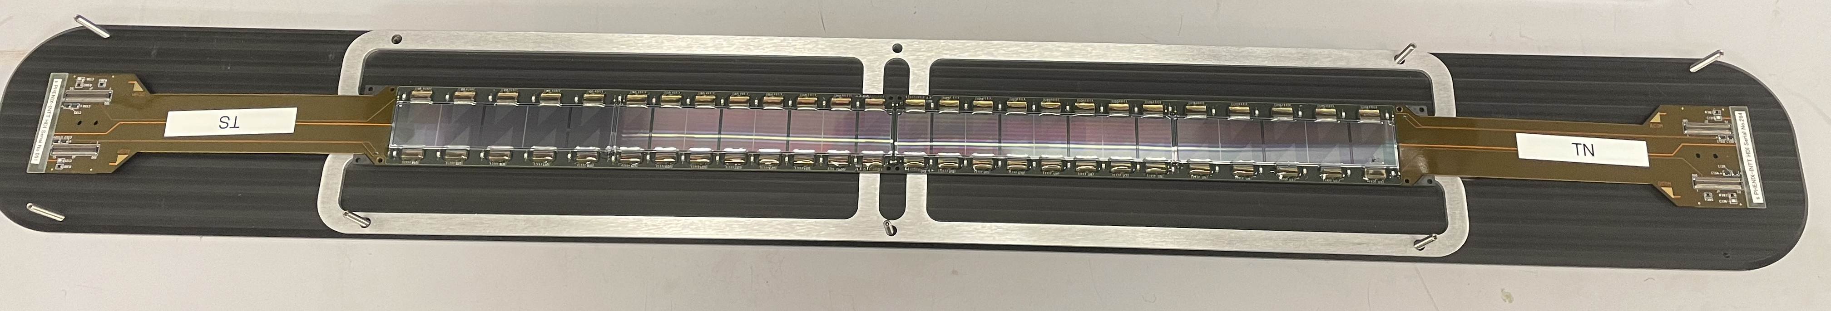
Visual Inspection
The ladder safely arrived at BNL
No damages during transportation observed

Slide 10
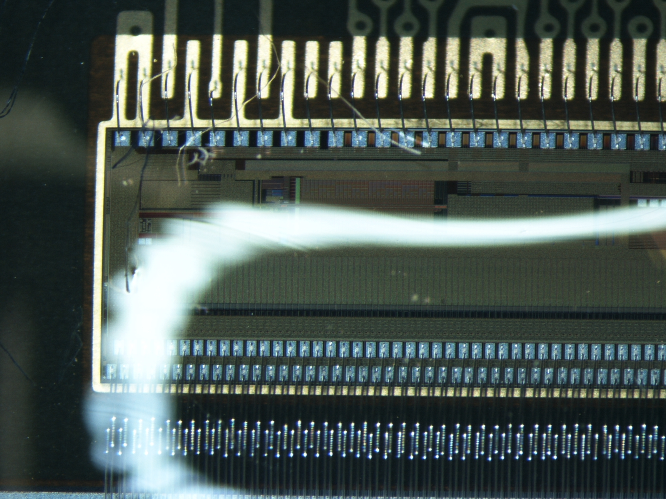
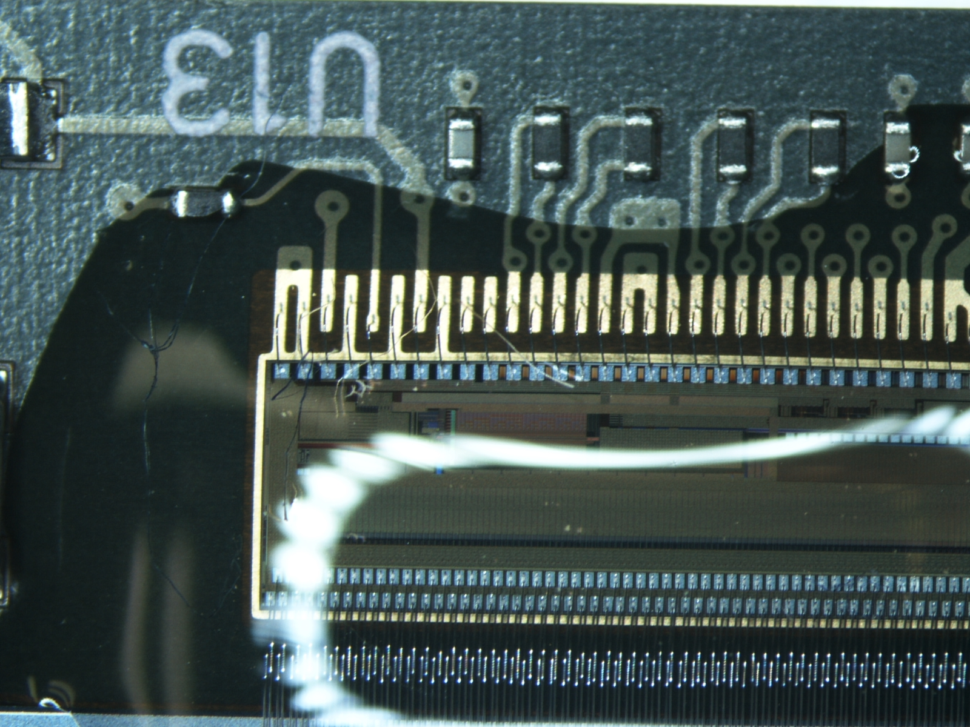
Visual Inspection
Dust on the ladders observed

Slide 11
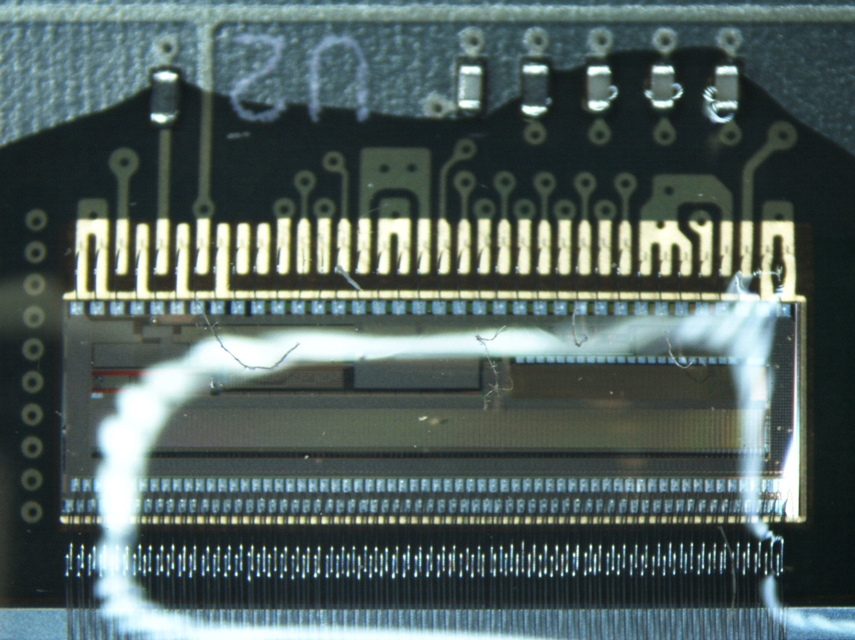
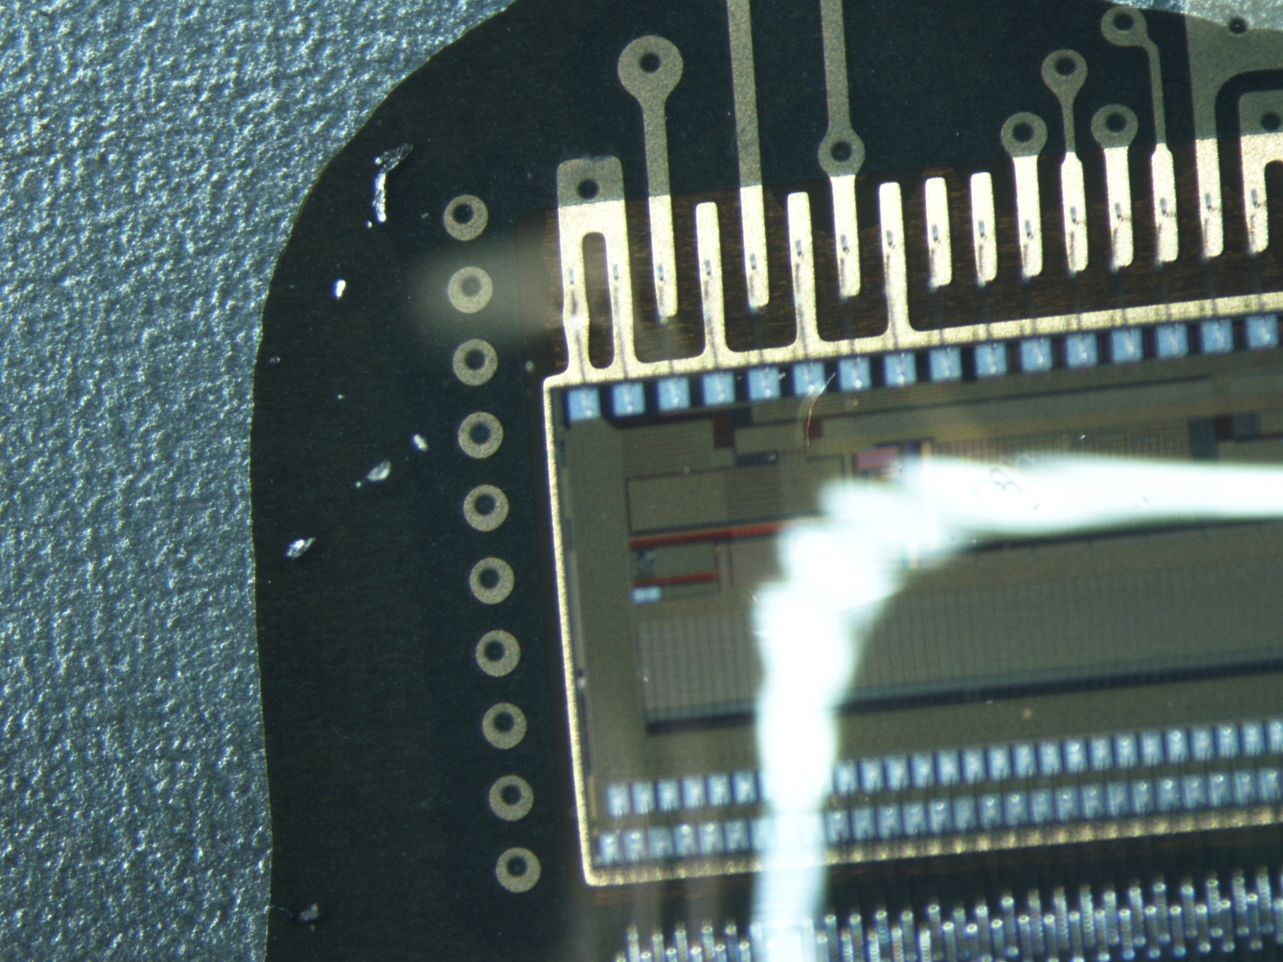
Visual Inspection
Dust on the ladders observed

Slide 12
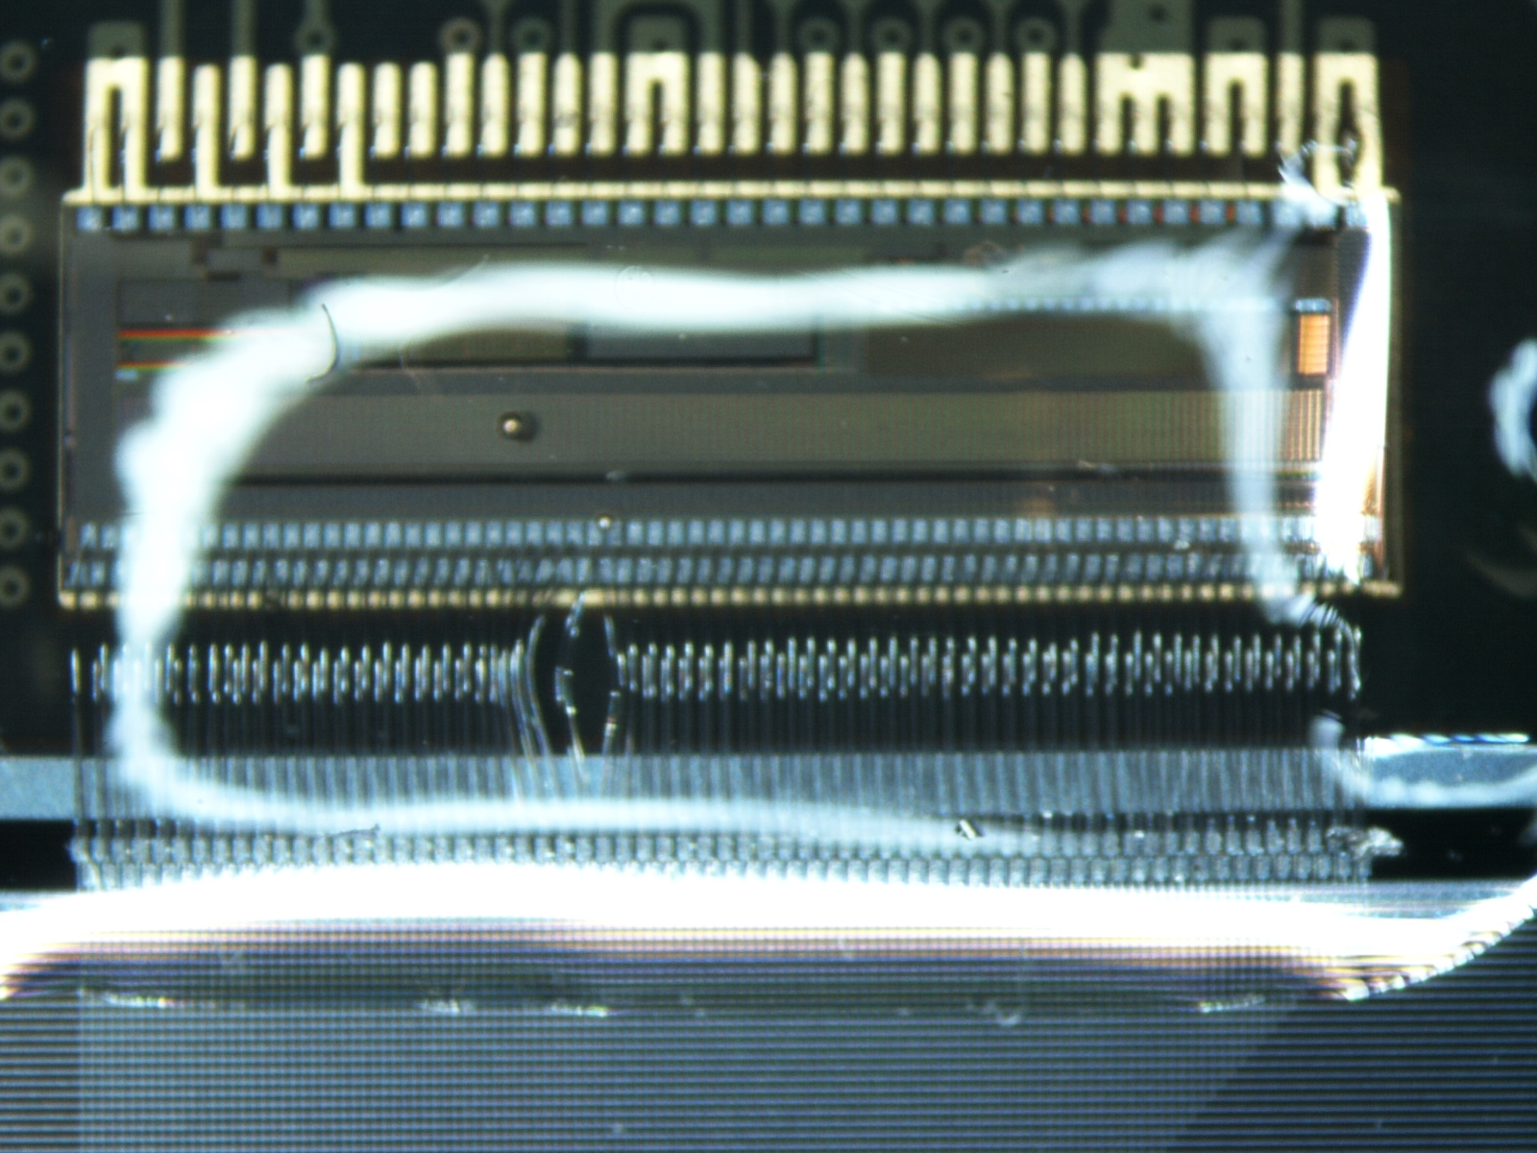
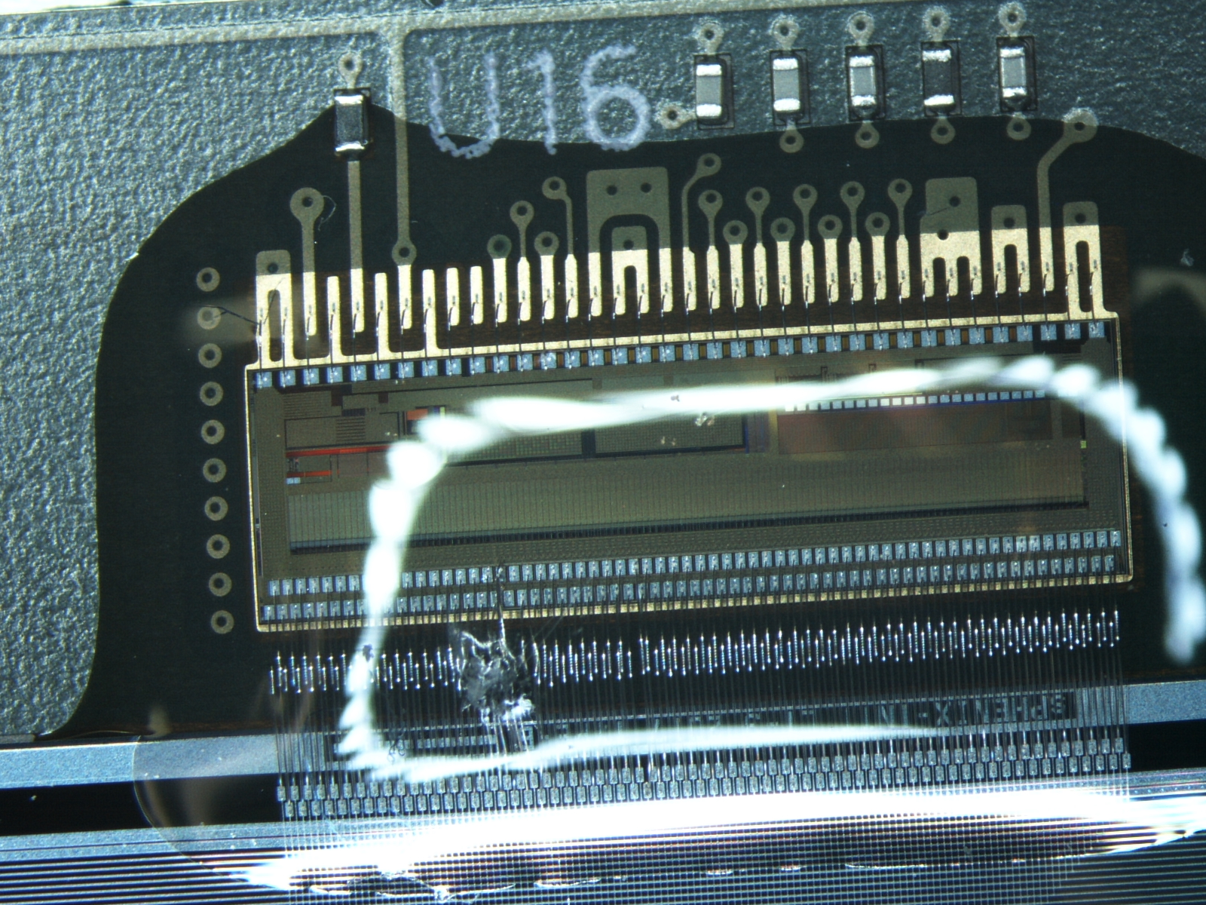
Visual Inspection
Wire bonding issues

Slide 13
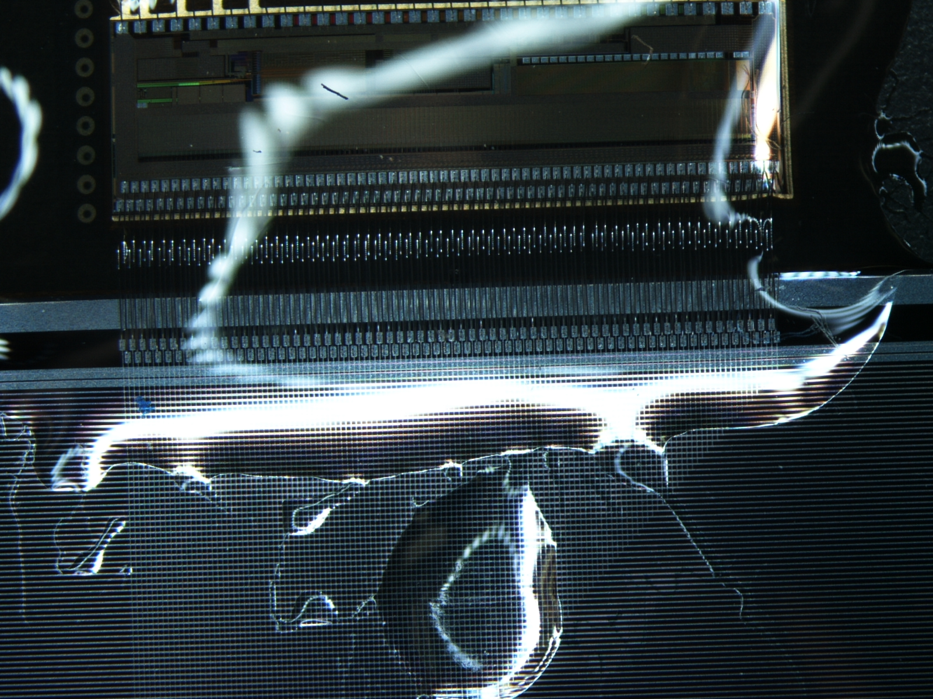
Visual Inspection
Encapsulation issue

Slide 14
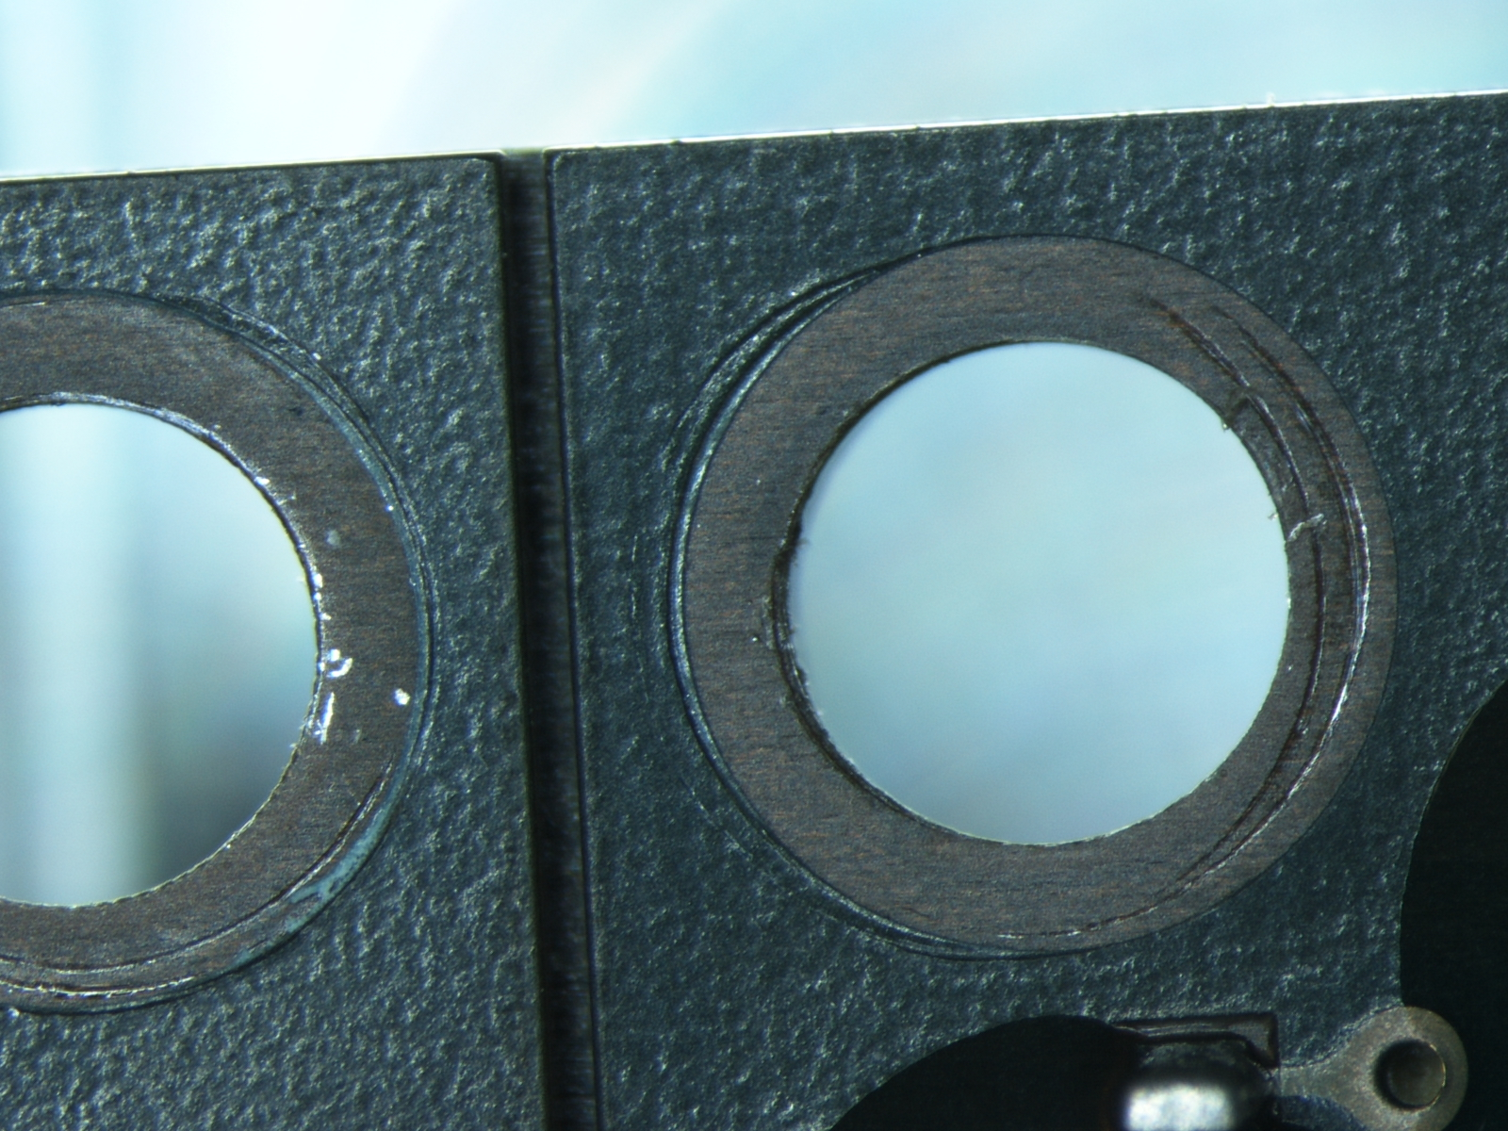
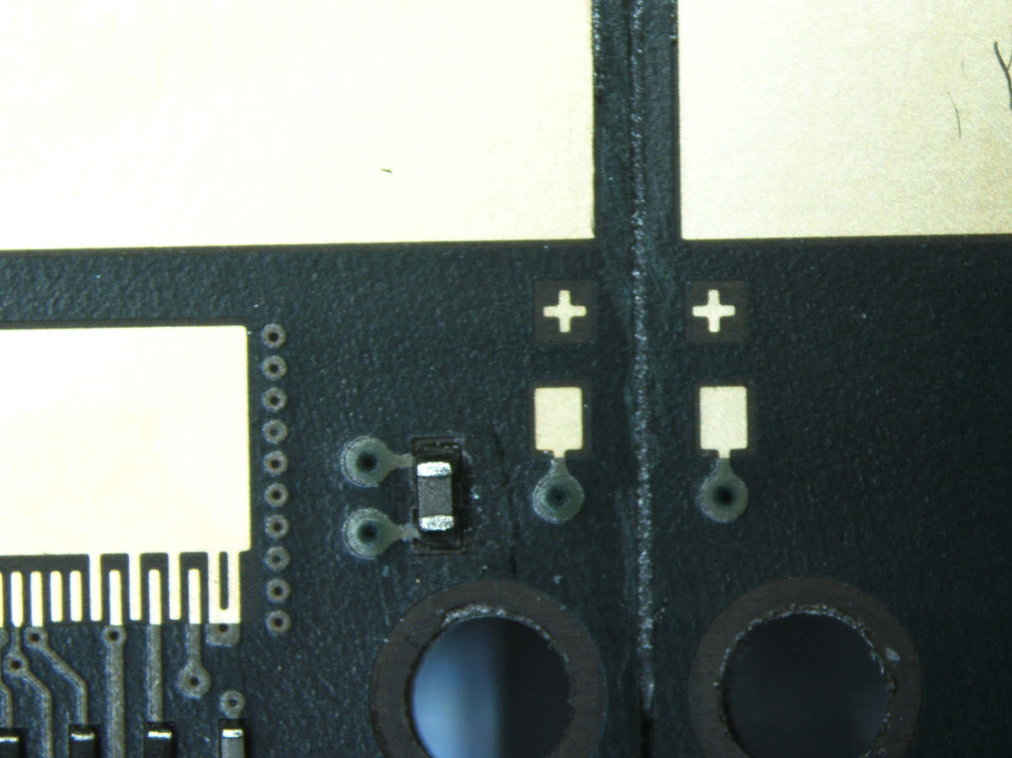
Visual Inspection
Gluing issue
There is no glue between the HDIs
Taiwan Ladder
BNL Ladder

Slide 15
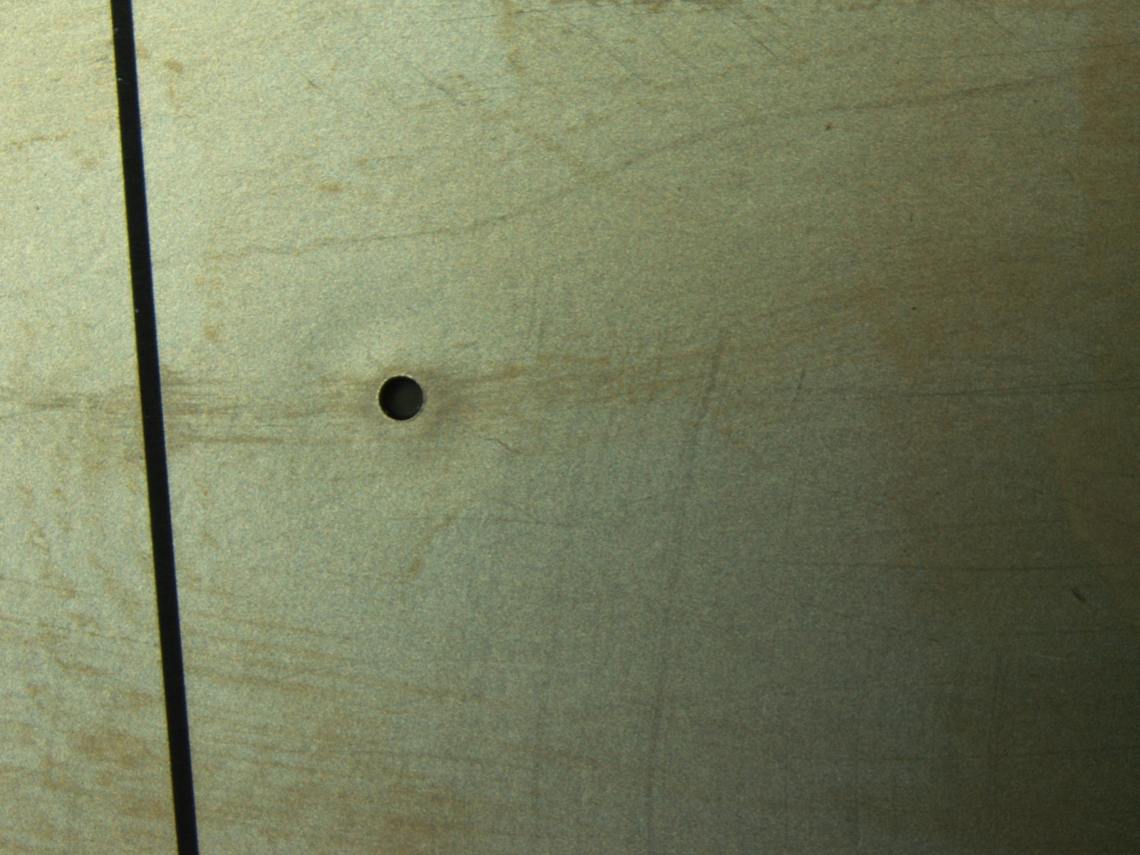
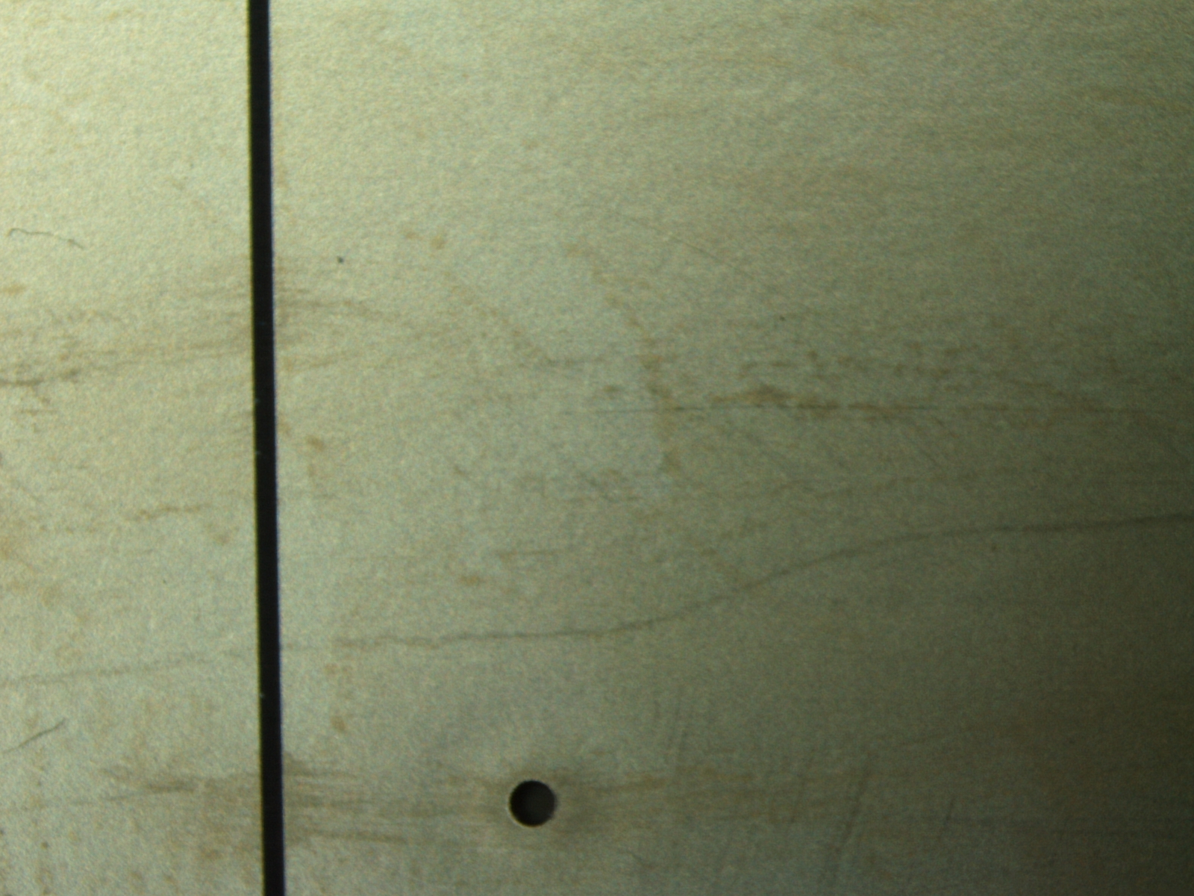
Visual Inspection

