Slide 1
SIDIS - Working Group
kick-off meeting
May 19, 2021
Marco Radici (INFN - Pavia)
Anselm Vossen (Duke)

Slide 2
Agenda
Date and Time of SIDIS WG regular meetings; weekly, bi-weekly, or…?
Physics Topics: discuss prioritisation w.r.t. detector features; which golden and silver channels?
“Technical discussion”: which plots, simulations?
AOB

Slide 3
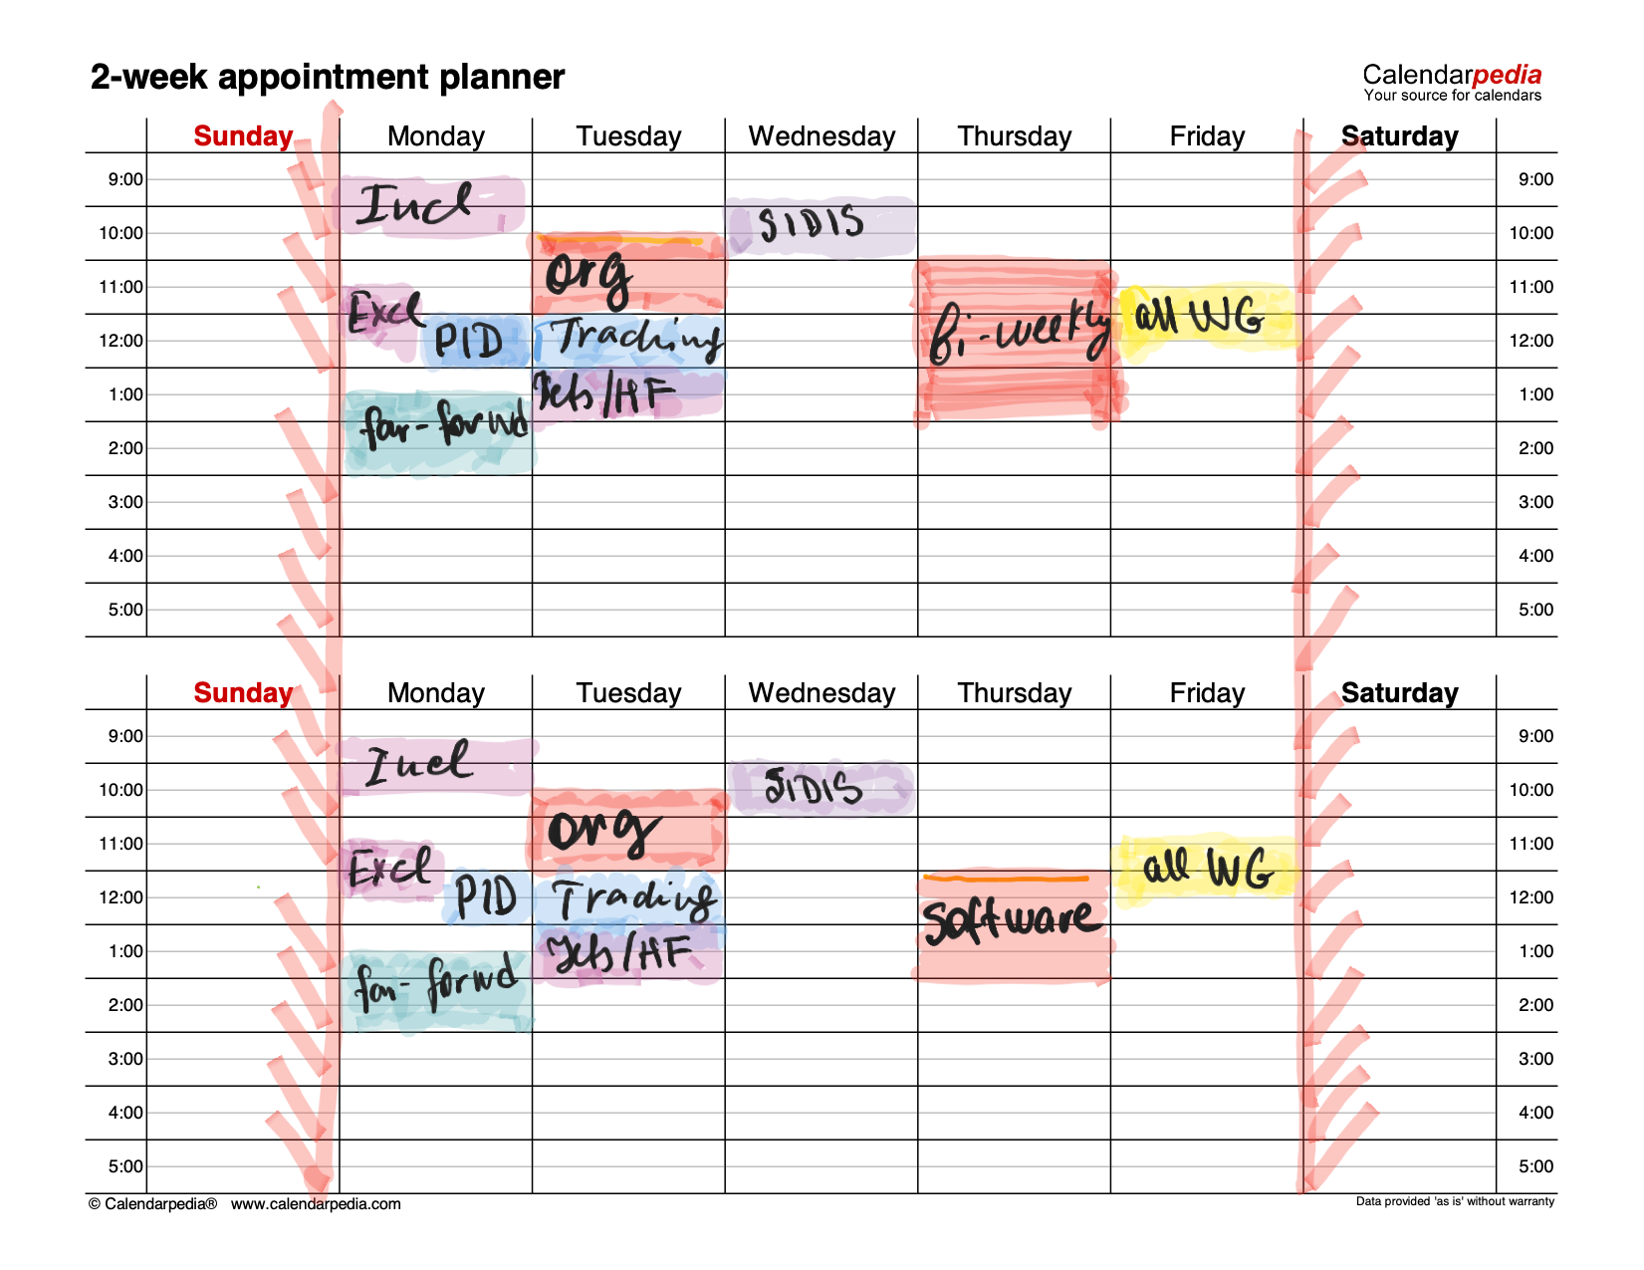
Calendar
from Yulia Furletova
SIDIS WG
currently
Wednesday
10am EST
Confirm / change date and time
Choose weekly / bi-weekly / … rate of meetings

Slide 4
SIDIS Physics Topics
EIC White Paper golden channel:
unpolarized TMD of valence/sea quarks
Sivers TMD of valence/sea quarks
unpolarized and Sivers TMD of gluons: di-hadron and/or di-jet ==> Jet / HF WG ?
EIC White Paper silver channel:
chiral-odd functions for valence/sea quarks: transversity and Boer-Mulders
transversity (also as PDF) ==> tensor charge

Slide 5
SIDIS Physics Topics (update)
unpolarized and helicity sea/strange quark PDFs ==> fragmentation function FFs
polarized fragmentation (Λ)
Jet-related TMDs (Sivers, Collins and jet substructure) ==> Jet / HF WG ?
chiral-odd higher twist: e(x), …
in-medium PDFs and FFs ?

Slide 6
Where does Athena have an advantage and what physics topic might profit
High B field
→resolution of high momentum tracks
→PID at high momenta
➔kinematic reach for evolution? Unexplored region
Hermetic coverage
→Cc events
→Kinematic reach using hadronic final state

Slide 7
Topics vs. Detector features
TMD evolution (Collins-Soper kernel) <==> energy reach
Gluon Sivers <==> di-hadron acceptance ?
Transversity and chiral-odd functions <==> (x,Q²) resolution, energy reach, PID coverage
sea/strange PDFs with FFs <==> PID coverage, energy reach ($z,Q^{2})$
Λ fragmentation <==> low energy
charged currents <==> hadronic final state
→Coordinate with DIS & Jet/HF WGs
in-medium PDFs & FFs <==> ?

Slide 8
Technical discussion
Impact plots vs. kinematical coverage plots ?
Full vs. fast simulations ?
Framework…?

Slide 9
People Power
….

Slide 10
Backup

Slide 13
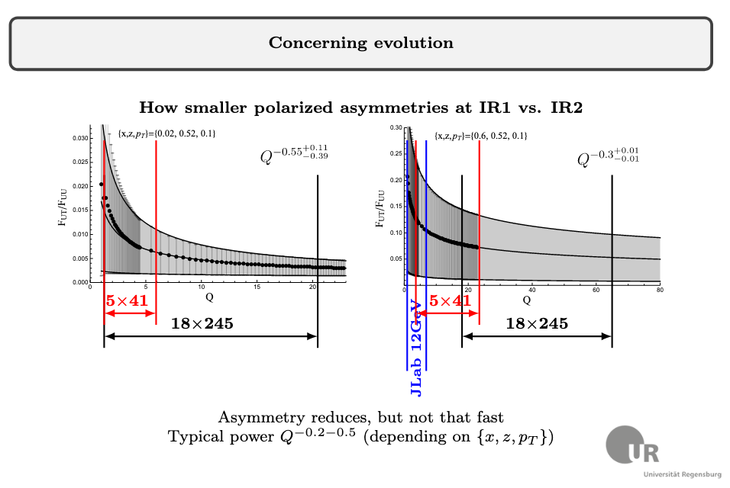

Slide 14
”Golden Measurements”
Measurement/process | Main detector requirements | Anticipated plot | Comments
Quark Sivers, 3D momentum structure, TMD evolution from single hadrons ➔3D image $(x,k_{t})$of the Sivers Function, Evolution test of Sivers at intermediate $x$ Alexey Vladimirov, | $η$ acceptance for hadrons angular resolution granularity of the detector (central to forward -1 to 4), pi/K/p identification Comments: PID$↔$Tracking, $B−$field →$\frac{δp}{p},$ min p | pseudo-3D Sivers function as a function kt for various x bins, Value of Tensor charge uncertainties + plot vs x, Q2 dependence of Sivers function or $A_{UT}$at fixed x | Use of existing simulations at Elke’s group + smearing + weights originating from theorists. Work on common database ongoing, integrate in SW environment Theory work on fits/parameterizations. Preparation of fitting experimental pseudo-data ongoing
Gluon Sivers via di-jets/di-hadrons ➔Probing the size of the gluon Sivers function Bowen Xiao | acceptance for back-to-back dihadrons | Size of the asymmetry as a function of $x$ | Continuation of study based on arXiv:1805.05290 together with current EIC detector design consideration of different jet algorithms Elke, Zheng, Lee and Yin Possible different parametrizations of gluon Sivers function inputs from Pavia

Slide 15
“Silver” channels
Measurement/process | Main detector requirements | Anticipated plot | Comments
Sea quark helicity measurements →flavor separated (anti)quark helicity distributions over wide range of x Ralf Seidl | hadron momentum and energy resolution in forward direction ($2<η<4$) for CC events | Update of previous sea quark helicity PDF uncertainty plots | Work will follow ongoing sensitivity studies by Elke’s group + Argentinian global fitters. Implementation of detector smearing, etc needs to be added to existing studies. Concentration on CC and $D/3He$.
FFs/nFFs/nPDFs via single hadron FF →Single hadron fragmentation functions for ep and eA for FFs, nFFs, nPDFs Ralf Seidl | See TMD SIDIS reqs | nPDF uncertainty expectation, (n)FF expectation | Prepared pythiaRHIC (Pythia 6) + eicsmear simulations using official 4 ep and 3 eAu beam energy combinations, for smeared simulation BeAST resolutions were used in eicsmear. Not implemented: magnetic field impact and PID (hadron, momentum, rapidity) ranges. Analysis will follow Charlotte’s paper extended to nFFs (and $ν$dependence of interest there)

Slide 16
“Silver” channels, cont
Measurement/process | Main detector requirements | Anticipated plot | Comments
Di-hadron correlations in eA →low x ➔Probing the onset of saturation phenomenon Bowen Xiao | backward hadron acceptance, granularity | decorrelation plot as in white paper | Continuation of work based on arXiv:1403.2413 with extension to jets with different algorithms using the new collisional energies at eRHIC.

Slide 17
“New” channels
Measurement/ process | Main detector requirements | Anticipated plot | Comments
Di-hadron FF for Tensor charge/Boer-Mulders ➔ Anselm Vossen | Single hadron reqs+min $z$ for partial wave expansion | Impact on tensor charge/transversity extraction Projected BM asymmetries
Lambda related spin measurements ➔L/T spin transfer, polarizing FFs (universality), jet structure Anselm Vossen | $Λ$ acceptance Slow pion→low momentum cutoff, displaced vertex | Precision of $Λ$ polarization measurements

