Slide 1

E864 Calorimeter Re-Use
J. Lajoie
Iowa State University

Slide 2
E864-EMCal
E864 calorimeter was originally 768 modules (at least ~400 still exist at BNL)
Compensating SPACAL design
Radiation length 7.8mm
Moliere radius 2.0cm
117 cm long
20 radiation lengths ~ 16cm – cut down the E864 modules!!!!
High granularity introduced by array of light guides, roughly matching tower size to Moliere radius
932 cut (16cm) E864 towers required to cover 1.4<η<4.0 at z=3.5m, which comes from 133 full E864 calorimeter towers
With a 5x5 lightguide array this yields 23,300 FEMC towers
117cm

Slide 3
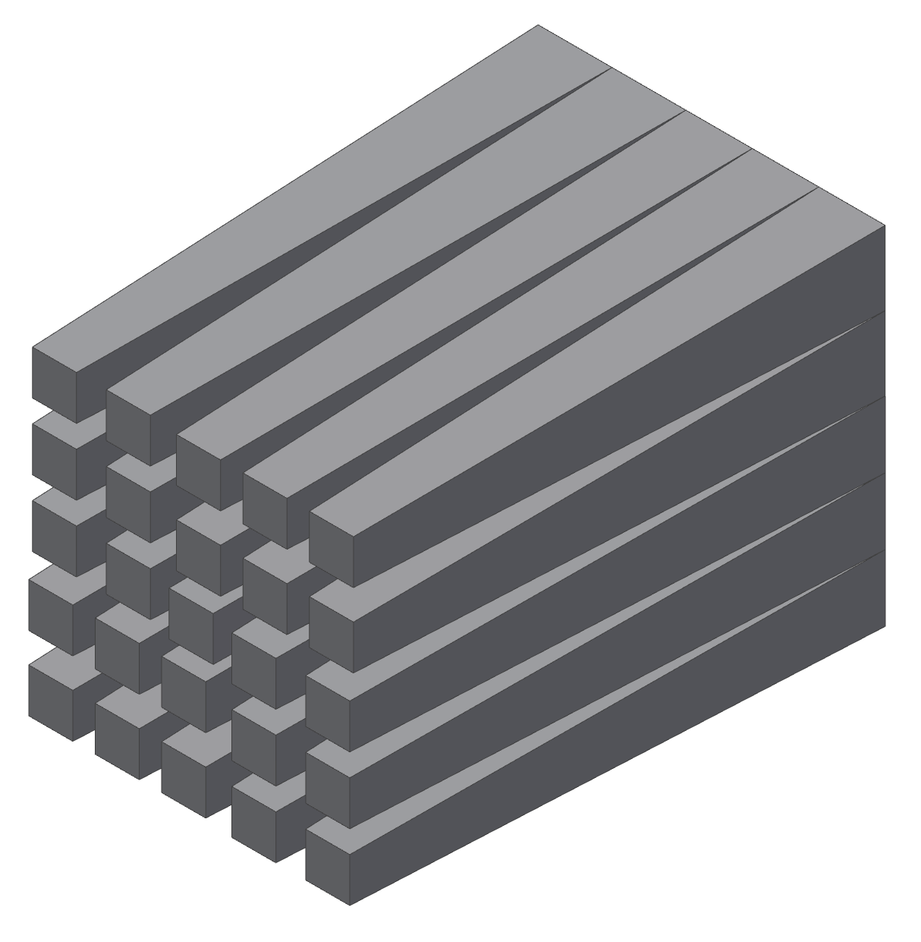
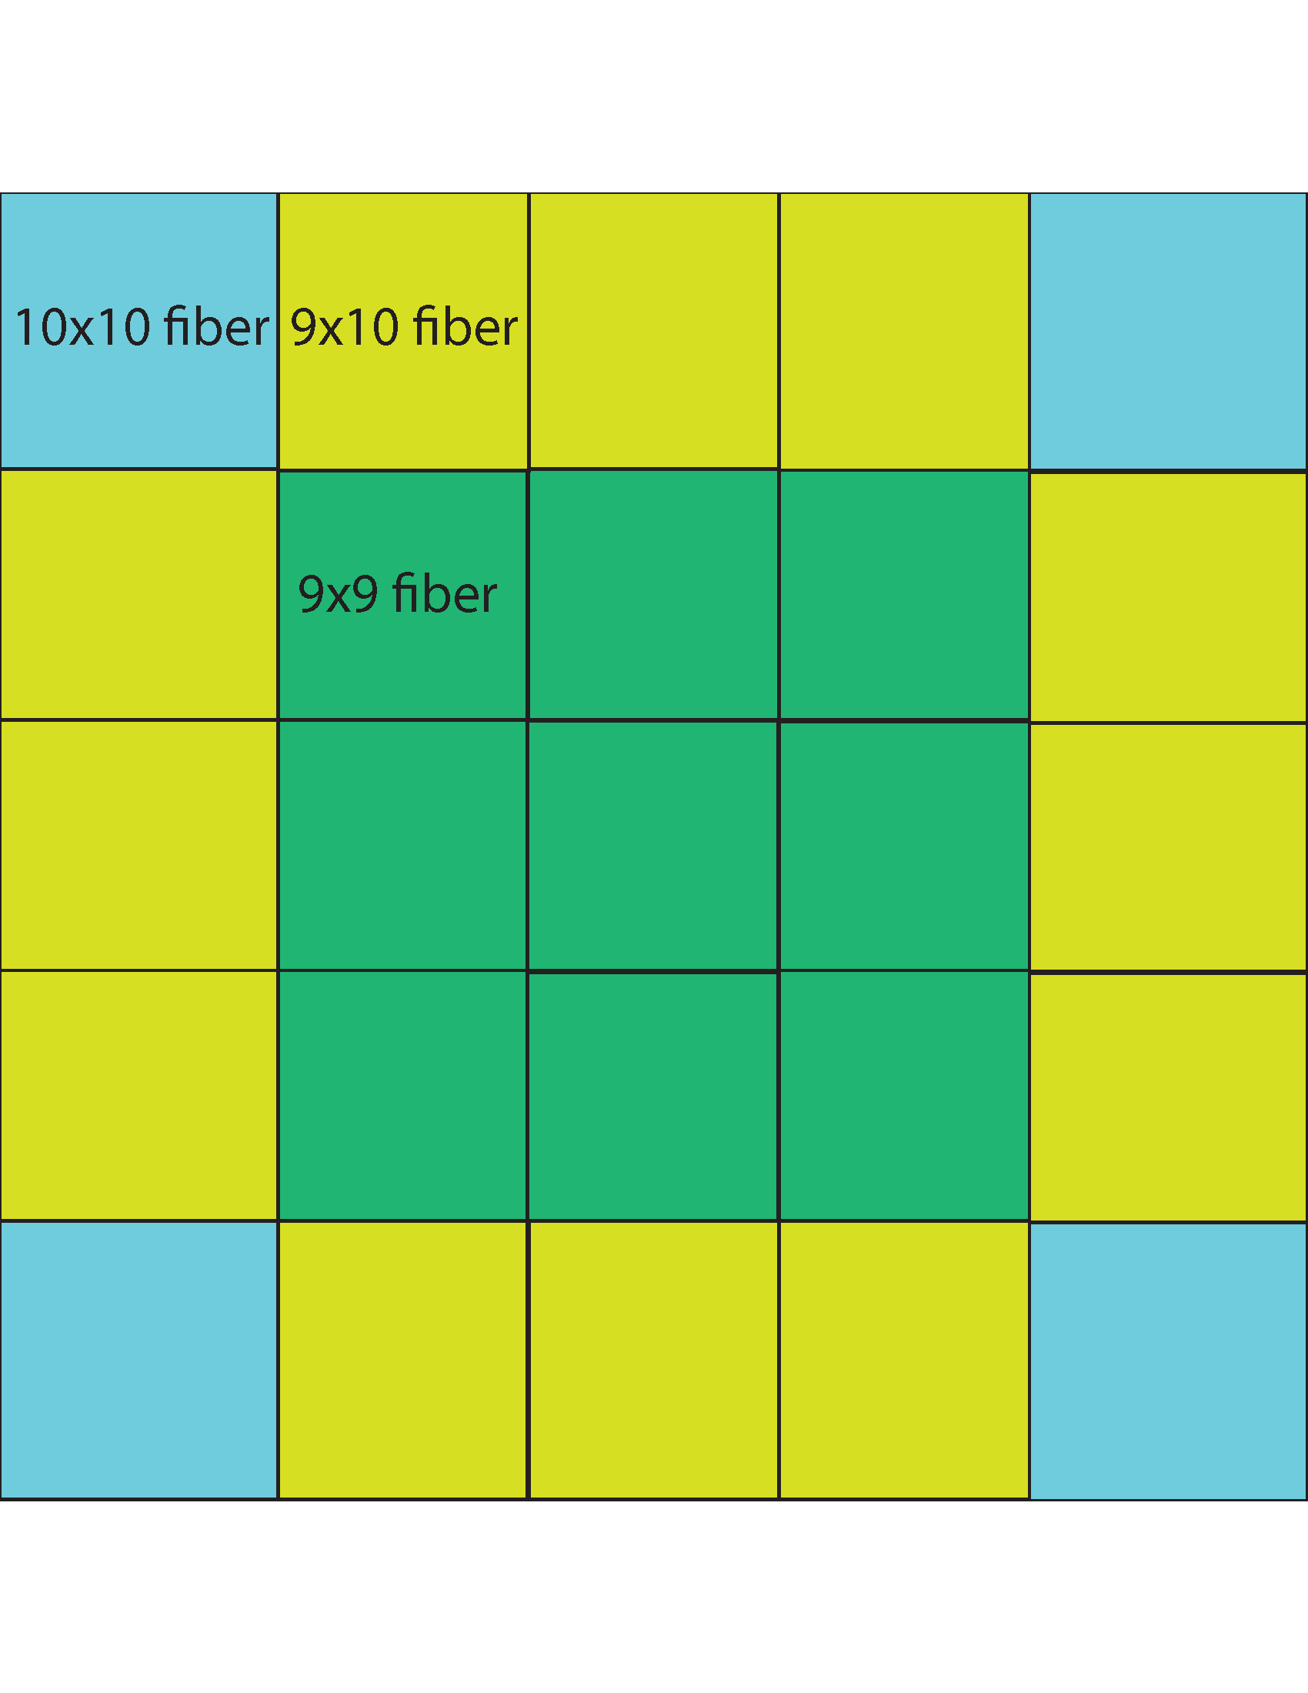
Light Guides
Light guide design - less constrained than central barrel EMC
Big pain in the tuchus – E864 modules is 47x47 array of fibers (unit cell is 0.2128cm), can’t get a uniform array of towers of the same size!!
Manufactured by hand in Ames - $4032
Solution – use an array of 25 light guides (nine 9x9 fiber light guides, twelve 9x10 light guides, four 10x10 light guides)
15 cm long, taper down to a 1.27cm square
(2x2 array of 3mm SiPMs, 22.3% of active area)
10x10 light guide
(2.128 cm)
9x9 light guide
(1.915 cm)
9x10 light guides
(1.915 x 2.128 cm)

Slide 4
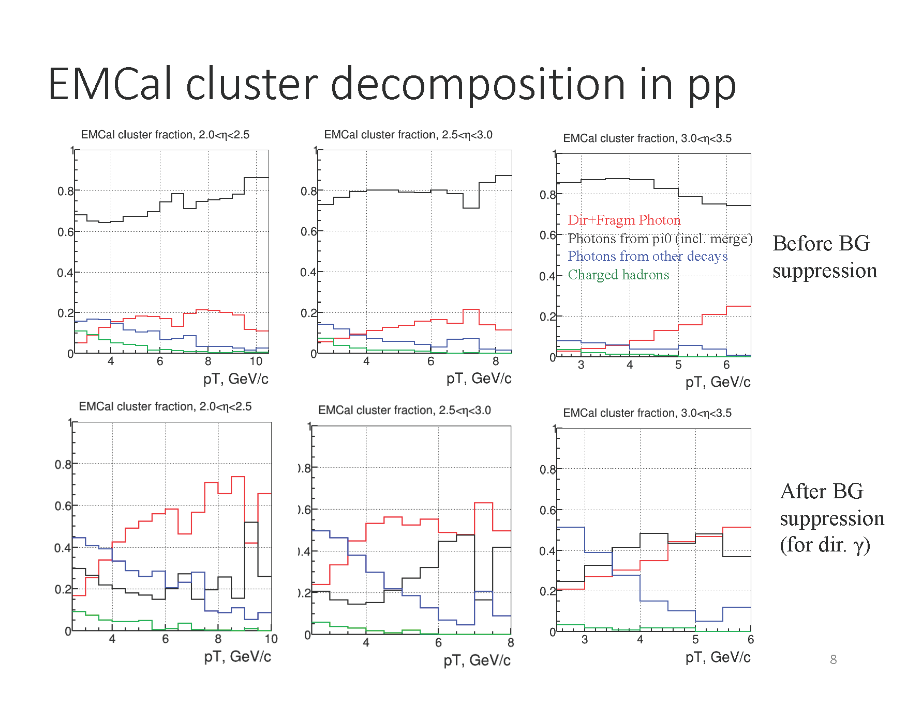
Gamma/π⁰ Separation
Full G4 simulations – cluster decomposition and hadron rejection makes prompt photons possible.

Slide 5
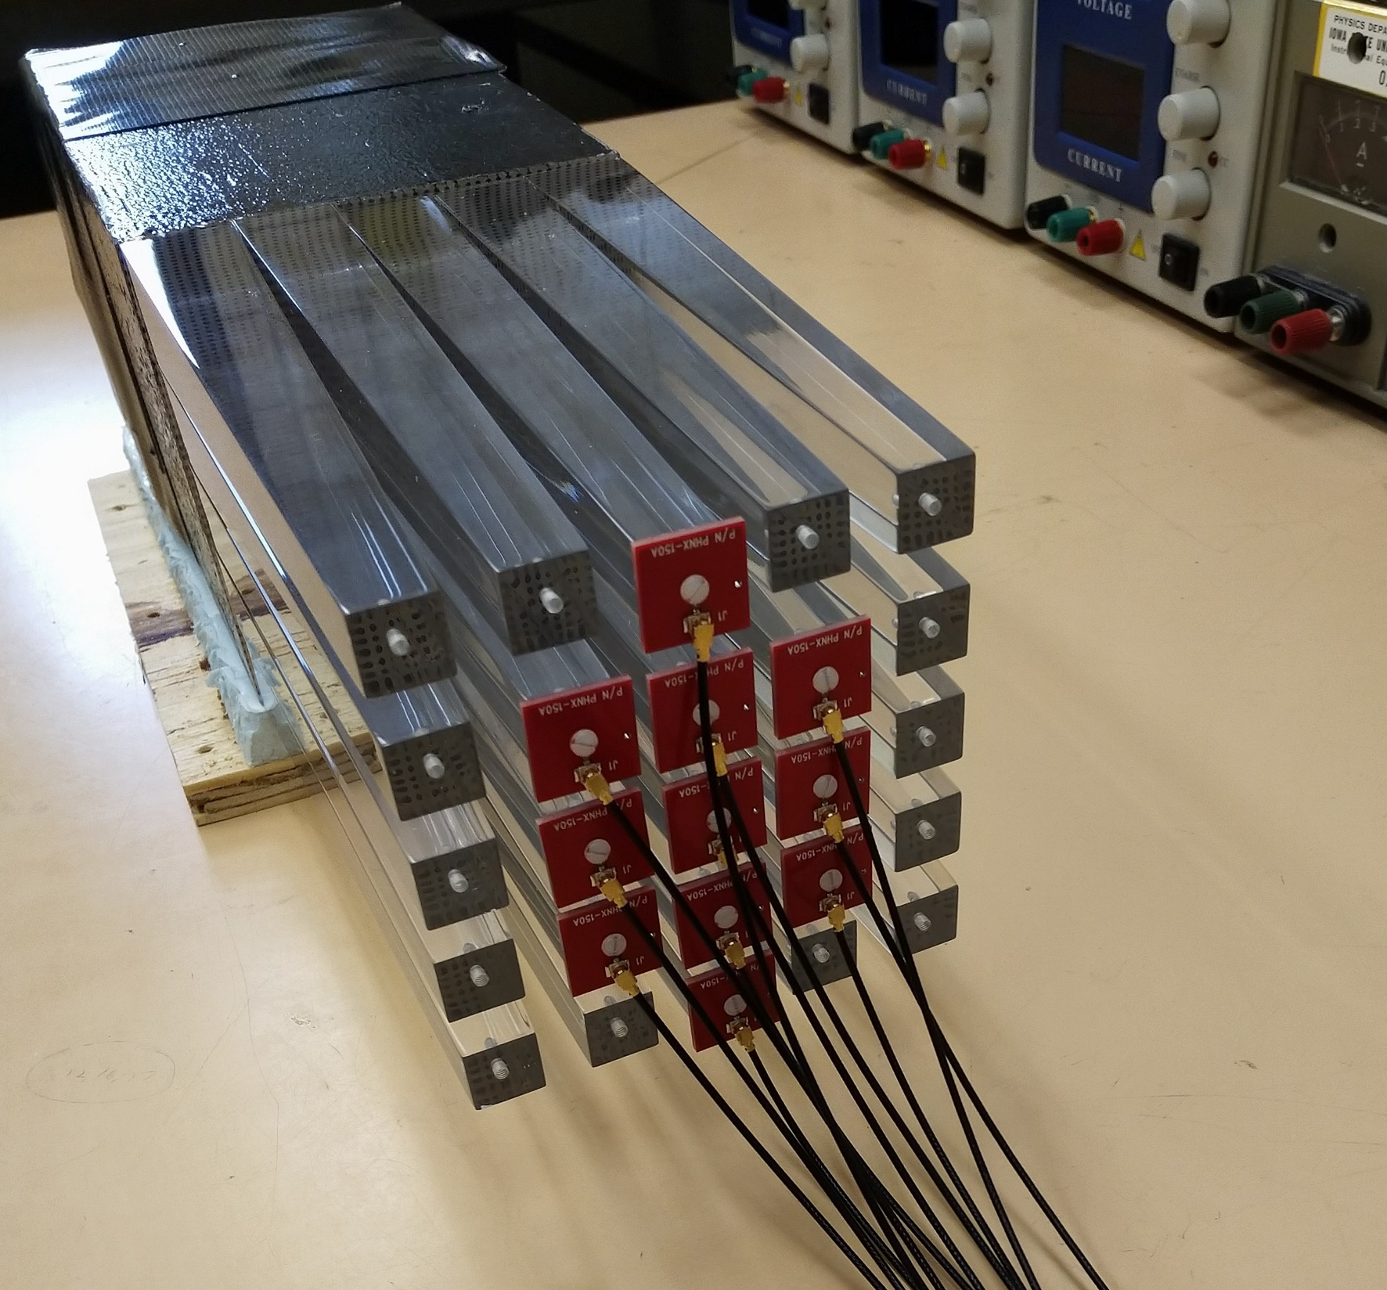
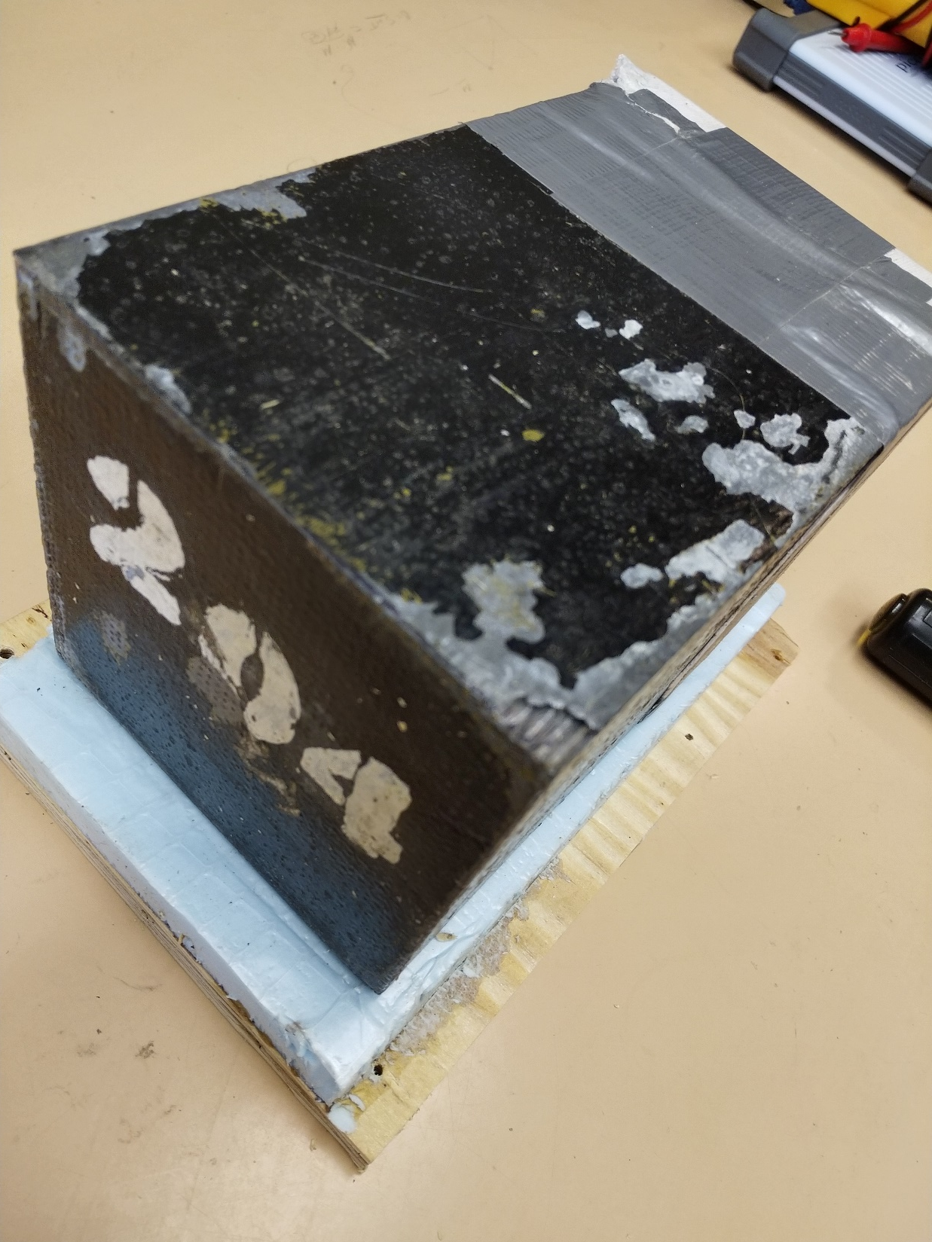
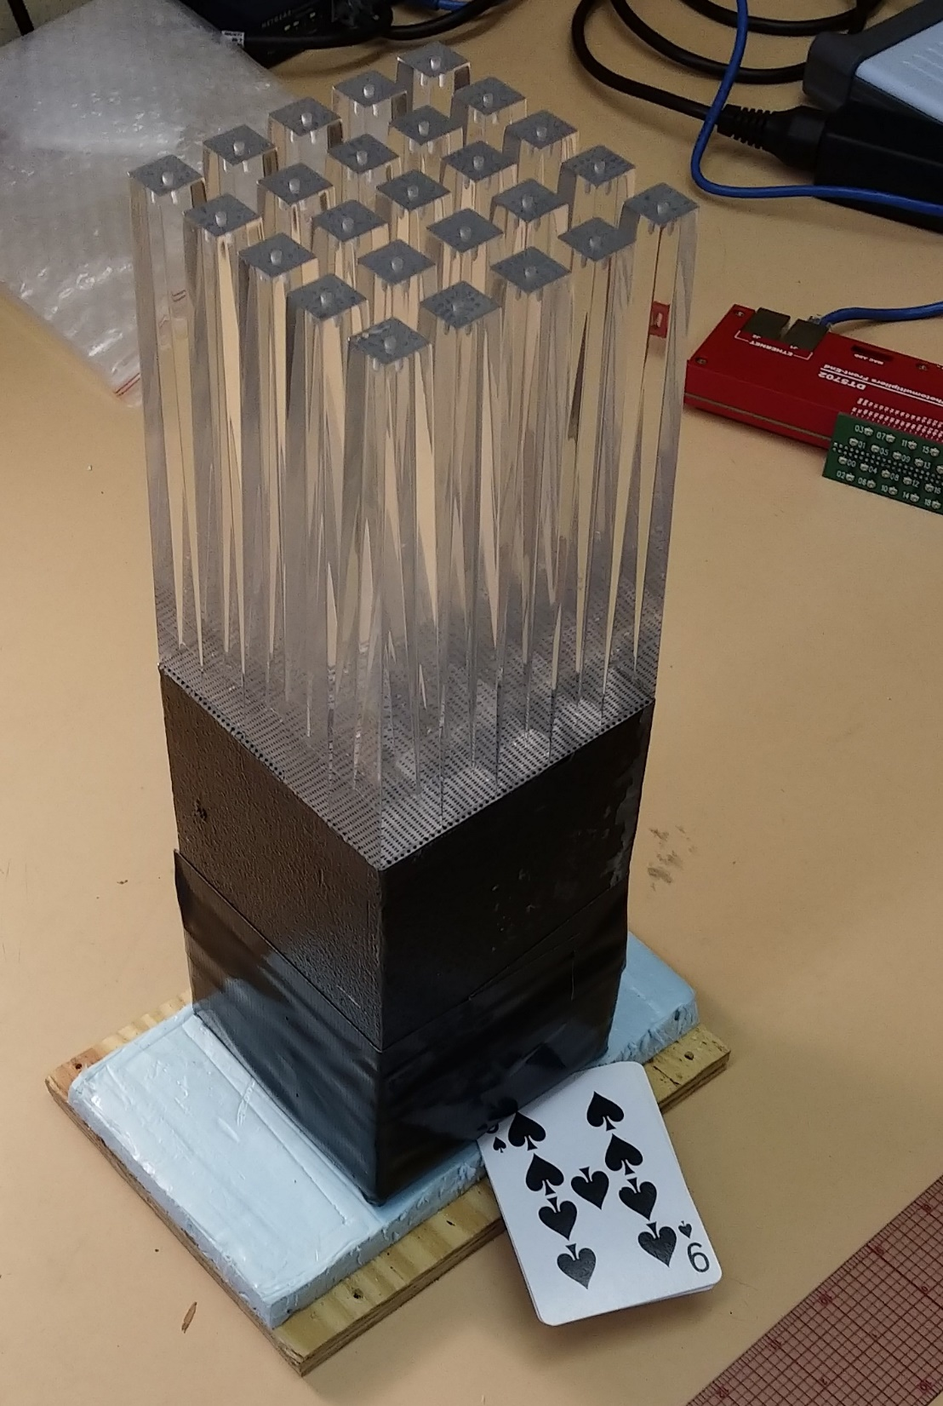
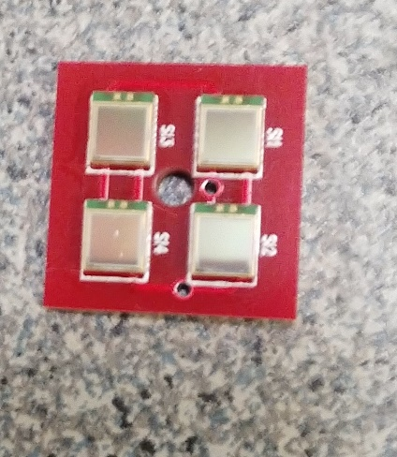
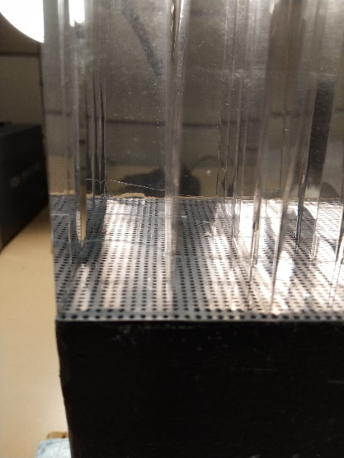
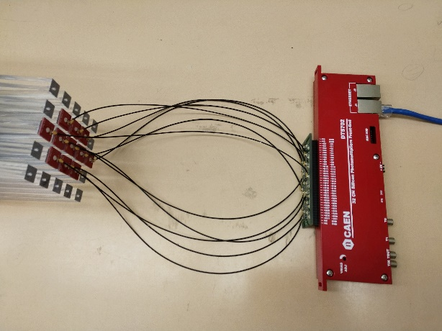
Prototype Development at ISU
SiPM readout boards installed (Hamamatsu 12572-015P)
Light guide array glued in place (Eljen EJ-600)
Cut module obtained from SBU
SiPM boards courtesy of Eric, Steve and Sal
CAEN DT5702

Slide 6
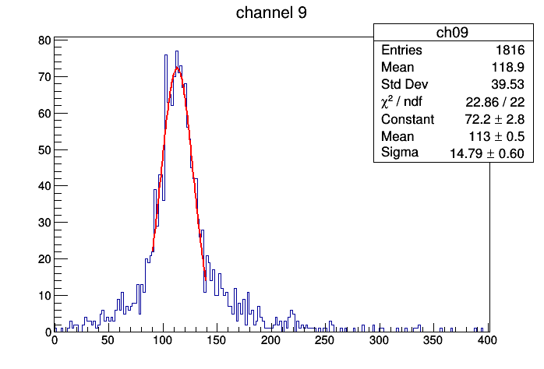
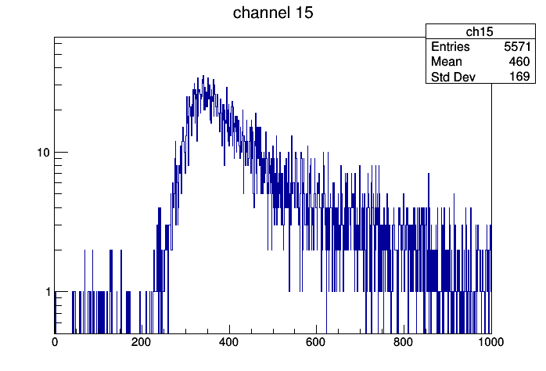

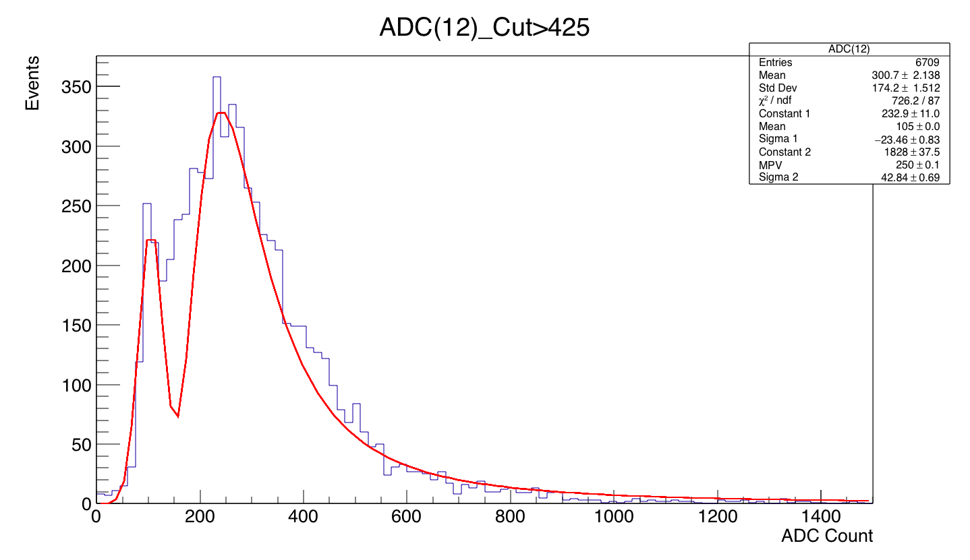
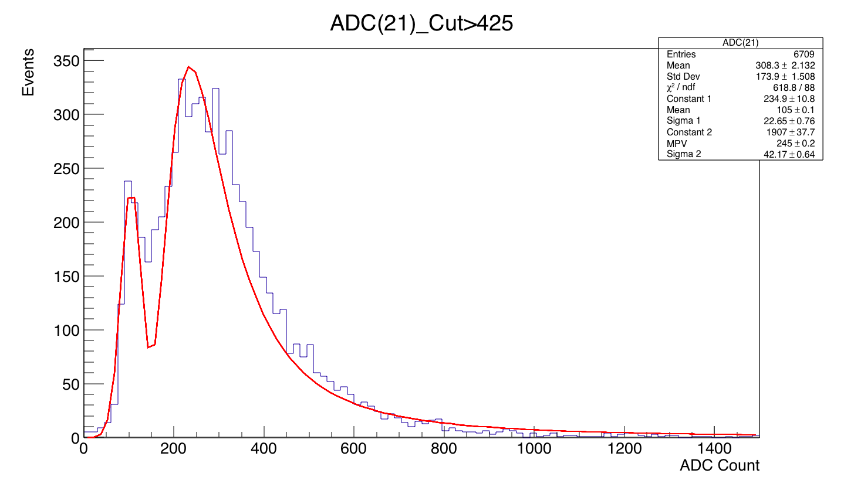
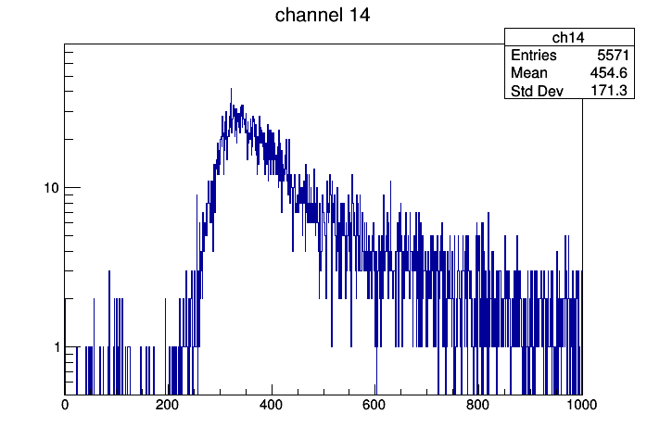
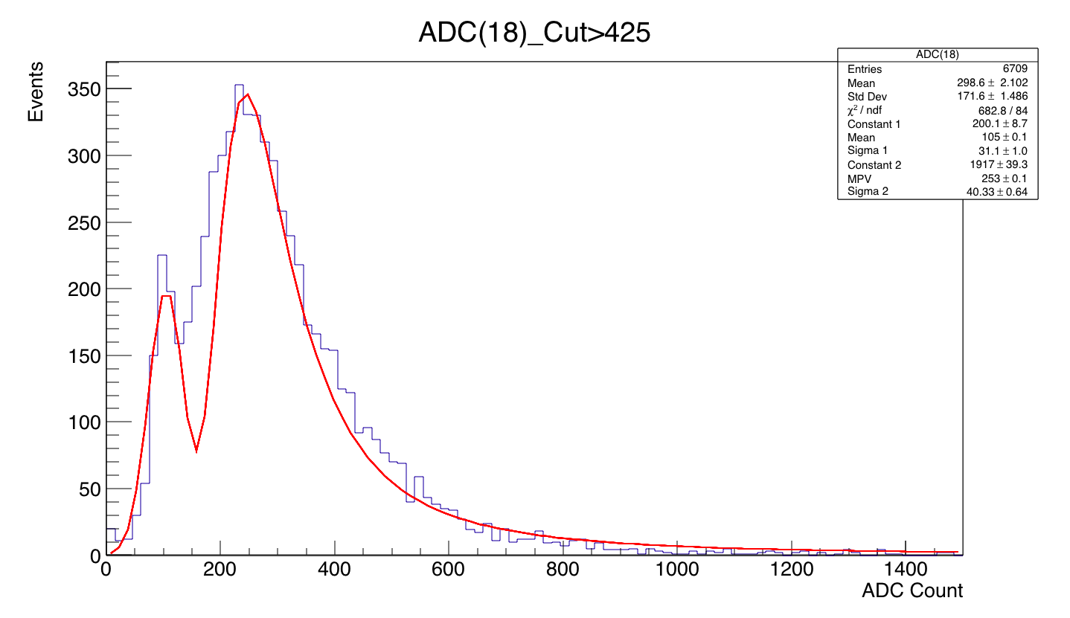
Cosmic Muon
Off-Axis Tower
(Pedestal)
Cosmic Ray Landau plus Pedestal (fit to Gaussian + Landau)
trigger threshold
MPV: 145 counts above ped.
Top and Bottom Trigger Towers
MPV: 140 counts above ped.
MPV: 148 counts above ped.

Slide 7
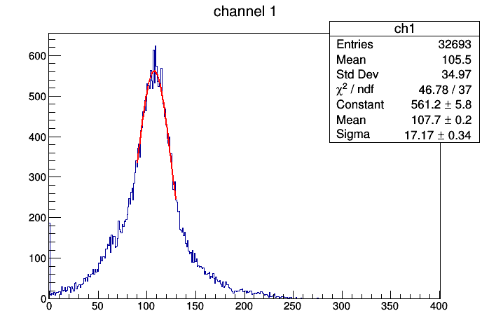
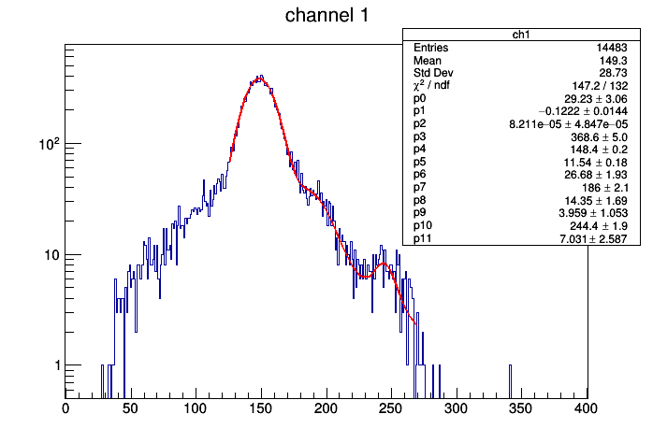
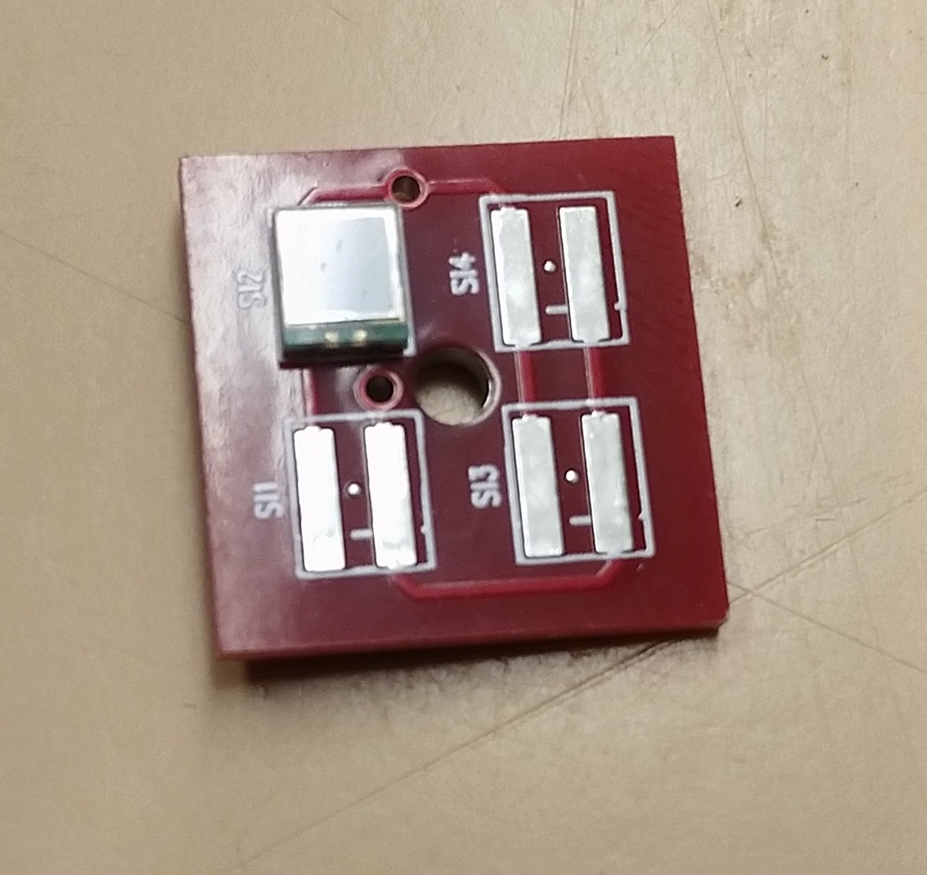
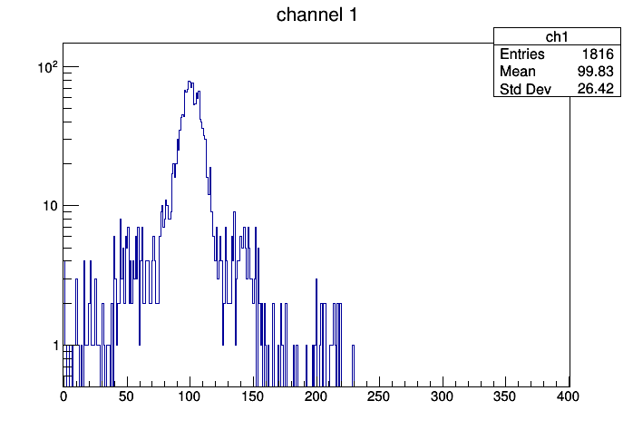
Previously - Single Pixel Peak
Tested with single SiPM on quad-board, V_{op} = 68.4V
Pedestal – noise trigger on another channel
Exposed to LED 1.65V (DAC1 threshold 215)
First peak minus ped = 40.7
Second peak minus ped/2 = 39.2
Third peak minus ped/3 = 45.6
Second minus first peak = 37.6
Third minus second peak = 58.0
Third minus first peak/2 = 47.8
Evidence for single and double pixel peaks in cosmics triggered data.
Approximately 45 ADC cts/pixel

Slide 8
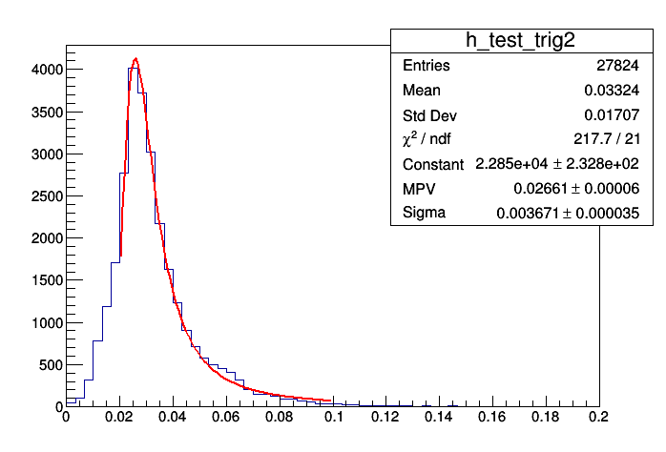
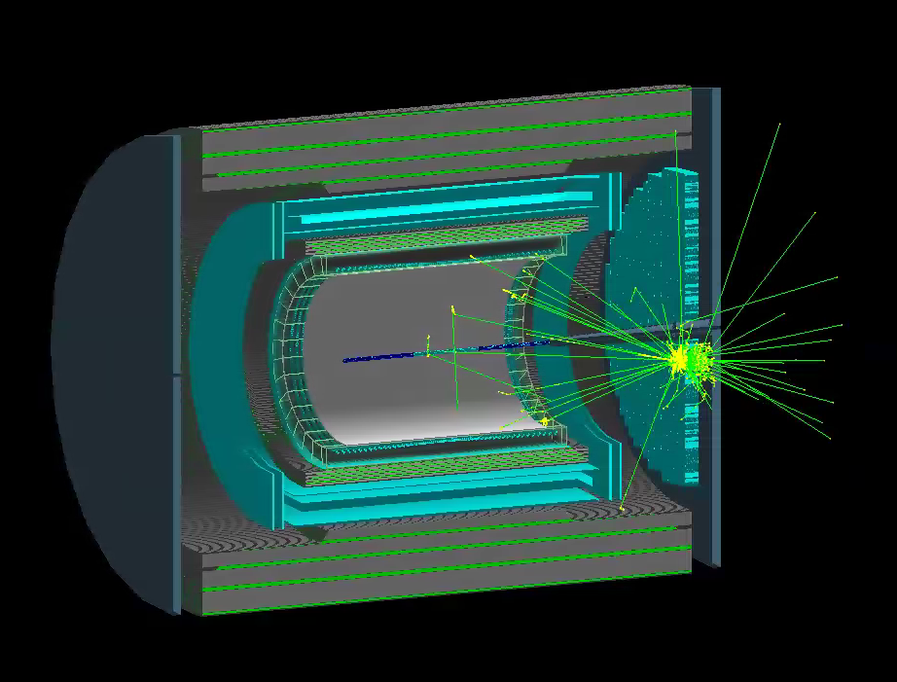
Prior Simulations and Calibration
Cosmics energy response determined with vertical muons down into fEMC stack in standard G4 setup (3% sampling):
Full simulation setup exists in G4:
30 GeV photon shower in G4
MPV is 26.6 MeV
~3 pixels/0.0266 GeV = 113 SiPM pixels/GeV
NIM A 406 (1998) 227-258:
136 +/- 5 p.e. /GeV (BCF-10, cosmics)
217 +/- 68 p.e. /GeV (BCF-12, laser)
deposited energy (GeV)
The fact that these numbers are so close seems like more of an accident:
E864 module is 117cm long, no reflector, 10cm tower, longer light guides, larger cathode area….
23+ years of age
Performance should be adequate above a few GeV, note that energies higher in forward region.

Slide 9
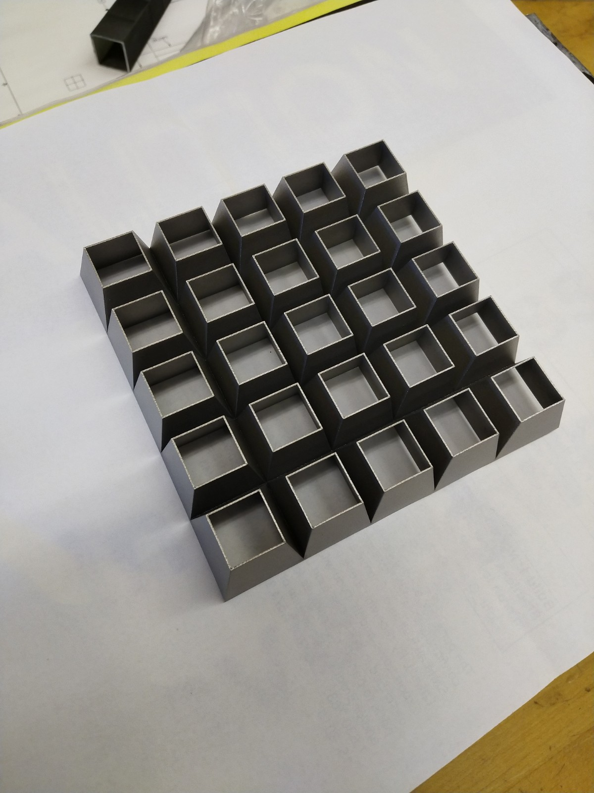
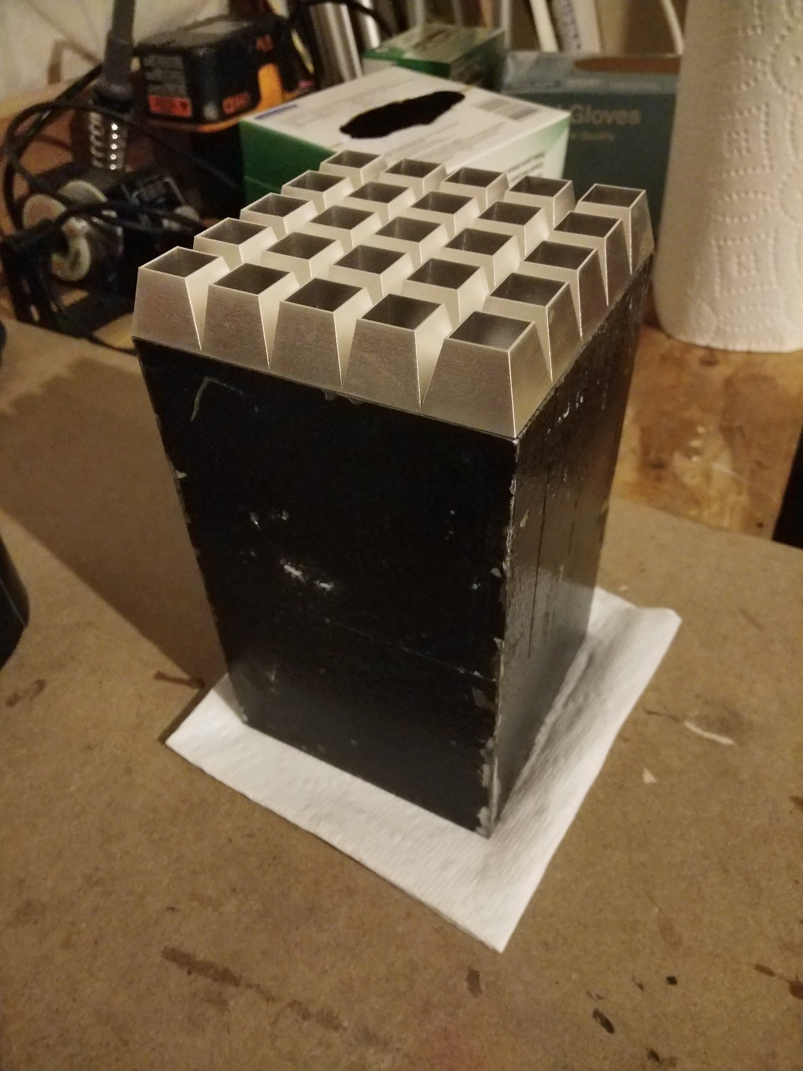
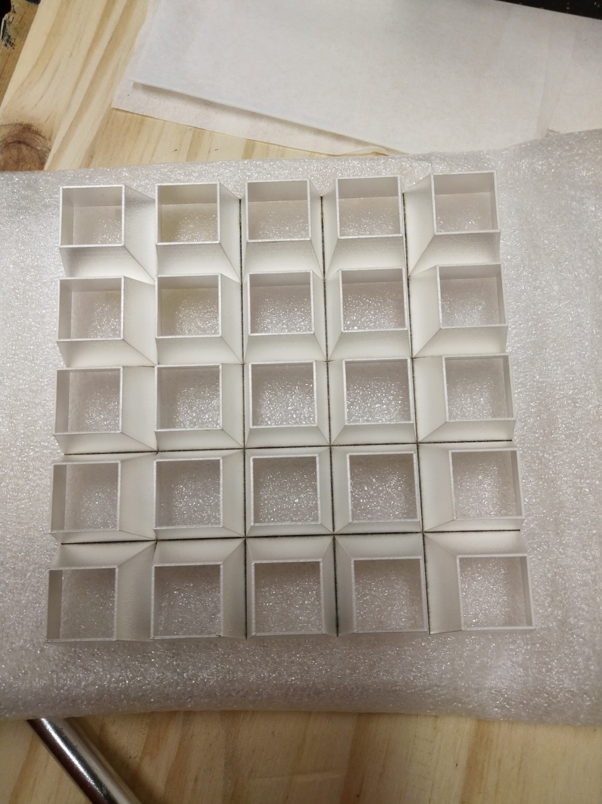
Prototype Light Guide #1
3D printed in stainless steel, Ag plated (surface not polished)
1.7 cm tower length limited by 0.4mm wall thickness, 30μm layers
Polishing tower interior not done prior to plating – concern over breakage
Plating:
83μm Cu (level)
4μm Ag
Ag chosen for reflectivity at 400nm. Surface reflective but not specular.
One-piece, installation easy
Epoxied in place with Eljen EJ-600 by layering a thin coat on the end of the module.

Slide 10
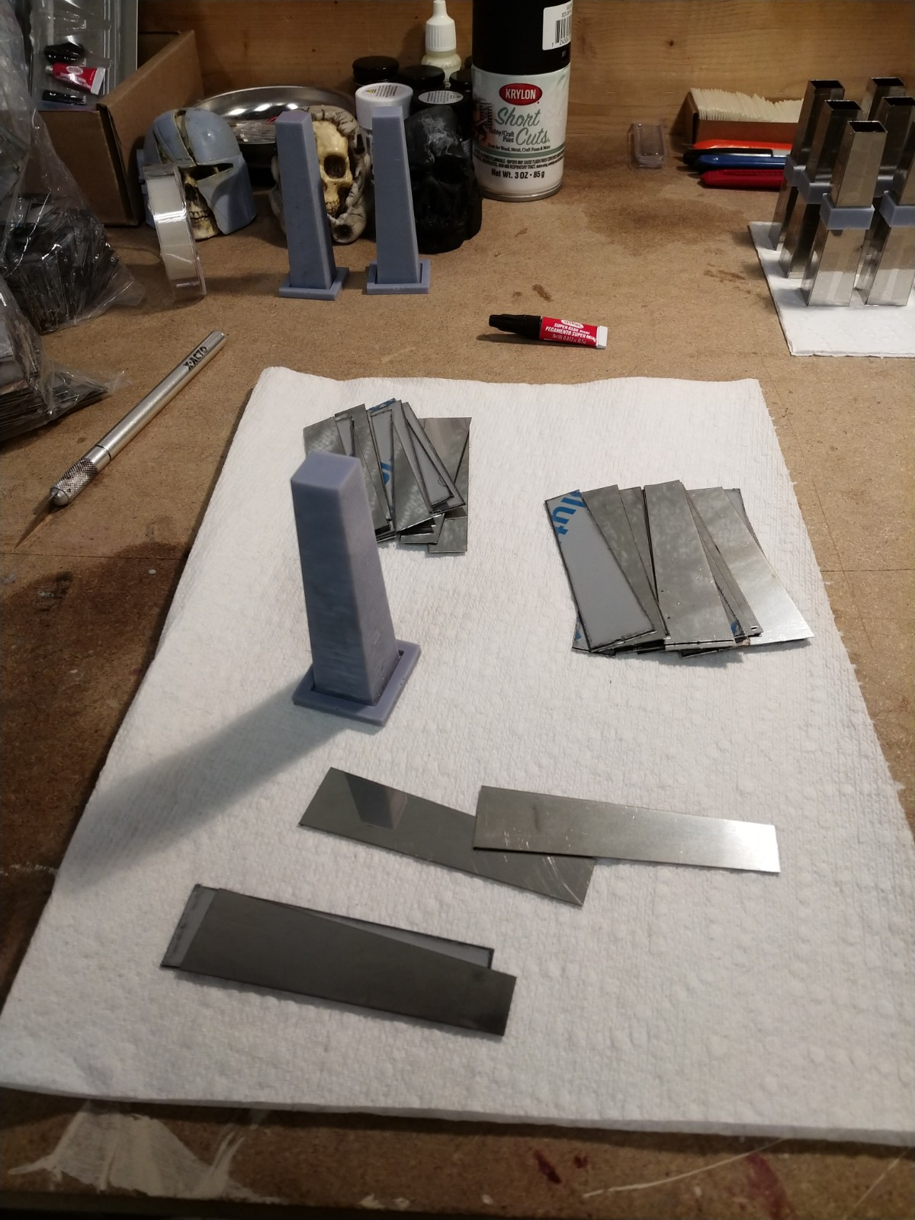
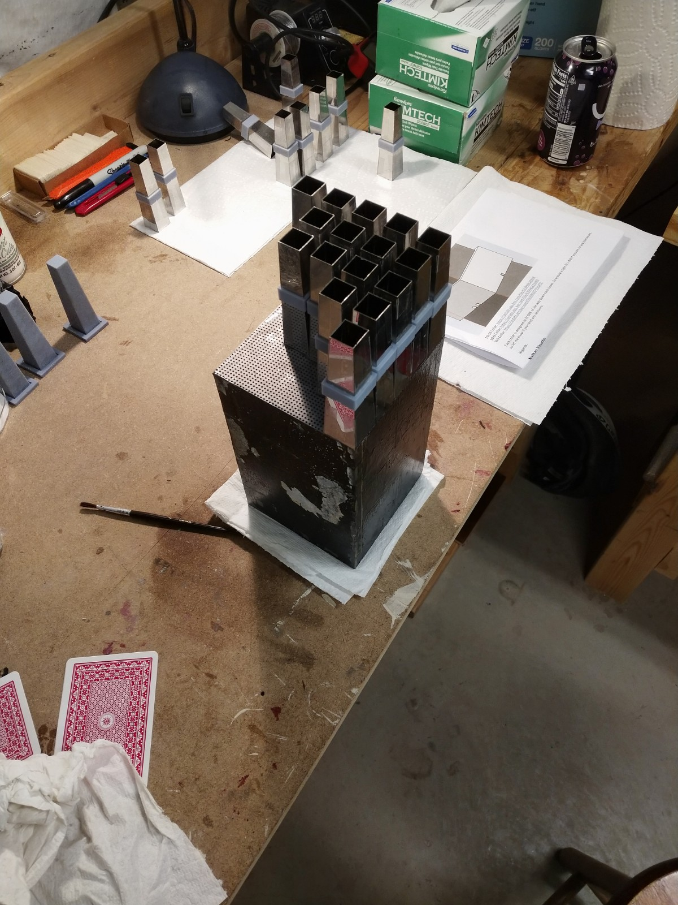
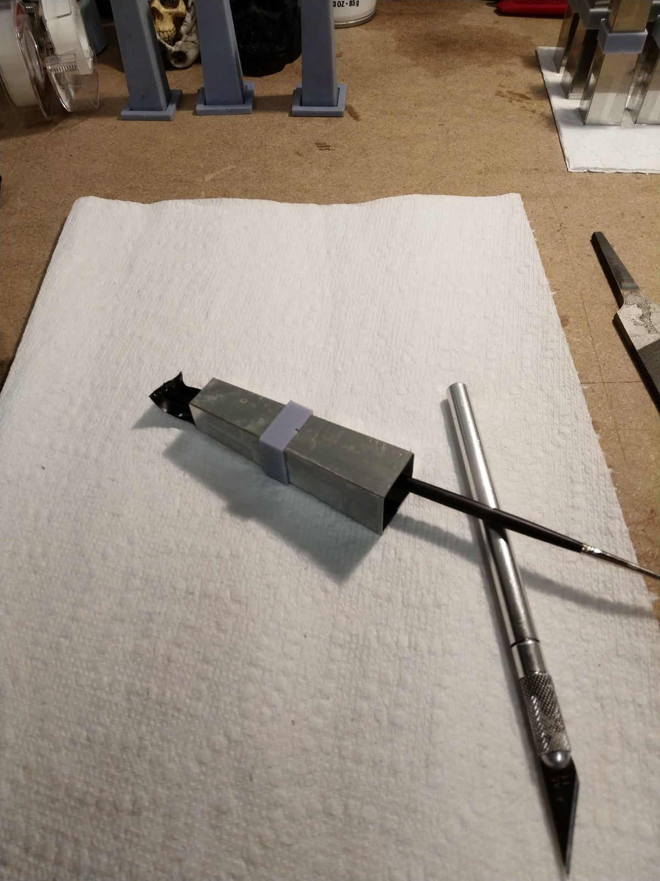
Prototype Light Guide #2
Assembled from 304 mirror polished stainless, laser cut to three different shapes.
26G (.0178” or 0.45mm thick)
7.5 cm long towers
Assembled on 3D printed jigs, fixed with tape and 3D printed collars
Labor intensive!
Truly mirror surface. Protective plastic removed after assembly.
Individually set into place on tower with surface coated with Eljen EJ-600
Surprisingly easy to get towers set after first row in place.
Very low cost, excluding labor

Slide 11
LAPPD Readout?
Suggestion by Alexander Kiselev to use 10x10cm LAPPD’s
Pad plane segmentation determines tower size
Much more straightforward than a light-guide solution

Slide 12
Thoughts on Implementation/Budget
A real budget requires a lot more work on open issues:
Light guides
Electronics (optimization, economy of scale)
Test beam performance
We can get a feeling from the following:
Machining costs unknown (contributed?)
Light guides at the current cost would be $3.8M
Well, that won’t work…..
Copy of fEMC electronics would cost per Eric Mannel:
Front end $35/channel, back end $70/channel, SiPM $9 per device
Net $140/channel
Yields $3.26M, perhaps $250k more for readout
This is just an honest start – needs value engineering….

Slide 13
Summary
Potential exist to re-use E864 hadronic calorimeters modules as Pb/Scifi EMCal
Cut down to 16cm
Potential to read out with fine segmentation
gamma/π⁰ separation
Gang channels to save cost, finer readout an upgrade option?
Expected performance consistent with similar options, ~13%/sqrt(E) with a few percent constant term
Prototype modules still seem to be alive
Readout is an unsolved challenge – needs test beam
Light guides/SiPM?
LAPPD’s?
Center-edge uniformity needs to be quantified.

Slide 14
BACKUP

Slide 15
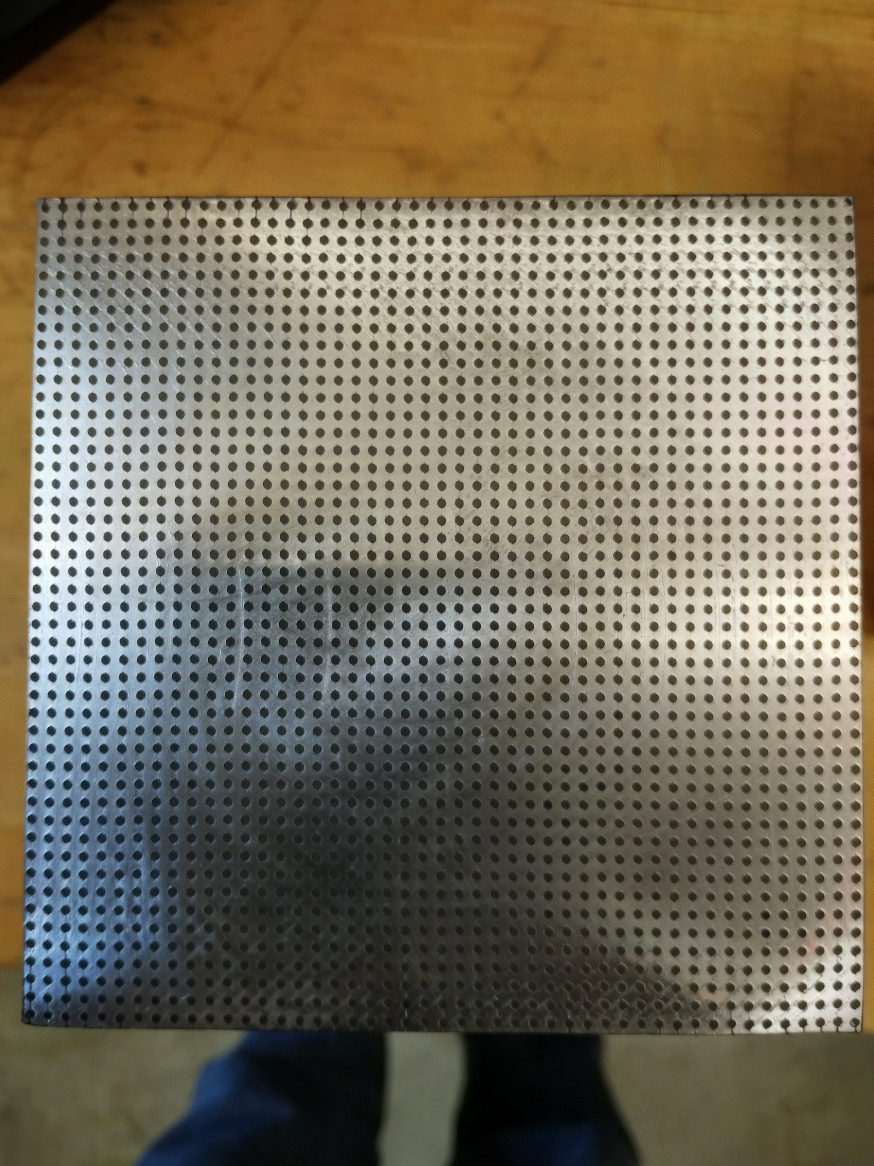
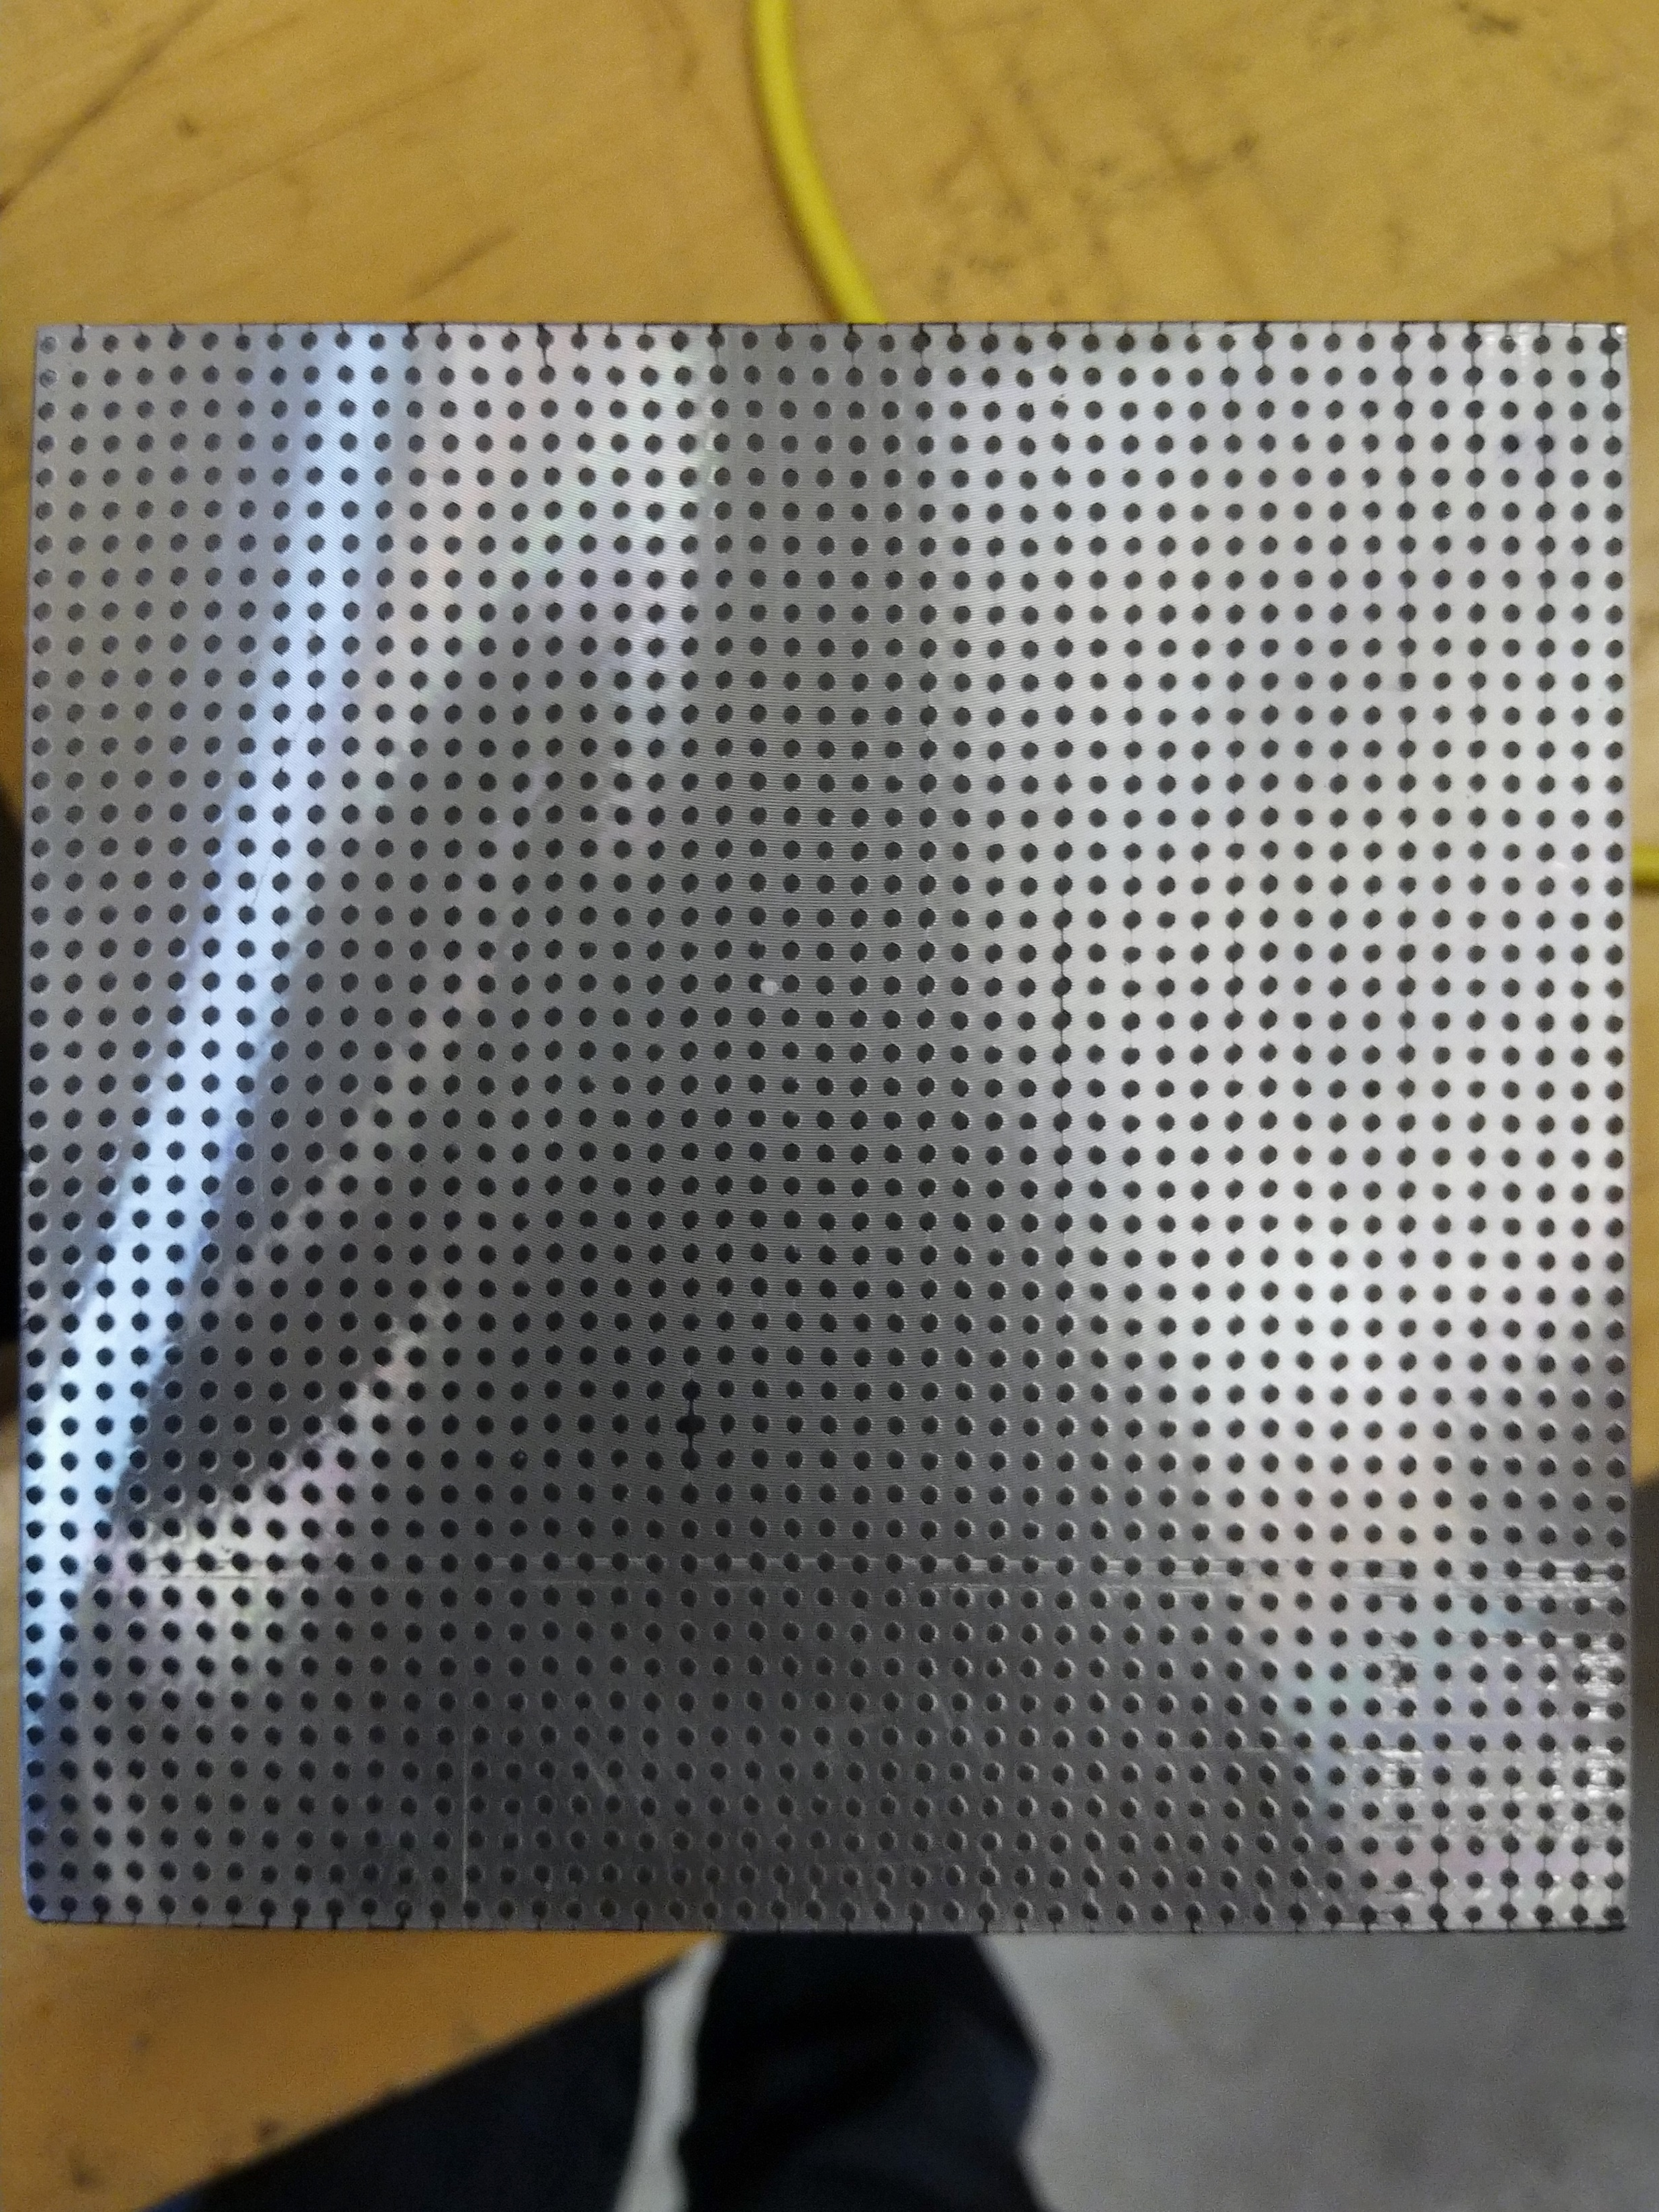

Slide 16
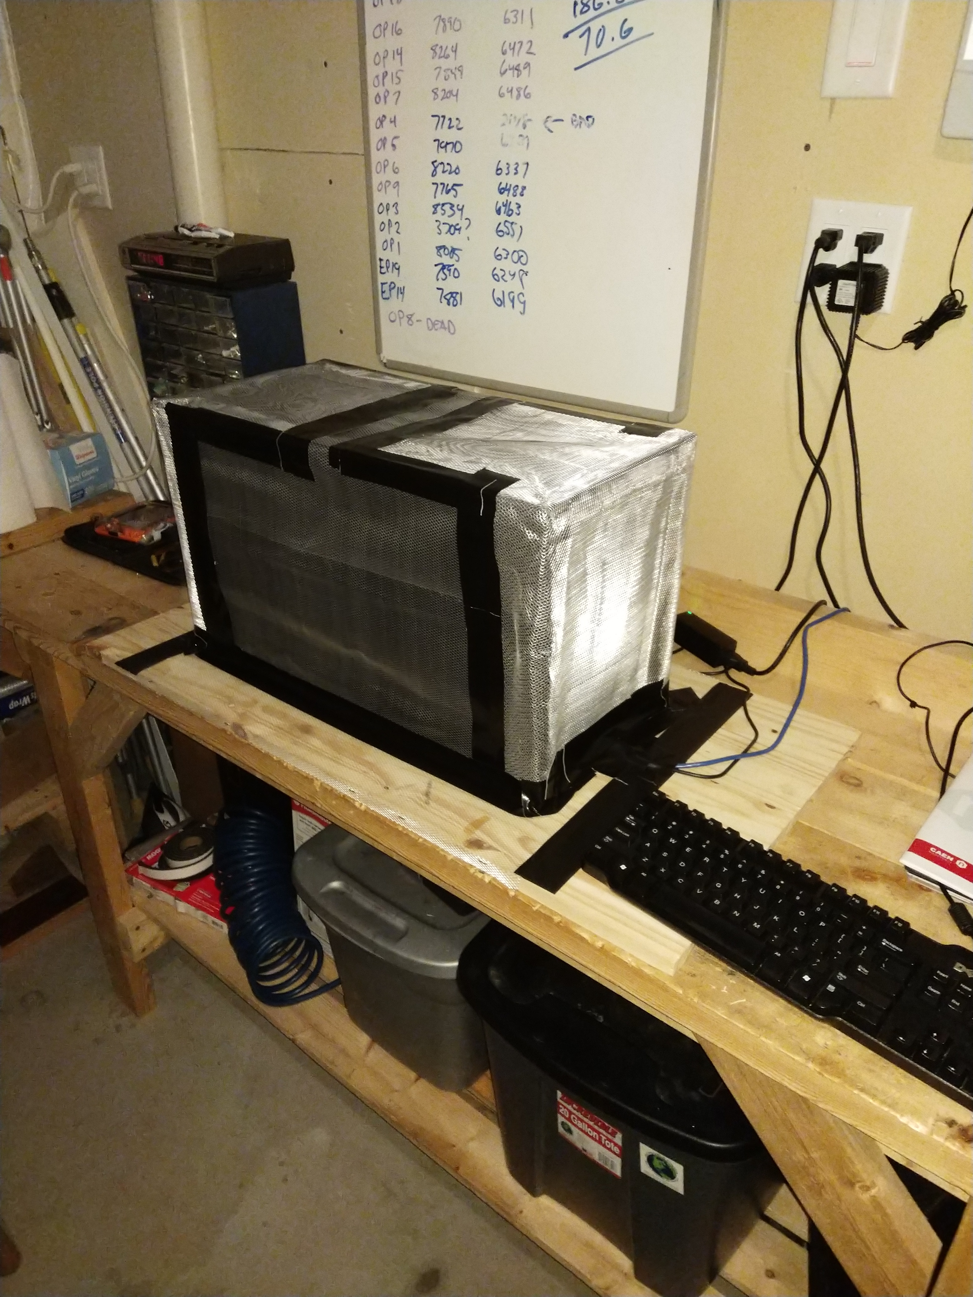
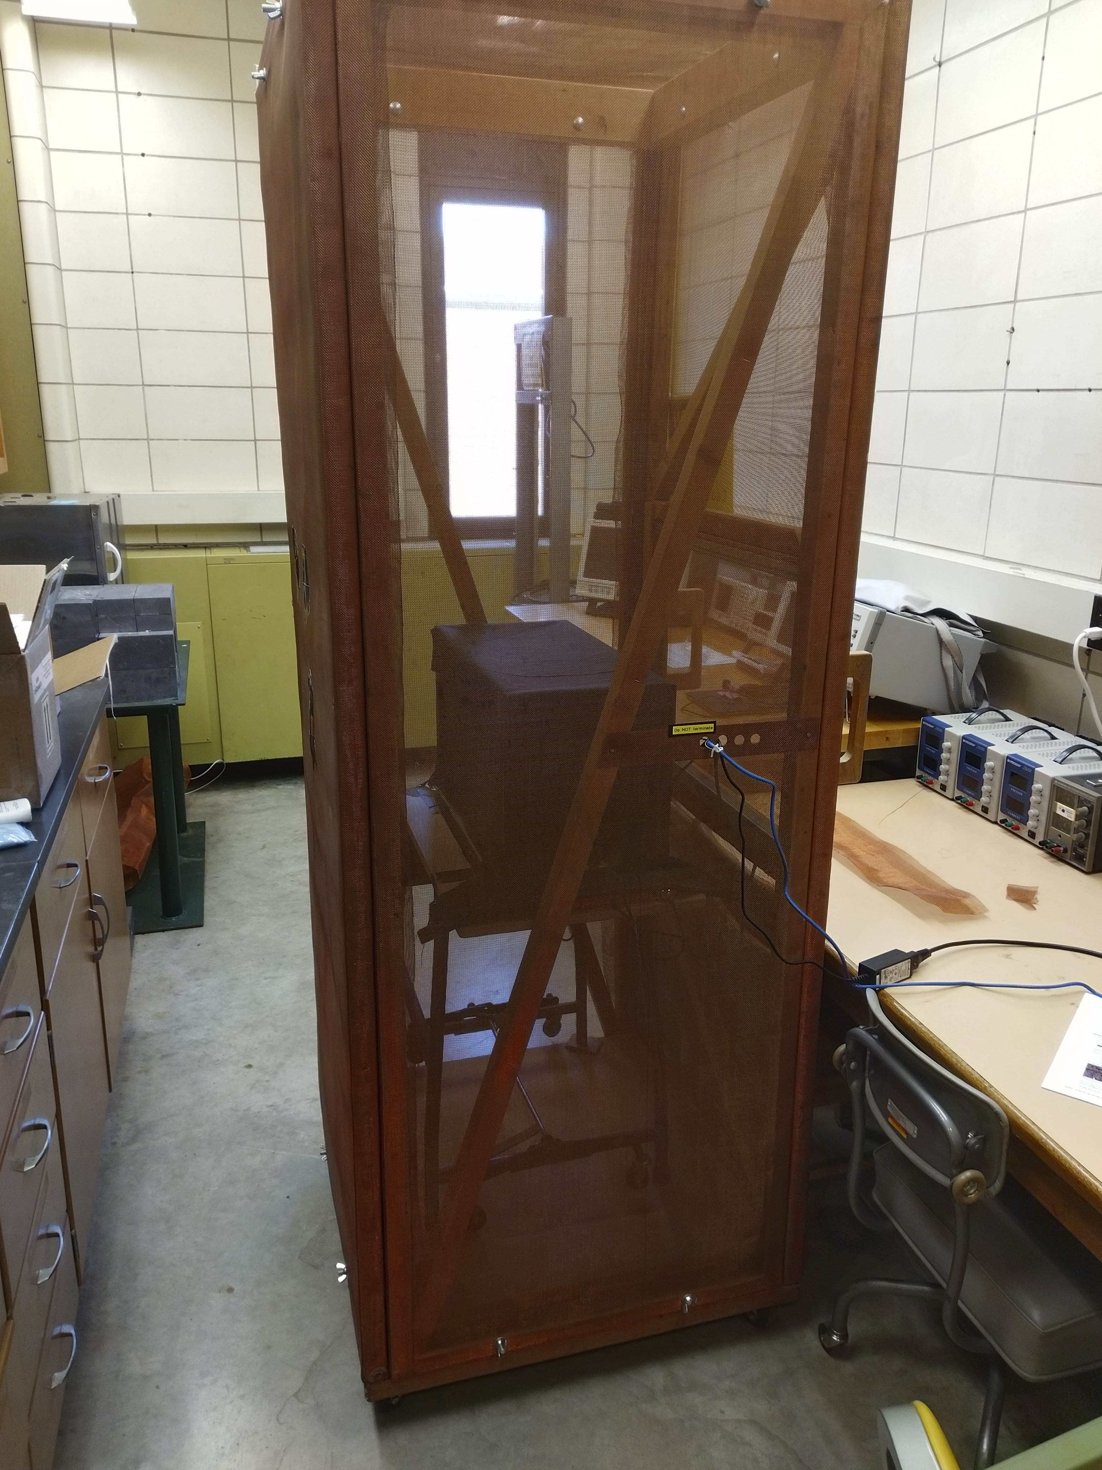
Noise and Shielding
In My Basement:
In P&A Lab:
Faraday
Cage
The CAEN DT5702 is very susceptible to external sources of noise, especially the trigger circuit. Best results obtained by shielding the detector and electronics inside a Faraday cage.
Dark Box

Slide 17
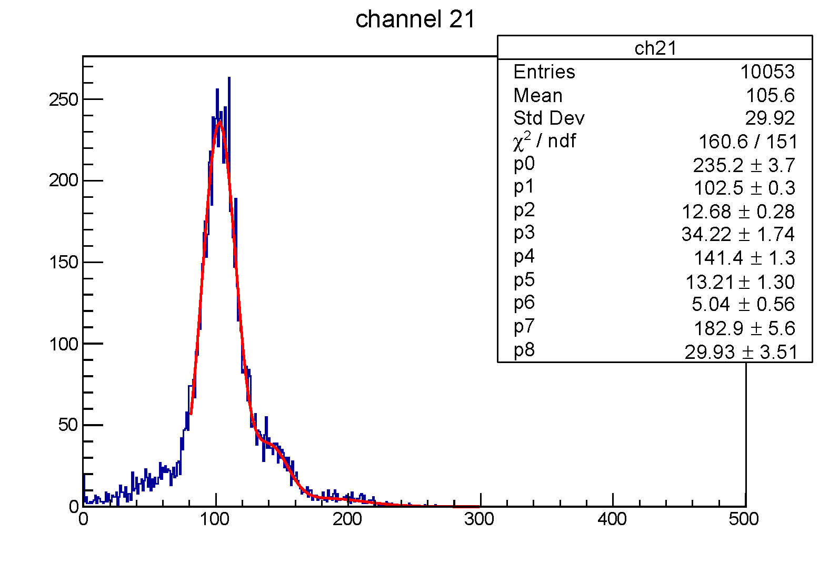
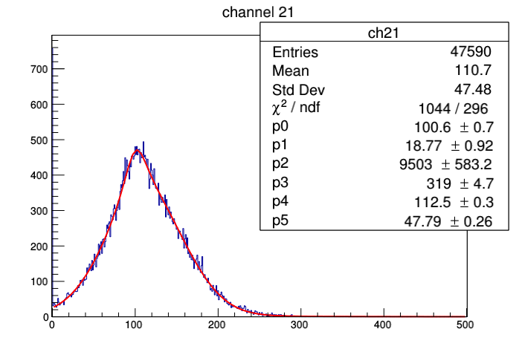
Pedestal Width
After shielding:
Without shielding:
Pedestal – noise trigger on another channel

Slide 18
Light Guides
Light guides are critical to this project:
Need to minimize non-uniformities between towers
Both within and between blocks!
Must reduce the cost
Right now it’s the most expensive item!
Original light guide design by Dan Cacace, some TracePro studies done to optimize length
Purchased TracePro license for ISU, additional studies by Ian Delk (ISU undergrad)
Looked at alternate design, optimize for light that is seen by SiPMs.
In contact with Oliver Rapp at NN, Inc. about injection molding
Didn’t balk at 15cm modules…
Need to send him a 3D model of what we want
Waiting on conclusions of light guide studies (next slides)…

Slide 19
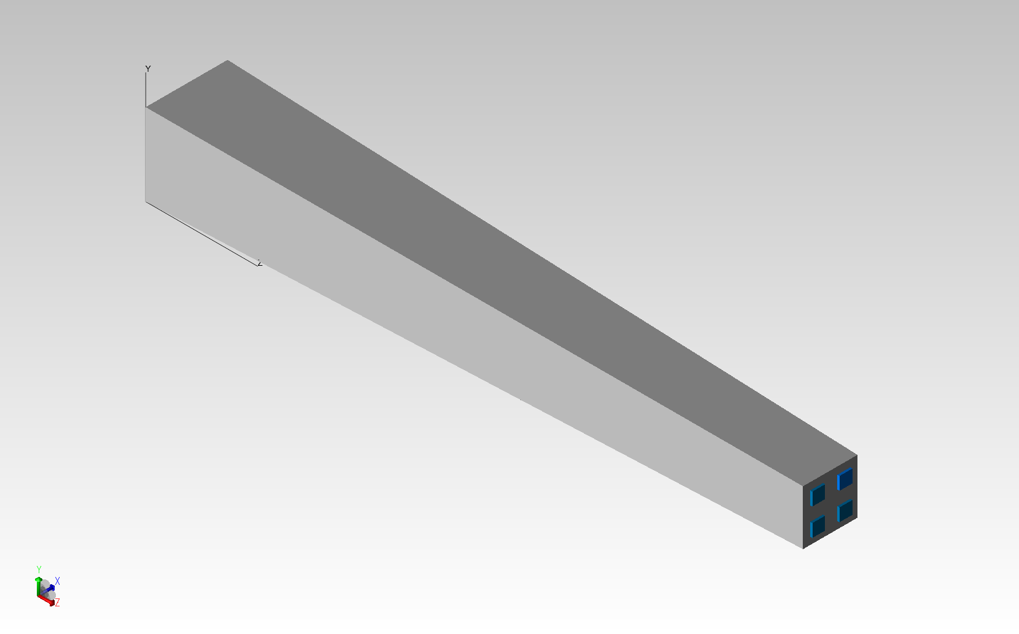
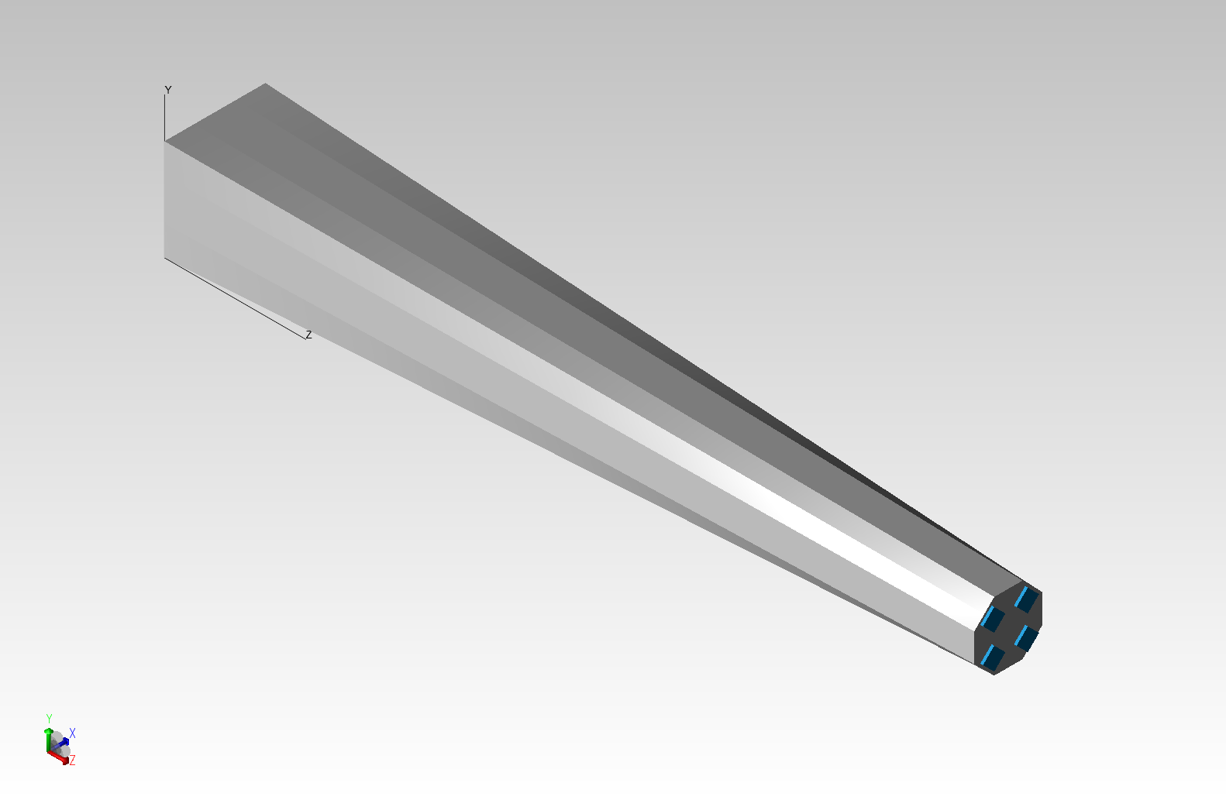
Light Guide Optimization (I)
1
2
3
Nine different light sources
a
b
4
5
6
c
d
Standard tapered rectangle design
7
8
9
Alternate octagonal design

Slide 20
Light Guide Optimization(II)
1
2
3
a
b
4
5
6
Tapered Square 9x9 Light Guide – 150mm
c
d
 | Source 1 | Source 2 | Source 3 | Source 4 | Source 5 | Source 6 | Source 7 | Source 8 | Source 9
SiPM a | 17261 | 16690 | 16235 | 16642 | 16673 | 16966 | 16093 | 16727 | 17812
SiPM b | 16427 | 16635 | 17203 | 16548 | 16709 | 16531 | 18140 | 16480 | 16423
SiPM c | 16143 | 16676 | 17855 | 16730 | 16551 | 16822 | 17133 | 16501 | 16421
SiPM d | 18065 | 16544 | 16104 | 16909 | 16648 | 16767 | 16387 | 16424 | 17145
total | 67896 | 66512 | 67397 | 66829 | 66581 | 67086 | 67753 | 66132 | 67801
% Dev | 0.011717 | -0.00891 | 0.004282 | -0.00418 | -0.00788 | -0.00035 | 0.009586 | -0.01457 | 0.010302
7
8
9
Deviations from mean of order 1%
Octagonal 9x9 Light Guide – 150mm
Deviations from mean of order 4-8%
 | Source 1 | Source 2 | Source 3 | Source 4 | Source 5 | Source 6 | Source 7 | Source 8 | Source 9
SiPM a | 16180 | 16598 | 23837 | 16839 | 21023 | 19692 | 23778 | 19615 | 17364
SiPM b | 23858 | 16786 | 15989 | 19615 | 21104 | 16643 | 17531 | 19545 | 23800
SiPM c | 23735 | 19592 | 17619 | 16627 | 21108 | 19520 | 15685 | 16607 | 23943
SiPM D | 17370 | 19807 | 23628 | 19604 | 21047 | 16933 | 23667 | 16758 | 15935
total | 81143 | 72783 | 81073 | 72685 | 84282 | 72788 | 80661 | 72525 | 81042
% Dev | 0.044787 | -0.06286 | 0.043885 | -0.06412 | 0.085204 | -0.06279 | 0.03858 | -0.06618 | 0.043486
Octagonal design gathers more light (rays) but has a larger center-to-edge variation.

Slide 21
Tapered Square 9x9 Light Guide – 100mm
1
2
3
 | Source 1 | Source 2 | Source 3 | Source 4 | Source 5 | Source 6 | Source 7 | Source 8 | Source 9
SiPM a | 17728 | 16578 | 16431 | 16265 | 16231 | 17203 | 16621 | 17068 | 18077
SiPM b | 16703 | 16268 | 18004 | 17085 | 16203 | 16478 | 17893 | 16864 | 16441
SiPM c | 16514 | 16932 | 17962 | 16320 | 16333 | 16905 | 17786 | 16389 | 16424
SiPM d | 17986 | 17065 | 16544 | 17138 | 16253 | 16341 | 16530 | 16539 | 17993
total | 68931 | 66843 | 68941 | 66808 | 65020 | 66927 | 68830 | 66860 | 68935
% Dev | 0.020201 | -0.0107 | 0.020349 | -0.01122 | -0.03768 | -0.00946 | 0.018706 | -0.01045 | 0.02026
a
b
4
5
6
c
d
7
8
9
Tapered Square 9x9 Light Guide – 50mm
 | Source 1 | Source 2 | Source 3 | Source 4 | Source 5 | Source 6 | Source 7 | Source 8 | Source 9
SiPM a | 18250 | 18238 | 20666 | 18086 | 18086 | 15508 | 20804 | 15556 | 9922
SiPM b | 20900 | 18066 | 18663 | 15580 | 15580 | 17974 | 10062 | 15299 | 21102
SiPM c | 20975 | 15733 | 10322 | 18065 | 18065 | 15274 | 18602 | 18390 | 10772
SiPM d | 9968 | 15306 | 21034 | 15370 | 15370 | 18138 | 20697 | 18106 | 18574
Total | 70093 | 67343 | 70685 | 67101 | 67101 | 66894 | 70165 | 67351 | 70370
% Dev | 0.022256 | -0.01785 | 0.030889 | -0.02138 | -0.02138 | -0.0244 | 0.023306 | -0.01773 | 0.026295
Octagonal 9x9 Light Guide – 100mm
 | Source 1 | Source 2 | Source 3 | Source 4 | Source 5 | Source 6 | Source 7 | Source 8 | Source 9
SiPM a | 7611 | 8827 | 23180 | 8505 | 21371 | 29374 | 23013 | 29692 | 23410
SiPM b | 22934 | 8928 | 7563 | 29644 | 21110 | 8886 | 23402 | 29172 | 22926
SiPM c | 22934 | 29563 | 23338 | 8838 | 21100 | 29574 | 7415 | 8832 | 23137
SiPM d | 23354 | 29618 | 23094 | 29455 | 21272 | 8816 | 23150 | 8853 | 7455
Total | 76833 | 76936 | 77175 | 76442 | 84853 | 76650 | 76980 | 76549 | 76928
% Dev | -0.01122 | -0.0099 | -0.00682 | -0.01626 | 0.091987 | -0.01358 | -0.00933 | -0.01488 | -0.01
Octagonal 9x9 Light Guide – 50mm
 | Source 1 | Source 2 | Source 3 | Source 4 | Source 5 | Source 6 | Source 7 | Source 8 | Source 9
SiPM a | 13318 | 13725 | 19784 | 13752 | 22214 | 24264 | 19598 | 24238 | 22612
SiPM b | 19776 | 13631 | 13309 | 24480 | 21969 | 13687 | 22553 | 24193 | 19806
SiPM c | 19578 | 24448 | 22712 | 13598 | 22186 | 24089 | 13216 | 13740 | 19796
SiPM d | 22645 | 24166 | 19572 | 24284 | 22166 | 13698 | 19697 | 13695 | 13413
Total | 75317 | 75970 | 75377 | 76114 | 88535 | 75738 | 75064 | 75866 | 75627
% Dev | -0.02271 | -0.01424 | -0.02194 | -0.01237 | 0.148797 | -0.01725 | -0.026 | -0.01559 | -0.01869

