Slide 1
Athena Calorimetry Discussion. 05/19/21 Technology choices. O.Tsai (UCLA)
Technology choice. Continuation and extension of YR discussions.
Traditional EM options were already extensively covered in YR.
Traditional HCal options somewhat discussed in YR (hadron endcap).
Imaging (PFA) calorimetry mentioned in YR, but have not been discussed in YR calorimetry WG.
Propose to allocate sufficient time in next WG meeting to discuss:
Imaging calorimetry for barrel in general.
EM option in particular.
Will ask ANL group to lead this discussion.
Time is short, we should start this discussion using calor mailing list.

Slide 2
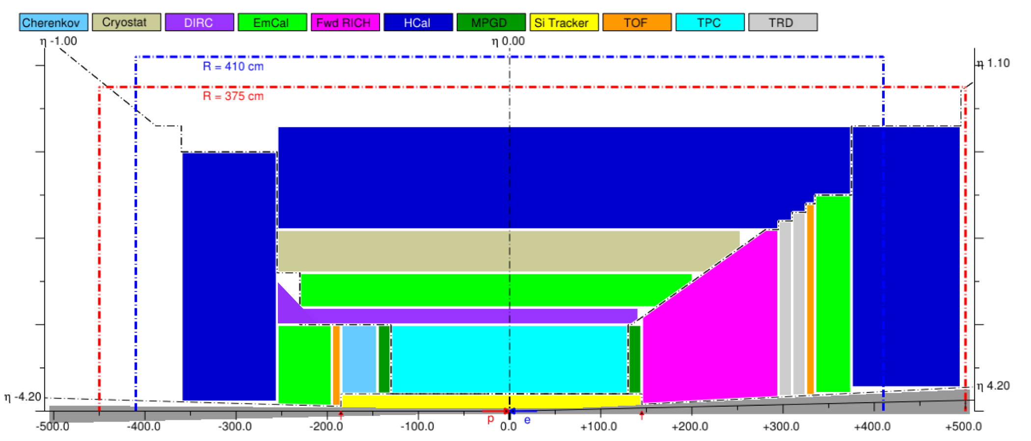
0
0
8
2
2
6
https://indico.cern.ch/event/361123/contributions/856620/attachments/1135126/1625995/KLM-Piilonen.pdf
EOI submitted to project https://indico.bnl.gov/event/8552/
Barrel Hcal (4)
eEndCap (0)
CORE

Slide 3
Barrel and Backward Hadron HCals.
Need to refresh requirements
‘Imaging’ calorimetry
Granularity vs resolution?
Granularity?
Propose to ask Jet and HF WG to join discussion next WG (Brian, Miguel…)
0
0
2

Slide 4
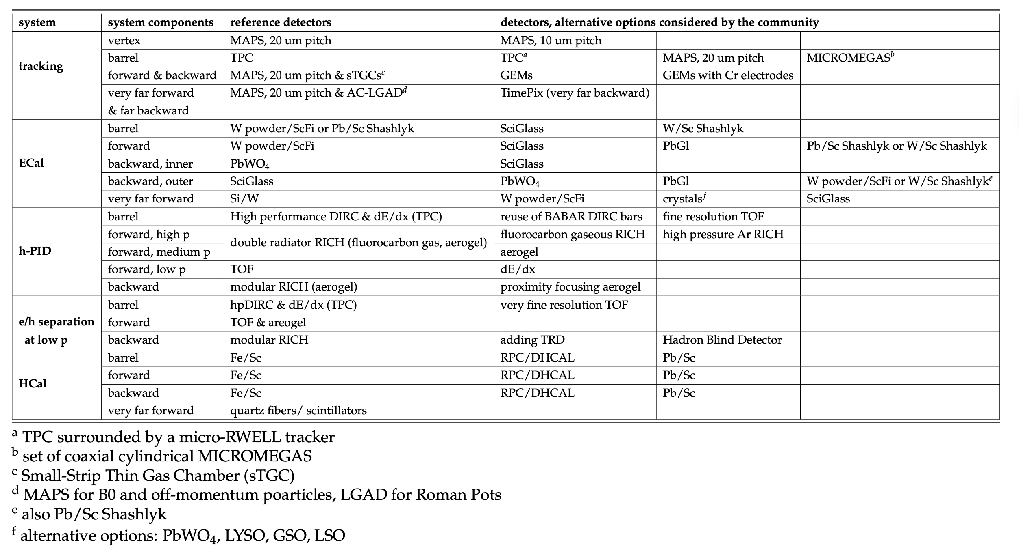
Can it be first option for barrel?
Neutron fluxes and RPC efficiency at EIC – estimates?
Contact experts in RPC
After we settle on requirements.

Slide 5
Discussion

