Slide 1
Upsilon Fast simulations
Assume known Hadron rejection factors calculated several years ago with geant4 simulations in central AuAu and estimate fake electron contribution and combinatorial background.
Assume measured cross sections for charm bottom and theory prediction for Drell Yan and estimate correlated (physics) background (mostly coming from Drell-Yan and bottom semileptonic decays).
Assume 100 MeV Upsilon mass resolution and extract Upsilon yield errors by fitting simulated mass distributions after background subtraction with Crystal-Ball function
We make update plots for R_{AA} for the 20-weeks running scenario, for the Year 1-3 datasets and also taking a look at what we would expect to see in the first year of running

Slide 2
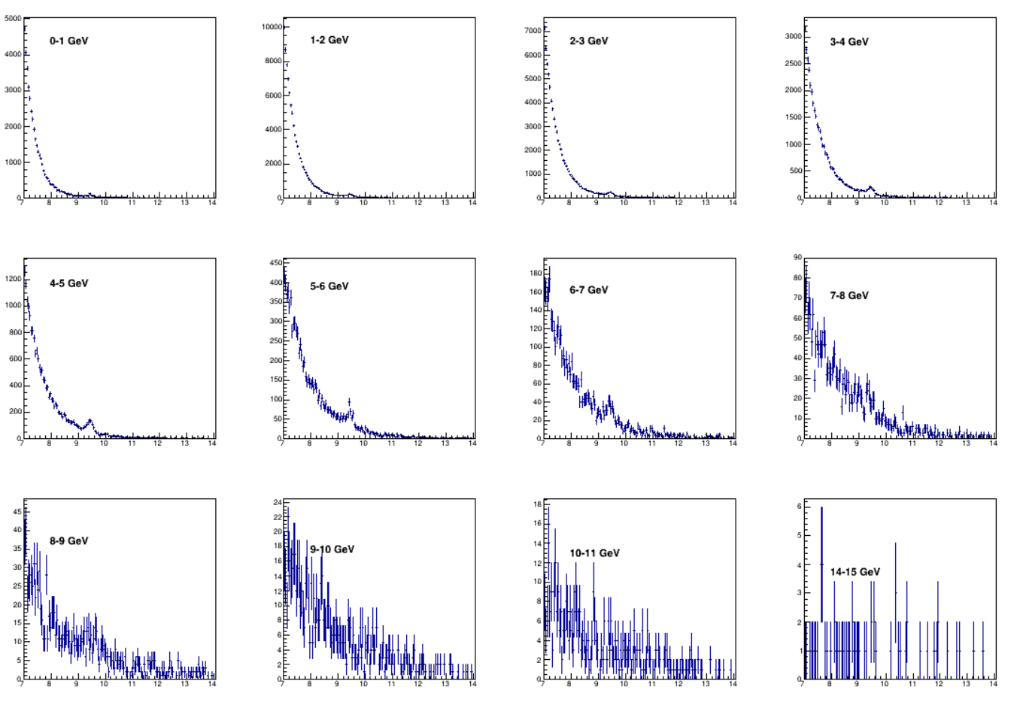
20weeks running - Invariant Mass – All backgrounds
14B central AuAu (Year 1 + Year 3)
Invariant mass (GeV)

Slide 3
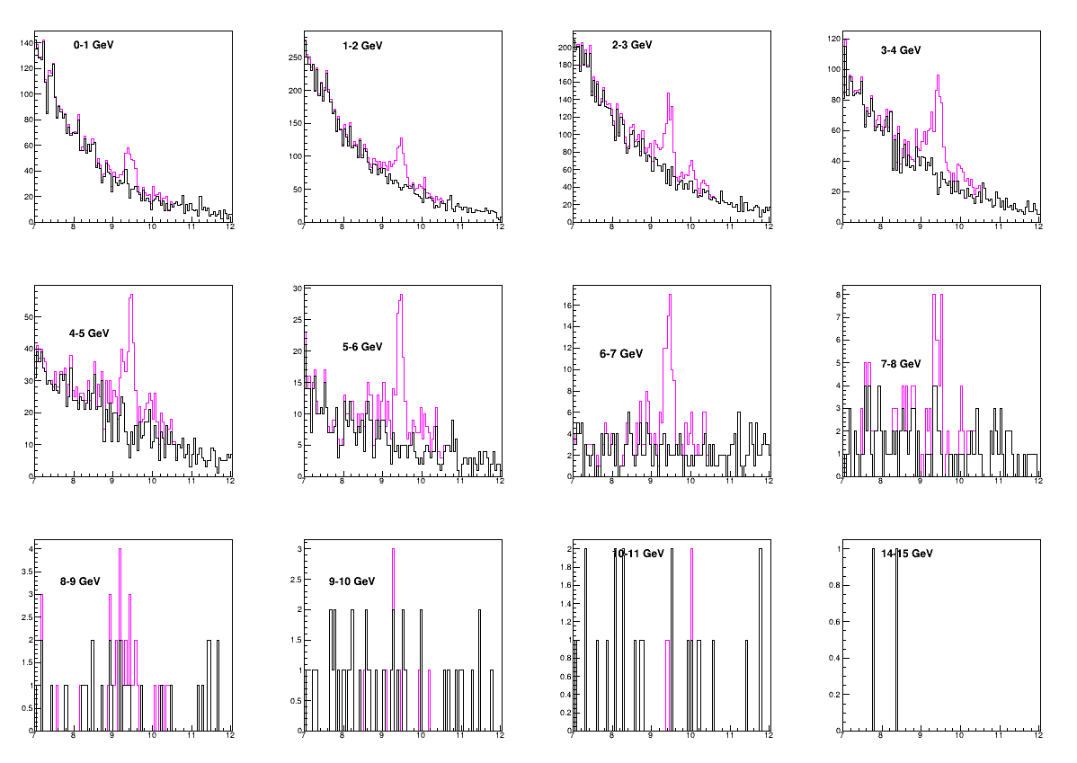
20weeks running - Invariant Mass
After combinatorial background subtraction
14B central AuAu (Year 1 + Year 3)
Invariant mass (GeV)

Slide 4
20 weeks R_{AuAu} Year 2023-2025
14B central AuAu and 2400B pp.

Slide 5
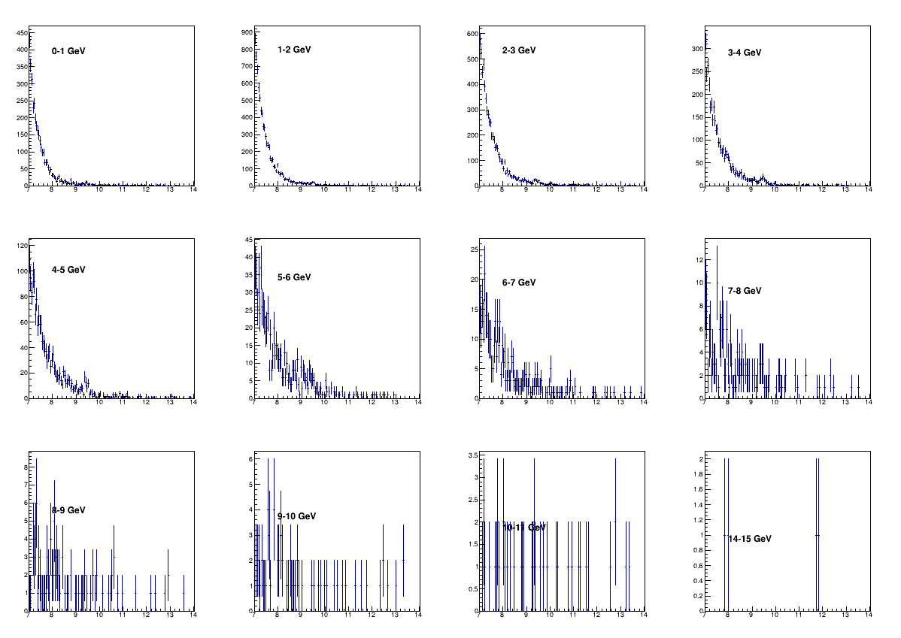
20weeks Year1 running- Invariant Mass
All backgrounds
1.2B central AuAu
Invariant mass (GeV)

Slide 6
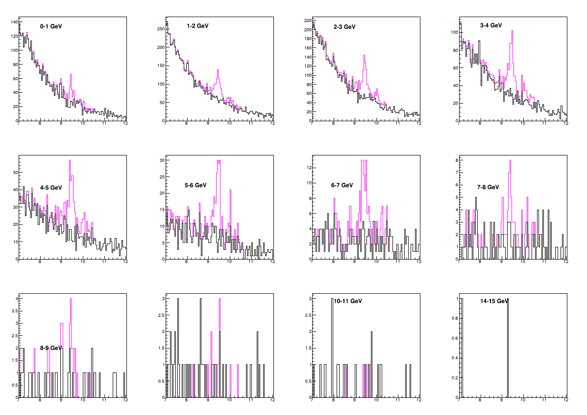
20weeks running – Year 1 Invariant Mass
After combinatorial background subtraction
14B central AuAu
Invariant mass (GeV)

Slide 7
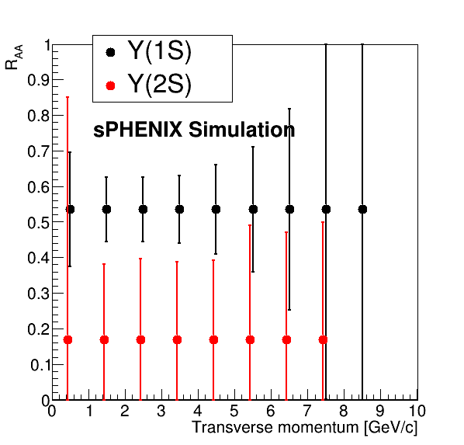
20 weeks R_{AuAu} plots - Year 1+2
1.2B central AuAu and 2400B pp

