Slide 1
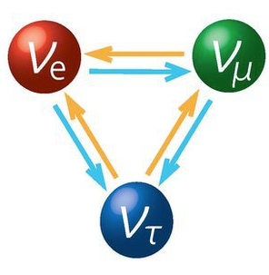

Review of Linear Algebra Applications in Some Neutrino Experiments
Xin Qian
BNL

Slide 2
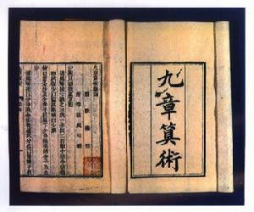
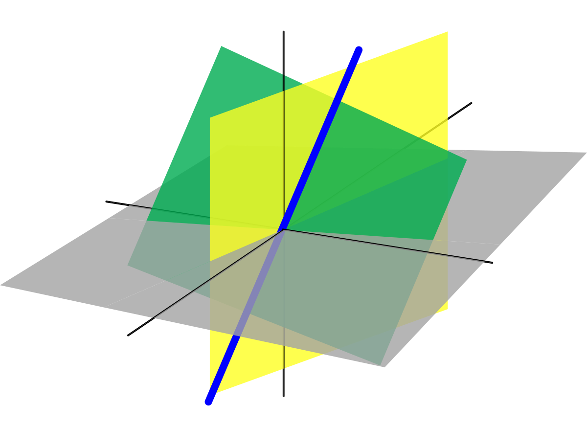
Introduction
Linear Algebra (LA) has a very long history:
  First appears in “The Nine Chapters on the Mathematical Art”
  Systematically introduced by Rene Descartes
An ancient Chinese book
Application of LA is very broad:
  We selected a few examples in the field of neutrino physics to illustrate its power
Cartesian coordinates in geometry

Slide 3
Weighted Least Squares (WLS)
A. C. Aitken Proc. R. Soc. Edinburgh 55, 42 (1935)
An approximation or a special case of the maximum likelihood approach
With unbiased measurements, this solution is the best linear unbiased estimator (BLUE)

Slide 4

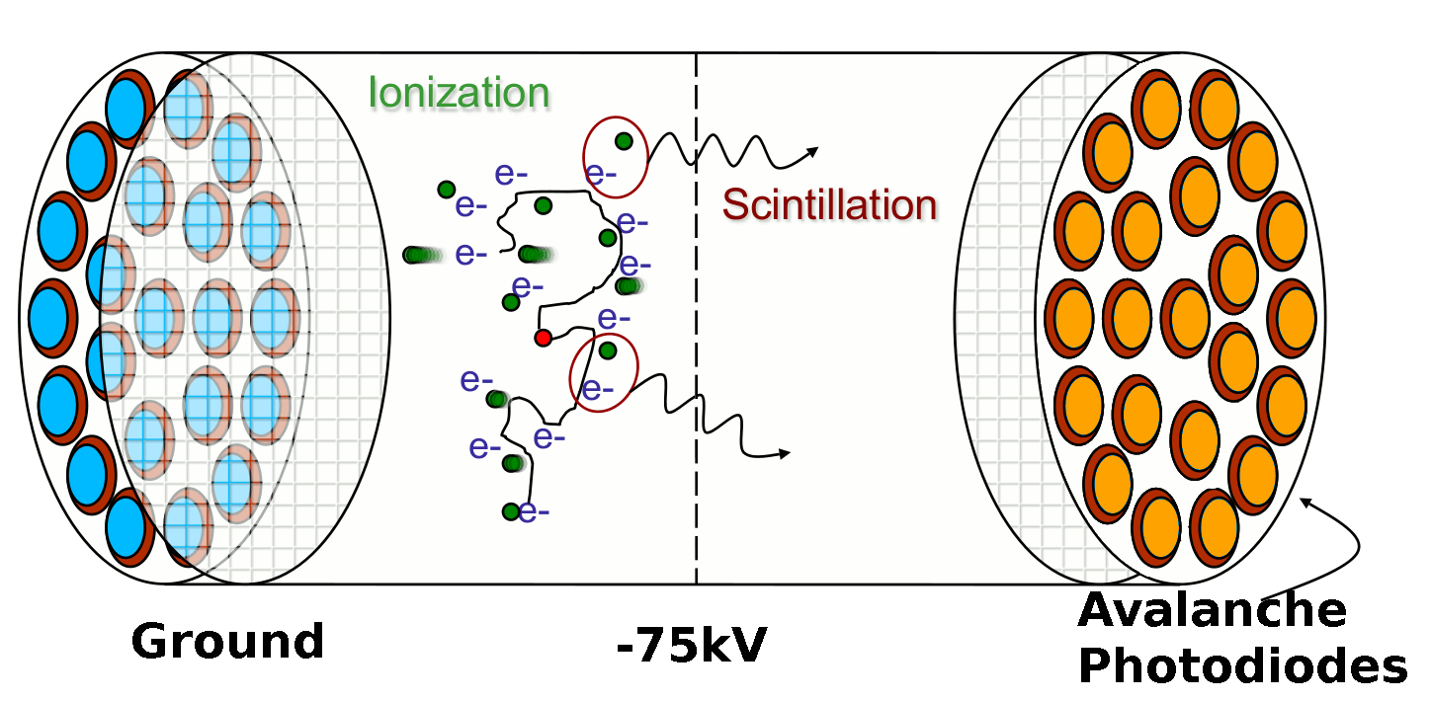
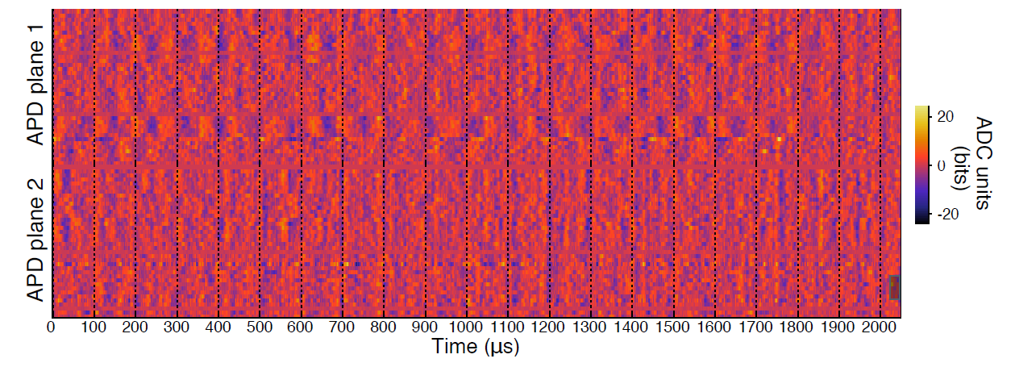
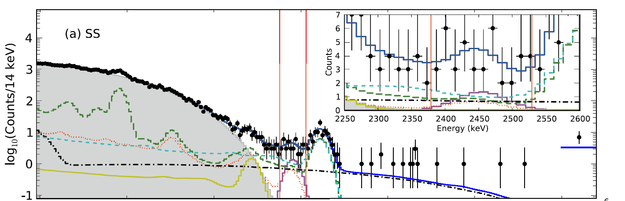
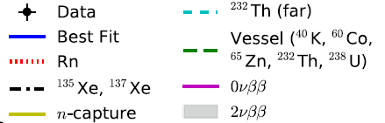
Improved Energy Estimator in EXO-200
Search for 0νββ with ¹³⁶Xe
  During the initial operation, observed correlated noise in the APD light readout
  An optimal energy estimator based on linear algebra to reduce correlated noise: JINST 11, P07015 (2016)
Liquid Xe Time Projection Chamber
Light waveform of an example noise event
Nature 510, 229 (2014)

Slide 5
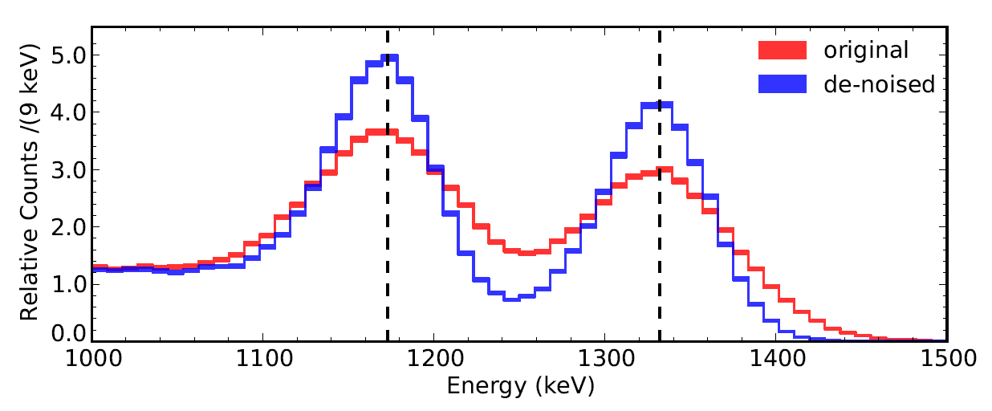
Improved Energy Estimator in EXO-200
Major challenge:
large dimension: 2048 (time bins) x 70 (APDs) ~ 1.43x10⁵ → difficult to calculate (R^{T}C⁻¹R)⁻¹
  More details in JINST 11, P07015

Slide 6

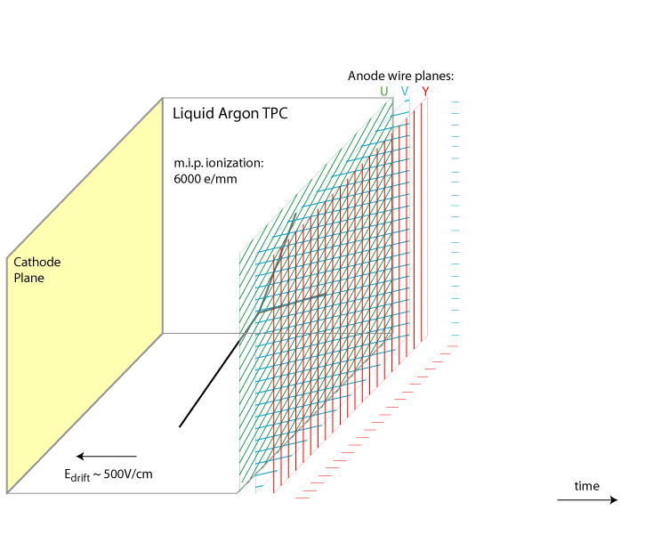
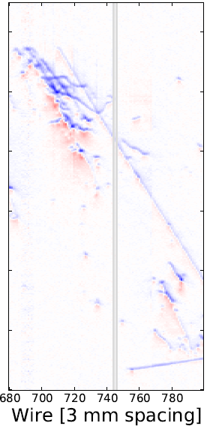
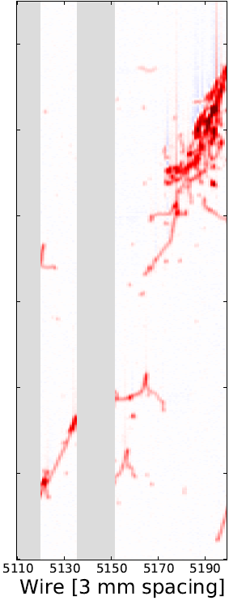
Signal Processing in Single-Phase LArTPC
Induction (U,V)
bipolar shape
Collection Y
unipolar shape
Number of ionized electrons
Field Response
Signal on Wire Plane
Electronic Response
Signal to be digitized by ADC
(Signal Processing)
Number of ionized electrons
time
Goal of signal processing is to reconstruct the distribution of ionization electrons from TPC waveforms
JINST 13 P07006/7 (2018)

Slide 7
Matrix Inversion and Deconvolution
Tensor R is Toeplitz
  Response only depends on the relative positions between signal and measurement
(R^{T}R)⁻¹ can be achieved through the deconvolution technique with fast Fourier transformation (FFT)
  O(N^{2.4~3}) → O(N logN)
  One of top 10 algs. in 20th century
Immense dimension of M and S:
2400 (chs.) x 8256 (time bins)
~ 2 x 10⁷
Extreme challenge in matrix inversion!
  1D deconvolution SP in LArTPC described in B. Baller JINST 12, P07010

Slide 8
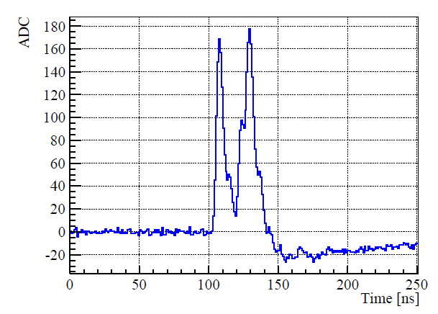
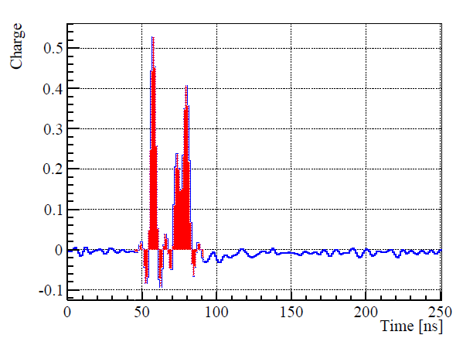
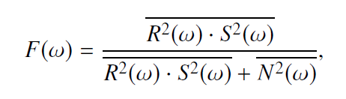

Deconvolution Technique
Time domain
M(t)
S(t)
Fourier transformation
Frequency domain
Back to time
domain
Inverse Fourier
transformation
PMT Signal Processing in Daya Bay: NIMA, 895, 48
Wiener filter: optimized by power of signal and
noise in freq. domain N. Wiener (1964)

Slide 9
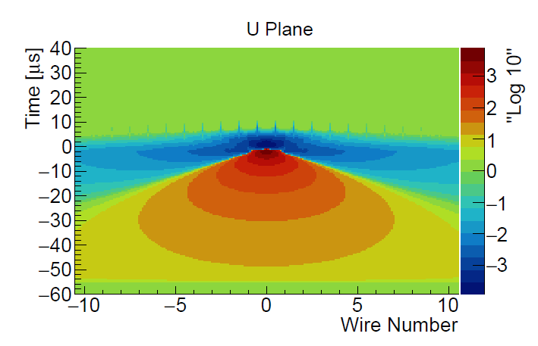
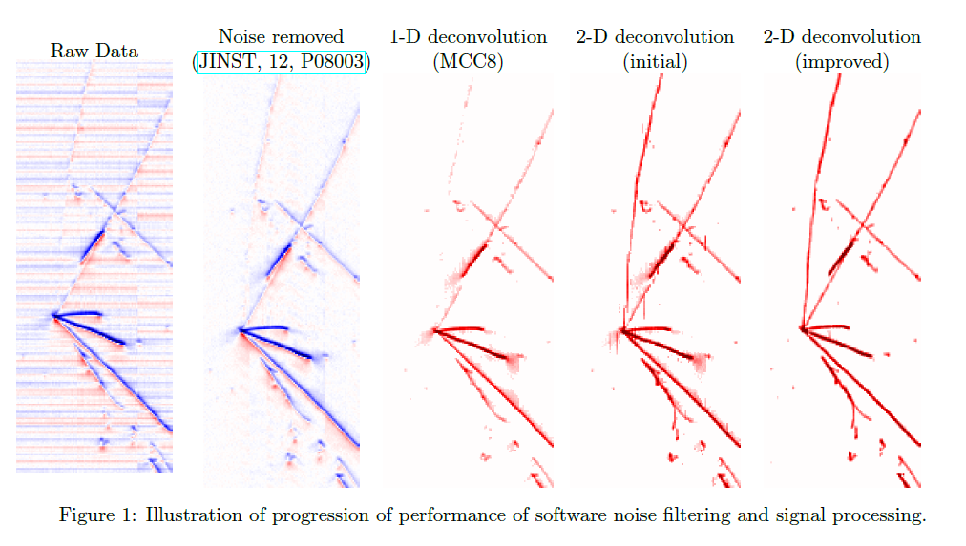

TPC Signal Processing: 2D Deconvolution
Measured waveform
1-D deconvolution
2-D deconvolution
  R₁ represents the induced signal
  from (i+1)th wire signal to ith wire
The inversion of matrix R can again
be done with deconvolution →
2-D Fast Fourier Transformation
JINST 13 P07006/7 (2018)

Slide 10
Intermediate Summary

Slide 11
Solution: Compressed Sensing
A powerful mathematical technique to recover sparse signal from under-determined (linear) system
Breakthrough: L0 (combinatorial) solution can be approximated by the (iterative linear) L1 regularization (E. Candes, J. Romberg, T. Tao arXiv-math/0503066)
||S||₀ counts the number of non-zero entries in S
Find the most sparse solution (NP-hard)
So far, one of the top 10 algs. in this century
Minimizing through coordinate descent (an iterative approach), J. Friedman et al. J. stat. soft. 33, 1
Allow positivity constraints. Implemented as RESS package

Slide 12

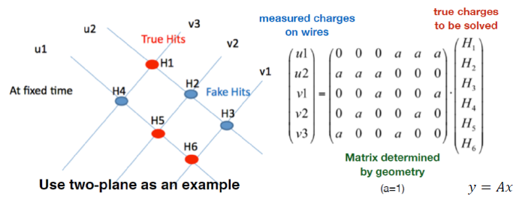
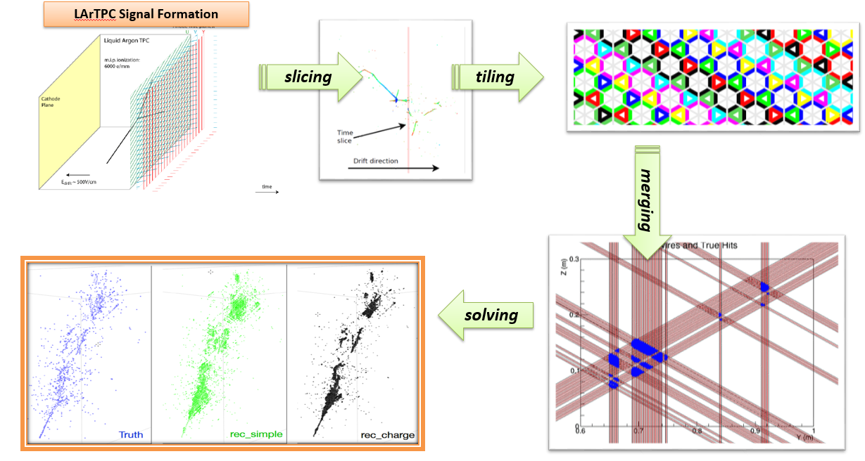
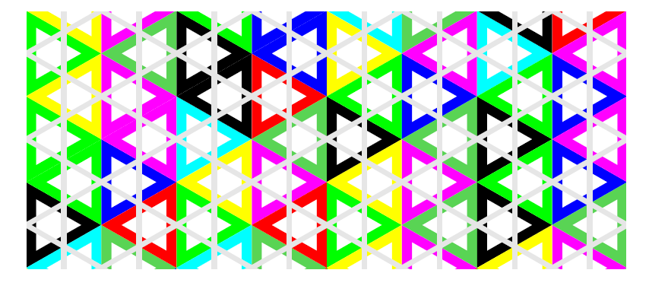
Wire-Cell Tomographic Event Reconstruction
“Three-dimensional Imaging for Large LArTPCs”, XQ,
C. Zhang, B. Viren, M. Diwan, JINST 13, P05032 (2018)
Sparsity, positivity, and connectivity information are added through compressed sensing (L1 regularization)
  ~ large charge → true hits
  ~ zero charge → fake hits

Slide 13
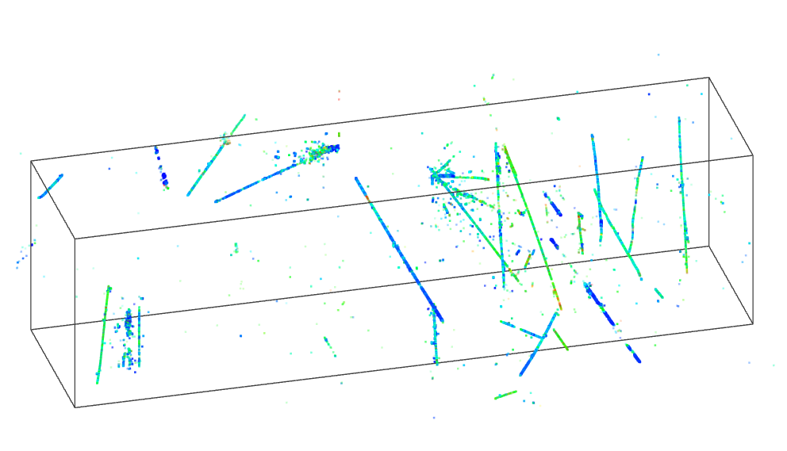
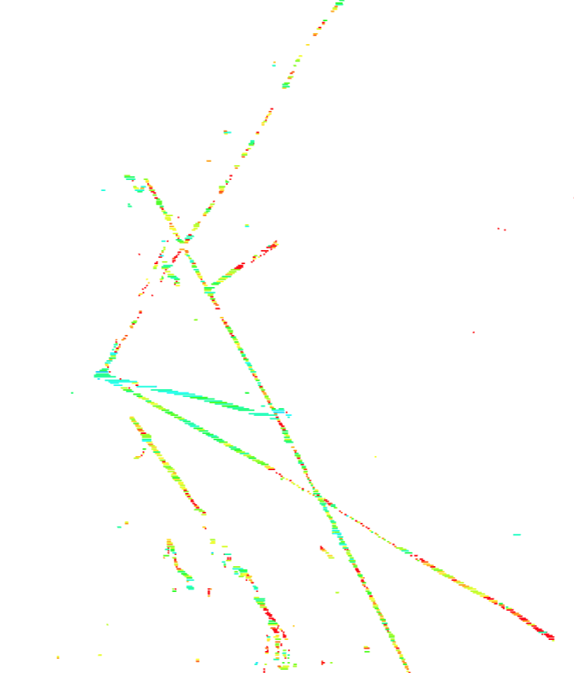
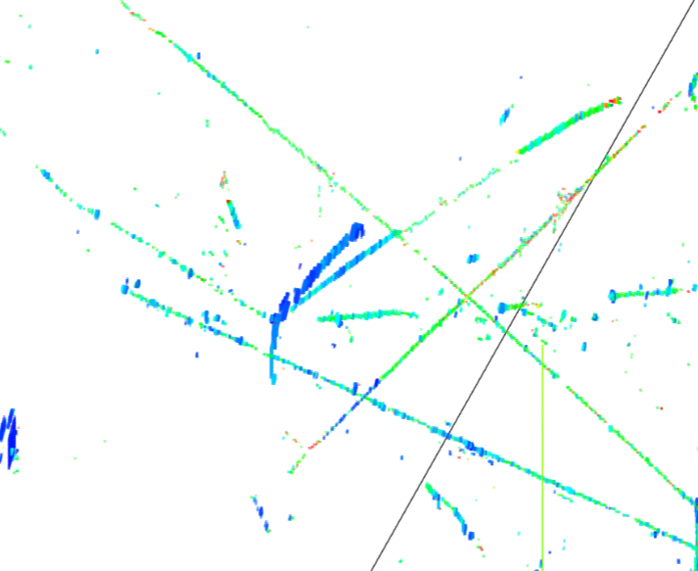
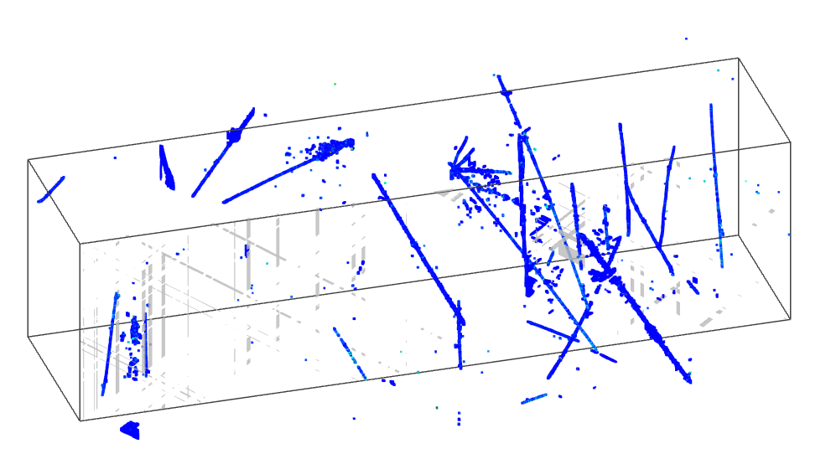
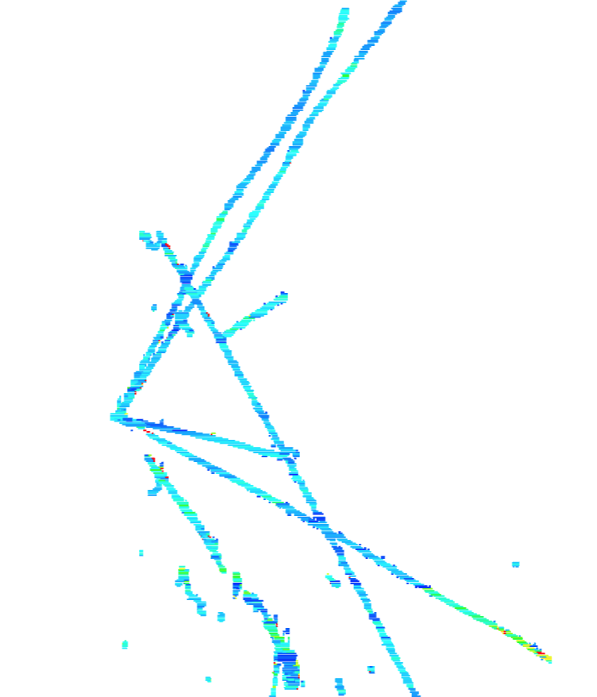
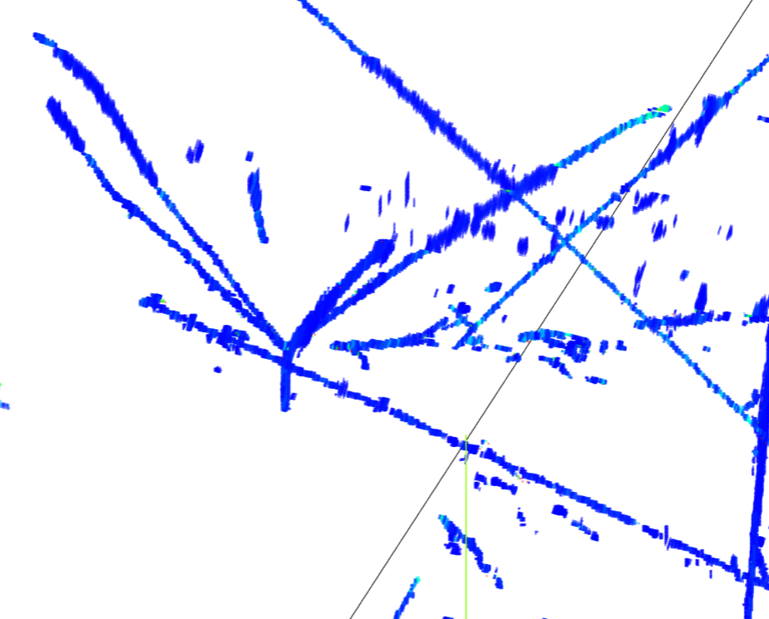
Wire-Cell on the MicroBooNE Data
2015, after several hours of CPU running
Bee link
(upper) 1D deconvolution + L0 regularization
2018, 1 min of CPU running
Bee link
(lower) 2D deconvolution + L1 regularization
JINST 13, P05032 (2018)
Notes:
Significant improvement in SP and … write something … why is better ??? Remove last line, more dots → more hits, high efficiency …

Slide 14
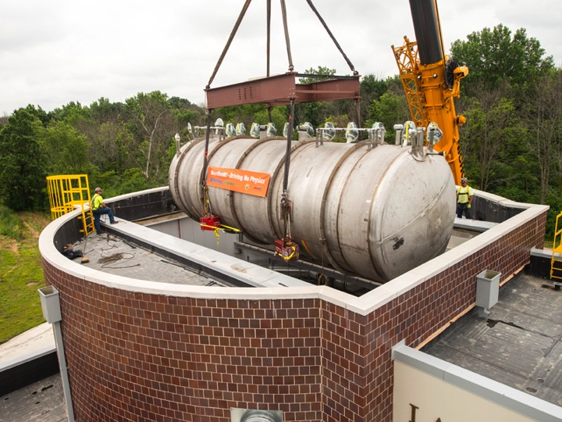
Neutrino Detection in MicroBooNE
Steps | Neutrino: Cosmic μ | Rejection Power
Hardware trigger | 1:20k (~26 per event) | 1
Steps | Neutrino: Cosmic μ | Rejection Power
Hardware trigger | 1:20k (~26 per event) | 1
Software trigger | 1:800 | 0.04
Steps | Neutrino: Cosmic μ | Rejection Power
Hardware trigger | 1:20k (~26 per event) | 1
Software trigger | 1:800 | 0.04
Offline light filter | 1:200 | 0.01
Selecting neutrinos (or rejecting cosmic muon rays) on a surface-running LArTPC is a big challenge!

Slide 15
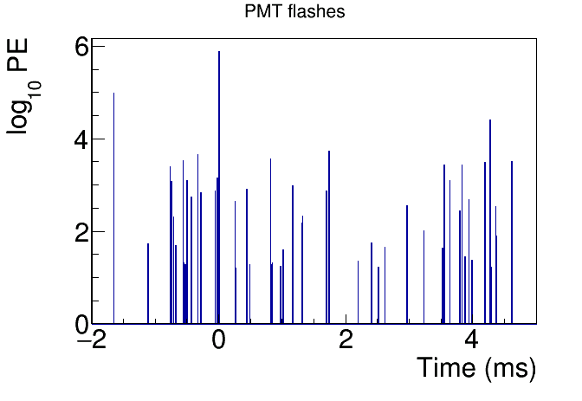
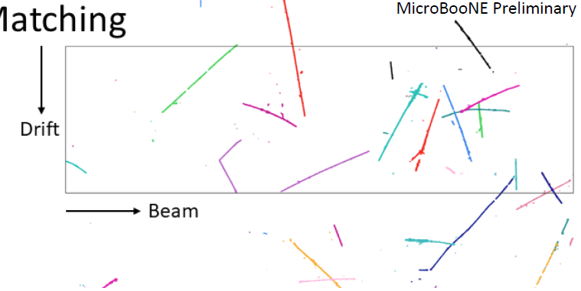
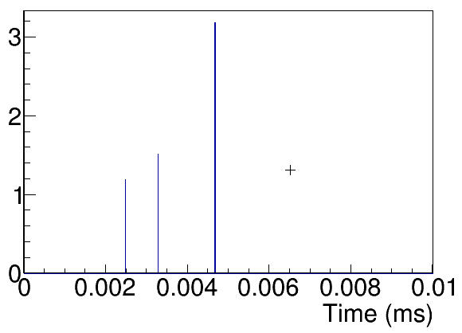
Compressed Sensing in Selecting Neutrinos
4.8 ms drift window
Coin. with ν beam
20-30 TPC activities
40-50 PMT activities
LArTPC is a slow detector, running on surface leads to significant challenges in selecting neutrinos
The key is to associate the correct T₀ (light info.) to the corresponding TPC cluster
  Combinatorial problem → compressed sensing!

Slide 16
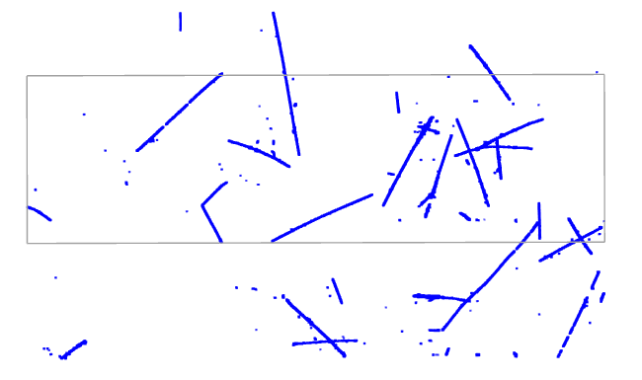
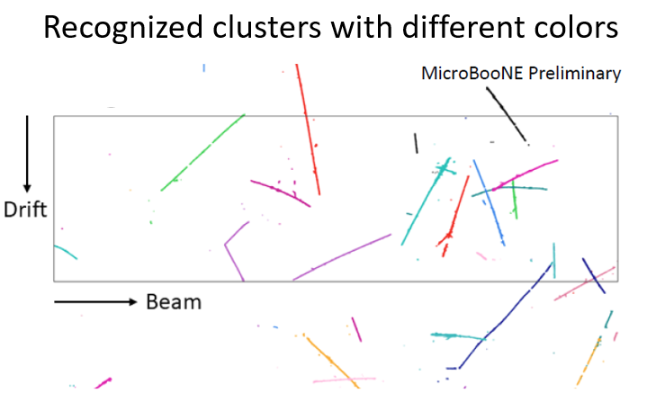
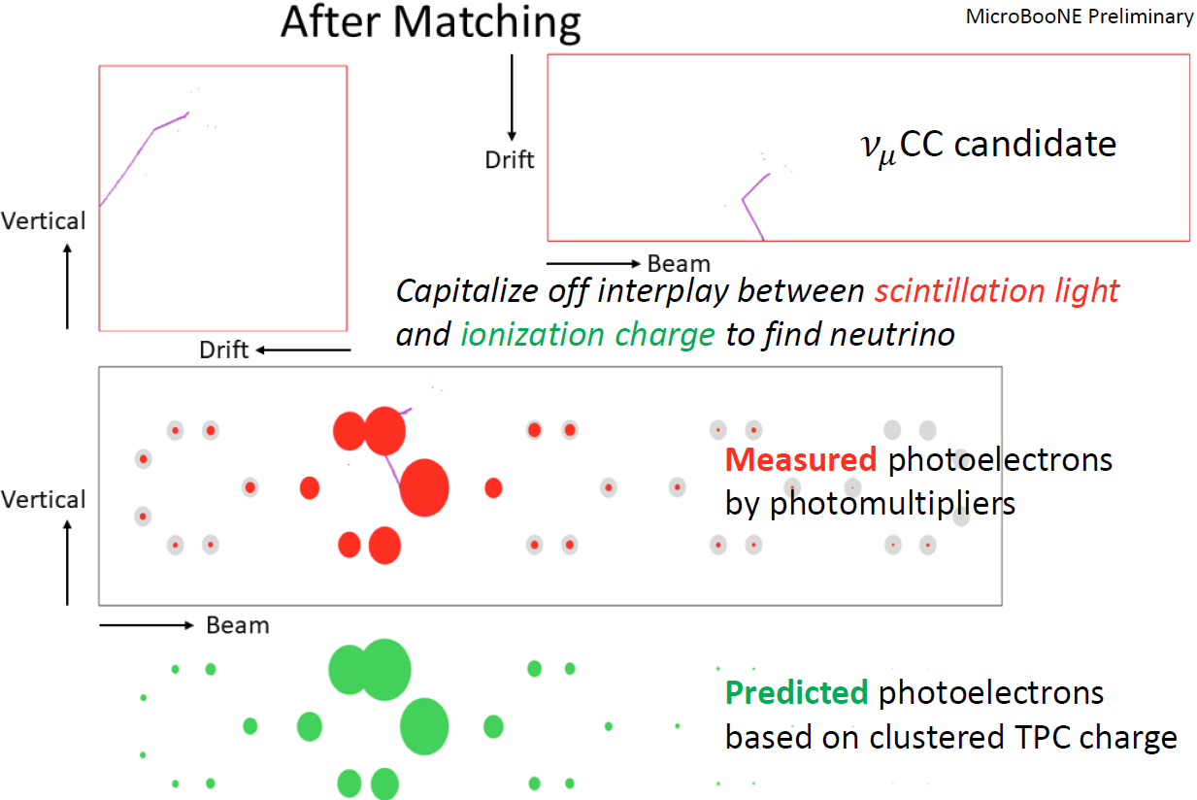
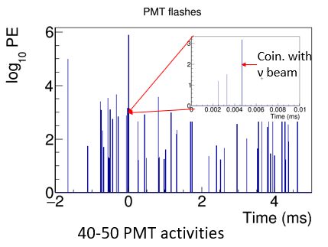
Matching Principle
4.8 ms drift window
Matching Hypotheses
Clustering
3D Image
Light Reconstruction
Hypotheses Selection
20-30 TPC activities
All possible hypotheses
One flash → many or zero TPC clusters within corresponding active volume (activities in inactive volume)
One cluster → at most one flash (inefficiency in the light system)
Light signal proportional to (reconstructed 3D) charge
Known light acceptance given position
Predicted vs. Measured light pattern with Compressed Sensing

Slide 17
Core Charge-Light Matching Algorithm
Overall test statistics to be minimized
Comparison of the measured and predicted light pattern
Each Charge Cluster can only be used once
Observed light flash may not correspond to any charge cluster
Aggressively pursue charge-light matching
Additional cuts to examine the “light mismatch” events
Compressed sensing to select the best pairs

Slide 18
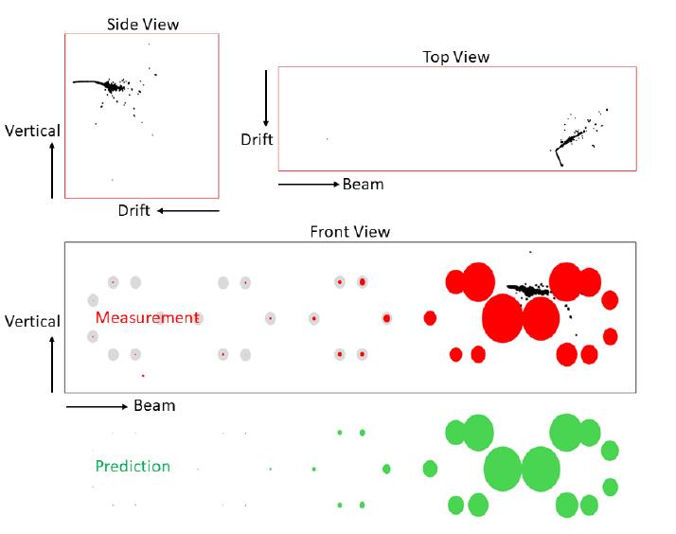
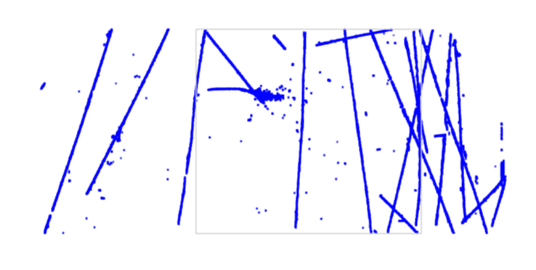
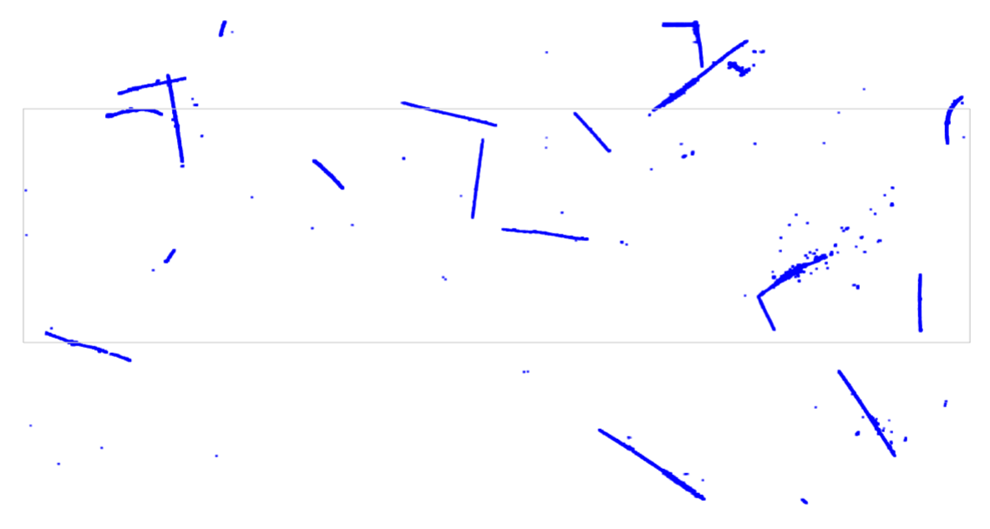
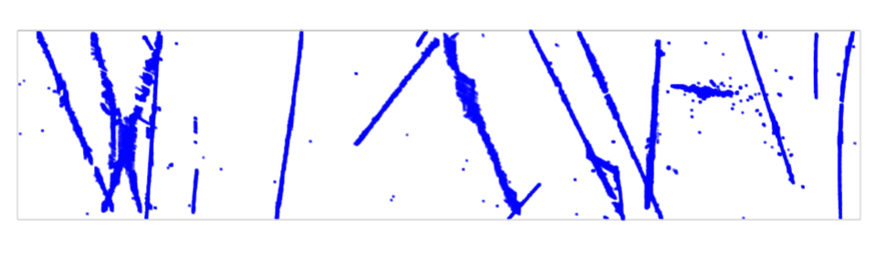
LArTPC Charge-Light Matching
After Charge-Light Matching
Side view
Top view
Front view
After 3D Imaging
Steps | Neutrino : Cosmic Muons
Offline light filter (late light correction) | 1 : 200
Many-to-many charge-light Matching | 1 : 7

Slide 19
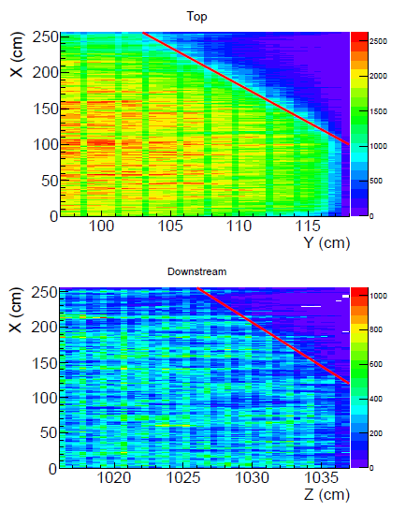
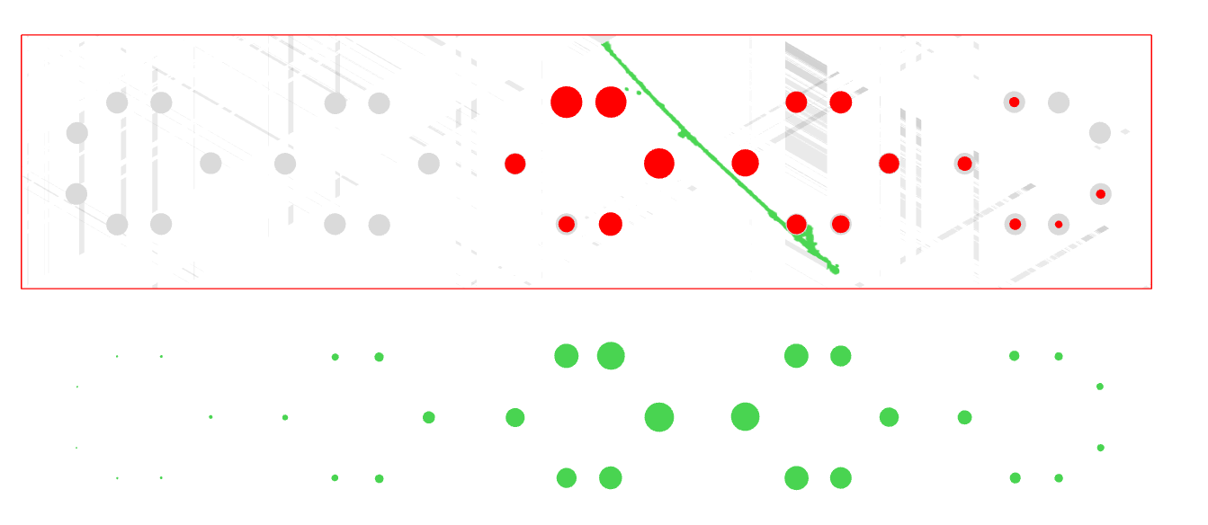
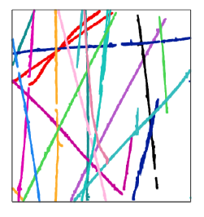
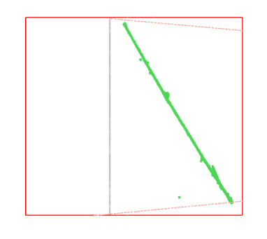
Through-going-muon rejection and effective detector boundary
Anode
E field (X)
Cathode
measurement
Vertical Direction (Y)
Vertical Direction (Y)
prediction
Beam Direction (Z)
Vertical Direction (Y)
After correcting t₀ for all cosmic muons in one event
Drift direction (X)
Steps | Neutrino : Cosmic Muons
Many-to-many charge-light matching | 1 : 7
After through-going-muon rejection | 1:1

Slide 21

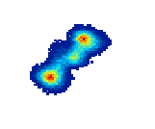
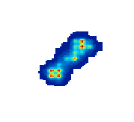

Iterative LA Approaches
A famous example is Bayesian unfolding
  G. Agostini, NIMA, 487, 362 (1995) & arXiv:1010.0632
  Used in many ν experiments extracting ν-A cross sections
  Equivalent to the more general Maximum Likelihood
  Expectation Maximization (ML-EM):
    A. P. Dempster et al. J. Royal Stat. Soc. B39, 1 (1977)
    L. A. Shepp and Y. Vardi, IEEE Trans. Med. Imaging 2, 113 (1982)
Truth
Observation
Reconstructed
NEXT 0νββ: JINST 12, P08009

Slide 22
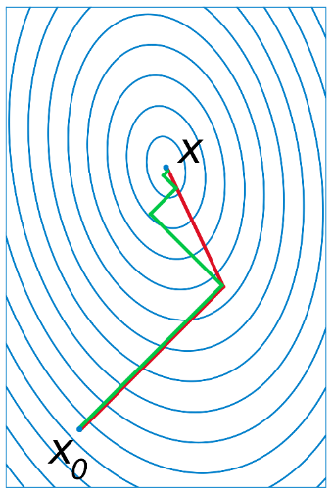
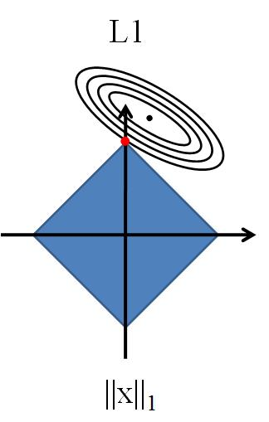
Iterative Approaches with Linear Algebra
Iterative approach based on Linear Algebra
to approximate nonlinear fits
  E.g. Track trajectory and dQ/dx fit in MicroBooNE
Iterated Weighted Least-Squares fit to
reduce bias in the Neyman or Pearson
χ² in counting experiments
  arXiv:1807.07911 and earlier works
BCGSTAB & Coordinate Descent

Slide 23
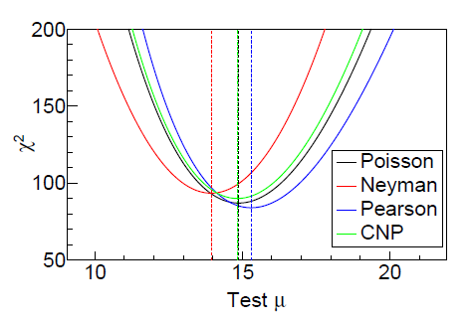
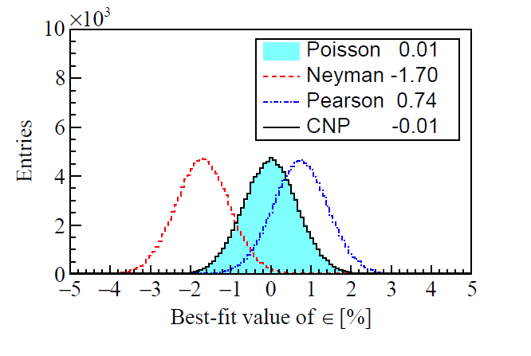
Combined Neyman Pearson (CNP) Chisquare
A linear combination of Neyman and Pearson χ², CNP χ² leads to a better approximation of Poisson χ², advantages in computation in certain scenarios
X. Ji, W. Gu, XQ, H. Wei, C. Zhang
arXiv:1903.07185

Slide 24
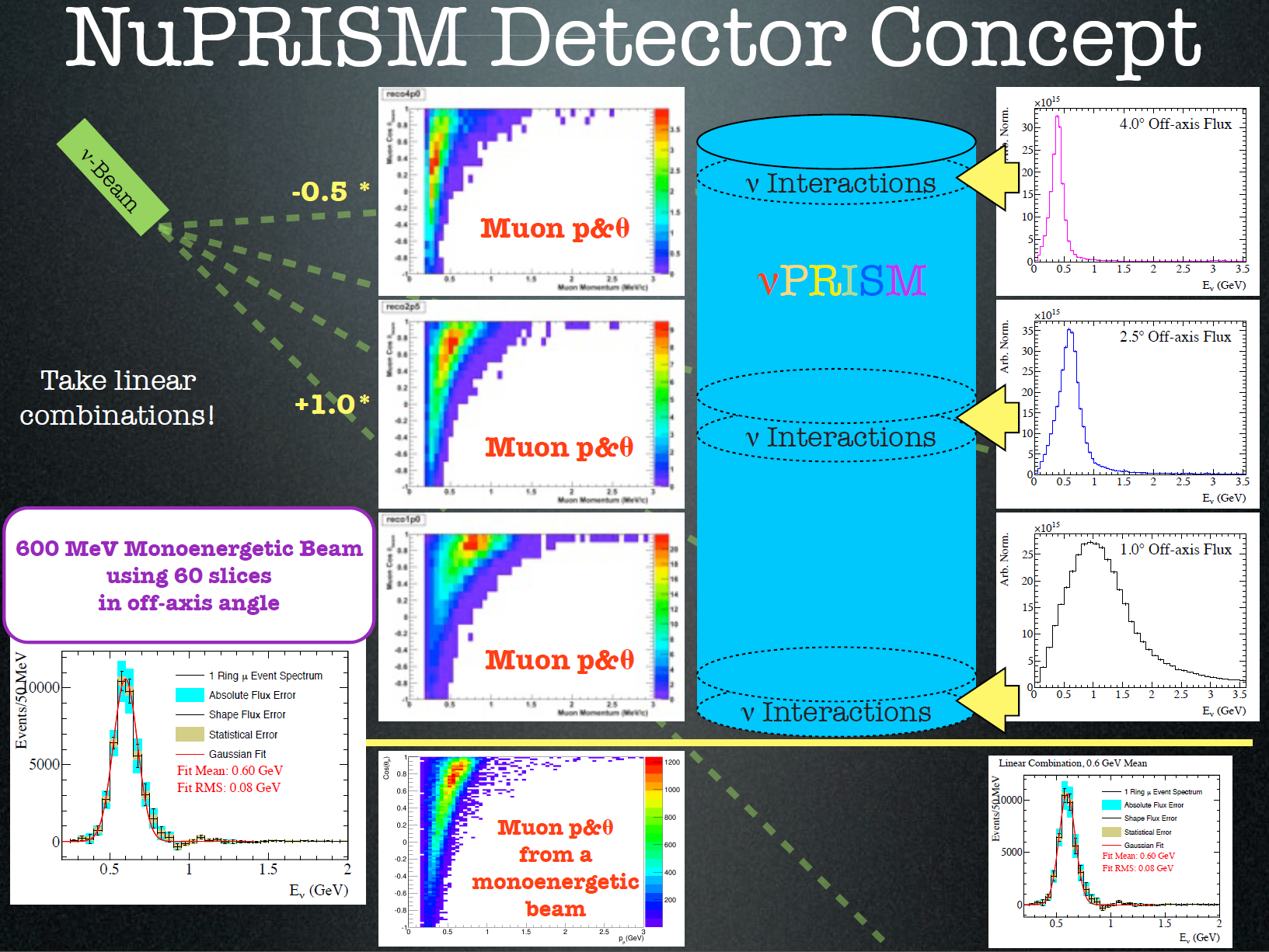
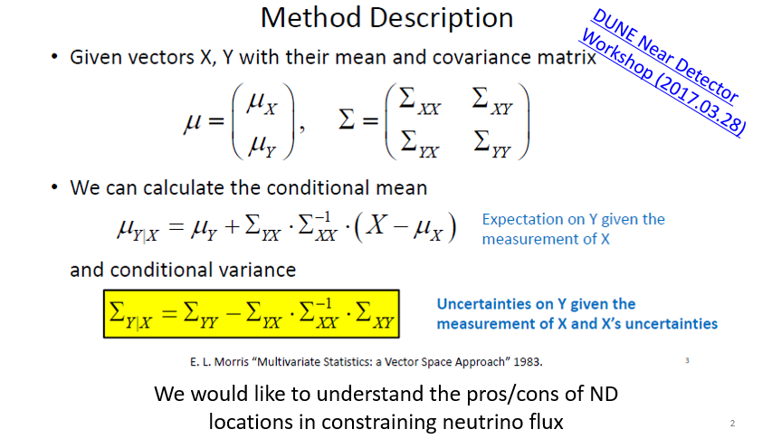


Linear Algebra in Designing Experiments
M. Wilkings et al. arXiv:1412.3086
Conditional Covariance Matrix,
also Gaussian Process arXiv:1709.05681

Slide 25
Summary
Linear Algebra is a very powerful tool in experiments
  Least square approach:
  Iterative approach:
Applications | Selected Examples
Signal Processing | MicroBooNE TPC and Daya Bay PMT waveform analysis
Data unfolding | EXO-200, Wiener-SVD
Event Reconstruction | Wire-Cell 3D imaging, Charge-light matching in LArTPC
Applications | Selected Examples
Numerical solutions | Coordinate Descent, BCGSTAB
Data unfolding | ML-EM (Bayesian unfold) in NEXT, ν Xs
Reducing bias | Iterative Least Weighted Squares
Approx. NL fit | Trajectory & dQ/dx fit in LArTPC
Also experiment’s designs

Slide 27
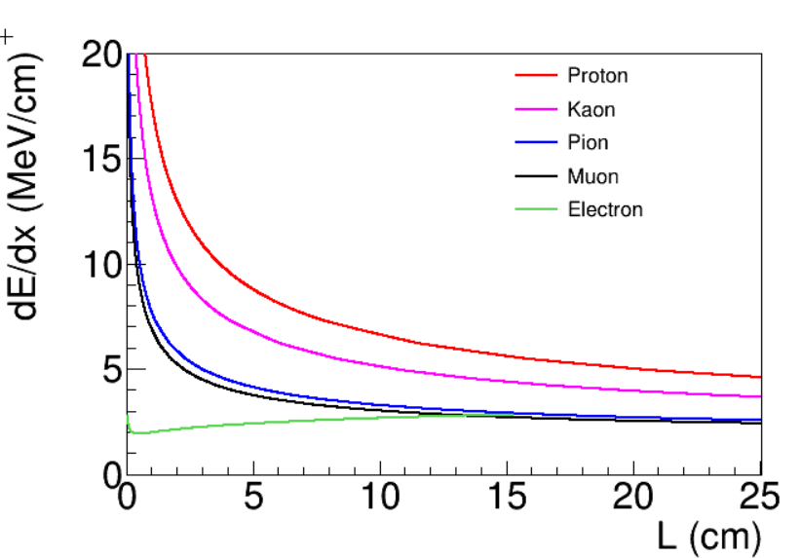


Stopped Muon Rejection
Drifting
Drifting
Vertical
Beam
Vertical
Determination of track direction is crucial to reject stopped muons
Search for the Bragg peak in dQ/dx near the stopping point is the key,
also important for PID

Slide 28



Trajectory and dQ/dx fit in Single-phase LArTPC
U view
Measurement: Three 2D projections (wire and time) with charge information
  Broadening caused by diffusion, detector response, signal processing …
Hypothesis is a 3D thin line (many points)
with charges
  “(3+1) x N” unknowns for “N” 3D points
  A non-linear fit → approximate with two linear fits: trajectory and dQ/dx
    Allow further iterations to refine the solution
V view
W view

Slide 29



Unknowns
Measurements

Slide 30



Stopped Muon Rejection
Drifting
Drifting
Vertical
Bragg peak
Beam
Vertical
Steps | Neutrino : Cosmic Muons
After through-going-muon rejection | 1:1
After stopped muon rejection | 7.6:1
London
Cooper-Troendle
Wenqiang Gu

Slide 31



Generic Neutrino Detection
Efficiency ~ 90% for
charge-current (CC) ν_{μ} interaction
Selected CC ν_{μ} interaction: ~ 11.5 k with 5e19 POT vs.
4.3 k in PRL 123, 131801 (2019) @ 50% purity
High-performance generic neutrino detection achieved
Hanyu Wei

Slide 32



Remaining Challenges in Signal Processing
JINST 13 P07006/7 (2018)
Still worse performance for the induction wire plane for prolonged topology (long in drift time) because of the signal ROI finding
Hanyu Wei Brooke Russell

Slide 33





ROI finding as Image Segmentation
UNet: arXiv:1505.04597
Time Tick
Deconvolved
with filters: field,
and electronic
effects ‘removed’
Channels
ROI finding
- Segmentation with UNet
Time Tick
Haiwang Yu
Channels

Slide 34



Deep Learning-Signal Processing Performance on ProtoDUNE Data
Current Signal Processing
Deep-Learning Signal Processing
Time Ticks
Channels
Significant Improvements in prolonged tracks
Haiwang Yu

Slide 35
Wiener-SVD Unfolding Approach
LArTPC Signal Processing
SVD Unfolding Approach
Unfold the ionization electron distribution from measured TPC waveforms
High-frequency electronic noise and the finite resolution of detector response leads to unstable deconvolved results
Wiener filter is added to stabilize the results, minimizing
Statistical (and systematic) uncertainties and smearing of finite response function leads to unstable unfolded results
Regularizations (e.g. constraining smoothness) is added to stabilize results (limiting variance)
  Regularization → Bias
  Optimize the strength of regularization to balance between bias and variance
  Strictly speaking, should also optimize the choice of binning (multi-dimensional scan)

Slide 36


Wiener-SVD Unfolding Approach
When the expected signal is known , Wiener filter can be used in SVD unfolding to obtain an optimized result in one shot
  Choose binning < smearing resolution
  Apply
  Wiener
  filter
  Naturally balances bias (sys.) and variance (stat.) → a smaller
  total uncertainty with no scanning of regularization strength
More details in X. Li et al. JINST 12, P10002
Wei Tang Xiaoyue Li

Slide 37


An Example of Energy Spectrum Unfolding
JINST 12, P10002
Wiener SVD unfold outperforms the standard SVD unfold approach with a simplified procedure
Wei Tang Xiaoyue Li

Slide 38




Linear Algebra in Experiment Design
100% cancellation of flux uncertainty with one reactor, one near and one far detector
Prog. Part. Nucl. Phys. 83, 1
Daya Bay ~95%

