Slide 1

The electron-ion collider:
A collider to unravel the mysteries of visible matter
E.C. Aschenauer (BNL)
Electron Ion Collider

Slide 2
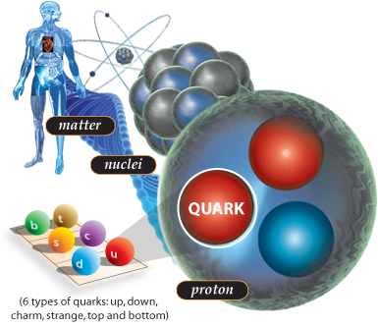
What composes visible matter
atom
if you look through a
higher and higher
resolution microscope
you discover a
femto Universe
size scale
10⁻¹⁵ m = 1 femto m (fm)
thickness of a hair: ~50 10⁻⁶m
Big Question:
can we understand
how the visible matter is formed
from the smallest
elementary building blocks
Notes:
a hair is 0.06 mm

Slide 3

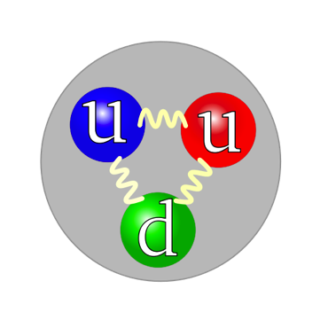
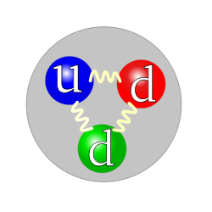

Study of the constituents of matter
NUCLEUS
A major goal of physics is to
understand the basic building blocks of all matter
and the pieces that make up those building blocks
and the pieces that make up those pieces…
and those pieces… etc…
A Nucleus is made of nucleons:
protons and neutrons
Proton
Neutron
increased resolving power
nucleons are very complex objects !!
quarks bound together
by gluons form nucleons
All elementary building blocks
can be characterized
by their
mass, spin and charge
reveal
more
&
more
details

Slide 4
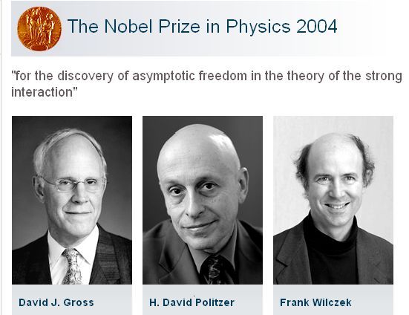
The Theory to explain the “femto-Universe”
Quantum Chromodynamics (QCD)
Its features:
Developed in the 1970s → Nobel Price in 2004
new particle to mediate the force that is characteristic for the theory
the gluon
discovered at the end of the 1970s at PETRA@DESY in Germany
The “charge” of the strong force is called color,
each quark comes in one of three colors: red, green or blue.
The color force is transmitted by the gluon and is very strong
we understand many things
but
cannot yet calculate/predict mass, charge and spin
from first principles in QCD
Force | Relative Strength
Gravitation Electromagnetic | 1 10³⁷ | keeps you in your seat acts on electrically charged particles
Force in QCD | 10⁴⁰ | holds nucleons together
The color force between quarks decreases with decreasing distance
and grows larger at large distances
→ Quarks and gluons can not be found in isolation
quarks and gluons together are referred to as partons

Slide 5

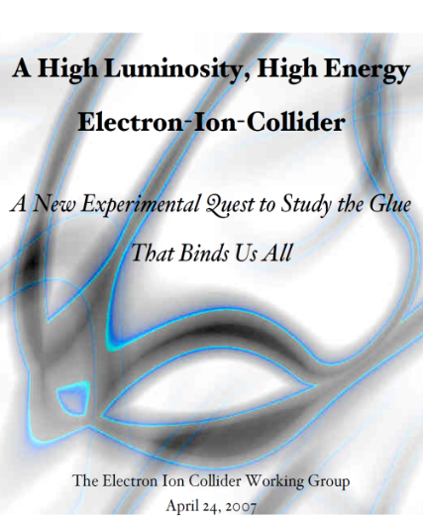
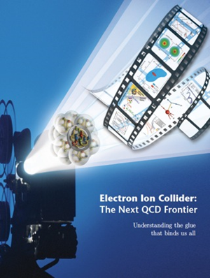

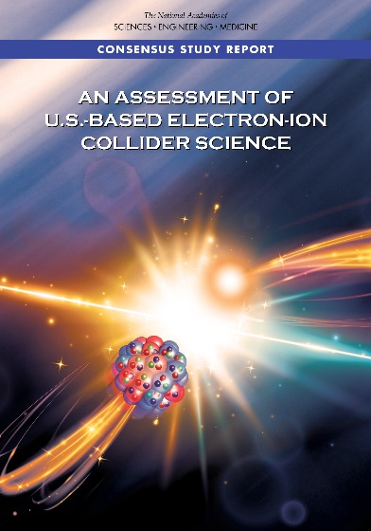
Developing The EIC Science Case
2002
2007
2009
2010
Gluons and the Quark Sea at High Energies
2012
2013
2015
Major Nuclear Physics Facilities for the Next Decade
2018
NSAC
March 14, 2013
National Academy of Science Report:
AN ASSESSMENT OF U.S.-BASED
ELECTRON-ION COLLIDER SCIENCE
“An EIC can uniquely address three profound questions
About nucleons—neutrons and protons—and how they
are assembled to form the nuclei of atoms:
• How does the mass of the nucleon arise?
• How does the spin of the nucleon arise?
• What are the emergent properties of dense systems of gluons?”

Slide 6
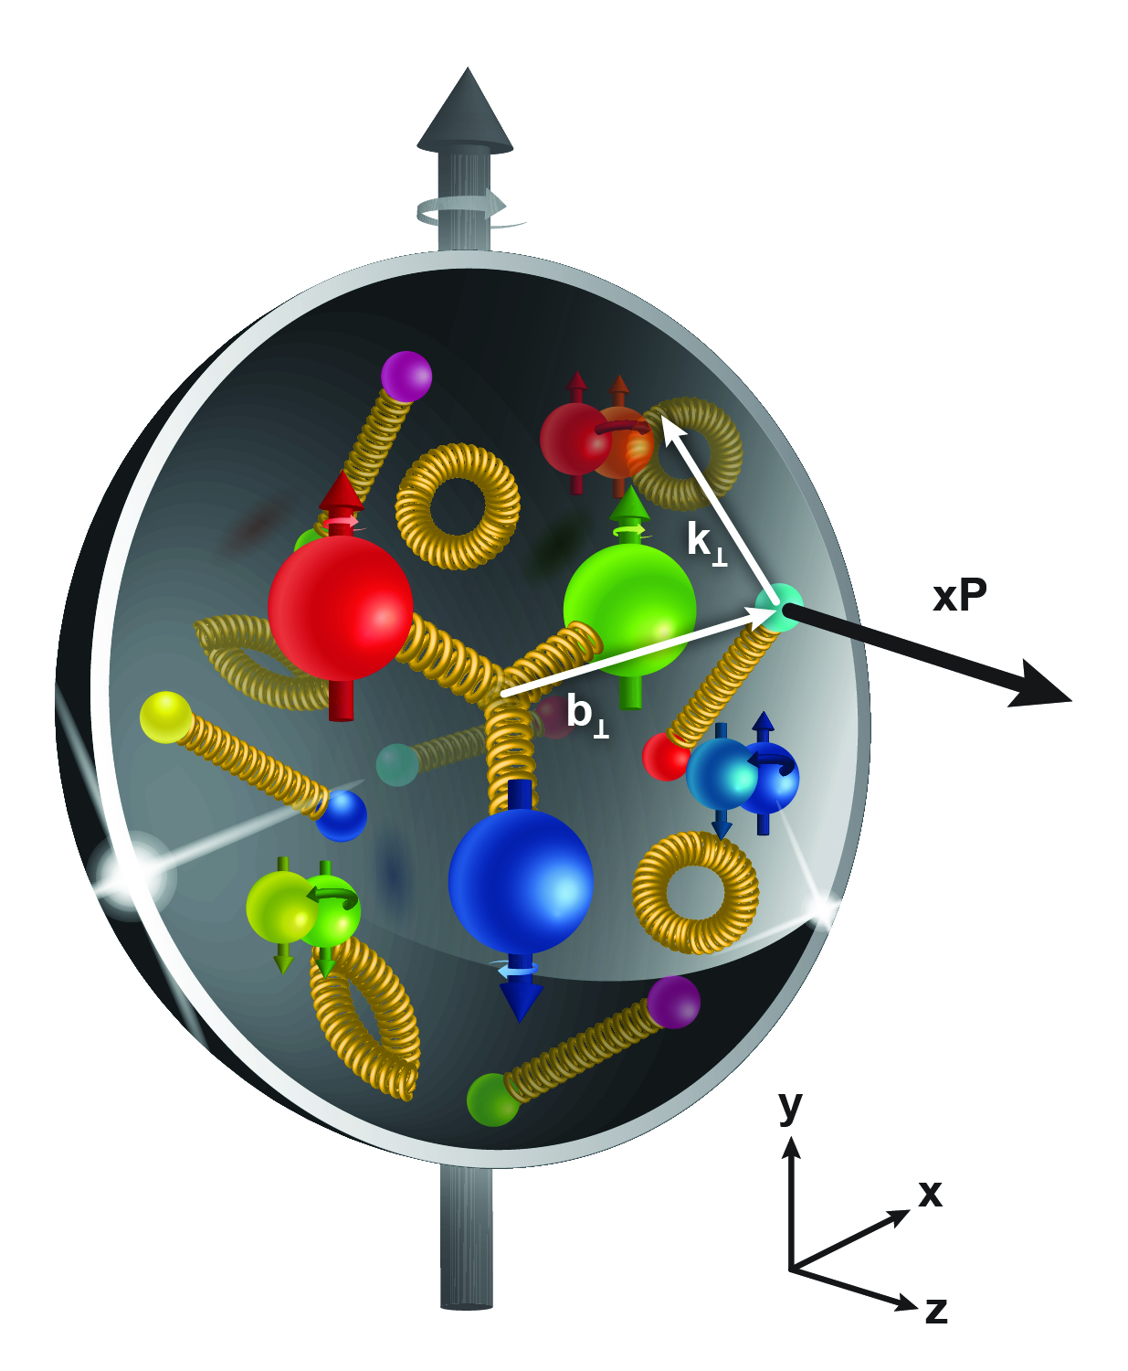
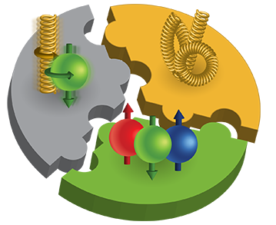
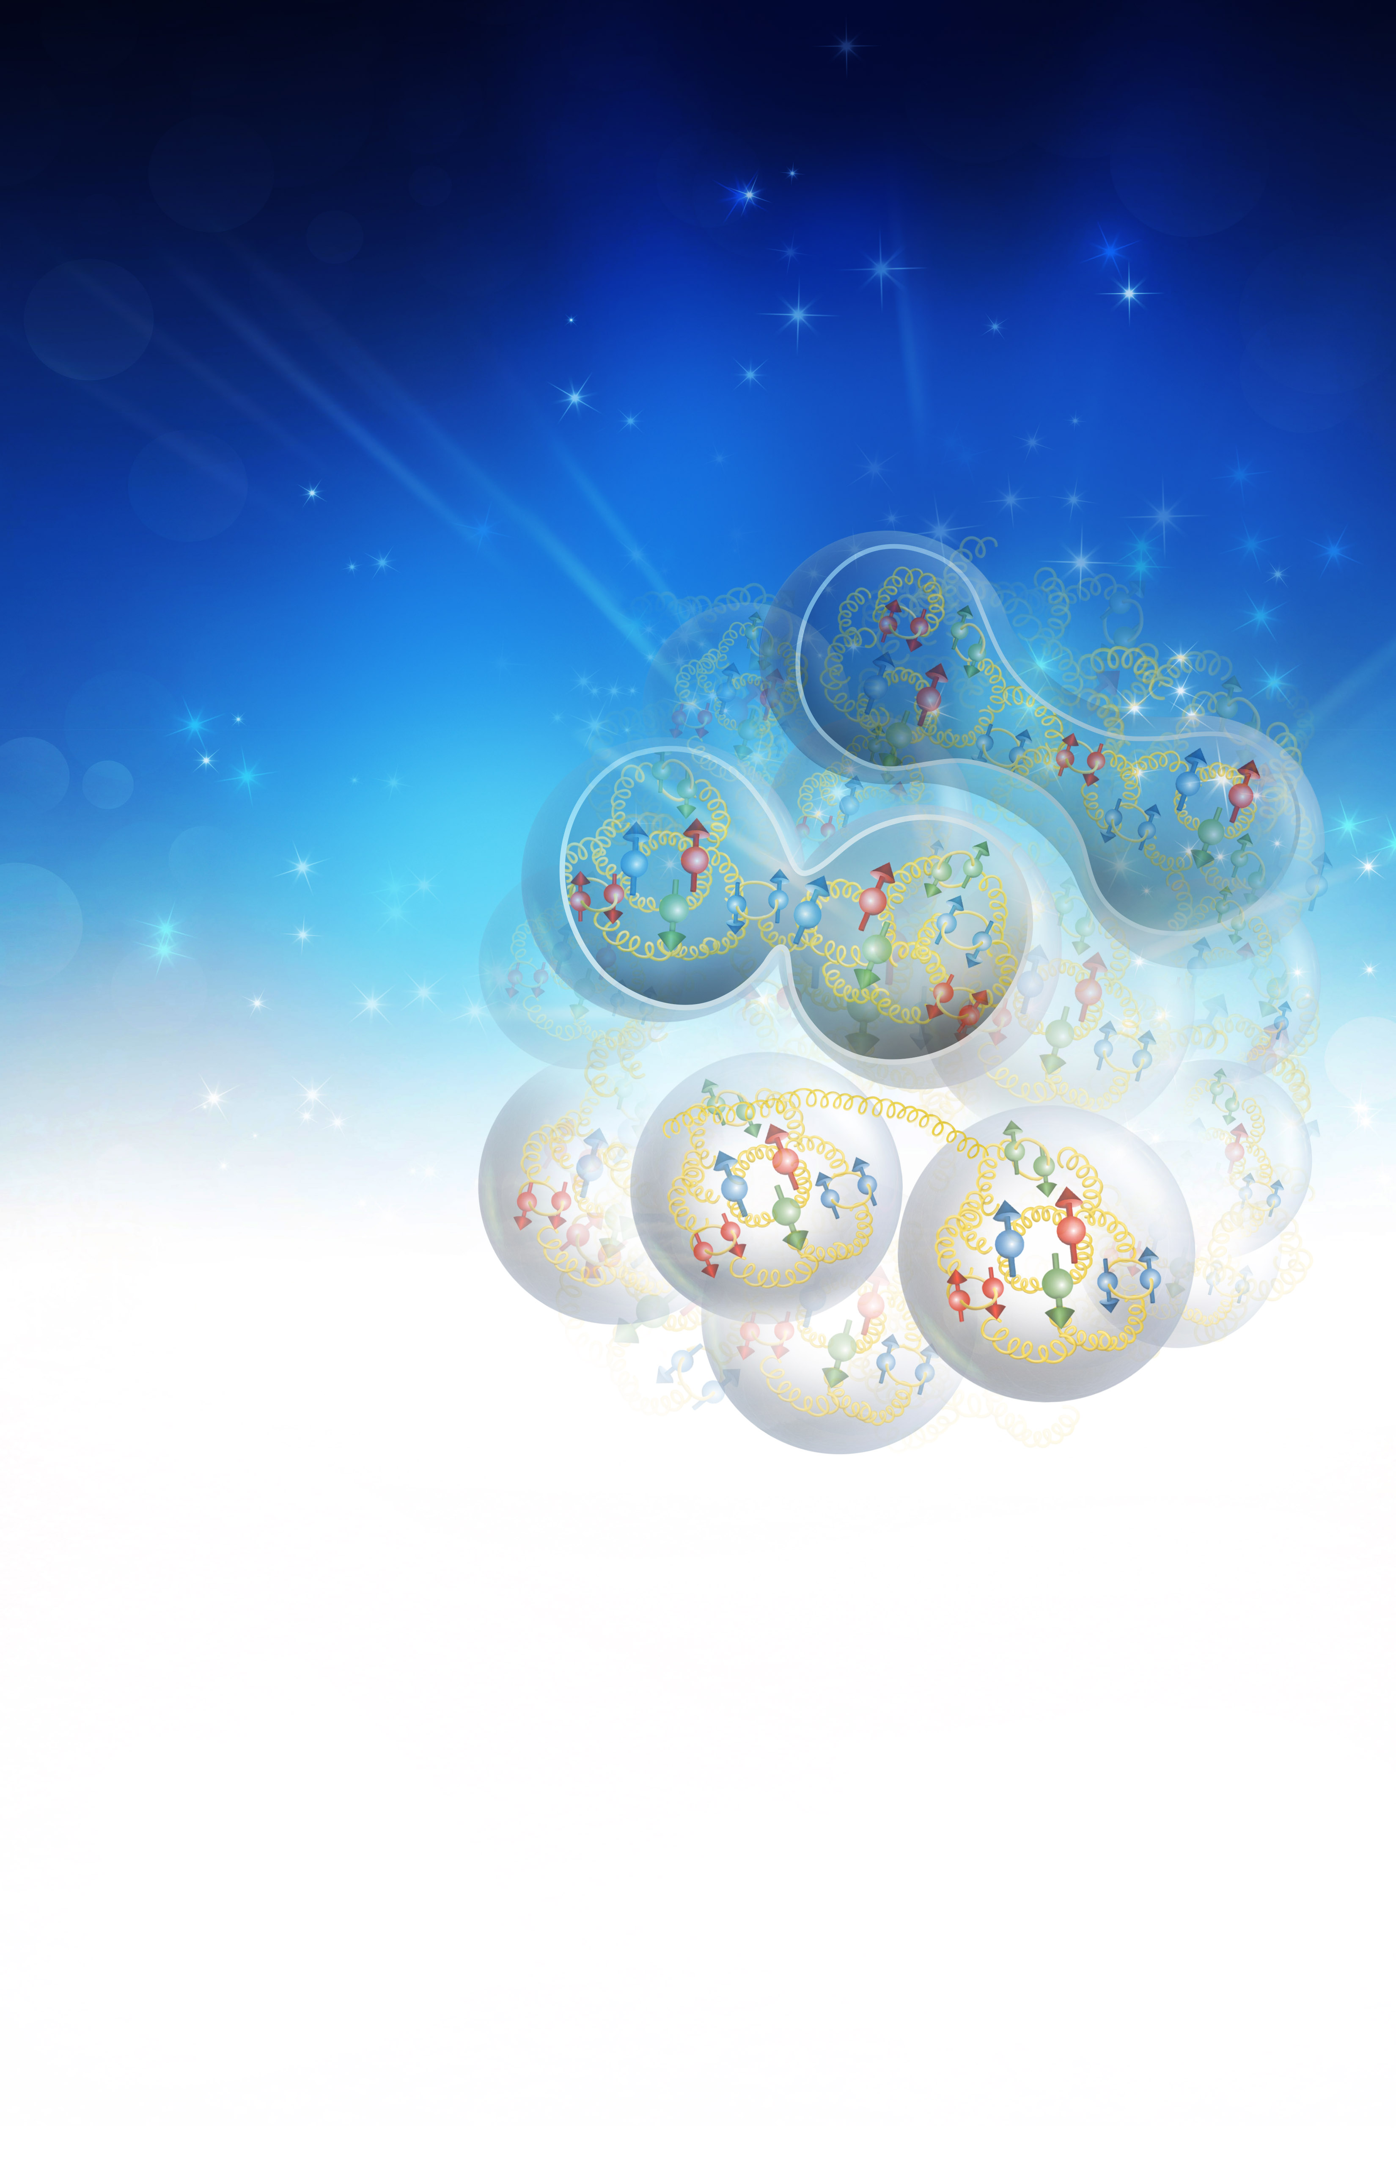
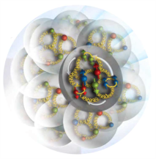
The EIC Physics
How are the sea quarks and gluons, and their spins, distributed in space and momentum inside the nucleon?
How do the nucleon properties emerge from them and
their interactions?
How do color-charged quarks and gluons, and colorless jets, interact with a nuclear medium?
How do the confined hadronic states emerge from these quarks and gluons?
How do the quark-gluon interactions create nuclear binding?
How does a dense nuclear environment affect the quarks and gluons, their correlations, and their interactions?
What happens to the gluon density in nuclei? Does it saturate at high energy, giving rise to a gluonic matter with universal properties in all nuclei, even the proton?
gluon
emission
gluon recombination
?
=

Slide 7
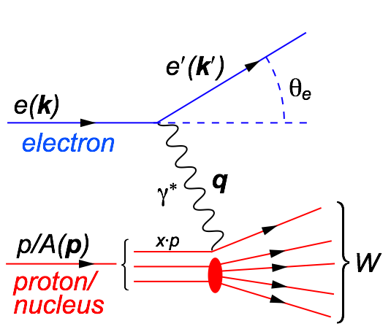

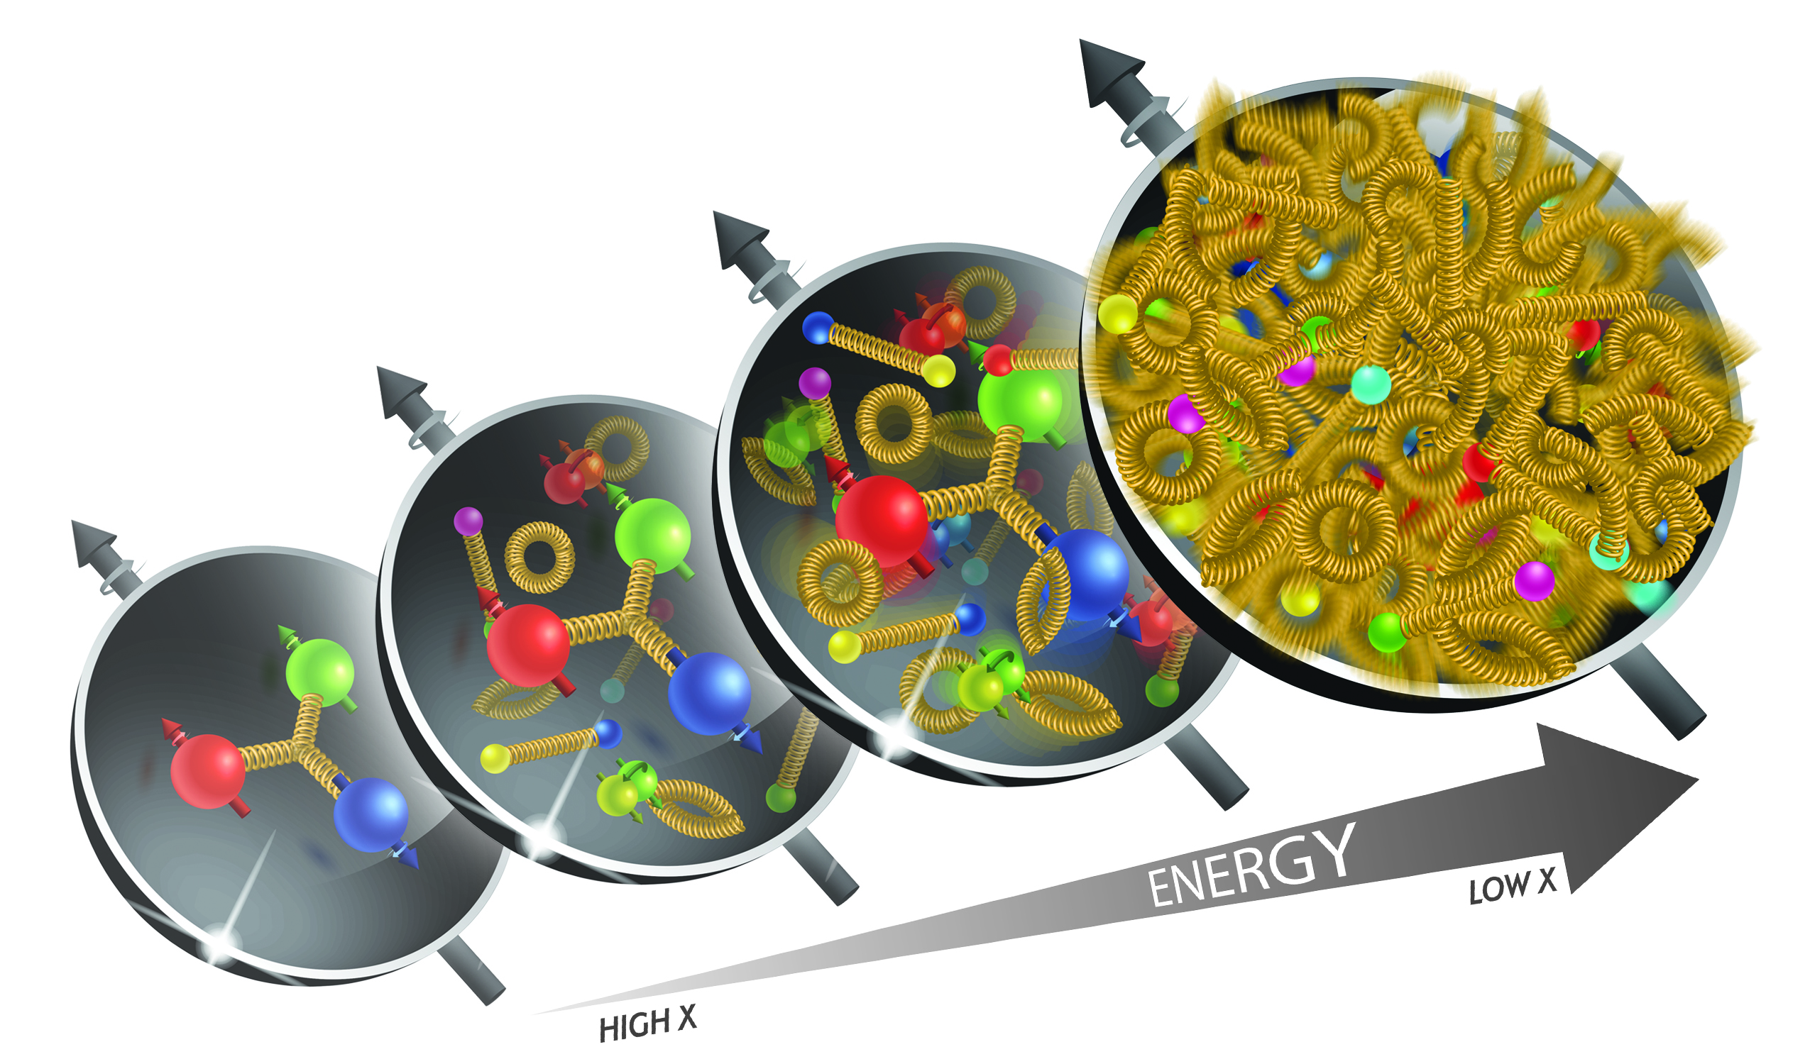
What is needed to address the EIC Physics
The Golden Process:
Deep Inelastic Scattering (DIS):
As a probe, electron beams
provide unmatched precision of
the electromagnetic interaction
Direct, model independent
determination of parton
kinematics of physics
processes
s: center-of-mass energy squared
Q²: resolution power
x: the fraction of the nucleon’s
momentum carried by the struck
quark (0<x<1)
y: inelasticity
large kinematic coverage:
center-of-mass energy √s: 20 – 140 GeV
access to x and Q² over a wide range

Slide 8
EIC: Access to terra incognita
increasing luminosity and center of mass energy
Resolving Power Q² (GeV²)
Gluons
live here
x
Fraction of overall proton momentum carried by q,g
increasing center of mass energy

Slide 9


What do we know: Mass of the Proton
Visible world: mainly made of light quarks – its mass emerges from quark-gluon interactions.
Proton
GeV
MeV
quark
Quark structure: uud
Mass ~ 940 MeV (~1 GeV)
Proton Mass: 1.8×10⁻²⁷ kg
The Sum of all Quark masses accounts for 1% of the proton mass
nucleon
Where does the rest of the mass hide ?
Density of quarks or gluons
inside the proton
Most of mass generated by dynamics
Gluon rise discovered by HERA e-p
gluon ocean
quark sea
q,g Density
Fraction of overall proton momentum carried by q,g
The proton is dominated by
gluons

Slide 10
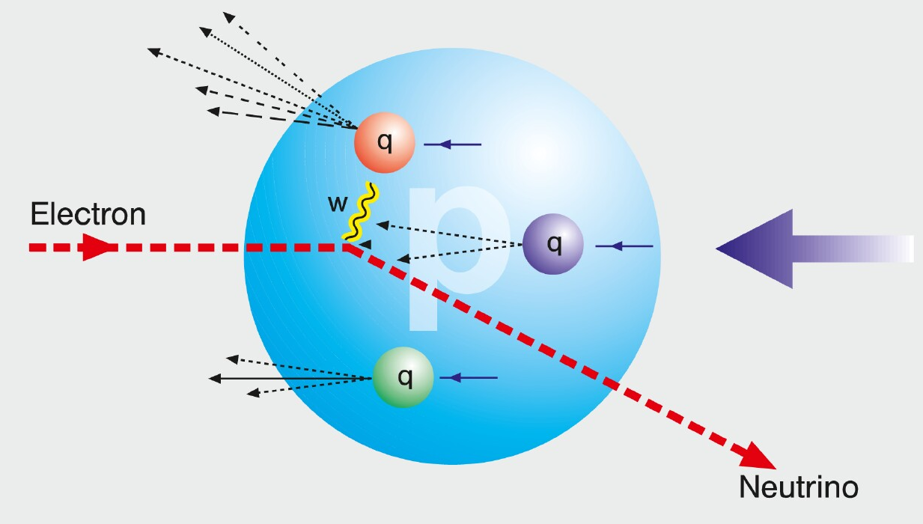
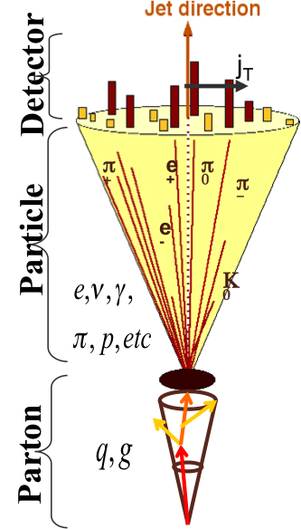
HOW TO ACCESS PARTONS IN DIS
SIDIS:
Detect scattered lepton (DIS) in coincidence with identified hadrons (SIDIS)
one can measure the correlation between different
hadrons as fct. of p_{t}, z, η
needs fragmentation functions to correlate
hadron type with parton
→ Detector: PID over a wide range of η and p
Charge Current:
W-exchange: direct access to the quark flavor
no FF – complementary to SIDIS
→ Detector: large rapidity coverage and large √s
Jets:
best observable to access parton kinematics
tag partons through the sub-processes and
jet substructure
di-jets: relative p_{t} → correlated to k_{t}
tag on PGF
→ Detector: large rapidity coverage and PID

Slide 11
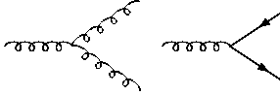
How to access Gluons in DIS
Gluons manifest themselves through
the behavior of the cross section as function of x and Q²
quark+anti-quark
momentum distributions
gluon momentum
distribution
without gluons the cross section depends only on x, no dependence on Q² → F₂(x)
Bjorken scaling
BUT:
Observe strong rise of cross section
with both x and Q²
Because of gluon initiated processes
Cross Section
Scaling violation
Gluon Distribution:
dσ(x,Q²)/dlnQ²
Resolution (Q² / GeV²)

Slide 12
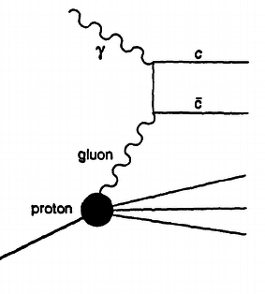

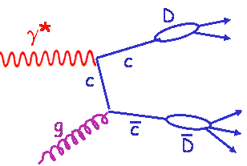
How to access Gluons in DIS
Gluons manifest themselves through
the scaling violation of the cross section as function of x and Q²
dF2(x,Q²)/dlnQ² → G(x,Q²)
Directly through the measurement of F_{L}
Through tagging of the photon gluon fusion process
  Di-jets
  charm production
quark+anti-quark
momentum distributions
gluon momentum
distribution
All these process need a wide coverage in x and Q²

Slide 13
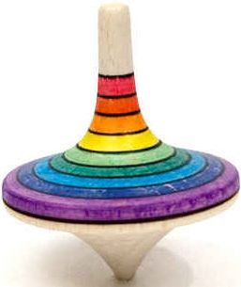
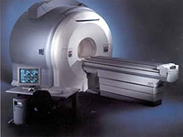
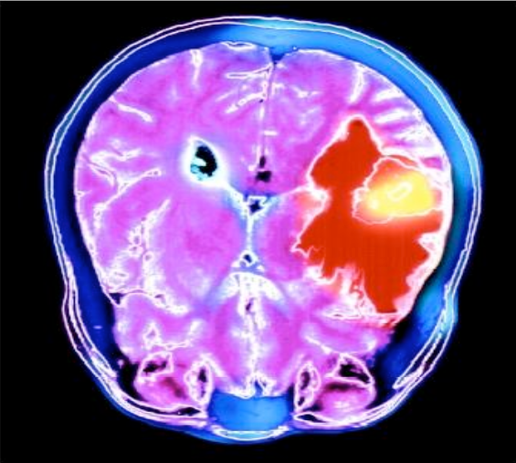
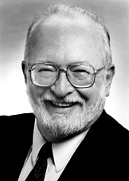
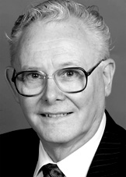
The Spin of the Proton
What is Spin? Google….
revolve quickly and repeatedly around one's own axis,
twist and turn so as to give an intended interpretation,
"The President's spokesmen had to spin the story to make it less embarrassing”
Wikipedia: In quantum mechanics and particle physics, spin is an intrinsic form of angular momentum carried by elementary particles, composite particles (hadrons), and atomic nuclei
Proton spins are used to image the structure and function of the human body using the technique of magnetic resonance imaging.
Paul C. Lauterbur
Sir Peter Mansfield
Nobel Prize 2003:
for their discoveries concerning magnetic resonance imaging

Slide 14
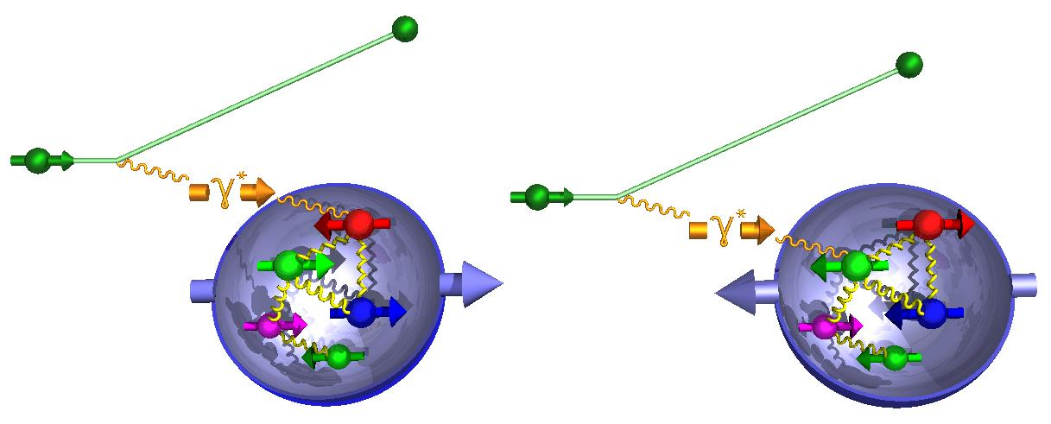
What forms the Spin of the Proton
SPIN is one of the fundamental properties of matter
all elementary particles, but the Higgs carry spin
Spin cannot be explained by a static picture of the proton
It is more than the number ½ ! It is the interplay between
the intrinsic properties and interactions of quarks and gluons
total
quark spin
gluon
spin
angular
momentum
What do we know:
To determine the contribution of quarks and gluons
to the spin of the proton, one needs to measure the
cross section difference g₁ as function of x and Q²
The current knowledge about g₁
as function of x at Q²=10 GeV²
-
EIC pseudo-data
g₁ ~
quark contribution:
The integral of g₁ over x from 0 to 1
gluon contribution:
dg₁(x,Q²)/dlnQ² → Δg(x,Q²)

Slide 15
What forms the Spin of the Proton
The polarized SF g₁(x,Q²) as
measured by EIC for low to high √s
The polarized SF g₁(x,Q²) as
measured by EIC for low √s
Only with the center-of-mass energies
available at EIC the different contributions
to the spin of the proton can be disentangled
arXiv:1509.06489
PRD 92, 094030

Slide 16
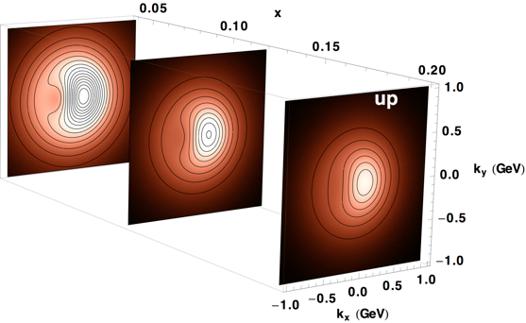
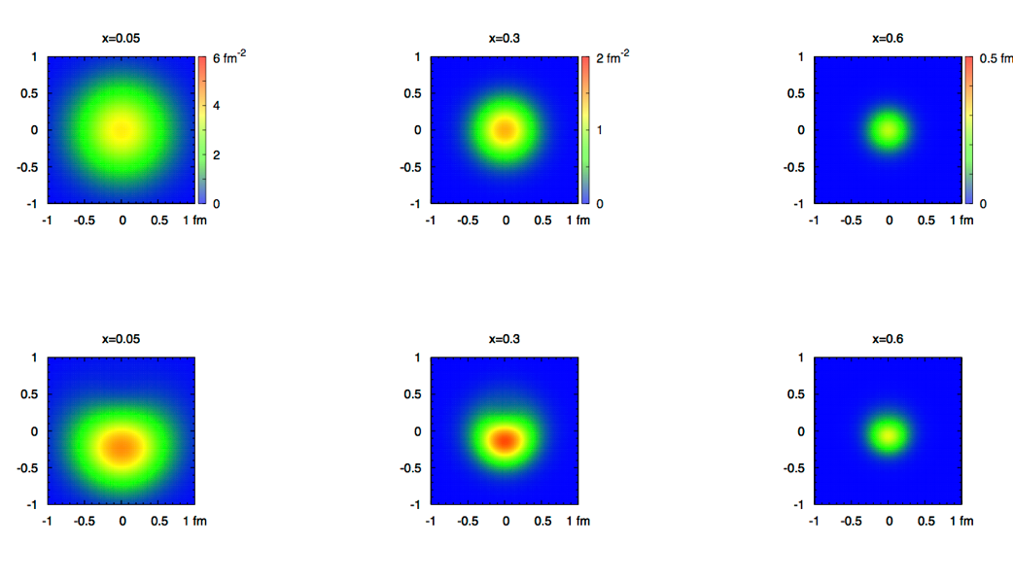
2+1 dimensional Imaging of Quarks & Gluons
Wigner function
W(x,b_{T},k_{T})
→ QCD genetic map
Momentum
space
Coordinate
space
∫d²b_{T}
∫ d²k_{T}
f(x,k_{T})
f(x,b_{T})
Quarks
Quarks
down quark
x
Spin-dependent 3D momentum space
images from semi-inclusive scattering
Spin-dependent 2+1D coordinate space images from exclusive scattering

Slide 17
What about Nuclei?

Slide 18
nPDFs before and after EIC
Ratio g(x,Q²)_{pb} /g(x,Q²)_{p}
DGLAP:
predicts Q² but not A-dependence and x-dependence
Saturation models:
predict A-dependence and x-dependence but not Q²
→ Need: large Q² lever-arm for fixed x, A-scan
LHC
RHIC
Measure different structure function in eA → constrain nPDF:
quark+anti-quark
momentum distributions
gluon momentum distribution
or tag on charm → F₂^{C}

Slide 19
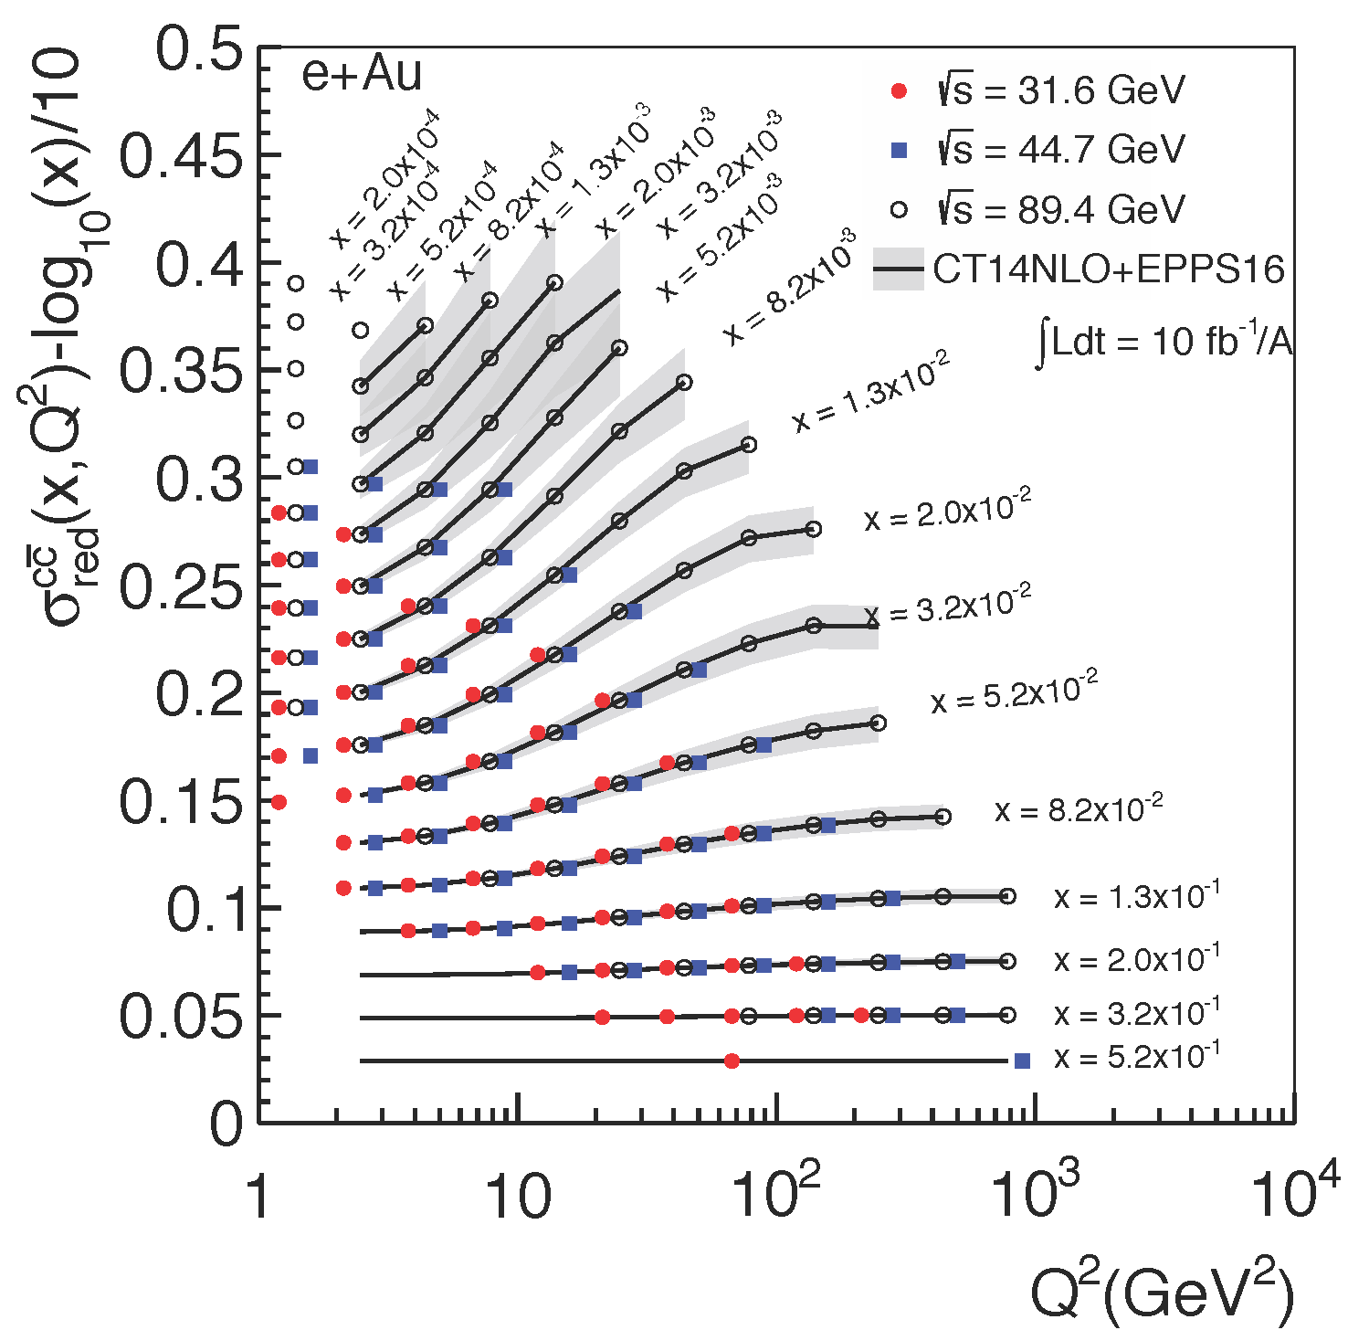
Inclusive Cross-Sections in eA
arXiv:1708.05654
Direct Access to gluons at
medium to high x by tagging
photon-gluon fusion through
charm events
Gluon distribution ~ dσ(x,Q²)/dlnQ²

Slide 20
EIC: Impact on the Knowledge of 1D Nuclear PDFs
√s < 45 GeV
√s < 90 GeV
Ratio of PDF of Pb over Proton
Without EIC, large
uncertainties
→ With EIC significantly
reduced uncertainties
Complementary to RHIC
and LHC pA data.
Provides information on
initial state for heavy ion
collisions.
Does the nucleus behave
like a proton at low-x?
→ relevant to very
high-energy cosmic
ray studies
→ critical input to AA
arXiv:1708.05654

Slide 21

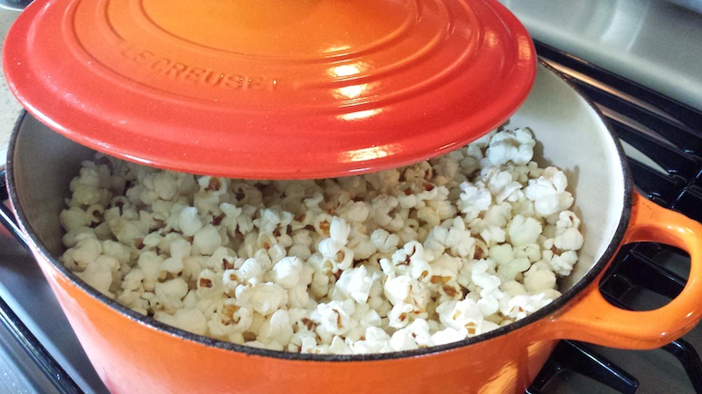

can EIC discover a new state of matter
Is the proton a runaway popcorn machine?
?
gluon
gluon
gluon
gluon
gluon
gluon
gluon
gluon
gluon
gluon
gluon
Does this rise get tamed ?
Important to understand the initial condition for heavy ion collisons
till today only ambiguous hints

Slide 22
can EIC discover a new state of matter
EIC provides an absolutely unique opportunity
to have very high gluon densities
→ electron – lead collisions
combined with an unambiguous observable
counting experiment of
Di-jets in ep and eA
Saturation:
Disappearance of backward jet in eA
EIC will allow to unambiguously
map the transition from a non-saturated to saturated regime
e
p
e
A
#backward jets in eA / ep
increased √s → increased suppression

Slide 23
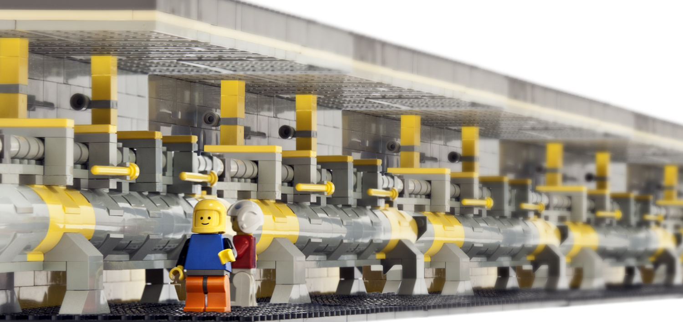
The EIC Accelerator

Slide 24
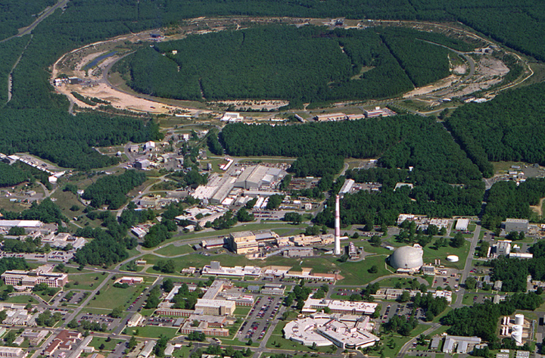

From RHIC to EIC
Jet/C-Polarimeters
RHIC
CeC
EIC
EIC Detector
PHENIX
RF
STAR
EIC Detector
LINAC
NSRL
EBIS
Booster
AGS
Electron accelerator
to be build
RHIC
Existing = $2B
p
70% Polarized protons
25-250 GeV
polarized leptons
5 to 18 GeV
e⁻
Light ions (d,Si,Cu)
Heavy ions (Au,U)
10-100 GeV/u
goal: 80% e⁻ polarization

Slide 25
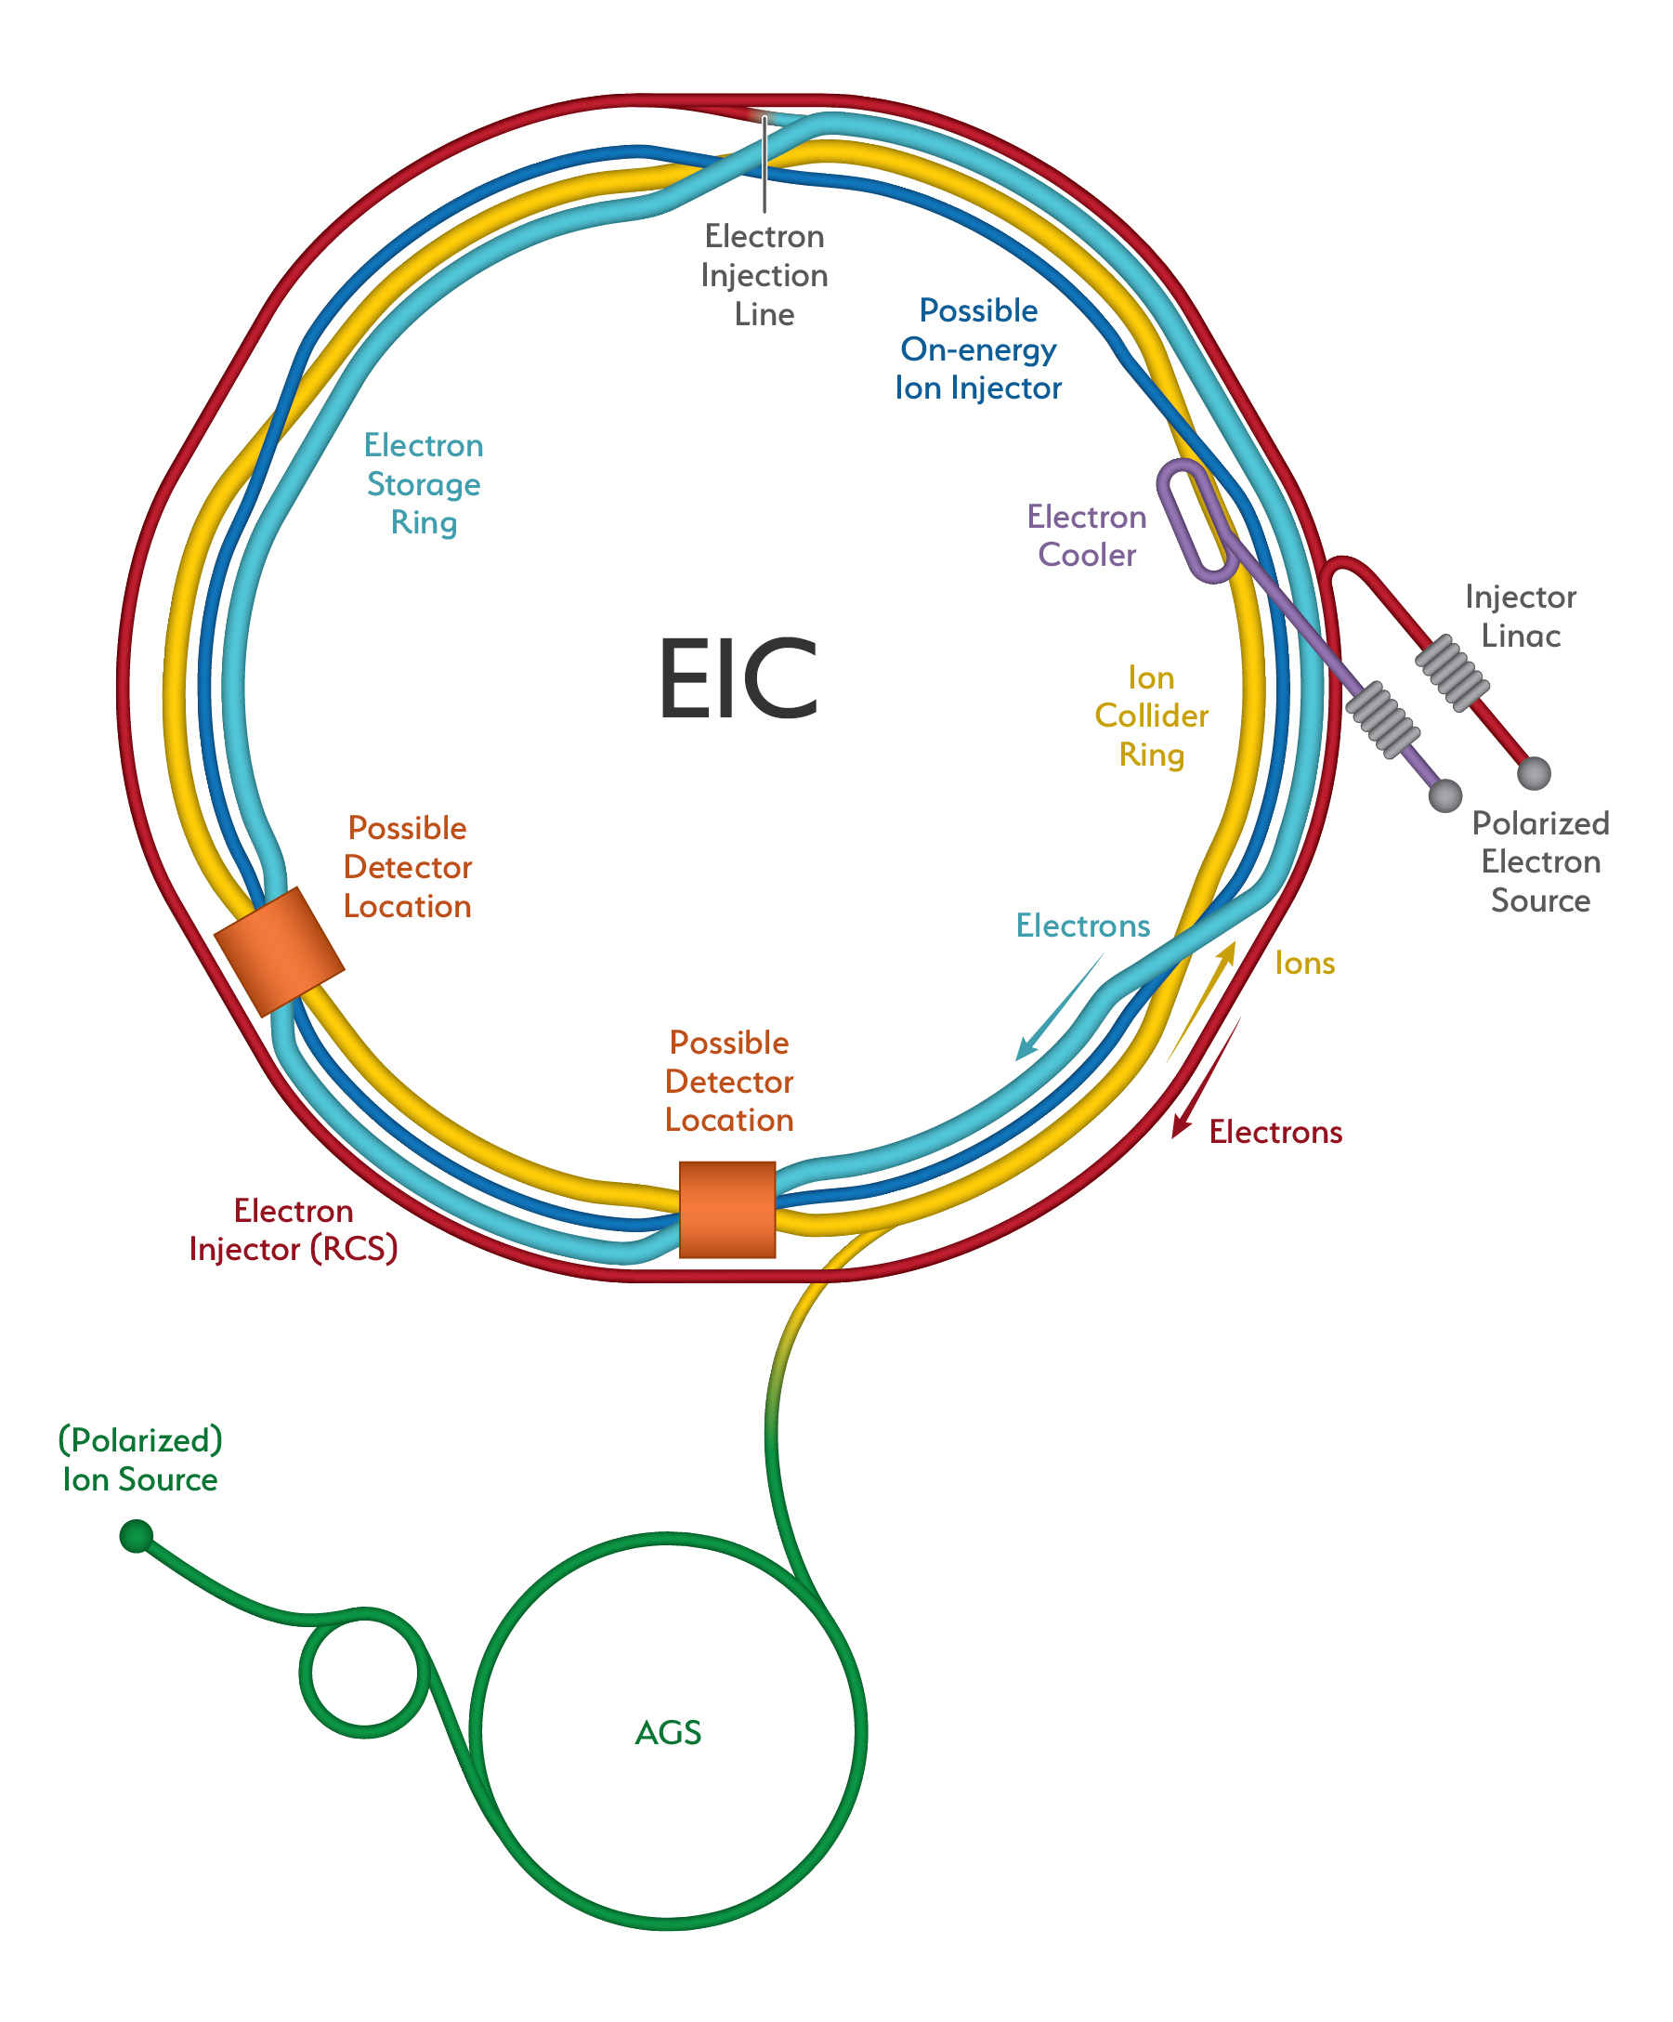
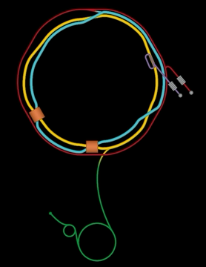
The EIC

Slide 26
The EIC: A Unique Collider
EIC
LHC / RHIC
collide different beam species: ep & eA
consequences for beam backgrounds
  hadron beam backgrounds,
  i.e. beam gas events
  → synchrotron radiation
asymmetric beam energies
boosted kinematics
  high activity at high |η|
Small bunch spacing: >= 9ns
crossing angle: 25mrad
wide range in center of mass energies
factor 6
both beams are polarized
→ stat uncertainty: ~ 1/(P₁P₂ (∫L dt )^{1/2})
collide the same beam species: pp, pA, AA
→ beam backgrounds
  hadron beam backgrounds,
  i.e. beam gas events, high pile up
symmetric beam energies
kinematics is not boosted
  most activity at midrapidity
moderate bunch spacing: 25 ns
no crossing angle yet
LHC limited range in center of mass energies
factor 2
RHIC wide range in center of mass energies :
→ factor 26 in AA and 8 in pp
no beam polarization
→ stat uncertainty: ~1/(∫L dt )^{1/2}
Differences impact detector acceptance and possible detector technologies

Slide 27
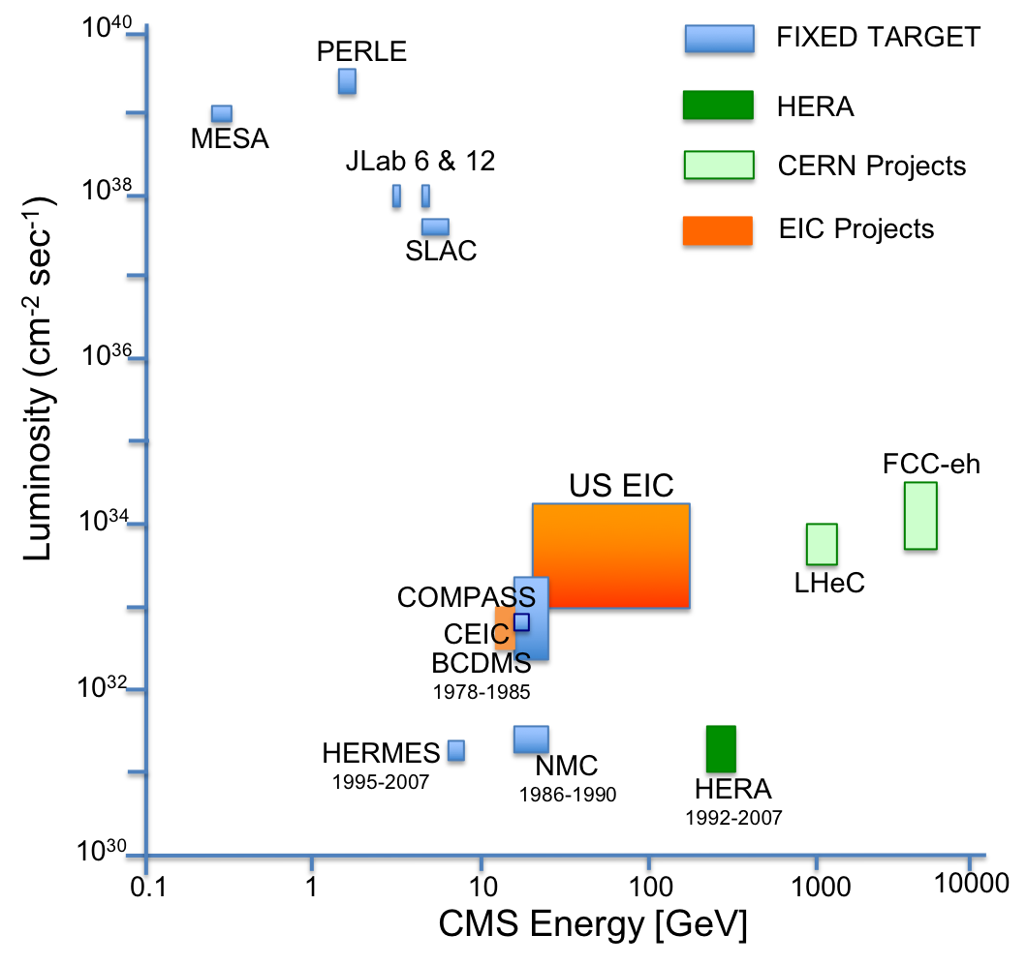
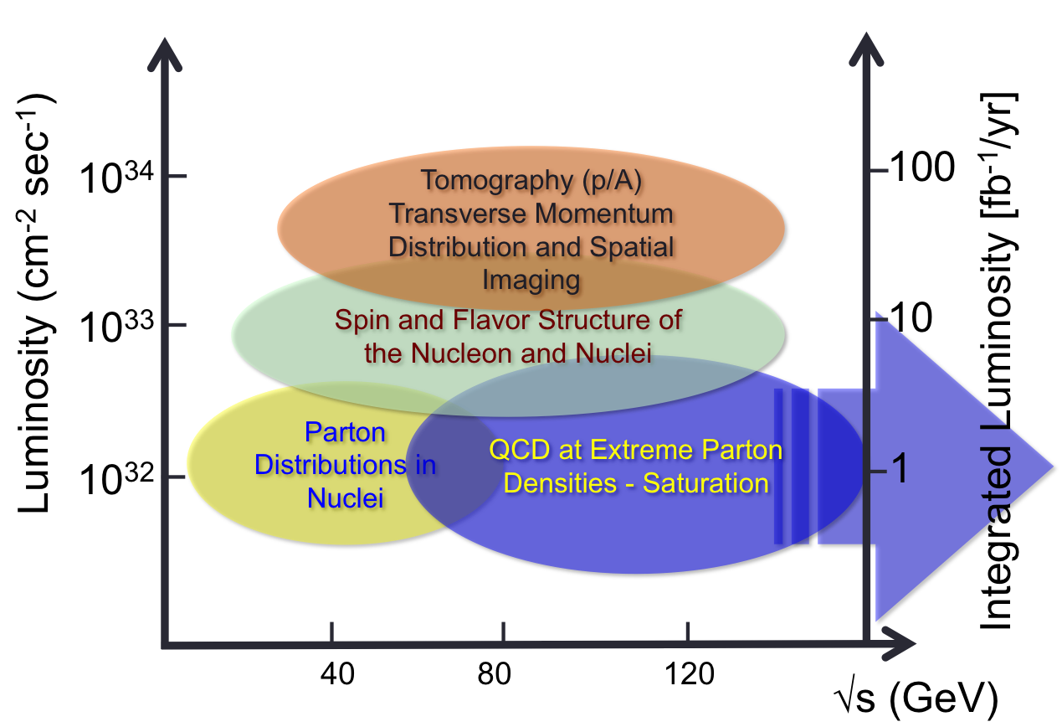
What is needed experimentally?
Luminosity - √s Energy and EIC Physics:
US-EIC:
polarization, ion species together with
its luminosity and √s coverage makes
it a completely unique machine world-wide.

Slide 28
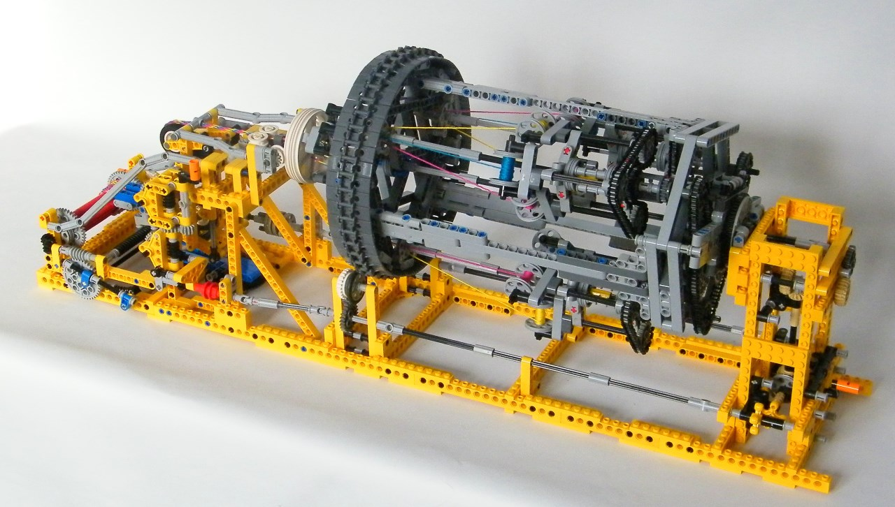
EIC Detector Concept

Slide 29
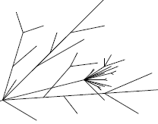
A typical High Energy Detector
Particle types:
  neutrinos (missing energy)
  muons μ
  hadrons π, K, p
    quarks, gluons → jets
  electrons, photons, π⁰
  charged particles
Rough Classification
track detectors for charged particles
  “massless” detectors
    gas detectors
    solid state detectors
beam pipe
magnet coil
  (solenoid, field || beam axis)
Calorimeter for energy measurement
electromagnetic
  high Z material (Pb-glas)
hadronic
  heavy medium (Fe, Cu, U)
  + active material
absorber (mostly Fe)
  flux return yoke +
active material

Slide 30


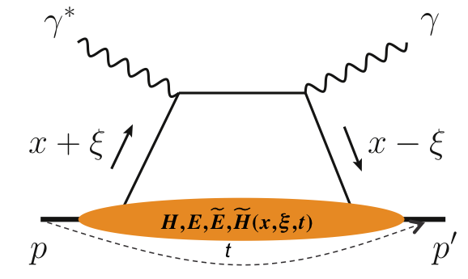
What is needed experimentally?
experimental measurements categories to address EIC physics:
Parton Distributions in nucleons and nuclei
Spin and
Flavor structure of nucleons and nuclei
Tomography Transverse Momentum Dist.
QCD at Extreme Parton Densities - Saturation
Tomography
Spatial Imaging
inclusive DIS
semi-inclusive DIS
exclusive processes
measure scattered lepton
multi-dimensional binning: x, Q²
reach to lowest x, Q² impacts
Interaction Region design
measure scattered lepton
and hadrons in coincidence
multi-dimensional binning:
x, Q², z, p_{T}, Θ
particle identification over entire region is critical
measure all particles in event
multi-dimensional binning:
x, Q², t, Θ
proton p_{t}: 0.2 - 1.3 GeV
  cannot be detected in main detector
  strong impact on Interaction Region design
∫Ldt:
1 fb⁻¹
10 fb⁻¹
10 - 100 fb⁻¹
machine & detector requirements

Slide 31

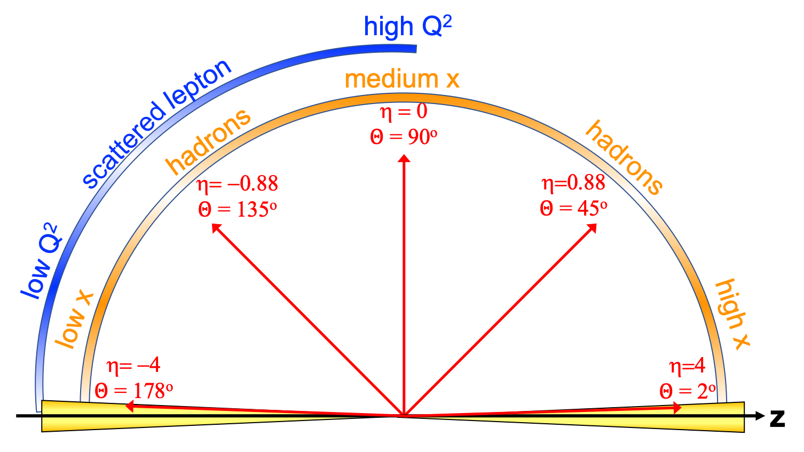
EIC General Purpose Detector: Concept
p/A beam
electron beam
inclusive DIS:
semi-inclusive DIS
Backward-η
Forward-η
Central
Detector
HCAL
Lepton
Endcap
Magnet
Hadron
Endcap
HCAL
ECAL
HCAL
ECAL
ECAL
Tracking
PID
PID
PID
Tracking
very low Q²
scattered lepton
Bethe-Heitler photons
for luminosity
Tracking
particles from nuclear
breakup and
from diffractive reactions
exclusive DIS
ZDC
Luminosity Detector
Forward Tracking
Low Q²-Tagger

Slide 32
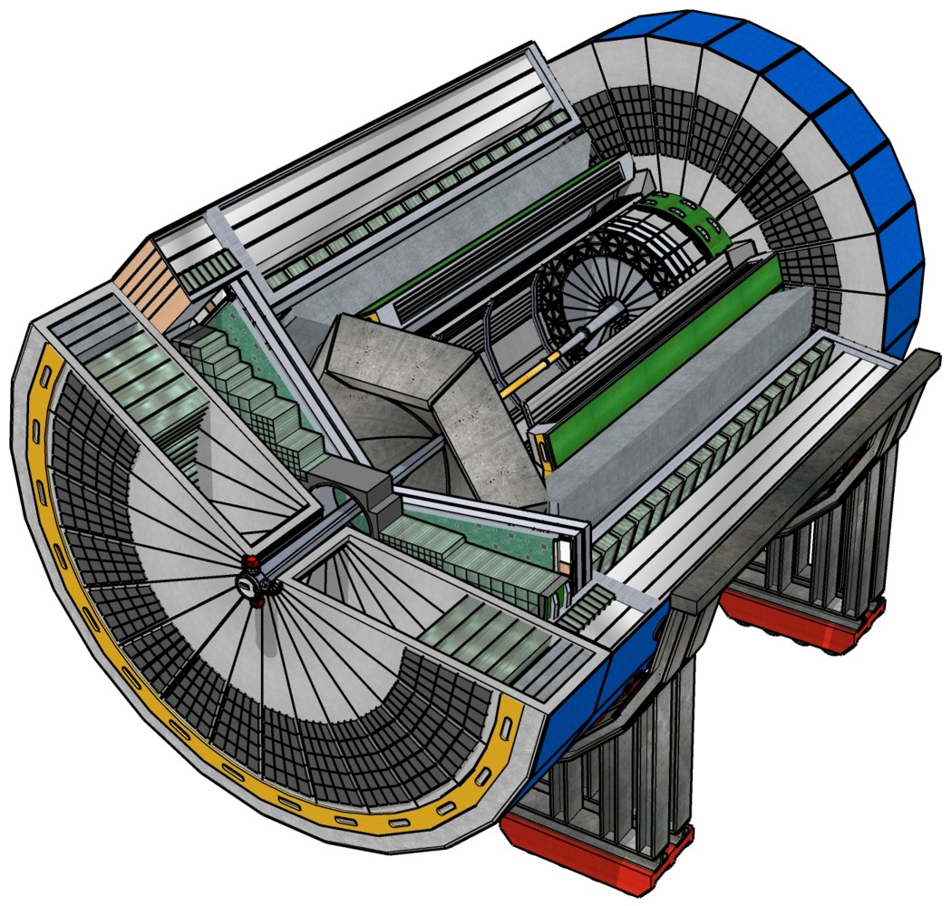
EIC Experimental Equipment
Any general purpose EIC Detector is complex
Overall detector requirements:
Large rapidity (-4 < η < 4) coverage; and far beyond in especially far-forward detector regions
High precision low mass tracking
  small (μ-vertex) and large radius (gaseous-based) tracking
Electromagnetic and Hadronic Calorimetry
  equal coverage of tracking and EM-calorimetry
High performance PID to separate π, K, p on
track level
  also need good e/h separation for scattered electron
Large acceptance for diffraction, tagging, neutrons from nuclear breakup: critical for physics program
  Many ancillary detector integrated in the beam line: low-Q² tagger, Roman Pots, Zero-Degree Calorimeter, ….
High control of systematics
  luminosity monitor, electron & hadron Polarimetry
Integration into the Interaction Region is critical

Slide 33
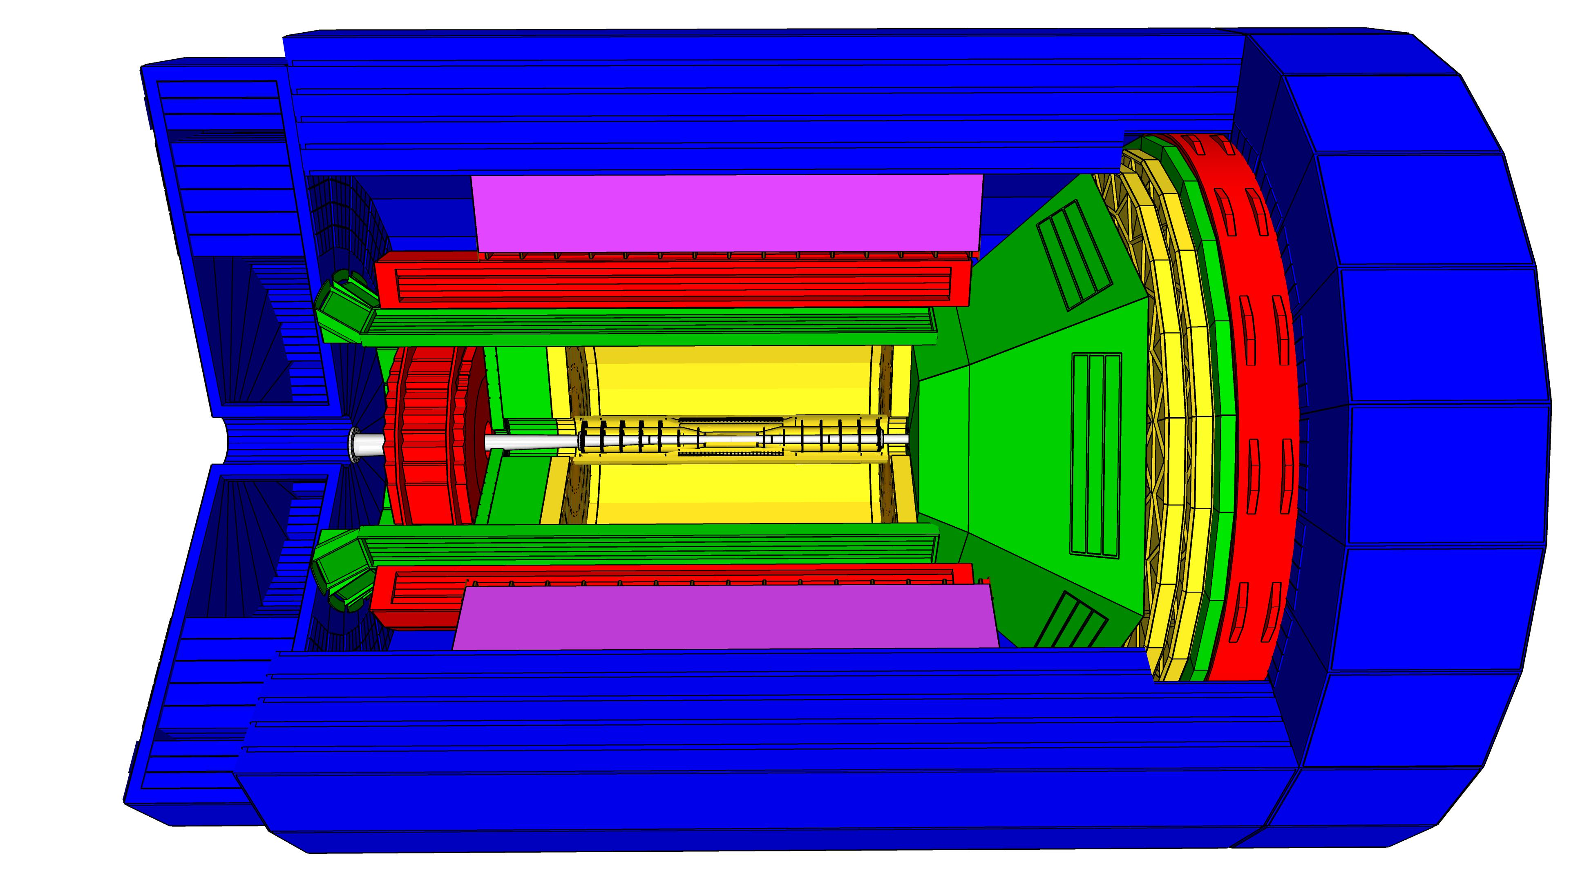
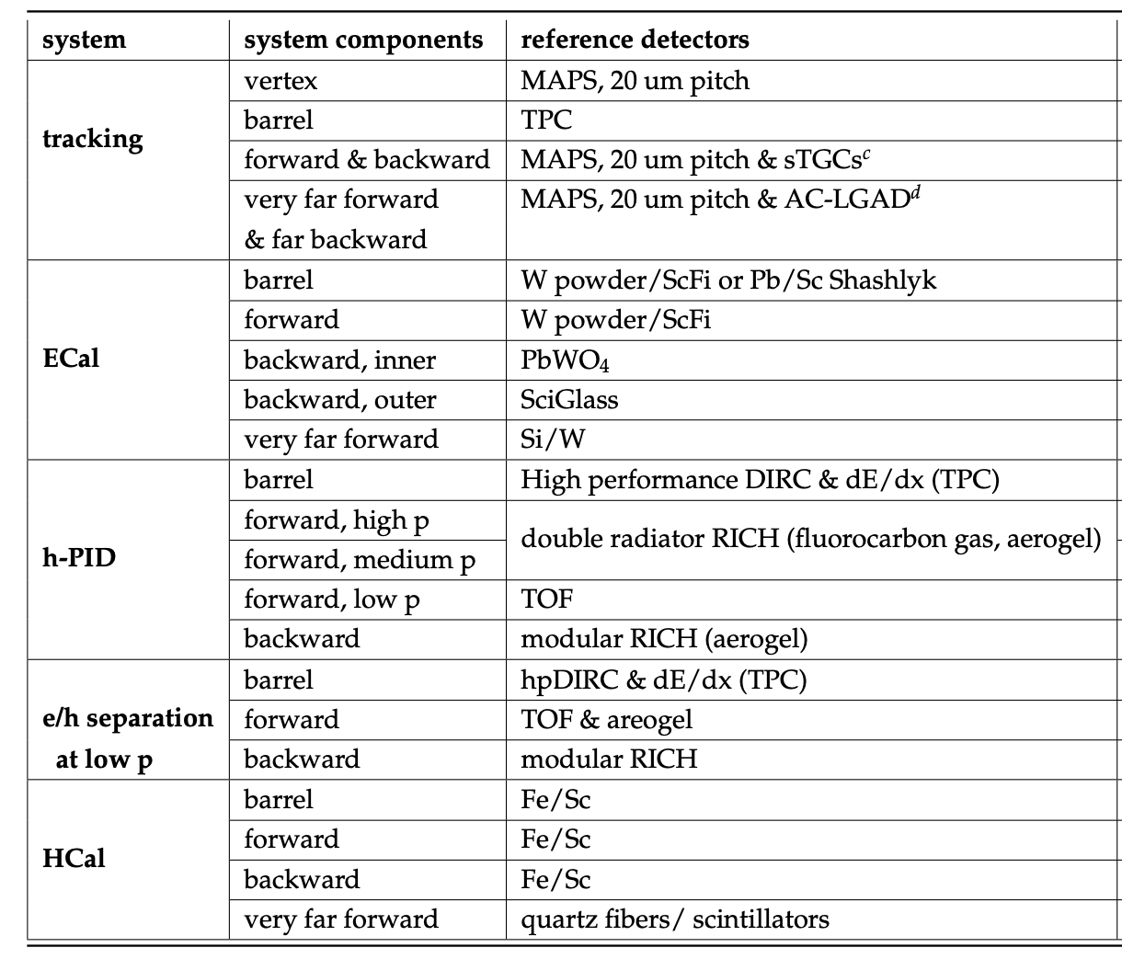
EIC General Purpose Detector
hadronic calorimeters
e/m calorimeters
solenoid coils
EIC general purpose Detector around
a new 3T Solenoid
Hermetic coverage
→ as close as possible to 4π
Coverage: 2º < Θ < 178º (-4<η<4 ) with 2π in Φ
silicon trackers
MPG trackers
PID/ RICH detectors
9.0m
Flow down of Physics Requirements
to detector design has been determined in 2020 EIC-UG
Yellow Report Initiative
https://arxiv.org/abs/2103.05419
electrons
hadrons
Technologies based on Generic EIC Detector R&D developed by EIC-UG members
https://wiki.bnl.gov/conferences/index.php/EIC_R%25D

Slide 34
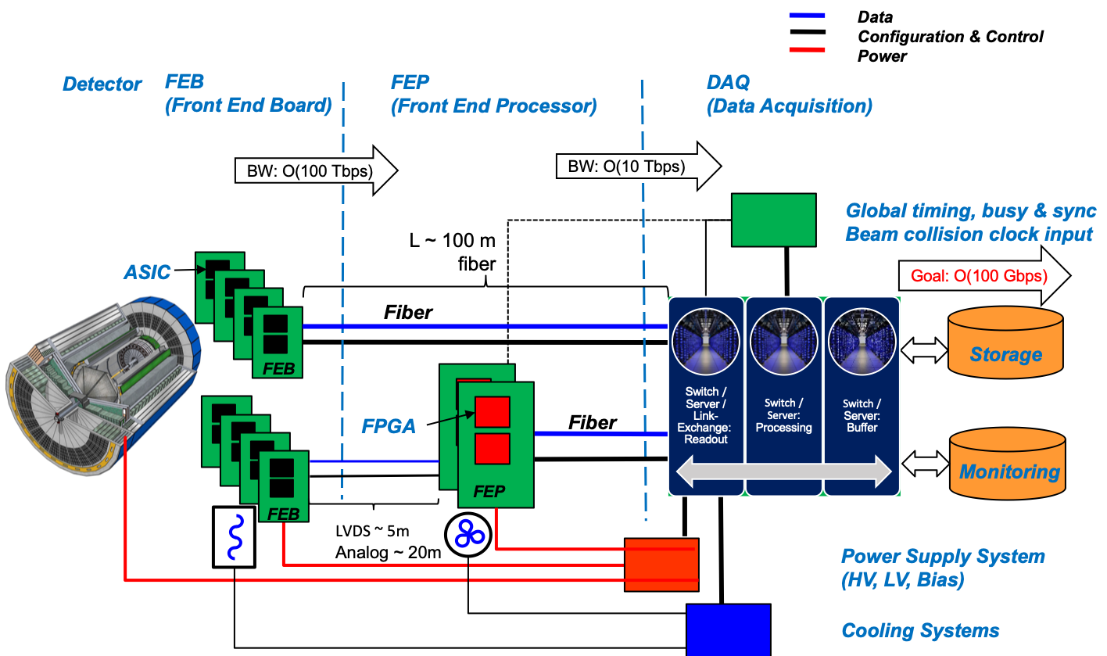
Streaming Readout Architecture
Possible at EIC as data rates manageable (500 kHz, O(100) Gbps)

Slide 35
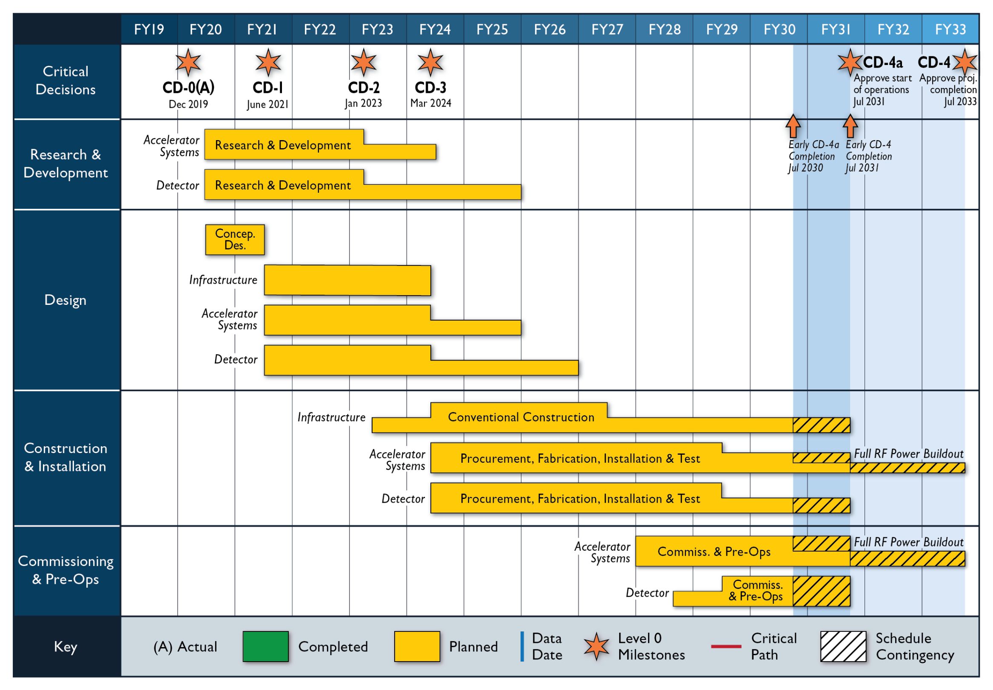
EIC Project Status
January 2020: Mission Need & CD-0 & site selection → BNL
June 28th 2021: EIC received CD-1
Start-of Construction

Slide 36

Take Away Message
Why EIC now?
“all stars align”:
theory developments will allow to obtain the answers to the big questions discussed
detector technologies allow for a collider detector with high resolution, wide acceptance and particle identification
BUT MOST IMPORTANTLY
accelerator technologies allow to built a collider with
  high luminosity
  highly polarized electron and light hadron beams
  a wide range in center of mass energies
  hadron beams with highest A
  demanding acceptance requirements can be realized in IR design
Current
knowledge about
nucleon structure
and the glue
EIC science program will profoundly impact
our understanding of the inner structure
of the world around us
uniquely tied to a future high energy, high luminosity,
polarized ep / eA collider
never been measured before & will never without
with EIC

Slide 37

Summary
Let’s get to work
and built EIC
Things to read: https://wiki.bnl.gov/eic/index.php/Publications_and_presentations

Slide 38


Slide 39







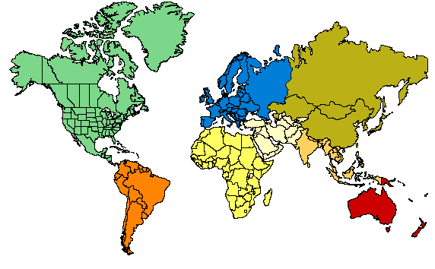



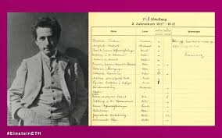
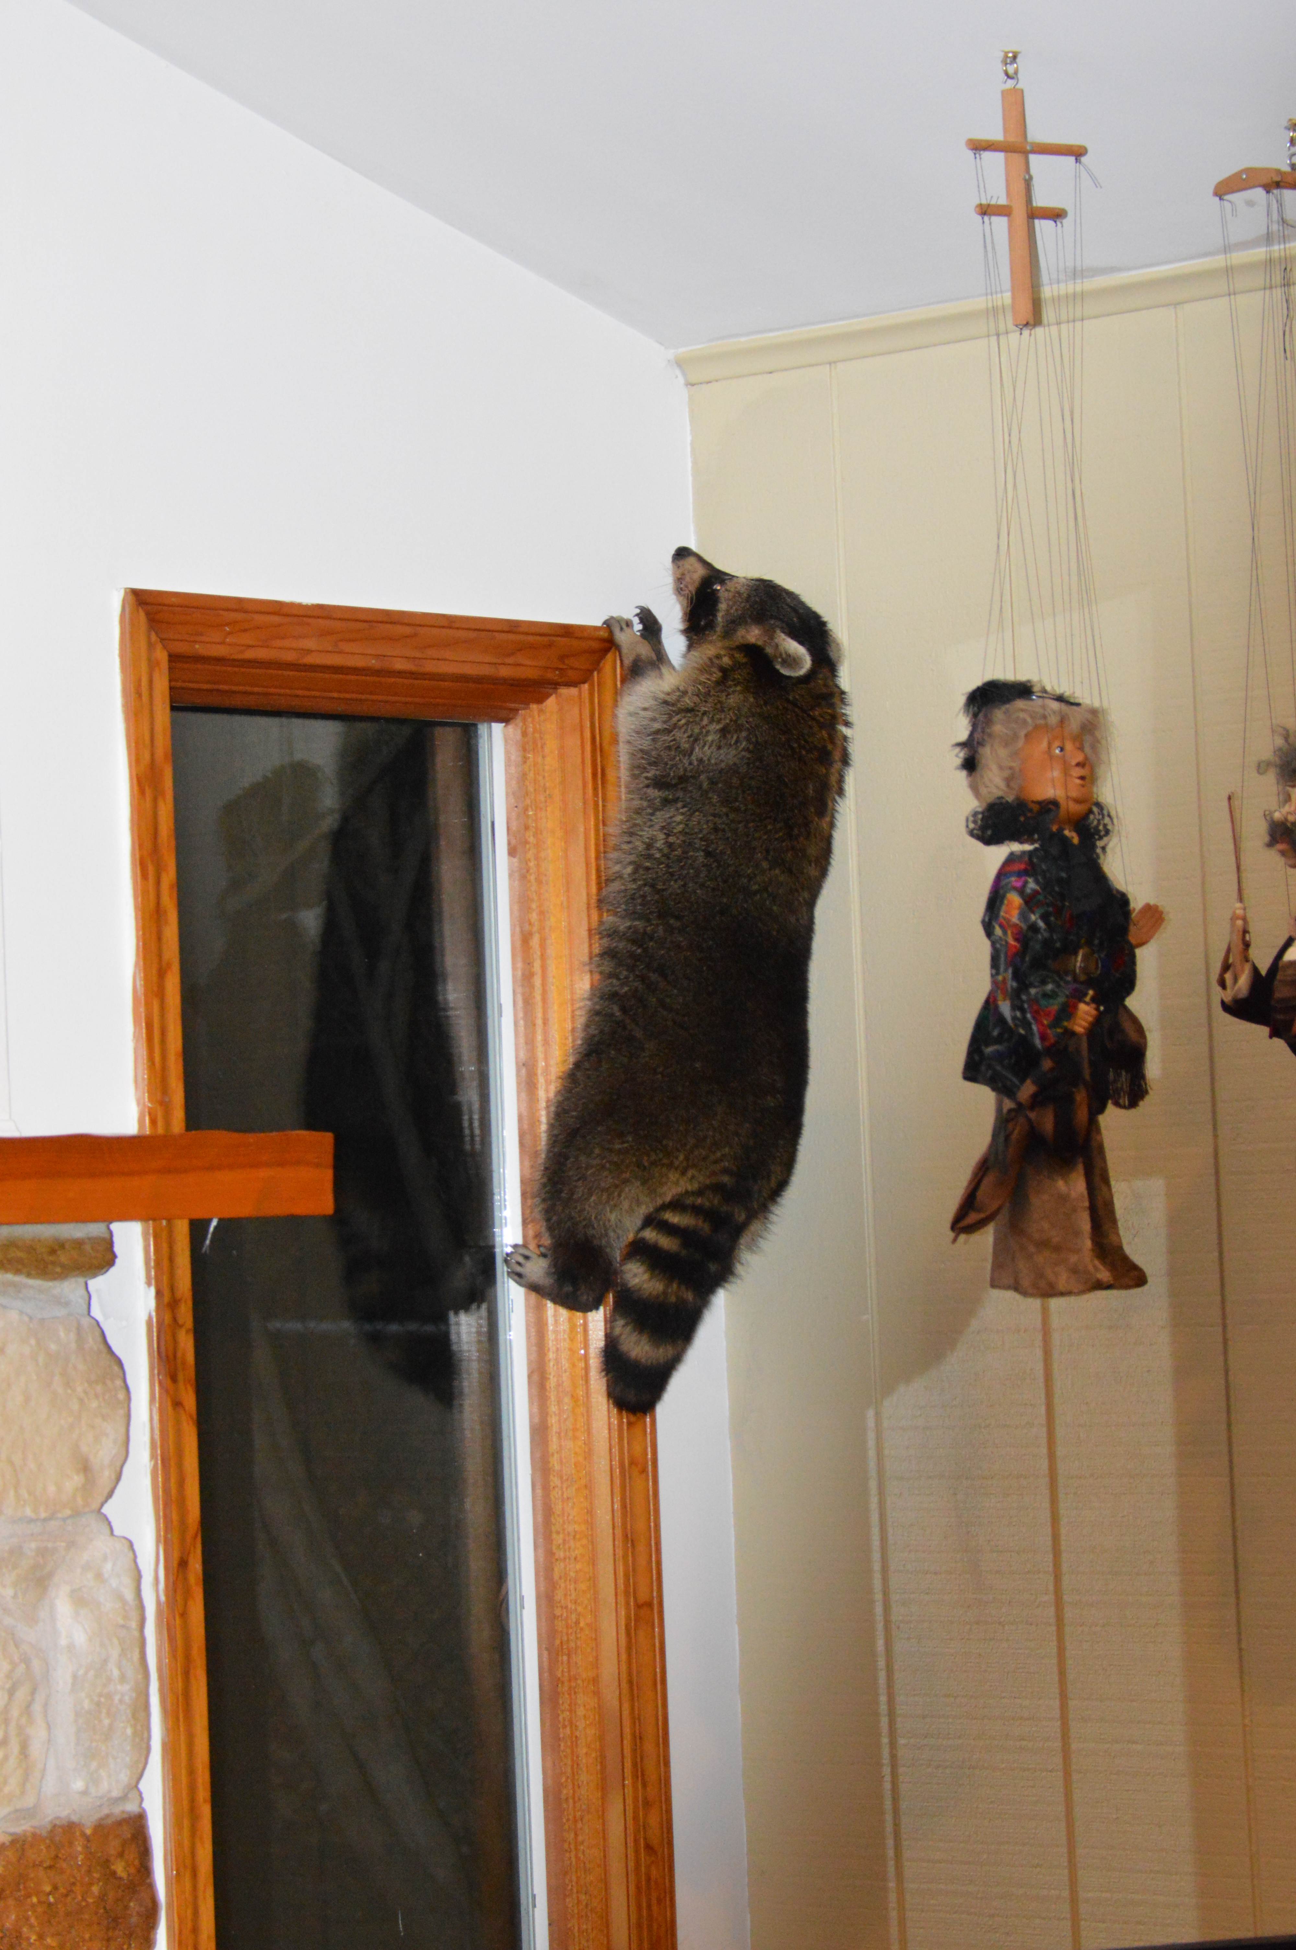
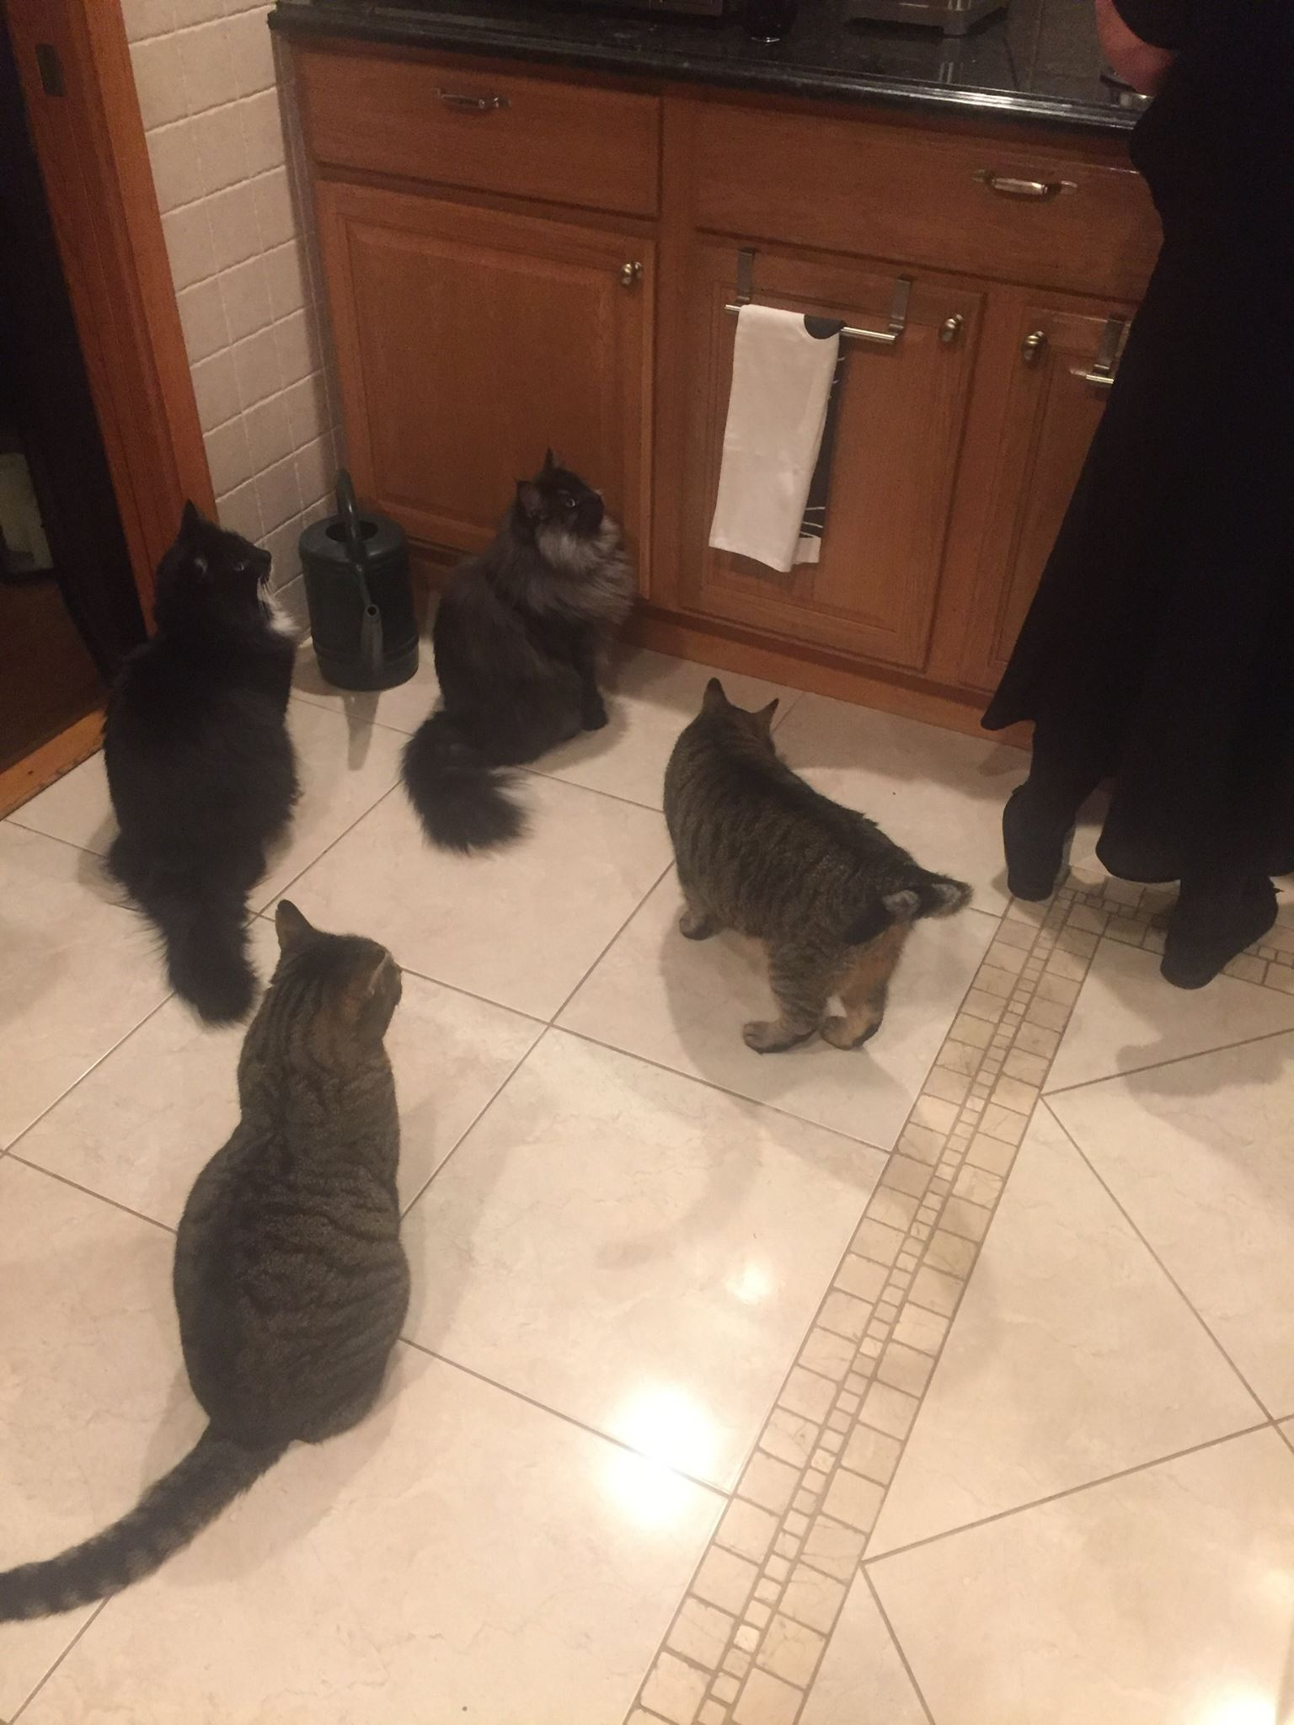

















My Way to EIC
BNL (2009 – today)
Cold QCD Group Leader
RHIC Polarimeters
PHENIX (2009 – 2011)
STAR (2011 – Now)
EIC (2009 – Now)
Research Topics:
RHIC: Cold QCD in pp & pA
EIC:
Physics, Detector,
IR-design, Polarimetry
DESY Hamburg HERMES@HERA
2nd PostDoc (1997 – 2001)
Scientist (2001 – 2006)
Research Topics:
Cold QCD in ep & eA
2000-2003:
6 y after PhD as a PostDoc
Run-coordinator & Deputy-Spokesperson
2003-2006: Spokesperson
2007 HERA closed
1st PostDoc
one of the first EU fellows
NIKEF, Amsterdam
University of Ghent, Belgium
Research Topics:
Nucleon-Nucleon Correlations
and
Meson Exchange Currents
PhD in Physics at ETH Zuerich
Switzerland (1994)
Topic:
Characterization of Pionic Atoms
spent 6 month in Moscow
to write a MC with
theorists
→ was pretty cool
1984-1989
Jefferson Lab (2007 – 2009)
12 GeV-Upgrade: Hall-D
Group Leader and Project-Leader
Built up the group and
sheparded the project through
CD-2, CD-3 and ~10 other reviews
Research Topics:
Gluex: Spectroscopy search for
Exotics and Glueballs
Education in Fuerth (Bavaria) Germany
Master in Physics (1990)
Friedrich Alexander University,
Erlangen (Bavaria) Germany
Topic:
Measure the strength of Gamov-Teller
transitions relevant for
Solar Neutrino Experiments
2009- today
2007-2009
1990-1994
1996-2006
1994-1996

Slide 40

from
Physics
Requirements from Physics:
High Luminosity: 10³³-10³⁴ cm⁻²s⁻¹
Variable center of mass energies from 20− 100 GeV, upgradable to 140 GeV
Electrons and protons/light nuclei highly polarized (70%)
Ion beams from deuteron to the heaviest nuclei (d to U)
Possibilities of having more than one interaction region with room for a wide acceptance detector with good PID (e/h & p, K, p)
large acceptance for small angle scattered particles along the beam line

Slide 41

The EIC Motto
To mine the vast amount of data to expose the fundamental laws of
Nature, highly sensitive instruments/detectors are needed.

Slide 42
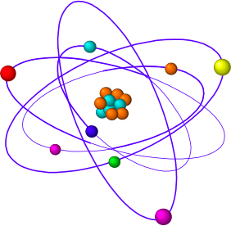
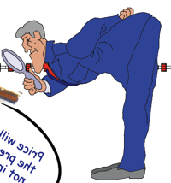
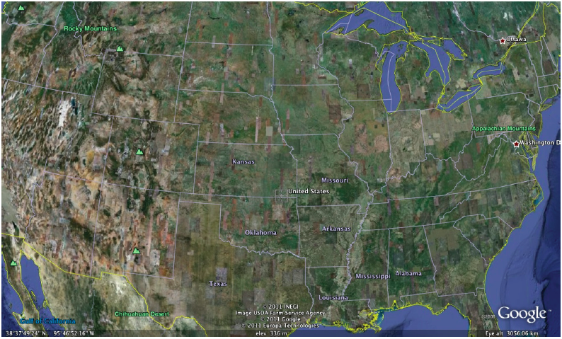



High Energy: Looking deeper and deeper inside!
neutron
proton
ATOM
10⁻¹⁰m
Nucleus
10⁻¹⁴m
Proton
10⁻¹⁵m
USA
Quarks and Gluons
10⁻¹⁷m
increase
beam energy
State of NY
Manhattan

