Slide 1
psTOF R&D (eRD10) Outline for FY2016
Bob Azmoun, Mickey Chiu, Edouard Kistenev, Eric Mannel, Andrey Sukhanov, Thomas Tsang, Craig Woody
Brookhaven National Laboratory
Ihnjea Choi, Chong Han, David Hjelmstad, Yakov Kulinich, Matthias Grosse-Perdekamp
University of Illinois at Urbana-Champaign
Marcus Alfred, James Lindesay
Howard University
Marcel Demarteau, Robert Wagner, Yunqi Xie
Argonne National Laboratory
John Harris, Richard Majka, Nikolai Smirnov
Yale University

Slide 2
Accomplishments
Simulation Studies of psTOF (Chong,Matthias)
  Pythia + parameterized response
  Occupancy (low channel count = lower cost)
  TOF with other detectors
  Start time aspects (Mickey)
Prototype Results (Ihnjea,Matthias)
  Cosmic Test Stand
  XX ps?
Preamps (Mickey,Andrey,Ihnjea)
  SPICE and lab studies
mRPC detailed detector Simulation (Mickey)
  Halfway done

Slide 3
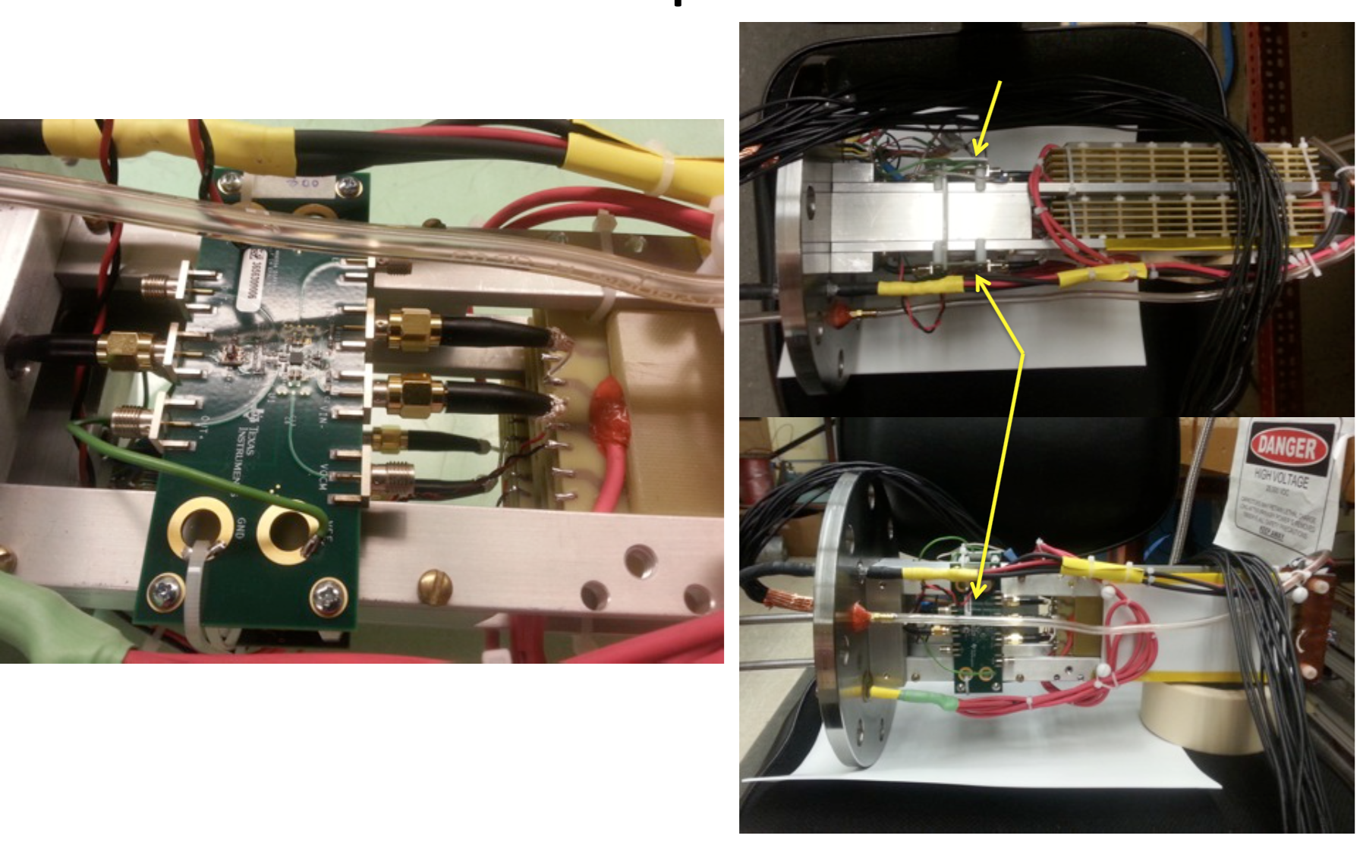
Test Stand at UIUC
Currently using LMH6554 (4 GHz GBW)
Results under study

Slide 4
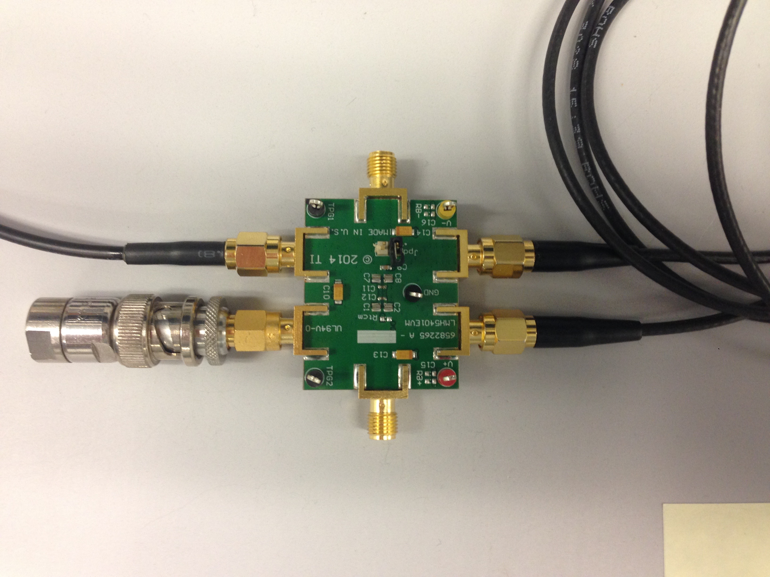
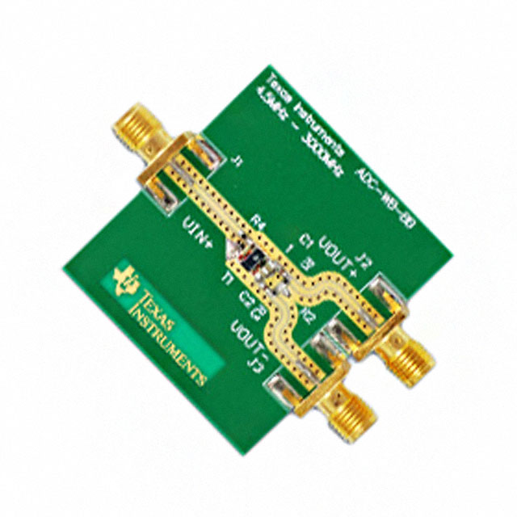
Preamp Test Chain at BNL
TI ADC-WB-BB
(Balun)
TI LMH5401EVM Eval Board
(Needs +/- 4 V, or +4 V)
Signal Generator
(HP 33250A)
Scope
(TDS3450
500 MHz)
LMH5401: 8 GHz GBW (gain*bandwidth product)
Andrey has now modeled it in Spice
Eval board is set for single-ended to differential, 4 V/V
I tested that, converted board to differential to differential 20 V/V, then retested.
Balun is used to convert from single-ended 50 ohm to 100 ohm differential

Slide 5
mRPC R&D For Fiscal 2016
Improved prototypes
  Better gas, smaller gaps, what else?
  Replacement of glass with better materials?
  Preamp boards (not TI eval modules)
  Would like to request continued funding for our post-doc at UIUC (0.5 FTE)
Beam Test at FNAL
Simulation?
  Electron ID using TOF+TPC dE/dx (solves pion contamination in e channel)
  Continue previous study, but with full Geant4 study?

Slide 6
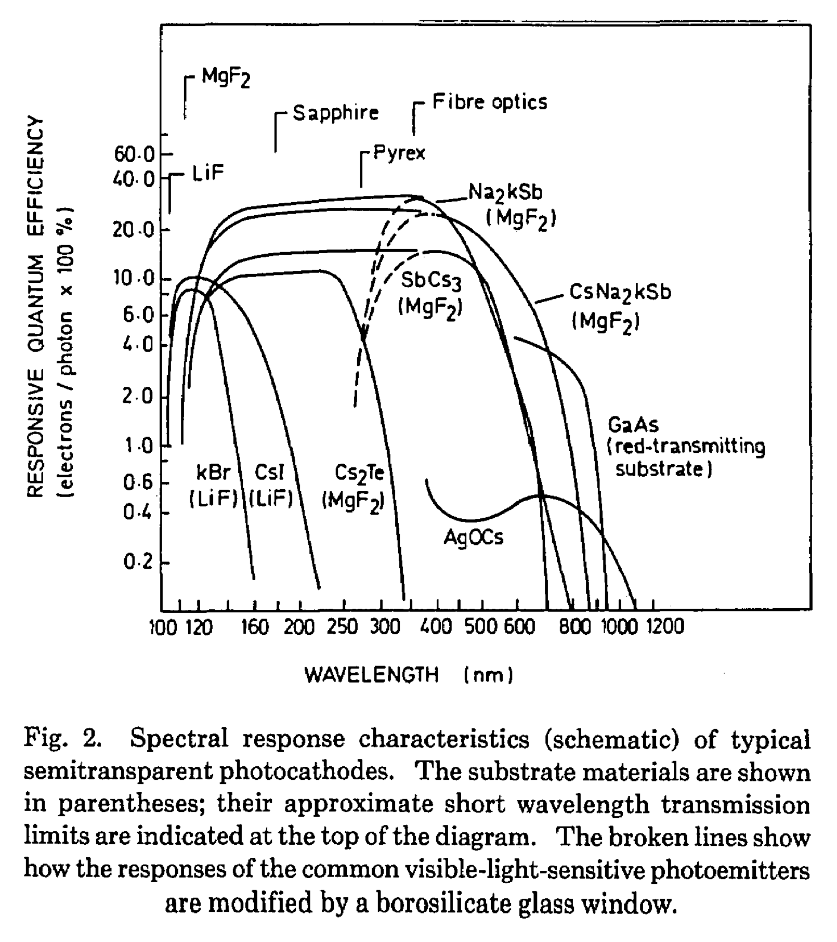
LAPPD 2016:
Optimization of Photocathode for UV
(Argonne, BNL, UIUC)
Optimize in UV for all our applications (Cerenkov).
Standard (K₂CsSb) and/or S20-like bialkali (Na₂kSb) photocathodes with fused silica window

Slide 7
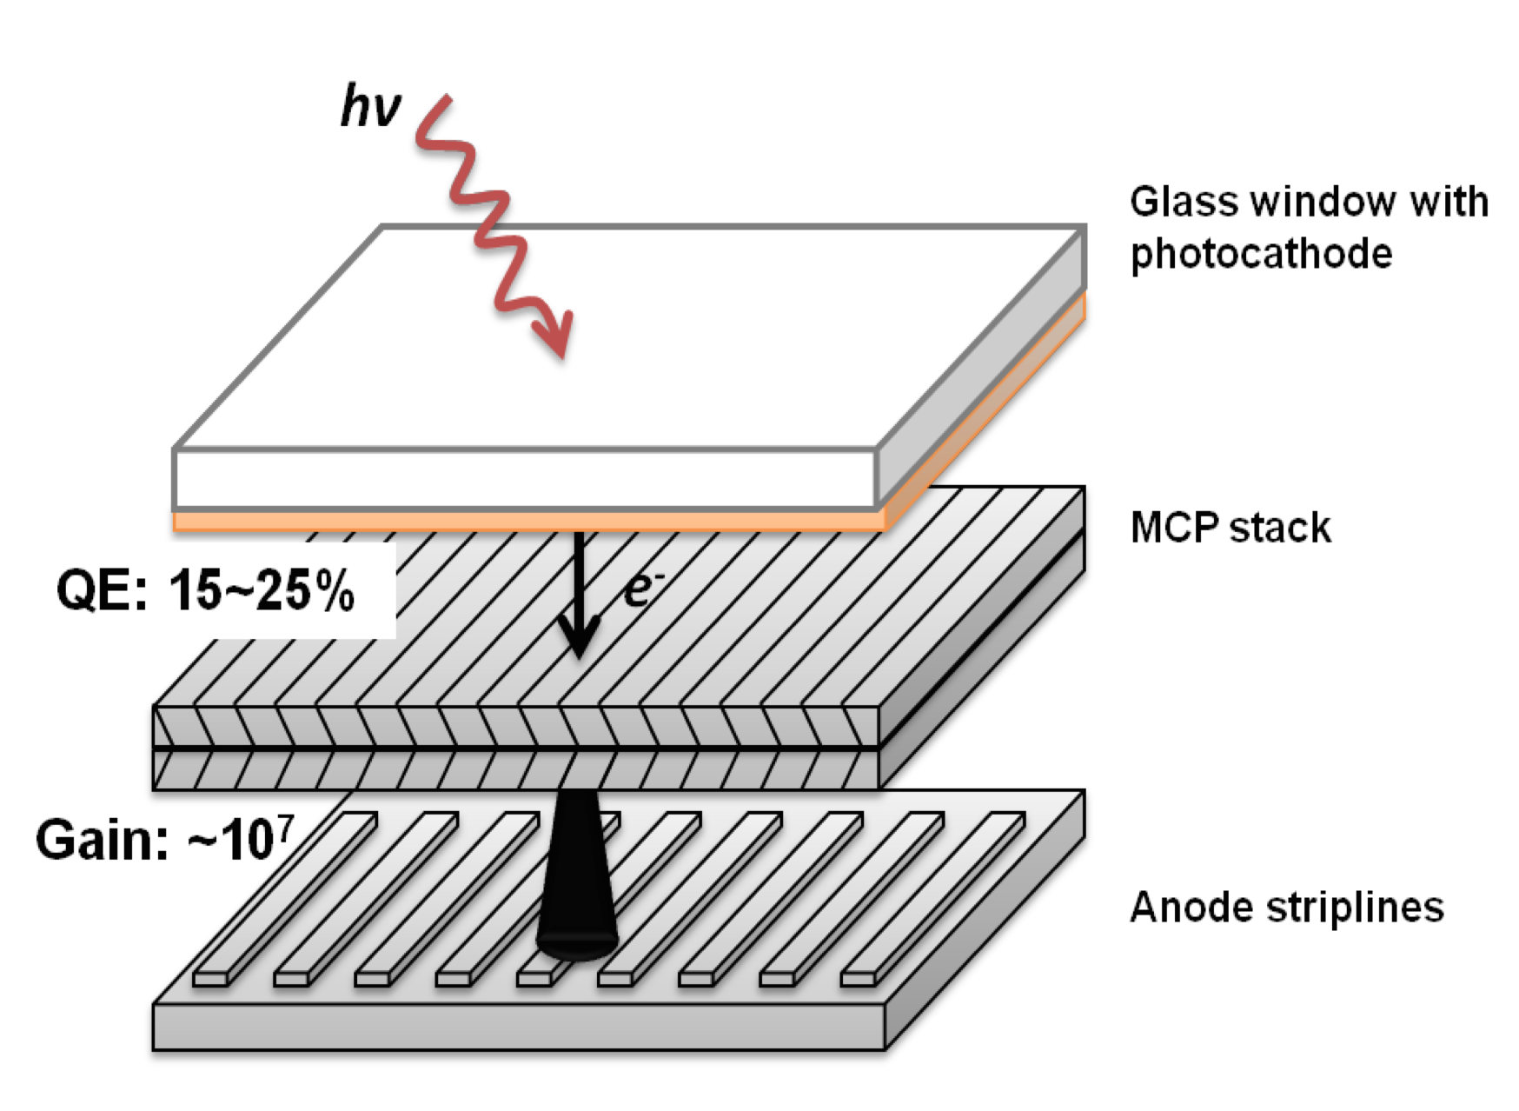
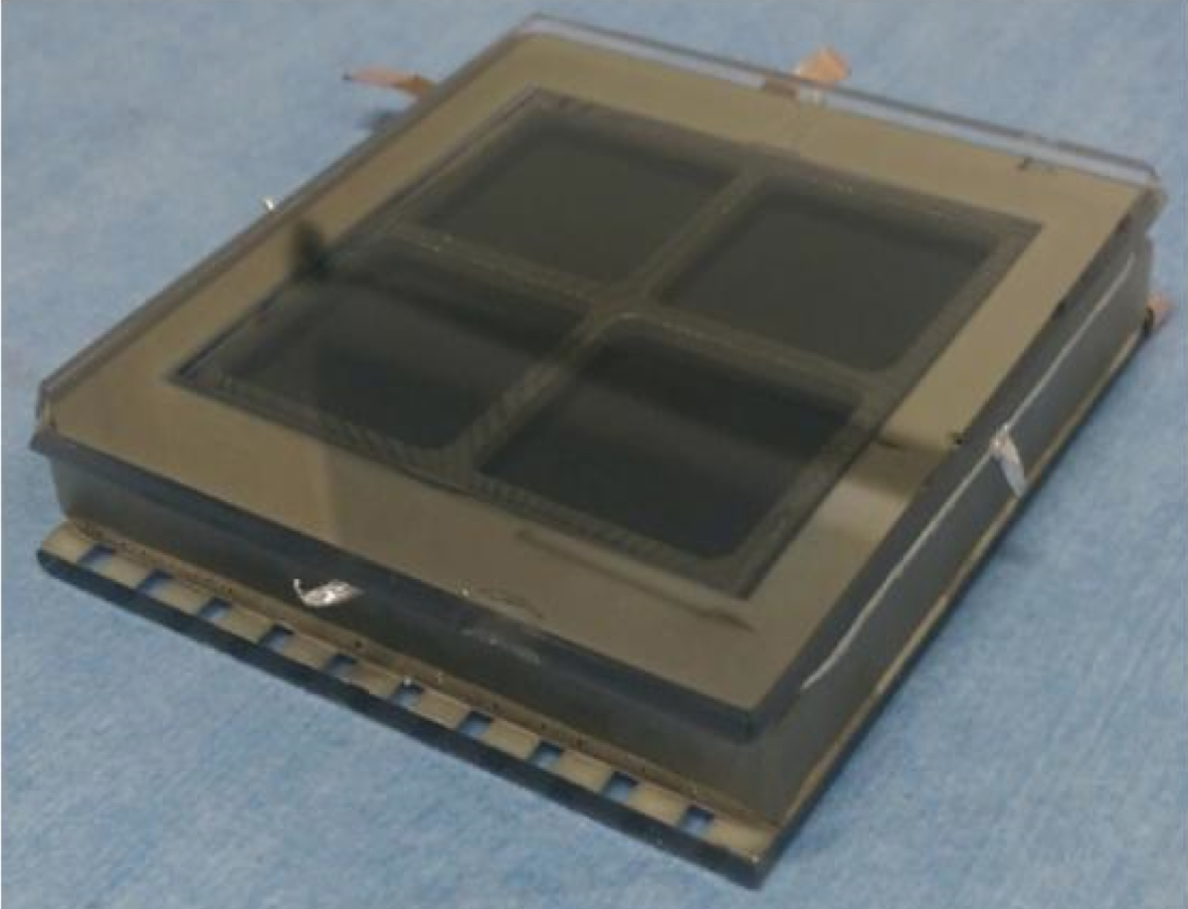
LAPPD 2017:
Pad Readout Option
(Argonne, BNL, Yale?)
Resistive Anode
Replace stripline anodes with resistive anode layer, such as graphite, coupled to external PCB
Or use glass PCB with via’s as base.
Useful for RICH/DIRC among others.

Slide 8
Budget Request
UIUC
Labor FTE Deliverable
———— ——— ——————
post-doc, Ihnjea Choi 50% 60k/year mRPC production/testing
Argonne
Labor FTE Deliverable
———— ——— ——————
post-doc, Jingbo Wang 20% 25k/year MCP-PMT testing
scientist, Junqi Xie 10% 25K/year CsI photocathode development, MCP-PMT fabrication
tech in 2nd year only 1 month 25k Signal pad readout fabrication
Materials
————
$35K 1st year only VUV photocathode characterization system including VUV light source, vacuum monochromator/accessories
$5K/yr Substrates, ALD activated MCPs, readout base and source material supplies
The budget request will be 90K for the first year and 80k for the second year.

