Slide 1
ATHENA S&C Update: First software tutorial
Wednesday 2021-05-26
The first tutorial session, based around full simulation, took placed on Friday May 21
The ATHENA S&C WG conveners: Andrea Bressan (University of Trieste and INFN) , Dmitry Romanov (Jefferson lab) , Sylvester Joosten (Argonne National Laboratory) , Whitney Armstrong (Argonne National Laboratory) , Wouter Deconinck (The University of Manitoba).

Slide 2
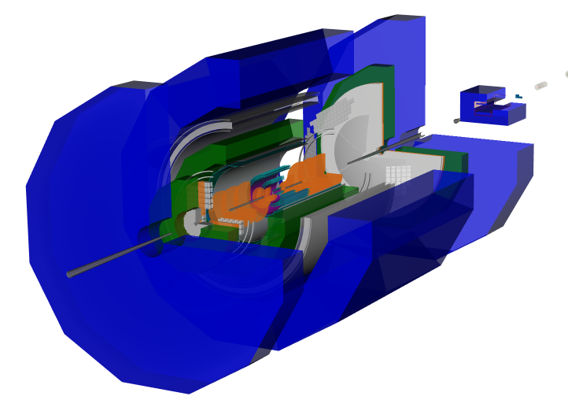
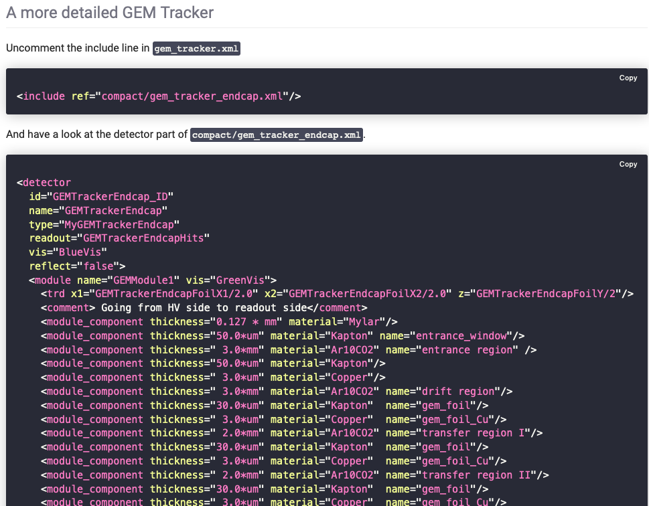
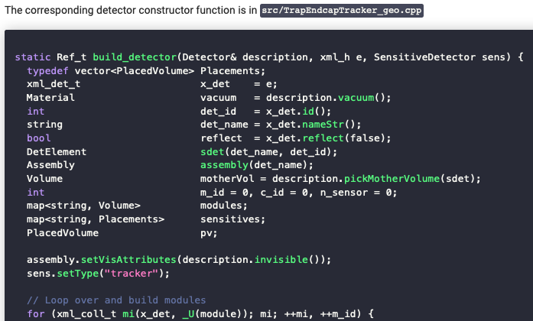
Tutorial focus: full simulation
https://eic.phy.anl.gov/tutorials/eic_tutorial/getting-started/quickstart
Environment setup
Geometry visualization
Realistic geometry descriptions
Introduction to geometry plugins

Slide 3
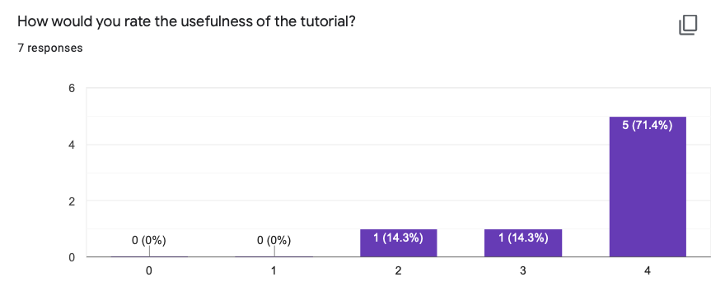
Tutorial was a big success!
54 sign-ups for the tutorial sessions, and over 60 people total in the sessions
Due to the large interest, we held two (identical) sessions
Currently collecting (anonymous) feedback to help guide future sessions
Next topics will include geometry hack-a-thon, reconstruction algorithms, and doing physics analysis from fully reconstructed events
Feedback form (takes ~5min): https://docs.google.com/forms/d/e/1FAIpQLSclPBXv13pVtawt35XeaCDMOcmdo8fhKTapdmjFO_6gPTV-8w/viewform?usp=sf_link

