Slide 1

Exclusive working group update
By: Igor Korover (MIT)
July 23rd 2021

Slide 2
All data is from 5x41 using IPRO = 4
DVCS Process:
With GK model
ep - > e’p’gamma
Generator used: MILOU3D
We have two GPDs models available: KM20 and GK that were used for YR
Simulation tool: Fun4all
From the simulation we have: 1) truth particle – can be smeared (then why to simulate)
2) track reconstruction for charged particles in main barrel
https://github.com/koigorek/ECCE-exclusive.git

Slide 3
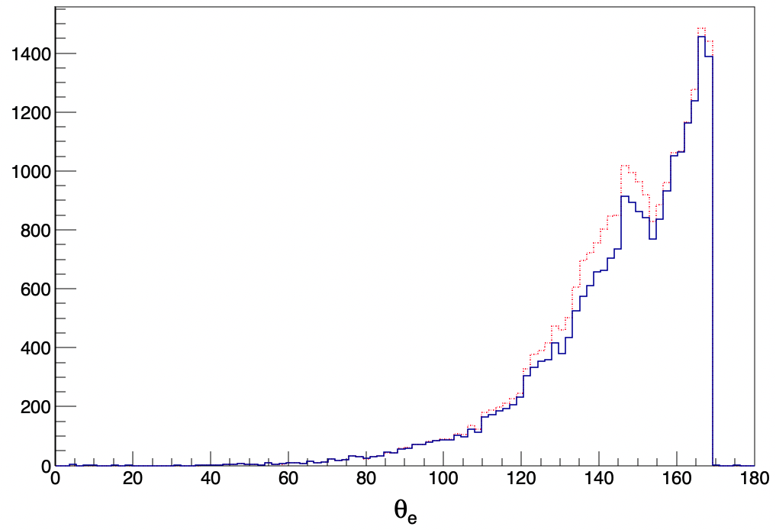
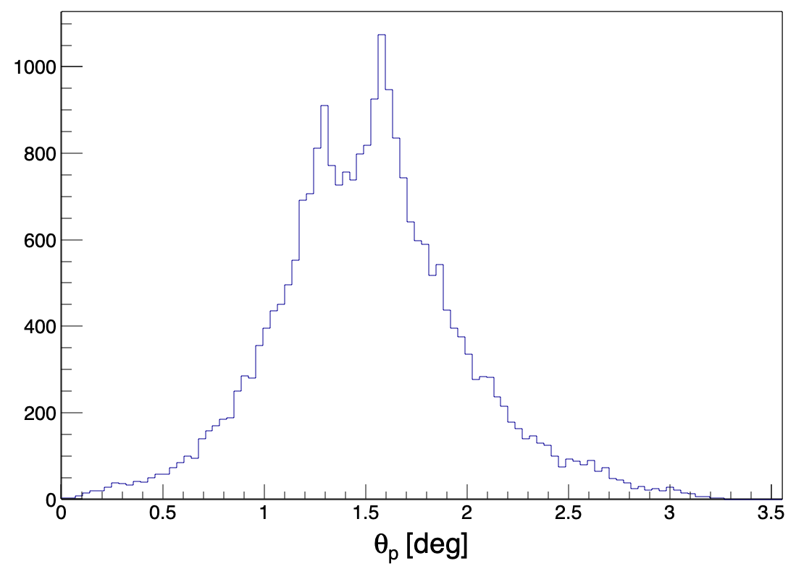
Electrons
Protons
(red – truth particle)
Not detected by the barrel
Detected in central barrel:
We have reconstructed tracks
﻿SvtxTrackEval *trackeval = _svtxEvalStack->get_track_eval();
Need to be smeared

Slide 4
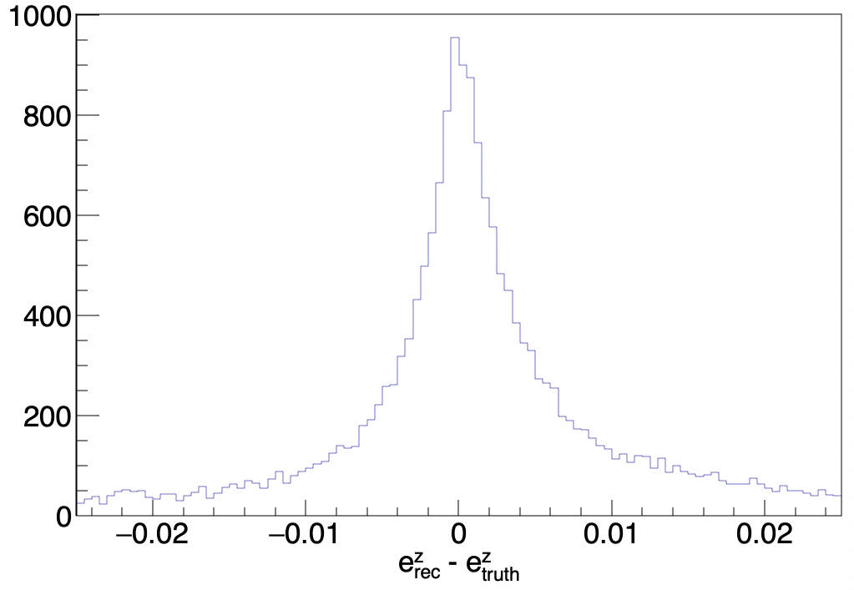
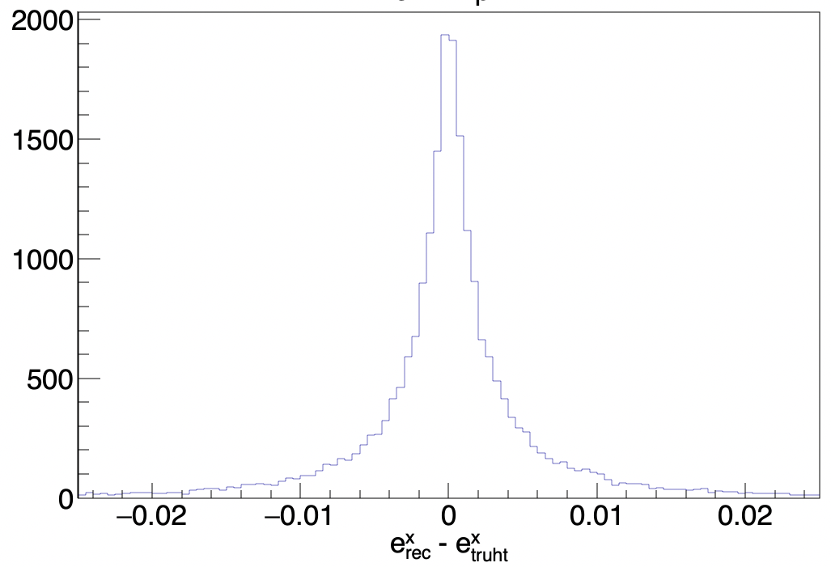
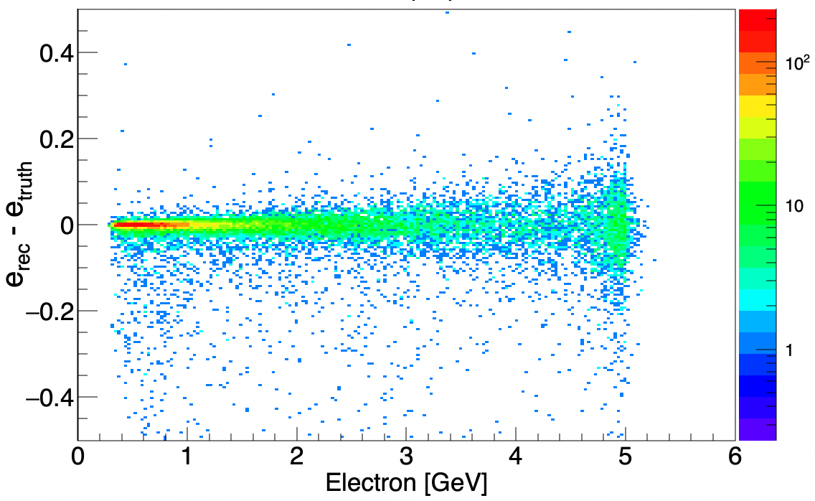
Reconstructed electrons:

Slide 5
How the electron momentum resolution affect physical quantity such as missing mass?

Slide 6
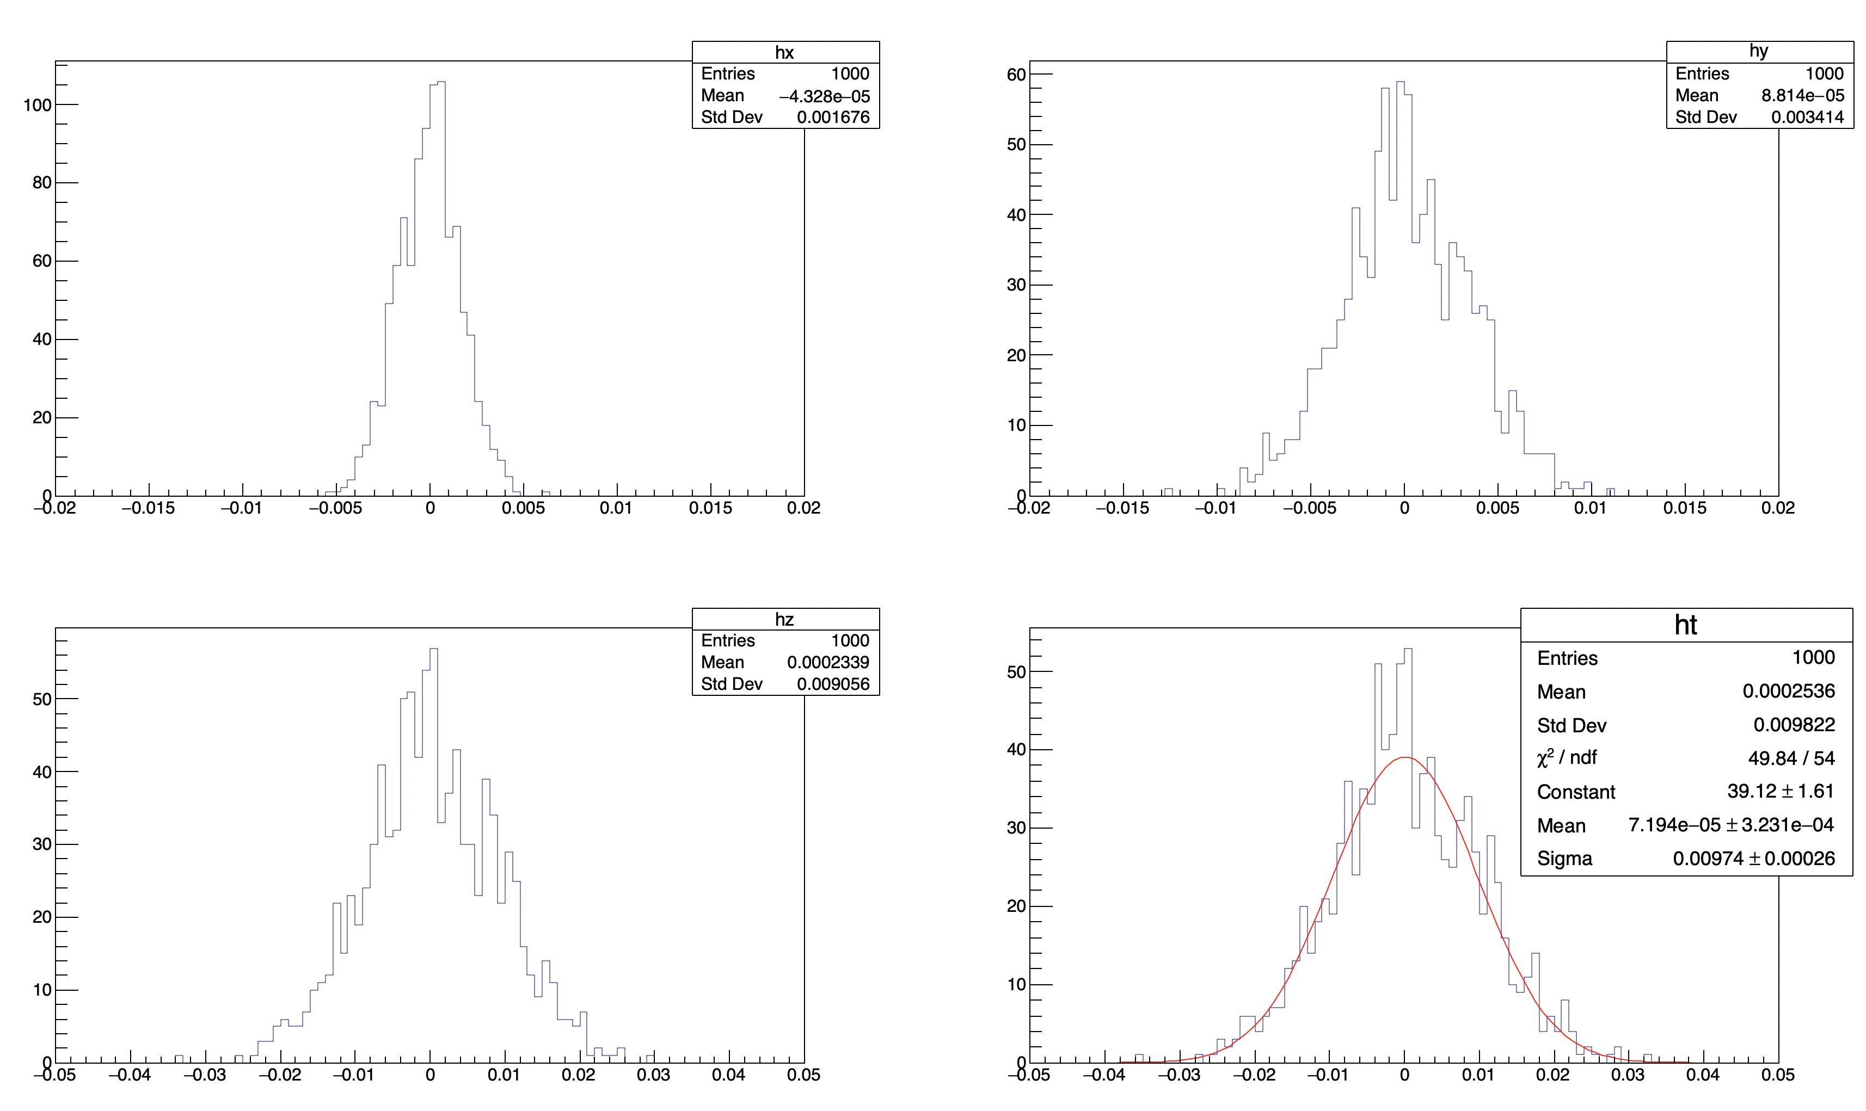
The electron momentum resolution < 1%
Taking arbitrary event and smearing only electron momentum (keeping the angles intact).
x
y
z
Outgoing electron: E_e ~ 1.2 GeV

Slide 7
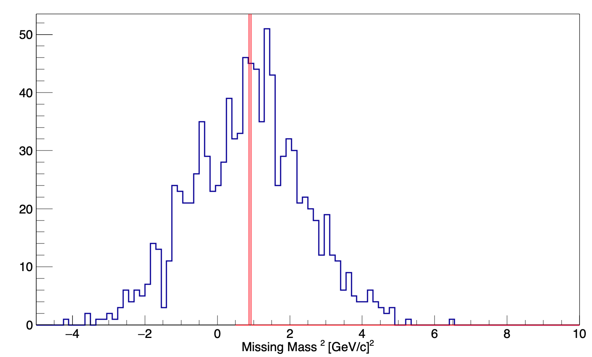
Significant effect on missing mass for (ep->e’gamma)P:
Blue histogram – smearing only electron.
For higher momenta the situation getting worse...

Slide 8
Detection of photons
Using:
﻿CaloRawClusterEval* clusterevalFEMC = _caloevalstackFEMC->get_rawcluster_eval();
In the simulation we can ”cheat”:
﻿PHG4Particle* primary = clusterevalFEMC->max_truth_primary_particle_by_energy(cluster_iter->second);
In real world, our ability to identify clustering will depend, background, calibrations etc

Slide 9
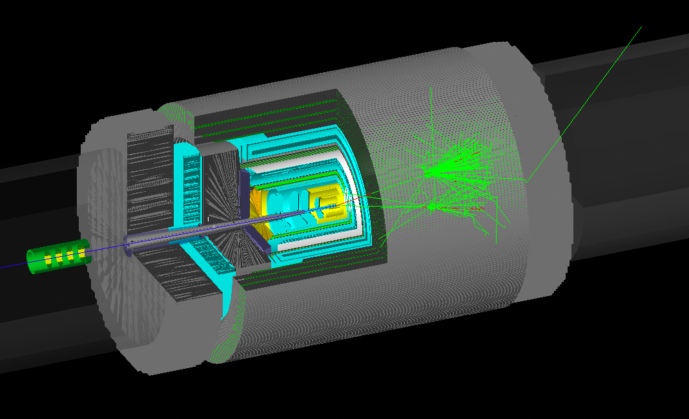

e
$$γ$$

Slide 10
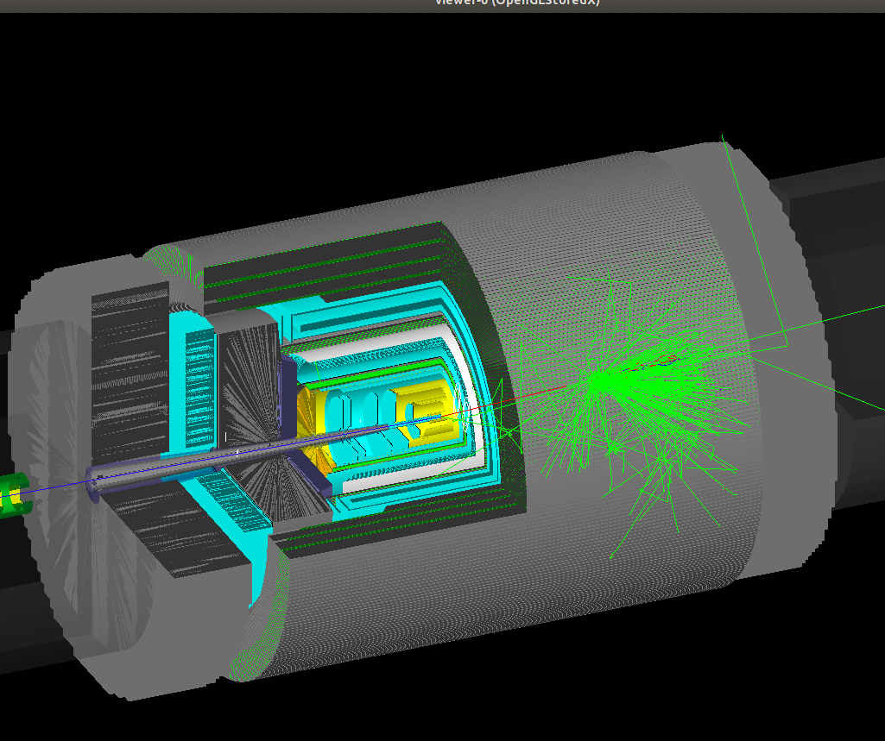

Slide 11
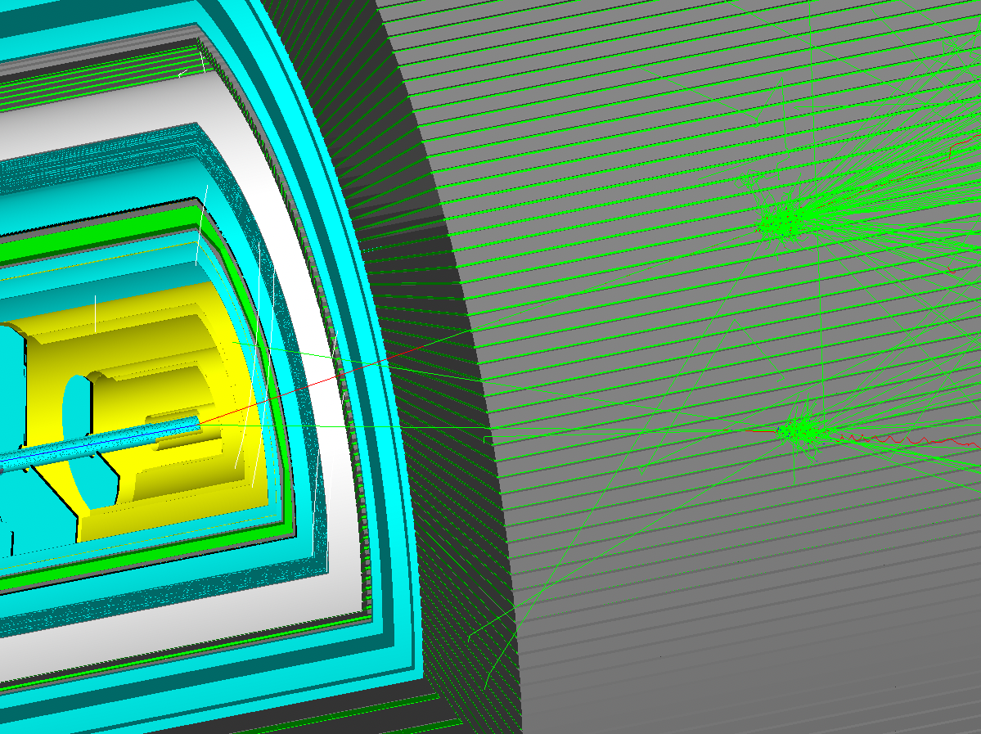

$$γ$$

Slide 12
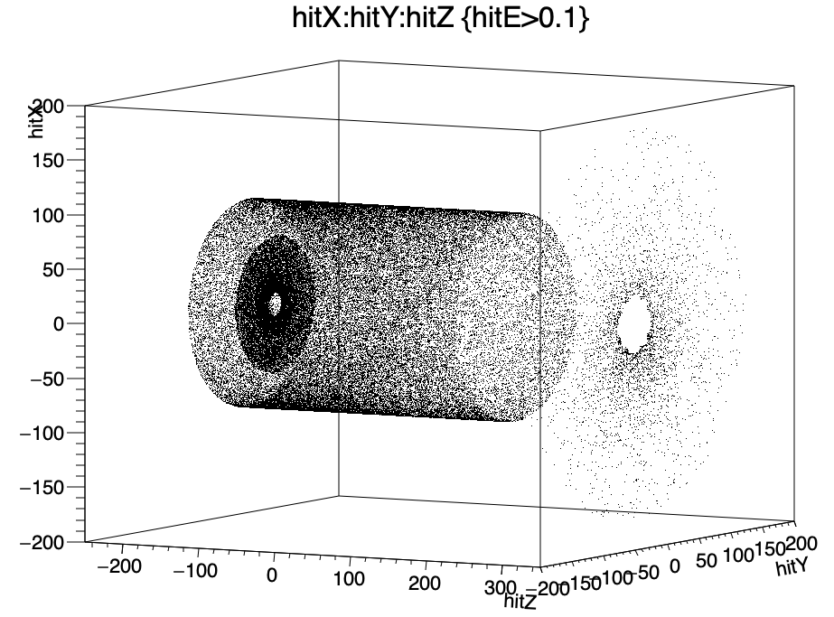
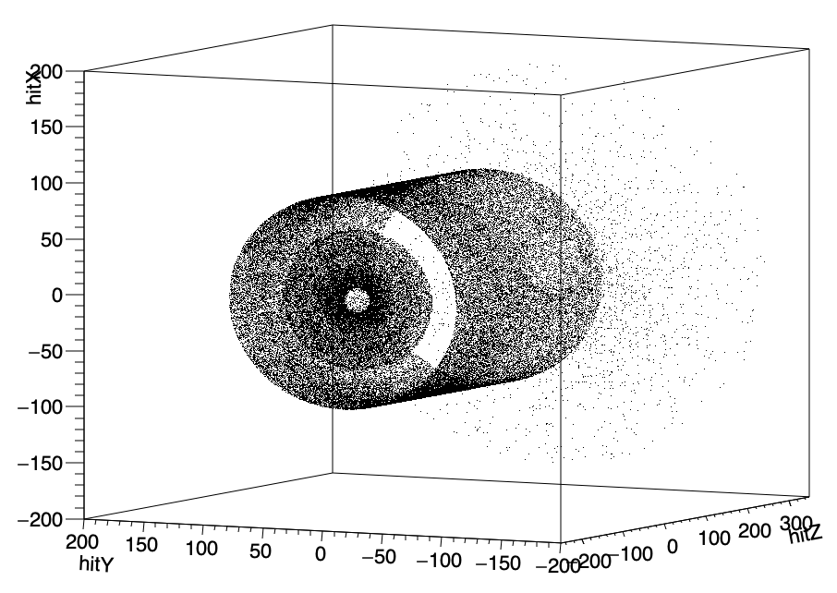
Hits in 3 different calorimeters

Slide 13
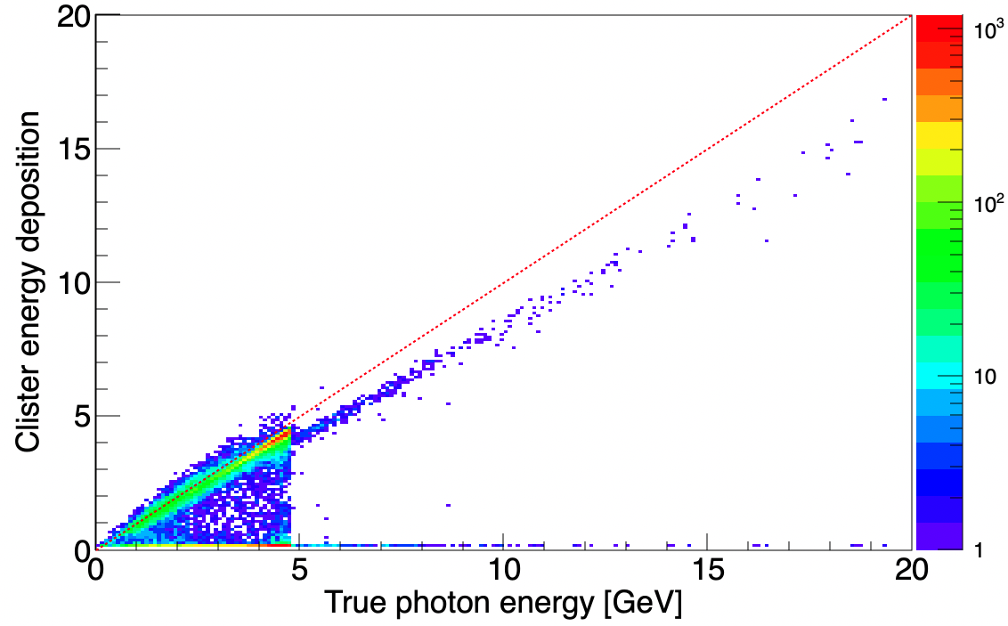
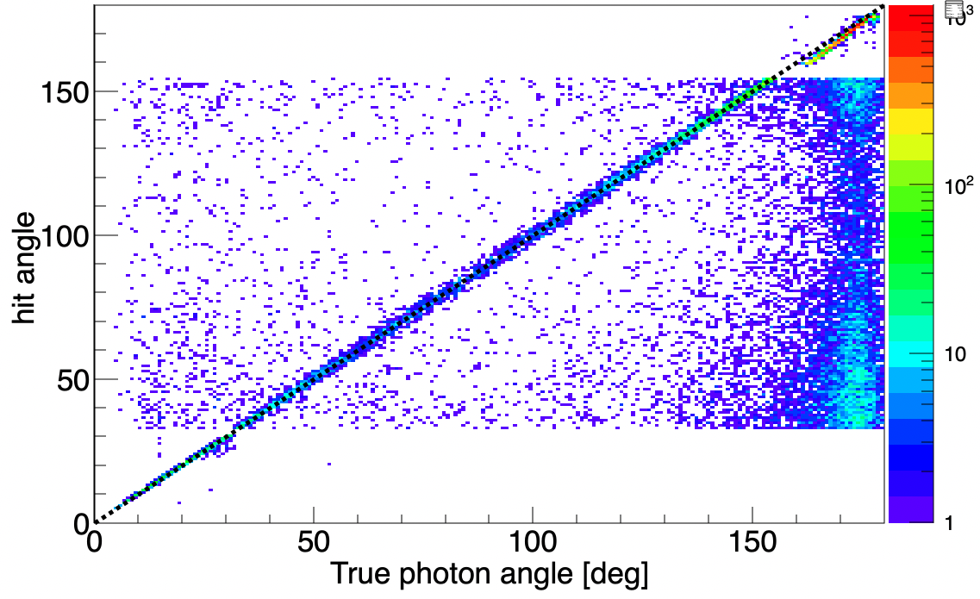
Basic calibration
Energy deposition and
angular dependence

Slide 14
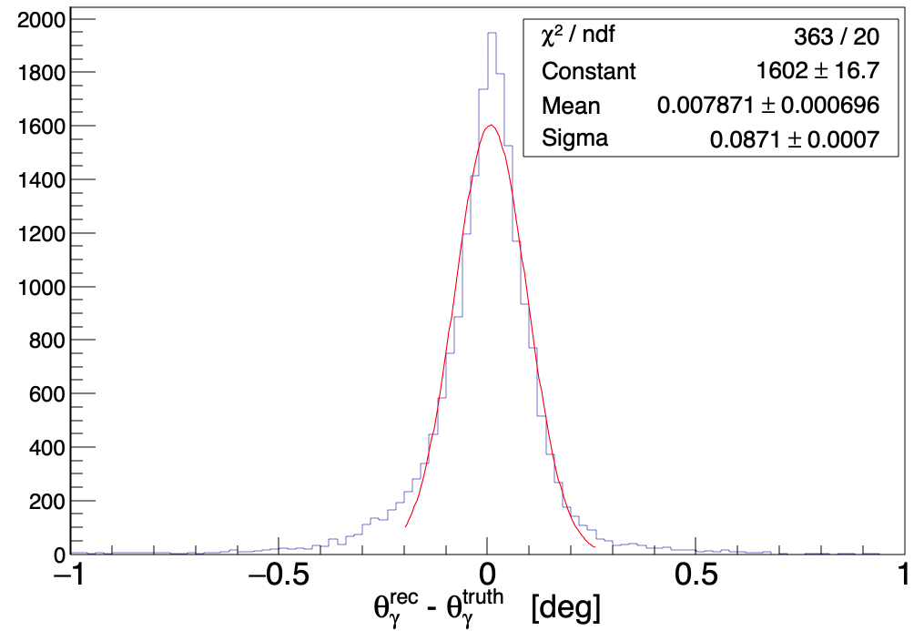
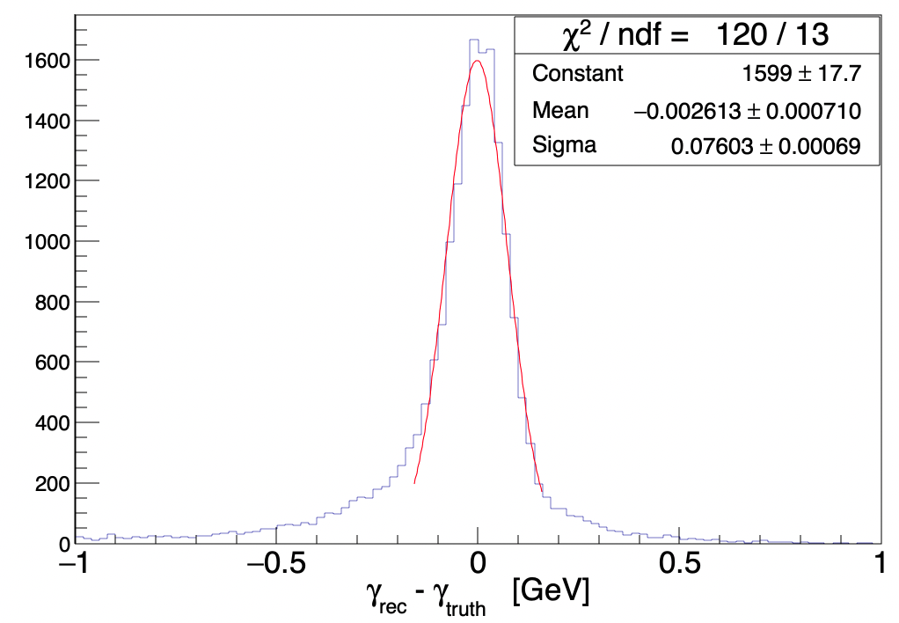
Photon momentum resolution

Slide 15
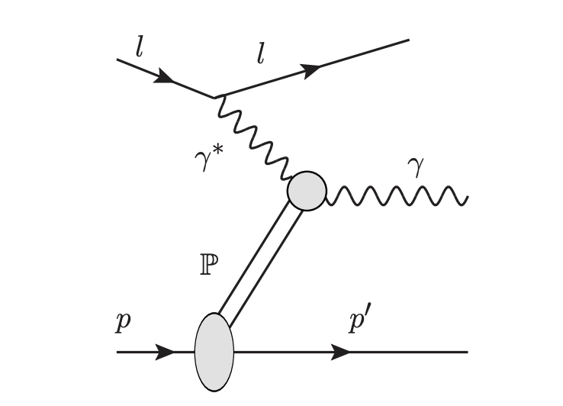

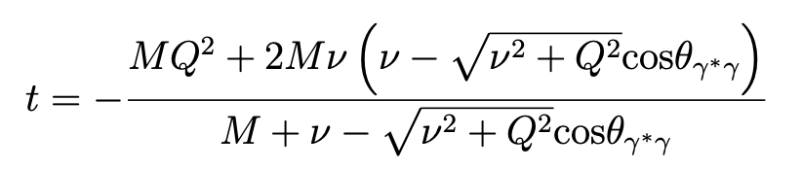



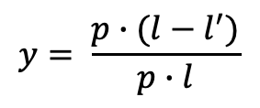
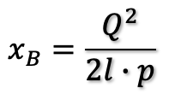

Defining kinematic variables:
Defined using truth particles and reconstructed
$$Q^{2}=−\left(l−l^{′}\right).M2$$
$ω=(l −l$’).E
$$x_{B}=\frac{Q^{2}}{2l∙p}$$
$$y= \frac{p∙(l−l^{′})}{p∙l}$$
$W^{2}=(p+(l−l$’)).M2
$$t=\left(p−p′\right).M2$$

Slide 16
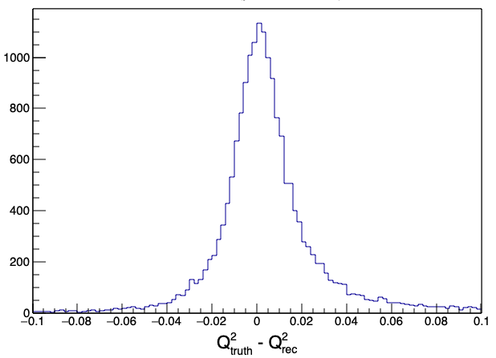
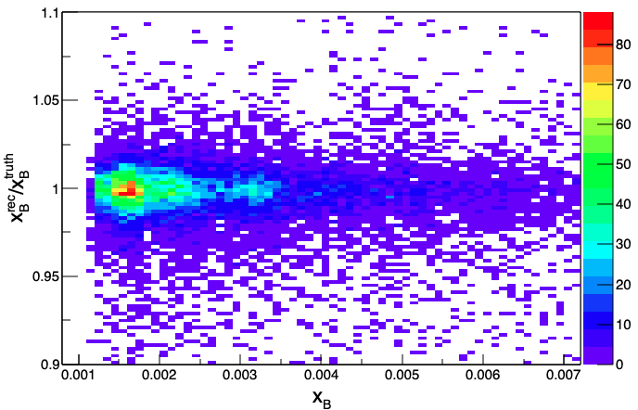
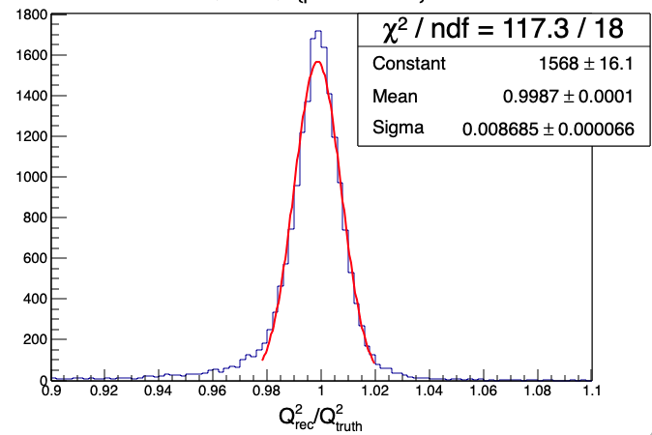
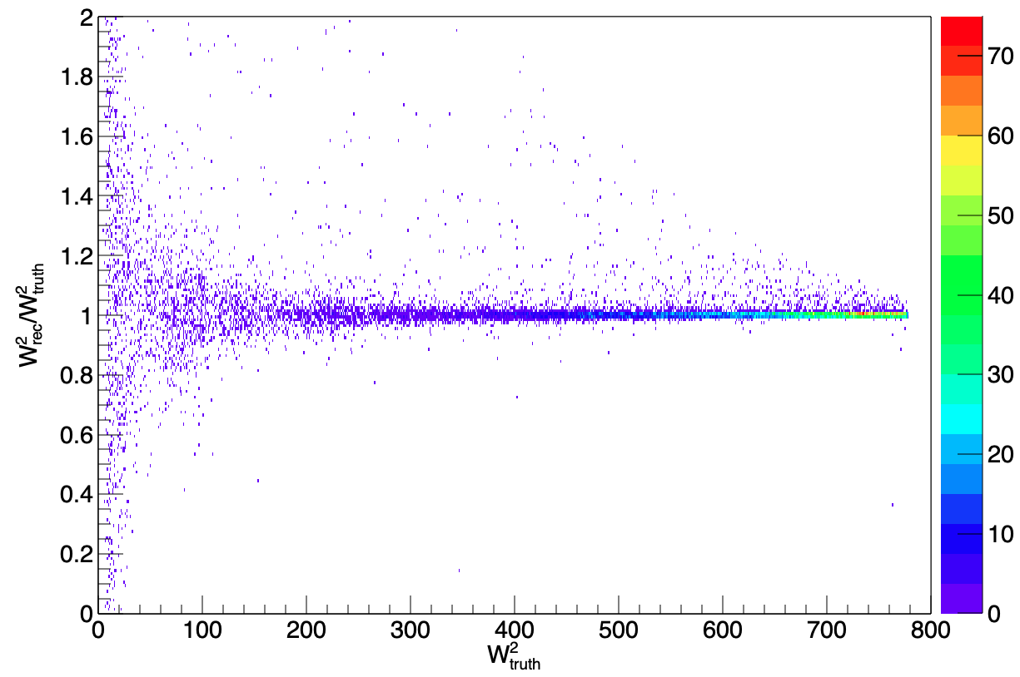
Comparison between truth and reconstructed kinematic quantities

Slide 17
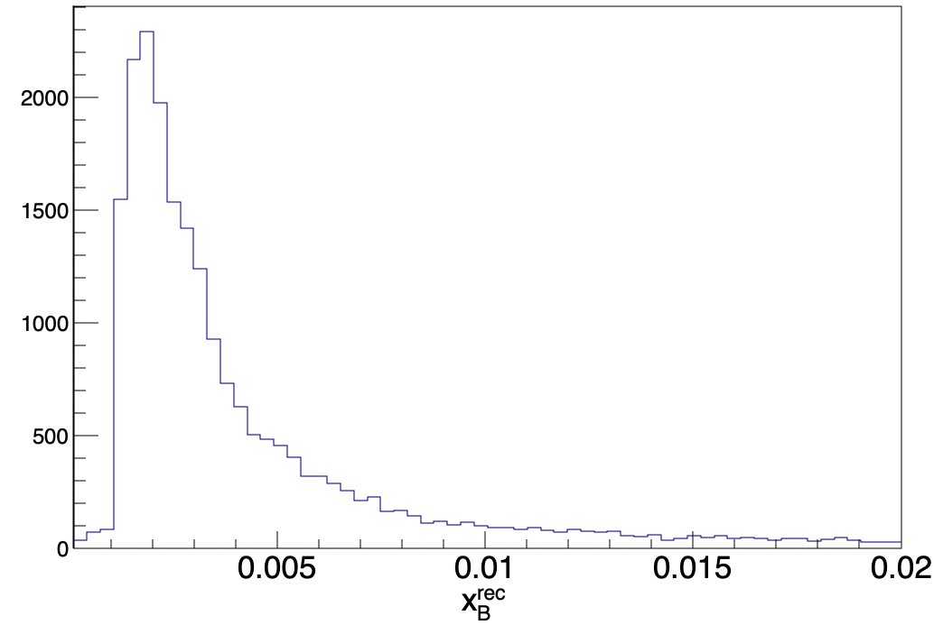
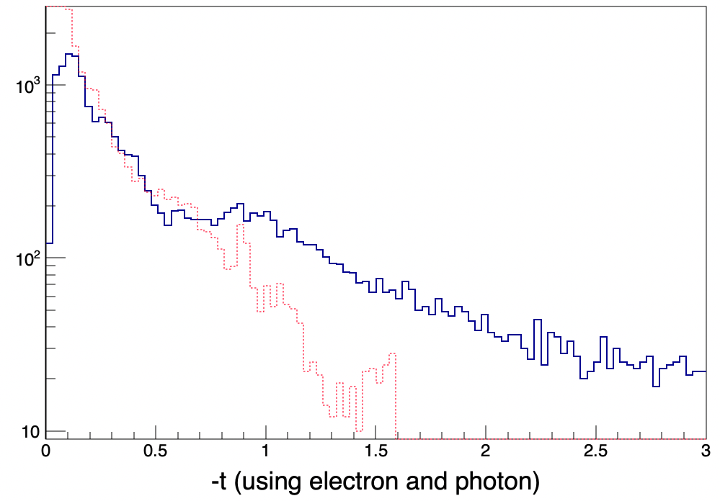
With cut: Photon > 100 MeV
(red– using truth particles)

Slide 18
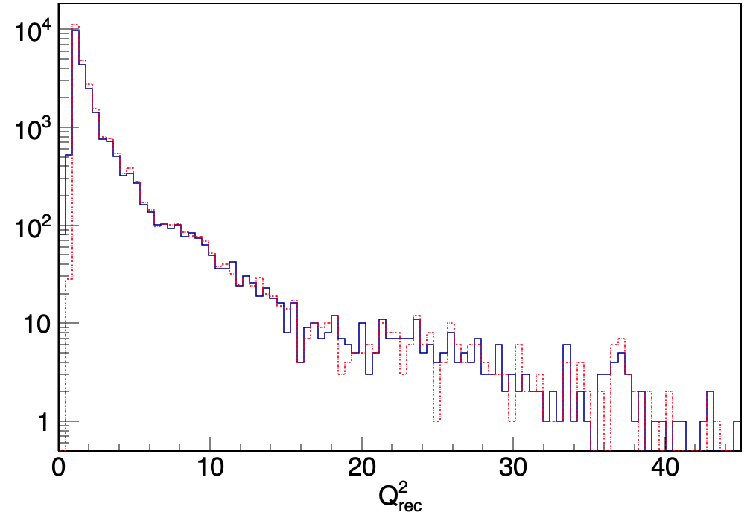
Event selection | Number of events
All | 25 K
#Reconstructed electron>0 | 23056
#Reconstructed electron>0 && Reconstructed photon energy > 100 MeV | 23052

Slide 19
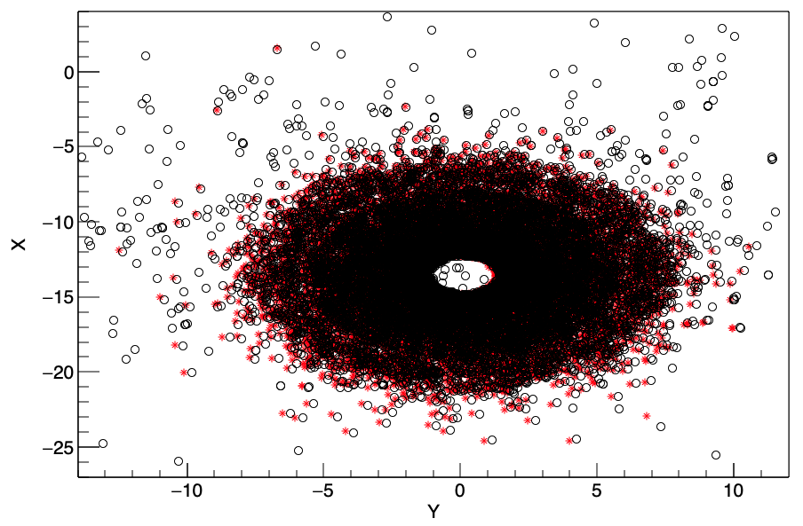
Red: Projection of the protons to the 1st layer of B0
(assuming straight line)
Black circles: hits detected in the B0 1st plane.
Shift between black and red symbols is due to the magnetic field.

Slide 20
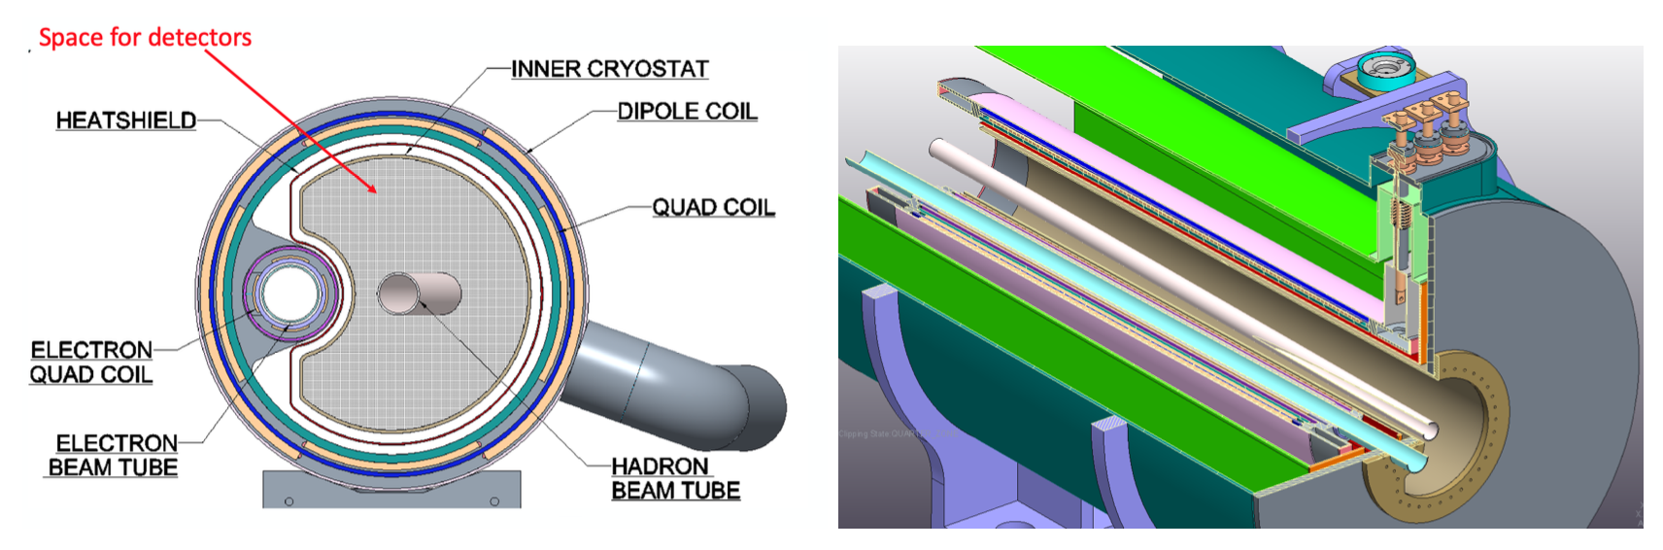

Slide 21
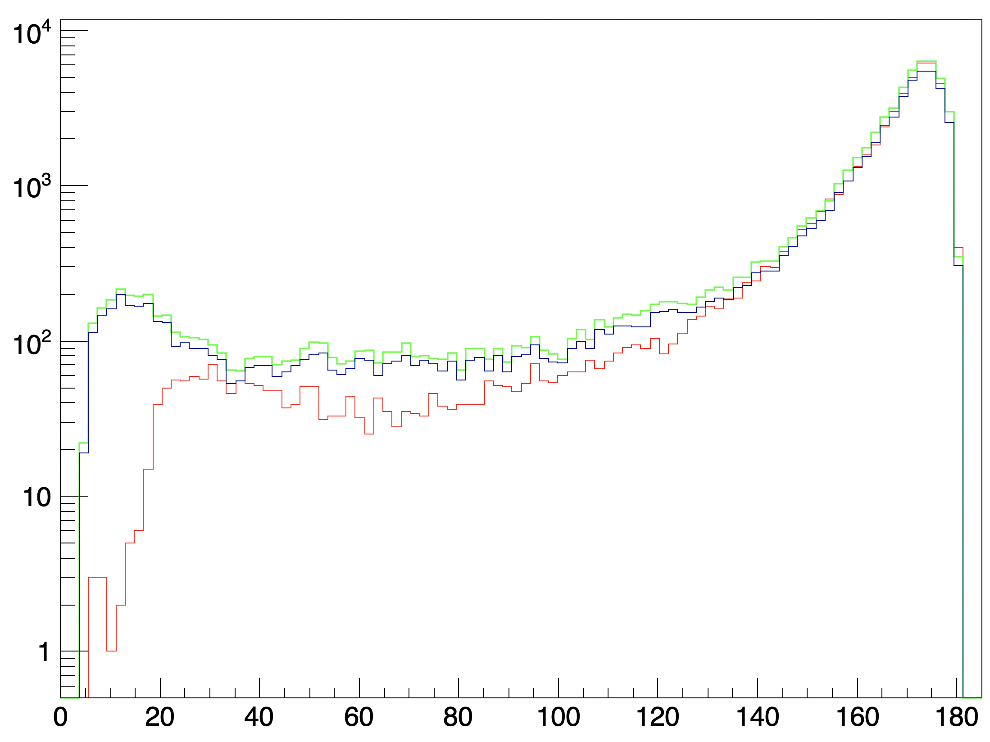
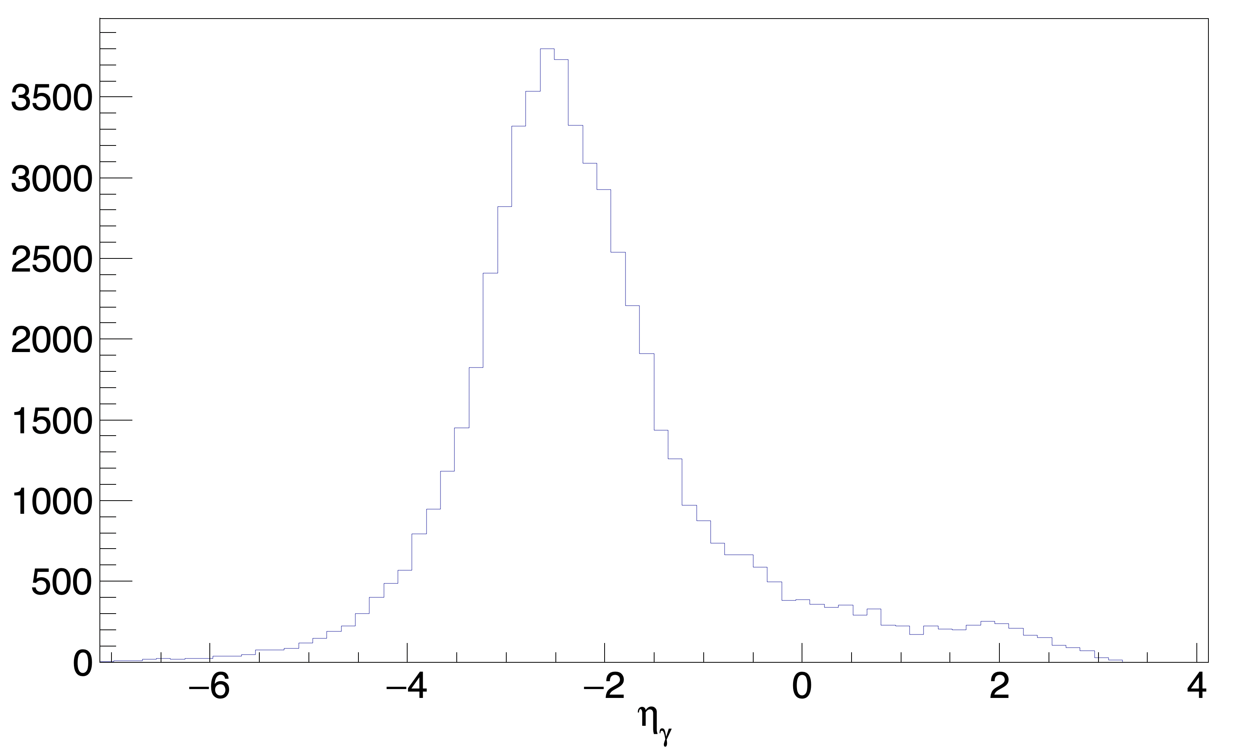
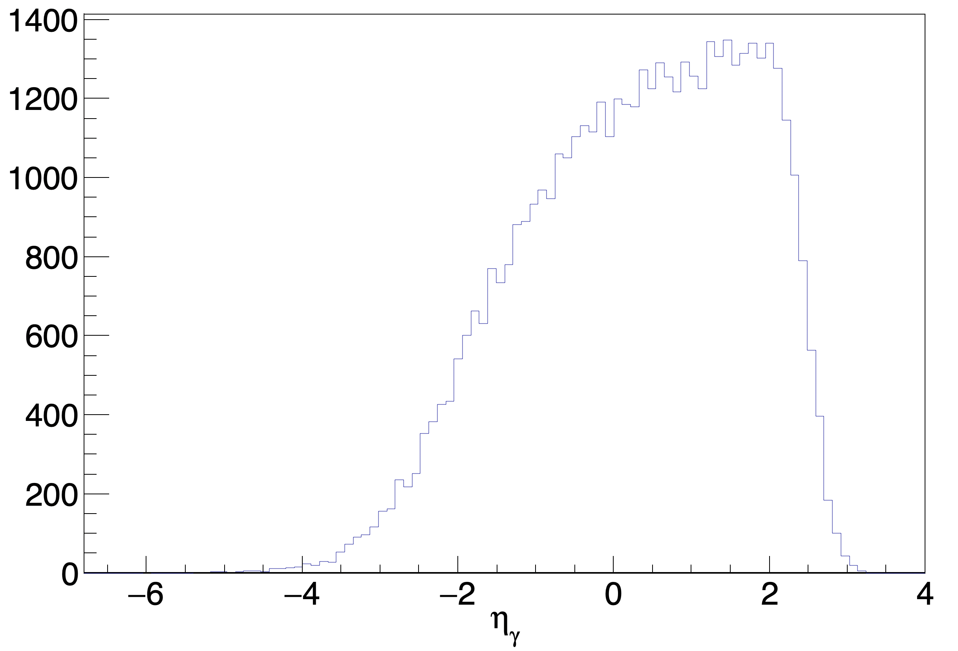
KM20 - model
*Generator ran locally using singularity.
GK
KM20 - Pure DVCS
GK - Pure DVCS

Slide 22
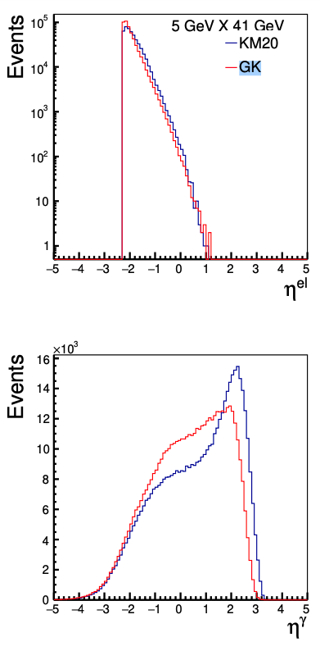
Yellow Report

