Slide 1
DVCS Working group
Status report
20 August 2021
Igor Korover

Slide 2
DVCS events where generated by Milou3d event generator using two models KM20 and GK
(in this report only GK presented)
Beam Setups:
 | Beam Energy setup [GeV] | Beam Energy setup [GeV] | Beam Energy setup [GeV]
GK | 5x41 | 10x100 | 18x275
KM20 | 5x41 | 10x100 | 18x275
Each setup include full process (BH + DVCS + interference term)
Generated 500K events for each setup (some setups are still running)
In total 12* generated file with 500K events each.

Slide 3
BH and Full simulation normalization
bases_milou.log
*************************************
* INTEGRATION TERMINATED *
*************************************
Total cross-section (nb) : 3.99499607
Error : 0.210341960
Number of events normalized to $ℒ=10 {fb}^{−1}$

Slide 4
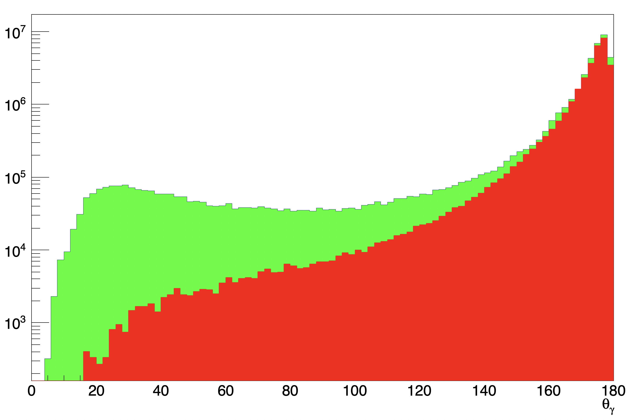
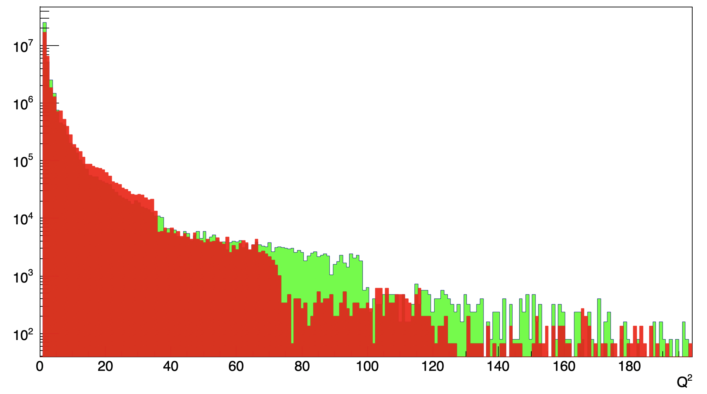
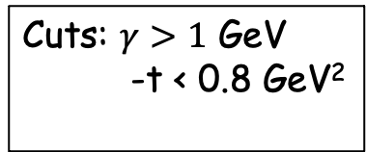
Generator output
Photon angle [deg]
Q²
Cuts: $γ>1$ GeV
-t < 0.8 GeV²
Red – BH
Green – Full (DVCS + BH + INT)

Slide 5
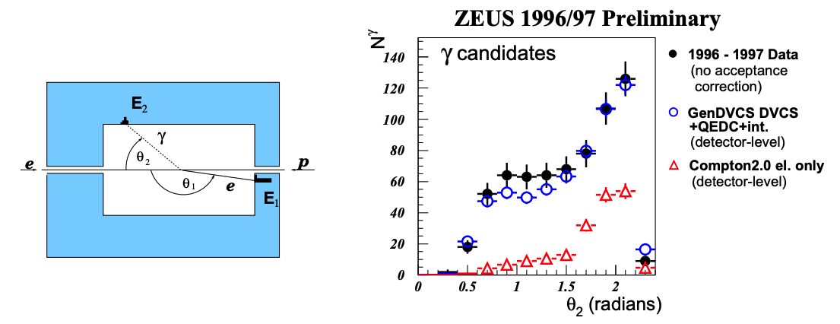

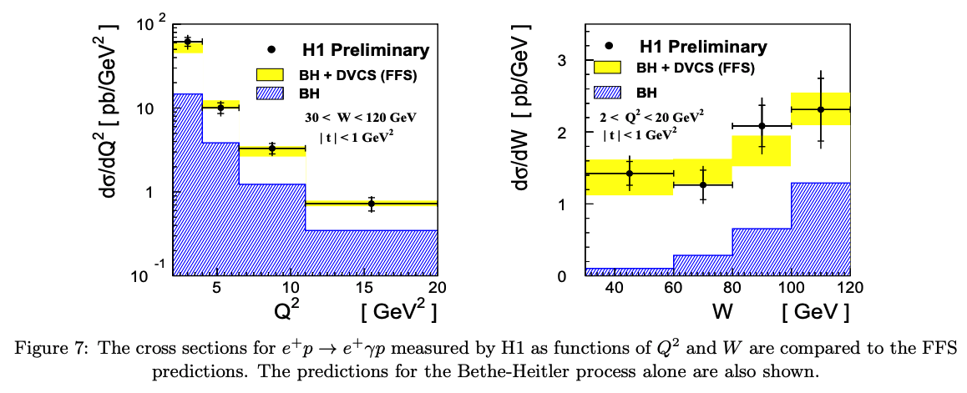
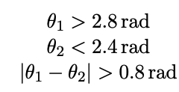
Selection of DVCS events: Starting point ZEUS:
https://arxiv.org/pdf/hep-ex/0108023.pdf
Basic set of cuts

Slide 6
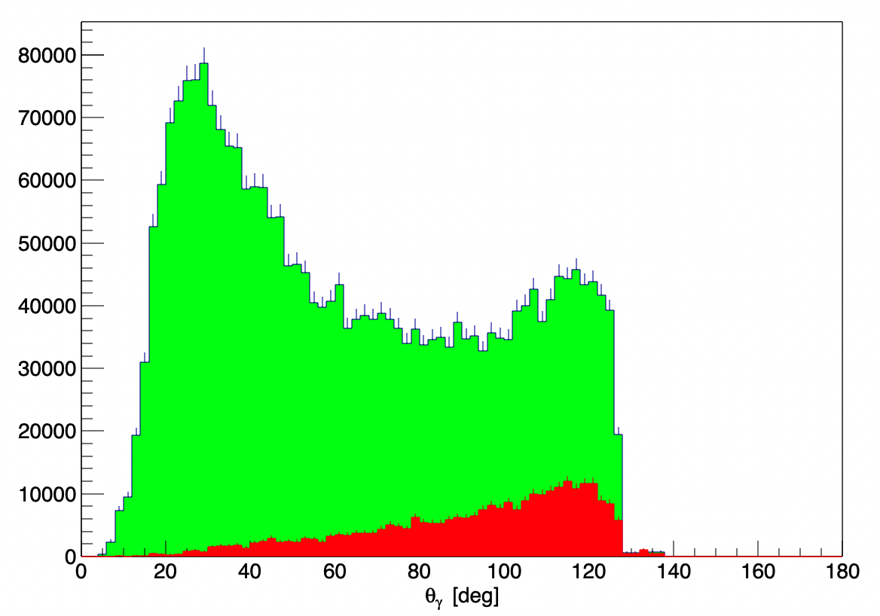
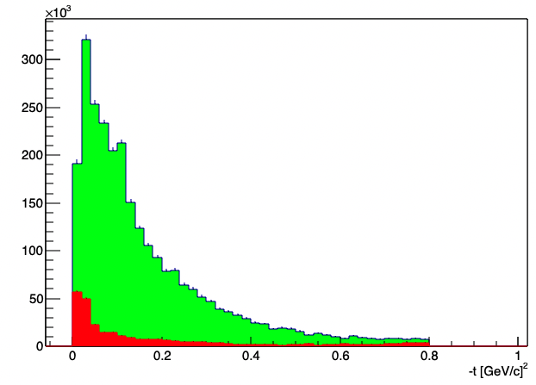
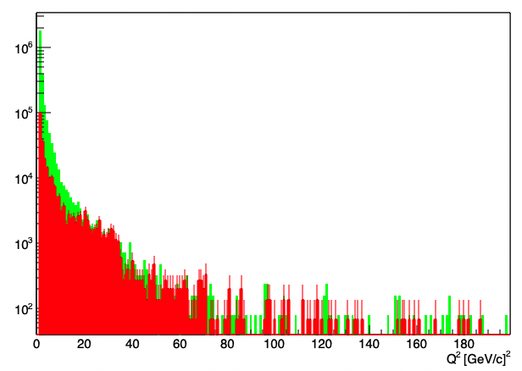
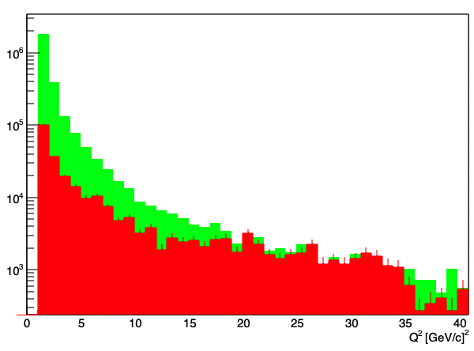
Application of ZEUS cuts (generator output): 10x100 GeV

Slide 7
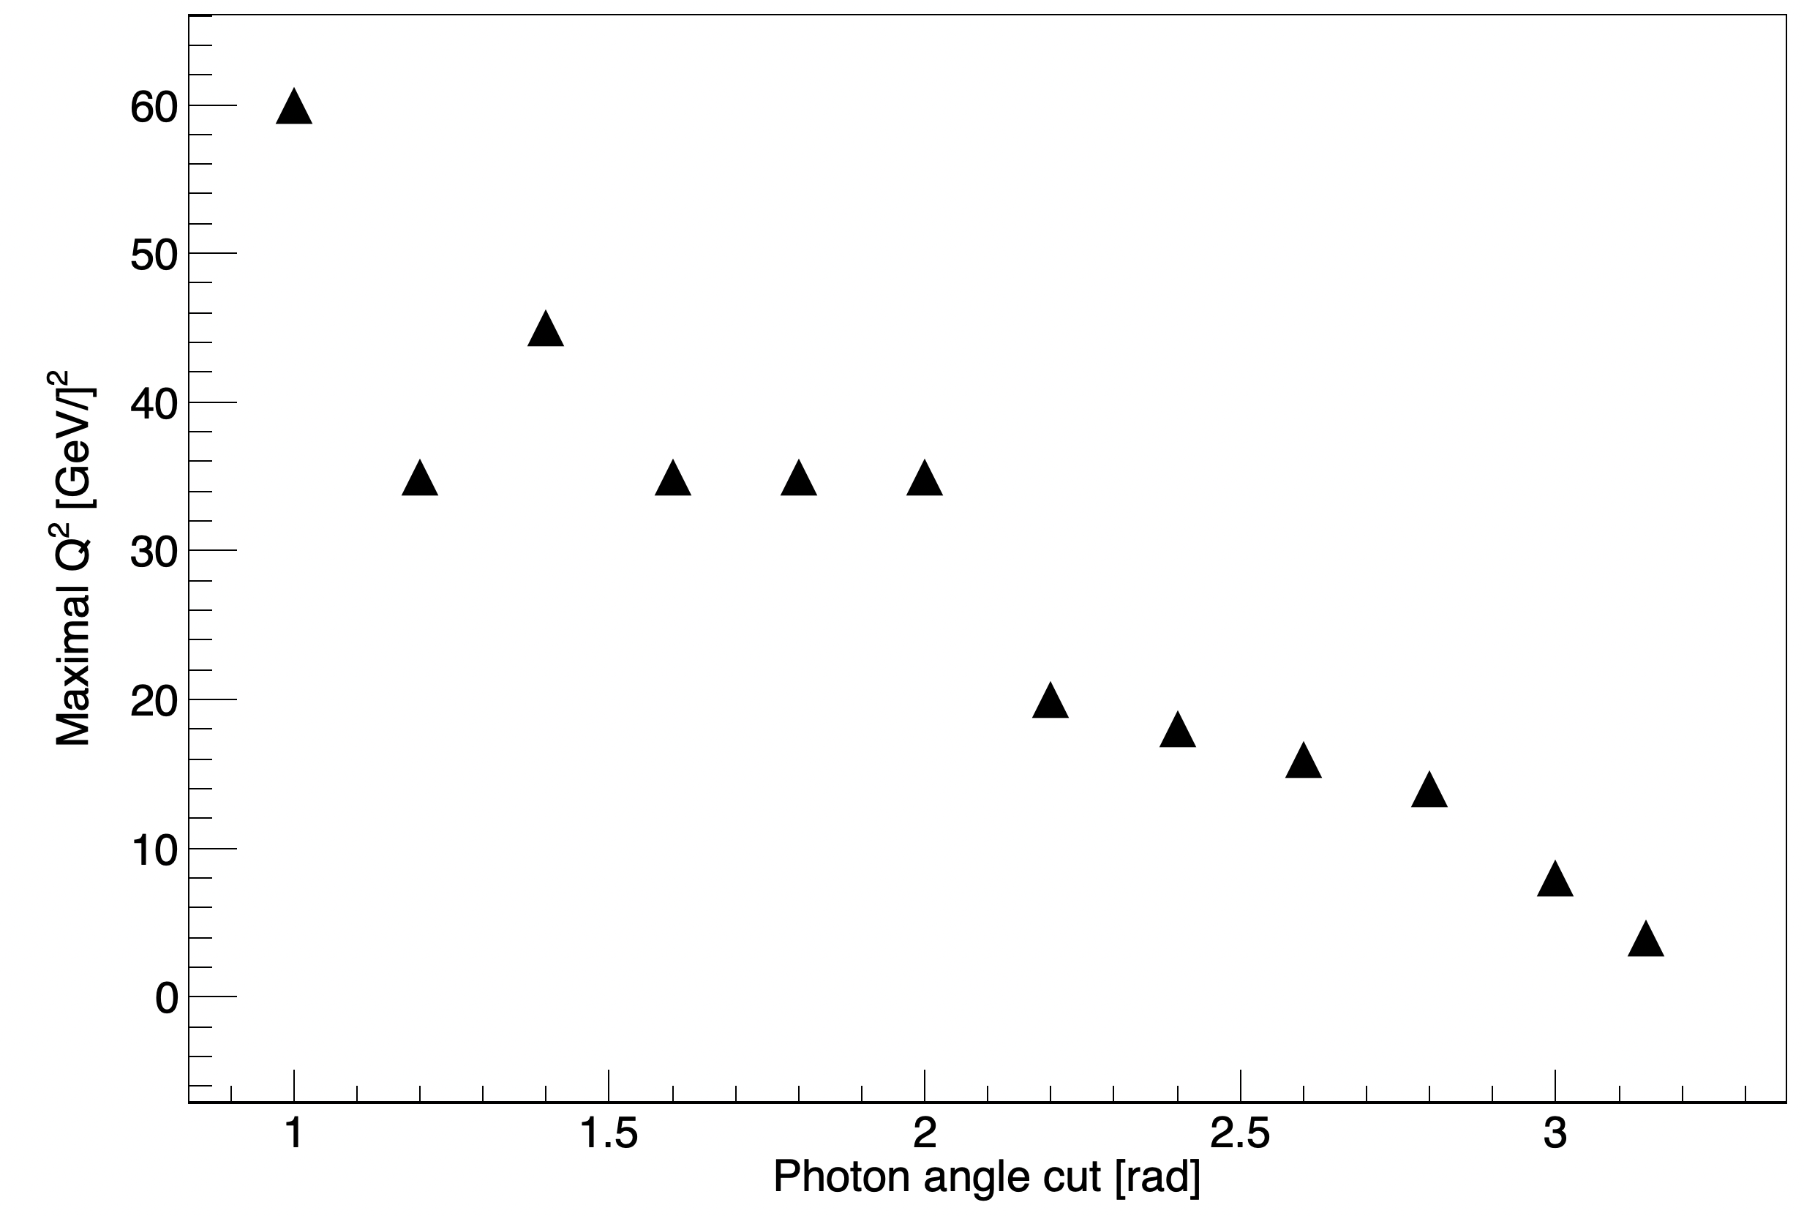
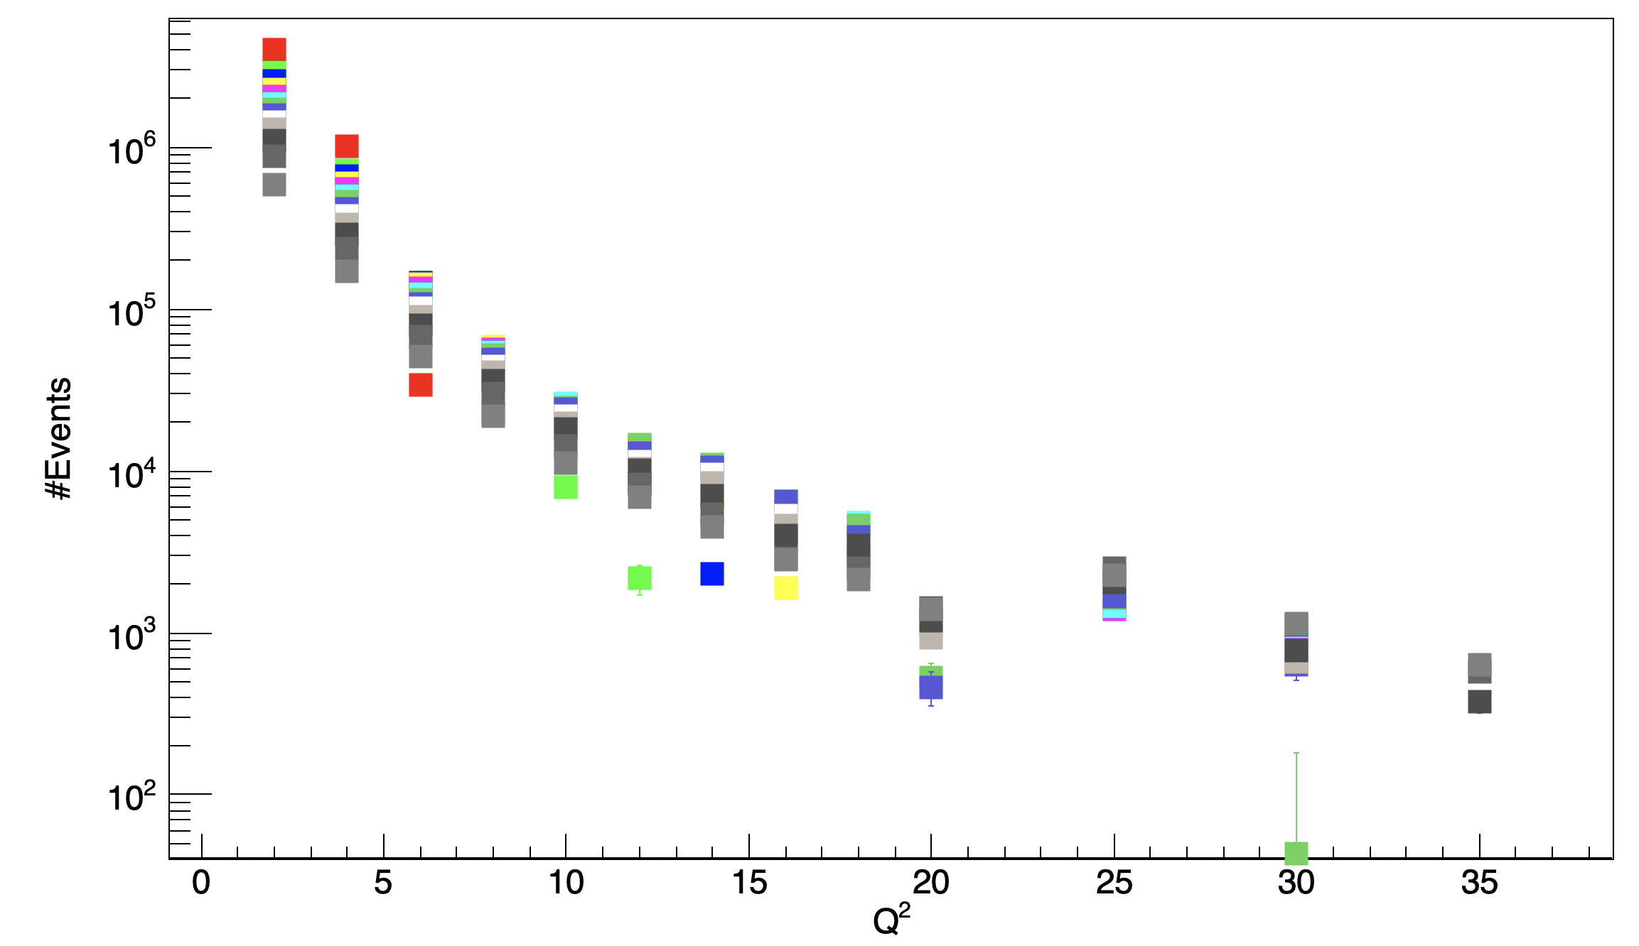
Cuts sensitivity (Generator)
Maximal value for Q2 when #Full > #BH
#Events for 10x100 – Luminosity 10 fb⁻¹
#Full - #BH for different cuts on photon angle
Beam 10x100
Beam 10x100

Slide 8
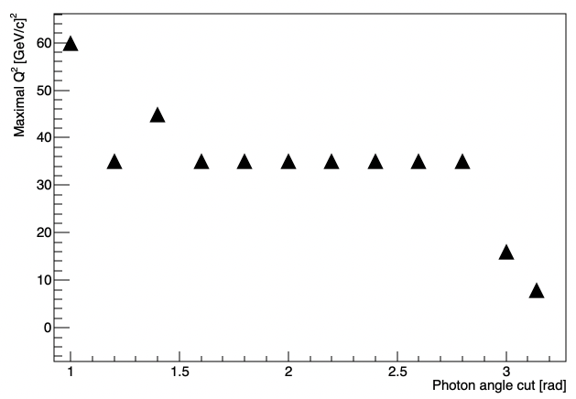
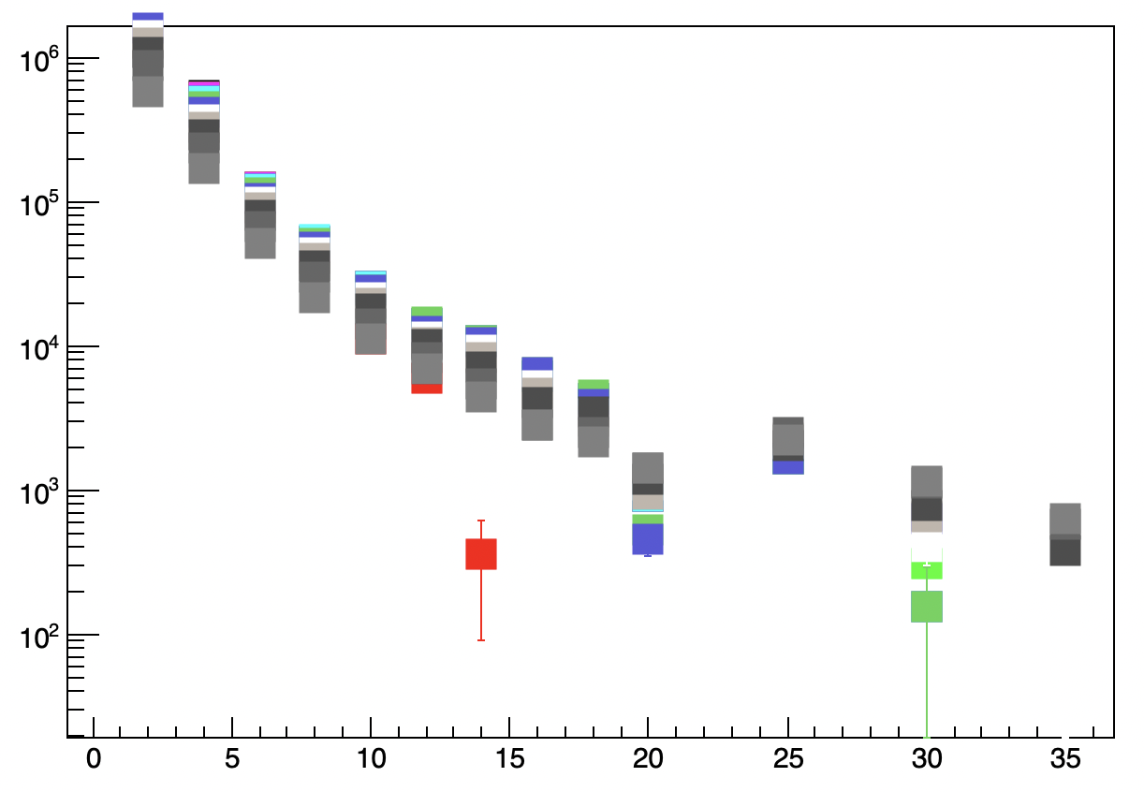
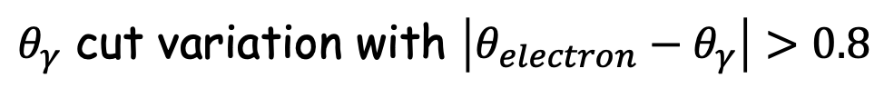
$θ_{γ}$ cut variation with $\left|θ_{electron}−θ_{γ}\right|>0.8$

Slide 9
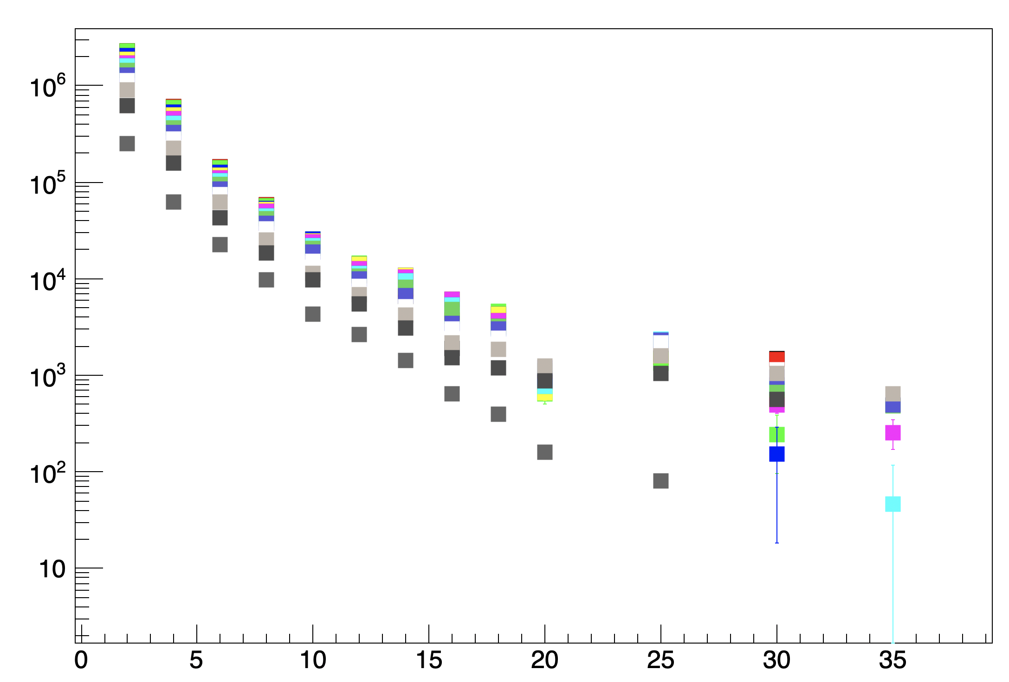
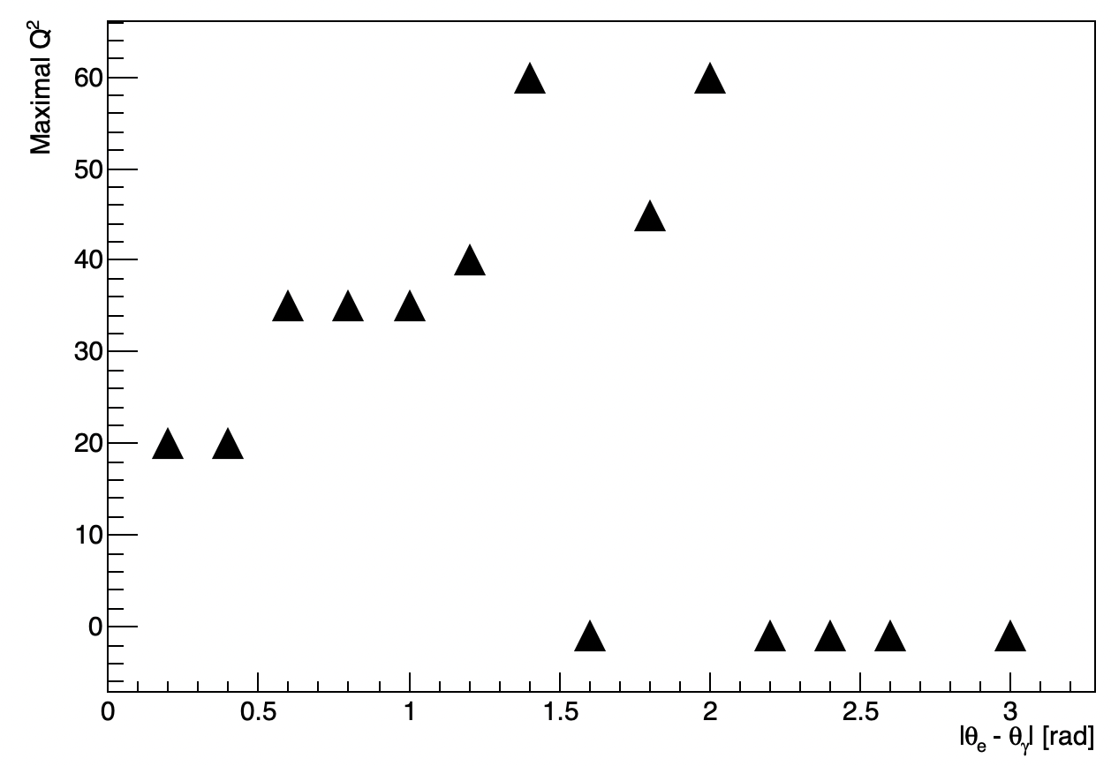
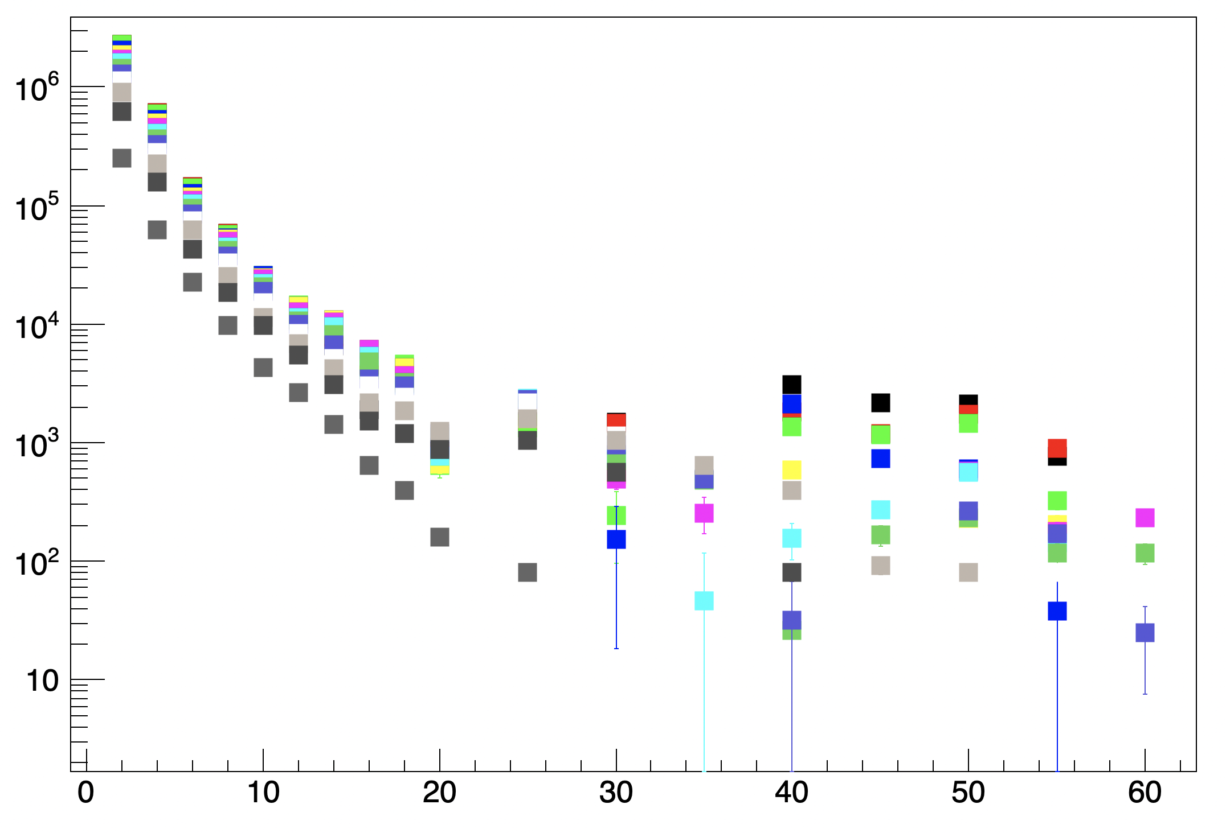
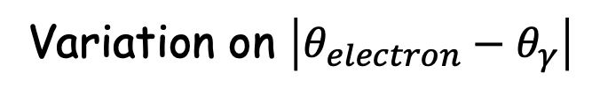
Variation on $\left|θ_{electron}−θ_{γ}\right|$

Slide 10
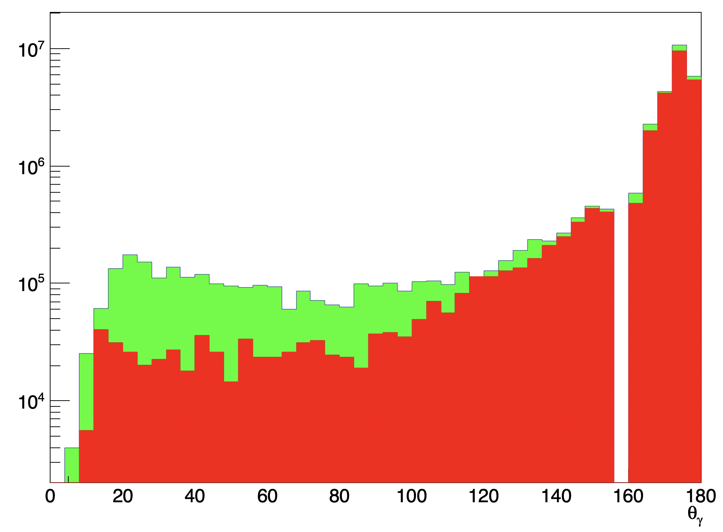
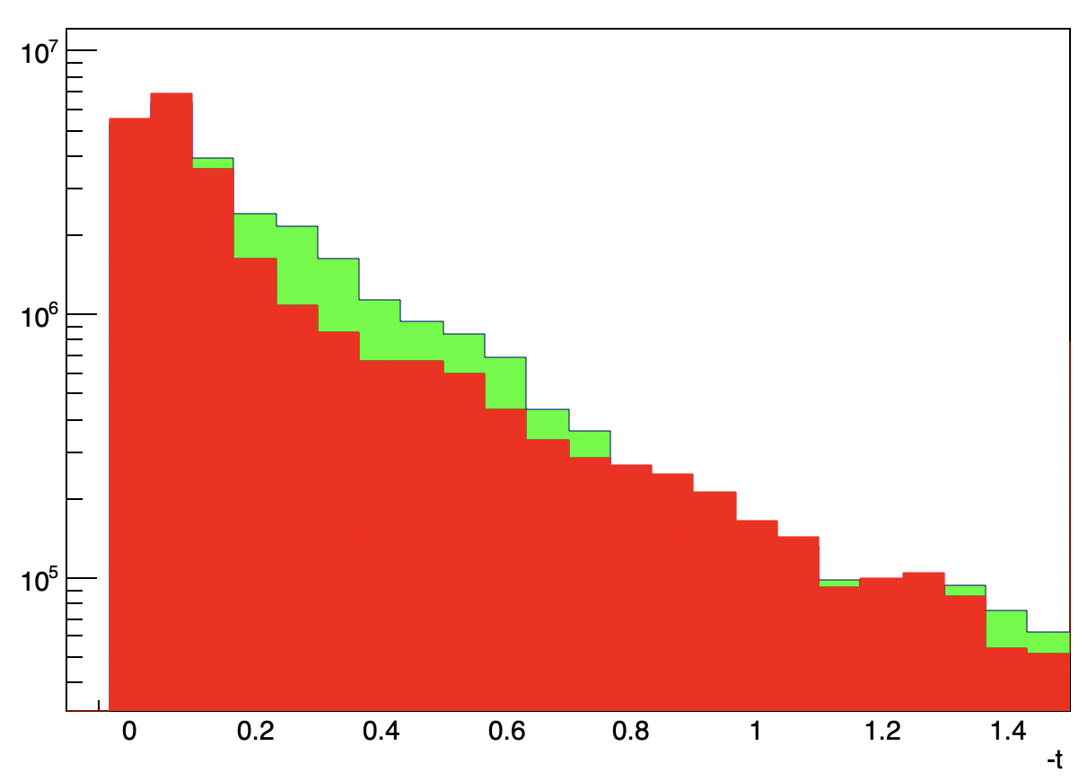
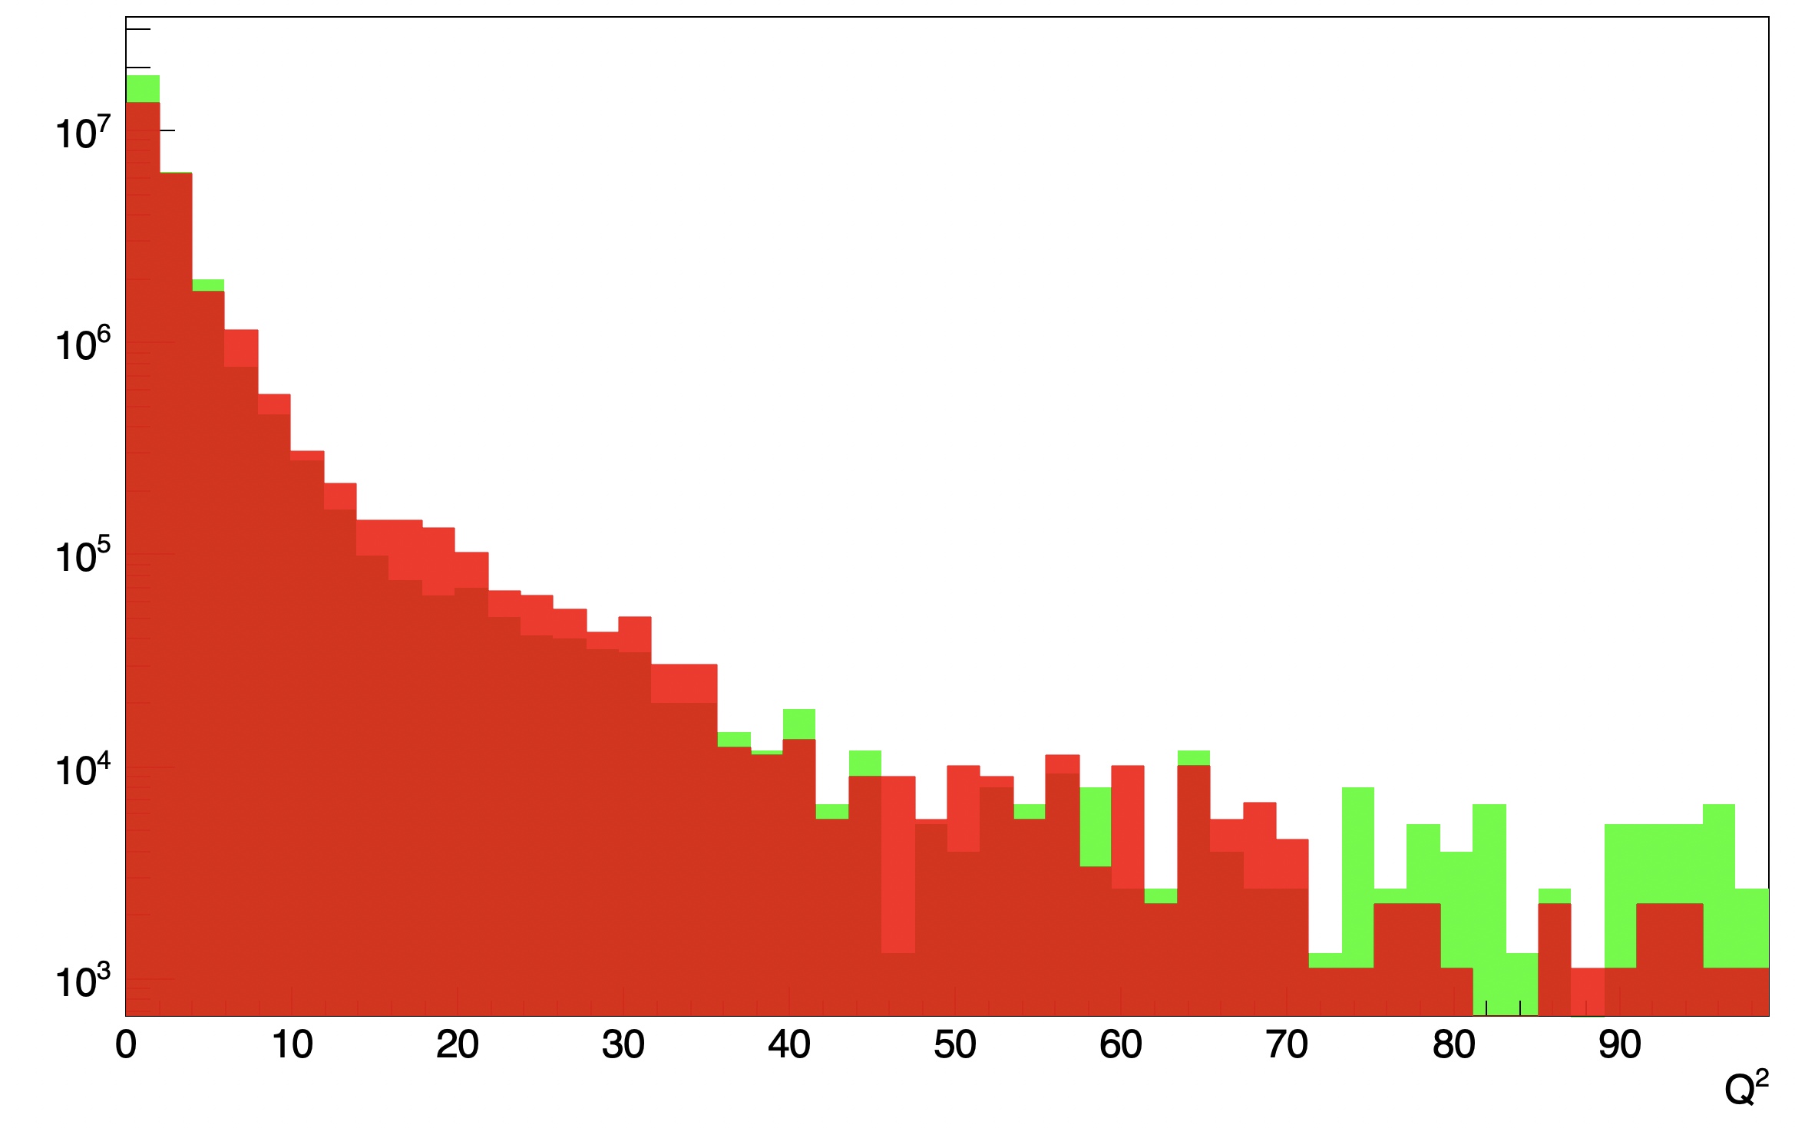
Fun4All
No angular cuts

Slide 11
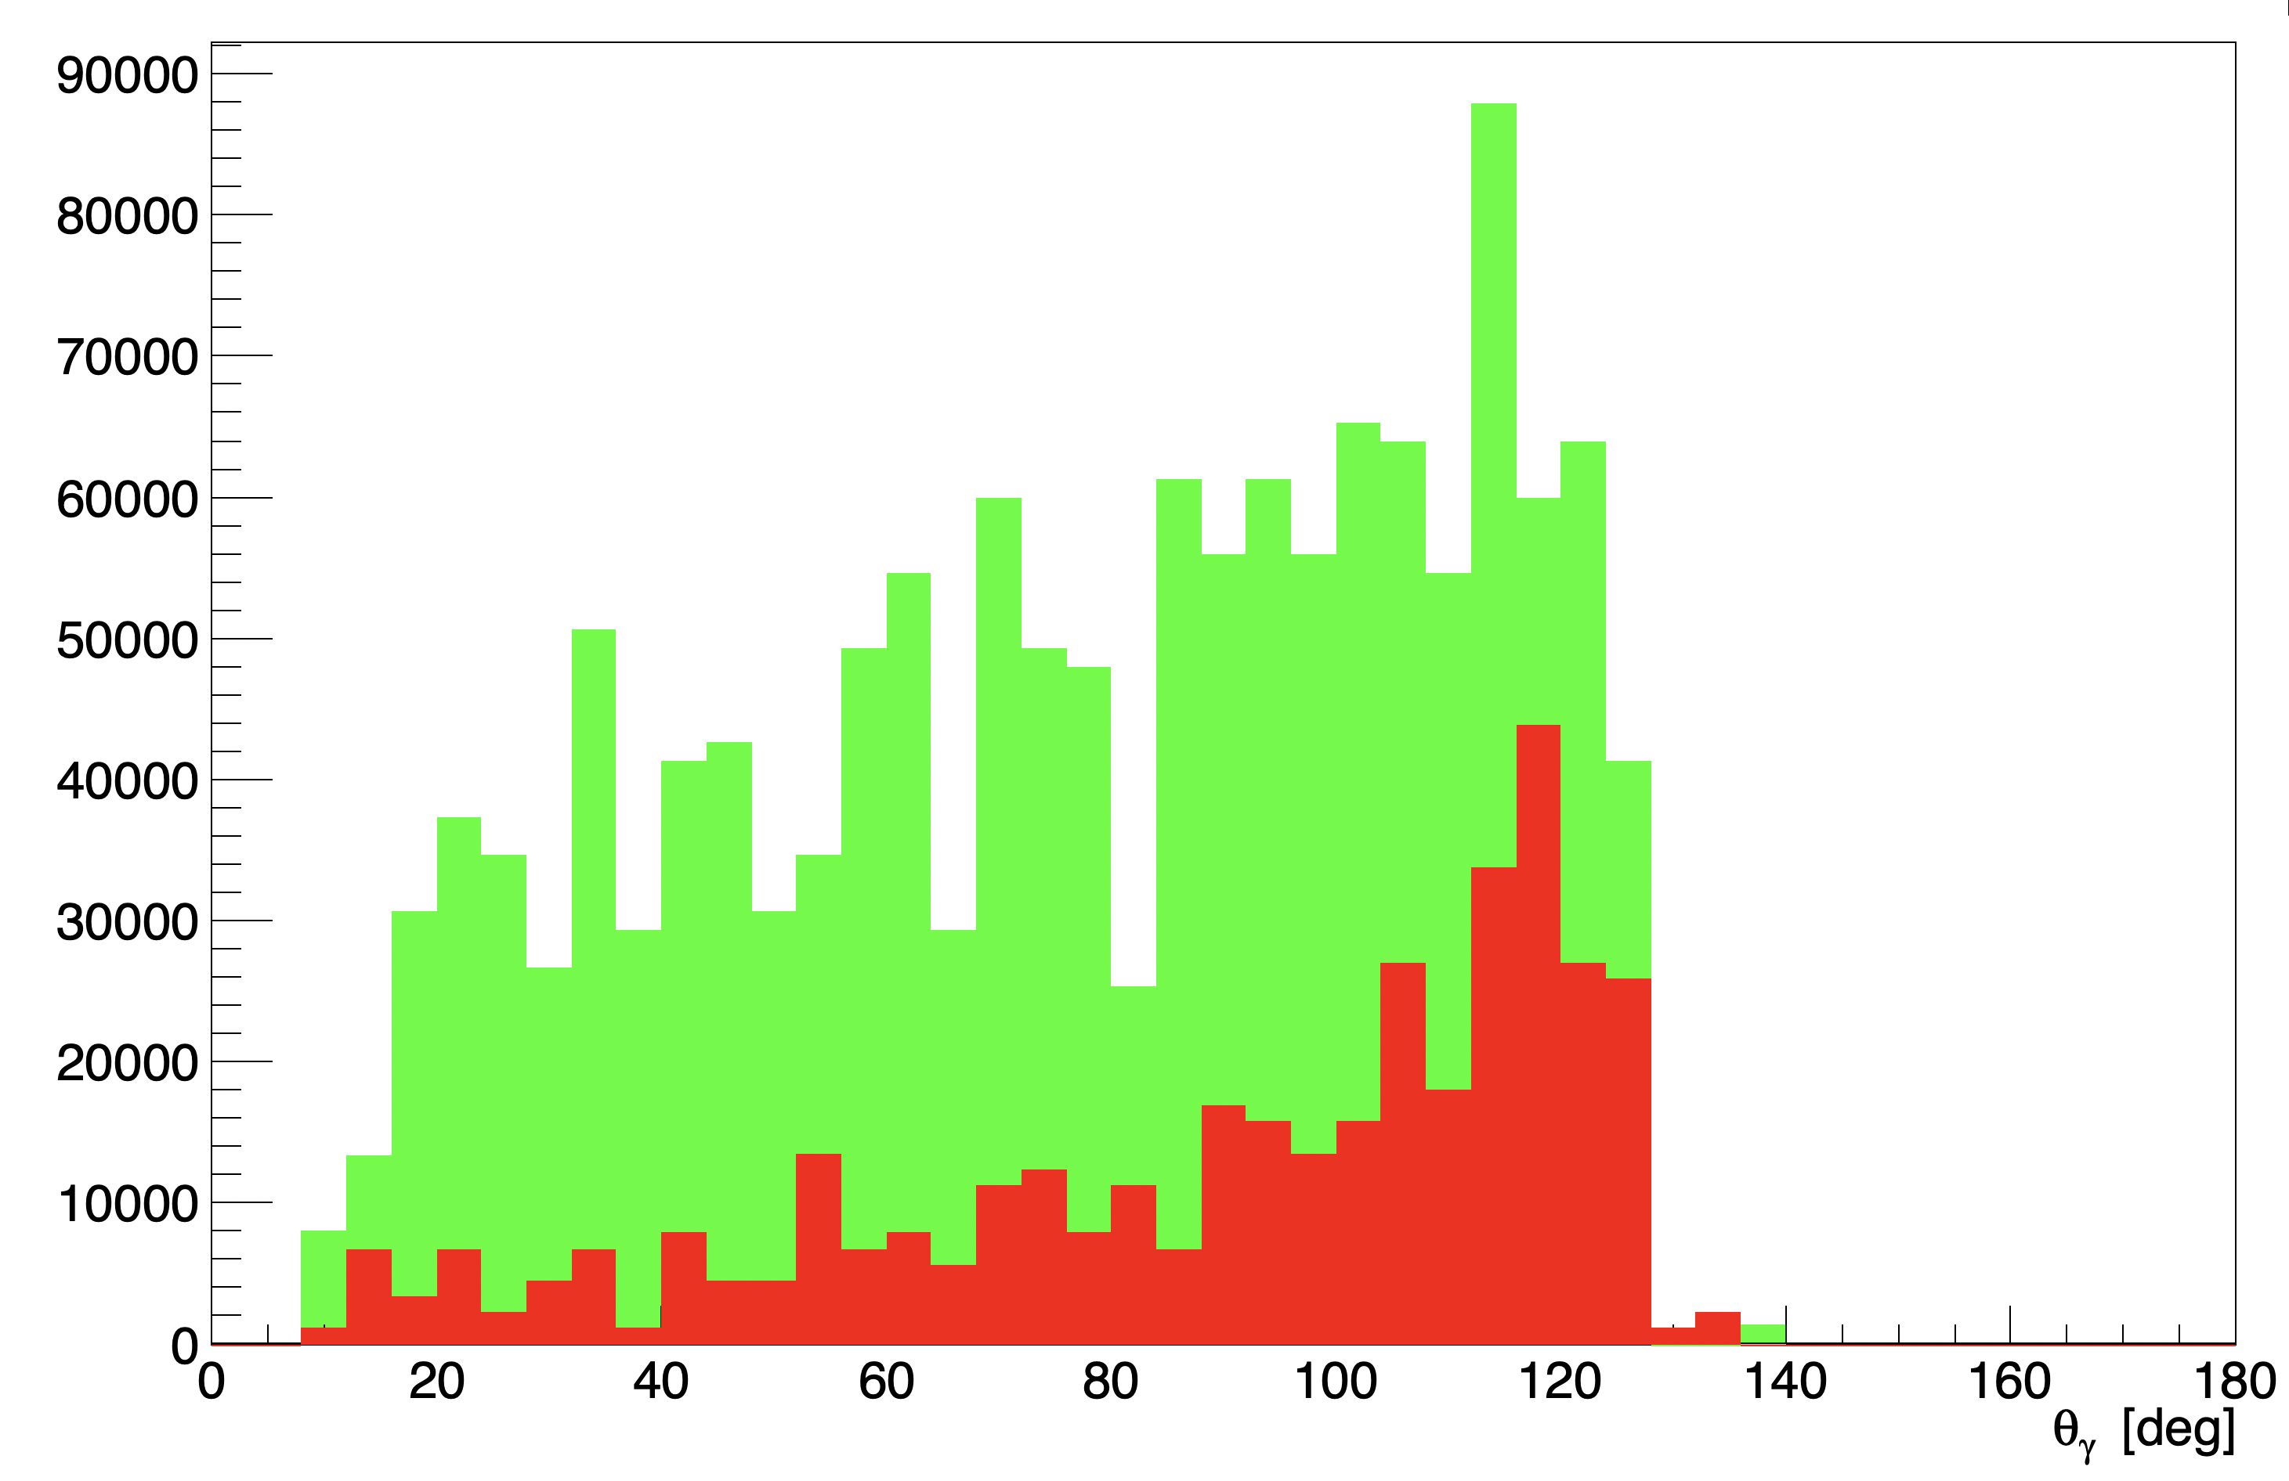
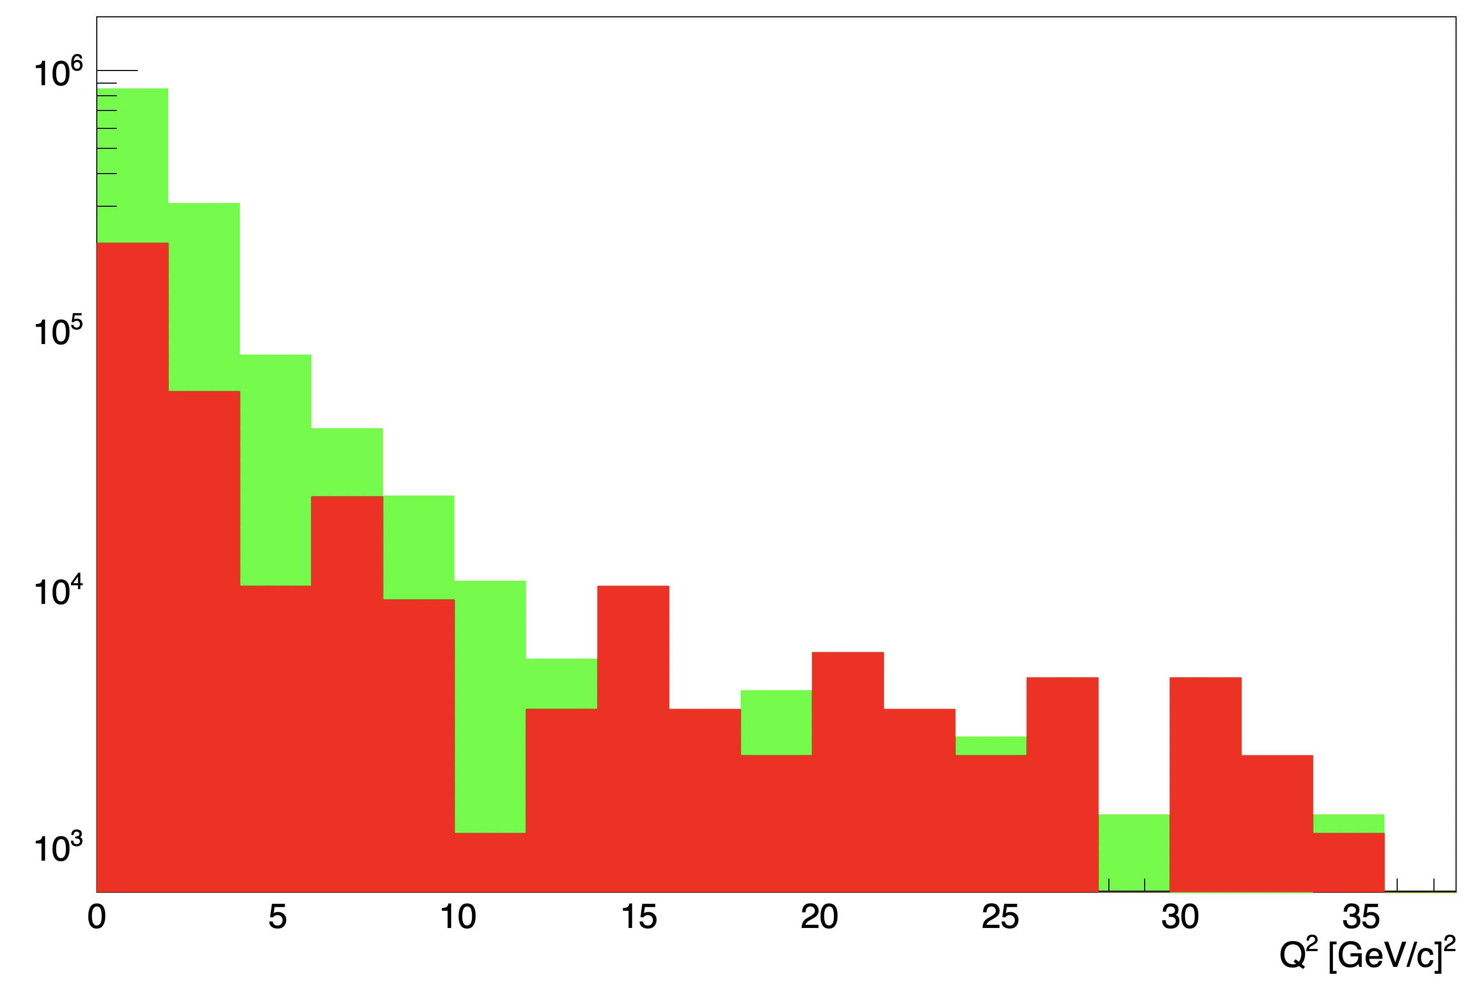
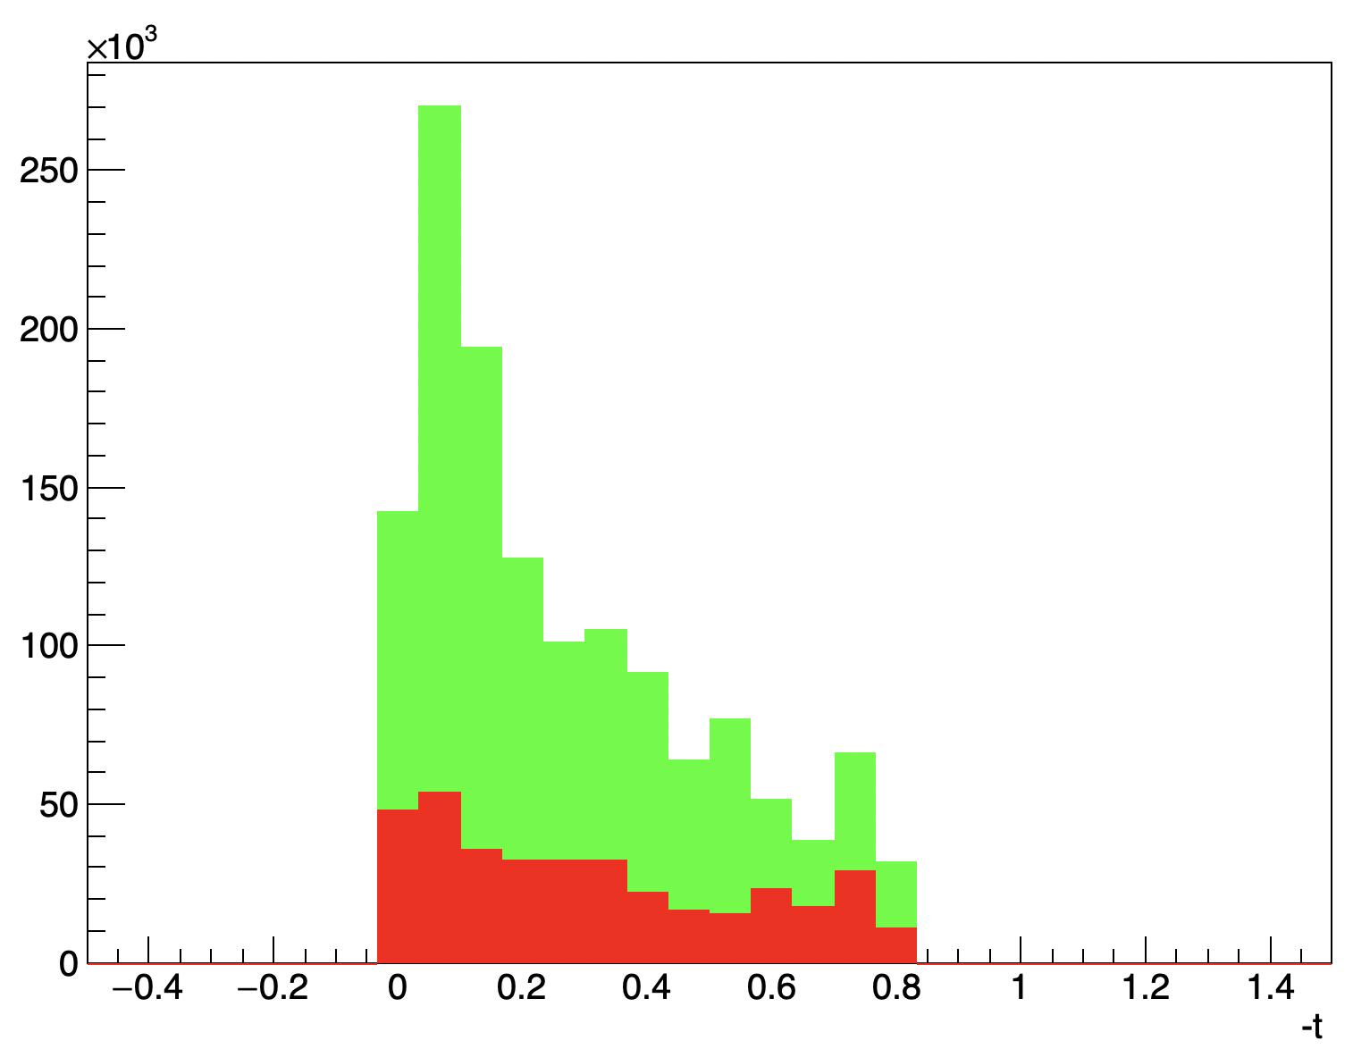
Fun 4 all simulation: Running on 30K events out of 500K generated.
To go to cross section need to estimate the
acceptance and the efficiency of the detector

Slide 12
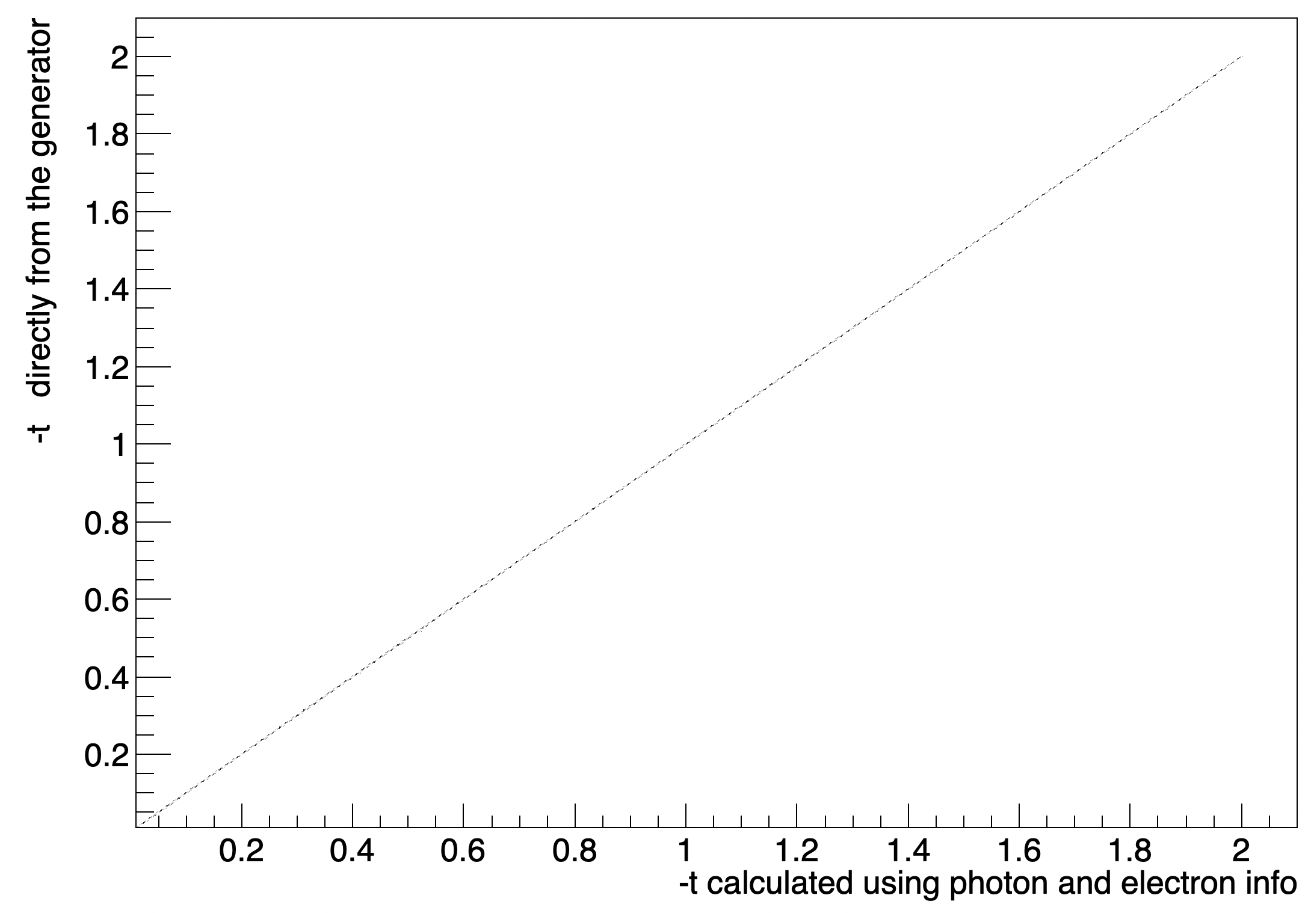
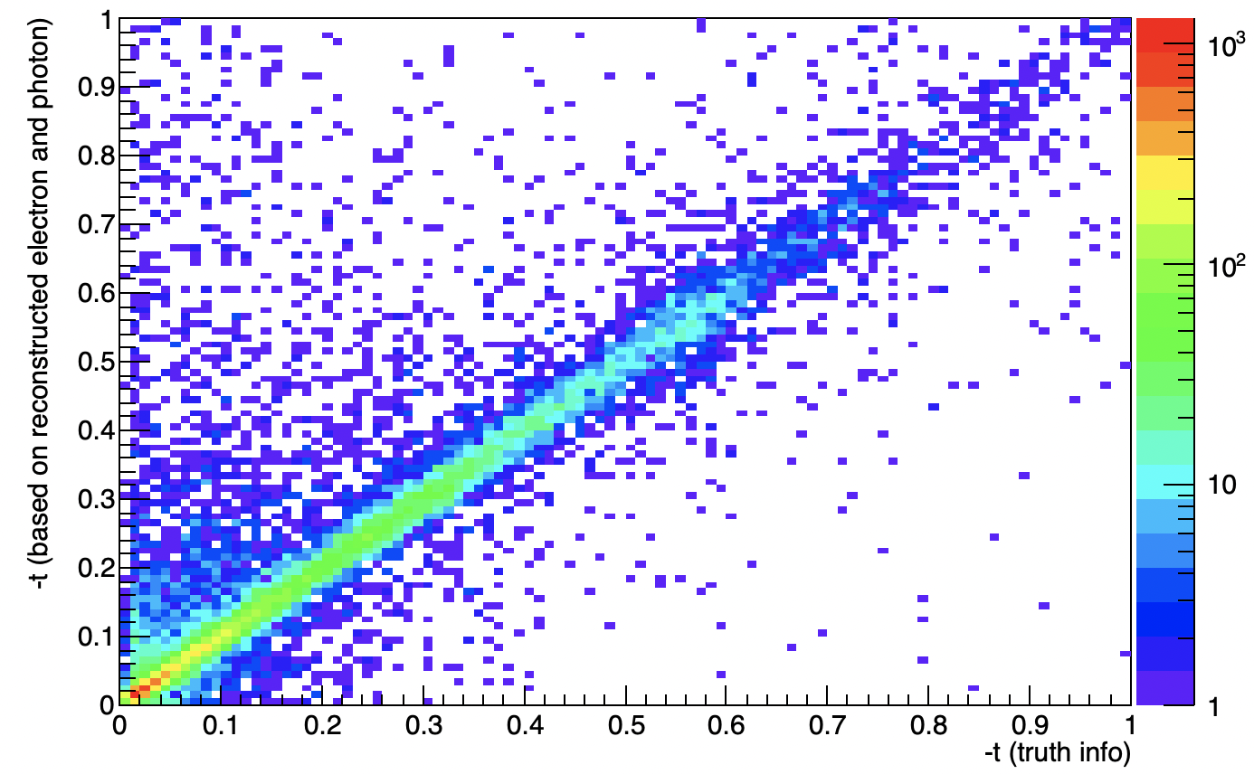

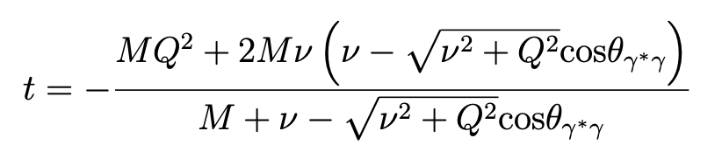
t reconstruction
Fun4all
Generator

Slide 13
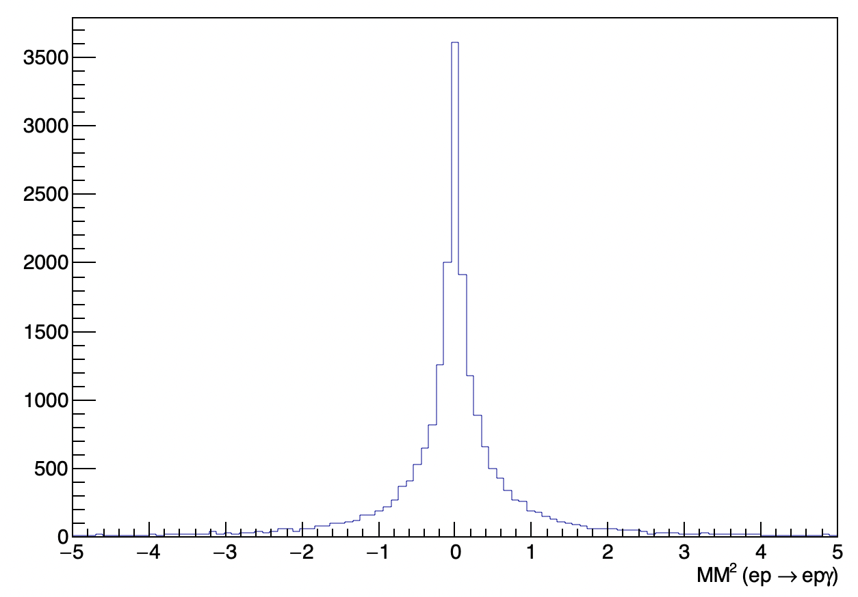
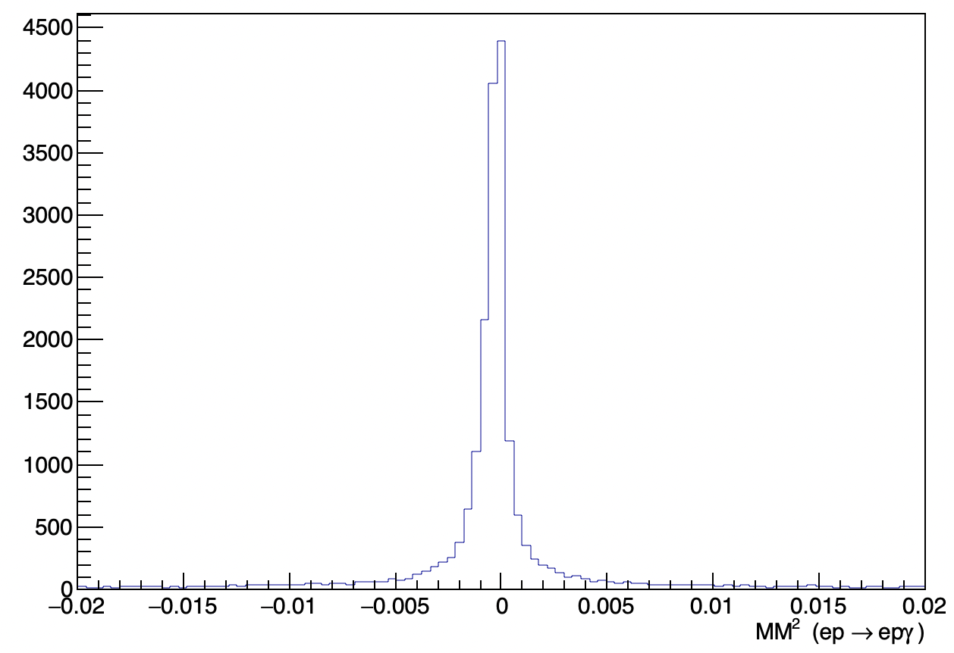
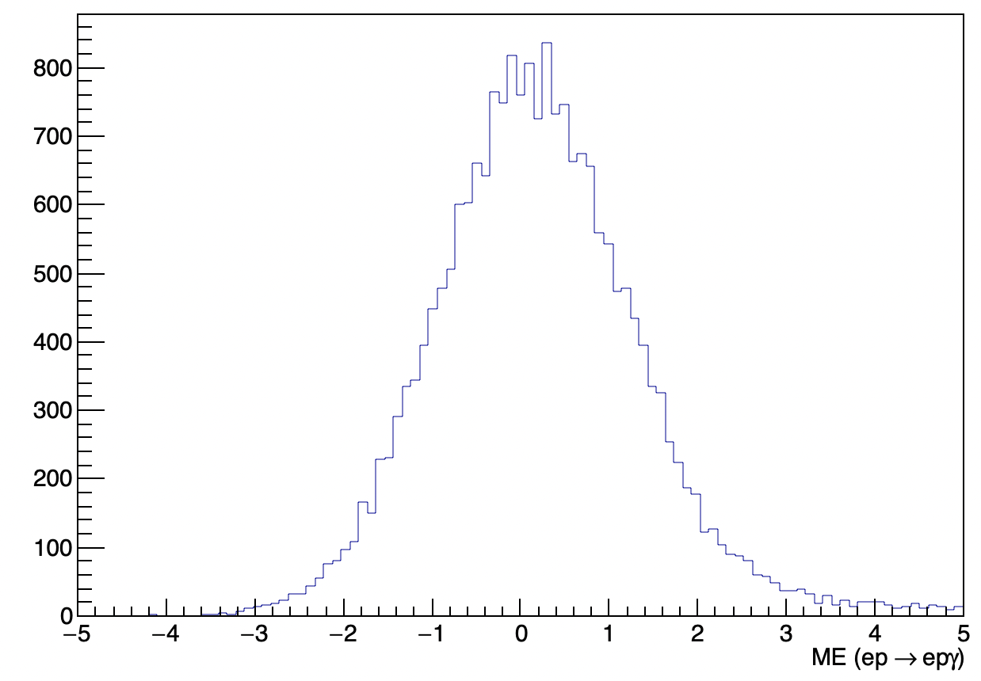

Missing mass (ep→ep$γ)$
Reconstructed
(e,gamma) +
Smeared proton 1%
Truth particles

Slide 14
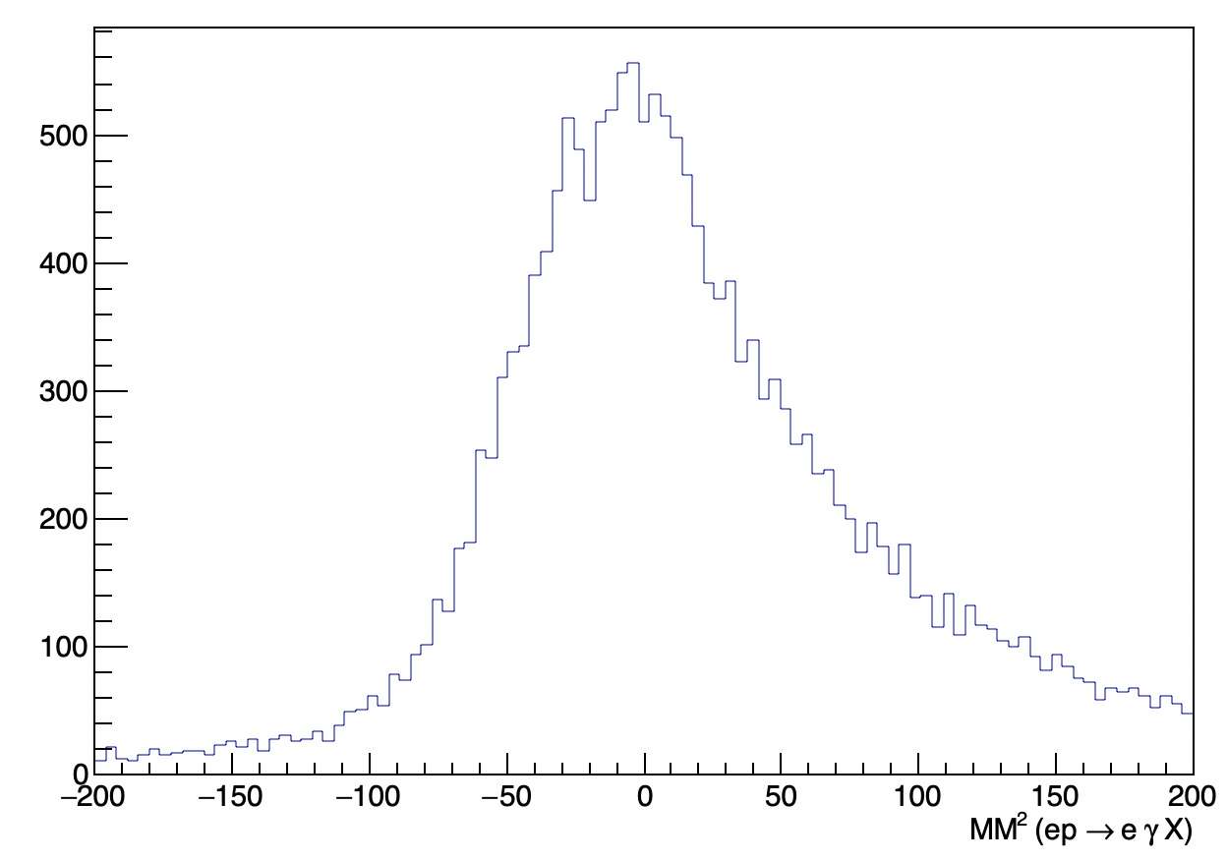
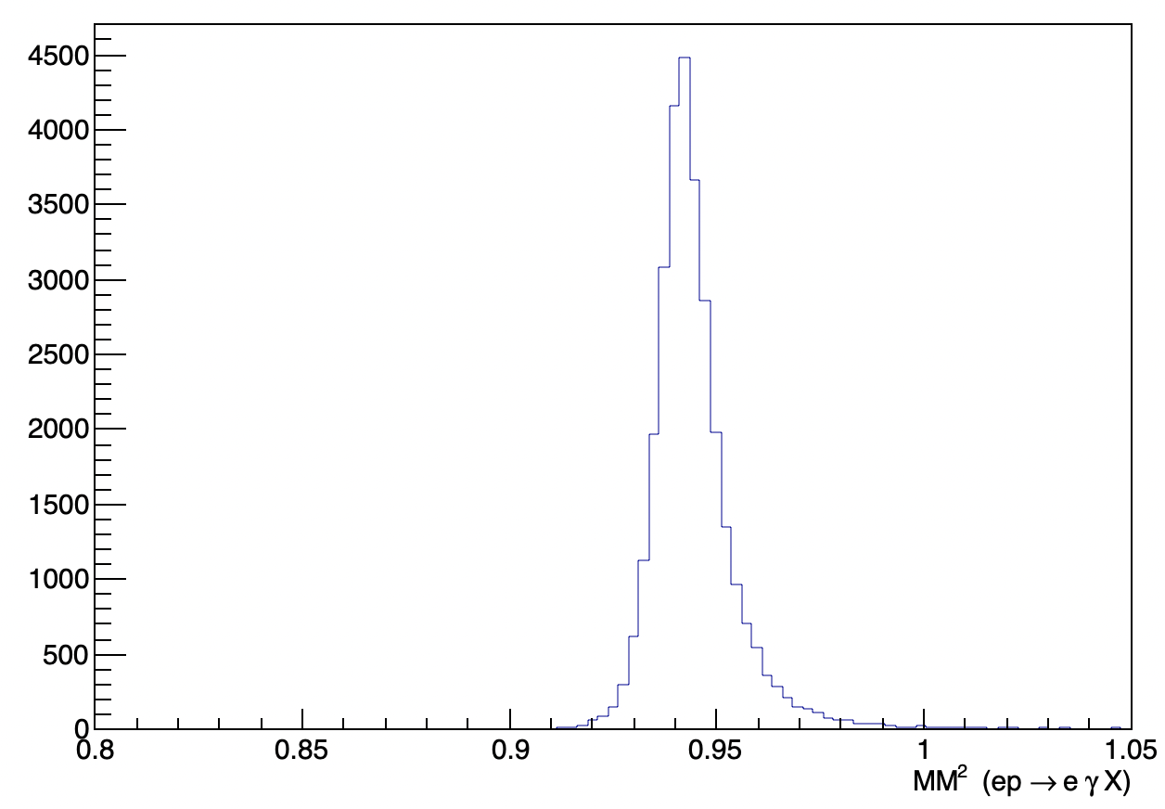
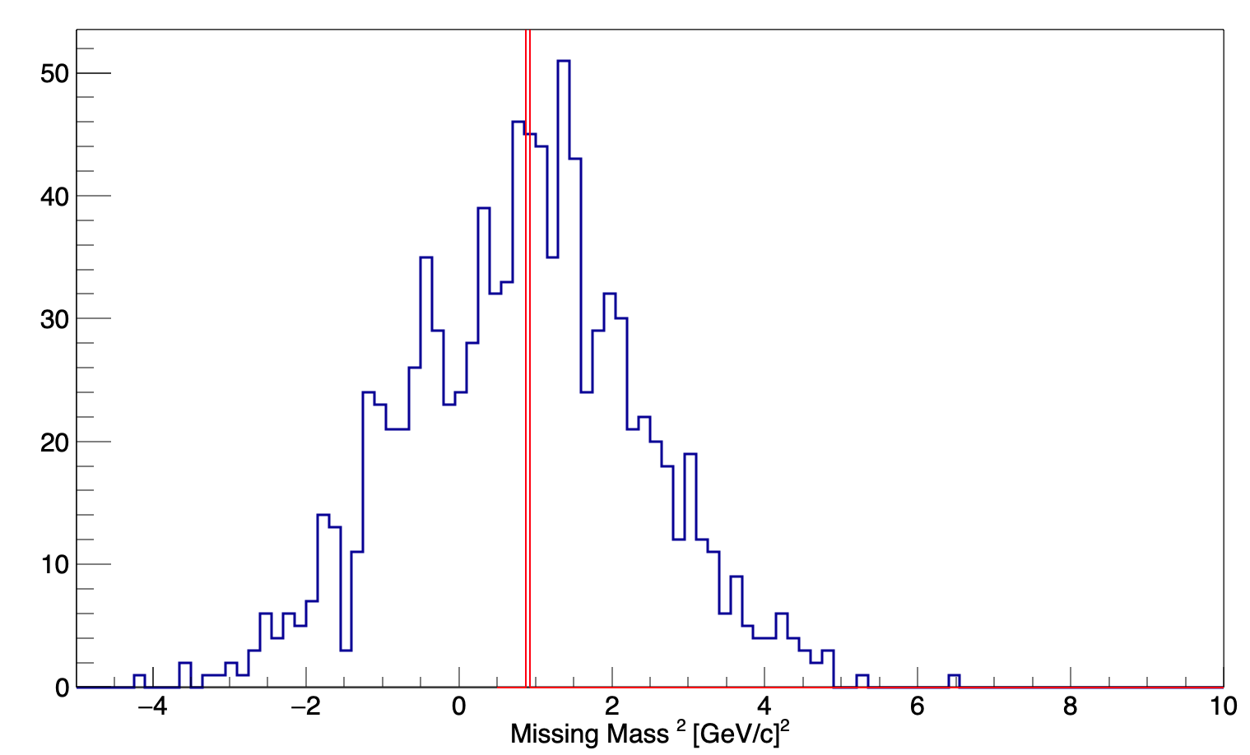
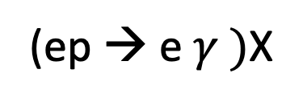
(ep → e $γ )$X
Truth particles
Electron momentum variation example <1%

Slide 15
To do:
Add proton acceptance
Estimate the total acceptance and efficiency
Extract cross sections as a function of Q², x, t
Add pi0 background

