Slide 1
TCS at ECCE
Kayleigh Gates
University of Glasgow, Scotland
27/08/21
Kayleigh Gates
University of Glasgow
27/08/2021

Slide 2
Time-Like Compton Scattering (TCS)
Exclusive process, often referred to as inverse of DVCS (real photon production).
Electron exchanges quasi real photon with target nucleon, release of virtual photon which decays into a lepton pair.
γp → μ+μ−p or γp → e+e−p
Bethe-Heitler (BH) mechanism dominant in kinematical regime of interest. Interference terms important for access to GPDs

Slide 3
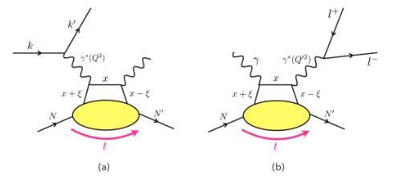
Time-like Compton Scattering (TCS)
DVCS TCS

Slide 4
EpIC
MC event generator using GPD models from the PARTONS framework, plus mFOAM (a general purpose MC event simulator integrated with ROOT) to generate random events in phase space
EpIC takes in an input .xml file, within which parameters are defined (kinematics/energy etc) and generates the four vectors of all the particles as the output.
EpIC has the capability to consistently overcome singularities involved in the BH process

Slide 5
What do files contain
Pure TCS set and a set of TCS+BH+(TCS+BH)
YR/PARTONS TCS kinematics used
  t = -1GeV² to 0 GeV²
  Q'² = 2GeV² to 10GeV²
  Phi = 0 to 2pi
  Theta = pi/4 to 3pi/4
  y = 0.01 to 0.95
  Q² = 0 GeV² to 0.15GeV²
1M events per file
10 files per energy and helicity setting;
  10M events 5x41 hel +
  10M events 5x41 hel -
  …..... for 5x41, 10x100 and 18x275
  60M events total per set

Slide 6
YR results
YR study with pure TCS – no beam smearing, no detectors
Resolution on t, nice peak at zero – requires proton information (scattered proton essential)
Detection of scattered proton close to beam line - acceptance of roman pots needs to be as close to beam line as possible
Requirement for good coverage in forward region for higher collision energies – very forward leptons shown to be lost in YR study

Slide 7
Aim
YR study with pure TCS – no beam smearing, no detectors
Good preliminary results show that reconstruction of the full interaction is feasible
Full GEANT4 simulation, with the inclusion of detectors and beam smearing
Repeat the study

Slide 8
Thank you for your attention
Questions?

Slide 9
References
TCS: Time - like Compton scattering: Exclusive photoproduction of lepton pairs, Edgar R. Berger(Ecole Polytechnique)M. Diehl(DESY)B. Pire(Ecole Polytechnique)(Oct, 2001) Published in: Eur.Phys.J.C 23 (2002) 675-689, e-Print: hep-ph/0110062 [hep-ph]
EpIC: K. Tezgin and P.Sznajder : Presentation 10/05/21 and Presentation 14/06/21
Yellow Report: Science Requirements and Detector Concepts for the Electron-Ion Collider: EIC Yellow Report: R. Abdul Khalek(Vrije U., Amsterdam and Nikhef, Amsterdam), A. Accardi(Hampton U. and Jefferson Lab), J. Adam(Brookhaven), D. Adamiak(Ohio State U.), W. Akers(Jefferson Lab)et al.(Mar 8, 2021) e-Print: 2103.05419 [physics.ins-det]

