Slide 1
SIDIS - Working Group 2nd meeting
Marco Radici (INFN - Pavia) Anselm Vossen (Duke) May 26, 2021

Slide 2
Agenda
Recap of charge
Recap of last meeting
Summary of kinematics/technology options
Recap possible impact plots
Summary of open software tasks
Action item:
→Agree on first simulation steps/workforce
→Agree on channels to be investigated/workforce

Slide 3
Charge
From the physics performance working groups, the proposal will need the following information and/or actions:
Identify the key physics observables described in the Yellow Report that pertain to your working group
In the Yellow Report, the community identified a number of physics goals and observables required at the EIC. Each physics group should identify which of these belongs within its purview, and formulate a plan for updating the YR plots using the actual detectors (and inactive materials!) that will be part of EIC@IP6.
Which 2 or 3 plots will illustrate ability of EIC@IP6 to address NAS report/YR physics?
It will be crucial to identify a subset of all the possible performance plots for your physics area that should be included in the proposal. There is a strict page limit for proposals, and they must include a detailed description of the detector systems and their cost. Consequently, each physics working group should anticipate being able to fill only a few pages in the proposal.
This, plus the limited time we have, requires identifying only a few performance plots for which your working group will carry out full simulations with the integrated EIC@IP6 detector. These most likely exist in more idealized form in the YR already. However, identifying the key plots early will allow the working group to work with the detector groups and inform the collaboration of the impact of specific technology choices.
Are there any additional physics performance plots that would give a competitive advantage to this proposal?

Slide 4
Recap
Meeting time
Discussed workforce
Exp: Duke, SBU (each about 1FTE)
Theory: HKCU (di-hadrons), INFN (upol TMD fits, transversity)
BNL?
Potential impact plots/channels (see following slides)
single hadron SIDIS, Colllins, Sivers
Upol TMDs (evolution)
di-hadron gluon TMDs
sea quark (polarized) PDFs
(nPDFs/nFFs )
(lambda)
(cc)
What are the unique features of Athena and how can this be used to differentiate our proposal?
PID → High impact feature for SIDIS
Large acceptance → hadronic reconstruction?
Large $x,Q^{2}$ coverage →high impact feature for SIDIS
High precision for high momentum tracks →impact?
Can this be used to reconstruct $K_{S}$ / suppress background → use instead of charged kaons where PID becomes worse e.g. for seq quark (polarized) PDFs
?

Slide 5
Next steps
Need to understand consequences of technology choices
Simulation!
Final plots need to be with full simulation (dd4hep framework)
Not ready yet
First evaluation with fast simulation→should be able to make rough estimate of technology choice impact

Slide 6
Tasks
Identify SW point of contact
Communicate needs/ make sure we adhere to best practices
→Chris Dilks?
Setup of fast simulation, initial exploration of SIDIS phase space (Delphes)
Duane
In charge of full simulations
Andrea Bressan is liason to EICUG computing
?
Initial investigation of ‘golden+’ channels? (or can we decide ad-hoc?)
Impact/update to YR plots
Identify critical detector components
Uniqueness

Slide 7
Kinematics coverages

Slide 8
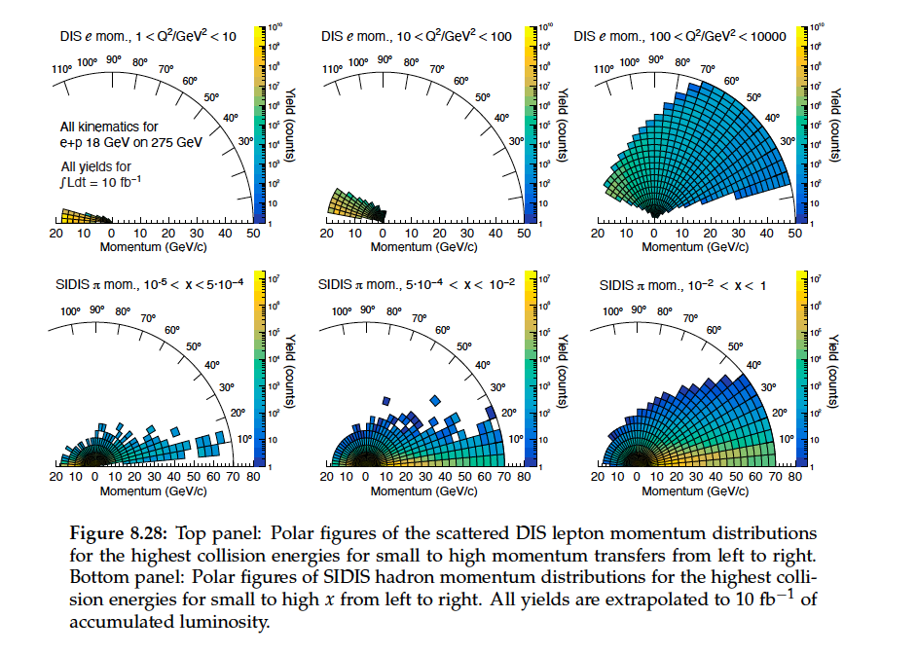

Slide 9
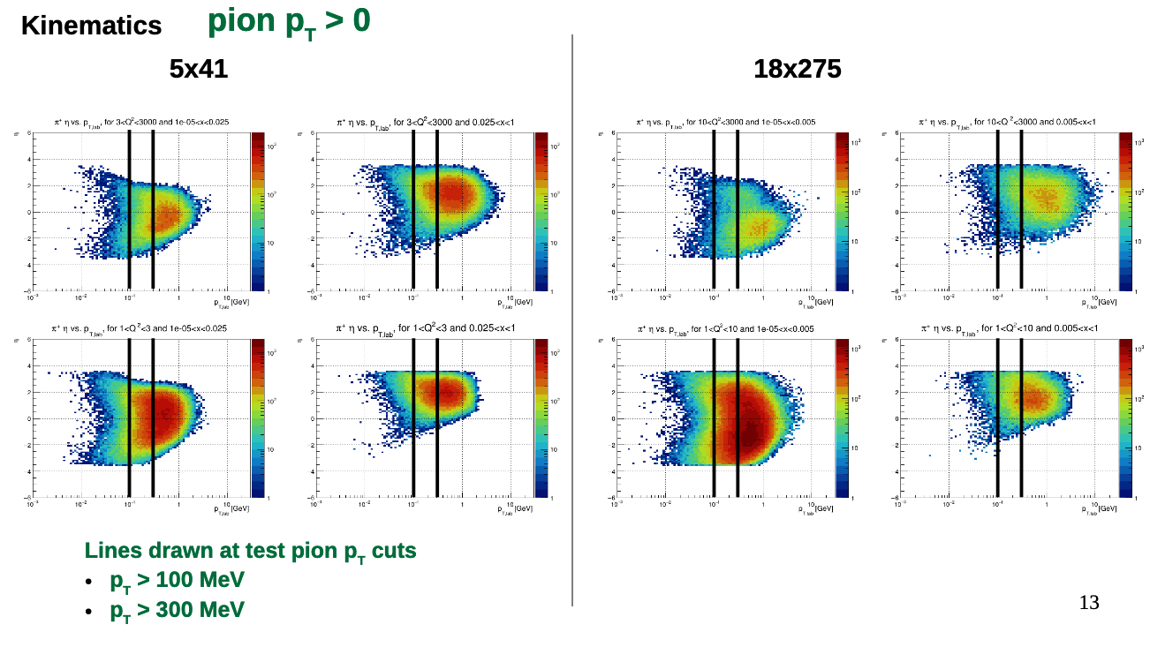
From chris

Slide 10
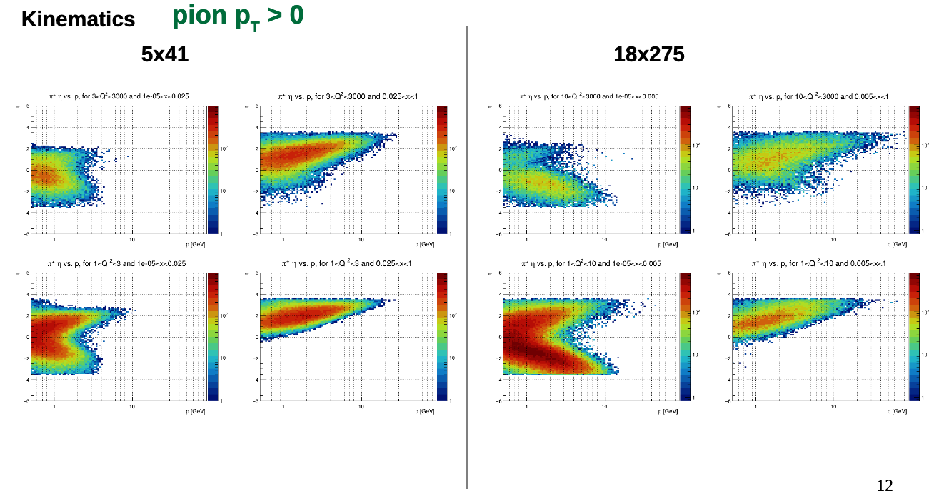

Slide 11
Slide from Yulia (https://www.dropbox.com/s/18okpfnud1886rq/6_ATHENA_YuliaFurletova.pptx?dl=0)
These are the main options we should evaluate

Slide 12
Channels

Slide 13
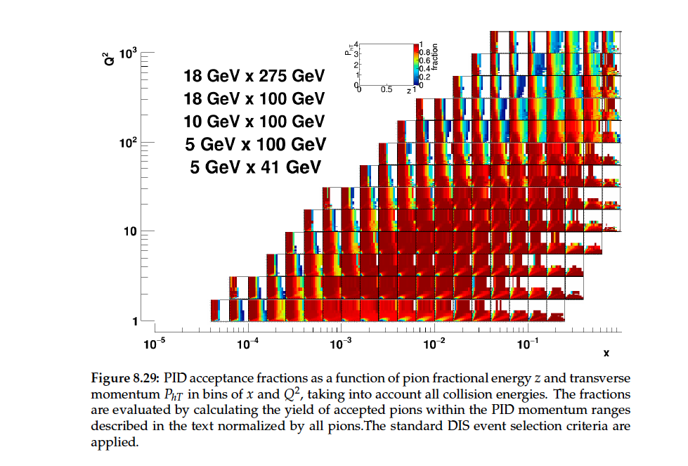

Slide 14
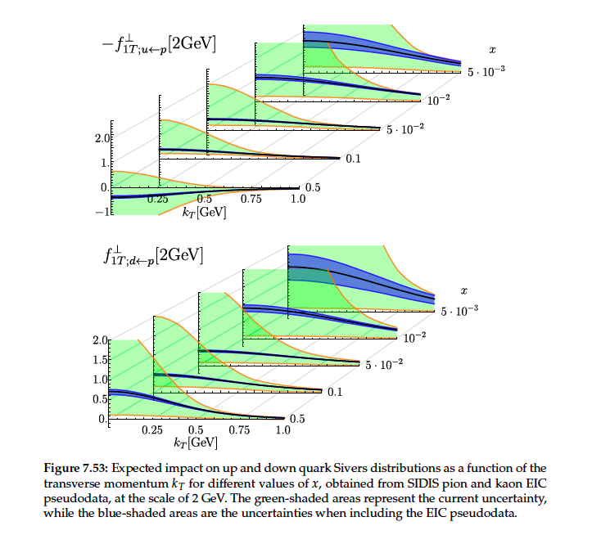
Sivers
Golden channel
Nicely combines evolution and polarization dependent TMD extraction
Kaons?
Theory dependence?
Difficult to pin down impact of phase space coverage on impact plots
Can this be shown w/ and w/o certain phase space
Candidate for impact plots?

Slide 15
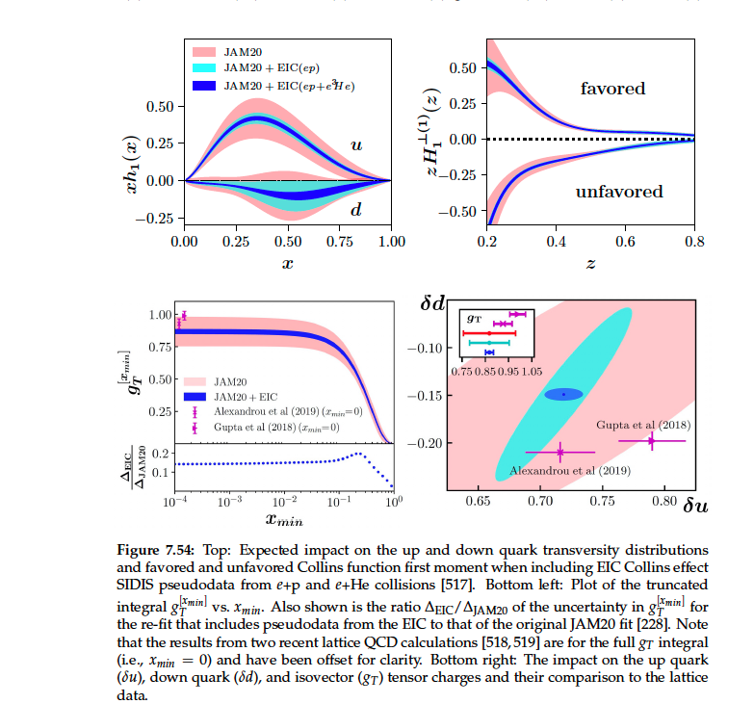
Collins/Transversity (similar di-hadrons)
Golden/silver channel
Possible critique:
What about impact of other experiments before EIC? (SoLID, Compass, RHIC)
(this is similar to Sivers, but Sivers has additional TMD evolution questions that need EIC)
→prefer Sivers plots?

Slide 16
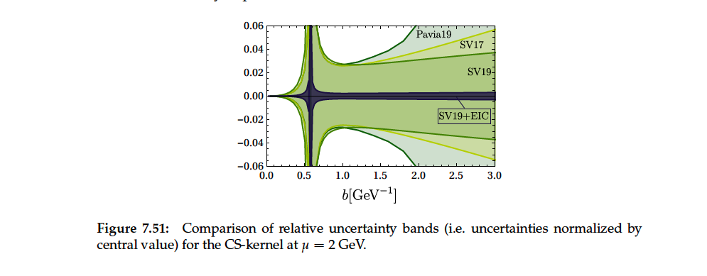
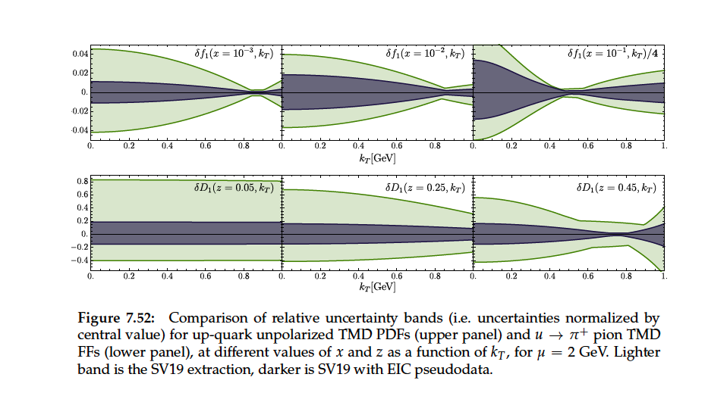
Upol TMDs/TMD evolution
Golden channel
Needs high $x,Q^{2}$ coverage
Too theory dependent?
Difficult to pin down impact of phase space coverage on impact plots
Can this be shown w/ and w/o certain phase space

Slide 17
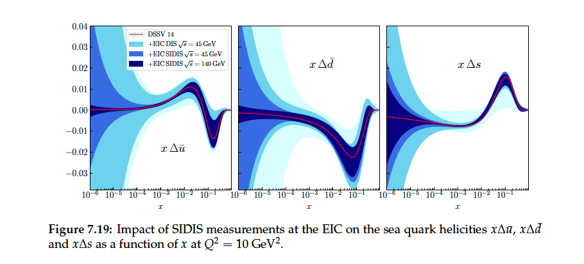
Sea quark helicities
Golden channel
Highlights need for good kaon PID
Can this be done with $K_{S}$ ? Any advantages?
Candidate for impact plot?

Slide 18
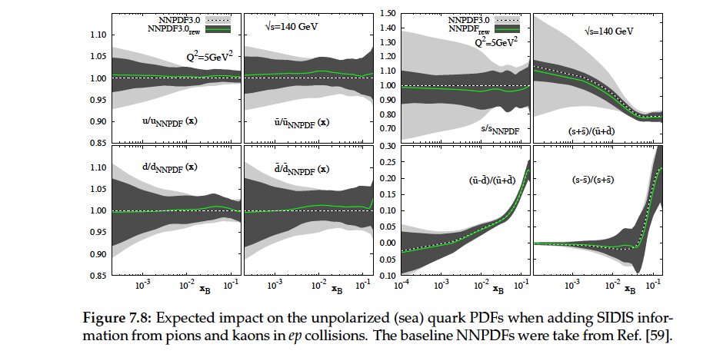
Sea quark PDFs
Similar reasoning to sea quark helicities

Slide 19
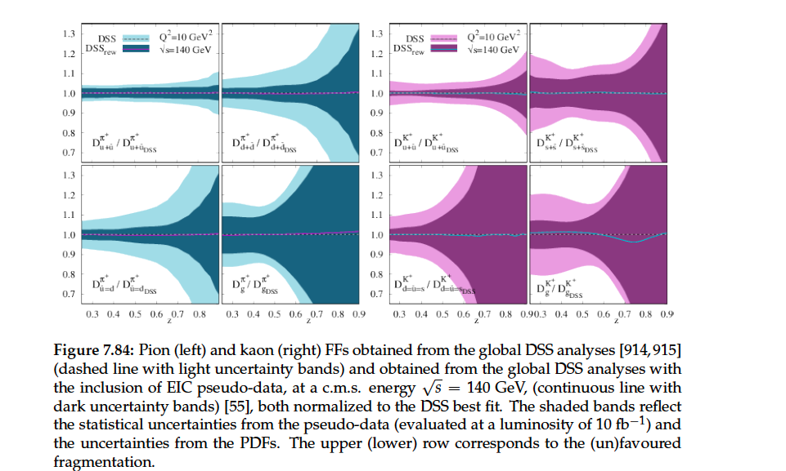
FFs
EIC impact moderate
→not a high impact measurement?

Slide 20
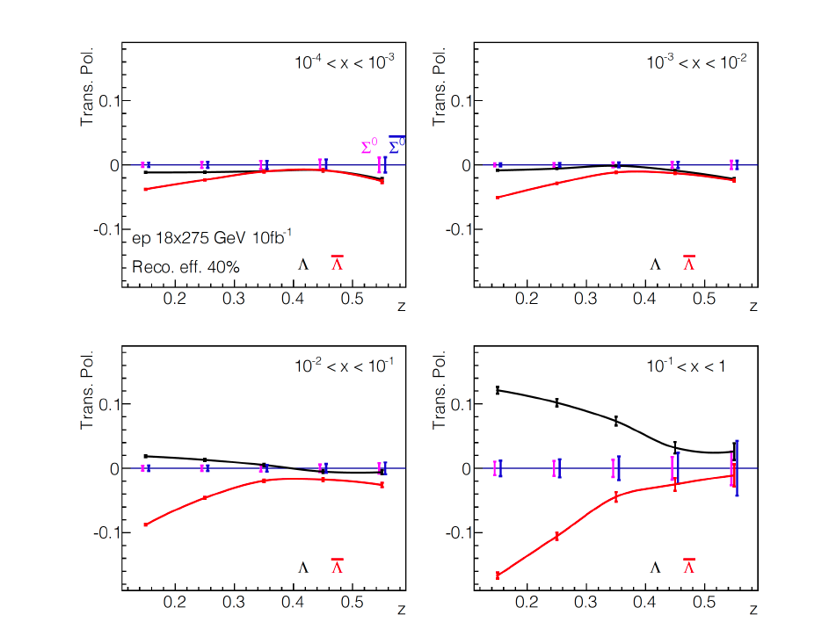
$$Λ$$
Novel measurement
Still significant systematics from feed-down
Mainly needs low $p_{T}$ acceptance
Too ‘excotic’ to be impact plot?

Slide 21
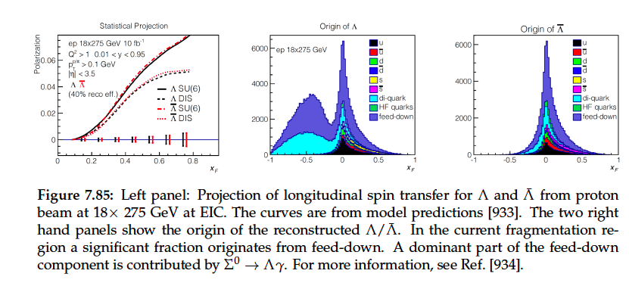

Slide 22
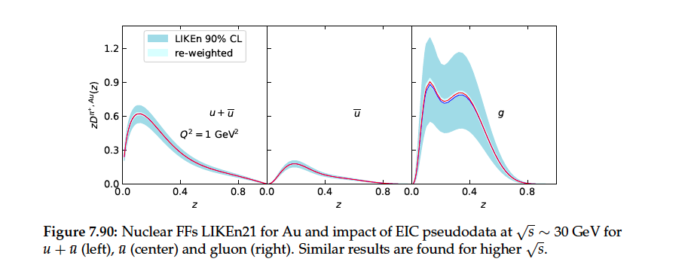
nPDF/nFF
High impact

Slide 23
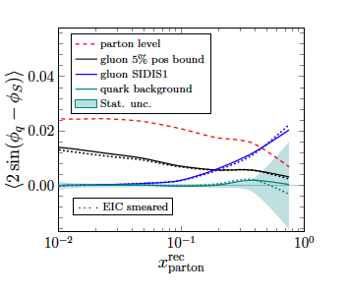
Di-hadron/jet gluon TMDs
Golden channel
Highlights acceptance (?)
Needs high Q2
→profits from hadronic final state reconstruction for high x?
What drives these uncertainties?

Slide 24
CC
→might be best addressed by DIS group

Slide 25
Software tasks
Produce fast simulation samples
Investigate channels
Start producing full simulations and exploring options to evaluate technology options
Learning by doing?
What data sets will we need for each channel? (only allocated ~10M events per channel [might be more if we ‘pool’ data between channels, WGs] )
First stab at impact plots..?

Slide 26
Discussion topics
Task list reasonable?
Do we already know which impact plots?
Suggestion: SIDIS coverage (PID), Sivers (+evolution), sea quark helicity,
How much do we have to improve YR simulations?
Systematics..?
How can we help getting full simulation data?
Get involved in subsystem simulation?

Slide 28
Backup

Slide 29
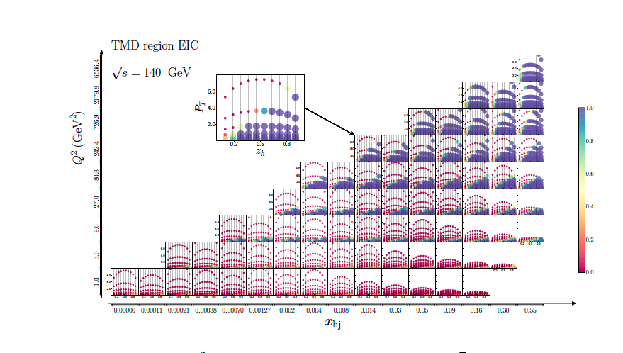
Affinity to tmd factorization
→overlap with Athena region? Resolution in that region?

