Slide 1
Electron-Ion Collider : roman pots readout
Transimpedance preamplifier simulations
Maxime Morenas
2nd June 2021

Slide 2
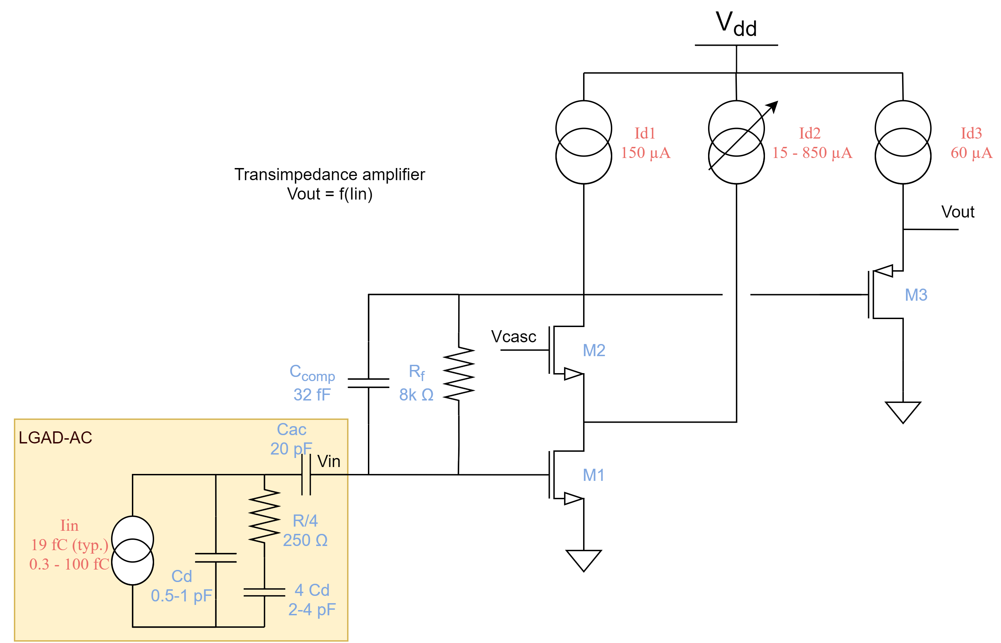
Towards a transimpedance preamplifier
A smaller input impedance (than a voltage preamplifier)
to avoid long distance crosstalk

Slide 3
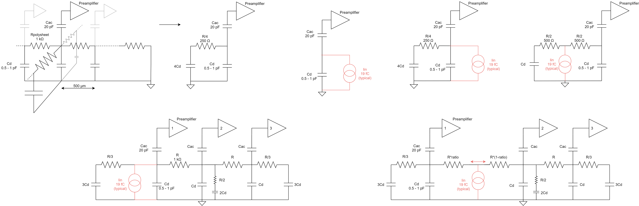
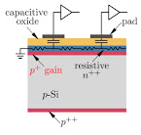
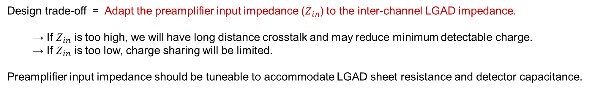
Charge sharing : a competition between $R_{sheet}$and $Z_{in}$
Preamplifier 1
2
3
4
5
6
7
8
From Nicolo Cartiglia
Design trade-off = Adapt the preamplifier input impedance ($Z_{in}$) to the inter-channel LGAD impedance.
  → If $Z_{in}$ is too high, we will have long distance crosstalk and may reduce minimum detectable charge.
  → If $Z_{in}$ is too low, charge sharing will be limited.
Preamplifier input impedance should be tuneable to accommodate LGAD sheet resistance and detector capacitance.

Slide 4
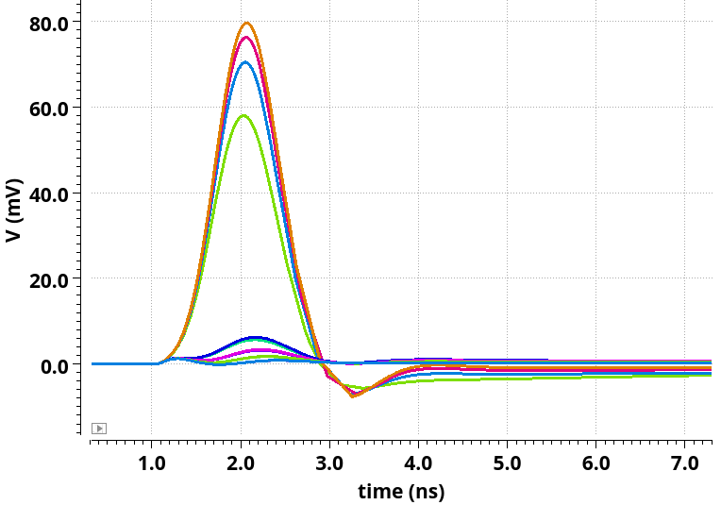

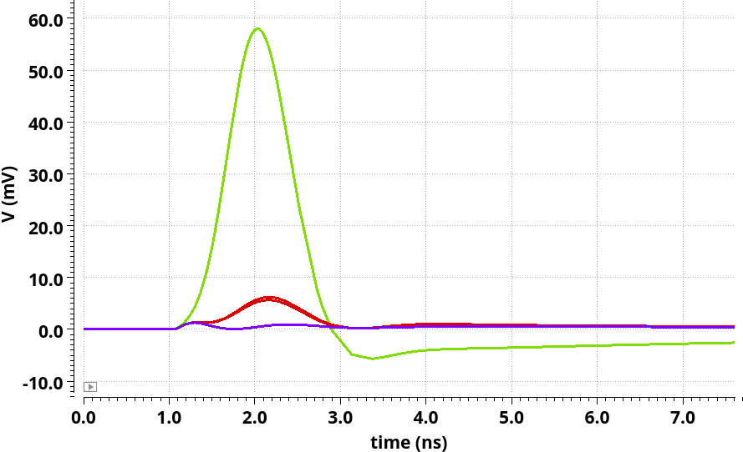



Preamplifier output signal
$R_{sheet}↗$
When the charge deposition (19 fC) happens exactly in-between 2 pads.
Rise time 10-90%
~700 ps
1
2
3
4
$R_{sheet}↗$
5
6
7
8
$$R_{sheet}=1 kOhm$$

Slide 5
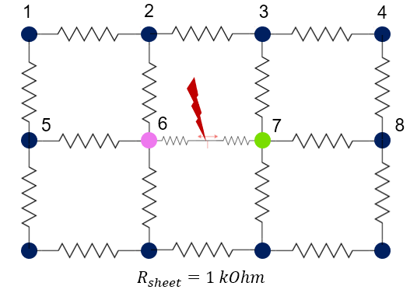
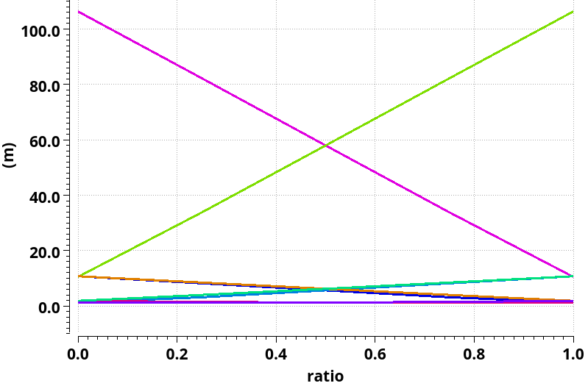
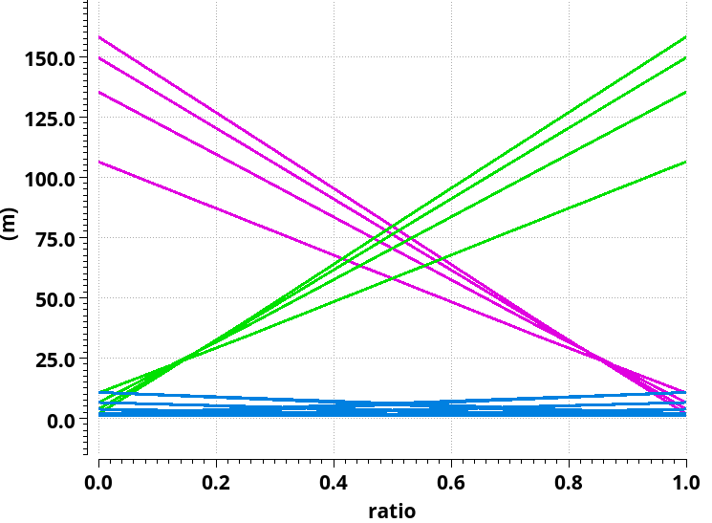





Charge sharing simulation
Preamplifier output voltage
19 fC
$R_{sheet}↗$
$Z_{in}↗$
$$R_{sheet}$$
10k
5k
2.5k
1k
$Z_{in}↗$
$R_{sheet}↗$
Minimum threshold
~ 5-10 mV
Charge deposition
below 6
Charge deposition
below 7
= distance from 6 to 7

Slide 6
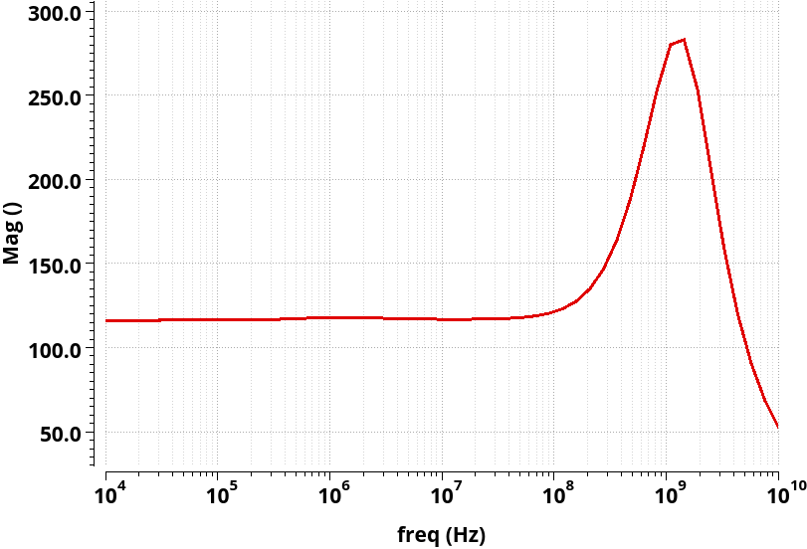
Low input impedance preamplifier (TZ)
in
Preamplifier input impedance could be tuned by making the current source Id1 variable.

Slide 7
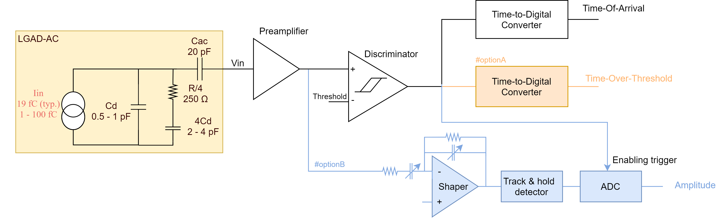
Charge measurement : TDC versus ADC
Option A :
  TOT TDC requires a high resolution since the preamplifier output pulse is short
  (with a low preamplifier input impedance TOT TDC)
  TOT measurements with LGAD (DC) have known issues due to digital activity coupling
Option B :
  ADC requires signal integration : shaper power consumption needs to be evaluated
  ADC usually works/dissipates continuously : it should be investigated if ADC can be started on demand.

Slide 8
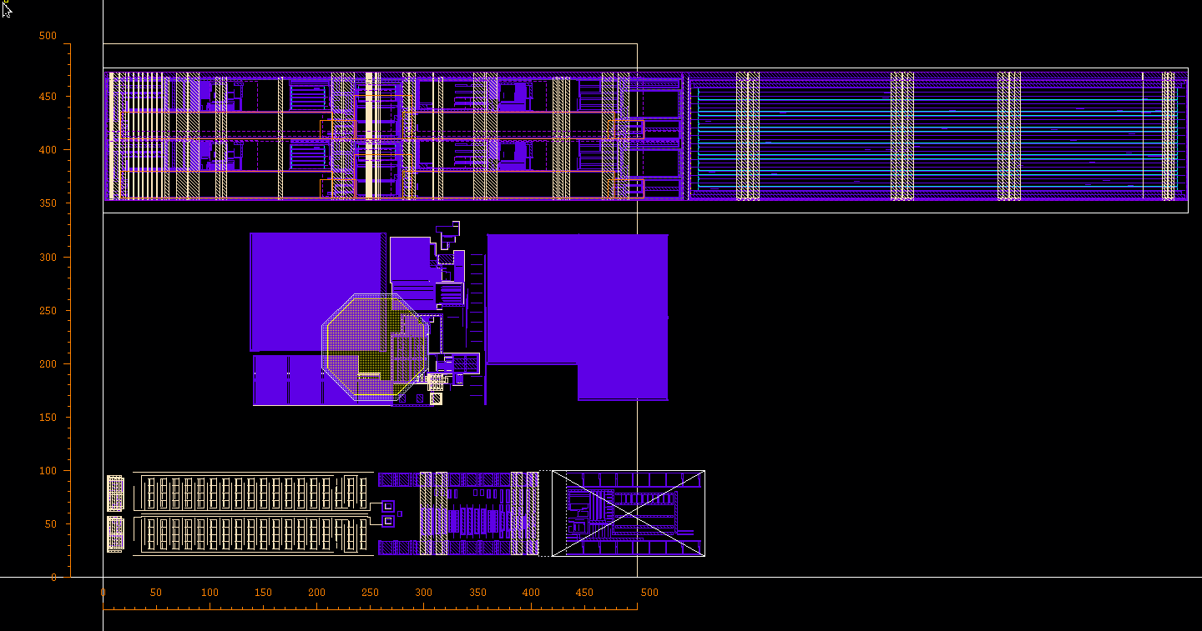
Foreseen pixel layout
TDC HGCROC [CEA]
PA+DISC ALTIROC [OMEGA]
ADC HGCROC [AGH]

Slide 9
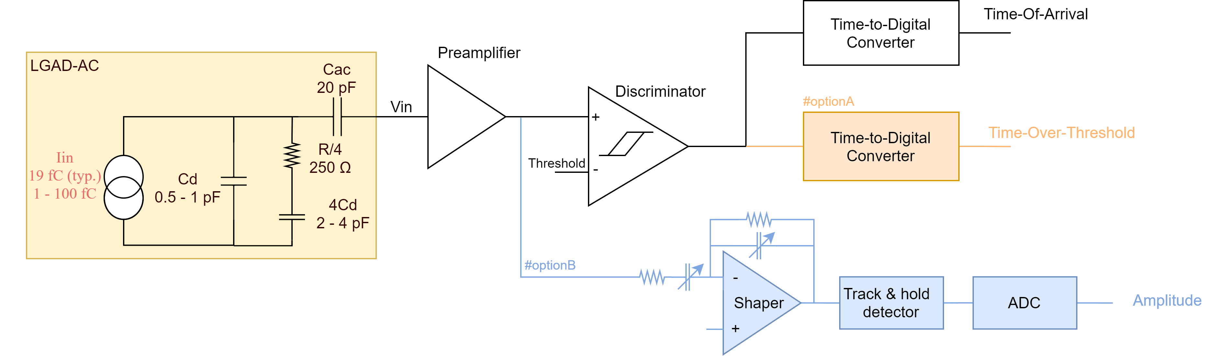
Conclusion
Low impedance preamplifier architecture (TZ) seems more adapted to AC-LGAD since reduced crosstalk with TZ may improve barycentering
The choice between TDC and ADC should be investigated regarding their power consumption (witch scales with the required precision : to be determined).
Next step : Is the power dissipation of the shaper a deciding factor ?

Slide 10
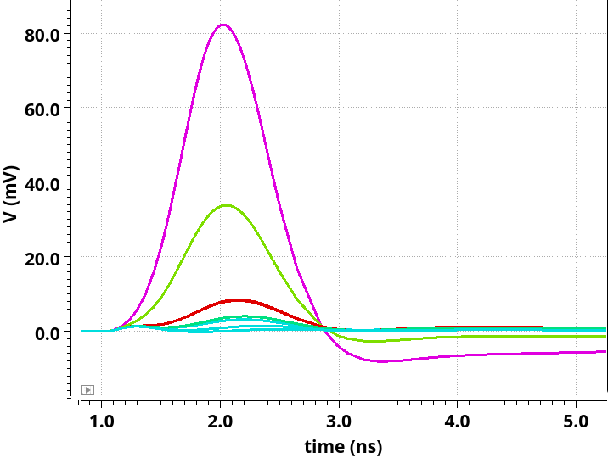
Preamplifier output signal with 25-75%
When charge deposition (19 fC) at distance ratio 25-75%
1
2
3
4
5
6
7
8
ratio 25-75%
$$R_{sheet}=1 kOhm$$

